Slide 1


Family Engagement in
Early Care and Education
Responding With Families
to Developmental Concerns

Slide 2
Overview
This module will focus on:
Observing children’s development together and understanding the benefits of screening
Approaches to conversations with families when developmental concerns arise
Partnering with families through the process of evaluation for possible services

Slide 3
By the end of this module,
you should be able to:
Describe ways to communicate with families about children’s development and the benefits of screening
Identify effective practices for talking with families about developmental concerns
Provide support and ideas about resources for families whose children may need further evaluation and special services

Slide 4
Observing Children’s Development

Slide 5
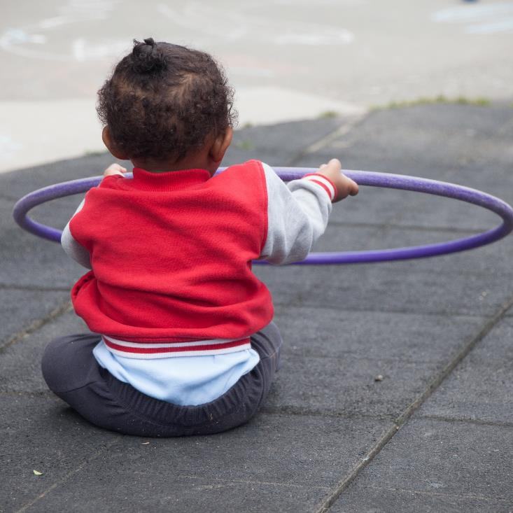
Observing Children
There are many reasons to observe children, including the joy of watching them grow and learn.
Image credit: EarlyEdU

Slide 6
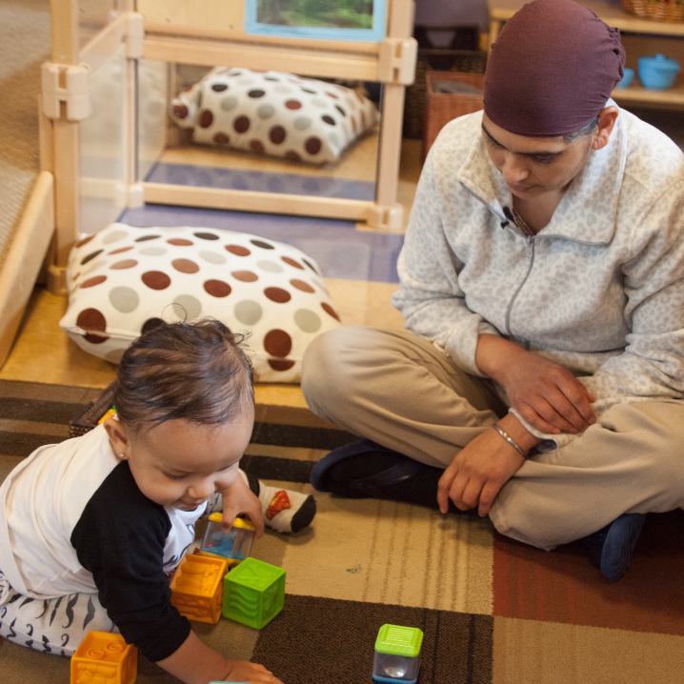
Noticing Development
You can observe children’s development with families, and collaborate and create opportunities to foster development and learning.
Image credit: EarlyEdU

Slide 7
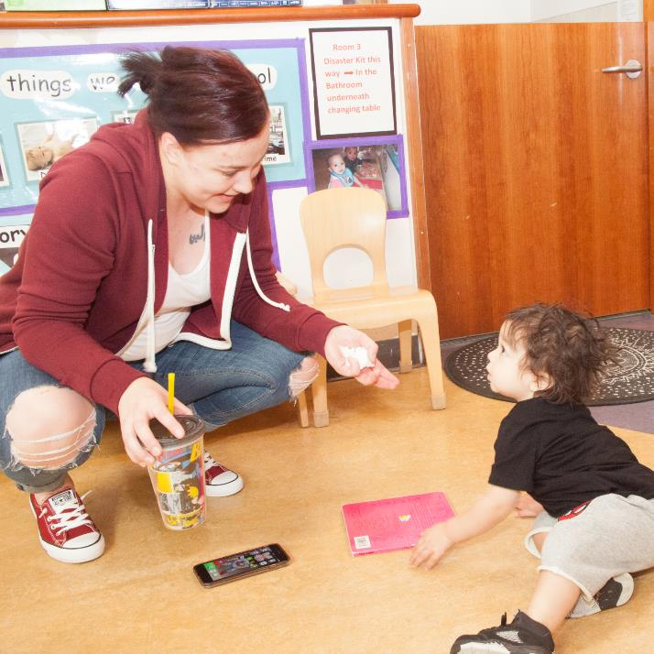
Sharing Observations
Sharing observations about children’s growth and development and exploring parents’ individual connections to their children helps to build strong relationships with parents.
Image credit: EarlyEdU

Slide 8
Sharing Observations
How can you:
Invite parents to share about their children’s development and any skills that are important to them?
Talk with parents about ways to make sharing about children’s strengths and progress a regular part of your communication?

Slide 9
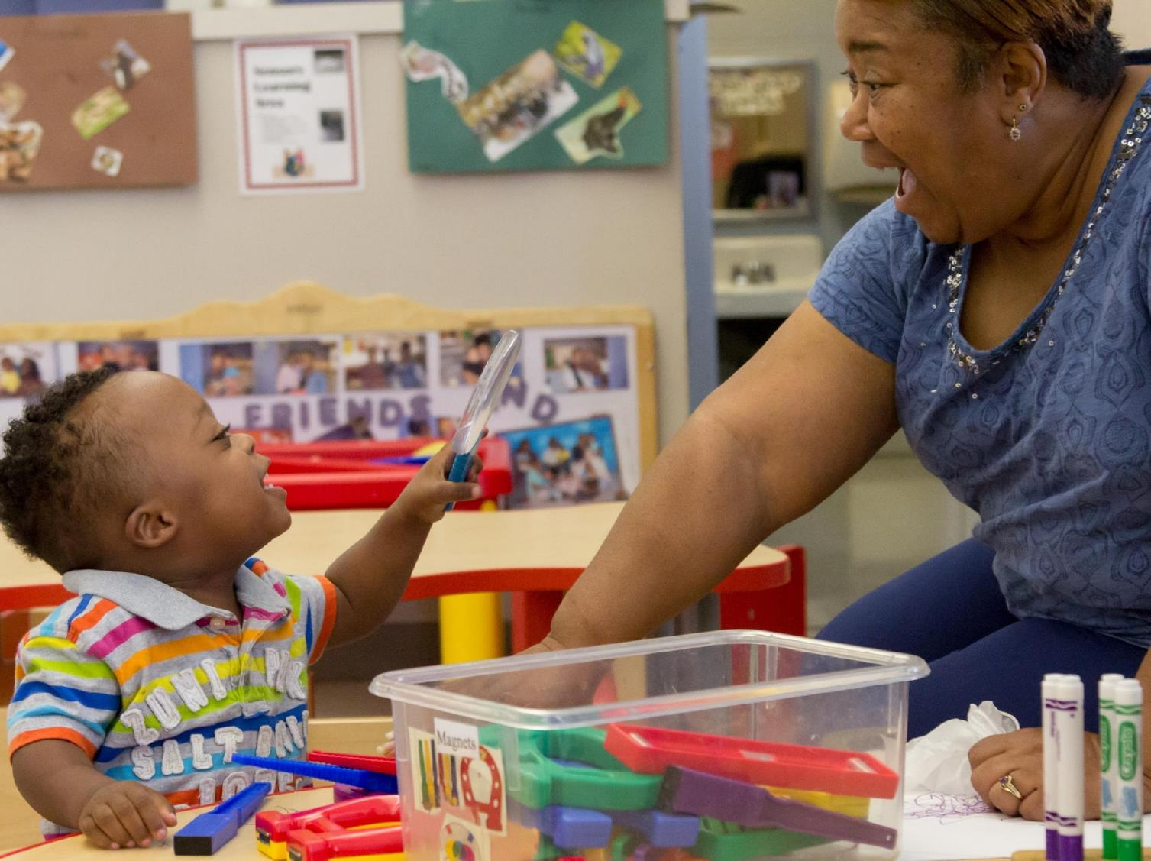
Make time to celebrate new skills.
Image credit: EarlyEdU

Slide 10
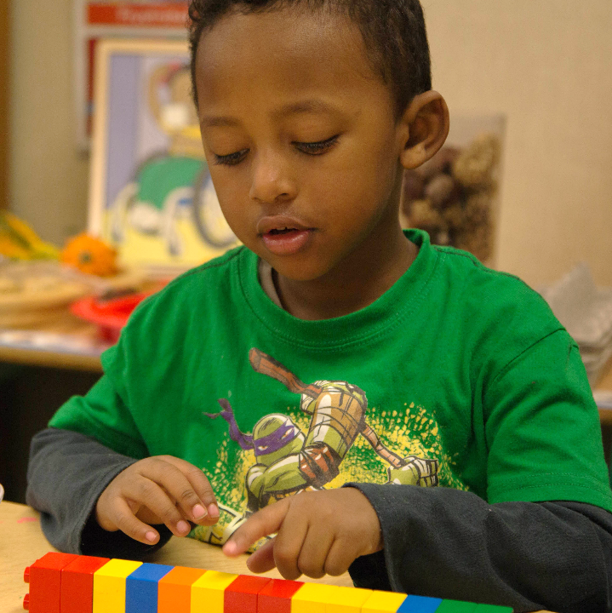
Talk Regularly About Development
Sharing excitement with families when children’s skills emerge can lay a foundation for more challenging conversations if a skill is not developing as expected.
Image credit: EarlyEdU

Slide 11
Relationship-Based Practices
You can use these six practices to build trusting relationships with parents:
Observe and describe children’s behavior
Reflect on the family’s perspective
Support competence
Focus on the family-child relationship
Value a family’s passion
Reflect on your own perspective

Slide 12
Conversations With Families When Concerns Arise

Slide 13
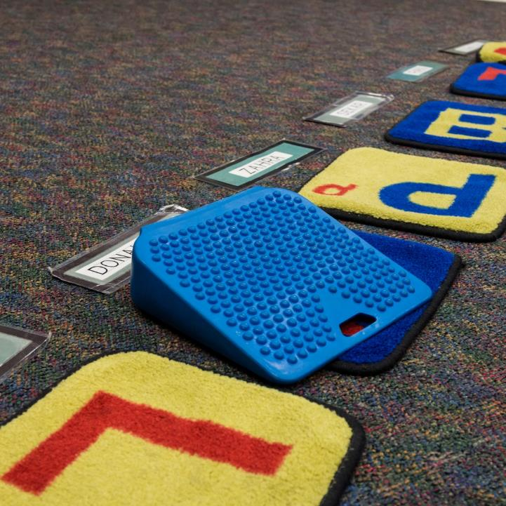
When Concerns Arise
Families and educators may have concerns or questions about children’s development
Communicating about these should be part of your ongoing relationship
Image credit: EarlyEdU

Slide 14

Developmental Screening
In some programs, such as Head Start and Early Head Start, educators and other staff do regular developmental screenings with children.
Image credit: EarlyEdU

Slide 15
Talking With Families About Concerns
Think about conversations you may have had with families about developmental concerns.
  What was successful?
  What did you find challenging?

Slide 16
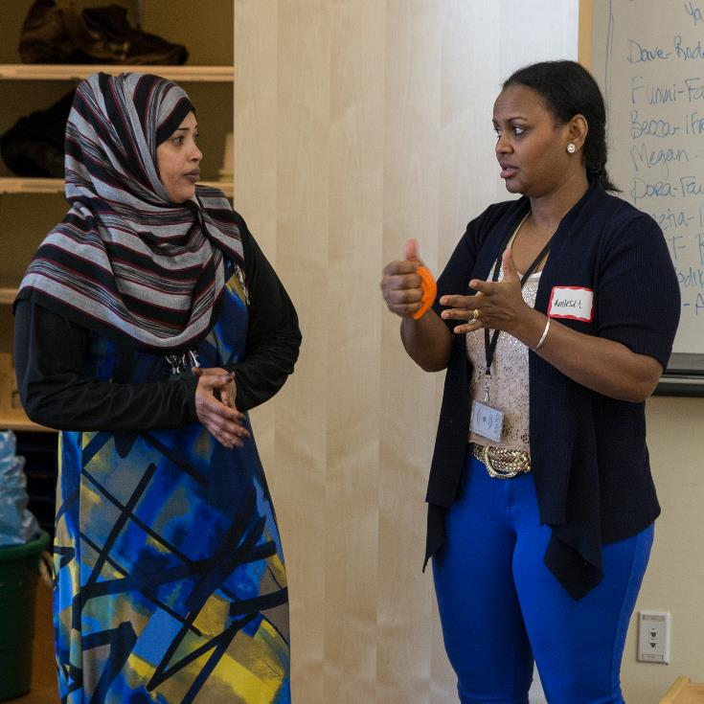
It is important to bring up any concerns that you have about children’s development.
Image credit: EarlyEdU

Slide 17
Planning to Talk With Families
Ask parents about a time that works well
Choose a private, comfortable location
Have developmental information available
Bring copies of information about the child and possible resources for evaluation
Include someone who speaks the parents’ home language, if needed

Slide 18
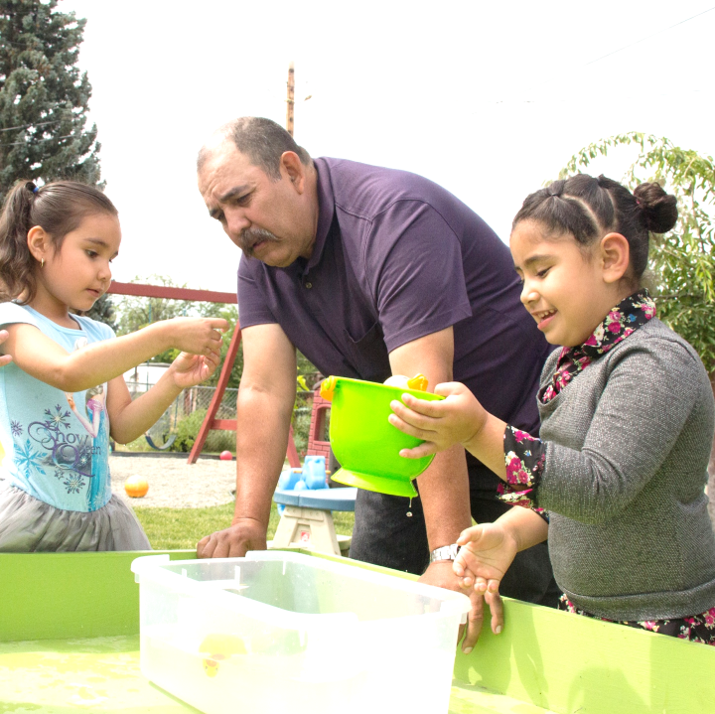
Cultural Perspectives
Remember that not all cultures view development the same way
Reflect on your own cultural biases
Image credit: EarlyEdU

Slide 19
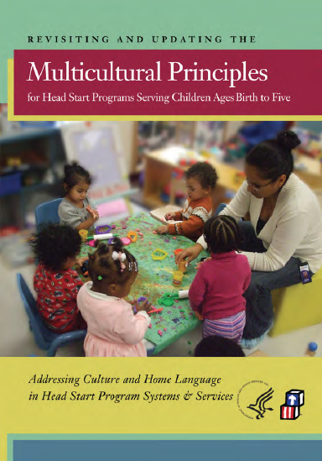
Image credit: Office of Head Start

Slide 20
Invite Families to Share
What do you see when Jeremiah plays with other children?
Is Lily trying to hold up her head at home?

Slide 21
Sharing Information
Provide details of your observations, using objective descriptions
Show families concrete information, such as pictures and photos
Do not diagnose or suggest a possible diagnosis for children

Slide 22
Shifting Perspectives
Sometimes you and parents may see the same concerns and agree on next steps
Other times, you may need to work hard to see parents’ perspectives and value what they are passionate about
If parents see the concerns differently, highlight common ground to build on

Slide 23

Observing the Child Together
After you or a parent has shared a potential developmental concern, you may want to engage in a process of observing the child together.
Image credit: EarlyEdU

Slide 24
Empathizing With Parents and Families
Parents and families may feel concerned or frustrated after conversations about their child’s progress or development. Educators can partner with families to move through this challenging time.
Express and demonstrate an ability to share an understanding of the feelings and concerns of parents and families
Communicate your confidence in the family’s ability to make the best choices for their child
Maintain a non-judgmental, non-defensive approach
Be available to the family, allowing them to take the lead in decision-making

Slide 25
Thinking About Approaches
Find a partner and read the scenarios on the handout
Think about the questions and make a plan together to talk with the child’s parents
Be ready to act out your conversation with the whole group

Slide 26
Partnering When Children May Need More Help

Slide 27



Partner with Families to Explore Resources
Families may want to seek evaluations or find out more about developmental concerns. Stay informed about the resources in your community.
Sources of information that parents and families can begin to explore include
      Pediatrician or health care provider
  Local school districts
  Part C Lead Agencies in your state/jurisdiction

Slide 28
IDEA: One System, Two Parts
The Individuals With Disabilities Act (IDEA) requires that all eligible children receive services.
Part C provides early intervention services for children birth to age 3 with special needs.
Part B provides special education services to preschool children with special needs.

Slide 29
Who Is Eligible?
Part C (Birth to 3)
Infants and toddlers with:
Established conditions
Developmental delays
Part B (3 to 5)
  Preschoolers with:
  Disabilities in certain categories
  Developmental delays
Eligibility rules vary by state.

Slide 30

Developmental Delays
A child may experience a developmental delay, as defined by each state, in one or more of these areas:
Cognitive
Physical
Communication
Social or emotional
Adaptive
Image credit: EarlyEdU

Slide 31
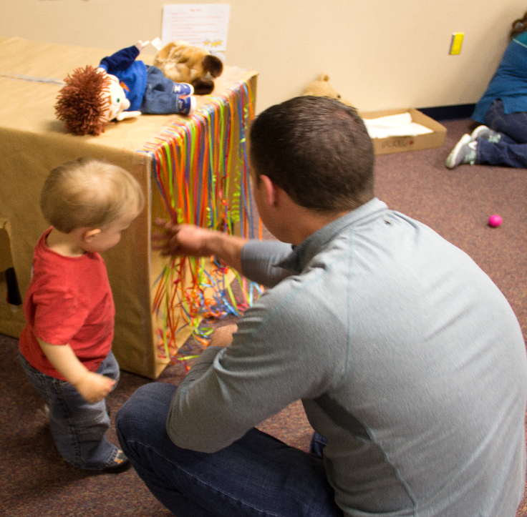
Meet Families Where They Are
Parents decide whether to seek out or use early intervention or special education services.
Image credit: EarlyEdU

Slide 32
Reflecting on Responses
Have you had experiences where parents chose not to seek an evaluation or use special services for which their child was eligible?
What was your response?
What would you do differently, if anything, in the future?

Slide 33
Services: The Basics
Each child receiving services must have a written plan developed by a team that includes the family:
Infants and toddlers and their families have an Individual Family Service Plan (IFSP)
Preschool children have an Individualized Education Program (IEP)

Slide 34
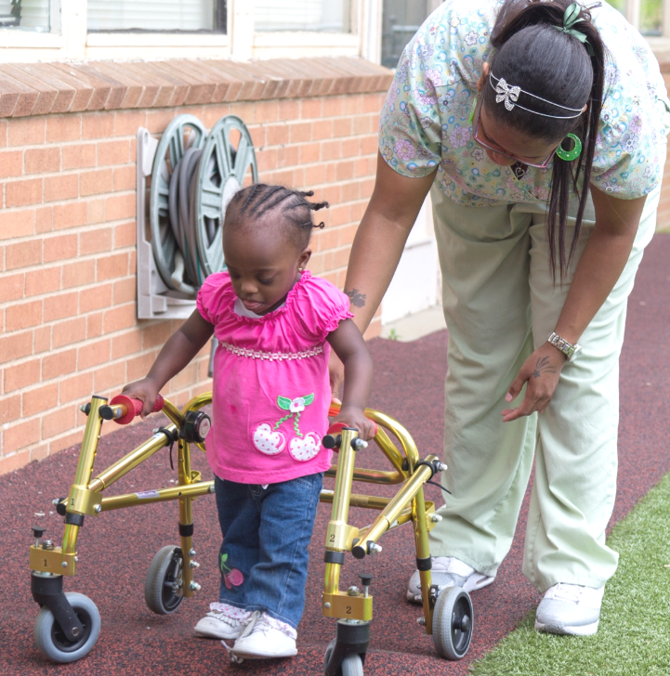
Why Services Are Important
Special services can:
Strengthen brain and physical development
Reduce the amount of ongoing and future challenges for these children
Image credit: EarlyEdU

Slide 35
Parents Sharing About Special Services
While you watch the next video, think about:
What did families value and find most useful in the services and help they received?

Slide 36

VIDEO: Parents Sharing
About Special Services

Slide 37
Video Debrief
Parents described:
Staff who welcomed them, were interested in their children, and supported their progress
New skills their children developed that improved their lives

Slide 38
Listening to Families
When parents learn that their child has a disability or developmental delay, they often experience a range of emotions, such as shock, anger, and grief.
This can be a grief experience for the family, similar to that of someone learning about the death of a loved one.

Slide 39

Parents may need time to adjust.
Image credit: EarlyEdU

Slide 40
Strengthening Partnerships
When you watch the next video, listen for any new ideas about partnering with families as they adjust to the idea that their child has a disability or developmental delay.

Slide 41
VIDEO: Strengthening Partnerships to Support Babies With Special Needs

Slide 42
Video Debrief
New concepts are:
Diagnoses and progress may be slow in coming for children and families
Parents need to consider the needs of the whole family, while you may be focusing on the child
You can support families in advocating for their children

Slide 43
Bringing It All Together

Slide 44
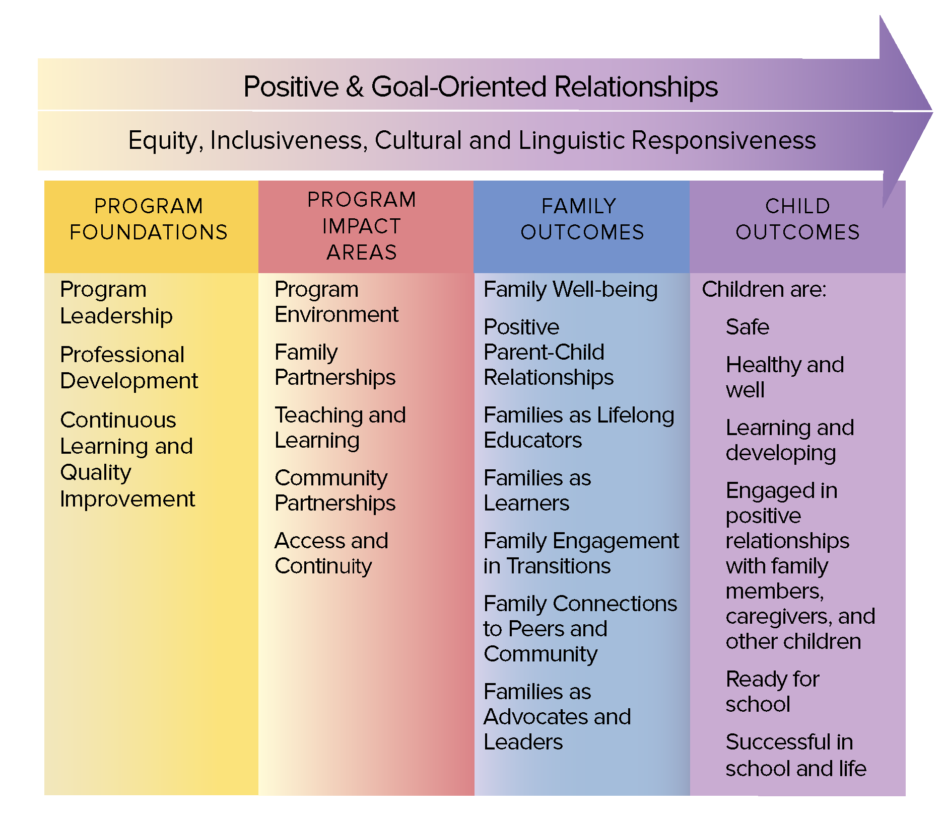
The Head Start Parent, Family, and
Community Engagement Framework
Image credit: Office of Head Start

Slide 45
Where Does It Fit?
Which part of the Parent, Family, and Community Engagement Framework does this topic relate to?
Form a small group and share ideas
Be ready to share your thoughts with the whole group

Slide 46
Exchanging observations helps you to reach a shared understanding of children’s development with parents and family
Adopting relationship-based practices can help to guide potentially challenging conversations about developmental concerns
Listening, and helping families to find specialized services, can positively impact children’s outcomes

