Slide 1

Head Start A to Z, 2.0
Recordkeeping and Reporting
Notes:
Slide 1
Facilitator Notes:
Welcome participants to the session and introduce yourself. If you have co-facilitators, invite them to introduce themselves as well. Begin the session with an introductory activity to create a positive group climate and begin the engagement process. Then, explain the following.
Say to Participants: “The National Center on Program Management and Fiscal Operations has updated Head Start A to Z to align with the revised Head Start Program Performance Standards that became effective November 2016. Head Start A to Z was originally designed to support new leaders in their Head Start roles. The term ‘leaders’ ensures that anyone at the management level, or in some cases the governing body, Tribal Council, or Policy Council level, can attend the sessions or use the materials for independent learning.
“The updated Head Start A to Z, 2.0, learning modules provide baseline-level information primarily through a leadership and management systems lens. The presentations are modeled on ‘learning organization’ concepts. In each of the modules, we recognize key characteristics of learning organizations, including a supportive learning environment, openness to new ideas, and time dedicated for reflection.
“Each attendee has an important role to play in the success of this session. Those with experience remind us where we’ve come from and what we must do to maintain our identity and uniqueness. New members bring a fresh perspective and remind us what we must do to prepare for the future. All roles are essential for Head Start programs to be learning organizations that continues to grow and flourish.
“Head Start A to Z, 2.0, is most successful when it helps us share the best of what we have to offer with a strength-based focus. As you engage in this session, we hope that you will support one another in the learning process by generously sharing your knowledge, experience, and perspective.”

Slide 2
Learning Objectives
As a result of this session, participants will:
Understand why accurate recordkeeping is a prerequisite for effective reporting
Learn how the recordkeeping and reporting system supports other Head Start management systems
Review regulatory requirements for recordkeeping and reporting
Understand the Four Data Activities and Responsible Data Life Cycle as frameworks for information management
Identify the role of leaders in supporting effective recordkeeping and reporting
Notes:
Slide 2
Facilitator Notes:
Distribute the Reflective Practice Tool handout.
Say to Participants: “In this module, participants will:
Understand why accurate recordkeeping is the basis of effective reporting
Learn how the recordkeeping and reporting system supports other Head Start management systems
Review regulatory requirements for recordkeeping and reporting
Explore the Four Data Activities and Responsible Data Life Cycle as frameworks for information management
Identify the role of leaders in supporting effective recordkeeping and reporting”
Guide participants to the Reflective Practice Tool handout.
Say to Participants: “At the end of our session, you will be asked to use this Reflective Practice Tool to write down some key thoughts based on what you’ve learned. We encourage you to jot down some preliminary thoughts as we move through the session.”

Slide 3
Six Guiding Principles for A to Z, 2.0
1
3
4
Successful programs are learning organizations.
Sound decision-making is informed by quality data.
Relationship-building is at
the heart of transformational leadership.
2
5
6
The effective delivery of services grows out of strong systems.
School readiness for all is our driving goal.
Culturally and linguistically diverse organizations rely on intentional, specific, and coordinated approaches.
Notes:
Slide 3
Facilitator Notes:
Distribute the Head Start A to Z, 2.0, Guiding Principles handout.
Say to Participants: “Head Start A to Z, 2.0, is based on six guiding principles. These guiding principles are foundational to the design of the modules and have been aligned with the HSPPS.
“Head Start directors and managers come from all walks of life with a wealth of employment experiences. However, we all share a commitment to a comprehensive, high-quality early childhood experience. We recognize that, to promote school readiness and be responsive to the needs of our communities, we must engage in ongoing professional development. Head Start A to Z, 2.0, was created to support professional growth and development for Head Start leaders.”
Guide the participants to the Head Start A to Z, 2.0, Guiding Principles handout. Review the six principles below. You may paraphrase or slightly summarize.
Successful programs are learning organizations. Head Start is a dynamic organization with high expectations, values, and traditions. Programs are constantly responding to changing community needs and evolving best practices. To cultivate a learning organization that thrives in this environment, program leaders must support all staff in becoming life-long learners who embrace challenges as opportunities for collective problem-solving and innovation.
The effective delivery of services grows out of strong systems. Program leaders must regularly refine their program’s management and fiscal systems. To target community needs and deliver comprehensive services, leaders need to understand systems thinking and view their program through a systems lens. They also need to recognize the relationship between systems, services, and child and family outcomes.
Sound decision-making is informed by quality data. Used in planning, evaluating, and communicating information, quality data is integral to cultivating a culture of continuous quality improvement. To this end, it is critical for leaders to establish efficient processes for collecting, aggregating, analyzing, and synthesizing data. This involves training teachers, home visitors, family advocates, health services workers, and other staff how to integrate data management into their day-to-day work.
Relationship-building is at the heart of transformational leadership. Robust Head Start communities build on authentic relationships between all of their stakeholders, from children, families, staff, and managers to governing bodies, Tribal Councils, and Policy Councils. To cultivate these communities, leaders need to communicate effectively, empower others, foster team-building, and nurture collaboration.
School readiness for all is our driving goal. Head Start leaders play an integral role in conceiving and promoting an inclusive vision of school readiness. To support children with diverse abilities and backgrounds to develop the skills, knowledge, and attitudes needed to be successful in school, effective leaders must stay informed on developments in early childhood education. They also must actively collaborate with parents, staff, governing bodies, local education agencies, and community partners in embedding these best practices into services and programming.
Culturally and linguistically diverse organizations rely on intentional, specific, and coordinated approaches. To ensure the full and effective participation of dual language learners and their families, Head Start leaders must coordinate program-wide plans that involve all service areas and multiple staff. This includes staying connected to the communities served, implementing targeted strategies, and articulating how programs and services address specific linguistic and cultural needs.
Say to Participants: “In addition to anchoring the content in Head Start A to Z, 2.0, you will revisit these guiding principles in all of the trainings offered by PMFO.”

Slide 4
Recordkeeping and Reporting: Setting the Stage
Notes:
Slide 4
Facilitator Notes:
Direct participants’ attention to the slide.
Say to Participants: “Have you ever worked with a director who:
Spent a great deal of time searching for something she could never seem to find?
Wondered whether the reimbursement claim he was submitting to the Child and Adult Care Food Program (CACFP) was accurate?
Was concerned about whether a child had received the correct dose of the correct medication at the correct time?
Worried about the program’s attendance level and if any children were chronically absent?
Hoped her Policy Council and governing body or Tribal Council would understand why she was proposing to end transportation in one part of the service area but increase it in another?”
As you describe each of these scenarios, take a moment to acknowledge the nodding of heads.
Say to Participants: “These are the problems that an effective recordkeeping and reporting system can prevent. In fact, in nearly every way you can imagine, the quality and success of your program depends on this system.”

Slide 5
Activity: Visual Program Model
My program's recordkeeping and reporting system
Notes:
Slide 5
Facilitator Notes:
Make sure participants have markers and paper. Prepare by writing the bulleted elements below on flipchart paper and posting it in the front of the room.
Say to Participants: “Before we get deeper into the content of this session, let’s engage in a fun activity. I’d like you to create a visual representation of your program’s recordkeeping and reporting system. Base your drawing on your current state of knowledge about your system.
“Split into groups of three and begin by describing your system to your team. You will have 10 minutes to do this.”
After 10 minutes, call the group back together.
Say to Participants: “Now, plan your drawing. Be creative! You can create a diagram, graph, flow chart, list, car, animal, or whatever else you’d like. If your team prefers, you can create one recordkeeping and reporting system that represents your group discussion.”
Call participants’ attention to the flipchart sheet you posted at the front of the room and review each bulleted item.
Say to Participants: “Be sure to include the following:
Elements and characteristics of your system
Information your system collects
Recordkeeping activities
Workplace behaviors required for recordkeeping
Reports your program creates and distributes
Relevant relationships between people, systems, and other organizations
Other elements you feel are important to your system
You will have 15 minutes to create your drawing.”
Say to Participants: “As we go through this session and you learn more about recordkeeping and reporting, make updates to the graphic you have just created. Take notes and jot down the ideas and thoughts. At the end of the session, we’re going to take a few minutes to update our drawings. Then, we’ll share them with one another.”

Slide 6
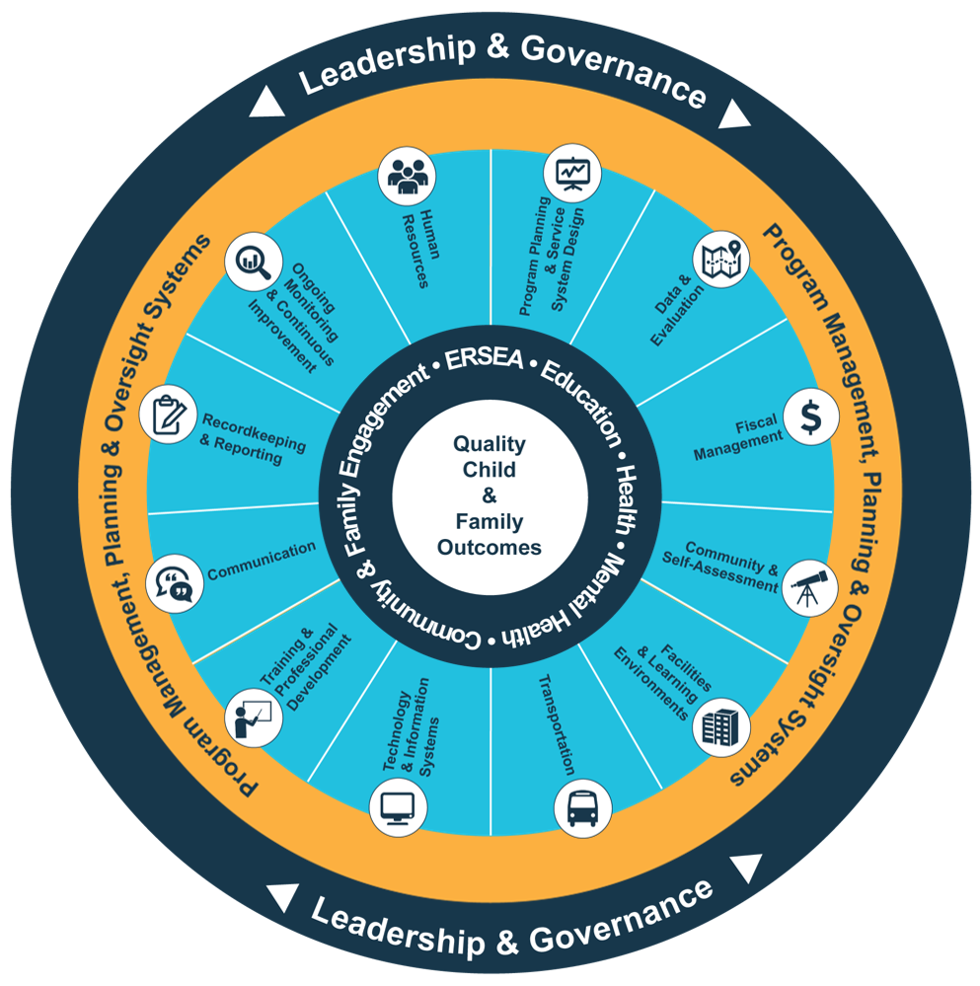
Head Start Management Systems Wheel
Five-Year Project Period
Notes:
Slide 6
Facilitator Notes:
Deliver the following material as a mini-lecture.
Say to Participants: “The Head Start Management Systems Wheel can help us understand how recordkeeping and reporting fits into the overall picture.”
In your own words, explain the graphic on the slide by pointing to its various elements and describing each, basing your descriptions on the bullet points below.
The dark blue outer circle includes the functions of leadership and governance. They are the bedrocks of effective management, encompassing and informing the 12 management systems.
The yellow circle outlines the scope of these systems.
The segmented aqua blue ring outlines each of the 12 management systems. These systems work together to inform and influence the program’s service delivery. These services include education, health, mental health, community partnerships, family engagement, and eligibility, recruitment, selection, enrollment, and attendance (ERSEA).
Say to Participants: “You see that one of the aqua blue wedges is labeled ‘recordkeeping and reporting.’ That’s the management system we’re looking at in this module. In Head Start, all of these systems work together to inform and influence the program’s service delivery, which you see in the dark blue inner circle. When innovative leadership, strong management systems, and well-designed services are working together, we produce quality child and family outcomes.”

Slide 7
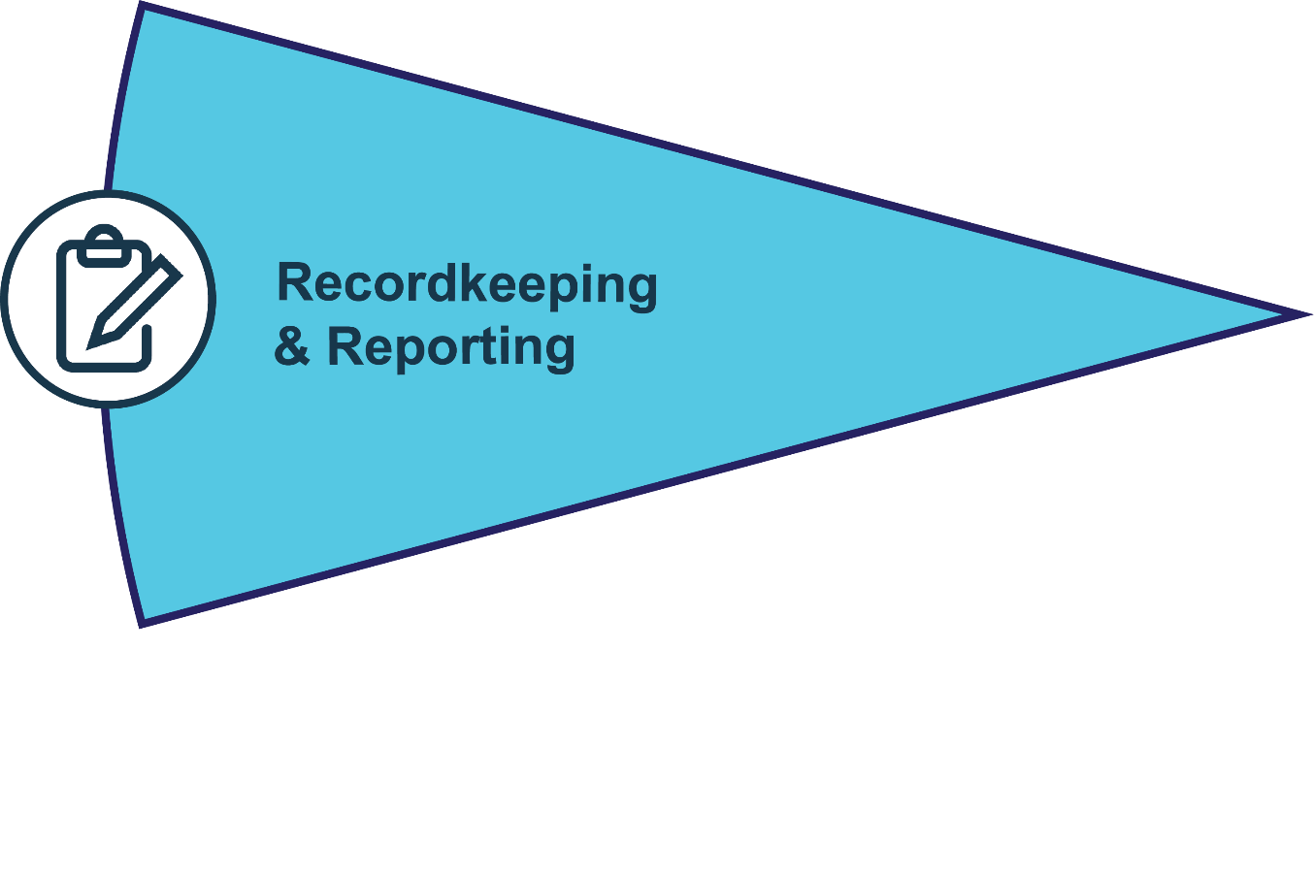
Recordkeeping and Reporting
Builds and maintains a program's institutional memory
Oversees and distributes strategic reports and recordkeeping activities
Informs staff, leadership, and external partners
Achieving program goals, 45 CFR §1302.102(d)
Protection for the Privacy of Child Records, 45 CFR §1303 Subpart C
Notes:
Slide 7
Facilitator Notes:
Direct participants’ attention to the slide.
Say to Participants: “As you see on the slide, recordkeeping and reporting is one of Head Start’s 12 management systems. This system:
Builds and maintains a program’s institutional memory
Oversees and distributes strategic reports and recordkeeping activities
Informs staff, leadership, and external partners”

Slide 8
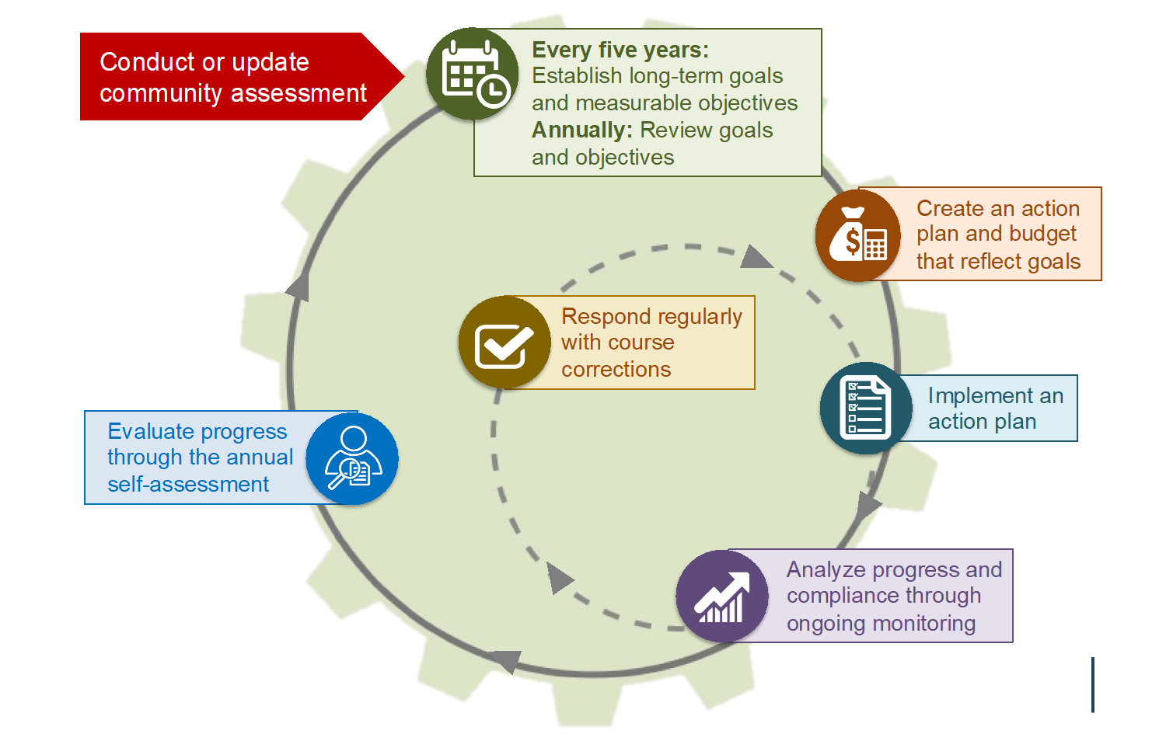
Program Planning Cycle
Notes:
Slide 8
Facilitator Notes:
Call participants’ attention to the slide.
Say to Participants: “Let’s spend a moment looking closely at how recordkeeping and reporting fits into the program planning cycle and feeds continuous quality improvement. Study look at the slide, noting how the various activities work together.”
Point out the activities on the slide, starting with the community assessment.
Say to Participants: “We can see that recordkeeping and reporting is linked to all the other management systems, but especially to:
Communications
Data and evaluation
Program governance
Program planning
Fiscal management
Human resources”

Slide 9
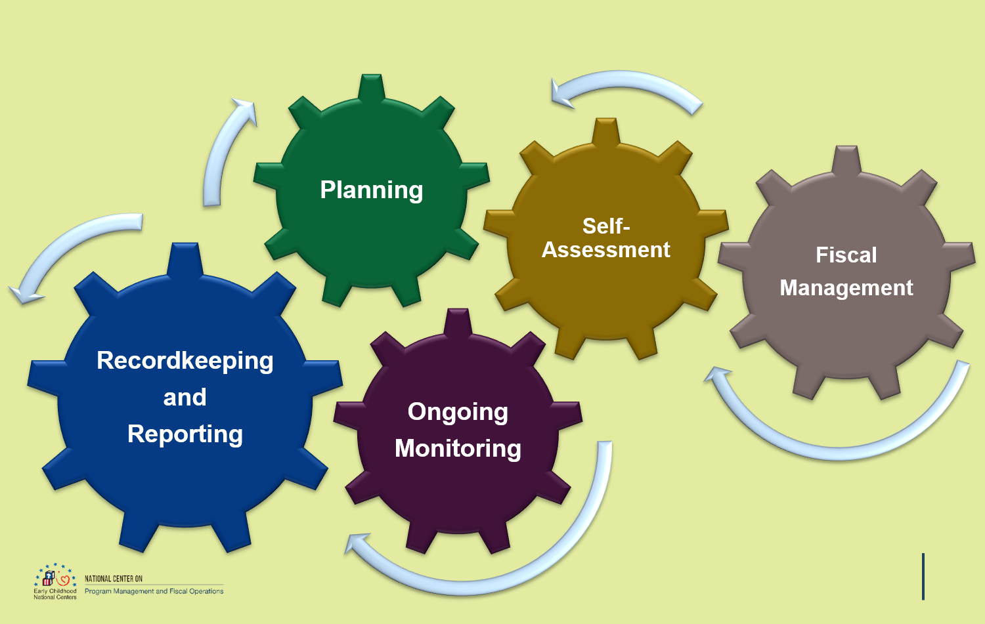
Systems Are Linked
Notes:
Slide 9
Facilitator Notes:
Call participants’ attention to the slide.
Say to Participants: “Head Start systems are interrelated. When one system is operating inefficiently, other systems suffer as well, and the quality of services to children and families becomes inconsistent. When this happens, children and families receiving services in one center may have a completely different experience from those across town in a different center. The recordkeeping and reporting system serves as a safeguard. It flags problems early and keeps programs on track even when they are in transition or under stress.”

Slide 10
Why Is Recordkeeping and Reporting Important?
Documentation of completed work
Program planning
Program operations
Program evaluation
Ongoing monitoring and self-assessment
Continuous improvement
Communication
Knowledge transfer
Institutional memory
Legal issues
Risk management
Leadership continuity
Notes:
Slide 10
Facilitator Notes:
Prepare for the following exercise by writing each of the 12 processes below on sticky notes or separate strips of paper. Give each participant one strip. If the group is large, participants may need to share. If you use strips of paper, make sure masking tape is available so participants can affix them to flipchart paper.
Say to Participants: “As we’ve said, the recordkeeping and reporting system is foundational to Head Start programs. It supports:
Documentation of completed work
Program planning
Program operations
Program evaluation
Ongoing monitoring and self-assessment
Continuous improvement
Communication
Knowledge transfer
Institutional memory
Legal issues
Risk management
Leadership continuity”
Ask the group to break into teams of three or four. Explain that each team member should spend one minute discussing how the recordkeeping and reporting system supports the process written on their sticky note. When everyone on the team has spoken, each participant should take one minute to develop a 15-second oral presentation to the reassembled group. If all team members are from the same program, the team may choose a representative to make the presentation.
After four minutes, call the group back together and begin soliciting volunteers to speak. As you move from topic to topic, make sure the following points are made:
Documentation of completed work: A good recordkeeping and reporting system establishes a strong information trail that informs internal and external stakeholders about the services your program is delivering. Documentation tracks a child and family from their point of entry until they exit the program, recording the services they receive and their progress throughout their time in the Head Start program.
Program planning: The recordkeeping and reporting system provides the information programs use to decide whether to expand, contract, offer different program options, or move the location of services. The data this system generates guides virtually all programming decisions.
Program operations: The recordkeeping and reporting system collects routine information that programs use to inform daily operations. For instance, facilities reports will flag the need for new playground equipment. Incident reports will tell you if a child has been injured getting off the bus. This constant flow of information allows programs to monitor and improve their services in real time.
Program evaluation: The recordkeeping and reporting system collects and analyzes outcomes information that tells programs whether they are meeting their goals.
Ongoing monitoring and self-assessment: Effective recordkeeping and reporting processes collect and analyze data for ongoing monitoring. A strong ongoing monitoring process enables program self-assessment.
Continuous improvement: Ongoing monitoring and self-assessment are data-informed processes that enable programs to determine what’s working and what needs correction or improvement. In this sense, continuous improvement is a direct outcome of effective recordkeeping and reporting.
Communication: Programs communicate with stakeholders constantly in many different ways—formally, informally, and through required reports. The recordkeeping and reporting system provides the information upon which those communications are based.
Knowledge transfer: A strong recordkeeping and reporting system educates staff, the governing body or Tribal Council, Policy Council, volunteers, community partners, and families about your program.
Institutional memory: By creating a body of historical knowledge about your Head Start program, records and reports develop institutional memory that supports your program during transitions.
Legal issues: If legal challenges arise, accurate records and complete reports allow programs to demonstrate they have followed proper procedures.
Risk management: The recordkeeping and reporting system helps programs identify, evaluate, and minimize the impact of financial risks.
Leadership continuity: A good recordkeeping and reporting system supports program stability by smoothing the transition between leaders.

Slide 11
Two Separate but Linked Processes
    Recordkeeping is the process of recording activities, transactions, and events into an information management system
    Reporting is the process of organizing records into topic-specific summaries that help us monitor our programs and tell us whether we are achieving our goals
Notes:
Slide 11
Facilitator Notes:
Call participants’ attention to the slide.
Say to Participants: “First, let’s define what we mean by recordkeeping and reporting.
Recordkeeping is the process of recording activities, transactions, and events into an information management system
Reporting is the process of organizing records into topic-specific summaries that help us monitor our programs and tell us whether we are achieving our goals
“When your records are accurate and complete, the reports you generate will tell you how well your program is working. These reports help you communicate effectively with your stakeholders. They are the basis of continuous improvement in your program.
“Let’s consider some examples. I’m going to give one, then ask for more from you. In Head Start programs, we continually assess children’s development using a valid and reliable assessment tool in order to individualize teaching practices for each child. At least three times per year, this assessment data is aggregated and analyzed, then summarized in management reports. The reports help teachers, program managers, leadership, and governance bodies understand whether we’re on track to meet our school readiness goals.
“What other dimensions of our programs does the recordkeeping and reporting system track, analyze, and summarize into reports?”
Solicit responses. Make sure the following items are mentioned:
Attendance by classroom
Number of children served meals
Number of home visits completed
Number of families referred to services
Teacher observations
“As we move through this session, remember that accurate records are the foundation of useful reports.”

Slide 12
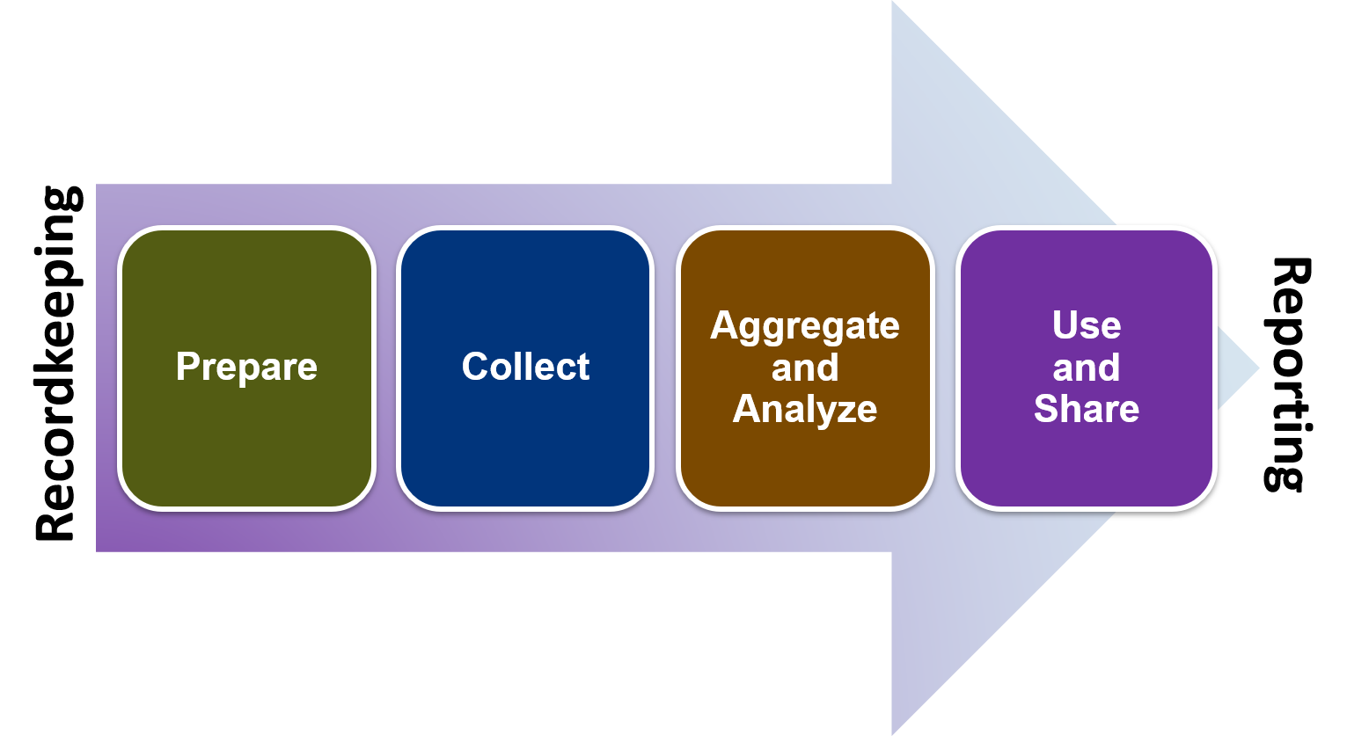
The Four Data Activities
Notes:
Slide 12
Facilitator Notes
Distribute the Four Data Activities handout.
Say to Participants: “We know that data—discrete units
of information, either in number or narrative form—is the basis of recordkeeping and reporting. We collect data in various forms and ways. We also report it in different ways for different stakeholders.
“In Head Start programs, we break down our treatment of data into four categories, called The Four Data Activities. Take a look at the handout.
“The four activities are: Prepare, Collect, Aggregate and Analyze, and Use and Share. They describe the basic tasks of recordkeeping and reporting.
“The first two activities, Prepare and Collect, constitute recordkeeping. You prepare for effective recordkeeping by deciding what kinds of information you need to collect and how you’re going to collect it. You collect that information through routine processes, such as taking attendance and documenting how many families you refer to which kinds of services.
“The third activity, Aggregate and Analyze, occasionally occurs as part of routine recordkeeping. It is sometimes conducted for specific reports your program is required to make. The fourth activity, Use and Share, is about reporting. It focuses on using your data internally and sharing it with external stakeholders via reports.
“There is one additional activity we want to recognize here. It concerns retaining, archiving, or disposing of data that is no longer immediately relevant. We will talk about that a little later.
“For now, just remember recordkeeping and reporting are two linked processes. They transform records into reports that our programs use at many levels for dozens of different purposes.
“Now that we’ve discussed the system as a whole, let’s focus on recordkeeping.”

Slide 13
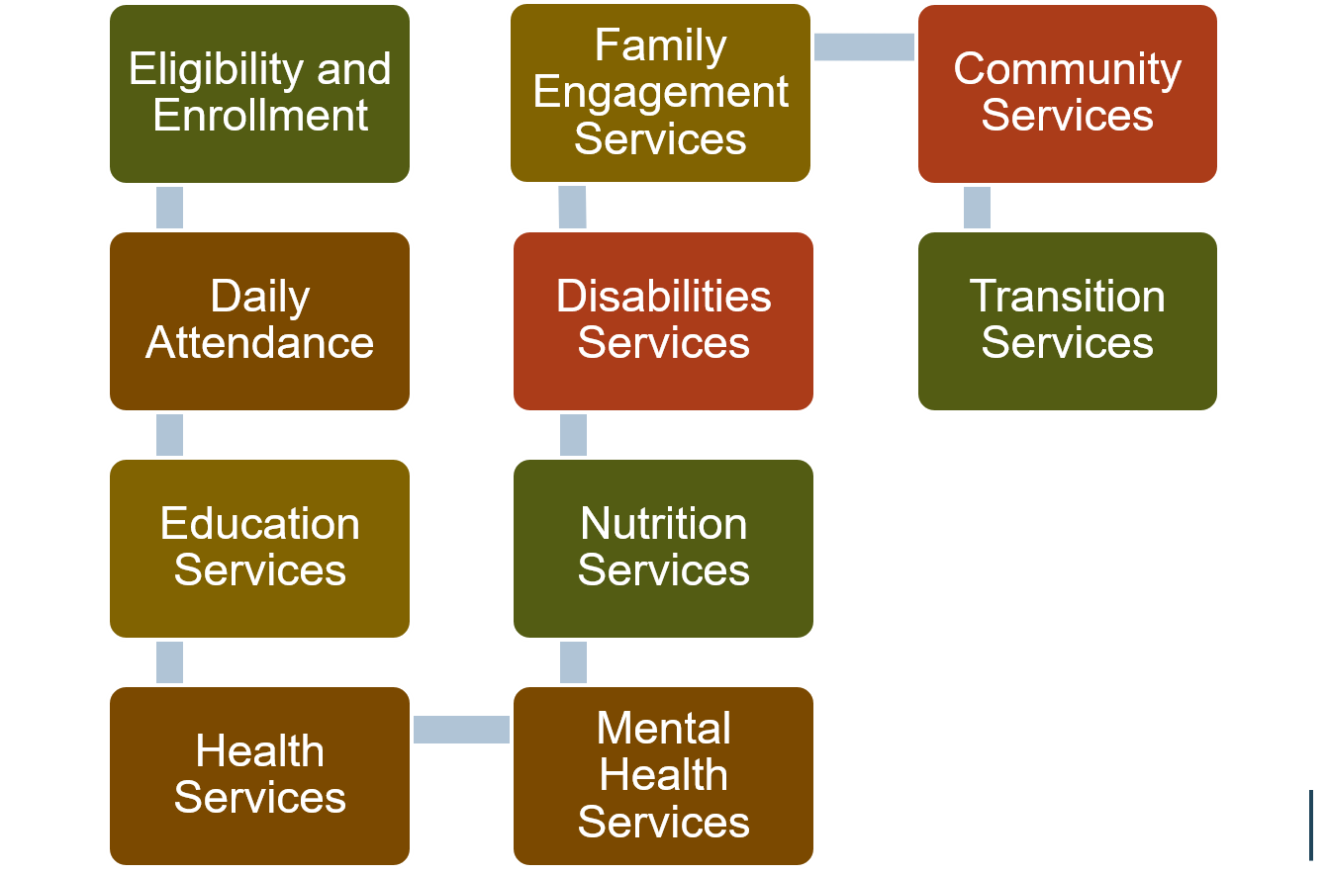
Records in the Life of a Head Start Child
Notes:
Slide 13
Facilitator Notes:
Begin this section on recordkeeping by distributing the Records in the Life of a Head Start Child handout.
Say to Participants: “When children and families are enrolled in a Head Start or Early Head Start program, a standard series of records is created. This graphic illustrates the categories into which these records fall.
“Each family is different, of course. Generally, however, any given family’s records will take this basic shape. As we talk about the records generated for each family as they move through Head Start, think about all the data each record would contain. Remember that data can take the form of numbers, written observations, or case notes.”
Review the blocks on the slide one by one, asking participants to name the records each category includes. Make sure the following are mentioned:
Eligibility and enrollment, including income, birth certificate, family status, and child care subsidy
Daily attendance
Individualized education services
Health services, including health screenings, dental exams, follow-ups, records on medical conditions, and referrals
Mental health services, including behavioral health plans and referrals
Nutrition services, including special diets, nutritional assessments, and allergies
Disabilities services, including contact notes, Individualized Education Plans (IEPs), Individual Family Service Plans (IFSPs), progress notes, and referrals
Family engagement services, including agreements and referrals
Use of community services by children and families
Transition services, including records on how children transition throughout the program and from the program into kindergarten or
another setting”
Ask participants to turn to a neighbor and discuss the handout. Ask each pair to identify which recordkeeping and reporting elements are most and least familiar to them. Ask for volunteers to share with the group, and lead a brief discussion.

Slide 14
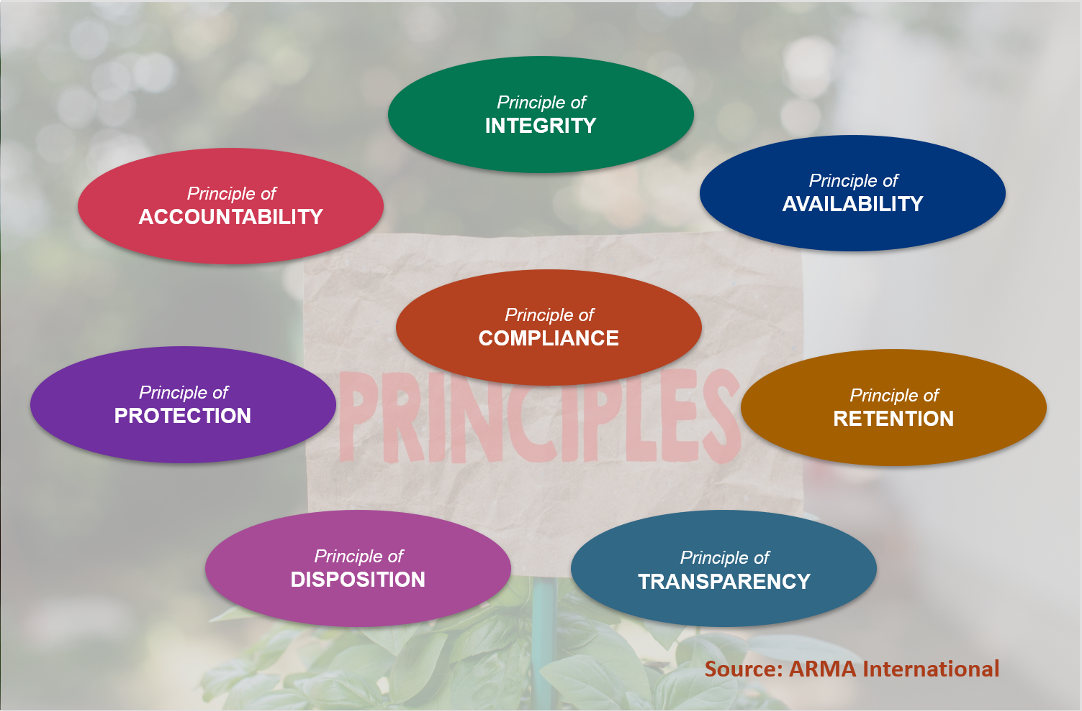
Generally Accepted Recordkeeping Principles®
Notes:
Slide 14
Facilitator Notes:
Call participants’ attention to the slide.
Say to Participants: “Organizations like Head Start that routinely collect and store large amounts of information must develop robust recordkeeping systems.
“What do robust systems look like? In 2009, ARMA International, a global information management membership organization, published the Generally Accepted Recordkeeping Principles®.¹ The principles create a framework for excellence in recordkeeping systems, and have been adopted widely by many different industries.
“Head Start programs should understand these principles and manage their records in accordance with them. The principles are:
Accountability. A senior staff member must supervise recordkeeping activities and processes.
Integrity. Information being collected must be authentic and reliable.
Protection. Confidential or private records must be protected.
Compliance. Recordkeeping systems must comply with applicable laws and regulations, and with the organization’s own policies.
Availability. Records must be easily retrievable.
Retention. Organizations must maintain records for an appropriate time. ‘Appropriate’ is defined by legal, regulatory, fiscal, and operational requirements.
Disposition. Organizations must securely dispose of records and information they are no longer required to maintain.
Transparency. Recordkeeping activities and processes must be documented in an open and verifiable way. Internal and external stakeholders should know how the recordkeeping system works.
“As you review these principles of recordkeeping, which ones do you think you need to learn more about? Why would knowing more be helpful to you in your Head Start role?”
Solicit responses.
¹ Generally Accepted Recordkeeping Principles®. ARMA International. 2017. www.arma.org/principles

Slide 15
Head Start Requirements
Head Start Requirements | Corresponding Generally Accepted Recordkeeping Principles®
Availability | Availability
Usability | Availability
Integrity | Integrity
Security | Protection
Routine reports to internal and external stakeholders | Transparency, Accountability
Retention and disposal of certain records | Retention, Disposition
Rights of parents to inspect and correct records | Protection, Transparency
Notes:
Slide 15
Facilitator Notes:
Continue your mini-lecture on recordkeeping.
Say to Participants: “The HSPPS require Head Start programs to manage their records in ways that support data availability, usability, integrity, and security.
Data availability is concerned with how accessible data is to the people who need it
Data usability refers to how easily and efficiently data can be used to help programs perform tasks and make decisions
Data integrity relates to the accuracy and consistency of stored data
Data security is concerned with protecting data from hacking and corruption
“The HSPPS and Head Start Act also address retention and disposition of certain records, and protection of PII.
“Look carefully at the slide. Note how the Head Start requirements correspond almost perfectly with the Generally Accepted Recordkeeping Principles® we just talked about. The only one not explicitly mentioned is compliance because, by definition, all Head Start recordkeeping and reporting activities occur within a compliance framework.”

Slide 16
Protecting Personally Identifiable Information
    Establishing procedures
    Confidentiality provisions
    Disclosures with and without parental consent
    Parental rights
    Maintaining records
    Protections for the privacy of child records, 45 CFR §1303 Subpart C
Notes:
Slide 16
Facilitator Notes:
Distribute the Protections for the Privacy of Child Records, 45 CFR §1303 Subpart C handout.
Say to Participants: “As we’ve just seen, one of the areas of overlap is ensuring that private records are protected. On the slide, we see the topics related to protection covered by the HSPPS.
“Let’s take a moment to look more closely at HSPPS requirements around safeguarding child records in particular. Review the information on your handout. Take about two minutes.”
After two minutes, continue.
Say to Participants: “The HSPPS say that programs must:
Ensure only parents and program officials have access to children’s records
Tell parents about everyone outside the program to whom a disclosure of PII has been made
Retain parental statements related to the child record for as long as the program maintains the record, and disclose the statement whenever it discloses the relevant portion of the child record
Allow parents to inspect, amend, and make copies of records
Destroy records when they are no longer needed
“The HSPPS also describe circumstances under which disclosures of PII can be made without a parent’s consent, such as to protect a child’s safety during an emergency.
“You may want to keep the handout for later reference. It includes many important details about HSPPS requirements on this subject.”

Slide 17
Data Plan Development
Notes:
Slide 17
Facilitator Notes:
Distribute the Guidance for Management of Program Data handout.
Say to Participants: “We’ve spent some time discussing HSPPS regulations requiring Head Start programs to ensure data availability, usability, integrity, and security. The regulations also say programs must develop procedures to support these four areas.
“We’re going to talk about this. First, though, let’s remind ourselves of the difference between policies and procedures.
Policies are principles, rules, and guidelines meant to help an organization reach its long-term goals. They are typically published in a booklet or other form that is easy to access.
Procedures are specific methods or steps staff use to carry out policies. They are much more detailed than policies.
“Turn to a neighbor and together decide which of the four sections on the handout you would like to dig into more deeply: data availability, integrity, usability, or security. Then, spend 10 minutes reading your section and writing a procedure supporting the area you selected.”
After 10 minutes, ask for volunteers to share their procedures. Conduct a group procedure-writing exercise for any sections that were not chosen.
Encourage participants to take the handout back to their programs to assess their data management policies and procedures.

Slide 18
Data Plan Development
Notes:
Slide 18
Facilitator Notes:
Distribute the Digital Data Inventory handout.
Say to Participants: “In this next activity, we’re going to look more closely at the types of information we collect and how we manage it.”
“Start with the first column of the Digital Data Inventory handout. List all the types of data your program collects and the sources of that data. It may be helpful to refer to the Year in the Life of a Head Start Child handout you received a few minutes ago. You have eight minutes for this exercise.”
After eight minutes, ask participants how far they were able to get. Tell them they may wish to complete the inventory with their program staff, filling in information for all of their data sources.

Slide 19
A short break for participants to review their visual program models…
Notes:
Slide 19
Facilitators Notes:
Introduce a short break for participants to review their visual program models and make revisions if they wish.
Say to Participants: “Before we move on to discuss reporting, take a short break to revisit the diagrams you made earlier in the session. Based on what you’ve learned so far, do you want to change your drawing in any way? Feel free to make any revisions now. Let’s take five minutes.”

Slide 20
Head Start Reporting
Programs must submit:
Self-assessment and improvement plan
Community assessment
Financial, enrollment, PIR, and other regular reports
Status reports
Significant incident reports
Annual report
Quality improvement plan in case of deficiency
Achieving program goals, 45 CFR §1302.102(d)
Grantee reporting requirements concerning certain conditions, 45 CFR §1304.12
Sec. 641A(g)(2) and 642(d)(2)
Notes:
Slide 20
Facilitator Notes:
Begin this section on reporting.
Say to Participants: “Now that we’ve spent some time talking about recordkeeping, let’s look at reporting. The Head Start Act established that programs must:
Conduct an annual self-assessment and submit improvement plans based on it
Conduct an annual community assessment
Regularly share several types of information with the governing body or Tribal Council and Policy Council, including monthly financial statements, enrollment reports, reports of meals and snacks, Program Information Reports (PIR), and the annual financial audit
“The HSPPS refined these requirements, saying that programs must also:
Submit status reports for the Policy Council and governing body or Tribal Council at least semi-annually
Submit reports on significant incidents, including incidents affecting the health and safety children, breaches of PII, bankruptcy, license revocation, or legal proceedings
Disseminate an annual report that includes a summary of the program’s most recent community assessment
Communicate deficiencies and a quality improvement plan to address them”

Slide 21
Summary of Reporting Requirements
Notes:
Slide 21
Facilitator Notes:
Distribute the Summary of Reporting Requirements handout.
Say to Participants: “On this handout, you’ll see many of the reports programs must generate. For each report, note:
How often it must be generated
The sources of required information
Intended recipients
Relevant regulatory language
“Have any of you been personally involved in creating some of the reports on the handout?”
Ask volunteers to describe their experiences and reflect on what was easy or challenging about them.
Say to Participants: “Keep this handout. It will be a useful reference tool for you when you return to your program.”

Slide 22
Writing Reports That Tell Your Story
Stories bring us together and move
us to action
Combining storytelling with data is powerful
Notes:
Slide 22
Facilitator Notes:
Call participants’ attention to the slide. Consider writing the ‘four A’s’ on flipchart paper as you discuss them.
Say to Participants: “As you know, many of the reports we generate are required by our funders and state or local authorities. In some cases, we have to follow a particular format. In other cases, we choose our own format. Either way, when we create reports, we’re communicating a message about our program. We’re telling a story.
“Tell the best story you can by attending to the four A’s. Be:
Accurate. Make sure all information in your report is correct. Be direct and forthright. The report must convey what the data actually says, not what you wish it said. Proofread your documents carefully. Typos are distracting and hurt your credibility.
Audience-specific. Highlight issues the report’s audience cares about. Take into account the level of detail needed by that audience, and their prior knowledge of the topic.
Appealing. Keep your communications simple, clear, and visually attractive. Tell a story in a compelling way, supporting it with a few carefully selected statistics.
Accessible. Use language appropriate for the reading level of your audience. Avoid jargon or acronyms when possible. Use bullet points rather than long narratives, and write in the language spoken by the audience members.”

Slide 23
Your Annual Report
Notes:
Slide 23
Facilitator Notes:
Continue the section on reporting.
Say to Participants: “Among all your required reports, the annual report is particularly important because it is seen by so many stakeholders. This report to the public is required, but grantees themselves can decide how to prepare and present it. Reports must include information on eight specific topics. They are spelled out in Sec. 644(a)(2).
“Keep these points in mind about the annual report.
The Head Start Act says which statistics must be included in your annual report. However, each program decides how to make those facts meaningful and interesting. Annual reports should tell the story of your program’s accomplishments over the past year.
Annual reports are always shared with the Policy Council and governing body or Tribal Council. They should also be shared with staff.
Many programs post their annual reports online so they can be easily accessed by members of the local community, school districts, and potential funders and partners.
Programs must include a summary of their most recent community assessment in each year’s annual report.
“Take three minutes and think about your organization’s annual report. What story does it tell about the work you do and successes you achieve?” Solicit responses.
Say to Participants: “How do you think your annual report could be even more impactful?”
Write responses on a flipchart.

Slide 24
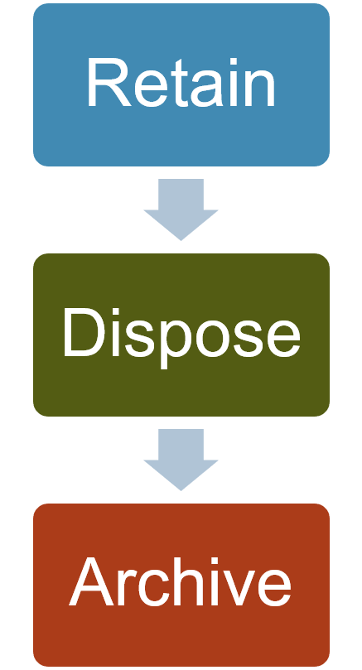
Retain, Dispose, or Archive?
Know where your data is located
Check applicable regulations
Know how to permanently purge digital documents
Have a plan for purging data from devices and systems when it is no longer needed
Weigh cost, security, and efficiency of archival system
Notes:
Slide 24
Facilitator Notes:
Begin this section on retaining, archiving, or disposing of records.
Say to Participants: “Now, let’s talk about how to manage records as they near the end of their useful life.
“In this phase, you need to decide what you’re going to do with your records over time. A number of questions come into play. When does data lose its relevance? When can you get rid of it? Should you archive it?
“For each type of record you have collected, ask yourself these questions:
Where are the records located?
What are the applicable regulatory requirements for retention?
If we purge records, can we ensure they are permanently deleted?
How much would it cost to archive records we may want to retain?
How secure are the records we archive?
How efficiently can we retrieve documents from our archival system?
“Many organizations develop a records schedule to help manage the data they collect. A records schedule provides instructions for both retention and disposition of records. The National Archive provides a list of frequently asked questions related to records scheduling and disposition. Note the link on the slide.”

Slide 25
Record Retention
Child eligibility determination records
Financial and statistical records and supporting documents related to Head Start award
Records of leases, purchases, construction, or renovation of facility funded by Head Start
Records relating to program income transactions after the grant concludes
Indirect cost rate proposals and cost allocation plans
Records related to litigation, audits, and claims
    Determining, verifying, and documenting eligibility, 45 CFR §1302.12(k)
    Retention requirements for records, 45 CFR §75.361
    Record retention, 45 CFR §1303.54
Notes:
Slide 25
Facilitator Notes:
Direct participants’ attention to the slide.
Say to Participants: “As we’ve said, there are clear federal requirements on how to retain some types of records, including:
Child eligibility determination records
Financial and statistical records and supporting documents pertinent to the Head Start award
Records of leases, purchases, construction, or renovation when a facility has been funded entirely or in part by Head Start funds
Records relating to program income transactions after the period of performance
Indirect cost rate proposals and cost allocation plans
Records related to litigation, audits, and claims
“Go to the source citations at the bottom of this slide to see precisely what the requirements are for each type of record. Remember that you also need to abide by state and local regulations on the retention of records.”

Slide 26
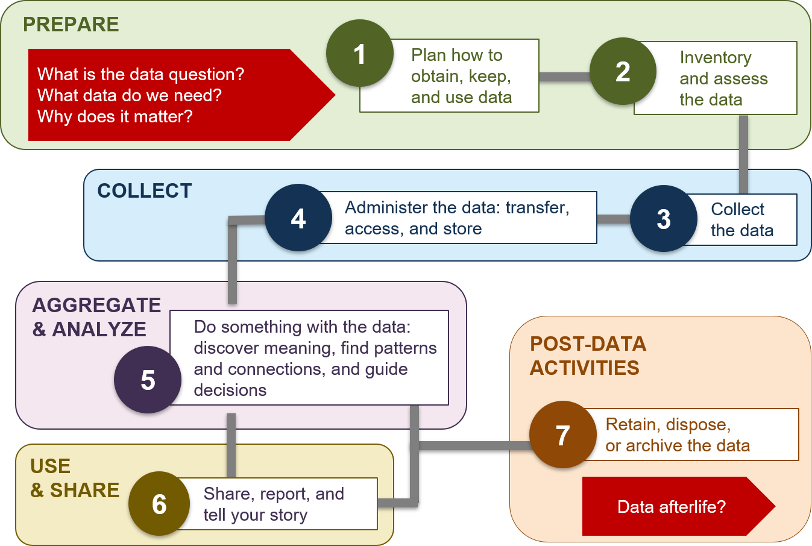
The Responsible Life Cycle of Data
Notes:
Slide 26
Facilitator Notes:
Distribute the Responsible Life Cycle of Data Graphic and Data Life Cycle Tip Sheet handouts.
Say to Participants: “We’ve talked about recordkeeping and reporting as two separate but related processes. On the slide, we see the whole life cycle of data through these two processes. We see data from the very beginning, when we decide what we need to collect, to the very end, when we dispose of or archive it.
“You may notice this diagram reflects the Four Data Activities, but breaks down each activity into smaller tasks. It also adds a final section on what we do with data at the end of its life.”
Ask participants to team up with a neighbor and discuss a phase of the life cycle they want to commit to learning more about once they get back to their program. After one minute, call the group back together and ask volunteers to share their responses.
Say to Participants: “We live in a world that is increasingly data-driven, as we know. We have more ways to collect, store, share, transmit, analyze, and publish information than ever before. We can assume our reliance on data will only grow in the future.
“For that reason, organizations are paying increasing attention to the ethics of information management. Our programs must do this, as well.
“We must be thoughtful stewards of the data we collect, and always use it in the best interests of the children and families in our programs.
“The Responsible Life Cycle graphic provides a structure for ensuring accountability and points us toward our ultimate goal, which is using information to improve our programs and tell the stories of our successes.”

Slide 27
The Leader's Role
Supervise recordkeeping and reporting activities
Communicate the importance of recordkeeping and reporting to staff
Ensure staff are trained to manage data through its life cycle
Use data generated
from the records to
craft and share compelling messages
Notes:
Slide 27
Facilitator Notes:
Give the following mini-lecture on the role of leadership in supporting recordkeeping and reporting.
Say to participants: “What is a leader’s role in recordkeeping and reporting?”
Solicit responses and write them on flipchart paper. Make sure the following activities are mentioned.
Leaders should:
Supervise recordkeeping and reporting activities and processes
Communicate the importance of accurate recordkeeping and reporting to staff
Ensure staff are supported and trained to manage data through its entire life cycle
Use the information generated from the records to craft and share compelling messages

Slide 28
Break
Notes:
Slide 28
Facilitator Notes
This is the time for participants to finalize their drawings.
Say to Participants: “Earlier, you each drew a visual representation of your program’s recordkeeping and reporting system. I’d like you to review that drawing now and make any additional changes or additions to it based on what you’ve learned today.”
After five minutes, bring the group back together and proceed.

Slide 29
Presentation of Visual Program Models
My program's recordkeeping and reporting system
Notes:
Slide 29
Facilitator Notes:
Call participants attention to the slide.
Say to Participants: “You were asked to include the following components in your drawings:
Elements and characteristics of your system
Information your system collects
Recordkeeping activities
Workplace behaviors required for recordkeeping
Reports your program creates and distributes
Relevant relationships between people, systems, and other organizations
Other elements you felt were important to your system
“You were also encouraged to update your drawing throughout the presentation. Let’s take time to share your drawings now. Each person or team has one minute to show their artwork and explain how it represents their organization’s recordkeeping and reporting system.”

Slide 30
Recordkeeping and Reporting Key Messages
Accurate recordkeeping is the basis of effective reporting
Recordkeeping and reporting supports other Head Start management systems
Regulatory requirements guide recordkeeping and reporting
The Four Data Activities and Responsible Data Life Cycle are frameworks for data management
Leaders must support effective recordkeeping and reporting
Notes:
Slide 30
Facilitator Notes:
Wrap up this session by reviewing its key messages.
Say to Participants: “We’ve reviewed a lot of material in this session. We explored how:
Accurate recordkeeping is the basis of effective reporting
Recordkeeping and reporting supports other Head Start management systems
Regulatory requirements guide recordkeeping and reporting
The Four Data Activities and Responsible Data Life Cycle are frameworks for data management
Leaders can support effective recordkeeping and reporting

Slide 31
Closing Reflections
What have
I learned?
What excites or concerns me about what I learned?
What will I do with what I've learned?
Adapted from Professional Development Guides for Implementing PFCE
Notes:
Slide 31
Facilitator Notes:
The final exercise is intended to help participants reflect on and reinforce what they’ve learned. Guide participants to the Reflective Practice Tool handout.
Say to Participants: “Now, let’s take some time to turn inward, to digest and reflect honestly on what we’ve learned and how we will use this information to benefit our Head Start work after we leave.”
Using the handout, direct participants to take a few minutes to reflect and write down their thoughts about the following questions on the handout:
What have you learned?
What excites or concerns you about what you have learned?
What will you do with what you’ve learned?
If time permits, allow volunteers to share their responses aloud, and process the activity using the following questions:
What themes are emerging?
What insights do you need to remember?
How can you use these insights?

Slide 32
Related ECLKC Resources
About Us
https://eclkc.ohs.acf.hhs.gov/about-us/article/office-head-start-ohs
Head Start Programs
https://eclkc.ohs.acf.hhs.gov/programs/article/head-start-programs
Head Start Act
https://eclkc.ohs.acf.hhs.gov/
policy/head-start-act
Notes:
Slide 32
Facilitator Notes:
Direct participants’ attention to the slide.
Say to Participants: “Here are several resources on the Early Childhood Learning and Knowledge Center (ECLKC) that can help you learn more about some of the topics we’ve discussed in this session. To learn more about recordkeeping and reporting, type in those search terms.”

Slide 33





Contact PMFO
pmfo@ecetta.info
https://eclkc.ohs.acf.hhs.gov/ncpmfo
Call us: 888-874-5469
Notes:
Slide 33
Facilitator Notes:
Review PMFO contact information.

