Slide 1
Practice-Based Coaching: Components & Implementation Strategies
EarlyEdU Alliance®
© 2019 University of Washington. All rights reserved.
Notes:
NOTE
Practice-Based Coaching (PBC) is an approach to instructional coaching that can be applied across diverse settings. This module was developed for various audiences including education staff members who work in preschool, infant-toddler and home-based programs as well as in family child care.
PBC is relevant to the 2016 Head Start Program Performance Standards requirements related to training and professional development that specify that programs must implement a research-based, coordinated coaching strategy for education staff [§1302.92 (c)].

Slide 2
Overview
This module describes Practice-Based Coaching (PBC) and its components which are:
Collaborative Partnerships
Shared Goals and Action Planning
Focused Observation
Reflection and Feedback
Notes:
This module describes Practice-Based Coaching (PBC) and its components which are.
Collaborative Partnerships
Shared Goals and Action Planning
Focused Observation
Reflection and Feedback
All these components are aimed at improving use of effective teaching practices.

Slide 3

Objectives
Participants should be able to:
Define Practice-Based Coaching.
Describe the components of PBC.
Identify key features of collaborative partnerships.
Describe strategies for effective implementation of PBC.
State the benefits of using video in coaching.
Notes:
By the end of this module, participants should be able to:
Define Practice-Based Coaching (PBC).
Describe the components in PBC.
Identify key features of collaborative partnerships.
Describe strategies for effective implementation of the PBC cycle components.
State the benefits of using video.

Slide 4
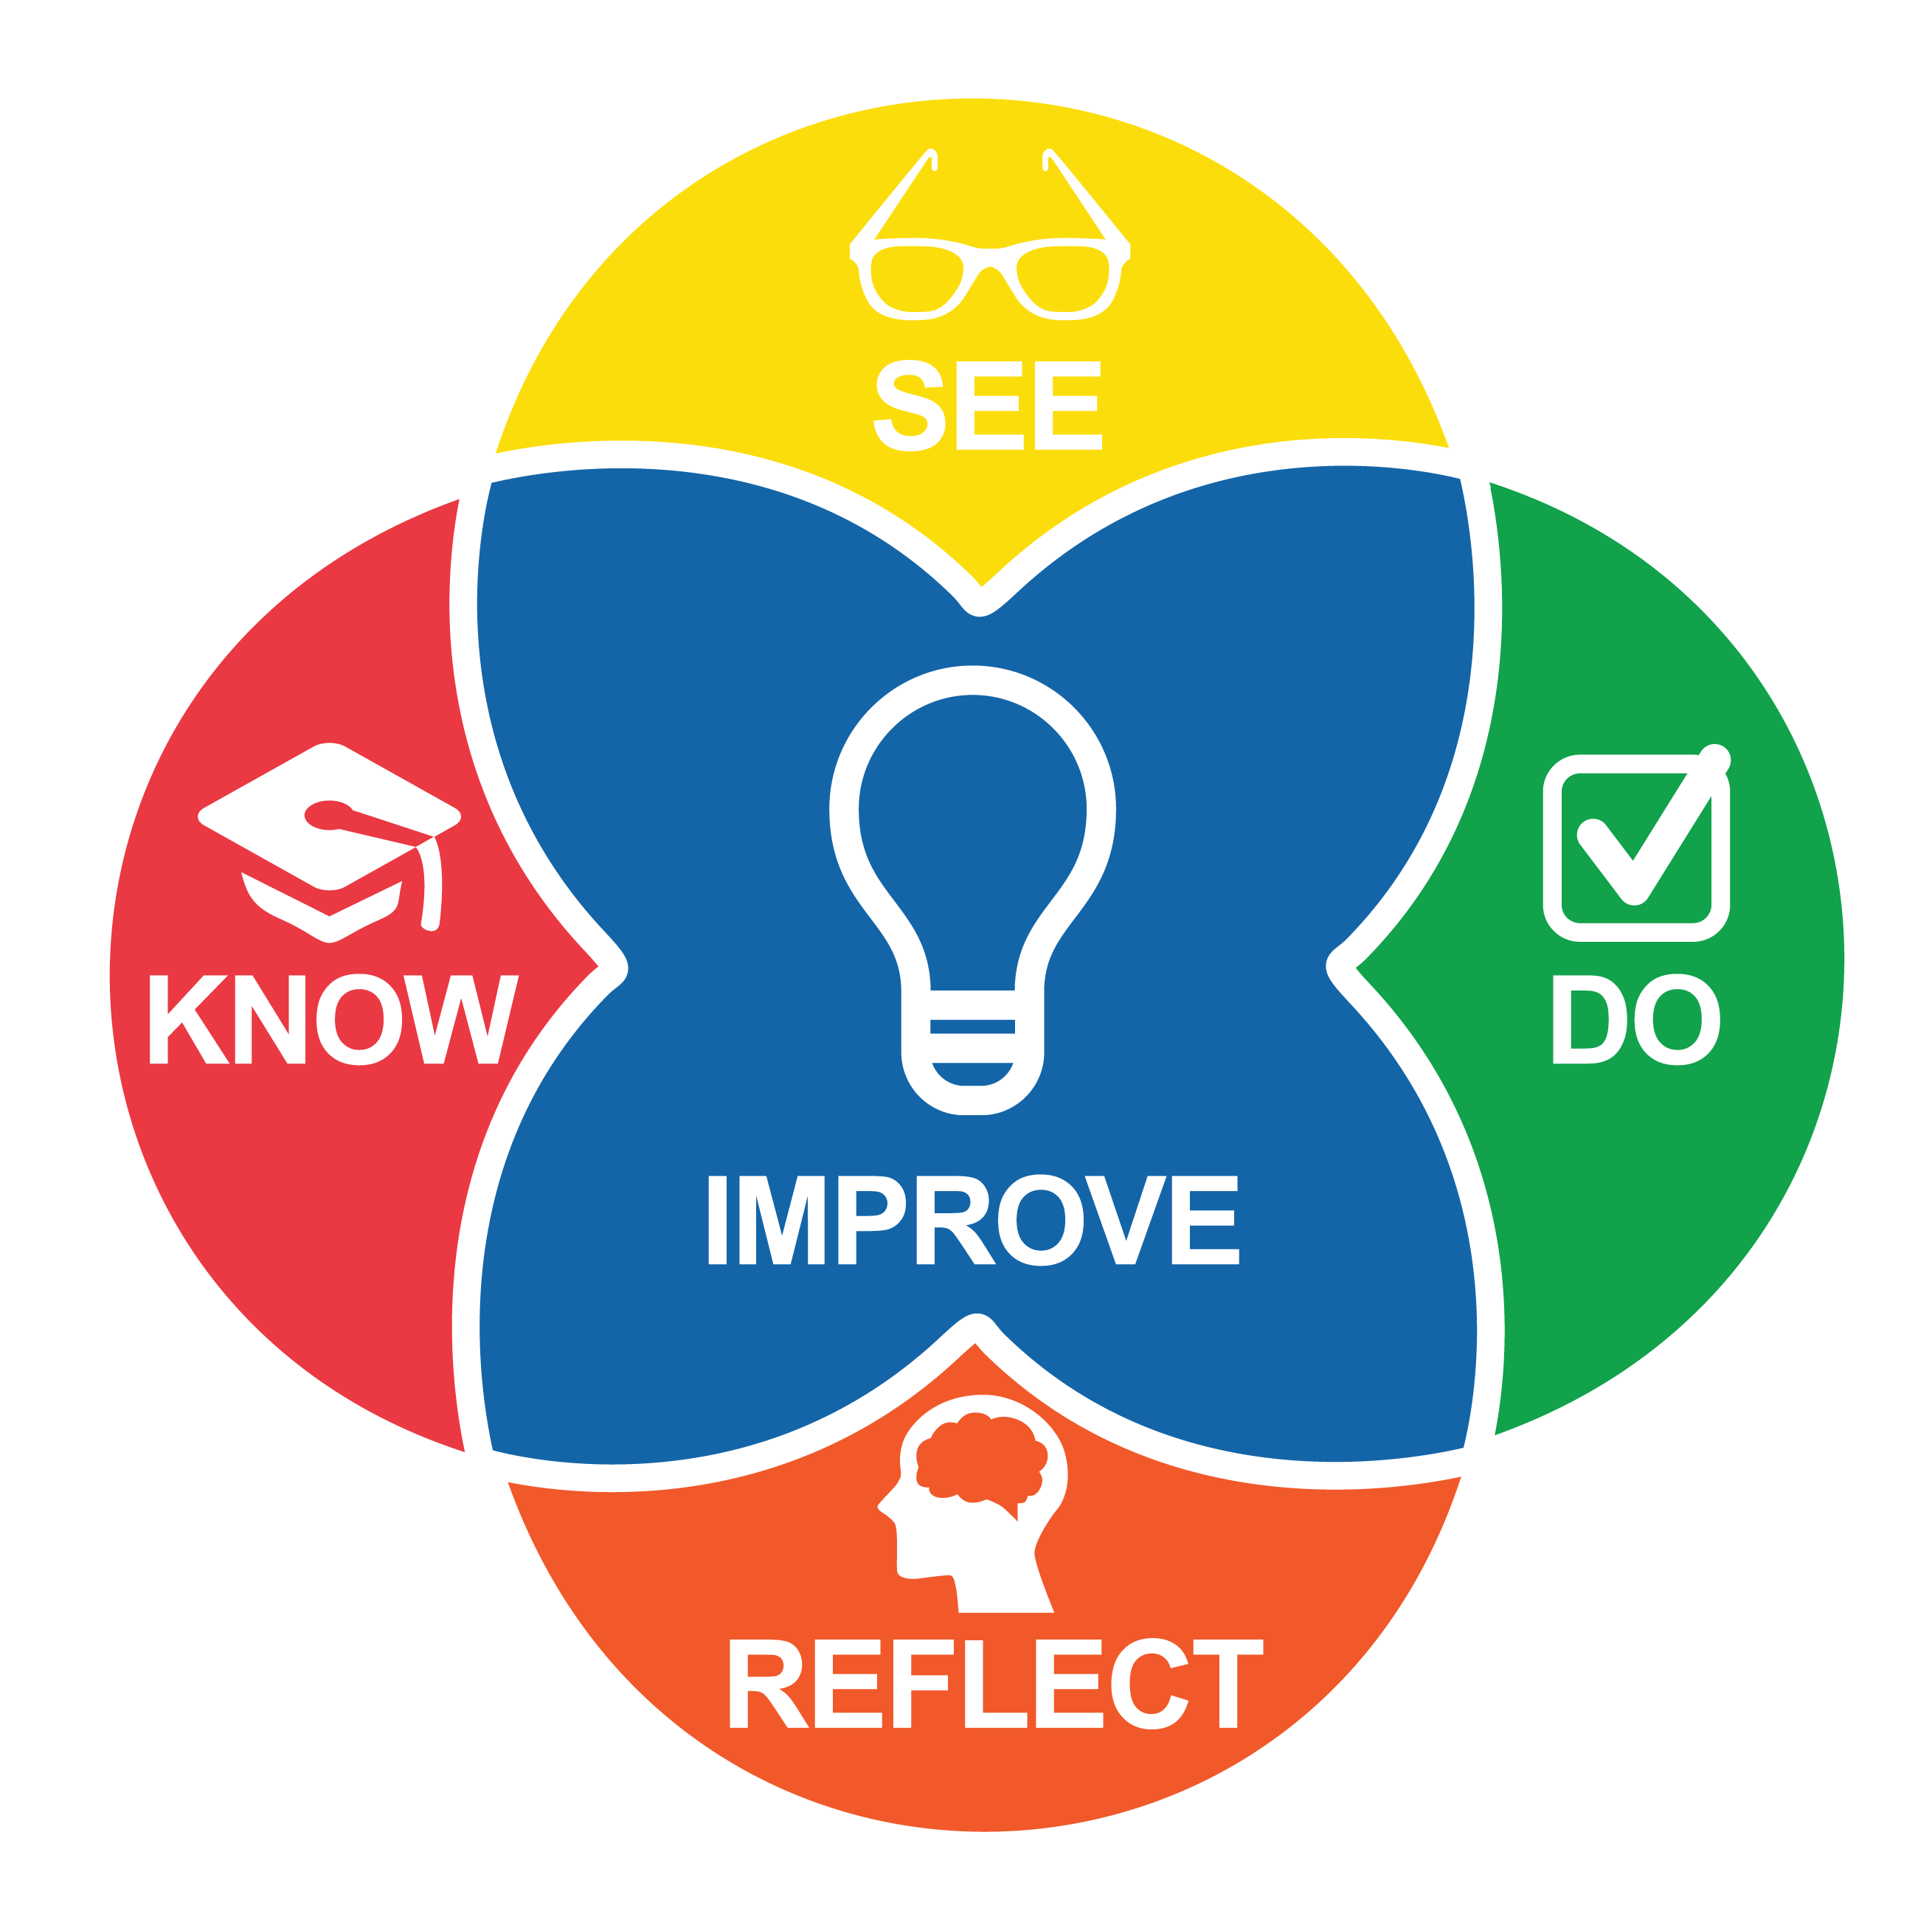
Intentional Teaching Framework
Notes:
EarlyEdU’s higher education courses (EarlyEdUAlliance.org) use the Intentional Teaching Framework (Hamre, Downer, Jamil, & Pianta, 2012; Joseph & Brennan, 2013), which guides participants to:
Know—Learn about child development and effective teaching practices.
See—Identify teaching practices and children’s responses in participants’ own videos and those of other participants, using specific behavioral language.
Do—Set goals, plan, and use strategies. (Do can also involve applying knowledge during in-class activities.)
Reflect—Observe and analyze their own practices, including in their own videos and their peers’ videos.
Improve—Plan for and implement positive, quantifiable change to teaching practices.
References
Hamre, B. K., Downer, J. T., Jamil, F. M., & Pianta, R. C. (2012). Enhancing teachers’ intentional use of effective interactions with children. In R. C. Pianta (Ed.). Handbook of early childhood education (pp. 507–532). New York: The Guilford Press.
Joseph, G. E., & Brennan, C. (2013). Framing quality: Annotated video-based portfolios of classroom practice by preservice teachers. Early Childhood Education Journal, 41, 423–430.

Slide 5
Activity 1
What do you already know about PBC?
Divide into groups by role:
  Coaches, education staff, students, directors
In your group, write what you know about PBC on the paper posted on the wall.
Notes:
In this activity participants share what they already know about Practice-Based Coaching.
Materials: Large sheets of paper
Instructions: Have participants divide into groups by the following roles:
Coaches
Education staff
Students
Directors
Post large sheets of paper on a wall, one for each group of participants. Have participants share their answers by writing them on the paper.
Review answers in the large group. Identify shared themes.
NOTE
Highlight terms that relate to defining features of PBC that are covered on slides 6, 7 and 65.

Slide 6
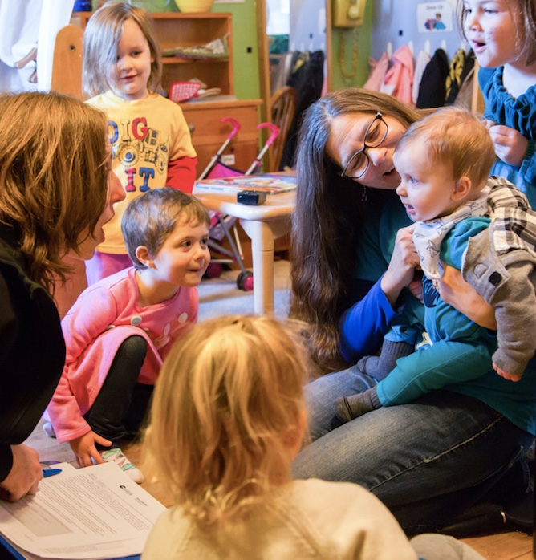
What Is PBC?
PBC is a cyclical process designed to support effective education staff practices that lead to positive outcomes for children and families.
Notes:
PBC is a cyclical process designed to improve effective education staff practices that lead to positive outcomes for children and families.

Slide 7
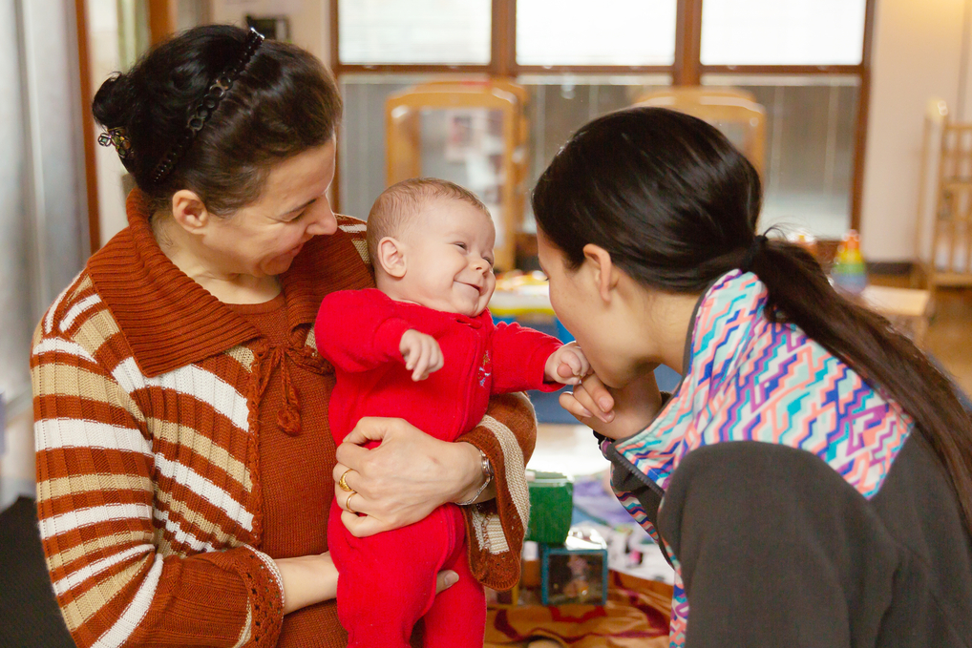
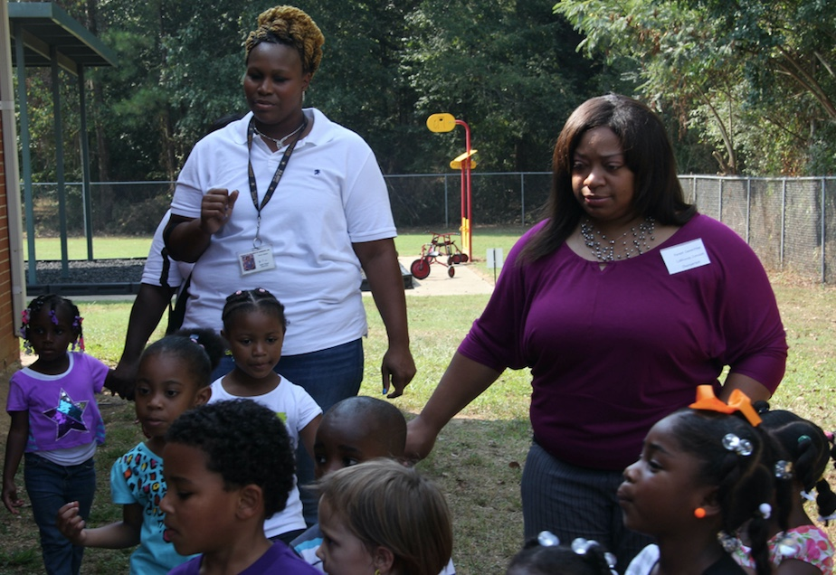
Focus on the How
PBC focuses on the how of coaching.
The educator sets the goals.
PBC can be applied across:
  Settings
  Content
Notes:
PBC focuses on the how of coaching (e.g., developing partnerships, settings goals).
PBC is directed by goals set by the educator, and can be applied across:
Settings (infant-toddler programs, home visiting, family childcare, preschool programs).
Content areas (e.g., literacy, math, social emotional support), curricula (e.g., Creative Curriculum, High Scope) or assessment, e.g., Infant/Toddler Environment Rating Scale (ITERS), Home Visiting Rating Scale (HOVERS) or Teaching Pyramid Observation Tool (TPOT).
NOTE
Specific goals and competencies vary depending on settings and who engages directly with children. In center-based programs, coaches support education staff who interact directly with children. Goals may, for example, focus on the educator responsiveness to a child. In home visiting, coaches support education staff who coach parents while the parents interact directly with their child. Goals may focus on the home visitor’s responsiveness to the parent.

Slide 8
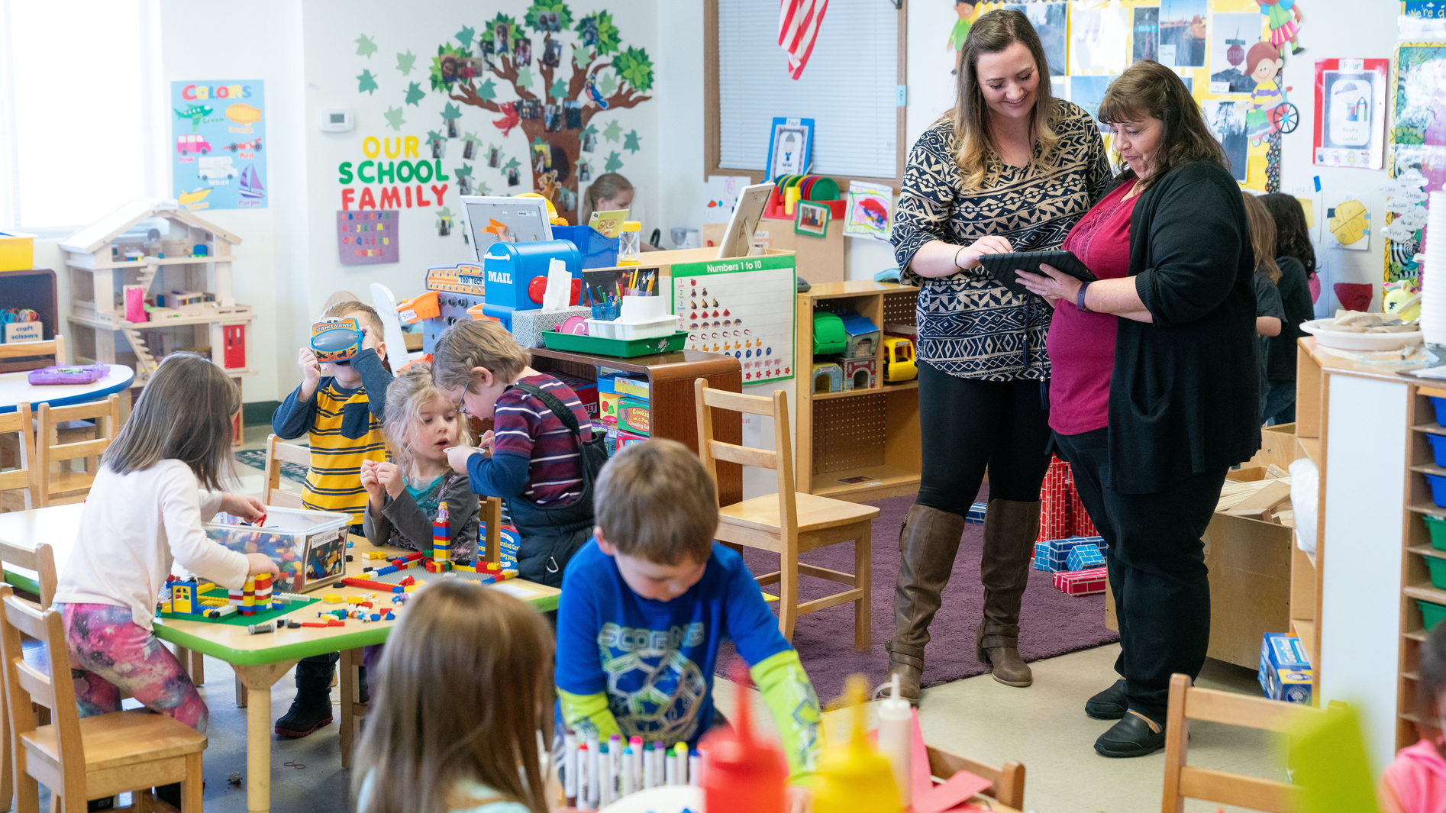
Why is Coaching Important?
Coaching is an effective source of professional development.
Notes:
Coaching is an effective source of professional development. Coaching includes multiple features of effective professional development such as:
Focus on issues relevant to daily practice
Ongoing, sustained learning opportunities
Active learning through inquiry, reflection and planning

Slide 9
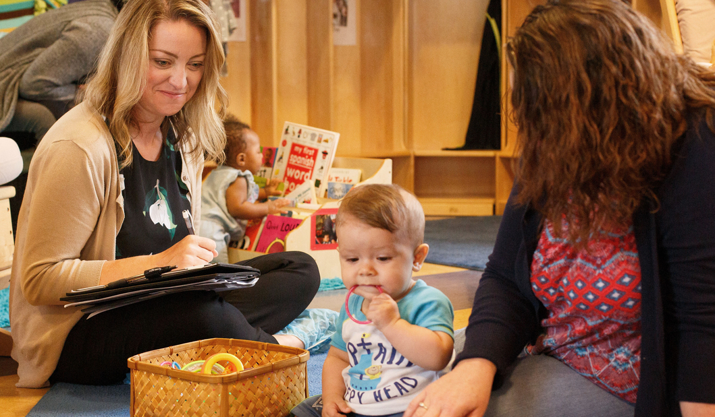
Coaching Benefits Children
Coaching influences teaching practices.
Quality teaching influences child outcomes.
Notes:
Instructional coaching influences the effectiveness of teaching practices.
Quality teaching influences child outcomes.
NOTE
PBC can be used for instructional coaching. Instructional coaching refers to coaching designed and structured around goals aimed at promoting education staff instructional competence.

Slide 10
Video 1
Role and Impact of Coaching
In this video coaches and educators discuss coaching.
As you watch, take notes on what they say are the benefits and impacts of coaching.
Notes:
Introduce the video.
This video shows coaches and educators talking about their experiences with coaching. The video also includes examples of educators interacting with coaches and educators interacting with children in a variety of preschool and infant and toddler programs.
As they watch the video, ask participants to take notes on what coaches and educators say are benefits and the impacts of coaching.

Slide 11

Video Role and Impact of Coaching
Video: Role and Impact of Coaching
Notes:
Show the video.
Length of video: Approximately 5 minutes

Slide 12
Video Debrief 1
What did you notice?
Notes:
Ask participants to share what they noticed.
Points to highlight from the video:
Coaches: Help educators engage in self-reflection, grow in their own professional development, improve teaching practices
Educators: Helped see my strengths, get another perspective, be challenged, get help, provide support, help work with children better

Slide 13




PBC Cycle
Effective
Teaching
Practices
Notes:
PBC is a cyclical process for supporting educators’ use of effective practices. The coaching cycle components are:
Planning goals and action steps
Engaging in focused observation
Reflecting on and sharing feedback about practices
PBC occurs within the context of a collaborative partnership.
Discussion
Invite participants to share what stands out for them from the model.
Points to highlight:
PBC:
Focuses on supporting educators in their use of effective practices.
Occurs in the context of a collaborative partnership between an educator and a coach.
Is an ongoing cyclical process that includes three interrelated components
Builds skills through observation, feedback and reflection.
Is directed by the goals an educator and coach identify and by child and family outcomes.
Is guided by an action plan
NOTE
Head Start defines Practice-Based Coaching (PBC) as "a professional development
strategy that uses a cyclical process. This process supports teachers' use of effective
teaching practices that lead to positive outcomes for children. PBC occurs in the
context of collaborative partnerships." The cyclical process involves creating shared
goals and action plans, conducting focused observations to document progress, and
providing reflection and feedback within the context of each of these processes.
For more information and resources on PBC in the context of Head Start refer to:
https://eclkc.ohs.acf.hhs.gov/professional-development/article/practice-based-coaching-pbc

Slide 14
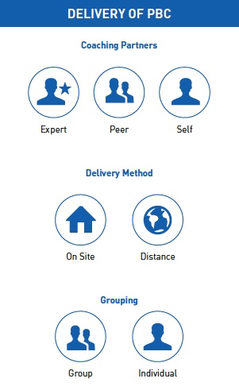
What Does PBC Look Like?
Notes:
Coaching Partners: The coach can be an expert, a peer, or even the educator (self-coaching).
Coaches are facilitators. They help educators unpack what they already know and come up with their own solutions.
Coaches provide support, not evaluation. Coaching is a safe space and a brave space. In other words, educators must feel supported and comfortable taking risks and trying new things.
Coaches do not provide technical assistance. Coaches are NOT problem-solvers, or advisors.
Delivery Method: Coaching can occur on site or at a distance, for example, using emails, phone calls, video and other digital technologies.
Examples
An expert supports a group of educators who come together in a live setting.
Peers support each other in a live setting.
An expert coach works with an individual educator from a distance.
Educators can observe themselves on video and use the PBC model components to reflect on their own practice.
Grouping: The coachee can be an individual or a group.
REFERENCES
U.S. Department of Health and Human Services, Administration for Children, Youth and Families, Office of Head Start (n.d.). Practice-based coaching at a glance.
https://eclkc.ohs.acf.hhs.gov/sites/default/files/pdf/pbc-at-a-glance.pdf

Slide 15
Discussion 1
Coaching and Adult Learning
Coaching is about supporting emotional, cognitive, and behavioral change in adults.
What is something new you recently tried to learn?
Why was it important to you?
What was most helpful in promoting your learning?
Notes:
Coaching is about supporting emotional, cognitive, and behavioral change in adults.
Ask participants to share something new they tried to learn (e.g, a language, a sport, a computer program, using public transportation).
Why was it important to them?
What was most helpful in promoting their learning?
Possible answers:
I need it for my job.
It was important to my children.
It sounded interesting.
It makes my commute easier.

Slide 16
Adult Learning Theory
Adult learners actively participate in their own learning experiences. Adult learners:
Need to know why they should learn something before learning it.
Use their own life experiences to make sense of new information.
Learn better by applying new strategies immediately to a real-life situation.
Notes:
Adult learners actively participate in their own learning experiences. From theory and research, we know that adult learners:
Need to know why they should learn something before learning it.
Use their own life experiences to make sense of new information.
Learn better by applying new strategies immediately to a real-life situation.
Discussion
Relate these points to participant responses in the prior discussion about adult learning (Slide 15). Ask participants how these points match their thoughts about learning something new.

Slide 17
PBC Cycle:
Shared Goals and Action Planning
Effective
Teaching
Practices
Notes:
Collaborative partnerships are the context in which all other coaching activities occur.
NOTE
Click to highlight Collaborative Partnerships.

Slide 18
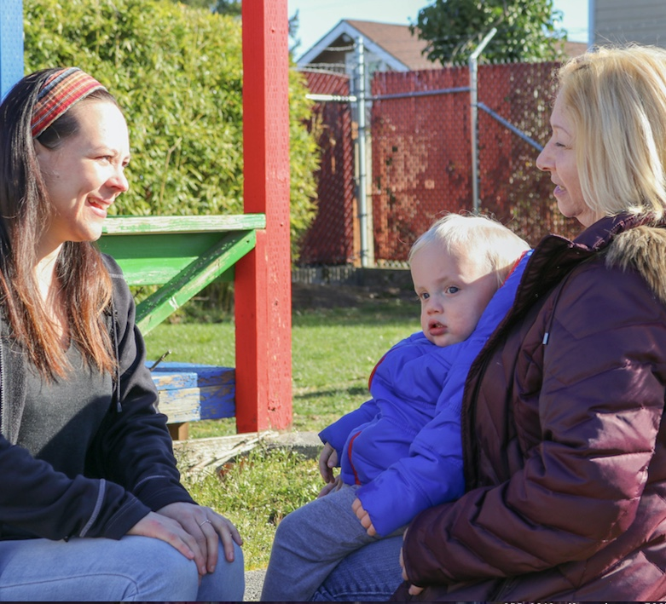
Collaborative Partnerships
The coach and educator work together to define and carry out the partnership.
Partnerships are centered around work.
The coach and educator bring their own specific expertise.
Notes:
Coaching is collaborative in that the coach and the educator work together to define and carry out the partnership.
Partnerships are centered around the work. They are professional in nature.
The coach and educator bring their own specific expertise to the partnership. The coach brings expertise in content and effective teaching or home visiting practices, and the educator bring expertise of the children, families, community and learning environment. The coach and educator’s knowledge and experiences are equally respected and considered relevant to the coaching process.

Slide 19
Discussion 2
Effective Partnerships
Think about your most effective professional partnerships.
What made those partnerships effective?
What experiences, structures, feelings, or dispositions helped make them successful?
Notes:
Ask participants to think about their most effective professional partnerships.
What made those partnerships effective?
What experiences, structures, feelings, or dispositions helped make them successful?
This discussion can be conducted in a variety of formats. Presenters should choose a strategy that best matches the group pf participants. Some examples of discussion formats are:
Large group discussion
Turn and talk to a partner
Write on a sticky note, then post it on a share board.
Points to highlight:
Clear roles and expectations
Trust and respect
Shared goals

Slide 20
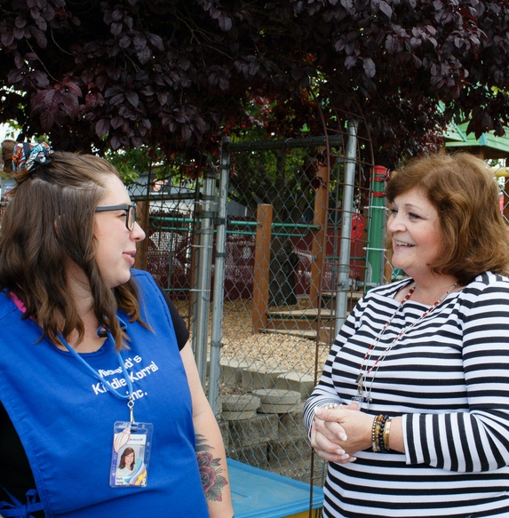
The Coaching Agreement
Educator and Coach’s Commitment
Timelines
Agreement on Roles
Privacy Guidelines
Notes:
A coaching (or partnership) agreement outlines what the educator can expect from the coach and what the coach can expect from the educator. It helps make the purpose and focus of coaching clear. A coaching agreement typically has several components:
Coach’s commitment. Coaches typically commit to maintaining confidentiality, helping develop goals and action plans, providing resources, scheduling mutually agreed upon observation times, and offering time and support for reflection.
Educator’s commitment. These commitments often include actively engaging in conversations with the coach, sharing pertinent information, being open to reflection, and trying out new practices.
Timelines for coaching. Some coaching agreements detail how often the coach will observe in the learning environment, whether and how video will be used, and how often coaching conversations will take place.
Agreements on the coach’s role in the learning environment. The agreement might describe what a coach can do during coaching visits (if applicable). This includes outlining how to let a coach know that an educator wants the coach to model, provide materials, or assist in some way.
Privacy guidelines. Most coaching agreements provide an assurance that the coach and educator will keep the conversations, observations, and data private between them. The agreement should clearly describe the kinds of information that will be shared about coaching (number of coaching cycles completed, topics of shared goals, minutes/hours spent coaching, results from classroom observation instruments, etc.). There must also be clear guidelines about when a coach must share information about observations or discussions (i.e., in mandated reporter situations or when the coach believes a child or adult is at risk of harm).
NOTE
Agreements are sometimes referred to as contracts.
Distribute and review the Sample Coaching Agreement handout.
In addition to one-on-one in-person coaching, coaching can also occur remotely using video, in a small group, or the educator can self-coach.
Ask participants to consider how the coaching agreement may vary depending on the different formats.

Slide 21
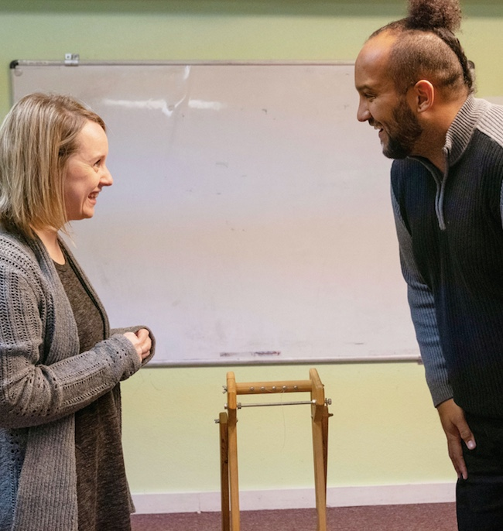
Addressing Culture and Equity Through Coaching
Acknowledge privilege.
Understand actions in the larger context of cultural beliefs and identity.
Value, and build on, cultural and linguistic resources.
Notes:
Coaches are able to build stronger collaborative partnerships when they understand that concepts, relationships and practices are embedded in culture. Coaches need to think critically about cultural identities and relationships to privilege and oppression. Through culturally responsive coaching, coaches:
Acknowledge privilege based on identity (age, race, gender, ability, religion, language, education, etc.). Privilege is an unearned advantage based on some aspect of identity (McIntosh, 2010).
Seek to understand an educator’s and their own practices in the larger context of cultural beliefs and identity.
Value and build on educators’ cultural and linguistic resources.
NOTE
Culture is created by a group of people who come together regularly and over time, developing a shared understanding of talk, routines, roles, relationships, responsibilities, and ways of using particular artifacts. (Frank, 1999)
Individuals experience culture in everyday interactions and practices. Culture influences our:
Core values—Learned ideas of what is considered good or bad, desirable or undesirable, acceptable or unacceptable
Attitudes—How the core values are reflected in specific situations in daily life such as working or socializing
Behaviors and practices—Characteristics which everyone sees
“Equity refers to the principles of fairness and justice. Each person receives the support and resources they need to be successful. Equity is not the same as equality. Equal treatment, when starting from unequal points, leads to inequity.” (NAEYC, 2018).
REFERENCES
Frank, C. (1999). Ethnographic eyes: A teacher’s guide to classroom observation. Portsmouth, NH: Heinemann.
McIntosh, P. (2010). “White privilege: Unpacking the invisible knapsack” and “Some notes for facilitators.” Wellesley College, Wellesley, MA: National SEED Project on Inclusive Curriculum
https://nationalseedproject.org/white-privilege-unpacking-the-invisible-knapsack
NAEYC (2018). Draft NAEYC position statement: Advancing equity and diversity in early childhood education. Washington, DC: National Association for the Education of Young Children.
https://www.naeyc.org/resources/position-statements/equity-draft

Slide 22
Video 2
Culturally Responsive
Coaching
In this video, coaches discuss what it means to be a culturally responsive coach.
While you watch the video, list attitudes and behaviors coaches mention as being reflective of culturally responsive coaching.
Notes:
Introduce the video.
In this video, coaches discuss what it means to be a culturally responsive coach. The video includes examples that relate to coaching in an American Indian Alaska Native Salish language immersion program.
Ask participants to take notes as they watch the video on attitudes and behaviors the coaches mention as being reflective of culturally responsive coaching.

Slide 23
Video Culturally Responsive Coaching
Video: Culturally Responsive Coaching
Notes:
Show the video.
Length of video: Approximately 3 minutes

Slide 24
Video Debrief 2
What did you notice?
More ideas?
Notes:
Ask participants to share:
What they noticed
More ideas
Points to highlight from the video:
Importance of building a trusting relationship
Coaches engage in self-reflection and reflect with peers.
Coaches listen and learn about educators’ cultural and linguistic background.
Coaches acknowledge power dynamics.

Slide 25
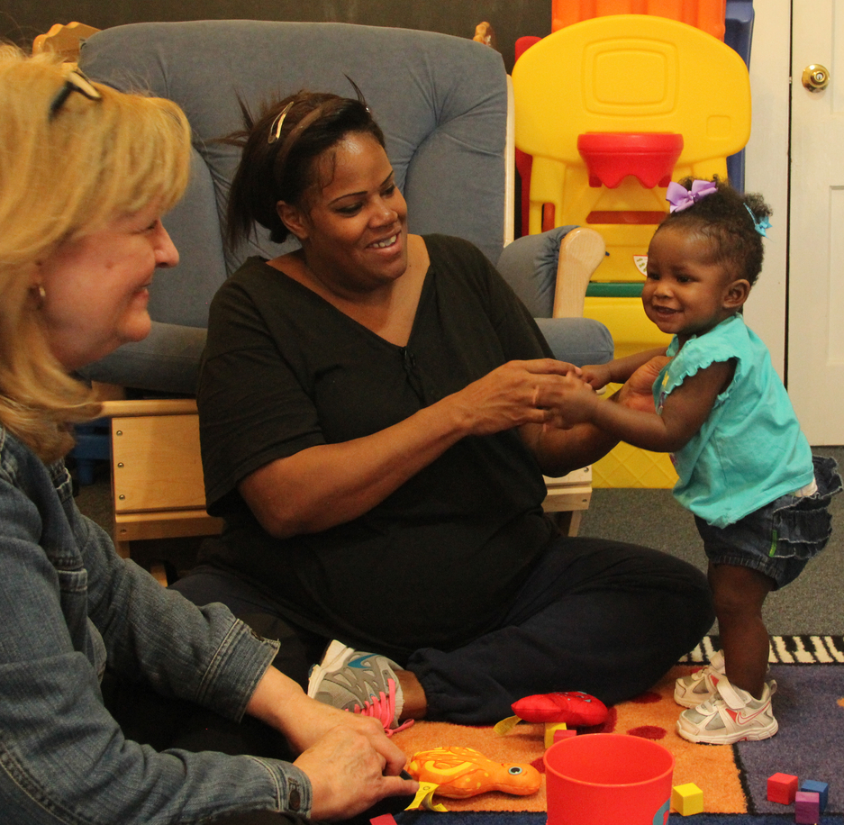
Reflecting on Equity and Diversity Through Coaching
Coaches encourage educators to:
Acknowledge assumptions and implicit biases.
Recognize and support each child’s strengths.
Engage in inclusive teaching practices.
Notes:
Coaches support educators in building their own capacity to engage in culturally responsive practices with children and families and ensure all children have access to equitable learning opportunities. This means:
Acknowledging assumptions and biases that may have a negative impact on educators’ interactions with children and families. Bias is an inclination or preference. It can also be known as prejudice. We are often unaware of our biases. This is known as implicit bias.
Recognizing and supporting each child’s unique strengths.
Engaging in inclusive teaching practices that demonstrate the value of diversity.
NOTE
In education, equity means that educators use teaching practices that enable children to be successful, regardless of race, gender, ethnicity, language, ability, family background, or family income (McGee Banks & Banks, 1995; NAEYC, 2018).
REFERENCES
McGee Banks, C. A., & Banks, J. A. (1995). Equity pedagogy: An essential component of multicultural education. Theory into Practice, 34(3), 152-158.
NAEYC (2018). Draft NAEYC position statement: Advancing equity and diversity in early childhood education. Washington, DC: National Association for the Education of Young Children.
https://www.naeyc.org/resources/position-statements/equity-draft

Slide 26
Video 3
Addressing Implicit Bias
In this video, coaches share examples of how they help educators reflect on implicit biases.
While you watch the video,
take notes on what strategies coaches used to help educators see implicit biases.
Notes:
Introduce the video.
In this video, coaches share examples of how they help educators reflect on implicit biases related to challenging behavior and gender.
As they watch the video, ask participants to take notes on strategies coaches used to help educators see implicit biases.

Slide 27
Video Addressing Implicit Bias
Video: Addressing Implicit Bias
Notes:
Show the video.
Length of video: Approximately 2 minutes

Slide 28
Video Debrief 3
What did you notice?
More ideas?
Notes:
Ask participants to share:
What they noticed
More ideas
Points to highlight from the video:
Coaches can use open-ended questions and data from observations to help educators see implicit biases.

Slide 29
Activity 2
Reflection on Culture
and Equity
Reflect on all the questions in the handout.
Select one or two to share with a partner.
Notes:
In this activity, participants have an opportunity to think critically about their own cultural identity and examine implicit biases and interpersonal power dynamics that impact relationships and interactions with others.
Distribute the Reflection on Culture and Equity: Think-Pair-Share activity handout and review directions.
Participants reflect on a series of questions, then select one or two to share with a partner.

Slide 30
PBC Cycle: Collaborative Partnerships
Effective
Teaching
Practices
Notes:
The first component of the PBC cycle is Shared Goals and Action Planning.
NOTE
Click to highlight Shared Goals and Action Planning.

Slide 31
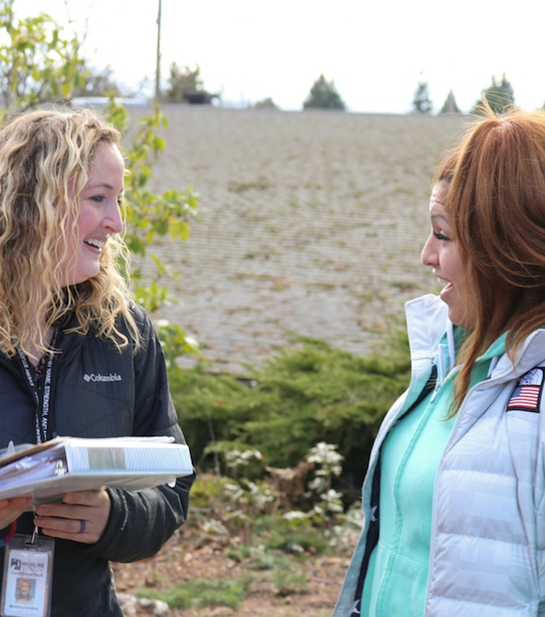
What is Shared Goals and Action Planning?
The educator and coach use a needs assessment, or other tool, and child data to determine practices to work on collaboratively.
Notes:
Shared Goals and Action Planning is a process in which the educator and coach use a needs assessment, or other adult-child interaction observation tool, along with child data to determine teaching or home visiting practices they will work on collaboratively.

Slide 32
Video 4
Writing Goals
Here, a coach supports an educator in identifying a goal and developing an action plan.
While you watch the video take notes on what the coach says and does to support the educator.
Notes:
Introduce the video.
In this video, a coach supports an educator in identifying a goal and developing an action plan, which involves, in this case, using an iPad to document children’s behavior.
As they watch the video, ask participants to take notes on what the coach says and does to support the educator in this process.

Slide 33
Video Writing Goals
Video: Writing Goals
Notes:
Show the video.
Length of video: Approximately 4 minutes

Slide 34
Video Debrief 4
What did you notice?
More ideas?
Notes:
Ask participants to share:
What they noticed
More ideas
Points to highlight from the video:
The coach:
Asks open-ended questions to help the educator identify a new goal.
Restates the goal and action plan steps using clear, observable descriptors.
Gives hints and examples to help the educator develop measurable criteria for completion.
Asks questions to help the educator clarify action steps and criteria.
Provides verbal and nonverbal encouragement.

Slide 35

Shared Goals and
Action Planning: How
Gather information.
Write shared goals.
Develop an action plan.
Notes:
Educators and coaches engage in three main steps toward identifying goals and developing an action plan. These are:
Gather information
Write shared goals
Develop an action plan

Slide 36
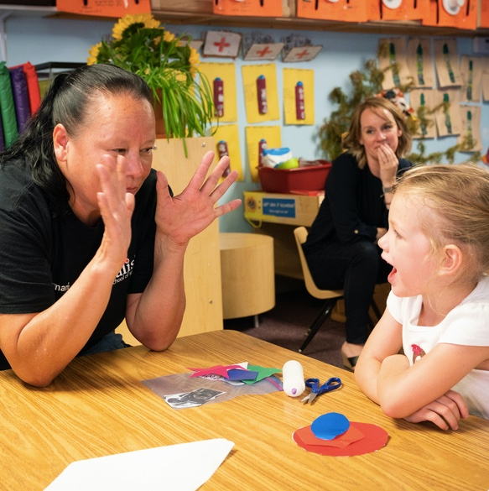
Gather Information
Gather information about an educator’s current practices.
Direct observation
Interviews
Self-reflection
Other data
Notes:
The first step toward identifying goals is to gather information about how an educator is currently using specific teaching or home visiting practices. Before gathering information, coaches should invite educators to share underlying values and assumptions related to their practices. The educator and coach then agree on one or more methods to gather information. These may include:
Direct observation of the educator by the coach
Interviews
Educator self-reflection on a needs assessment form or other adult-child interaction observation tool
Other data the program may already be collecting by valid and reliable data collectors such as completing the Environment Rating Scales (ITERS, ECERS or FCCERS) or the Classroom Assessment Scoring System (CLASS)
The best way to gather information is a combination of these methods.

Slide 37
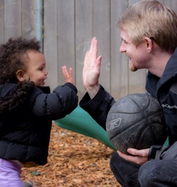
Write Shared Goals
The educator and coach select a a goal to target for improvement.
Shared goals address:
A specific teaching or home visiting practice.
Strategies and resources.
Notes:
Goal setting is the process of selecting a specific teaching or home visiting practice to target for improvement and writing a goal for the implementation of that practice.
Goal setting is a collaborative effort between the educator and coach. The more input the educator has in setting goals, the more likely the educator will be motivated to work on them.
The coach can and should play a supporting role in selecting and clarifying goals by making suggestions, affirming ideas, assisting with wording, and helping to make goals specific and achievable.
The coach and the educator should develop a shared understanding of the goal by discussing underlying values and assumptions related to the goal.
In PBC, shared goals should focus on two areas:
A specific teaching or home visiting practice—or a set of practices that support child learning, and;
Strategies and resources that support an educator’s confidence and competence to use these practices in the early learning environment.
Initially, an educator and coach should write just one or two goals to help focus coaching and to keep goals achievable within a specified time frame. Then, as a goal is achieved, another goal can be written to keep the coaching cycle going.
Written goals should be:
Specific
Observable
Achievable within a defined time frame. (Typical time frames for working on and accomplishing goals in coaching are 2 to 4 weeks.)

Slide 38
Develop an Action Plan
Action plans include:
The goals that are the focus of coaching.
Actions toward achieving the goal.
How to know when the goal is achieved.
Timeframe for completion.
Supports or resources needed.
Considerations on supporting and valuing all children.
Notes:
Once an educator and coach have written a specific, observable, and achievable goal, an action plan is developed to provide a road map to support achieving the goal throughout the coaching process.
Action plans which are working documents that are used to guide coaching.
They include:
The goals that are the immediate focus of coaching,
Planned actions or action steps toward achieving the goal.
An explicit statement about how the educator will know when the goal is achieved.
A timeframe for completion.
Supports or resources needed to complete the goal (materials, equipment, or personnel).
Considerations for how teaching and home visiting practices and resources support and value the cultures and languages of all children in the program.
Distribute and review the A Guide to Shared Goal Setting and Action Planning handout.

Slide 39
PBC Cycle: Focused Observation
Effective
Teaching
Practices
Notes:
The second component of the PBC cycle is Focused Observation.
NOTE
Click to highlight Focused Observation.

Slide 40
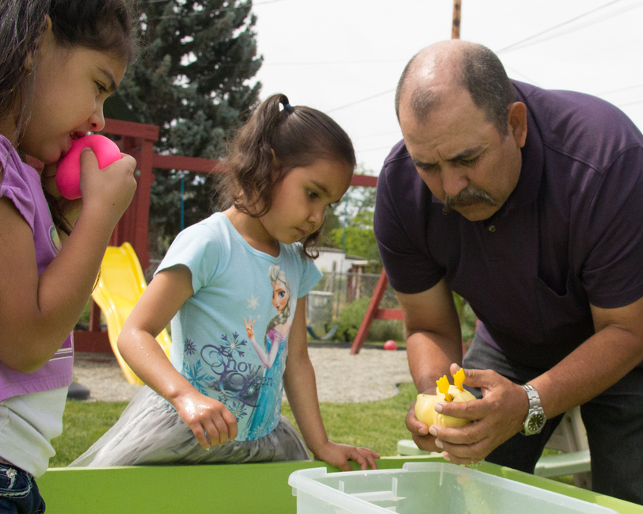
What is Focused Observation?
The coach zeroes in on the educator’s goals and practices to:
    Gather information.
    Record notes.
    Use supportive
    strategies.
Notes:
A focused observation is an observation centered and guided by the shared goals and action plan.
During a focused observation the coach zeroes in on the educator’s goals and practices to:
Gather information on the educator’s implementation of the shared goal and action plan.
Record personal notes to help plan feedback the coach will share about implementation of the action plan.
Use supportive strategies during the observation that may help promote the educator’s learning.
NOTE:
The term observation refers to the process of gathering and recording information about practices implemented during on-going activities and routines in the early education learning environment and during home visits.

Slide 41
Video 5
Focused Observation
In this video, coaches and educators describe what happens during a focused observation.
While you watch the video, take notes on what coaches do during a focused observation.
Notes:
Introduce the video.
In this video coaches and educators describe what happens during a focused observation. The video includes examples of coaches observing educators and modeling practices in infant-toddler and preschool programs. One example shows a coach demonstrating to an educator how to use an iPad to document children’s behavior.

Slide 42
Video Focused Observation
Video: Focused Observation
Notes:
Show the video.
Length of video: Approximately 3 minutes

Slide 43
Video Debrief 5
What did you notice?
More ideas?
Notes:
Ask participants to share:
What they noticed
Other ideas
Points to highlight from the video:
The educator and coach agree upon what will happen ahead of time.
Coaches can take written notes or use video during the observation.
Coaches can use a variety of strategies to provide support and promote the educator’s learning including sharing tips and modeling a practice.
Coaches build relationships with children as well as with the educator.

Slide 44
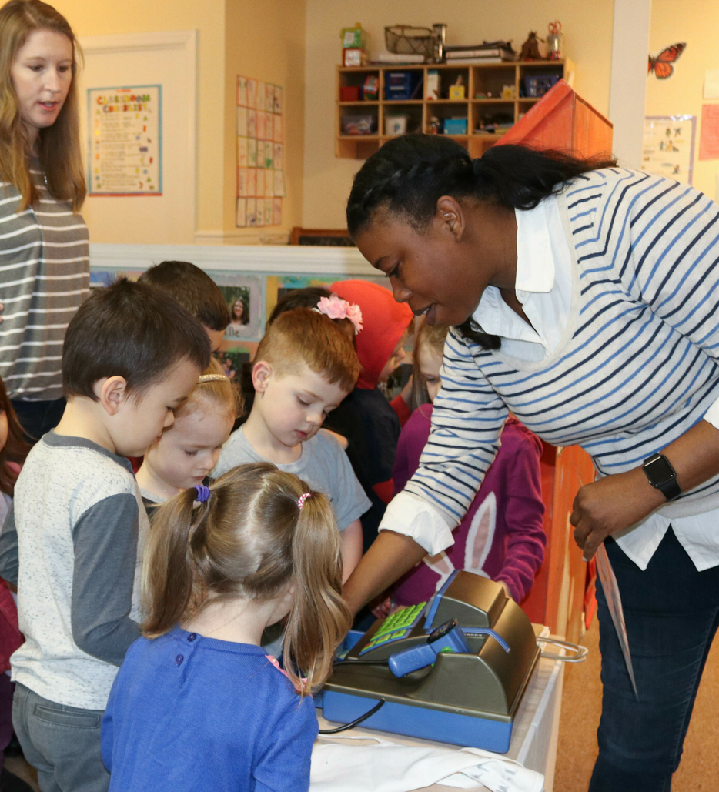
Focused Observation: How
Determine the specific goal of the observation related to the action plan.
Agree on:
A data collection method
Coaching strategies
An observation format
A time to observe
Notes:
Coaches and educators agree on how the focused observation will take place, including:
What the coach will be specifically looking for related to the action plan.
What data the coach might collect.
What observation coaching strategies will be used.
The format for the observation. Coaching observations can occur in a variety of formats, in person or remotely (via video or other digital technologies).
A time to observe. Depending on the purpose of the observation, best times may be when the educator is most likely to implement the teaching practices from the action plan, or during a specific situation in which the educator has requested additional support.

Slide 45

Collecting Data
Coaches can use various methods to collect data.
Anecdotal Notes
Video
Tallies
  Amount
  Frequency
  Duration
Notes:
Records help document educators’ progress towards the action plan goal and steps.
Coaches can use various qualitative and quantitative methods to gather information on an educator’s implementation of a shared goal including:
Anecdotal notes.
Video.
Tallies (such as amount, frequency, duration).
NOTE
Qualitative data provide a description of how an educator implements the shared goal using written words, interview transcriptions or videos.
Quantitative data refer to information that can be measured and written down as numbers. This information is used to measure the amount, frequency or duration of the educator’s implementation of the shared goal (e.g., how many new vocabulary words an educator uses during an activity, how often an educator collects data on children, how long an educator waits for a child to respond to a question).

Slide 46
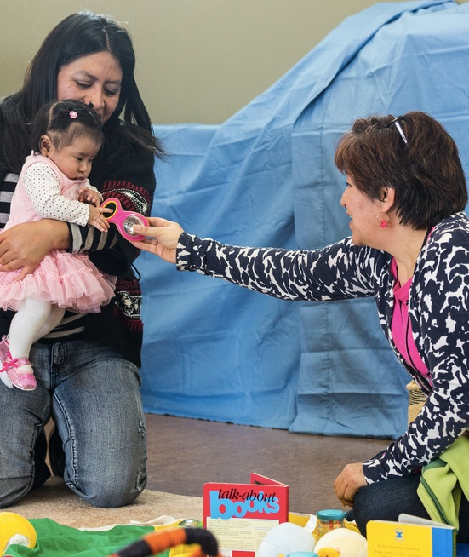
Gathering Information Objectively
A good observer is specific and objective.
Do I use words that describe but do not judge?
Can I see and/or hear it?
Would another person agree?
Notes:
As they focus their observations of an educator’s implementation of the shared goal(s), coaches need to be mindful of assumptions and biases that may influence what they are recording.
A good observer is specific and objective. Observations should reflect facts, not opinions, assumptions or guesses.
Do I use words that describe but do not judge.
Can I see and/or hear it? Don’t assume feelings and motivation.
Would another person agree about what occurred?

Slide 47
Recording Notes
Notes may address:
Feedback the coach might want to provide.
Questions about instances that may require further clarification.
Supports the educator may need next.
Follow-up observations on previously met goals.
Notes:
During the focused observation, coaches also record personal notes and insights about information the coach would like to share with the educator later during the debriefing session. To guide the reflection process with the educator, these notes may include summaries of data, questions, and feedback on what the coach saw.
Notes may address:
Feedback the coach might want to provide.
Questions about instances that may require further clarification.
Supports the educator may need next.
Follow-up observations on previously met goals.
Distribute and review the Observation Template handout.
Ask participants to think about what a focused observation might look like when a coach is coaching remotely, in a small group, or an educator is self-coaching. What methods might a coach use to gather information in these different situations?.

Slide 48
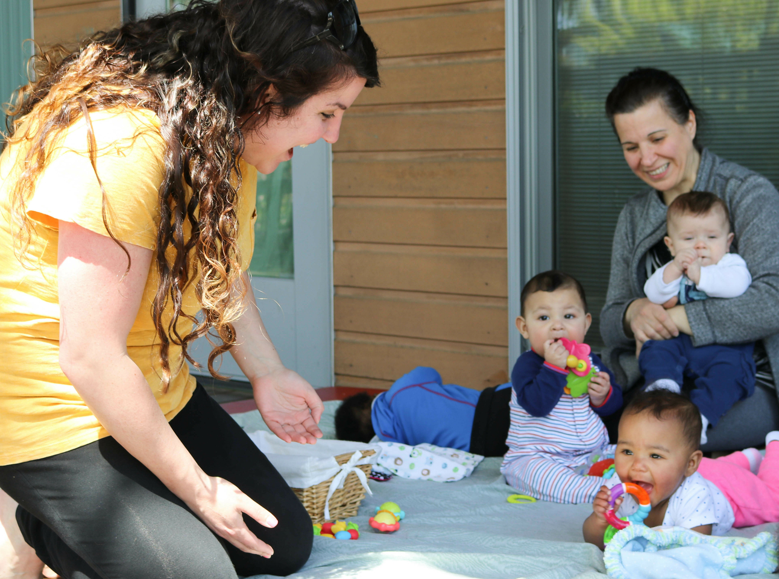
Coaching During the Observation
The coach may also provide a variety of supports during the observation. These might include:
Modeling of practices
Side-by-side support
Other help
Notes:
If focused observation is conducted onsite, the coach may also provide a direct demonstration of a practice. This might include:
Modeling a teaching practice
Side-by-side support
Other help in the learning environment
NOTE
During a home visiting observation, modeling a teaching practice means the coach models strategies focused on home visitor and parent interaction.
Distribute and review the Coaching Strategies handout.
Ask participants to share strategies a coach can use to provide coaching to educators when coaching remotely.

Slide 49
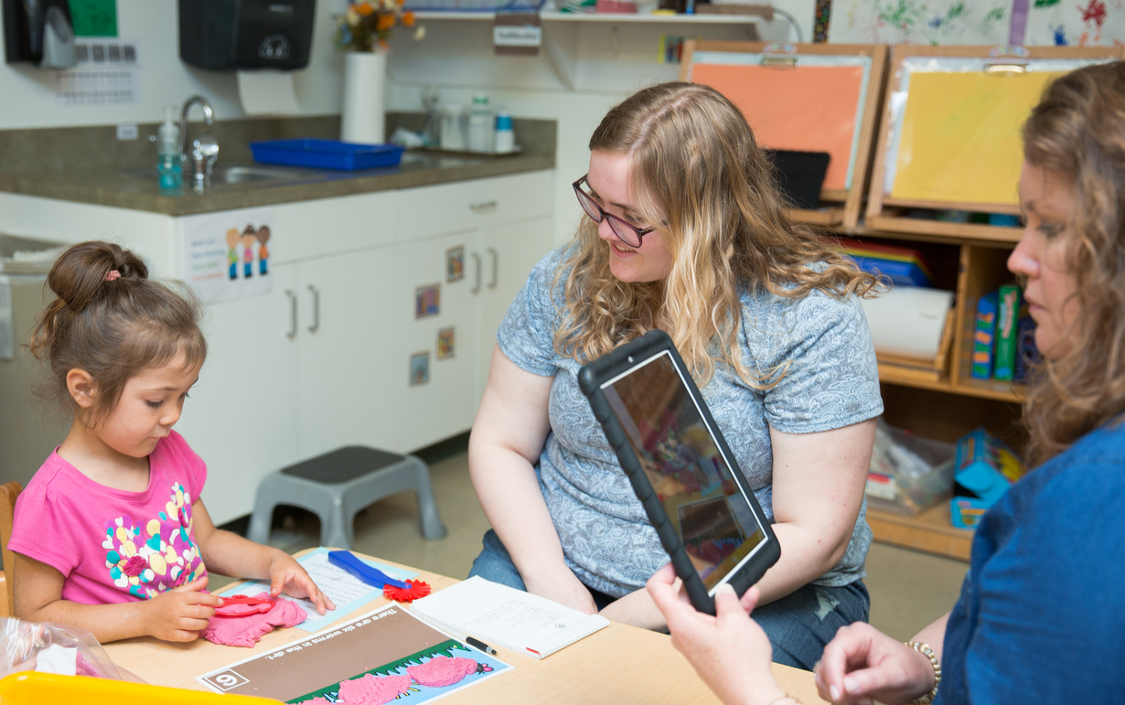
Using Video in Coaching
Video is a powerful tool for observation,
reflection, and feedback.
Videotaping can be done by the educator or the coach.
Notes:
Video is a powerful tool for focused observation, reflection, and feedback. Videotaping can be done by the coach or by the educator. With video, a coach and educator can view the video multiple times and focus on precise skills or behaviors that may have been missed in live observations. Video observations can be incorporated into reflection and feedback conversations. This allows the coach to anchor the feedback in a visual example of the educator’s teaching practice that is related to the action plan goal.

Slide 50
Video 6
Video in Coaching
Watch educators and coaches discuss the benefits of using video in coaching.
While you watch the video, think about your own experiences with being filmed.
What made it feel comfortable?
What were some concerns?
Notes:
Introduce the video.
In this video, coaches and educators talking about the benefits of using video in coaching.
As they watch the video, ask participants to think about their own experiences with being filmed.
What made it feel comfortable?
What were some concerns?

Slide 51
Video Using Video in Coaching
Video: Using Video in Coaching
Notes:
Show the video.
Length of video: Approximately 2 minutes

Slide 52
Video Debrief 6
What are your experiences with being filmed?
What made it feel comfortable?
What were some concerns?
Notes:
Ask participants to share their experiences with being filmed.
What made it feel comfortable?
What were some concerns?
Possible answers
Trust. Educators need to feel safe and respected.
Invited, not forced. Educators need to actively understand the benefits of using video.
Reciprocity. Educators should be willing to be filmed and watch themselves on video.
Confidentiality. Educators must be assured that videos will not be shared outside of the coaching partnership. When considering videotaping during a home visit, a coach needs to gain the trust and consent of the family, in addition to the home visitor.
Optional: Share information on the Coaching Companion, a video-based tool that can be used to support coaching.
The Head Start Coaching Companion is a video sharing and coaching feedback application for early care and education programs to use with their staff. The Head Start Coaching Companion helps coaches and educators work together, even between coach visits or from a distance. Users share video files, ask questions, and exchange feedback. They can also share their own videos and track progress through the three major components of Practice-Based Coaching (PBC). These are: shared goals and action planning, focused observation, and reflection and feedback.
For more information, refer to the following resources:
Head Start Coaching Companion handout
https://eclkc.ohs.acf.hhs.gov/sites/default/files/pdf/coaching-companion.pdf
Coaching Companion Overview video
https://www.earlyedualliance.org/coaching-companion/

Slide 53
PBC Cycle: Reflection and Feedback
Effective
Teaching
Practices
Notes:
The third component of the PBC cycle is Reflection and Feedback.
NOTE
Click to highlight Reflection and Feedback.

Slide 54
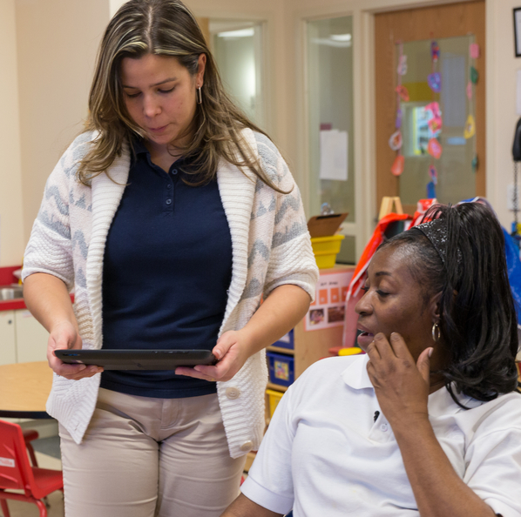
Providing Feedback
When educators and coaches reflect on practice implementation, the coach:
Provides encouragement and support.
Helps the educator monitor progress towards goals.
Provides opportunities for deeper insight.
Notes:
A debriefing session (in person, via phone, using video conferencing technology, or through email) occurs to discuss what was observed. The discussion is guided by the shared goal and action plan.
During this process, educators and coaches reflect on the implementation of the practice. The coach:
Provides encouragement and support for the educator.
Helps the educator monitor progress towards goals.
Provides opportunities for deeper insight into diverse perspectives and cultural influences that underlie teaching practices.
Distribute and review the Tips for Coaches: Reflection and Feedback handout.
Ask participants to share ideas for how reflection and feedback may occur when an educator self-coaches.

Slide 55
Reflection and Feedback: How
When reflecting and giving feedback,
the coach:
Shares observations.
Asks open-ended questions.
Guides discussion on practices that value and affirm all children.
Encourages recognition and sharing of assumptions and implicit biases.
Offers resources.
Celebrates successes and progress.
Notes:
Both the educator and the coach engage in strength-based reciprocal conversations where they reflect on the focused observation and progress toward the action plan. When reflecting and giving feedback, the coach:
Shares observations regarding the targeted teaching or home visiting practice.
Asks open-ended questions that help the educator examine implementation of practices, and challenges that are impeding the use of a practice.
Guides discussion on practices that value and affirm the cultures and languages of all children.
Encourages recognition and sharing of assumptions and implicit biases underlying practices.
Offers resources to support implementation.
Celebrates successes and progress.

Slide 56
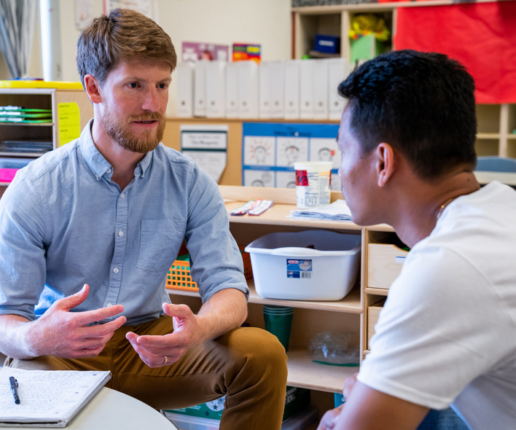
Reflection
Reflective phrases
  I hear you. It sounds like…
Open-ended questions
  What happened yesterday?
  Why do you think…?
  What might happen if…?
Notes:
The goal of reflection is to promote deeper thinking and more intentional teaching. A coach uses different strategies to invite reflection.
Reflective phrases, that restate, in slightly different words, what the educator has said. e.g., I hear you; It sounds like…
Open-ended questions that invite the educator to:
Recall their own actions, e.g., Tell me what happened yesterday; How did circle time go?
Share their perception and insights, e.g. “Why do you think that happened? “What would that look like for you?”
Make comparisons to the past or imagine the future, e.g., “How did this compare to last week? What might happen if…?

Slide 57
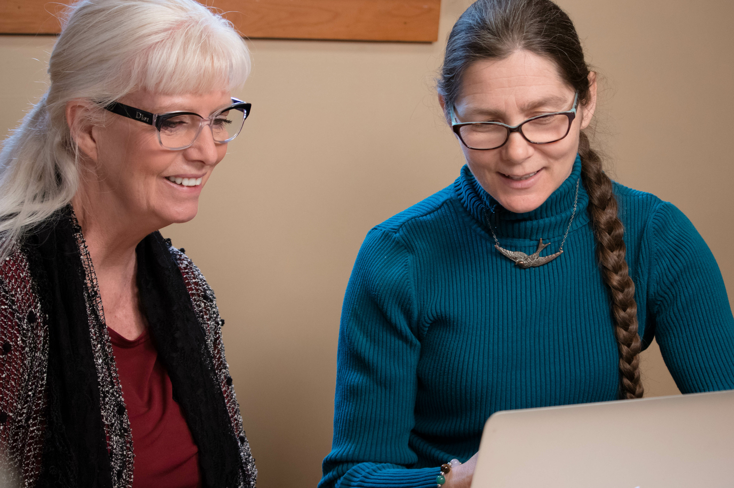
Goals of Providing Feedback
The goal of providing feedback is to get the educator to reflect.
The coach can give two types of feedback:
Supportive Feedback
Constructive Feedback
Notes:
The goal of providing feedback is to get the educator to reflect and identify what went well, what didn’t work, and what could be done differently next time. The coach can give two types of feedback:
Supportive feedback recognizes an educator’s effort or progress in trying out a new skill (e.g, It really worked well when you… , I noticed you successfully ….”)
Constructive feedback focuses on providing information or resources to help an educator expand or adjust a practice (e.g., What would be another way of…, Something you might try…. )

Slide 58
Effective Feedback
Effective feedback is:
Linked. Coaches explicitly link the focused observation to the action plan
Specific. Coaches clearly describe what was observed.
Responsive. Coaches respect the educator’s perspective and values.
Notes:
Effective feedback is:
Linked explicitly to the action plan and the focused observation.
Specific. Coaches clearly describe what was observed, using direct quotes and data whenever possible.
Responsive. Coaches acknowledge and respect the educator’s perspective and values.

Slide 59
Activity 3
Are These Statements Effective ?
The video is a great example of your goal in action: wanting to embed more math language in dramatic play.
You are so patient with the children! They are lucky to have you.
Notes:
Ask participants to decide whether the following statement reflects effective feedback and why. If not, ask them to offer an improvement.
The video is a great example of your goal in action: wanting to embed more math language in dramatic play.
Yes, this is an effective statement. It is linked to the educator’s action plan. It recognizes the educator’s success.
You are so patient with the children! They are lucky to have you.
No, this is not an effective statement. It does not give any specific information. It is really a compliment. A possible improvement is: You waited 5 seconds for Diego to answer your question, and when he did he was so proud he got it right.]

Slide 60
Activity 3 (continued)
Are These Statements Effective ?
I noticed Michael wandering around the room during circle time. Tell me more about that.
You did a great job today!
I saw you used gestures when talking about the schedule with Emma. What other visual supports might you use?
.
Notes:
I noticed Michael wandering around the room during circle time. Tell me more about that.
Yes, this is an effective statement. It gives specific information and offers an opportunity for reflection.]
You did a great job today!
No, this is not an effective statement. It does not give any specific information. It is general praise. A possible improvement is: You helped the parent identify more opportunities for Camila to practice
I saw you used gestures when talking about the schedule with Emma. What other visual supports might you use?
Yes, this is an effective statement. It gives specific information and offers an opportunity for reflection.]

Slide 61
Video 7
Reflection and
Feedback Examples
As you watch this video of coaches in conversation with educators, write down examples of:
Reflective phrases and questions.
Supportive and constructive feedback.
Notes:
Introduce the video.
This video shows two examples of an educator and coach engaged in reflection and feedback. The first example is from a preschool program; the second example is from an infant-toddler program.
As they watch this video, ask participants to use the Reflection and Feedback: Video Viewing Form to write down examples they hear of the coaches using:
Reflective phrases and questions
Supportive and constructive feedback
Distribute and review the Reflection and Feedback: Video Viewing Form handout.

Slide 62
Video Reflection and Feedback Examples
Video: Reflection and
Feedback Examples
Notes:
Show the video.
Length of video: Approximately 7 minutes

Slide 63
Video Debrief 7
Share examples of:
  Reflective phrases and questions
  Supportive and constructive feedback
Notes:
Ask participants to share examples of:
Reflective phrases and questions
Supportive and constructive feedback
Examples from the video:
Reflective phrases and questions
Did you think you would be including all of those teaching and learning objectives together in just one activity?
Had you planned that?
Did you know she was subitizing?
Supportive and constructive feedback.
I’m seeing sort and classify. I’m seeing literacy. (supportive)
Look at the engagement there. (supportive)
It seems like you are more aware of it. (supportive)
I find it easier when… (constructive)
Are there times of the day where you find it more natural? (constructive)
For the future, we often talk with children about what we are going to do next. (constructive)
A couple of moments when I heard… (supportive)

Slide 64




PBC Cycle: Review
Effective
Teaching
Practices
Notes:
PBC is a cyclical process that occurs in the context of collaborative partnerships and involves creating shared goals and actions, focused observations and reflection and feedback.
NOTE
This is an animated slide that may be used as a knowledge check.
The slide shows a blank PBC Cycle graphic.
Point to each part and ask participants to identify the corresponding PBC cycle component.
As participants identify each component, click on the slide to reveal the text. Follow the order below:
Shared Goals and Action Planning
Focused Observation
Reflection and Feedback
Collaborative Partnerships
Effective Teaching Practices
For collaborative partnerships, ask participants to share some features. Encourage them to include features related to culture and equity.
Optional: Show the NCQTL PBC video: Practice-Based Coaching: Collaborative Partners
https://eclkc.ohs.acf.hhs.gov/professional-development/article/practice-based-coaching-pbc
Length of video: Approximately 8 minutes

Slide 65
Summary
PBC is an effective professional development approach.
PBC promotes effective teaching practices that result in positive outcomes for children and families.
With PBC, educators and coaches work collaboratively through a cyclical process.
Notes:
PBC is an effective professional development approach.
The goal of PBC is to promote use of effective teaching strategies that result in positive outcomes for children and families.
Educators and coaches work collaboratively through a cyclical process of creating shared goals and action plans, conducting focused observations to document progress, and providing reflection and feedback on implementation of practices.
Discussion
Ask participants to share some final thoughts about PBC.
Points to highlight:
Relationships are built on transparency, consistency and mutual respect.
Shared understanding and focus. Coaches build stronger collaborative partnerships when they seek to understand an educator’s and their own practices in the larger context of cultural beliefs and identity.
Equity focus. Coaches support educators in building their own capacity to address implicit biases and ensure all children have access to equitable learning opportunities.
Coaches value and build on educators’ cultural and linguistic resources.
Coaches offer flexible delivery options.
Coaches and educators engage in skilled conversations about effective practices that promote positive outcomes for children and families.
Coaches and educators celebrate successes and progress.

Slide 66
Assignment
Poster
Create a poster that summarizes key concepts of PBC.
Posters can:
Be physical or digital
Use words and images
Include the following components:
  Collaborative partnerships
  Shared goals and action planning
  Focused observation
  Reflection and feedback
Address culture and equity
Notes:
Optional Poster Assignment
This assignment gives students an opportunity to summarize what they learned in the session. Posters should highlight key concepts of Practice-Based Coaching with attention to the broader context of culture and equity.
Posters can be physical or digital and should use a combination of words and images.
All posters should include:
A title
At least one item representing each of the following:
Collaborative partnership
Shared goals and action plans
Focused observations
Reflection and feedback
Distribute and review the Poster Assignment handout.

Slide 67
Closing slide
© 2019 University of Washington. All rights reserved.
Notes:
This is the end of the session on Practice-Based Coaching

