Slide 1
Ongoing Child Assessment to Support Learning
Ongoing Child Assessment
to Support Learning
EarlyEdU Alliance®
© 2020 University of Washington. All rights reserved.
Notes:
Welcome! This module teaches observation and assessment practices for early learning professionals working with children from birth to age 5 in a variety of early learning settings, from family programs to private programs to Early Head Start/Head Start. In this module, the terms early learning professional, early childhood educator, and their variations refer to educators who work with children from birth to 5.
Most of the core principles apply to educators working with children throughout that age range. Some parts of the module may have more examples, photos, or videos from one age range or type of early learning environment. Some practices may be more relevant to one age range than another.
The aim is for early childhood educators to learn and apply best practices in assessing children to help better guide their learning and development toward outcomes identified by programs, families, curriculum, and state or federal early learning guidelines, and to respond to children’s individual needs.
You may need to alter the module activities to individualize this learning experience to match the needs of the participants in your class. Some participants may be new to the field, others may have years of experience and are furthering their education. Some participants may be working in a family childcare with limited assessment procedures while others may be in Head Start programs with lengthy, structured requirements.
Guidance for some of the learning activities may include possible participant responses. These are not intended to be comprehensive; they are merely suggestions to help you in leading the activity.
Finally, you will need Internet access to present this module as it contains links to outside content.

Slide 2
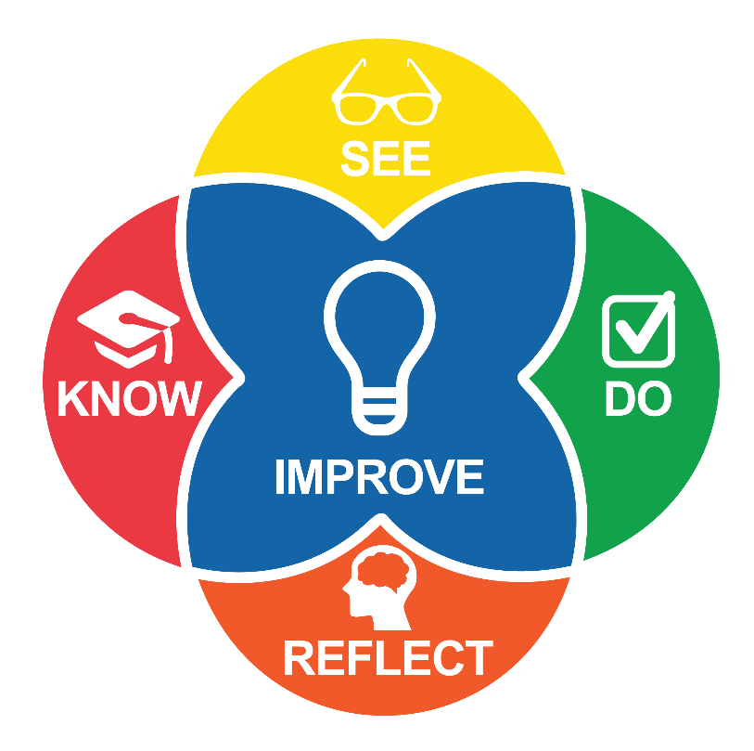
Intentional Teaching Framework
Notes:
EarlyEdU’s higher education courses and modules (EarlyEdUAlliance.org) use the Intentional Teaching Framework (Hamre, Downer, Jamil, & Pianta, 2012; Joseph & Brennan, 2013), which guides participants to:
Know—Learn about child development and effective teaching practices. Please note, teaching practices for home visitors means supporting parents as they teach their child.
See—Objectively describe, using specific behavioral language, what is happening in video clips shown during the module.
Do—Set goals, create plans, and use strategies. (Do can also involve applying knowledge during in-module activities.)
Reflect—Participants observe and analyze their practices using video recordings of their time in the early learning environment.
Improve—Plan and implement positive, quantifiable change to teaching practices.
REFERENCES
Hamre, B. K., Downer, J. T., Jamil, F. M., & Pianta, R. C. (2012). Enhancing teachers’ intentional use of effective interactions with children. In R. C. Pianta (Ed.) (2012). Handbook of early childhood education (pp. 507–532). New York: The Guilford Press.
Joseph, G. E., & Brennan, C. (2013). Framing quality: Annotated video-based portfolios of classroom practice by preservice Teachers. Early Childhood Education Journal, 41, 423–430.

Slide 3
House Framework
Image credit: National Center on Quality Teaching and Learning
Notes:
This module uses the Framework for Effective Practice, also called the House Framework, developed for the Office of Head Start. The Framework supports young children’s school readiness.
This module supports two pillars of the House: Ongoing Child Assessment and Research-Based Curricula and Teaching Practices. The foundation is Engaging Interactions and Environments, and the roof is Highly Individualized Teaching and Learning. Educators use all areas to help children progress toward school readiness.
REFERENCE
U.S. Department of Health and Human Services, Administration for Children and Families, Office of Head Start, National Center on Quality Teaching and Learning. (2014, Spring). House framework for effective everyday practice. https://eclkc.ohs.acf.hhs.gov/teaching-practices/article/framework-effective-practice

Slide 4
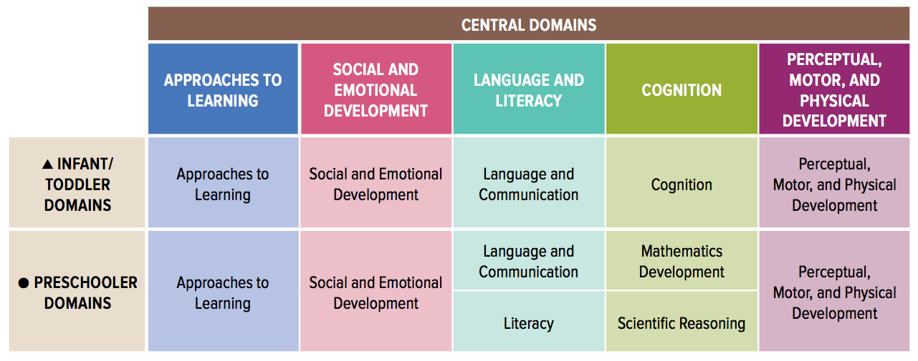
Head Start Early Learning Outcomes Framework
Head Start programs choose curriculum and assessments that align with the Head Start Early Learning Outcomes Framework.
Image credit: Office of Head Start
Notes:
Head Start Program Performance Standards require that programs use assessments that are:
Aligned with goals in the Head Start Early Learning Outcomes Framework.
Standardized and structured (observation-based or direct).
Valid and reliable and appropriate for the population of children they serve.
Conducted by trained staff.
Appropriate developmentally, linguistically, culturally, and by age.
Appropriate for children with disabilities.
A guide for aligning assessments with the framework is the Implementation Guide: Using the ELOF to Inform Assessment (full reference below).
Some companies that develop assessment measures have already done the work of aligning the tool with relevant early learning standards.
REFERENCES
U.S. Department of Health and Human Services, Administration for Children and Families, Office of Head Start. (n.d.). Head Start Early Learning Outcomes Framework: Ages Birth to Five. https://eclkc.ohs.acf.hhs.gov/school-readiness/article/head-start-early-learning-outcomes-framework
U.S. Department of Health and Human Services, Administration for Children and Families, Office of Head Start, National Center on Quality Teaching and Learning. (n.d.). Implementation guide: Using the ELOF to inform assessment. In Early Learning Outcomes Framework Implementation Toolkit. https://eclkc.ohs.acf.hhs.gov/sites/default/files/pdf/no-search/elof-04-inform-assessment.pdf

Slide 5
Objectives
Observe children objectively and responsively.
Describe bias and what steps you could take to mitigate it.
Make plans for ongoing child assessment.
Share clear and engaging assessment information with families as partners.
Explain effective strategies to assess children, who are dual language learners, in language development and other areas.
Share information with families of children who are learning more than one language.
Share information with families of children who have disabilities.
Notes:
Let’s review our objectives for this module. After leaving this module, participants will be able to:
Observe children objectively and responsively.
Describe bias and what steps you can take to mitigate it.
Make plans for ongoing child assessment.
Share clear and engaging assessment information with families as partners.
Explain effective strategies to assess children who are dual language learners (DLLs) in language development and other areas.
Share information with families of children who are learning more than one language
Share information with families of children who have disabilities.

Slide 6
Reflect on Your Experiences with Assessment
Did you think assessment results accurately reflect your abilities? Why or why not?
Did your feelings change before and after?
Were there times that you were being assessed and didn’t realize it?
What feelings do you have now related to assessment or testing?
Notes:
To begin, encourage participants to reflect on their memories of being assessed at any level. Ask participants to write a brief response to the questions on the slide about their memories and feelings regarding their assessment and testing experiences.
Invite participants to share their reflections with a partner.
After participants have talked with a partner, bring the group back together and ask for volunteers to share highlights of their responses.
This activity is adapted from an article in the National Association for the Education of Young Children’s special issue, Spotlight on Young Children and Assessment.
REFERENCES
Biggar, H. (2010). Reflecting, discussing, exploring: Questions and follow-up activities. Spotlight on Young Children and Assessment. 60-64.

Slide 7
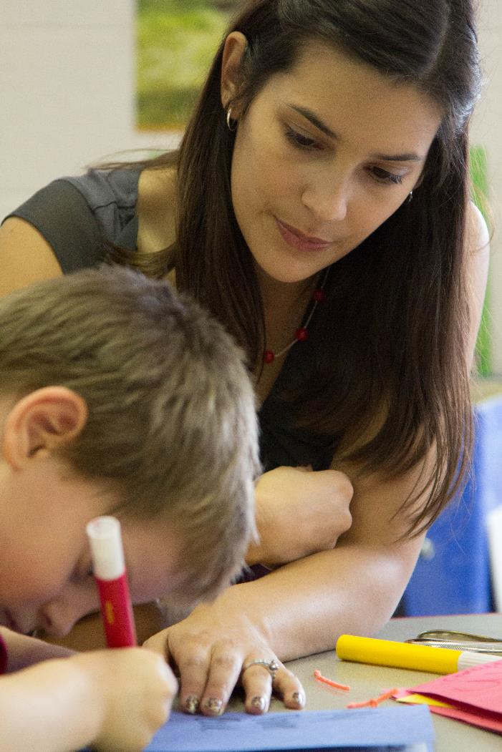
Assessment Meaning
In early childhood education, assessment has multiple meanings.
Image credit: EarlyEdU
Notes:
The word assessment has several meanings in early learning environments due to the wide variety of disciplines involved in the field. There is no official agreement regarding the terminology. This module will define the words describing different types of assessments as they arise so that participants can understand their meaning in this module.
Assessment can refer to a variety of methods to measure and appraise children’s knowledge and abilities, from observation to tests. The term assessment can refer to a single evaluation or measure or an ongoing process where educators gather information about children’s learning at multiple points in time.
Early childhood professionals often use specific assessment measures or tools for particular assessment purposes. For some types of single point in time assessments, educators need to use standardized assessment measures that require adherence to a detailed set of instructions for the tools to be useful. Generally, those conducting more formal assessments use them for higher stake decisions, such as assessing children for eligibility for services due to delays or disabilities.
In this module, we will focus on ongoing assessment where educators gather multiple types of information on children in order to adjust their teaching.
REFERENCES
McAfee, O., Leong, D. J. (2011). Assessing and guiding young children’s development and learning. Upper Saddle River, NJ: Pearson Education
National Research Council. (2008). Early childhood assessment: Why, what, and how. Committee on Developmental Outcomes and Assessments for Young Children, C.E. Snow & S.B. Van Hemel (Eds.). Board on Children, Youth, and Families, Board on Testing and Assessment, Division of Behavioral and Social Sciences and Education. Washington, DC: The National Academies Press. https://www.nap.edu/catalog/12446/early-childhood-assessment-why-what-and-how

Slide 8
Video Intro: Assessment
Tool Considerations
As you watch the video, think about this question:
What does the speaker say is important when selecting and using assessment tools?
Notes:
Ask participants to think about this question while watching the video on the next slide: What does the speaker say is important when selecting and using assessment tools?

Slide 9
Video: Assessment Tool Considerations
Video: Assessment Tool Considerations
Notes:
This slide contains the video Assessment Tool Considerations. It features Dr. Gail Joseph, associate professor in educational psychology and director of Cultivate Learning and EarlyEdU Alliance at the University of Washington. This video is 2 minutes, 56 seconds long.

Slide 10
Video Debrief: Assessment
Tool Considerations
What did you hear the speaker say about considerations for assessment tools?
Notes:
Ask participants what key points they heard about using assessment tools accurately.
The speaker points out that these tools should:
Match the assessment purpose.
Be valid and reliable.
Be socially valid.

Slide 11
Key Parts of Ongoing Assessment
Observing children’s strengths, progress, and development by collecting evidence over time during children’s regular routines and environments.
Interpreting information to make informed decisions about teaching and responding.
Partnering with families to gather information and plan ways to support children’s learning.
Notes:
Ongoing assessment is a process where educators generally use a variety of documentation methods during children’s regular routines and environments to measure children’s progress toward learning outcomes. Educators may also use a specific assessment measure called an observation-based assessment tool in combination with other methods. While the majority of early learning programs use observation-based tools, some Head Start programs may use direct assessment tools for ongoing assessment.
An observation-based assessment tool can help educators evaluate children in all areas of development and organize information. Any assessment tool used should reflect curriculum goals, which are often required by states and the federal government to align with early learning guidelines and/or the Head Start Early Learning Outcomes Framework (ELOF), depending on the early learning program. The curriculum should be comprehensive and based on research and child development stages. In Head Start programs curriculum must align with the ELOF.
Educators should use information about children’s progress to plan the next steps in teaching.
This process is one that educators should do in partnership with families.
REFERENCES
McAfee, O., Leong, D. J. (2011). Assessing and guiding young children’s development and learning. Upper Saddle River, NJ: Pearson Education
U.S. Department of Health and Human Services, Administration for Children and Families, National Center on Quality Teaching and Learning. (2011). Curriculum, assessment, and the Head Start Framework: An alignment review tool. https://eclkc.ohs.acf.hhs.gov/sites/default/files/pdf/curriculum-alignment-tool.pdf

Slide 12

The Ongoing Assessment Cycle
Observe
Instruct
Document
Interpret—Create hypotheses
Image credit: EarlyEdU
Notes:
The process of recording observations of children, working to make sense of the assessment information, and then using that understanding to improve teaching and learning creates a continuing cycle. This picture illustrates the assessment-instructional cycle.
The cycle begins with the observation of children in typical routines and environments.
As previously discussed, common ways to document these observations include taking anecdotal notes, completing checklists, collecting work samples, and recording and viewing video clips. Documentation allows educators to summarize and then apply what has been learned through observation.
After collecting the documentation, the teaching team interprets it and then uses its findings to guide and plan changes in instruction.
Educators make changes to their instruction.
The cycle continues as the teaching team observes again to see the impact that the modified instruction has on individuals and groups of children.

Slide 13
Ongoing Assessment Purposes
Track children’s progress and development
Guide early learning professionals’ planning and teaching
Identify children who may need special services
Report and communicate with others
Evaluate programs
Notes:
These are the five basic reasons that early childhood educators assess the development and learning of infants to preschoolers.
To continually monitor children’s learning and development during familiar routines and environments.
To help them plan instruction and adjust plans accordingly to children’s needs and interests. (A later section of this module will address this aspect of ongoing assessment.)
To identify children who may need special services.
To communicate with families about their children’s progress and development. Other assessments may go to specialists, administrators, or members of the community.
To help convey program accountability, such as outcomes mandated by the state or federal government.
REFERENCE
McAfee, O., Leong, D., & Bodrova, E. (2010). Basics of assessment: A primer for early childhood educators. Washington, DC: National Association for the Education of Young Children.

Slide 14
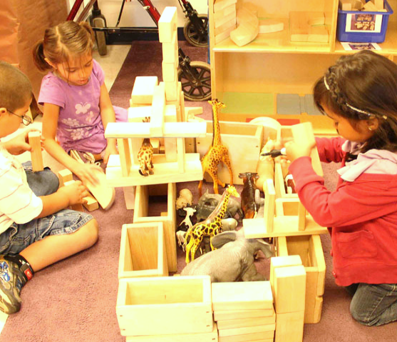
Creating a Culture of Inquiry
Reflection
Curiosity
Systems thinking
Embracing change
Using feedback
Tolerance of failure and vulnerability
Image credit: EarlyEdU
Notes:
This slide is animated so that points appear one by one.
Using ongoing assessment as a part of the regular system of learning promotes a culture of inquiry among educators and children alike. Early learning professionals can foster and embrace this culture of inquiry with the support of administrators by:
Embracing change: Seeking to understand the benefits of new and improved assessment practices.
Fostering curiosity: Continually looking for information about the perspectives, goals, interests, and progress of children and families.
Promoting reflection: Finding time to meet with colleagues and discuss effective assessment and teaching.
Engaging in systems thinking: Ensuring an understanding of programs’ assessment systems.
Welcoming and using feedback: Using data to answer questions about programs’ impact.
Tolerating failure and vulnerability: Recognizing when approaches are not working and changing module if necessary.
REFERENCES
U.S. Department of Health and Human Services, Administration for Children and Families, Office of Head Start, National Center on Quality Teaching and Learning. (2014, Spring). Administrative support [Presentation]. In Administrative Support. https://eclkc.ohs.acf.hhs.gov/video/administrative-support

Slide 15
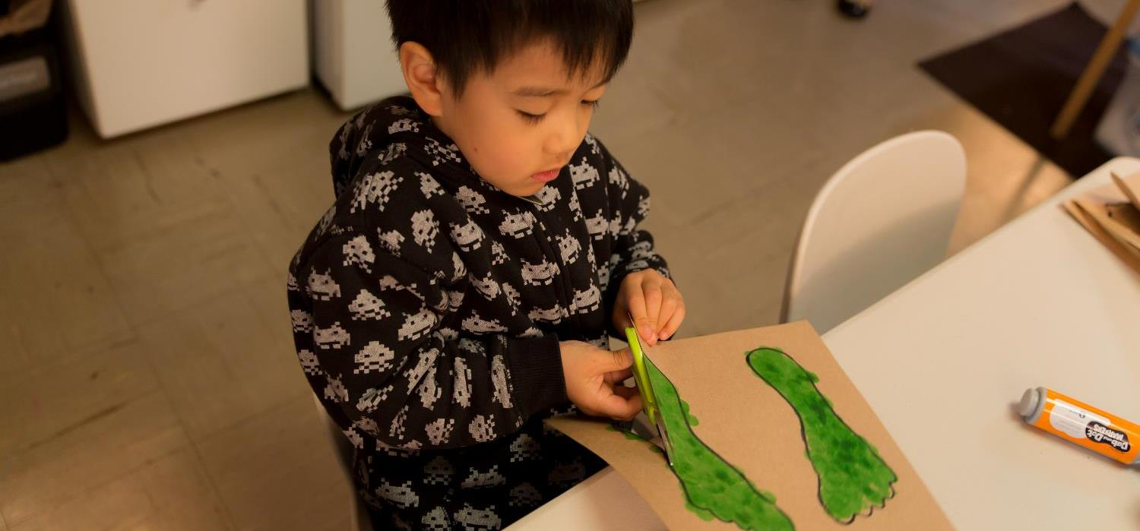
Young children’s development is often uneven
Image credit: EarlyEdU
Notes:
Young children learn through play and interactions with others and their environment. They develop quickly, at their own pace, and with different interests. They may learn in quick spurts, then more slowly, and sometimes they even take a few steps backward before moving forward in developing skills. In addition, children’s development may vary by domain area.
Early learning educators need to be aware of children’s individual development and developmental benchmarks in addition to curriculum goals and early learning guidelines. Curriculum and assessments should allow for uneven development, acknowledging that it is typical for children of one age will show a range of abilities.
Young children can be limited in their ability to understand and share their ideas. For instance, they may have trouble understanding and following directions if the directions are too wordy or include unfamiliar words. Children may also speak a different home language than English, so they lack fluency in expressing ideas. Also, children with suspected or identified disabilities may not follow typical developmental patterns.
Young children are often sensitive to the context of assessment—the physical environment, the people involved, and the activities. Children are likely to perform well when they are in an environment in which they are comfortable, doing an activity they find interesting, and with adults they know and trust.
Other variables to consider include whether children are tired, hungry, or ill. In addition, children’s temperament can be a factor in assessment. The younger a child, the more likely the child is to become overwhelmed or distracted, fall asleep, or choose not to follow requests. Early childhood professionals should be ready to alter activities or revisit assessments at times when young children can best participate.
Understanding family context is key for educators when assessing young children. This includes family language and culture.
Educators should invite parents to share information about children and may want to conduct home visits, if possible.
REFERENCES
Illinois State Board of Education: Early Childhood Education. (2012, May). Authentic assessment and early childhood education—an update and resources. Little Prints, 6(1).
McAfee, O., Leong, D., & Bodrova, E. (2010). Basics of assessment: A primer for early childhood educators. Washington, DC: National Association for the Education of Young Children.
Trister Dodge, D., Heroman, C., Charles, J., & Maiorca, J. (2010). Beyond outcomes: How ongoing assessment supports children’s learning and leads to meaningful curriculum. Spotlight on Young Children and Assessment. https://www.oercommons.org/authoring/14360-beyond-outcomes-how-ongoing-assessment-supports-ch/view

Slide 16
Definition of Observation
“Observation means intentionally watching and listening to learn about children.”
(Dichtelmiller, 2011, p. 55)
Notes:
Ask participants what they think the word observation means. This slide is animated so that participants can discuss what they think the word means before a definition appears on the screen.
One definition of observation is: “Observation means intentionally watching and listening to learn about children” (Dichtelmiller, 2011, p. 55).
Another definition, as stated by the U.S. Department of Health and Human Services and the Office of Child Care (2010), is: “The process of gathering information that documents a child’s growth and development.”
This second definition includes the concepts of documentation and assessment.
REFERENCES
Dichtelmiller, M. L. (2011). The power of assessment: Transforming teaching and learning. Washington, DC: Teaching Strategies.
U.S. Department of Health and Human Services and the Office of Child Care. (2010, April). Infant/toddler: Development, screening, and assessment. https://childcareta.acf.hhs.gov/sites/default/files/public/infant-toddler_development_screening_and_assessment.pdf

Slide 17
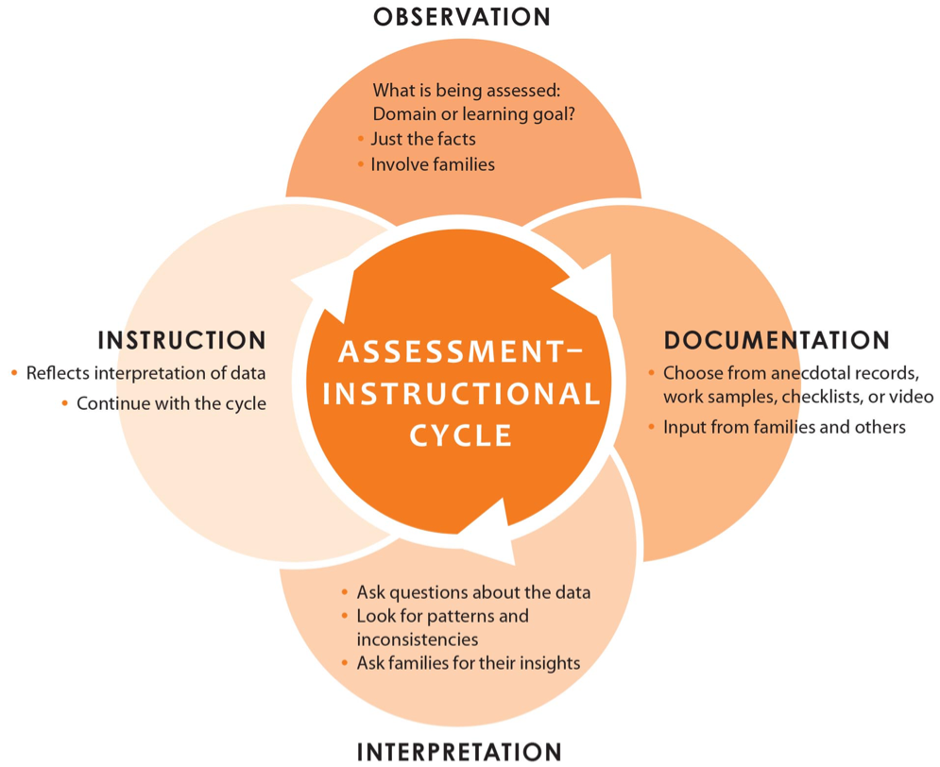
Observation
Notes:
Observation is one way to collect ongoing assessment data. Information collected in the context of typical activities captures an authentic picture of a child’s development. Observations can be documented through anecdotal records, video recordings, or checklists.

Slide 18
Video Intro: Observation
As you watch the next video, listen for concepts that are important to observing effectively.
Notes:
As they watch the next video, ask participants to listen for concepts that are key to observing effectively .

Slide 19
Video: Observation
Video: Observation
Notes:
This slide contains the video Observation. The video is 2 minutes, 2 seconds long.

Slide 20
Video Debrief: Observation
What did you hear about important concepts for effectively observing young children?
Notes:
Ask participants to share what they heard about key concepts for observing children effectively.
They may share that effective observation requires:
Listening and watching closely
Collaborating
Watching during planned activities and when children are playing
Making objective notes about what educators see and hear, focused by their assessment planning
In addition, the video concludes with the idea that observations are important for educators to make their teaching meaningful and to individualize teaching for all children.

Slide 21
Objective Documentation
DO
DON’T
Describe interactions with concrete words.
Add details.
Use adjectives like kind or bad.
Add your opinion or interpretation.
Notes:
A key part of objective observations includes the way you document what you see. These are some guidelines for documenting objective observations.
Do:
Describe interactions with concrete words.
Add details.
Don’t:
Use adjectives like kind or bad.
Add your opinion or interpretation.
Learning to document accurately and with facts can take practice.

Slide 22
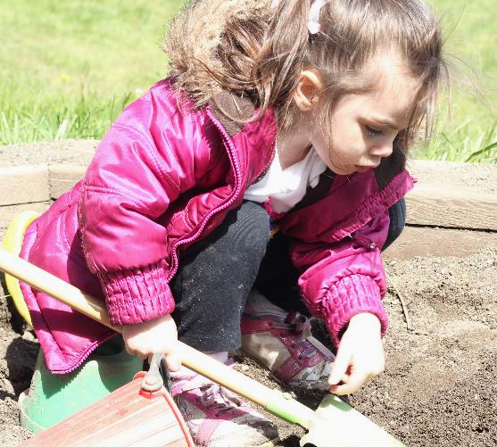
How to Document Observations
Watch and listen
Observe details about the child’s body position, facial expression, words or vocalizations, actions, interactions, and creations
Be objective
Image credit: EarlyEdU
Notes:
When documenting observations, early learning educators should focus on what they see and hear and avoid forming conclusions or judgments.
Factual observations document:
Exact words children say.
Descriptions of children’s actions, gestures, and creations.
Adjectives such as fussy, hyperactive, or happy are words that indicate the observer is interpreting a child’s behavior.
Ask participants what they notice about the child in this photo. Answers may include:
The child is holding the shovel with her right hand.
She is crouching and looking down at the soil where the shovel is touching the dirt.
She is wearing a heavy coat, which is unzipped.

Slide 23
Activity: Fact or Opinion
Find a partner.
Read the examples together.
Which observations are stated objectively?
Which ones share opinions?
Notes:
Materials: Fact or Opinion? Handout
Ask participants to find a partner and read the handout with examples of observation documentation. Participants need to decide whether the documentation examples are objective or express opinions.
Encourage participants to identify any opinions expressed and to think about what impact these judgements could have on communicating about that child.
In doing the activity, participants may note that:
The first statement is subjective because it uses the words nicely and interrupts. Both words include the opinion of the person using them. A more objective statement might say, “Ali is playing with Jordan today. He asked Jordan if he could play.”
The second statement is also subjective because it expresses the surprise of the person saying the statement. The description also describes Delaney as quiet. A more objective statement might be: “Delaney knew letter sounds b, m, s, and t today.”
The third statement is objective and detailed, including what foot the child used and how far the ball went.
Participants may provide a wide variety of statements about the two pictures (in the handout and on the next two slides). Here are a couple of possible objective and subjective descriptions:
Picture 1: Jeremy was having a great time today when he was holding the rope and getting ready to go outside (subjective). Jeremy was laughing hard as he held the rope to go outside (objective).
Picture 2: Kaya was trying to upset Sean today when she erased his work on his whiteboard (subjective). Kaya used the eraser on the end of her pen to erase Sean’s work on the whiteboard he was using today (objective).

Slide 24
Video Intro: Container Play
Watch the next video and write down your observations about what you observe.
Use objective language and include details.
Notes:
Ask participants to document their observations, using facts and details, as they watch the video on the next slide.
You may choose to play a shorter portion of this video so that participants can capture more of their observations. You may also want to play the video twice so participants can practice observing closely and capturing their observations in writing. Encourage participants to develop their own shorthand for documenting their observations.

Slide 25
Video: Container Play
Video: Container Play
Notes:
This slide contains the video called Container Play, which features a toddler playing with some containers.
The video is 1 minute, 27 seconds long.

Slide 26
Video Debrief: Container Play
What did you observe when you watched the video?
Notes:
Ask a few participants to read their observations. Ask for other participants to add any observations they had that were not already mentioned.
The point of this exercise is for participants to practice documenting their observations using concrete, factual terms and to see how much they can learn in a little more than 1 minute.
Participants may observe that:
The toddler sits and looks around, then crawls to the shelf.
He puts his arms on the second shelf and moves his right leg to a crouch position.
The boy pulls two bowls (one inside the other) from the shelf, which is at his eye level.
He takes the green plastic bowl out of the orange plastic one and turns over the orange one in his hands.
He looks around, turning the orange bowl over in his hands.
You can hear his breathing.
The child makes a sound (uuuh), then drops the bowl and uses his index finger to push on a rectangular object on the bottom shelf.
Then he leans back, picks up the orange bowl, and places the green one inside it.
He turns the bowls over, then back to right-side up, shaking the two bowls and holding his thumb on the tops of them.
The two bowls hit one another as he continues to shake them.
The toddler puts out his right hand and grabs the green bowl, then shakes again.
Then he puts the bowls inside a canister and leans over to look inside it.
He turns the canister over, and the smaller green bowl falls out.
The boy shakes the canister a few times—looking into it and holding it sideways—and the orange bowl falls out.
He holds the canister in his right hand and picks up the orange bowl by the rim using his left hand.
He pushes the two things together so that the side of the canister is touching the bottom of the bowl.
The boy sets down the canister and picks up the bowl with his right hand, putting it inside the canister.
He immediately picks up the canister and turns it upside down.
He is holding the canister with two hands by the top edge and turns it upside down a couple more times.
The bowl clanks inside the canister as he moves it upside down then right-side up.
Then the boy puts his face up to the edge of the canister.
Ask participants to reflect on: What was the toddler exploring? What might he have been learning? Would you have noticed that if you hadn’t observed so closely?
Responses may include:
He was exploring sound and spatial concepts.
He used his right hand predominantly for tasks that required more precision.
He remained engaged in the activity.
Participants may have other observations.

Slide 27
Video Intro: Responsive Observation
When you watch the next video, listen for key parts of responsive observation.
Notes:
This section addresses what is often educators’ natural responses to close observation of children. Sometimes this is also called responsive teaching.
Responsive observation and teaching are closely related to the Teacher Sensitivity dimension in the Classroom Assessment Scoring System™ (CLASS), used to evaluate Head Start and other early childhood programs, with which participants may be familiar. Teacher Sensitivity is part of the CLASS Emotional Support domain.
For young children, especially infants and toddlers, responsive observation builds relationships, helps form strong attachments to caregiving adults, and supports brain development.
Ask participants to listen for key elements of responsive observation as they watch the next video.
REFERENCES
University of Virginia Curry School of Education. Classroom Assessment Scoring System™. http://curry.virginia.edu/research/centers/castl/class
U.S Department of Health and Human Services, Administration for Children and Families, Office of Head Start, National Center on Quality Teaching and Learning. (2013). Improving teacher–child interactions: Using the CLASS™ in Head Start preschool programs. https://eclkc.ohs.acf.hhs.gov/sites/default/files/pdf/using-the-class-in-hs-preschool-programs.pdf

Slide 28
Video: Responsive Observation
Video: Responsive Observation
Notes:
This slide contains the video Responsive Observation, which introduces the topic. It is 2 minutes, 45 seconds long.

Slide 29
Video Debrief: Responsive Observation
What did you hear about key elements of responsive observation?
Notes:
Ask participants what they heard about responsive observation.
They may point out that educators:
Observe
Ask questions
Develop theories
Respond in the moment
Need to practice this skill
Can use it to build relationships, meet children’s needs, and support their development and learning
Note that this video also shows evidence of intentional teaching, since one of the educators talks about a goal of helping a child interact with peers.
REFERENCE
U.S Department of Health and Human Services, Administration for Children and Families, Office of Head Start, Early Head Start National Resource Center. (2013). Observation: The heart of individualizing responsive care. https://eclkc.ohs.acf.hhs.gov/sites/default/files/pdf/ehs-ta-paper-15-observation.pdf

Slide 30
Responsive Observation Cycle
Watch
Adapt
Ask
Notes:
This cycle (adapted from an online professional development module referenced below) of watch, ask, adapt can occur naturally with careful, regular observation. Educators often start to ask questions about behaviors and skills that they see, develop theories about what they mean, and try out responses and scaffolding that is individualized for each child.
This cycle recognizes that young children are diverse, and adults should respond to their individual needs and temperaments. Responsive observation is particularly important for infants and toddlers because it helps caregivers connect with them. This closeness is a foundation for healthy emotional growth.
Later in this module, participants will learn about more formal ways that early learning professionals can use information, or documentation of their observations, to adjust their teaching.
REFERENCES
U.S. Department of Health and Human Services, Administration for Children and Families, Office of Head Start, Early Head Start National Resource Center. (2011). Look again: Using sensitive, skilled observation in your program [Audioconference handout]. https://eclkc.ohs.acf.hhs.gov/sites/default/files/pdf/look-again-using-sensitive-skilled-observation-materials.pdf
WestEd & California Department of Education. (May 2014). Responsive caregiving [PowerPoint presentation]. In the Program for Infant/Toddler Care. https://www.pitc.org/cs/pitclib/view/pitc_res/1269

Slide 31
I Wonder Questions
What are the areas where you could ask I wonder questions about children as you observe?
What are your ideas about what questions you could ask when observing children?
Notes:
Materials: Poster-sized paper, felt pens
Ask participants to share their ideas about I wonder questions they might ask about the children as they observe. You might encourage participants to think about the Head Start Early Learning Outcomes Framework. Write their ideas on the poster-sized paper so the group can see.
Some examples are:
How does this child calm themselves? (self-regulation)
How is this child feeling? (emotion)
Does the family see this behavior at home? How do they interpret it? (family partnership)
REFERENCE
U.S. Department of Health and Human Services, Administration for Children and Families, Office of Head Start, Early Head Start National Resource Center. (2011). Look again: Using sensitive, skilled observation in your program [audioconference handout]. https://eclkc.ohs.acf.hhs.gov/sites/default/files/pdf/look-again-using-sensitive-skilled-observation-materials.pdf

Slide 32
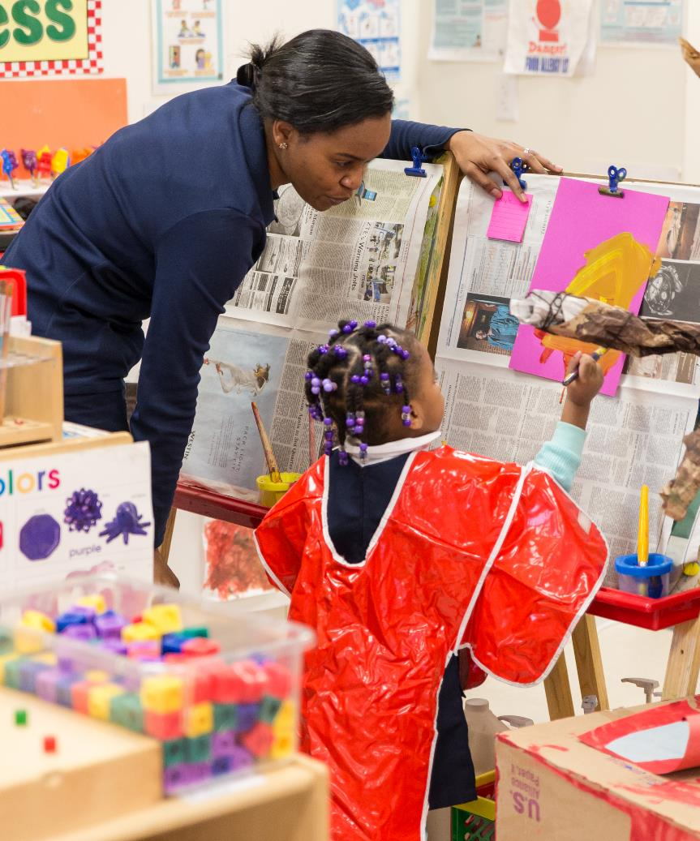
Focused Observation
Focused observation is intentional and directed at a particular behavior or skill.
Image credit: EarlyEdU
Notes:
Early learning educators should be continually observing children, making sure they are safe and responding to their interests and needs to scaffold their skills. Focused observation is a pre-planned observation used to look for information about a child’s knowledge and skills in a particular area. Sometimes early childhood educators may need to plan a learning experience or interaction to observe a particular skill. Educators can also observe children’s skills in more than one domain at the same time.
Goals for children’s development and learning provide a framework--often referred to as a developmental lens--for focused observation. This requires knowing key indicators for children’s development across all domains.
Questions to help guide an early childhood educator’s focused observation may include:
What do you want to learn?
What skill level does the child have?
Has the child met a goal?
REFERENCES
First 5 California. (2015, Nov. 10). Observing with purpose: Strategies for observing young children’s learning and development [Video]. https://www.youtube.com/watch?v=BwzSn1VHvCQ
The Center for Early Childhood Education at Eastern Connecticut State University. Observing young children [Video]. http://www.easternct.edu/cece/e-clip-observing-young-children/
U.S Department of Health and Human Services. Administration for Children and Families. Office of Head Start. Early Head Start National Resource Center. (2013). Observation: The heart of individualizing responsive care. https://eclkc.ohs.acf.hhs.gov/sites/default/files/pdf/ehs-ta-paper-15-observation.pdf

Slide 33
Video Intro: Look at Me! Using Focused Child Observation with Infants and Toddlers
Think about this question as you watch the next video: What can you learn from focused observation?
During the video, you will also observe a few children and discuss what you learned.
Notes:
Ask participants to think about this question while they are watching the next video: What can educators learn from focused observation?
During the video, the narrator will ask questions about the children in the video. You may want to stop the video to have participants discuss the questions. Note that the video addresses infants and toddlers, but the information applies to working with all young children.
Information that accompanies the next slide describes possible answers to the narrator’s questions.

Slide 34
Video: Look at Me! Using Focused Child Observation with Infants and Toddlers
Watch this Early Head Start video:
https://eclkc.ohs.acf.hhs.gov/video/look-me-using-focused-child-observation-infants-toddlers
Notes:
This Early Head Start video, Look at Me! Using Focused Child Observation with Infants and Toddlers, addresses the observation of infants and toddlers and includes how to use focused observations to address specific questions about children’s skills and development. Educators can also use focused observation with preschool children. This video is 7 minutes, 43 seconds long.
Note: The presentation must be in Slide Show mode to play this video.
The video begins to address focused observation at about 02:00, then gives opportunities to observe children. Participants first watch Meadow and focus on her motor skills at 02:10. The narrator asks observers to think about what Meadow is doing and how adults could support her. Possible answers include:
Meadow is trying to push the pedals on a tricycle, but one pedal keeps slipping backward.
After several attempts, she starts using her feet on the ground to move the tricycle forward.
Other questions the narrator asks are: How did she move her body? Her feet? Her hands? Did you learn anything about her ability to problem-solve or persist at a task? How could you support her? Did you learn anything else? What do you think the narrator means when she says, “Everyone who watches Meadow will see this differently”?
At 04:56, participants have another opportunity to watch a child, this time an infant with her mother.
The narrator asks: What did you see this child do? How did the mother respond? Did you learn anything about this child’s development? Ask participants to share their ideas. One description is:
The infant is turning over what looks like a small plastic plate in her hands, then claps, while intermittently looking toward the camera. The mother says, “You clap,” then claps her hands, then says, “Yay.”
The child looks at her mom when she responds, then smiles a bit and claps, using the plate. The infant again looks back at the camera and seems very aware that someone she doesn’t know is present.
Ask participants to think about what area of development this excerpt is highlighting. Answers may include communication or interactions with an adult.
REFERENCE
U.S. Department of Health and Human Services, Administration for Children and Families, Office of Head Start, Early Head Start National Resource Center. (2013). Look at me! Using focused child observation with infants and toddlers [Podcast]. https://eclkc.ohs.acf.hhs.gov/video/look-me-using-focused-child-observation-infants-toddlers

Slide 35
Video Debrief: Look at Me! Using Focused Child Observation with Infants and Toddlers
Based on the video, what are your responses to the question:
What can you learn from focused observation?
Notes:
Remind participants of the original question about the video: What can educators learn from focused observation?
Participants may have discussed this question as they talked about their observations of the children in the video. The video describes the purposes of focused observation, when done over time, as a way to:
Measure a child’s (and family’s) progress and development as a part of ongoing assessment.
Understand more deeply their intentions, behavior, and goals.
This video reflects Head Start’s focus on family goals in addition to their child’s goals.
The video also states that focused observation informs educators’ work with children and adds to educators’ communications with families.

Slide 36
Noticing Bias
“An observation is like a photograph—it captures a moment in time. As an observer, you are like a photographer, focusing on some things, ignoring others. Like the photographer, you bring your own ideas, preferences, and perceptions to the act of observing.”
Jablon, Dombro, and Dichtelmiller, 2007, p. 31
Notes:
As educators prepare to observe children, it is important that they reflect on their own and others’ biases. In this section, participants will examine the concepts of cognitive bias and implicit bias and their possible impact on young children in early learning settings.
This section will describe what bias means and give participants opportunities to reflect on their biases. While all people have biases, they tend only to recognize bias in others.
The first step to acting intentionally toward others in a way that aligns with that person’s values is for that person to recognize unconscious thoughts that may be impacting their ability to be intentional.
Ask participants what they think this quote means.
“An observation is like a photograph—it captures a moment in time. As an observer, you are like a photographer, focusing on some things, ignoring others. Like the photographer, you bring your own ideas, preferences, and perceptions to the act of observing” (Jablon, Dombro, & Dichtelmiller, 2007, p. 31).
The quote describes how everyone brings their own views and perspectives to situations. People filter what they see through their own mental models, shaped by their biases, attitudes, assumptions, and expectations. This means that they are part of the observation. This applies to educators too.
REFERENCES
Cohen, D., Stern, V., Balaban, N., & Gropper, N. (2008). Observing and recording the behavior of young children. New York, NY: Teachers College Press.
First 5 California. (2015, November 10). Observing with purpose: Strategies for observing young children’s learning and development [Video file]. https://www.youtube.com/watch?v=BwzSn1VHvCQ
Jablon, J.R., Dombro, A.L., & Dichtelmiller, M.L. (Eds). (2007). The power of observation for birth through eight. 2nd Edition. Teaching Strategies.
Project Implicit. Recognizing & understanding stereotypes and bias. https://implicit.harvard.edu/implicit/iatdetails.html

Slide 37


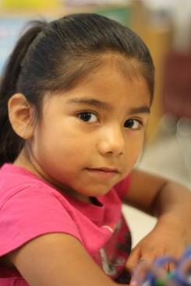
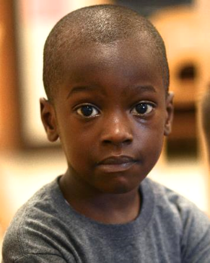

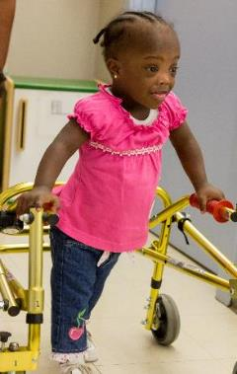
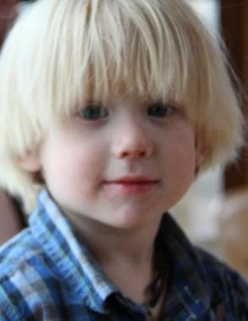
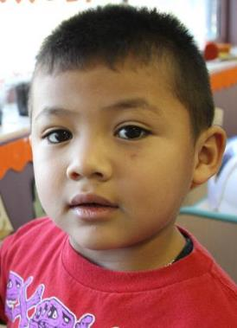
Reflecting on Bias
Image credit: EarlyEdU
Notes:
Note: Ask participants to take a few moments to look at these photos of young children.
After participants have had time to study them, ask them to reflect on their impressions of these children just from looking at the photos. Encourage participants to think about what they would expect if this child walked into their early learning program.
Invite participants to notice whether their perceptions emphasized perceived deficits or strengths. You could ask participants to raise their hands if they imagined strengths and then invite them to raise their hands if they thought about challenges.
Stereotypes can be defined as an exaggerated or distorted belief about a person or group that does not allow for individual differences. Stereotypes serve as an efficient way for people to organize information mentally. People rely on stereotypes because each person only has access to the information around them—what they see, hear, and read.
First impressions come from individual characteristics that trigger stereotypes and bias. With first impressions, cognitive bias can arise in the form of the Halo Effect. This means that if a person perceives that someone has one desirable trait, it is assumed that they have additional desirable traits. In other words, the initial perception of desirable traits permeates overall perception.
This can also work the opposite way so that a person perceived to have a negative trait is thought to have others. Ultimately, cognitive bias means that people tend to have a perspective—for or against people--based on characteristics.
REFERENCE
Project Implicit. Recognizing & understanding stereotypes and bias. https://implicit.harvard.edu/implicit/iatdetails.html

Slide 38
Discussion: Influence of Bias
How do you think educators’ initial impressions of young children influence their interactions and teaching?
What can educators do to see individual children more accurately?
Describe a time when you revised your thoughts about a child.
Notes:
Ask participants to break into small groups to talk about:
How educators’ impressions of children might affect their teaching and interactions with children.
What educators can do to see individual children more accurately.
Times when they have worked to revise their thoughts about children. Remind participants to keep the confidentiality of children and families.
A big takeaway should be that educators’ conscious or unconscious biases can affect how they view children, interpret their behavior, and respond to them. One way that early learning professionals can work to change their biases is by honing their critical thinking skills and engaging in reflective and independent thinking. Like other people, educators can learn to recognize biases and work to understand individual children more accurately.
Other ways to combat biases may be to get to know children’s families and to observe children closely to find out more about them and their personalities and interests.
REFERENCE
Project Implicit. Recognizing & understanding stereotypes and bias. https://implicit.harvard.edu/implicit/iatdetails.html

Slide 39
Activity: Writing Reflection on Bias
Take a moment to think about the children in your setting or children you have worked with in the past.
What kinds of assumptions do you make about certain groups of children?
What steps could you take to mitigate that?
Notes:
This is an independent writing activity intended for reflection rather than sharing.
Encourage participants to write two steps they can take to overcome a bias toward certain people or groups of people.
The work of making a paradigm shift, or changing the way a person views reality, begins with self-reflection and confronting individual stereotypes and bias. This allows people to challenge a mindset that is often unconscious and the result of many life experiences.
REFERENCE
U.S. Department of Health and Human Services, Administration for Children and Families, Office of Head Start, National Center on Cultural and Linguistic Responsiveness. (n.d.). Supporting the school readiness and success of young African American boys project: Reflections on a culturally responsive strengths-based approach. https://eclkc.ohs.acf.hhs.gov/sites/default/files/pdf/young-african-american-boys-project-guide.pdf

Slide 40

What Do We Know About Children Who Are Dual Language Learners?
Image credit: EarlyEdU
Notes:
Earlier, we mentioned that children who are dual language learners might have additional considerations for ongoing assessment. Young children who are learning more than one language are a very diverse group, and as mentioned before, their numbers are rising. Nearly one in three children in the U.S. lives in a family where a language other than English is spoken.
Slightly more than a quarter of children in Head Start and Early Head Start programs live in households where members speak a language other than English. Of those, 84 percent of the preschool-age children speak Spanish, and 91 percent of infants and toddlers are Spanish-speaking.
Children who are dual language learners are more likely than those who are not to have parents without a high school education, to live in low-income families, and to have families who are raising them in non-mainstream cultural norms.
The video we will watch next shares effective practices for assessment with children who are dual language learners.
REFERENCES
U.S. Department of Health and Human Services, Administration for Children and Families [ACF]. (2018). Report to Congress on dual language learners in Head Start and Early Head Start programs. Washington, DC: U.S. Department of Health and Human Services. https://eclkc.ohs.acf.hhs.gov/sites/default/files/pdf/report-congress-dual-language-learners.pdf

Slide 41
Video Intro: Assessing Dual Language Learners and English Learners
While you watch the next video, listen for effective practices in assessing children learning more than one language.
Notes:
While they watch the next video, ask participants to listen for effective practices in assessing children who are learning more than one language.

Slide 42
Video: Assessing Dual Language Learners and English Learners
We’ll watch this video featuring Dr. Linda Espinosa, professor emeritus at the University of Missouri, Columbia:
https://vimeo.com/222887856
Notes:
This video, called Assessing Dual Language Learners and English Learners, is 12 minutes, 47 seconds.
The first 7 minutes, 16 seconds, directly address the topics of this module. At about 10 minutes, Dr. Linda Espinosa begins to talk about using assessment tools with children learning more than one language.
Note: This presentation must be in Slide Show mode to access the video through the link.
REFERENCE
The National Academies. (n.d.). Assessing dual language learners and English learners [Video]. https://vimeo.com/222887856

Slide 43
Video Debrief: Assessing Dual Language Learners and English Learners
What practices did you hear described that are important in assessing children who are learning more than one language?
Notes:
Ask participants to share the practices highlighted in the video that are important in assessing children who are learning more than one language.
Participants may share that educators must:
Find ways to assess children in their home language to find out what children know.
Ask families, with an interpreter if needed, about children’s language development, and trust families to provide information.
Use observational skills across settings. Some children act differently and speak more in various areas of the early learning program, such as outside or in dramatic play. This may be in their home language or English.
Understand that children, especially those learning more than one language, can vary a lot in development and still be progressing typically. Some children may quietly observe before they speak in complete sentences, while others may start repeating a few words and interacting with peers.
View individual language assessments of children who are dual language learners as hypotheses. Children can change a lot, and educators can underestimate or overestimate what children know. Educators can continue providing opportunities for children to show what they know and revising those initial assessments.
With infants, observe whether they are making progress developmentally with actions such as looking in adults’ eyes and reaching for objects.
Use a variety of methods to assess the progress of children who are dual language learners even when other children are receiving particular school readiness assessments. These are often not appropriate for children who are dual language learners because they are typically in English and normed on English-speaking populations. Translating them into another language is not a recommended practice.
If educators must, due to requirements, give such a test in English to children who are dual language learners, they should also gather information in the children’s home languages to combine that information with results from the assessment. Otherwise, educators who are assessing children who don’t understand English may conclude that these children are behind, which can result in over-referral for evaluation for special services or low expectations for children who are dual language learners.

Slide 44
Recommended Assessment Steps for Children Who Are Dual Language Learners
Assess receptive and expressive language
Gather information in English and home language
Documentation
Assess in home language
Screening tools in home language and language dialect
Notes:
For each assessment period, early learning professionals can assess dual language learners’ (DLLs) receptive and expressive language in both English and in their home language to gather information about their progress in each language.
Receptive language is what children understand, and expressive language is what children are able to communicate. Educators may need to assess children in their home languages in essential domains. Early learning professionals should observe their language development.
For assessment of all other domain areas, early learning professionals can gather information in both English and their home language so that children can demonstrate what they know in both languages. Children who are DLLs often express some knowledge and understanding in one language and other knowledge and understanding in their second language.
Educators should use the same methods to document the progress of children who are dual language learners that they use to record the progress of children who speak only English. The purposes of assessment are the same—to track and communicate children’s progress and development, adjust instruction to help children learn more effectively, and recommend children for evaluation if concerns arise about a child’s progress or development.
A report by the National Institute for Early Education Research at Rutgers University (2016) found that less than 5 percent of preschool children in state pre-k programs were assessed in their home language.
Programs should try to find screening tools that use the home language and language dialect of the children enrolled because this tells early learning professionals what children understand, not just how proficient they are in English. Results from assessments of children who are dual language learners can vary widely between assessments given in their home language and English.
More information about the technical quality of commonly used assessment instruments, including appropriateness for children who are dual language learners, may be found in Understanding and Choosing Assessments and Developmental Screeners for Young Children Ages 3-5: Profiles of Selected Measures, 2009-2011 (reference below).
REFERENCE
Center for Applied Linguistics. (2011, February). Indigenous language students from Spanish-speaking countries: Educational approaches. http://www.cal.org/heritage/pdfs/briefs/indigenous-language-students-from-spanish-speaking-countries-educational-approaches.pdf
Figueras-Daniel, A. (November 8, 2016). Special report: Shortcomings of pre-k policies for children who are dual language learners. National Institute for Early Education Research, Rutgers Graduate School of Education. http://nieer.org/2016/11/08/special-report-shortcomings-pre-k-policies-children-dual-language-learners
Peterson, C., & McLean, M. (2012, April 25). Finding reliable and valid instruments that measure children’s progress . . . And what to do when there are none [Presentation]. National Center on Quality Teaching and Learning and Early Head Start National Resource Center.
Scheffner Hammer, C. (2012). Dual language learners’ language development: A range of possibilities (Young Exceptional Children Monograph Series No. 14). In R. M. Santos, G. A. Cheatham, & L. Durán (Eds.), Supporting young children who are dual language learners with or at-risk for disabilities (pp. 1-5). Missoula, MT: The Division for Early Childhood.
U.S. Department of Health and Human Services, Administration for Children and Families, Office of Planning, Research and Evaluation. (2011, June 15). Understanding and choosing assessments and developmental screeners for young children ages 3-5: Profiles of selected measures, 2009-2011.

Slide 45
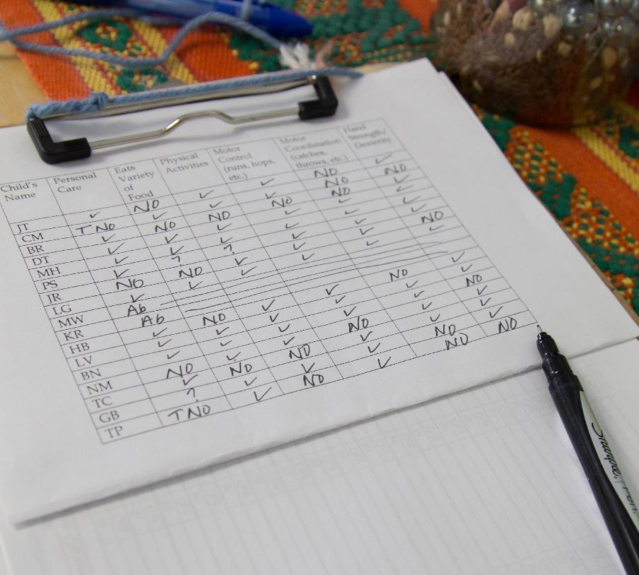
Alternative Approaches
If no appropriate instruments are available in a child’s home language, early learning professionals may want to:
Observe the child using a general developmental checklist.
Find an interpreter who understands early language development in the child’s home language.
Notes:
If no appropriate instrument is available in a child’s home language, early childhood professionals may need to observe the child with the help of a general developmental checklist. This option is a possibility if educators are not required by their program to use a particular assessment tool with children who are dual language learners.
Educators can also use an interpreter who is knowledgeable about early development and fluent in the child’s home language. It’s important to realize that languages differ greatly in grammatical constructions once children are putting three or more words together.
Educators can also use standardized assessments as one piece of data but should not score them if they are not valid and reliable for children who are dual language learners.
REFERENCE
Scheffner Hammer, C. (2012). Dual language learners’ language development: A range of possibilities (Young Exceptional Children Monograph Series No. 14). In R. M. Santos, G. A. Cheatham, & L. Durán (Eds.), Supporting young children who are dual language learners with or at-risk for disabilities (pp. 1-5). Missoula, MT: The Division for Early Childhood.

Slide 46
Inviting Families to Share
Ask families of children who are dual language learners about their children’s:
Language background in all languages
Dual language development
Language dominance
Home language experiences
Notes:
Information from families can be particularly important as part of multiple ongoing assessment methods for children learning more than one language, especially since assessment measures are not always available in children’s home languages. With the help of interpreters, if necessary, families can share information about children’s language abilities.
Educators can gather information about children’s language development in four areas:
Language background in all languages to which they have exposure
Their language development in more than one language, such as sequential or simultaneous
Language dominance
Home language experiences
The document Gathering and Using Language Information that Families Share gives more detailed questions that educators can ask families as part of the ongoing assessment process.
REFERENCES
Espinosa, L. (2010). Getting it right for young children from diverse backgrounds. Upper Saddle River, NJ: Pearson Education.
U.S. Department of Health and Human Services, Administration for Children and Families, Office of Head Start, the National Center on Cultural and Linguistic Responsiveness. (n.d.) Gathering and using language information that families share. https://eclkc.ohs.acf.hhs.gov/sites/default/files/pdf/gathering-using-language-info-families-share.pdf

Slide 47
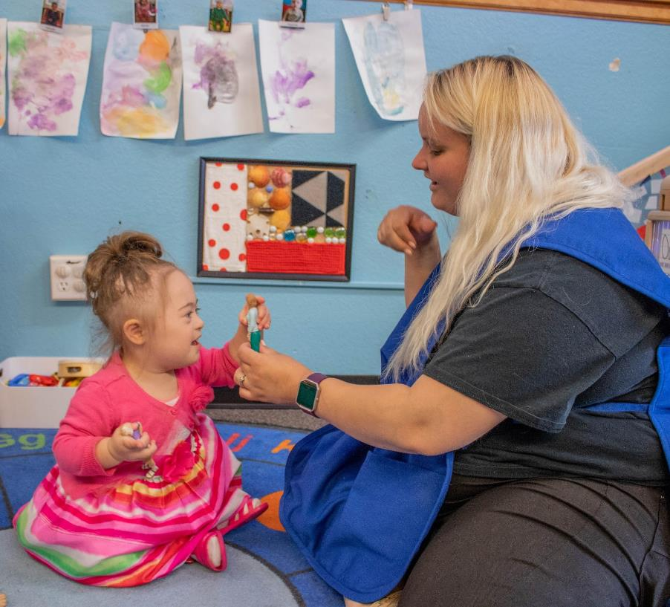
Assessing Children With Disabilities or Suspected Delays
IEPs and IFSPs
Ongoing assessment and typical routines
Teamwork with families and specialists
Evaluation
Image credit: EarlyEdU
Notes:
An important purpose of ongoing assessment is to help educators implement teaching plans and practices that support all children, including those with disabilities or suspected delays, in progressing toward goals.
Early learning professionals may monitor the progress of children with disabilities toward goals in an Individualized Family Service Plan (IFSP) or Individualized Education Program (IEP). IFSP and IEP plans guide services to help children with disabilities progress and learn. In most states, preschool children receive special education services through IEPs, while children ages 3 and younger receive early intervention services through IFSPs. An IEP focuses on the educational needs of the child, while an IFSP focuses on the child and family and the services necessary to support the child’s development.
In this section, participants will learn about issues unique to tracking the progress and development of young children with disabilities or suspected delays. Educators should also monitor the progress of children with disabilities through ongoing assessment in typical routines and environments, just like the way they monitor the progress of typically developing children.
Educators should work as a team with families and specialists, such as those providing behavior support and speech and physical therapy, to support the progress of children toward goals.
In general, the term assessment (as opposed to ongoing assessment, or authentic assessment), when referring to young children with disabilities or suspected delays, describes gathering materials to prepare for an evaluation. Evaluation is the process of stating concerns, gathering information, and deciding on any next steps regarding special services or early intervention services. For Part C programs that support infants and toddlers and Part B programs that support pre-K, these terms may have different meanings as defined in Individuals with Disabilities Education Act (IDEA) (2004).
REFERENCES
Division of Early Childhood (DEC) of the Council for Exceptional Children. (2007). Promoting positive outcomes for children with disabilities: Recommendations for curriculum, assessment, and program evaluation. Missoula, MT: DEC. https://www.naeyc.org/files/naeyc/file/positions/PrmtgPositiveOutcomes.pdf
Pacer Center. (2011) What is the difference between an IFSP and an IEP? Action Information Sheets. http://www.pacer.org/parent/php/PHP-c59.pdf

Slide 48
Video Intro: Assessing Children with Disabilities
Think about these questions while watching the video:
What is the same when assessing children with disabilities and those who are typically developing?
What can be different?
Notes:
This video highlights steps to ongoing assessment of children with disabilities. It also includes working with specialists. The video is titled assessing children with disabilities, but all information is applicable to supporting a children with suspected delays as well.
While watching the next video, ask participants to think about the questions:
What is the same when assessing children with disabilities and those who are typically developing?
What can be different?

Slide 49
Video: Assessing Children with Disabilities
Video: Assessing Children with Disabilities
Notes:
This video Assessing Children with Disabilities is 2 minutes, 8 seconds long. It features educators talking about their approaches to assessing children with disabilities.

Slide 50
Video Debrief: Assessing Children with Disabilities
Share your responses to the questions:
What is the same when assessing children with disabilities and those who are typically developing?
What can be different?
Notes:
Ask participants to share their responses to the questions:
What is the same when assessing children with disabilities and those who are typically developing?
What can be different?
Participants may say that with both groups—children who have disabilities and those who are typically developing—educators:
Track progress.
Use the information to inform their teaching.
Share information with families.
Possible differences are that when educators are assessing the progress of children with disabilities, they may:
Share and collaborate with specialists.
Do more planning, such as breaking down annual goals into smaller steps.
Collect data more frequently.

Slide 51
Practices to Engage Families
In partnering with families of children with disabilities or suspected delays for ongoing assessment, use the same basic practices as with all families:
Respond to each family as unique
Encourage two-way, equal communication
Notes:
When early learning professionals partner with families of children with disabilities or suspected delays, the same basic principles apply as with all families. Educators and others on the individual plan team should:
Respond to each family as unique. Families will vary in areas like values, passions, perspectives on child rearing, and goals for their children.
Encourage two-way, equal communication where families feel encouraged to share concerns, information, and ideas. Communication should be clear and open.
Educators should also use strengths-based attitudes and relationship-based practices.
REFERENCES
Grisham-Brown, J., & Pretti-Frontczak, K. (2011). Assessing young children in inclusive settings. Baltimore, MD: Paul H. Brookes Publishing.
U.S. Department of Health and Human Services, Administration for Children and Families, Office of Head Start, National Center on Parent, Family, and Community Engagement. (n.d.). Building partnerships: Guide to developing relationships with families. https://eclkc.ohs.acf.hhs.gov/family-engagement/developing-relationships-families/building-partnerships-guide-developing

Slide 52
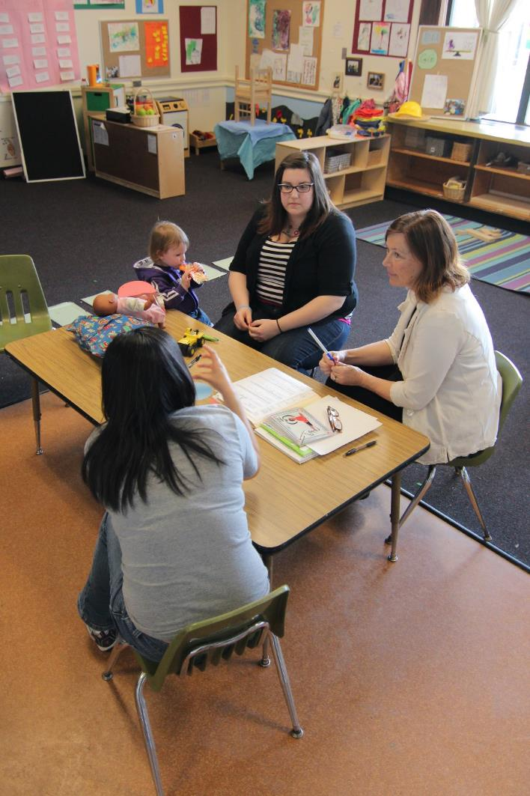
Families as Partners
Families should be equal and contributing partners throughout the assessment process, including progress monitoring, of children with disabilities.
Image credit: EarlyEdU
Notes:
The role of families in the assessment of all young children is important, as identified by the 2003 position statement by the National Association for the Education of Young Children (NAEYC) and the National Association of Early Childhood Specialists in State Departments of Education (NAECS/SDE). The family role is of even greater importance when educators are assessing the progress of children with disabilities.
In integrated assessment teams, families are equal partners in a family- and child-centered process. The team must design the assessment process to include families at each step and consider family preferences, values, needs, languages, and culture. The role of family members as children’s most significant teacher is firmly established in early childhood education, early intervention, and special education fields.
REFERENCES
Division for Early Childhood (DEC) of the Council for Exceptional Children. (2007). Promoting positive outcomes for children with disabilities: Recommendations for curriculum, assessment, and program evaluation. Missoula, MT: DEC. https://www.naeyc.org/files/naeyc/file/positions/PrmtgPositiveOutcomes.pdf
Grisham-Brown, J., & Pretti-Frontczak, K. (2011). Assessing young children in inclusive settings. Baltimore, MD: Paul H. Brookes Publishing.
National Association for the Education of Young Children, National Association of Early Childhood Specialists in State Departments of Education. Early childhood curriculum, assessment, and program evaluation: Building an effective, accountable system in programs for children birth through age 8. https://www.naeyc.org/files/naeyc/file/positions/pscape.pdf

Slide 53
Discussion: Families and Assessment
What does family engagement mean?
What prevents educators from fully engaging as partners with families in the assessment process?
Notes:
Pose the questions:
Broadening our focus to families of all children we work with, what does family engagement mean?
What prevents educators from fully engaging as partners with families in the assessment process?
Lead a short discussion.
One description of family engagement comes from Head Start and Early Head Start (2018): Participants should describe family engagement as building relationships with families that support family well-being, the relationships between children and parents, and the growth of both children and parents.
Responses to the second question will depend on participants’ experiences and views. Possible answers include:
Attitudes that convey that early childhood educators are professionals who are educated on caring for and teaching young children while parents are not.
Lack of attempts to understand the perspectives of families from cultures different than the educators’ or program staff.
Not creating enough time to talk with families on a regular basis.
REFERENCE
U.S. Department of Health and Human Services, Administration for Children and Families, Office of Head Start, the National Center for Parent, Family and Community Engagement. (2011). The Head Start parent, family, and community engagement framework: Promoting family engagement and school readiness from prenatal to age 8. https://eclkc.ohs.acf.hhs.gov/hslc/tta-system/family/docs/ncpfce-assessment-101411.pdf

Slide 54
Video Intro: Partnering with Families
While watching the next video, listen to what early childhood professionals share about how they communicate with families about assessment information.
Notes:
Ask participants to consider this question while watching the next video: What do early childhood educators share about how they communicate assessment information to families?

Slide 55
Video: Partnering with Families
Video: Partnering with Families
Notes:
This slide contains the video Partnering with Families. It is approximately 5 minutes long.
In this 5-minute video, a narrator describes ways to partner with families around ongoing assessment. Brief teacher interviews and video clips show how teachers connect with families and share assessment data both formally and informally. At 2:10, gathering information is discussed. At 2:57, ways of sharing observations with families are discussed. At 3:44, ways to truly partner with families are covered, including listening, working together, organizing data, supporting the family, and being positive.

Slide 56
Video Debrief: Partnering with Families
Share what you heard educators say about strategies they use in sharing assessment information with parents.
Notes:
Ask participants to share what they heard educators say about strategies they use in sharing ongoing assessment information with parents.
Participants may respond that they heard early childhood educators and administrators say they:
Share portfolios, observations, and children’s progress with families.
Ask parents questions about their observations of their children at home.
Discuss with parents, ways that educators and parents can work together on children’s goals.
Prioritize parent-educator partnerships and emphasize that parents are their children’s primary teachers.

Slide 57
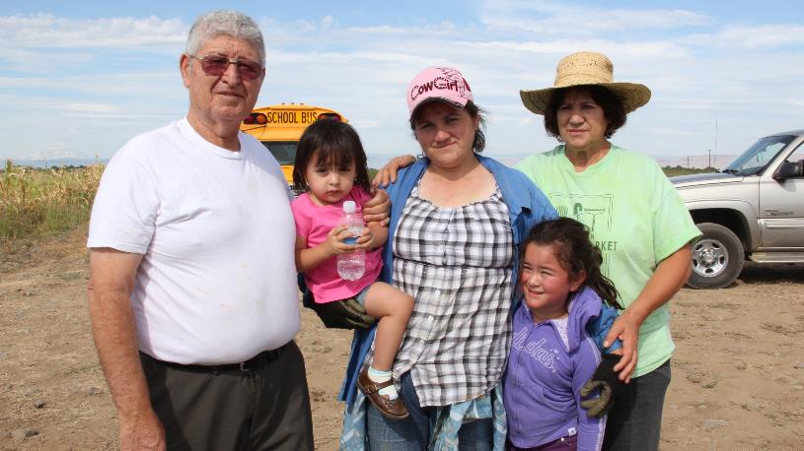
Discussion: Your Approaches
How do you invite families to share information about their children’s abilities, development, and interests?
Image credit: EarlyEdU
Notes:
Materials: Handout, Gathering and Using Information Families Share
This discussion topic is for participants to talk about ways they may already be gathering information about children from families.
Typical times that early childhood educators may gather information include conversations during home visits, scheduled conferences, and informal conferences. Many programs also ask families to fill out questionnaires describing their children’s development, skills, preferences, and behavior.
You may want to highlight some core ideas for treating parents as equal partners, such as starting with the family’s perspectives, listening and remaining open to their ideas, and supporting parent competence.
You can use the handout, Gathering and Using Language Information Families Share as a reference for this discussion.
REFERENCE
U.S. Department of Health and Human Services, Administration for Children and Families, Office of Head Start, National Center on Parent, Family, and Community Engagement. (2011). Family engagement and ongoing child assessment. https://eclkc.ohs.acf.hhs.gov/sites/default/files/pdf/family-engagement-ongoing-child-assessment-eng.pdf
U.S. Department of Health and Human Services, Administration for Children and Families, Office of Head Start, the National Center on Cultural and Linguistic Responsiveness. (n.d.) Gathering and using language information that families share. https://eclkc.ohs.acf.hhs.gov/sites/default/files/pdf/gathering-using-language-info-families-share.pdf

Slide 58
Video Intro: Assessment Planning
Think about these questions while watching the next video:
What are some strategies that these educators share about planning to assess?
What helps them succeed?
Notes:
Think about these questions while watching the next video:
What are some strategies that these educators share about planning to assess?
What helps them succeed?

Slide 59
Video: Assessment Planning
Video: Assessment Planning
Notes:
This slide contains the video Assessment Planning. This video is 6 minutes, 32 seconds long.

Slide 60
Video Debrief: Assessment Planning
What are some strategies that these educators share about planning to assess?
What helps them succeed?
Notes:
Ask participants to respond to these questions:
What are some strategies that these educators share about planning to assess?
What helps them succeed?
Educators say that they:
Start assessment planning in the summer (or before the new program cycle starts). This will be a tentative plan that will change as educators learn children’s skills and interests.
Make time to reflect.
Consider individual goals and group approaches.
Other elements that speakers mention that help them plan for assessment are:
Make assessment part of the program culture.
Embed assessment goals into lesson plans.
Think about all the domains.
Make changes as teaching staff observes children’s skills and interests.
Plan a variety of activities for children to learn skills.
Assess several areas at once, if possible.
Participants may have other points that they heard educators express in the video.

Slide 61
Activity: Mind Map
Divide into small groups.
Create a mind map on the poster-sized paper based on the handout.
Brainstorm answers to each question.
Be ready to share with the larger group.
Notes:
Materials: Mind Map handout, poster-sized paper, pens
Ask participants to divide into small groups. Have them create a mind map on their poster-sized paper based on the one in the handout.
Have each group answer the questions:
When thinking about all the tasks involved in ongoing child assessment, what aspects do you feel you know and can do?
What are areas where you know you need more support, learning, or experience for growth?
What are your goals for growth?
What would help you achieve your goals in this area?
Give each group about 10-15 minutes to write their responses. Ask groups to share the highlights and note patterns among the groups.
This activity can be a starting point for participants to think about what areas of assessment they already do well and which they would like to focus on improving.

Slide 62
Video Intro: Using Data to Celebrate
The next video will feature early childhood educators talking about how data helps them see children’s progress and support their learning and development.
Notes:
This module has covered many topics around ongoing assessment, from effective observation and documentation practices to sharing information with families. Data from ongoing assessment shows educators and families a picture of a child’s development and can be used to celebrate it!
The next video will feature early childhood educators talking about how data from ongoing assessment helps them see children’s progress and support their learning and development.

Slide 63
Video: Using Data to Celebrate
Video: Using Data to Celebrate
Notes:
The video Using Data to Celebrate is 1 minute, 5 seconds long.

Slide 64
Video Debrief: Using Data to Celebrate
What did you hear educators say about how observing and assessing children fuels their passion for their work with young children?
Notes:
Ask participants to think about the question: What did you hear educators say about how observing and assessing children fuels their passion for their work with young children?
Participants can think about this question independently. In a reflection activity on the next slide, they will have a chance to think about its application to their teaching practice.

Slide 65
Activity: Remember What Led You to This Work
If you were teaching others about the topics in this course, what would you tell them about how to retain their enthusiasm and balance assessment responsibilities?
How will you retain your passion for your work and include effective ongoing assessment practices?
Notes:
Materials: paper and pencils/pens OR chart paper and markers
Ask participants to reflect on what led them to work with young children.
Pose the questions:
If you were teaching others about topics in this module, what would you tell them about how to retain their enthusiasm for their work with young children and balance assessment responsibilities?
How will you retain your passion for your work as an early childhood educator and include effective ongoing assessment practices?
Ask participants to write a brief response. Encourage anyone who is comfortable doing so to share their reflection.

Slide 66

Closing Slide
© 2020 University of Washington. All rights reserved.
Notes:
This is the end of the module on Ongoing Child Assessment. For more in-depth information, check out the Child Observation and Assessment course from EarlyEdU Alliance. For a shorter resource, see the 15-minute in-service suite, Ongoing Child Assessment, on the Head Start Early Childhood Learning & Knowledge Center (ECLKC) website.

