Slide 1

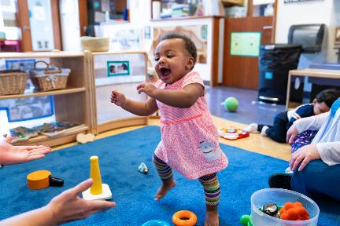
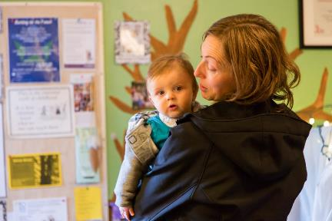
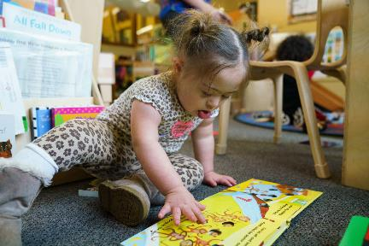
Routines-Based
Assessment and Planning for Infants and Toddlers

Slide 2
Objectives
Define and describe routines-based assessment
and planning
Tell the benefits of routines-based assessment
and planning for infants and toddlers
Describe the steps for implementing routines-
based assessment and planning
2

Slide 3
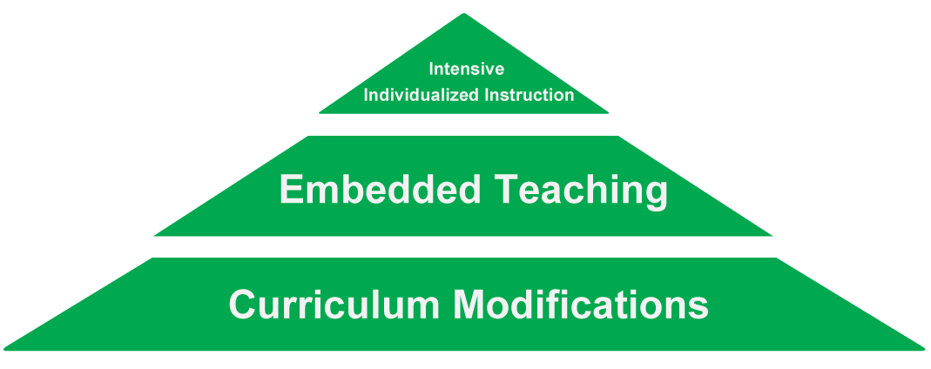
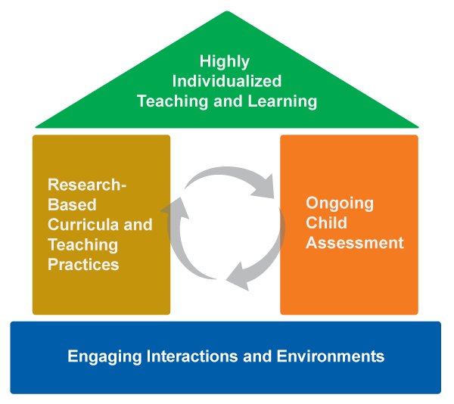
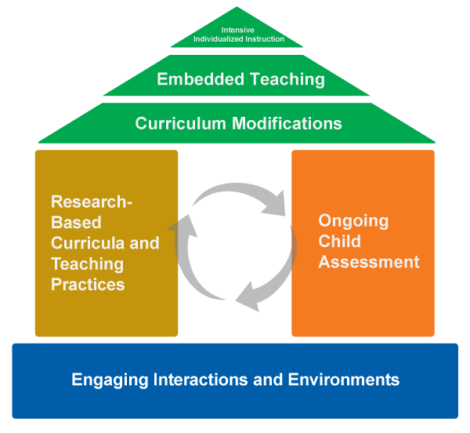
Framework of Effective Practice

Slide 4
What Is Routines-Based Assessment and Planning?
A process for using the typical routines of the day to
identify an individual child’s strengths and needs
AND
A process for using the typical routines of the day as
the context for implementing opportunities for
learning and practice
4

Slide 5
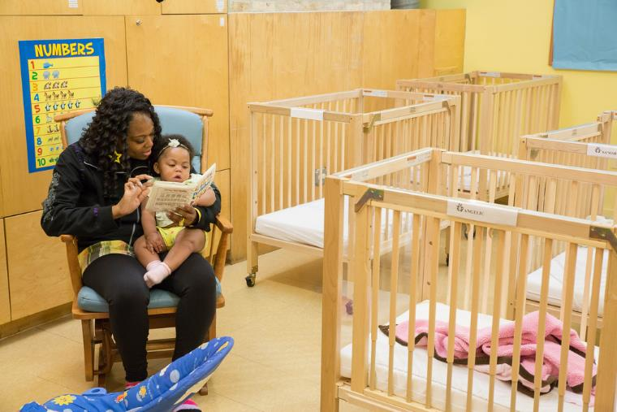
Assessment
Gathering information to make decisions
5

Slide 6
Why Use Routines-Based
Assessment and Planning?
See child in authentic situations and environments
Focus on functional goals and objectives (relevant, worthwhile, socially meaningful, etc.)
Give a complete picture of the child
6

Slide 7
DEC Recommended Practices
Assessment Practice 7. Practitioners obtain information about the child’s skills in daily activities, routines, and environments such as home, center, and community.
Environment Practice 1. Practitioners provide services and supports in natural and inclusive environments during daily routines and activities to promote the child’s access to and participation in learning experiences.
Instruction Practice 5. Practitioners embed instruction within and across routines, activities, and environments to provide contextually relevant learning opportunities.
7

Slide 8
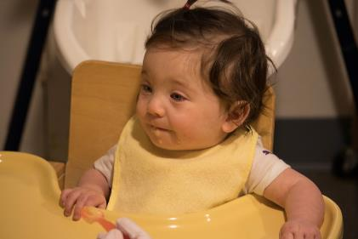
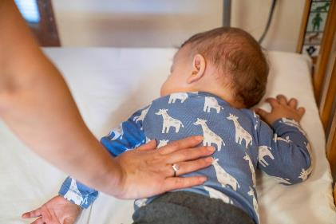
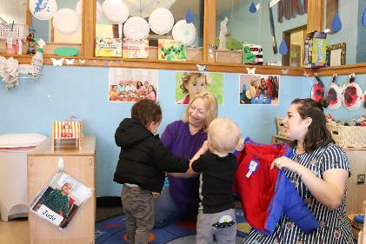
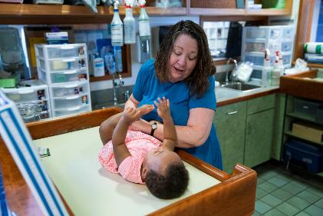
What Does Routines-Based
Assessment Look Like?
8

Slide 9
How To Use Routines-Based
Assessment and Planning
Assess the learning environment
Gather information about the individual child
Assess the child’s learning needs in typical routines
Clarify and prioritize current concerns for the child
Create a plan
Use an activity matrix
Implement the plan
Evaluate the plan and monitor child progress
9

Slide 10
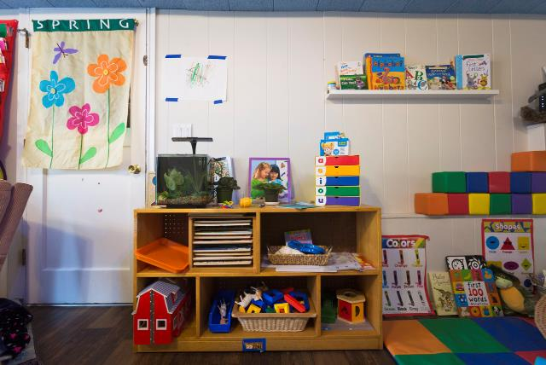
Assess the Learning Environment
Responsive caregiving
High quality child and adult interactions
Predictable routines
Measurement Tools:
  Infant/Toddler Environment Rating Scale (ITERS)
  Family Child Care Environmental Rating Scale (FCCERS)
10

Slide 11
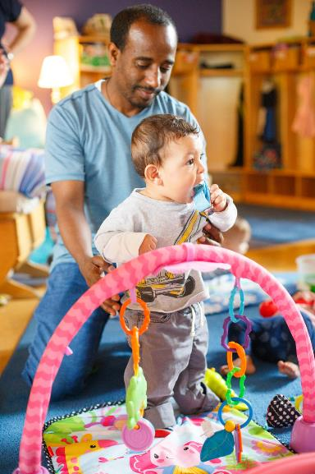
Gather Information on Individual
Goals and Objectives
Individual plan
  such as: Individualized Family Service Plan (IFSP), behavior support plan
Curriculum-referenced assessment
Family priorities
Observations
11

Slide 12

Assess Learning Needs of the Child Within Routines
12

Slide 13
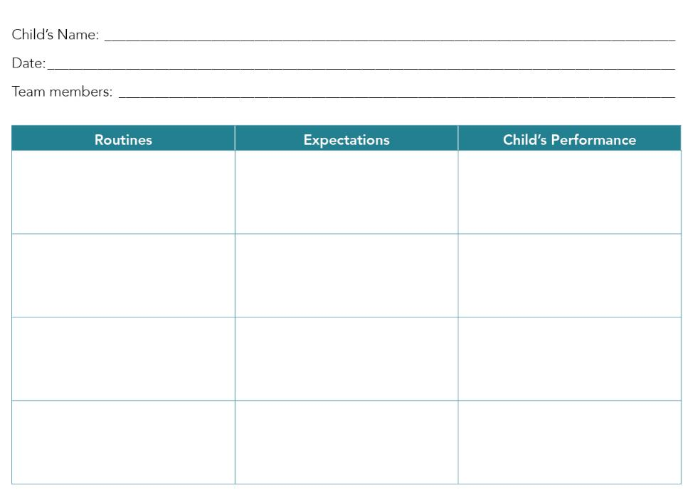
Routines-Based Assessment
13

Slide 14
Routines-Based Interview
Interviewer prepares the family
Family members report on their routines
Interviewer reviews concerns and strengths
Family selects goals/objectives
Family puts goals/objectives into priority order
(McWilliam, 2010)
14

Slide 15
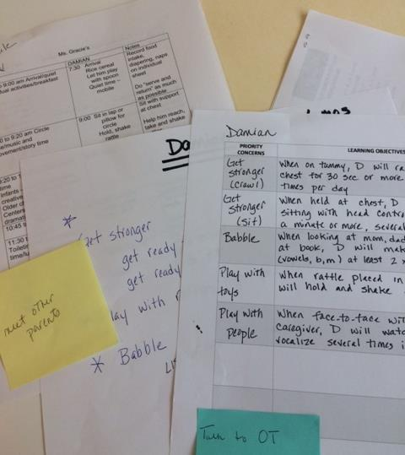
Clarify and Prioritize
15

Slide 16
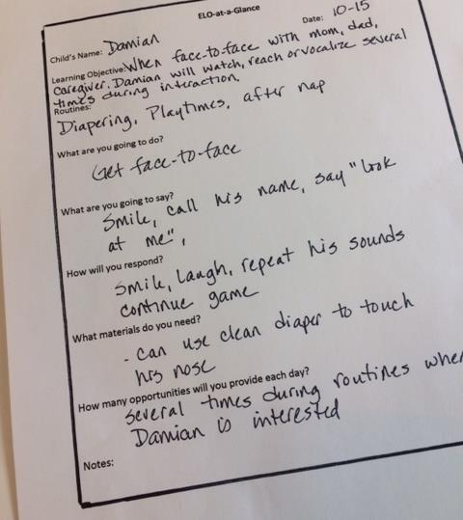
Create a Plan
16

Slide 17
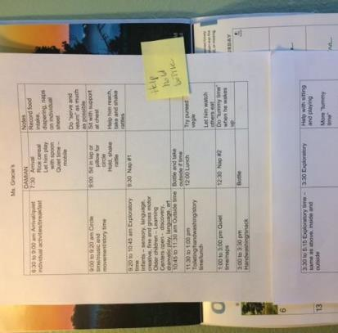
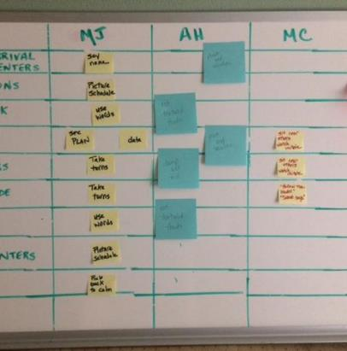
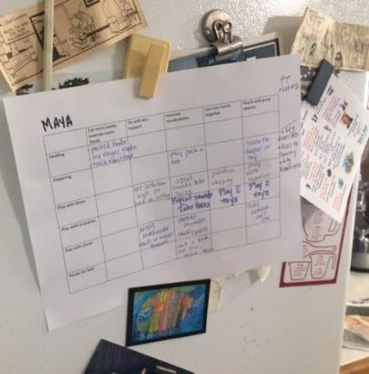
Use an Activity Matrix
17

Slide 18
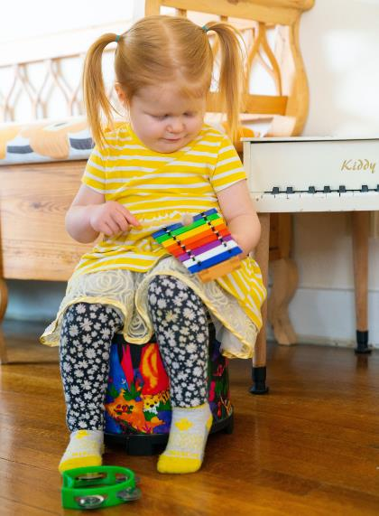
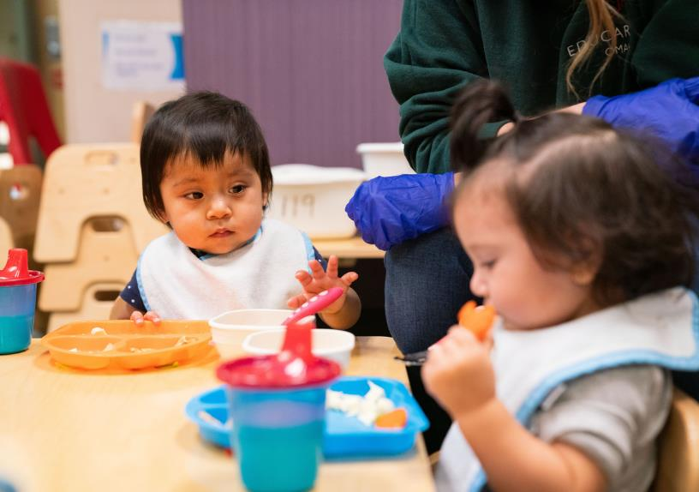
Implement the Plan
18

Slide 19
Evaluate the Plan and Monitor
Progress
19

Slide 20
Review
Define and describe routines-based assessment and planning
Tell the benefits of routines-based assessment and planning for infants and toddlers
Describe the steps for implementing routines-based assessment and planning
20

Slide 21

Thank you!
Thank you for your time and attention today
See the Early Childhood Learning and Knowledge (ECLKC) website for more resources https://eclkc.ohs.acf.hhs.gov
July/2020
21

