Slide 1
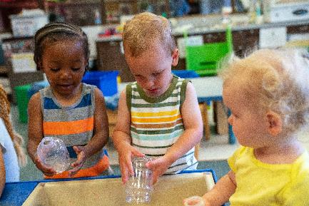
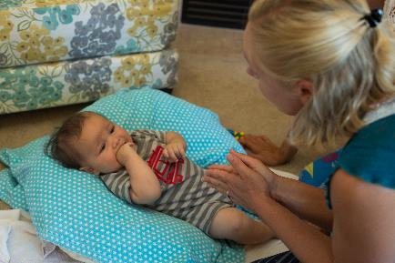
Embedded Learning Opportunities for Infants and Toddlers

Slide 2
Objectives
Define embedded learning opportunities (ELOs)
Understand the what, when and how of ELOs
Create and implement plans for ELOs
2

Slide 3
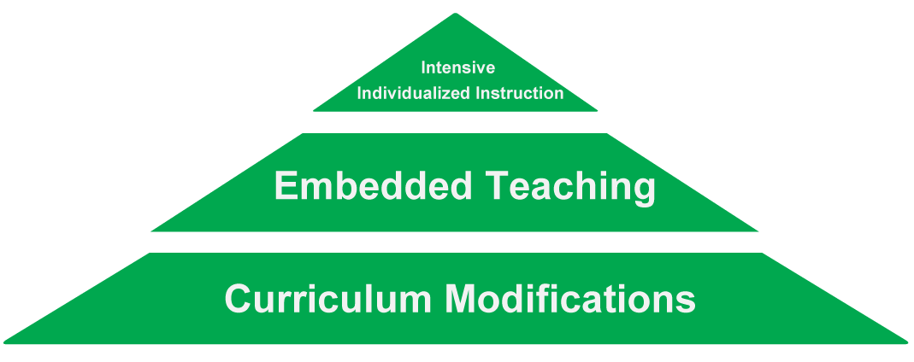
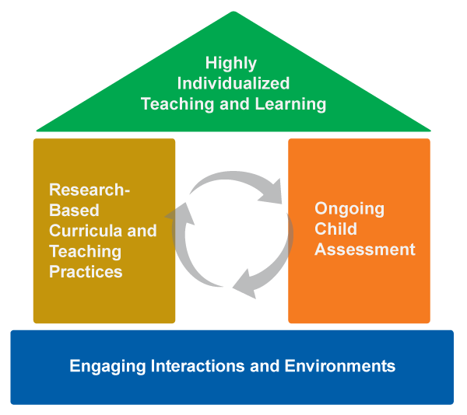
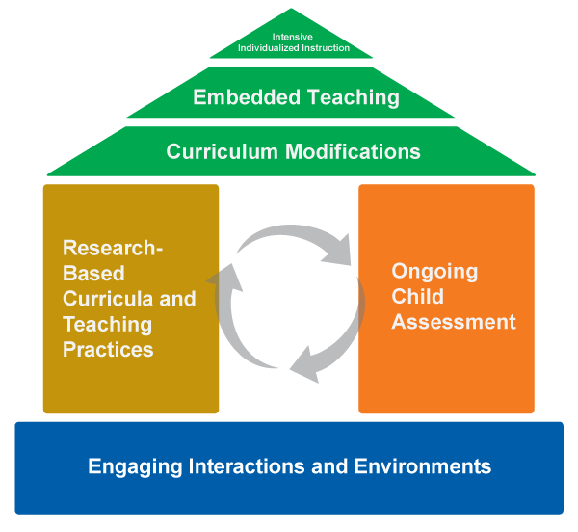
Framework of Effective Practice

Slide 4
Case Studies
PJ – Home-Based Setting
9 months old
Hani – Family Child Care – 18 months old
Santino – Child Care Center
2 ½ year old
4

Slide 5
Case Studies
PJ – Home-Based Setting
9 months old
Learning Objective: will turn his head when his name is called
Hani – Family Child Care
18 months old
Learning Objective: will bring spoon with textured food to mouth and eat
Santino – Child Care Center
2 ½ year old
Learning Objective: will take turns with peers during play times
5
Notes:
NOTE TO DESIGN
Insert photos of infants/toddlers engaged in activities similar to examples in notes and activities.

Slide 6
Embedded Learning Opportunities
Definition
Short, planned interactions that provide opportunities for learning priority learning objectives
Occur within ongoing activities, routines and transitions
DEC Recommended Practice
INS5: Practitioners embed instruction within and across routines, activities, and environments to provide contextually relevant learning opportunities.
6

Slide 7
Benefits of Embedded Learning Opportunities
Take advantage of existing routines and authentic activities
Maximize motivation by following the child’s interests
Highlight functional skills
Enhance generalization
7

Slide 8
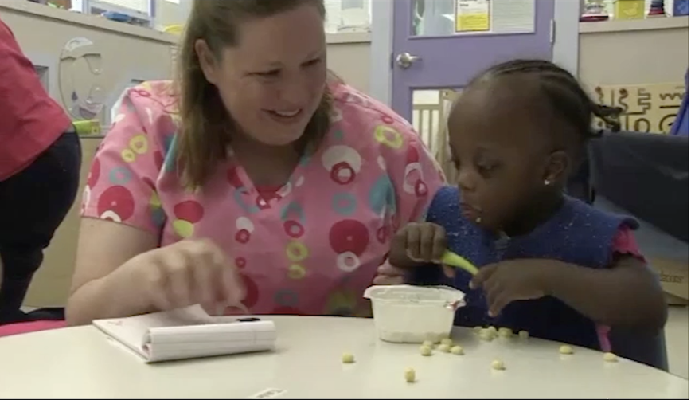
Video Example 1
8

Slide 9
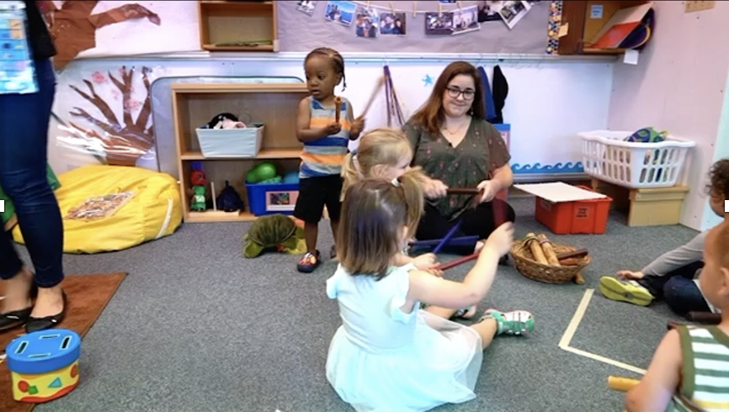
Video Example 2
9

Slide 10
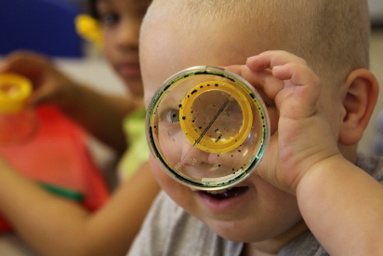
Embedded Learning Opportunities
WHAT
WHY
WHEN
10
Notes:
DESIGN
Add 3 photos

Slide 11
Embedded Learning Opportunities
What to teach: high-priority individual learning objectives
When to teach: during activities, routines, and transitions
How to teach: complete teaching loops
11

Slide 12
What to Teach
High-priority learning objectives
Individualized Family Service Plan (IFSP) goals
Individual Learning Plan objectives
Family priorities and concerns
Routines-Based Assessment objectives
12

Slide 13
When to Teach
Activities
Routines
Transitions
13

Slide 14
How to Teach
Clarify the learning objective
Document child’s current performance
Design the teaching interaction
Leverage the child’s interest
Determine what you will say or do
Decide on materials
Plan how you will respond
Keep track of opportunities
Document child’s learning and progress
14

Slide 15
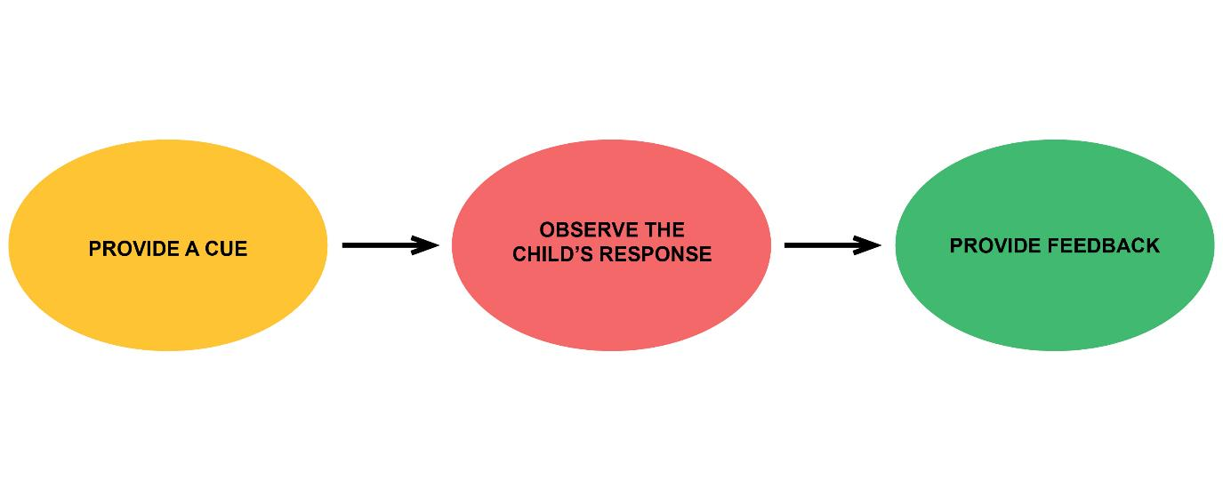
ELO Graphic
15

Slide 16
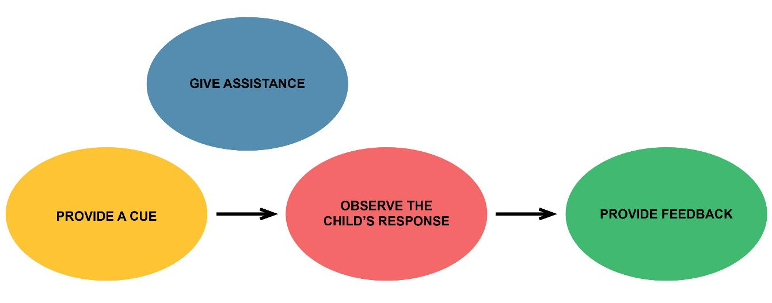
ELO Graphic
16

Slide 17
ELOs-at-a-Glance
17

Slide 18
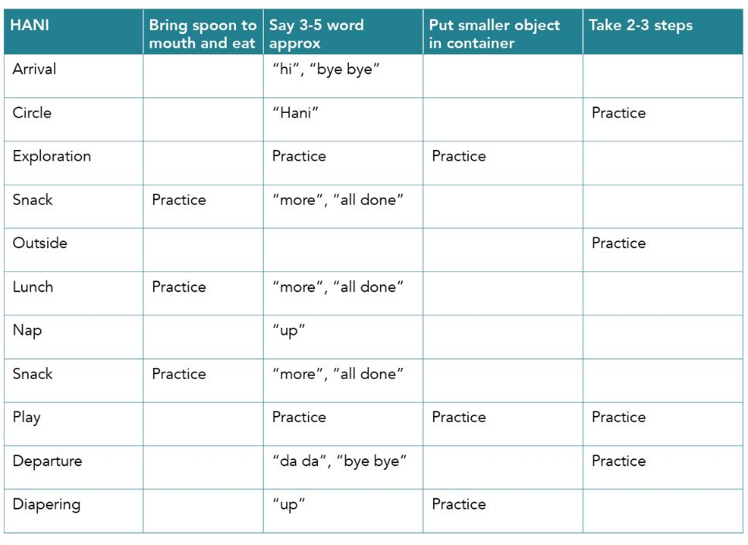
ELOs and the Activity Matrix
18

Slide 19
Case Study: Monitor Progress
19

Slide 20
Review
Define embedded learning opportunities (ELOs)
Understand the what, when and how of ELOs
Learn ways to plan for ELOs
20

Slide 21
Thank you!
Thank you for your time and attention today
See the Early Childhood Learning and Knowledge Center website for more resources:
https://eclkc.ohs.acf.hhs.gov
June/2020
21

