Slide 1
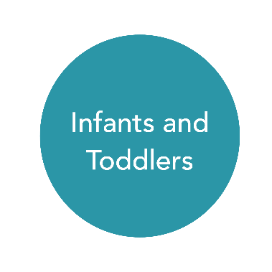
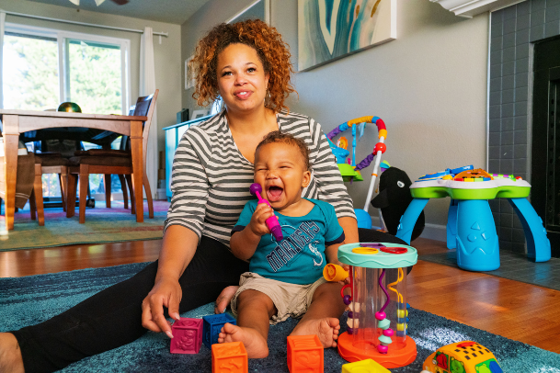
Activity Matrix for Infants and Toddlers

Slide 2
Objectives
Describe the uses and benefits of the activity matrix.
Practice creating and using an activity matrix for home- based, family child care, and center-based programs.
2

Slide 3
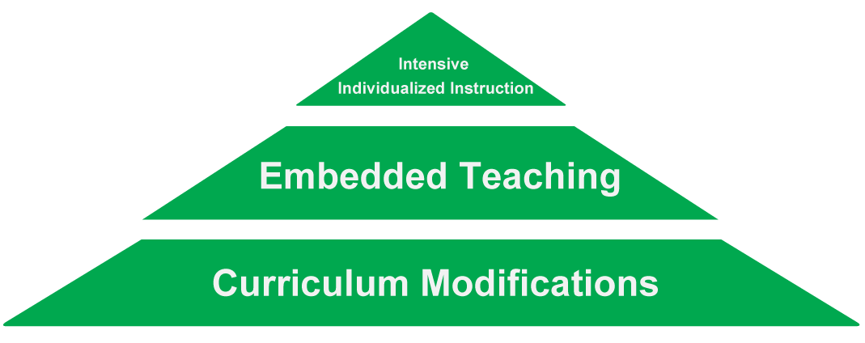
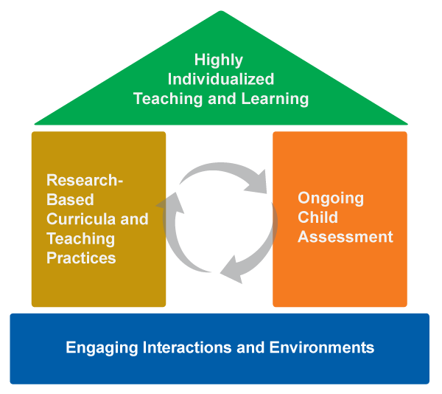
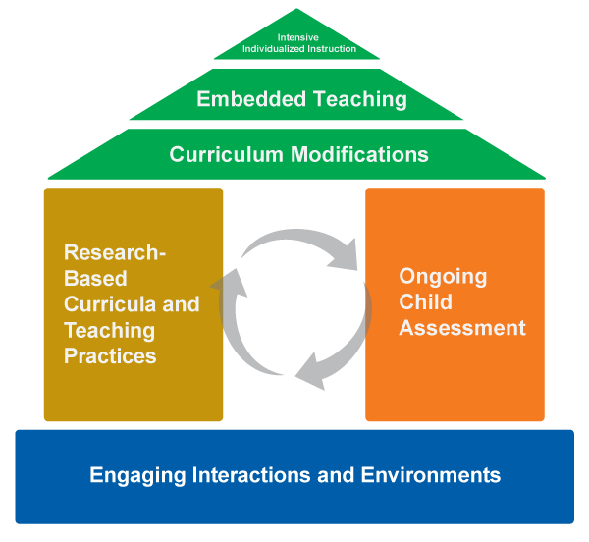
Framework for Effective Practice

Slide 4
What is an Activity Matrix?
The Activity Matrix is a tool for activity:
Planning
Organization
Implementation
4

Slide 5
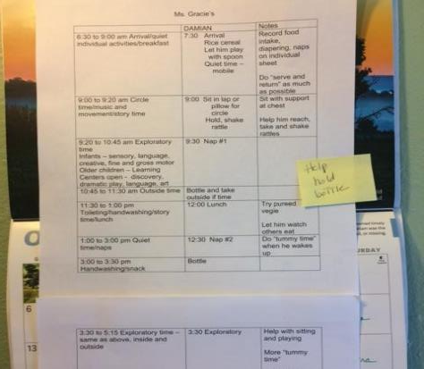
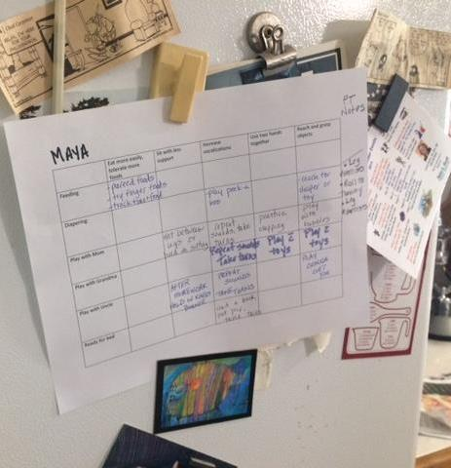
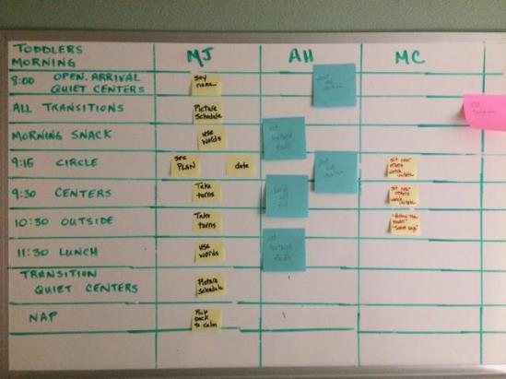
Activity Matrix Examples
5

Slide 6
What are the Benefits?
Organize teaching and learning.
Maximize learning time within naturally occurring activities, routines, and transitions.
Support educator awareness of individual child objectives and learning opportunities.
Match child’s learning objectives with activities, routines, and transitions.
6

Slide 7
Steps to Create an Activity Matrix
Gather or organize the child’s individual learning objectives.
Identify the general schedule of the day, including typical routines.
Select preferred daily activities, routines, and transitions — individualized for the child and the family.
Incorporate individual learning objectives within daily activities, routines, and transitions.
Build upon natural strategies used by caregivers.
Use the matrix, monitor child progress, and adjust as needed.
7

Slide 8
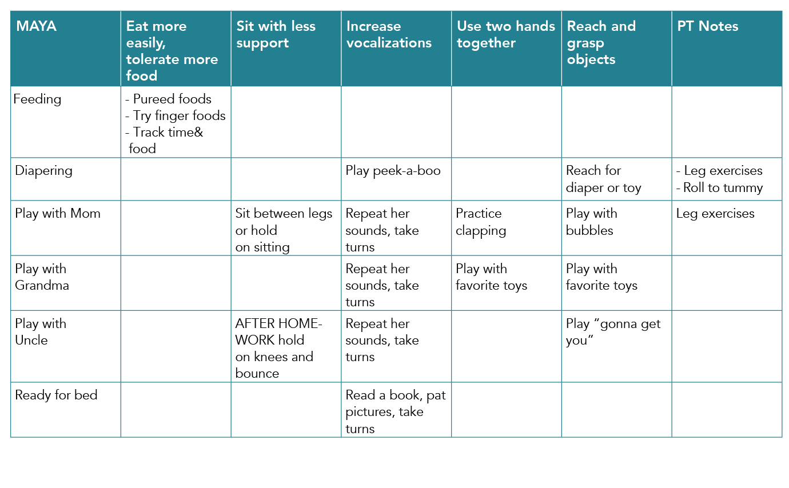
Home-Based Setting Example
8

Slide 9
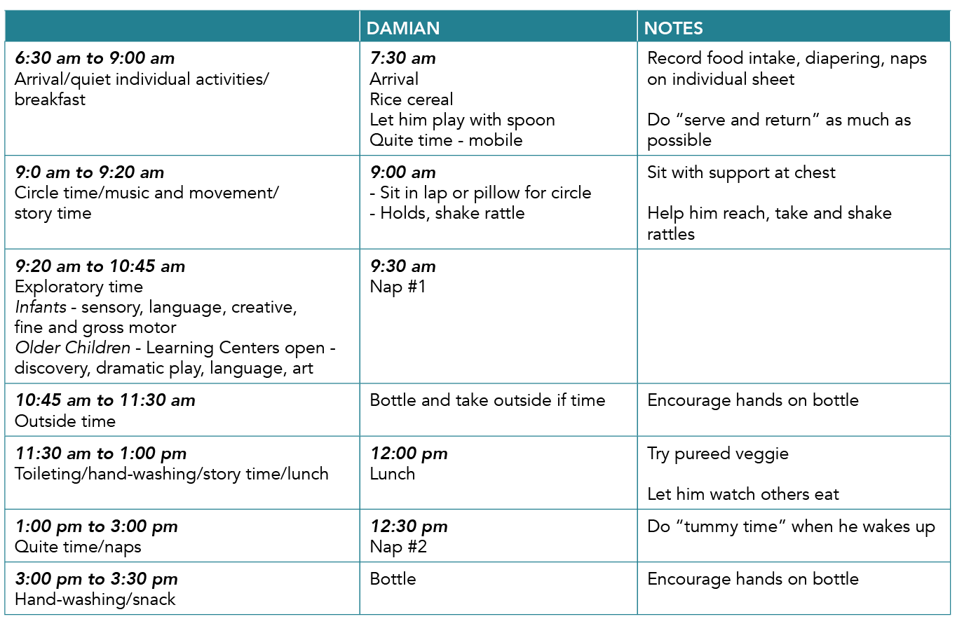
Family Child Care Setting Example
9

Slide 10
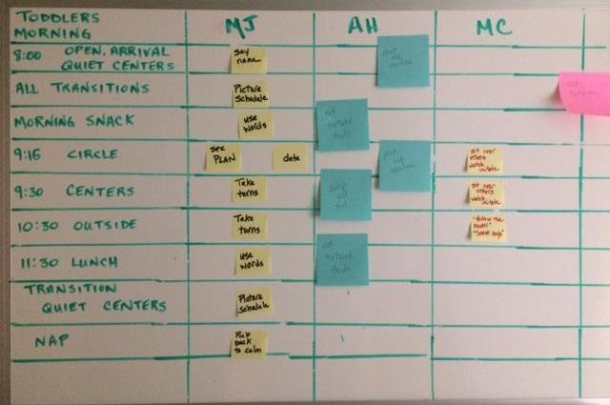
Center-Based Setting Example
10

Slide 11
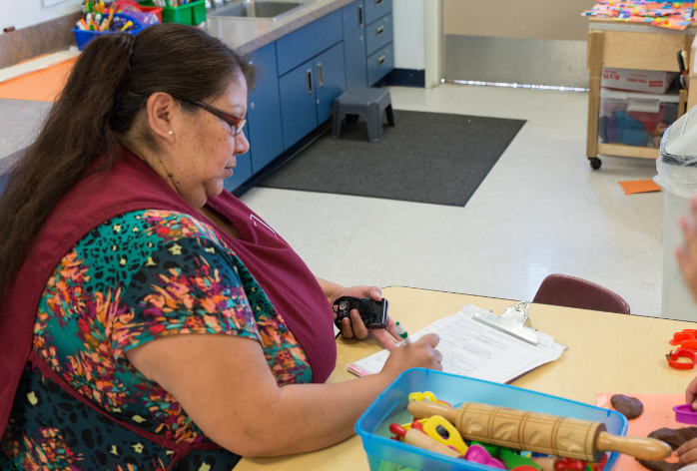
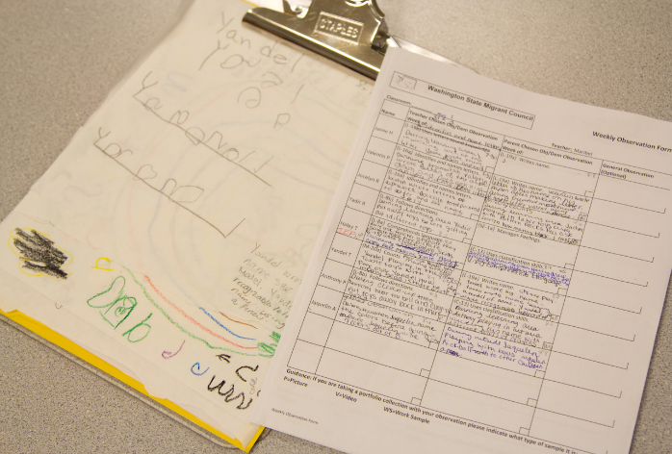
Make Your Own Matrix
11

Slide 12
Getting Started
Start small
One activity or routine
One developmental domain
One child in the group
12

Slide 13
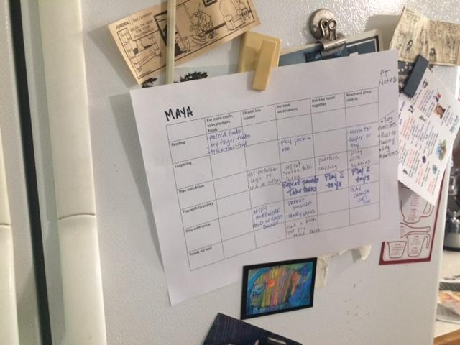
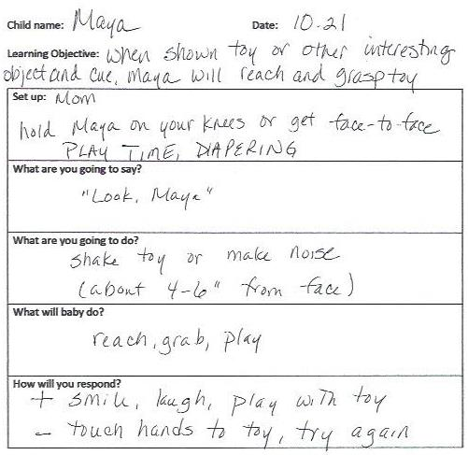
More Tips
13

Slide 14
Review
14

Slide 15
Review: Benefits
Effective way to organize teaching and learning
Maximize learning time within naturally occurring activities, routines, and transitions
Help all educators be aware of individual child objectives and learning opportunities
Match child’s learning objectives with activities, routines, and transitions
15

Slide 16
Thank You!
See the Early Childhood Learning and Knowledge Center (ECLKC) website for more resources: https://eclkc.ohs.acf.hhs.gov
16

