Slide 1
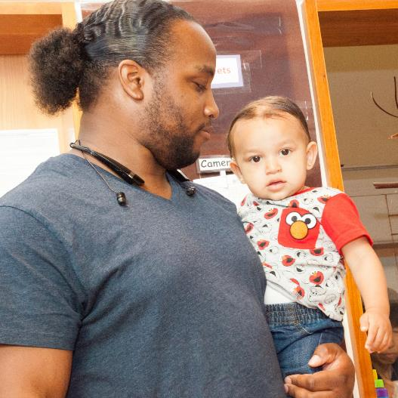

Family Engagement in
Early Care and Education
A Relationship-Based Approach
to Family Engagement

Slide 2
Overview
Understanding family engagement as relationship-based means:
Adopting strengths-based attitudes
with families.
Reflecting on your own perspectives.
Learning about families’ perspectives and funds of knowledge.
Identifying strategies to create a welcoming environment.

Slide 3
By the end of this module, you should be able to:
Describe ways to create a
program-wide, relationship-based culture that supports effective
family engagement.
Identify and reflect on personal values, experiences, ethics,
and biases.
Identify ways to explore with
families their interests, strengths, and priorities.

Slide 4
Engaging All Families: A Strengths-Based Approach

Slide 5
Believing and Doing
What do you believe about parents’ roles in their
children’s development?
How do you demonstrate this?
What would someone observe in your program that communicates these values?

Slide 6
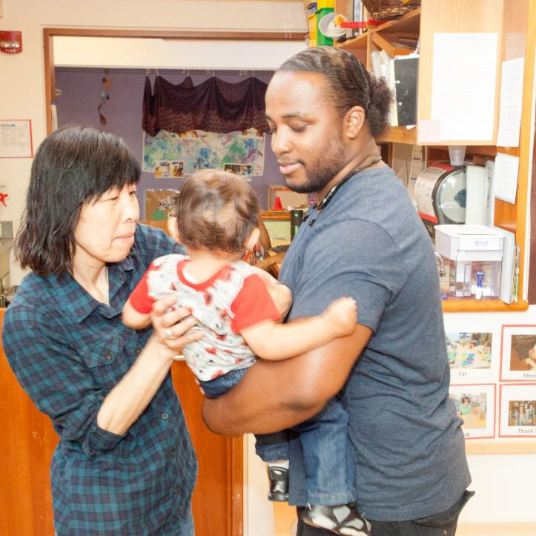
Positive Goal-Oriented Relationships
Based on trust
Formed through repeated interactions between program staff and families
Built over time
    Image credit: EarlyEdU

Slide 7
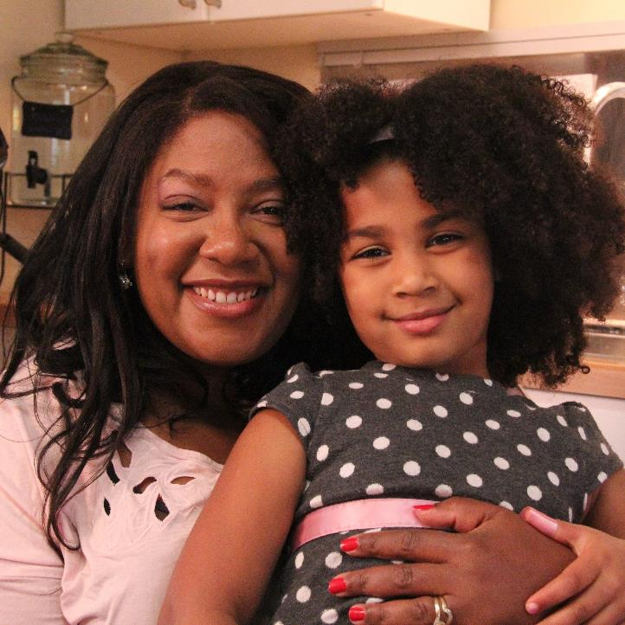
Strong early childhood educator-parent relationships boost parent-child relationships,
which are critical
for children’s
well-being and learning outcomes.
Image credit: EarlyEdU

Slide 8
Results of Family Engagement
Family engagement includes positive relationship qualities—safety, encouragement, trust, mutual respect and caring, and hope—and can lead to educator and family:
Changes in attitude
Increases in motivation
Sense of possibility
Shifts that promote positive family and
child outcomes

Slide 9
Family Engagement Is . . .
Relationship-based
Ongoing
Responsive to the strengths, interests,
and needs of families
Program-wide
Collaborative
Supportive of children’s growth, development, and learning
Important to begin before birth

Slide 10

Image credit: Office of Head Start

Slide 11
Strengths-Based Attitudes
Families:
Are the first and most important teachers of their children.
Are our partners in supporting their children’s development.
Have expertise about their children.
Have something valuable to contribute.

Slide 12
Observing Strengths-Based Attitudes
Think about a time when
you or someone you know
used a strengths-based
attitude with a family.
Which attitude was used?
What did you or someone
else say or do that reflected
that attitude?

Slide 13
Relationship-Based Practices
Describe observations of the child’s behavior to open communication with
the family.
Reflect on the family’s perspective.
Support parental competence.
Focus on the family-child relationship.
Value a family’s passion.
Reflect on your own perspective.

Slide 14
Finley’s Parent-Teacher Conference
Watch this video from the Results Matter Video Library.
What attitudes and practices do you see the educator using to connect with the parent?

Slide 15

VIDEO: Finley’s Parent-Teacher Conference

Slide 16
Video Debrief
The mother has expertise about her daughter, Finley.
The mother has something valuable to contribute.
The mother and early childhood educator share observations about Finley’s behavior at home and in the early learning environment.
The educator supports the mother’s competence.

Slide 17
Benefits of Family Engagement
Recognizes parents’ skills as their child’s nurturer and teacher
Creates a network of support for young children that encourages healthy development and well-being
Improves quality of early childhood programs
Provides stronger community support
to the next generation

Slide 18
Exploring Perspectives and Influences

Slide 19
Think about your own family
and how you were raised.
How were your attitudes, beliefs,
and values about caring for and
guiding young children shaped
by your family?
Have these changed over time?
If so, how?
What caused these
changes or reinforced what you
already thought?

Slide 20

Perspective Taking
Image credit: Office of Head Start

Slide 21
Real to Reel: Exploring Culture and Emotions
Think about these questions while watching the video linked to the
next slide:
How are culture and language represented in your program?
How might knowledge of cultural influences on emotions affect your work with families?
What other aspects of interaction
may be influenced by culture?

Slide 22
VIDEO: Real to Reel: Exploring Culture and Emotions

Slide 23
Video Debrief
How are culture and language represented in your program?
How might knowledge of
cultural influences on emotions affect your work with families?
What other aspects of interaction may be influenced
by culture?

Slide 24
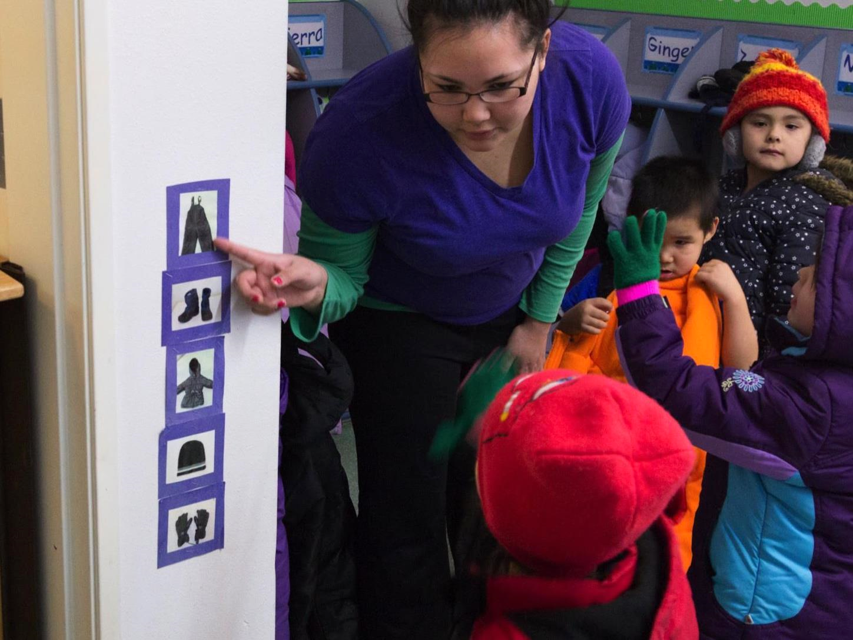
At What Age Should a Child . . .
Image credit: EarlyEdU

Slide 25
Child Development and Culture
Think about your own upbringing, children you know, or experiences you have had, and respond to the prompts on the handout.
Discuss your responses
with a partner.

Slide 26
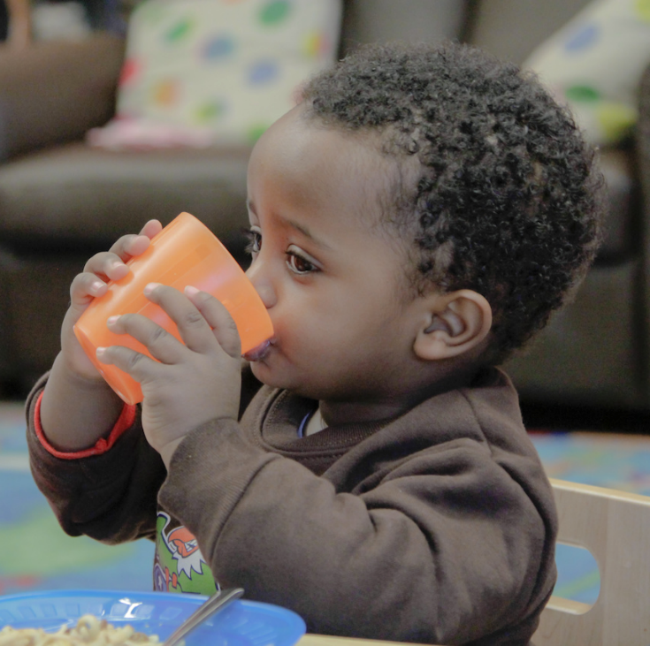
Expectations
There are guideposts
for growth and development:
  Centers for Disease Control and Prevention milestones
  Early learning guidelines
Our expectations for specific behaviors and interaction patterns are influenced by culture.
Image credit: EarlyEdU

Slide 27
Looking at Differences
Consider the expectations that families in your program have for their children’s development. What do you see that is the same? What do you see that is different?
How do families’ styles of talking and interacting with children vary?
How does your program collect and use information about families’ cultures and languages?

Slide 28

Image credit: Office of Head Start

Slide 29
Wondering About Families

Slide 30
Thinking About Families
What do you enjoy most in working with families?
What do you find challenging?

Slide 31
Funds of Knowledge
“Essential cultural practices and bodies of knowledge that are embedded in the daily practices and routines of families”
(Office of Head Start, Early Childhood Learning and Knowledge Center, n.d.)

Slide 32
Identify Funds of Knowledge in the Household
Identify the rich experiences in a
family’s life.
Use what you learn from the families themselves, rather than making use of stereotypes and over-generalizations.
Help children build on what they
already know.

Slide 33
The Power of Reflection
How am I incorporating my children’s and their families’ assets and strengths in my teaching?
How am I taking into consideration the
assets and strengths these families have in
my teaching?
What can I do to improve how I communicate with parents?
What can I do to improve what I do in the classroom that is responsive to their unique lived, cultural, and linguistic experiences?
(Amaro-Jiménez & Semingson. 2011, p.7)

Slide 34
Funds of Knowledge:
In His Own Words
Watch as Dr. Luis Moll
describes the concept funds
of knowledge.

Slide 35
VIDEO: Funds of Knowledge–Luis Moll

Slide 36
Video Debrief
Funds of knowledge are about the knowledge base generated by families depending on their experiences.
Early childhood educators can learn about and use this information to support children’s ongoing learning.

Slide 37
Funds of Knowledge
Form small groups.
Think about funds of knowledge
for you and your family.
Fill in your funds of knowledge on the handout.
Add a new category based on
your culture.
In your small group, share what
you feel comfortable discussing about your funds of knowledge.

Slide 38
Celebrating Culture
As you watch this video, consider the following:
How does this parent describe the impact of the teacher listening and taking time to learn about their family’s strengths and needs?
Identify ways family
experiences are valued in the early learning program.

Slide 39
VIDEO: Celebrating Culture

Slide 40
Video Debrief
Feels “welcomed” and “at ease”
Describes her daughter
feeling proud
“Brightens a child’s eyes” when a teacher learns something unique about a child and family
Describes the motivation
to learn

Slide 41
Welcoming Families

Slide 42
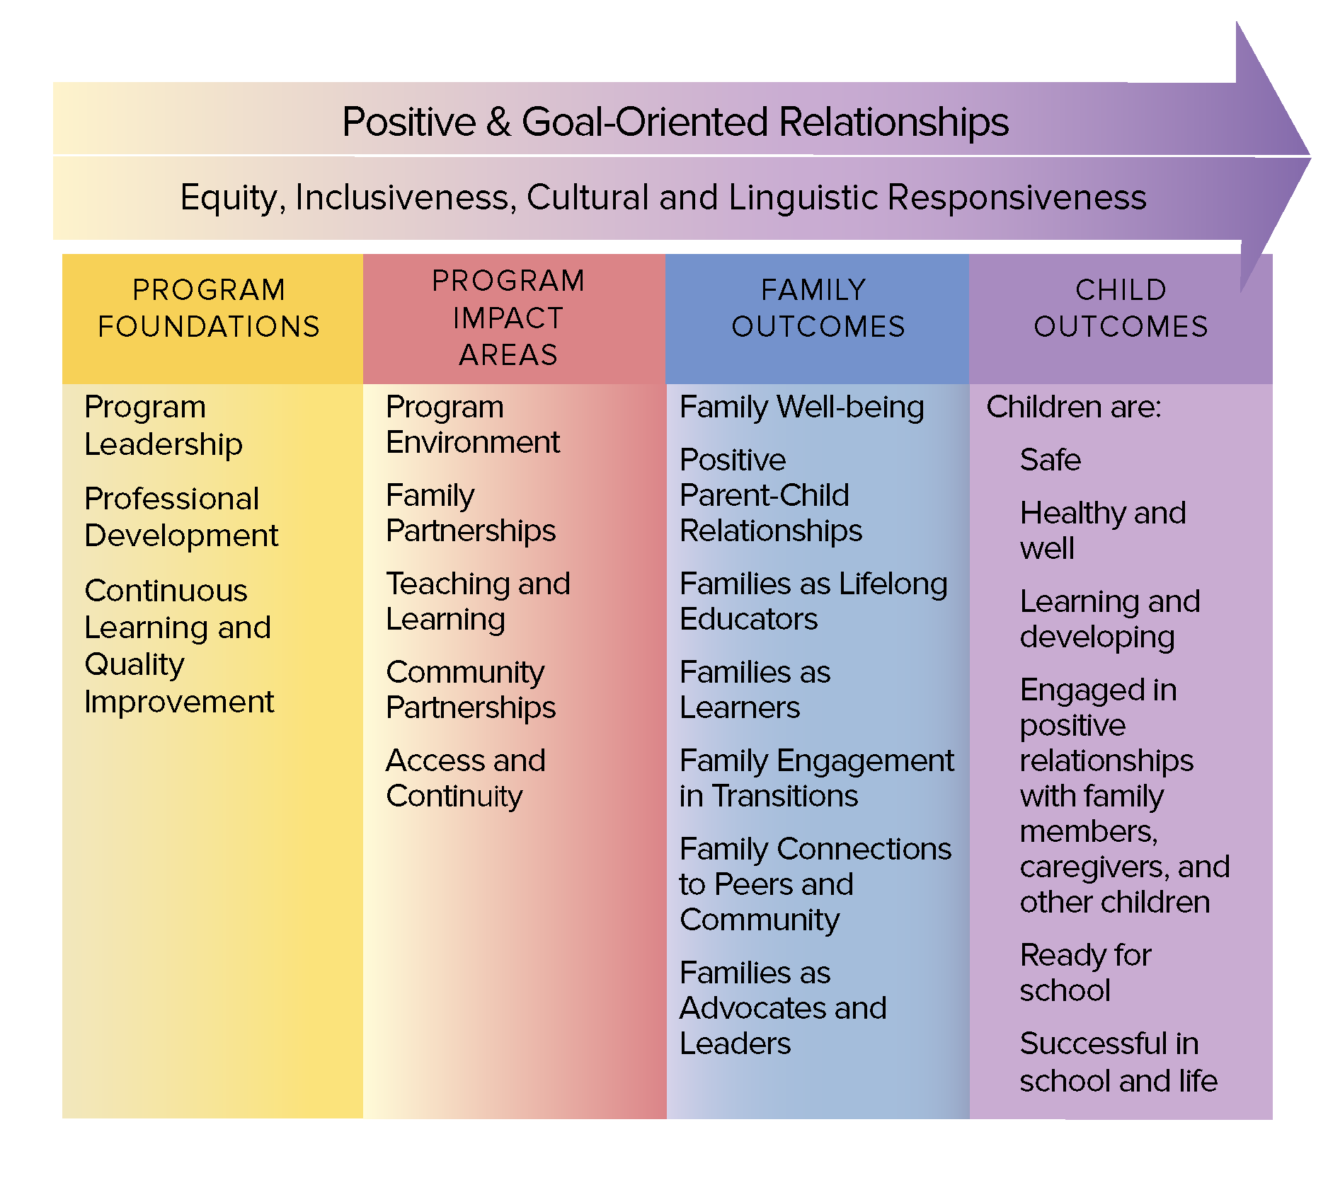
The Head Start Parent, Family, and Community Engagement Framework
Image credit: Office of Head Start

Slide 43
Meaningful Connections
What are two new ways that your program can create a welcoming, inclusive environment to engage
all families?

Slide 44
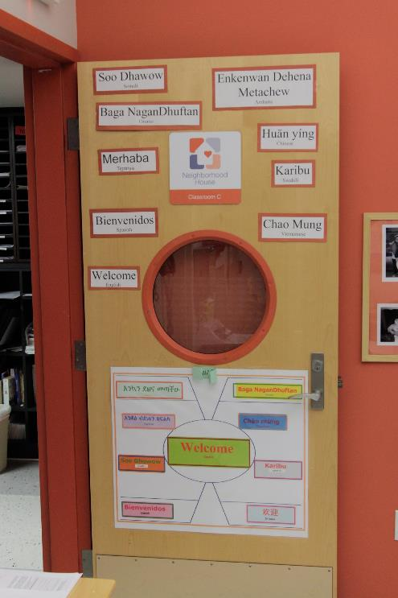
Strategies for Welcoming Families
Explore with families how they might share their language and culture in the early learning program.
Create opportunities with families to share common words or phrases in their
home language.
Image credit: EarlyEdU

Slide 45
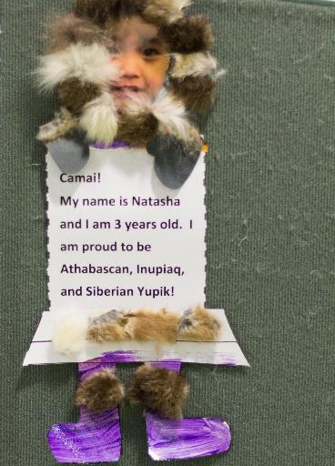
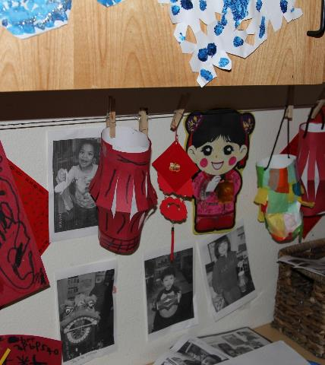
Strategies for Welcoming Families
Invite families to share:
Photos of themselves and their children, neighborhood landmarks, or community activities.
Songs, poems, drawings, music,
or stories.
Image credit: EarlyEdU

Slide 46
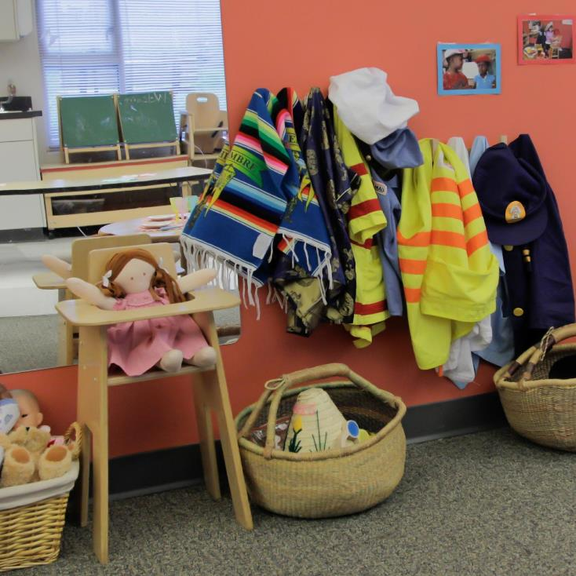
Strategies for Welcoming Families
Ensure that dolls represent a variety
of cultures.
Invite parents to donate empty food containers for pretend play areas.
Invite parents to share family recipes, family stories, and artifacts.
Image credit: EarlyEdU

Slide 47
Bringing It All Together

Slide 48
A relationship-based approach to family engagement involves:
Adopting strengths-based attitudes.
Reflecting on your
own perspectives.
Learning about families’ perspectives and funds of knowledge.
Identifying strategies to create a welcoming environment.

