Slide 1
Building Skills
In Two Languages

Slide 2
Overview
This module highlights practices for teachers who are working with children who are dual language learners to:
Teach new words and clear meanings.
Have meaningful conversations.
Encourage children’s home languages in addition English development.

Slide 3
By the end of this module, you should be able to:
Teach dual language learners new vocabulary and clear meanings.
Have conversations with dual language learners that build language skills.
Share ways to talk with families about continuing to use their home languages with their children.

Slide 4
Intentional Teaching Framework

Slide 5
What Is a Dual Language Learner?
A child learning two languages may:
Learn the languages at the same time (often from birth).
Develop a second language while learning a first language.

Slide 6
Developing Two Languages at Once
Typical patterns:
Birth up to 3 years
Before a child has a vocabulary
A simultaneous process of language development in both languages

Slide 7
Layering One on Top of the Other
Usually children age 3 and older
The way older children and adults learn concepts and languages
New labels for existing concepts and words

Slide 8
Development Patterns
Young children who start using a second language later may:
Continue to use their home language.
Learn that their home language isn’t working and may observe.
Begin using words and phrases in the new language.
Begin to communicate in sentences.

Slide 10
Supporting English and Home Languages

Slide 11
Which Language for Teaching?
Monolingual: Most early childhood teachers speak one language well—English—and should model that with home language support.
Bilingual: Teachers who speak the home language of the majority of the children in the program and English can teach in both languages with specific times for instruction in each language.

Slide 12
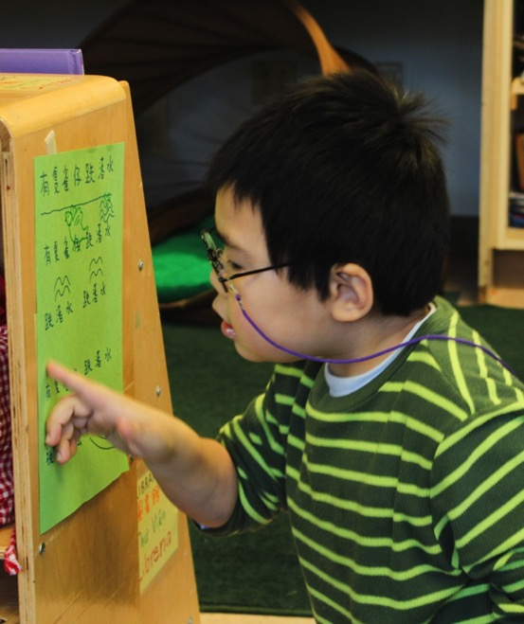
“…while all teachers cannot teach in all languages, they can support all languages by learning strategies to systematically introduce English during the preschool years while simultaneously promoting home language maintenance.”
(Espinosa, 2013, p. 1)

Slide 13
Meeting the Challenge
Think about these questions while watching the video:
Who can English-speaking teachers ask to help support home language development?
What are strategies teachers can use to encourage children’s home language development?

Slide 14
VIDEO: Meeting the Challenge

Slide 15
Video Debrief
What did you notice?
Teachers can ask families, community members, and staff to support home languages.
Strategies include posting labels and children’s names in two languages.
In a bilingual program, teachers can use each language in intentional ways.

Slide 16
Why Encourage Home Languages?
Language systems become more complex the longer a child uses a language.
Children can use concepts learned in their home language to compare and contrast new words.

Slide 17
Ways to Support Home Languages
Teachers who speak English can support home languages in their programs by:
Learning key words in home languages
Posting labels and including books in more than one language
Working with staff, families, and community volunteers who speak children’s home languages

Slide 18
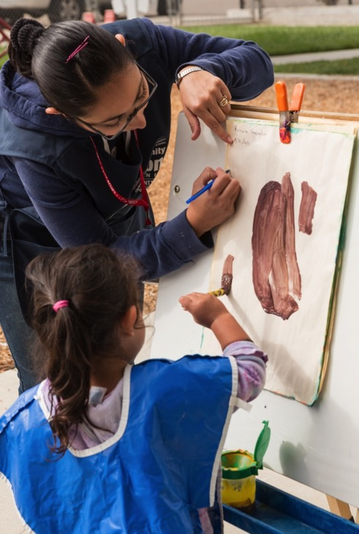
Benefits of Two Languages
Cognitive flexibility
Ability to develop relationships in two languages
Strong ties with community and culture

Slide 19
Teaching New Words

Slide 20
Process of Learning Vocabulary
dog
calceta
perro
red

Slide 21
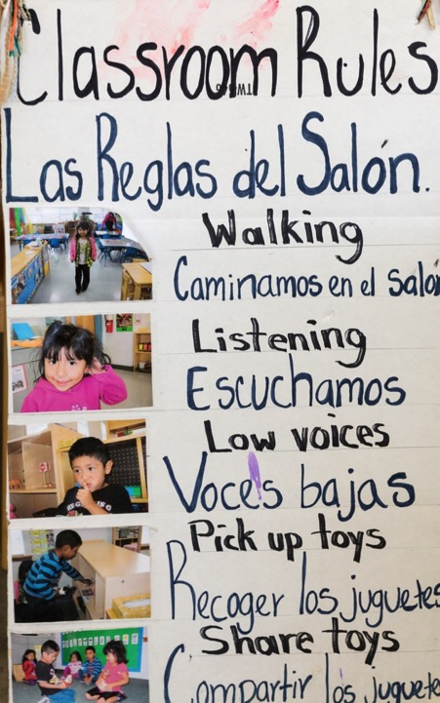
Increase Breadth and Depth
Children learning two languages may have:
Large gaps in vocabulary
Less breadth (number of different words) and depth (knowledge of multiple meanings of the same word)

Slide 22
Strategies for Teaching New Words
Pre-teach vocabulary words.
Create activities that encourage children to use and express new words.
Use pictures, real objects, and gestures with new words.
Use children’s interests to support language development.
Teach children to recognize similar words across languages.

Slide 23
Meanings of Words
Create small groups of two to three people.
Choose one of the photos on the next slide.
Brainstorm possible words you could teach children related to the activities in the photo.
Develop child-friendly definitions and strategies to teach them to dual language learners.

Slide 24
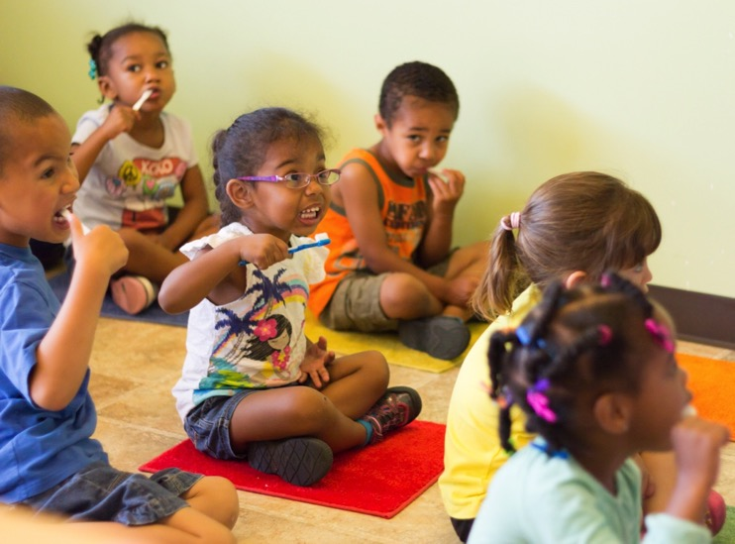
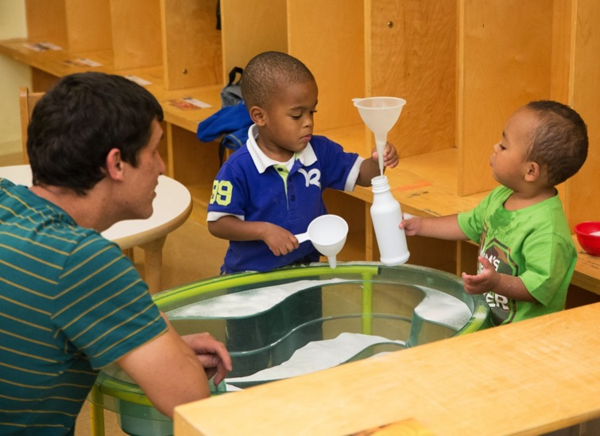
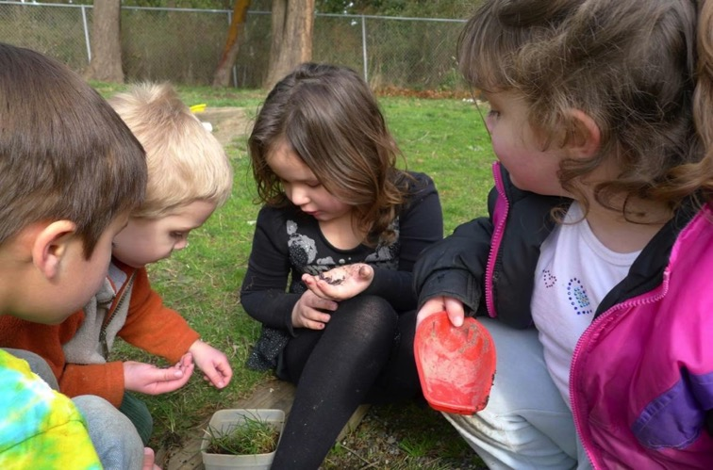
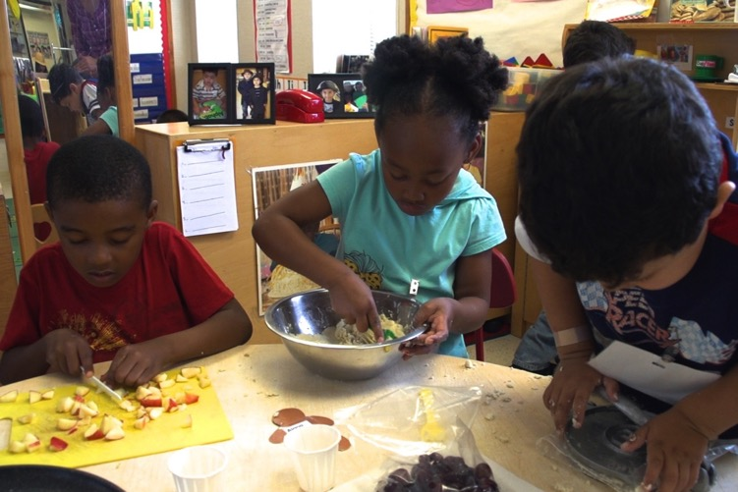

Slide 25
Having Meaningful Conversations

Slide 26
Impact of Teacher Talk
The amount, diversity, and complexity of teacher talk in preschool predicted second language vocabulary skills in first grade.

Slide 27
Conversation Basics
Ask open-ended questions
Observe, wait, listen
Comment on the child’s interests
Expand the child’s comments

Slide 28
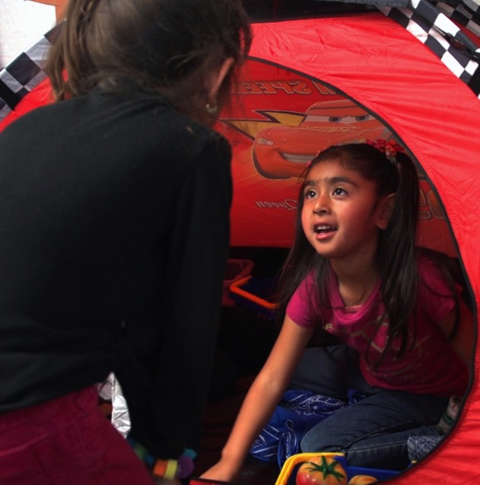
Talking with Dual Language Learners
During conversations:
Repeat key words
Adjust your language to match a child’s cues
Provide scaffolding
Model language

Slide 29
The Need for Scaffolding
“The underlying principle for young DLLs (dual language learners) is that they need additional scaffolds and supports to comprehend the meaning of lessons, because they are simultaneously learning the new language while also learning the cognitive and conceptual content.”
(Espinosa, 2012, p. 15)

Slide 30
Encourage a Storytelling Format
In addition to reading and telling stories, use a storytelling approach to:
Explain the day’s plans.
Help children to describe what they plan to do or did.

Slide 31
Interact at Different Stages
Child | Teacher
Using home language only | Provide language modeling and parallel talk (describe what the child is doing and seeing), teach new words
Observing and silent or speaking less | Continue language modeling and parallel talk, teaching new words, observe what the child is understanding
Using key phrases in the second language | Continue modeling, parallel talk, new words, and observing, add more words to extend language
Developing fluency in new language | Provide all of the above, adding more opportunities for child to express thoughts

Slide 32
When Children Aren’t Talking
Children who speak a home language and enter an English-speaking class may just observe and listen at first.
Continue talking to those children.
Describe what they are doing.
Interact with them even though they don’t appear to understand.
Demonstrate interest in their attempts to communicate.

Slide 33
Boosting Language Birth to 3
Use a higher-pitched voice.
Exaggerate your expressions and the sounds in the words you use.
Repeat words or phrases over and over.

Slide 34
Teachers who are Bilingual…
Can use both languages in the classroom as part of an intentional, balanced approach.
Should use one language at a time during instruction.
Can switch languages in a discussion to support a specific, planned goal.

Slide 35
Children’s Language Mixing
Using elements of two languages together
Borrowing words from the dominant language and using them when talking in the non-dominant one

Slide 36
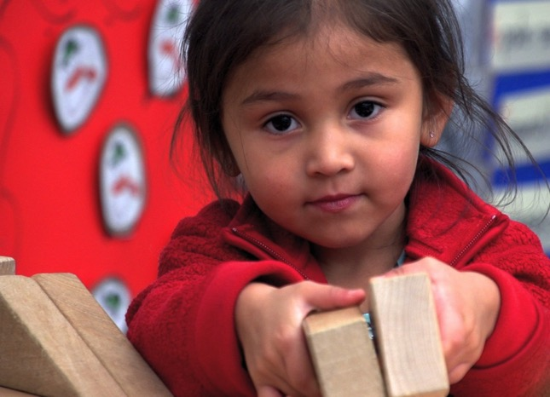
Response to Code Switching
Answer in the language you usually use with the children in your program.
Example: If a child says, “Quiero mas blocks,” the teacher could hold up the choices and say, “You want more cube-shaped or prism-shaped blocks?”

Slide 37
Conversation Dream
Think about these questions while watching the video:
What effective practices does this teacher use during this conversation?
How does the child respond?

Slide 38
VIDEO: Conversation Dream

Slide 39
Video Debrief
What did you notice?
The teacher extends the conversation, repeating the child’s words and adding more.
She asks open-ended questions.
She waits for answers.
She scaffolds with hints.
She provides a new word and its meaning.

Slide 40
What Did You Eat?
Think about these questions while watching the video:
What effective practices does this teacher use in these conversations?
How do the children respond?

Slide 41
VIDEO: What Did You Eat?

Slide 42
Video Debrief
What did you notice?
The teacher moves to the child’s level and speaks warmly.
She responds with more exact words.
She asks questions and waits for answers.
She responds by repeating children’s words and adding more.

Slide 43
Preparing for a Fire Drill
Imagine you speak English and have a new child in class who speaks only Mandarin. Your class is preparing for a fire drill.
How could you have a conversation with that child to prepare him for the drill?
What else could you do to help him understand and feel more comfortable?

Slide 44
Bringing It All Together

Slide 45
Partnering with Families
Support families in their goals for their children.
Explain how learning the home language supports children’s English development.

Slide 46
One Scenario
Read the handout and reflect on these questions:
What did the staff learn and how did they learn it?
What could the staff do to avoid this situation in the future?

Slide 47
Using Information from Families
What you find out from families can help you:
Create familiar situations for children and help them get their needs met.
Provide new opportunities.
Plan effective communication methods with families and children.
Connect in the classroom with a child’s interests and abilities.
Add information to a child’s portfolio.

Slide 48
Talking with Families
Find a partner.
Identify questions to ask families about language use and development and information about the importance of home languages to share with families.
Take turns playing the roles of the teacher and parents and asking questions and giving responses.

Slide 49
Have rich interactions with dual language learners that match their language development.
Teach new vocabulary in ways that children learning more than one language can understand.
Communicate regularly with families to effectively support English and home language development.

Slide 50
Talking with Children Learning Multiple Languages
Choose a child in your class to have a in-depth conversation with, and observe that child.
Make a plan to have an extended conversation using the planning form.
Have the conversation.
Write a reflection about the experience.

Slide 51
Talking with Families
Choose a child’s family—in consultation with other staff—to talk with about language goals and development in English and home languages.
Get any needed permissions to film the conversation.
Make a plan to talk with the family and to record the conversation.
After you film the conversation, write a reflection by answering the questions in the assignment.

