Slide 1
Mindfulness:
A Resilience Practice

Slide 2
Overview
This module will focus on practices to:
Help teachers manage stress and build resilience.
Pause and focus on the present moment.
Teach children to pause and use their senses to focus on what is happening in the current moment.

Slide 3
By the end of this module, you should be able to:
Describe negative and positive impacts of stress.
Use mindfulness practices that lead to calm and centered states.
Lead children in a mindfulness practice.

Slide 4
Intentional Teaching Framework

Slide 6
Teacher Resilience = Child Outcomes
Child social, emotional, and academic outcomes
Classroom climate
Use of evidence-based practices
Relationships with children and parents
Teacher resilience and well-being

Slide 7
Managing Stress

Slide 8
Teaching, Caring, and Stress

Slide 9
What is stressful about your work as an early childhood educator?
Turn and exchange ideas with a partner.
Be ready to share your thoughts with the larger group.

Slide 10
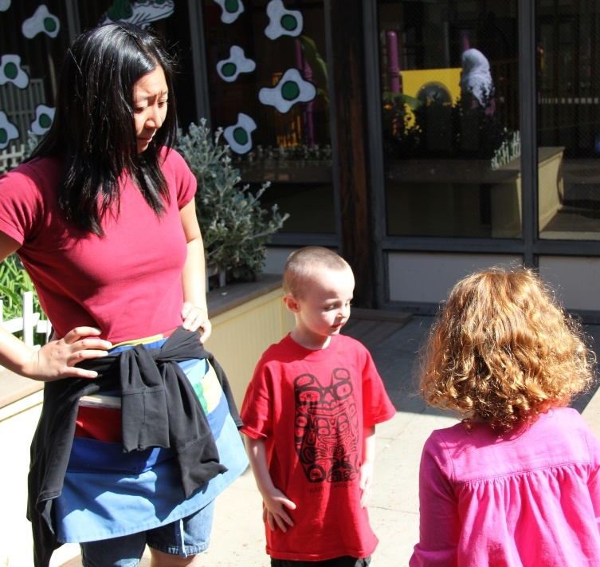
Top Five Stressors for Teachers
Challenging behavior
Isolation from colleagues
Interactions with upset parents
Insufficient resources
Life stressors outside of the job

Slide 11
What is Stress?
Definition:
Homeostatic balance (a state of homeostasis): Having an ideal body temperature, an ideal level of glucose in the bloodstream, an ideal everything
Stressor: Anything that knocks you out of homeostatic balance

Slide 12
The Yerkes-Dodson Law
Think about these questions while watching the video:
When does stress have a positive impact?
When does it impact negatively?

Slide 13
VIDEO: The Yerkes Dodson Law

Slide 14
Video Debrief
When stress is moderate and manageable, it affects a person’s performance positively.
When it is too intense, people become exhausted and disorganized and their performance plummets.

Slide 15
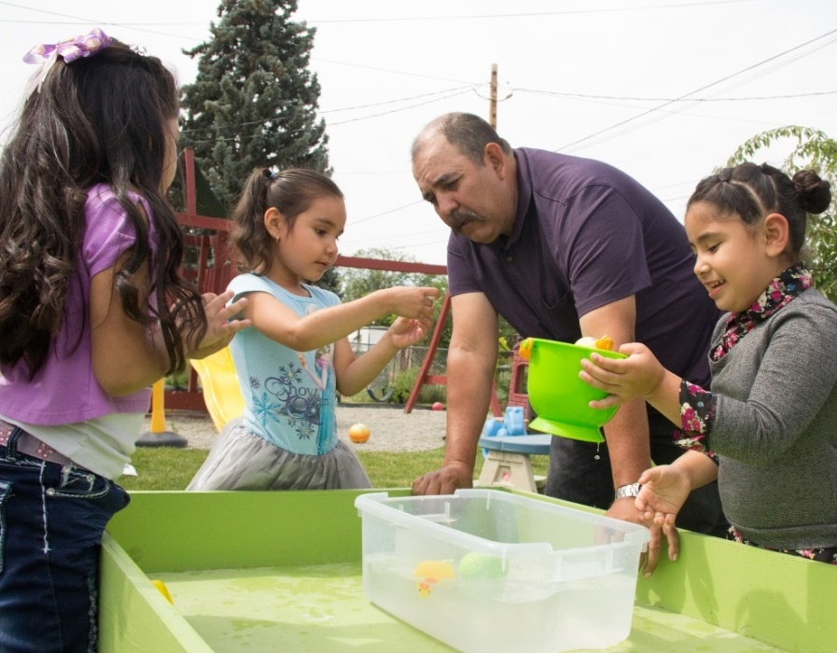
What is Manageable Stress?
Pause for a moment to think about what manageable stress—stress that puts you in prime condition for doing effective work— is for you.

Slide 16
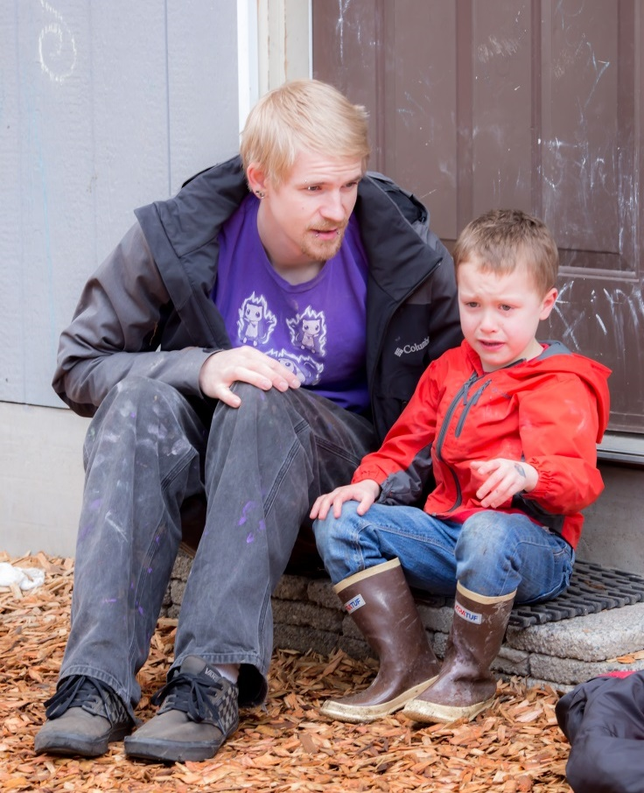
Impacts of Intense Stress
Too much stress or poor stress management impacts the mind and body, causing heavy allostatic load.

Slide 17
Some Effects
Body | Mind | Behavior
Headache Muscle tension or pain Cardiovascular issues Fatigue Change in sex drive Stomach upset Sleep problems | Anxiety Restlessness Lack of motivation Memory issues Irritability or anger Sadness or depression | Angry outbursts Avoidance of key activities Overeating or undereating Social withdrawal Drug or alcohol abuse

Slide 18
Goal is Resilience
Resilience is the ability to survive and thrive in the face of life’s daily ups and downs, curve balls, and stressors.

Slide 19
We Can All Become Resilient
Resilience does not require something rare or special— it’s ordinary magic.

Slide 20
Some Steps Toward Resilience
Develop helpful and optimistic thinking.
Seek social support.
Get good sleep.
Clarify values and doing what matters.
Manage emotions effectively.
Engage in physical activity.
Use mindfulness practices.
Purposefully practice gratitude.
Make time for recreation and relaxation.

Slide 21
Using Mindfulness Practices

Slide 22
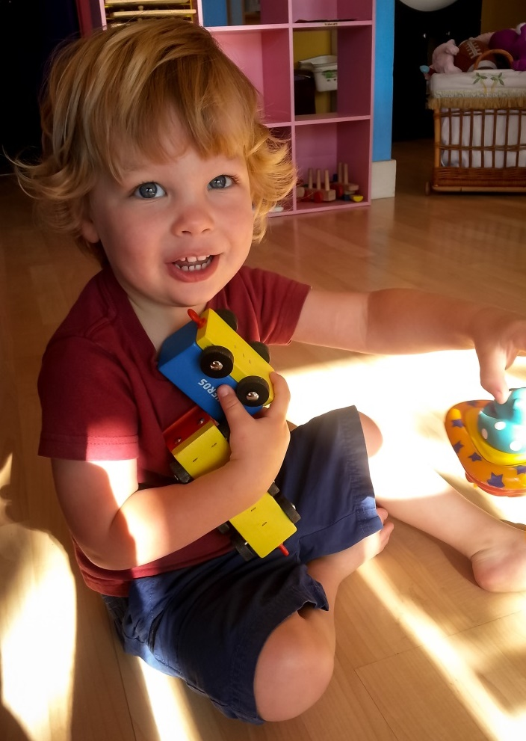
What is Mindfulness?
“The awareness that emerges through paying attention on purpose, in the present moment, and nonjudgmentally to the unfolding of experience moment by moment.”
(Kabat-Zinn, 2003, p. 145)

Slide 23
Scientific Benefits
Concentration and clarity in thinking
Increased calmness
More skillful response to difficult situations
Increased empathy and understanding of others
Decreased stress and anxiety
Enhanced physical health

Slide 24
The Benefits of Mindfulness
While you are watching this video, think about these questions:
What are the benefits of mindfulness for you?
What are the possible impacts for the children you work with?

Slide 25
VIDEO: The Benefits of Mindfulness

Slide 26
Video Debrief
Using mindfulness practices, teachers can:
Be calmer and better observers of children.
Have a more positive affect, which impacts the mood in the classroom.
Respond to challenges more calmly.

Slide 27
How Mindfulness Works
Mindfulness practices:
Purposeful attention to the present moment with a receptive attitude
Awareness:
Noticing what is happening within self, to others, and in surroundings
Empowerment:
Liberated from distressing thoughts and feelings and able to be calmer and think more clearly to make good decisions

Slide 28
Notice Five Things
While you are watching the video, think about these questions:
What are the elements of the strategy?
Where can you do this practice?
What is its purpose?

Slide 29
VIDEO: Notice Five Things

Slide 30
Video Debrief
Notice five things you can see, hear, and connect with your body.
You can do this practice in the classroom or, really, anywhere.
The purpose is to practice becoming calm and centered.

Slide 31
Notice Five Things
Pause, sit quietly, and think about:
Five things you can see.
Five things you can hear.
Five things that connect with your body.

Slide 32
Bringing It All Together

Slide 33
Manage stress well to build your resiliency and better observe and respond to children.
Use mindfulness practices as one way to remain calm and centered.
Teach these practices to children in addition to using them yourself.

Slide 34
Choose One: Mindfulness Practices
Watch the videos showing mindfulness practices or read about them on the handout.
Choose one.
Try one at least once while in or out of the in the classroom during the next week.
Reflect on the experience.

Slide 35
Notice Five Things with Children
Review the steps to the mindfulness practice Notice Five Things.
Set up your video camera to film your lesson with children.
Lead children in the activity.
Review the recording and reflect on the experience and children’s responses.

