Slide 1
Using Interactive Media
In Early Learning

Slide 2
Overview
This module will focus on practices to:
Select and use interactive media with young children in early childhood settings.
Interact with children as they use media to help meet learning goals.

Slide 3
By the end of this module, you should be able to:
Describe criteria for selecting media in early childhood programs.
Evaluate interactive media for use in early childhood programs.
Demonstrate effective interactions with children who are engaging with media.

Slide 4
Intentional Teaching Framework

Slide 6
Evaluating Media

Slide 7
Technology and Me
Ask your partner to recall a memory of a key encounter with media (e.g., television or computer program, website, or game) as a young child and why it was memorable.
Introduce your partner to the group.
Share your partner’s media experience.

Slide 8
What did you learn from engaging with this media?
What have you seen young children learn from media?
How and why did the learning happen?

Slide 9
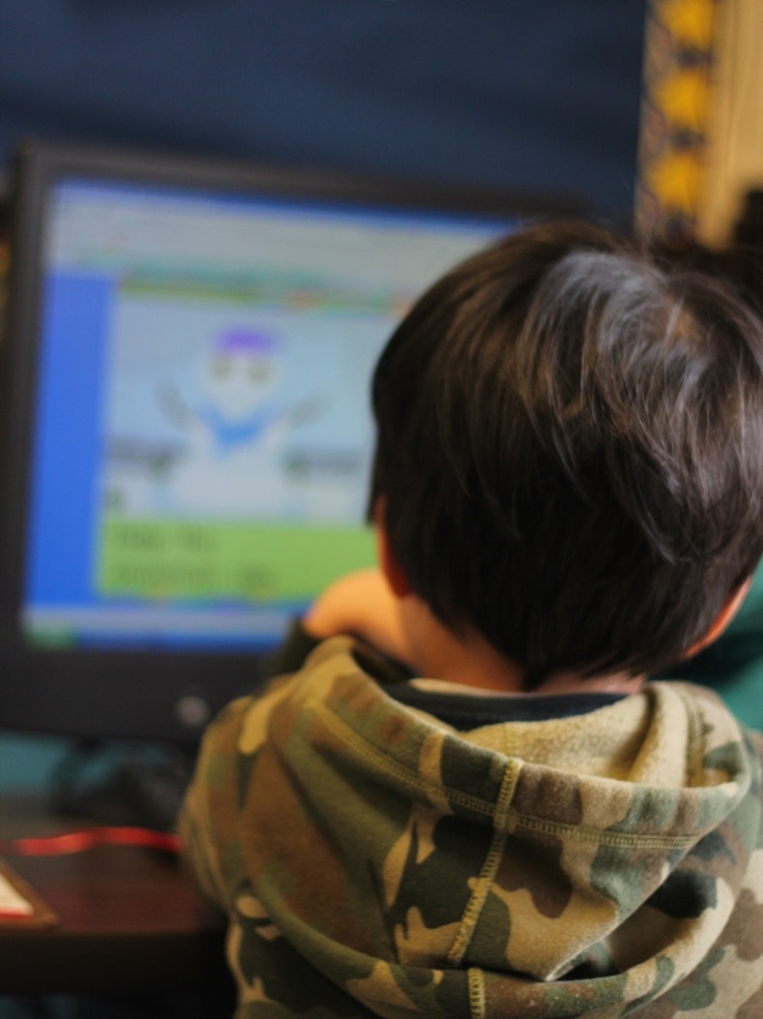
Teachers in the Lead
In early childhood settings, teachers are often the ones who will select the media for children, use it in their classroom, integrate it in the program, and evaluate its success.

Slide 10

VIDEO: Teachers in the Lead

Slide 11
Young Children and Media Today
Many children birth to age 8 are using some media:
Three-fourths of children have access to mobile devices at home.
The number of children who’ve used mobile devices went from 38 percent in 2011 to 72 percent in 2013.

Slide 12
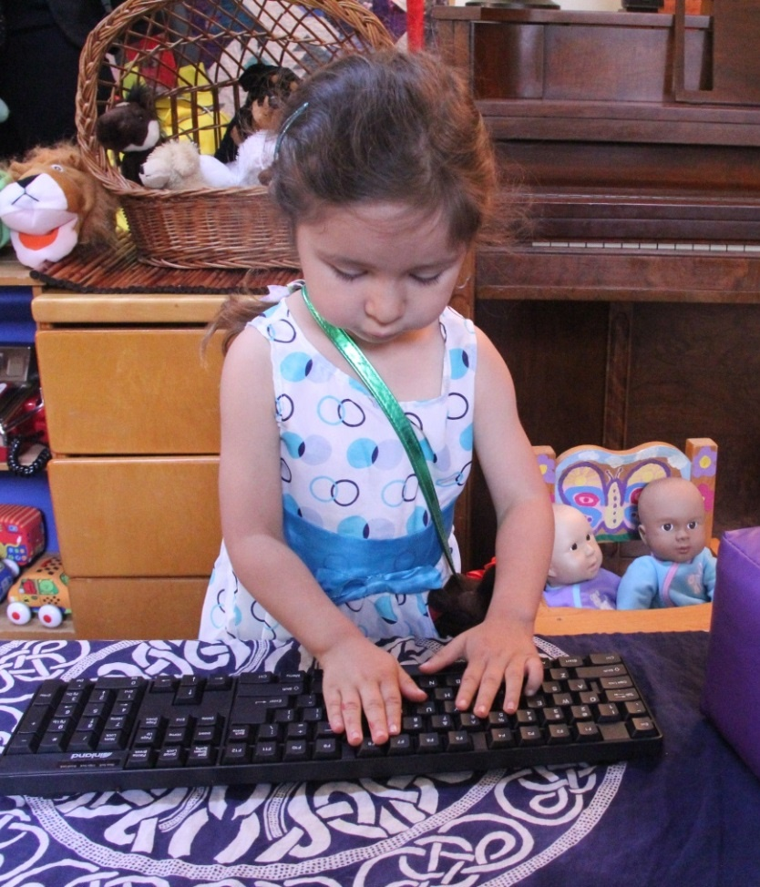
Issues of Equity
Young children today need to develop technology-handling skills the same way they need book-handling skills.

Slide 13
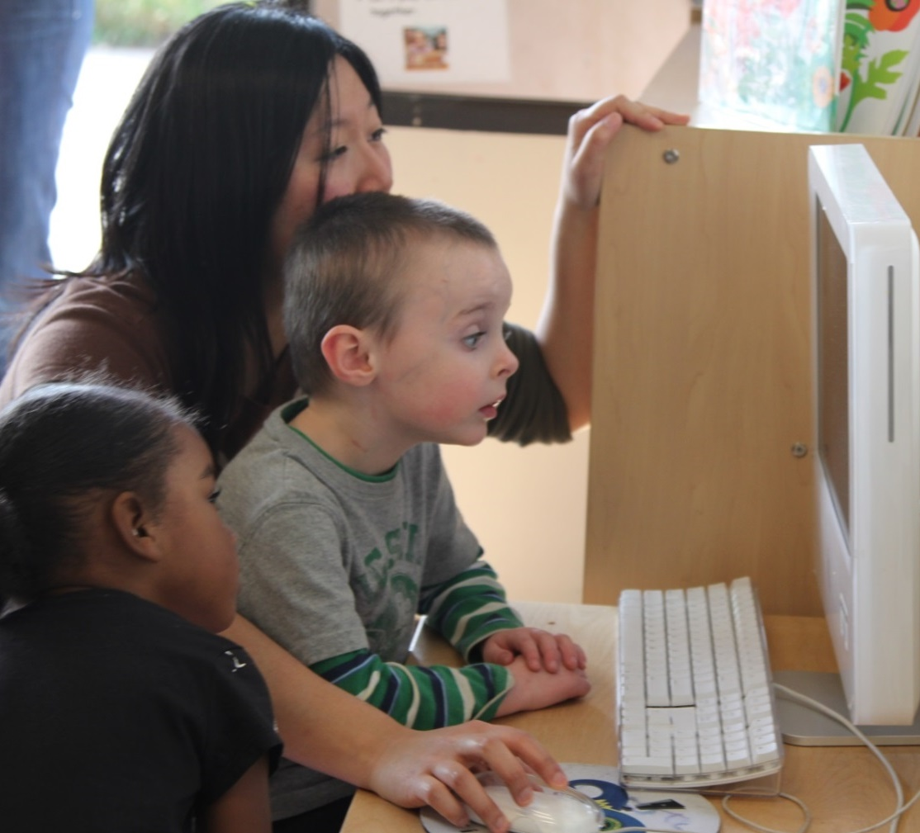
Your Criteria for Using Media
Food for thought: What should we consider when making decisions about interactive media in early education?

Slide 14
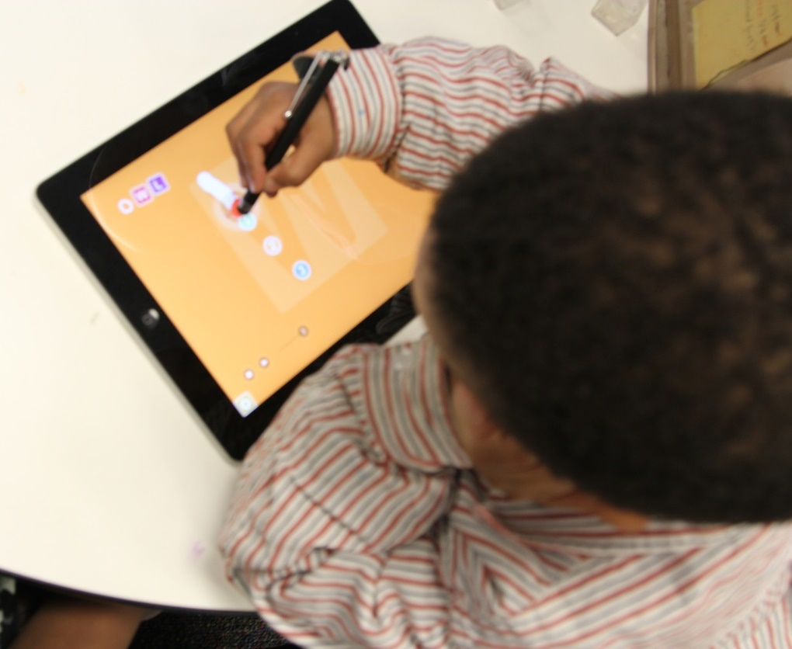
Guidance on Using Media
Make decisions informed by knowledge.
Choose challenging and achievable goals.
Be intentional.

Slide 15
Joint Position Statement
“Technology and interactive media are tools that can promote effective learning and development when they are used intentionally by early childhood educators, within the framework of developmentally appropriate practice, to support learning goals established for individual children.”
(NAEYC and Fred Rogers Center, 2012, p. 5)

Slide 16
Integration
Think of technology you use every day to accomplish something.
Write a brief paragraph describing how you use the technology. Imagine that the reader has no experience with this technology.

Slide 17
Integrating Technology
Think about these questions as you watch the video:
Why do the speakers integrate technology into their curriculum?
What does it mean to: Structure the technology to support children…Wherever they are developmentally?

Slide 18
VIDEO: Integrating Technology
(Excerpt from Real to Reel: Building Blocks)

Slide 19
Video Debrief
What did you notice?
Integrating technology in the curriculum gives children another way to learn concepts.
You can use technology to individualize according to children’s needs.

Slide 20
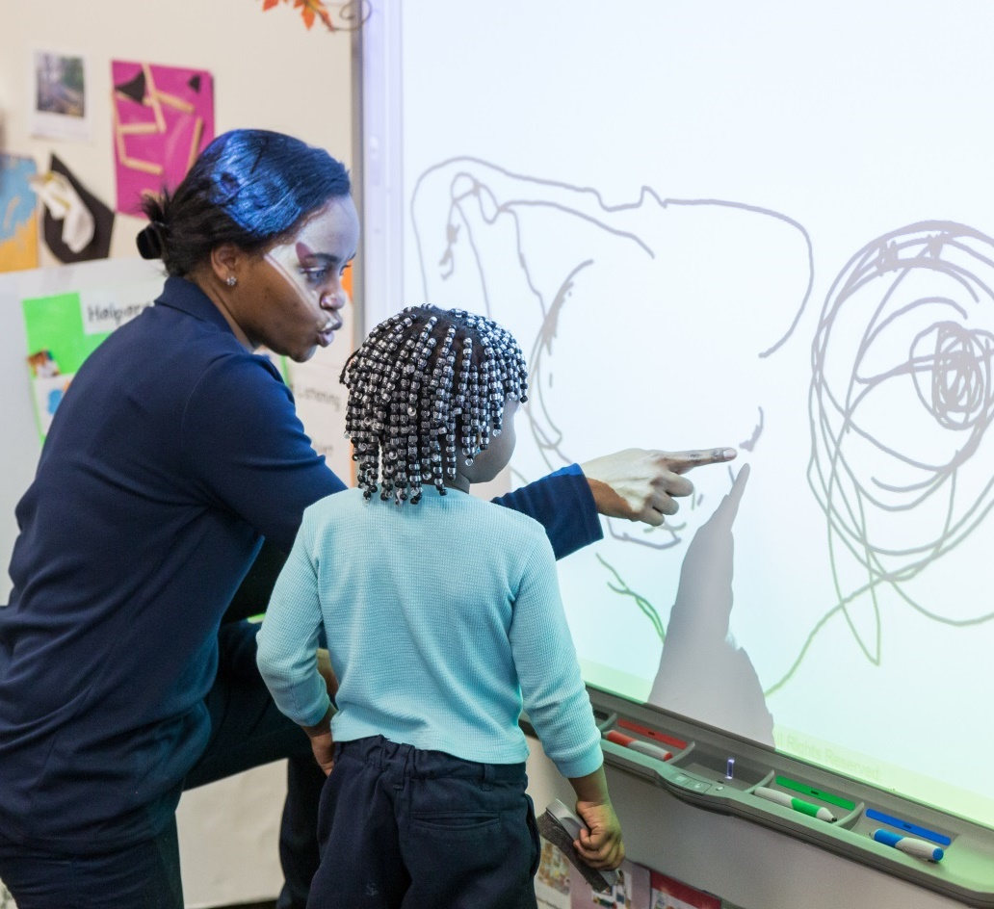
Possible Uses of Digital Media
Drawing
Digital forms of block games that build early reading skills
Storytelling
Manipulating objects

Slide 21

Infants and Toddlers
In general, recommendations for media use are:
Interactions with adults
Age-appropriate content
Limited time

Slide 22
Infants Learn from Caregivers
Infants learn most effectively through responsive interactions with caregivers.
From 12 to 24 months, children can begin learning some language from screens but still learn better from interactions.

Slide 23
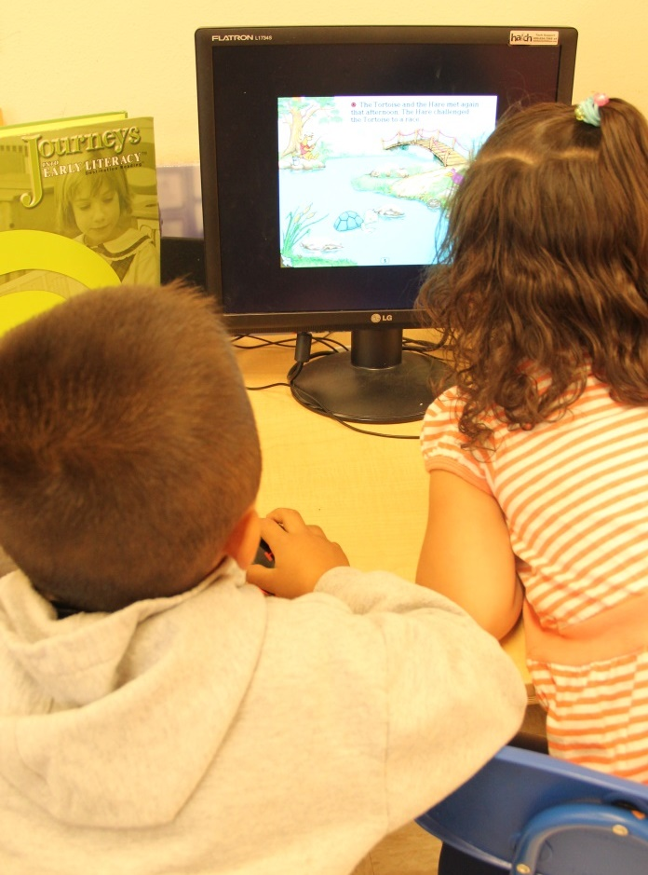
Consider Amount of Time
Early childhood educators must balance opportunities for learning with the potential for misuse and overuse of media.

Slide 24
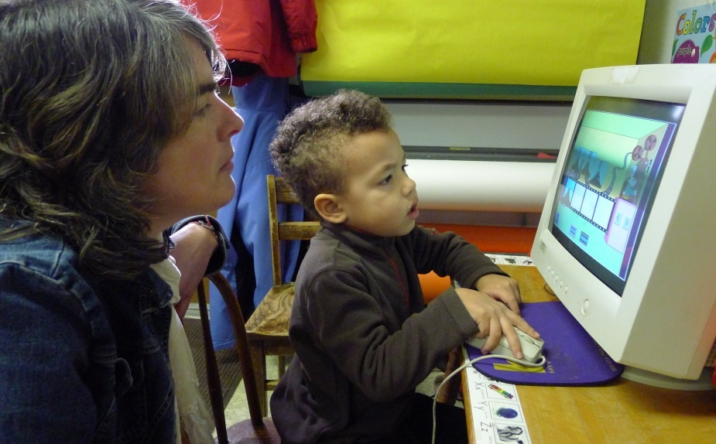
Opportunity to Individualize
Teachers can use digital media specifically with:
Dual language learners
Children with special needs
Children who need extra motivation

Slide 25
Adaptation Using Technology
Think about these questions as you watch the video:
What were the steps for introducing technology to support a child’s learning?
How did the teaching team use media to meet a specific child’s needs?

Slide 26
VIDEO: Adaptation Using Technology

Slide 27
Video Debrief
What did you notice?
The teaching team tried several modifications and found success using an iPad.
They were able to offer activities at the child’s ability level, then gradually increase her skill until she could write her name.

Slide 28
Criteria for Media Use
Thinking about your experiences, knowledge of child development, and information from this module, write a list of key points to consider in choosing media for an early childhood classroom.
Find a partner and share lists.

Slide 29
Using Media Together

Slide 30
What Is Co-Viewing?
“Joint media engagement (JME) refers to spontaneous and designed experiences of people using media together. JME can happen anywhere and at any time when there are multiple people interacting together with media. Modes of JME include viewing, playing, searching, reading, contributing, and creating, with either digital or traditional media…”
(Stevens & Penuel, 2010)
(Takeuchi & Stevens, 2011, p. 9)

Slide 31
Why Co-Viewing?
Joint media engagement ties technology
to other aspects of a child’s life.
When a teacher, parent, or sibling talks to
a child about a shared media experience and encourages a child to expand on it, opportunities for learning grow.

Slide 32
Joint Media Engagement
Write down an experience of shared media use that helped you learn.
What was the mode of engagement?
How did social partners help you learn?
Find a partner and share.

Slide 33
Possible Talk Moves
Point out screen activity that is central to the program’s learning goals.
Have conversations that connect children’s lives to what is on screen.
Check understandings by asking children what they think and to talk about it.
Provide or focus on language related to the media activity.

Slide 34
Spelling “Pig”
Think about these questions as you watch this classroom video:
What does the teacher do as she interacts with the child?
How does the child respond?
What else could the teacher do that would be effective?

Slide 35
VIDEO: Spelling “Pig”

Slide 36
Video Debrief
What did you notice?
The teacher directs the child’s focus to the learning goal, spelling pig, by asking questions.
The child is engaged and responds to the questions and does the activity.
The teacher could ask open-ended questions.

Slide 37
Bringing It All Together

Slide 38
Professional Development
Educators can grow in their use of digital media if they have opportunities to:
Keep learning about emerging technologies and their successful use in children’s learning.
Share experiences with using media in their programs.

Slide 39
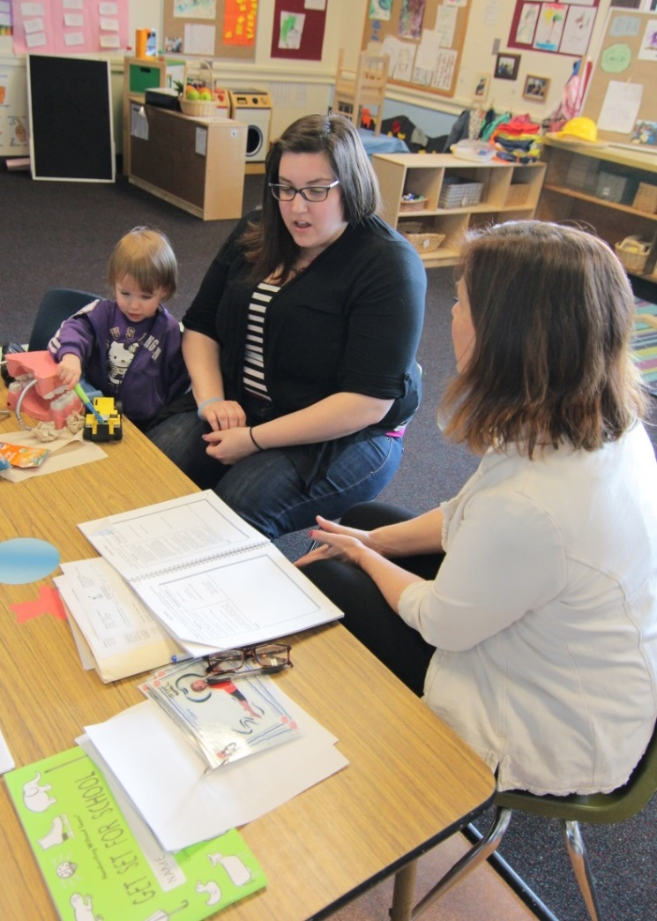
Family Engagement
Ask parents to share about their child’s media use.
Explain to families how and why their children are using interactive media to meet their learning goals.

Slide 40
Key Points for Families
When children are using screen media:
Interact with them to enhance their learning.
Choose video chats as one effective form of interactive media for children
2 years and older.

Slide 41
Conversations with Families
Form small groups and discuss:
What are key points to share with families as they make decisions about media and their children?
What do you want to find out from families?
How can you communicate that you want to work together?

Slide 42
Select and use interactive media intentionally in early childhood programs.
Interact with children using media to extend their learning.
Engage parents to partner with teachers to support children’s effective media use.

Slide 43
Review of Interactive Media
Pick a digital game for young children that you want to try and review.
Try out the game.
Write a reflection about your experience playing it and the learning potential of the game.

Slide 44
Interacting Together
Choose media that you are introducing in your program or one that children are already using, and make a plan to interact with children who are using it.
Film yourself interacting with children while they use media.
Review and reflect on the experience.

