Slide 1
Emotional Literacy

Slide 2
Overview
This module will focus on practices to:
Teach children emotional vocabulary, especially words for positive feelings.
Help children identify emotions in themselves and others.
Talk with parents about emotional literacy.

Slide 3
By the end of this module, you should be able to:
Teach children expanded emotional vocabulary.
Use strategies to help children identify emotions.
Plan to use books to encourage emotional literacy.
Describe effective approaches to talk with parents about emotional literacy.

Slide 4
Intentional Teaching Framework

Slide 5
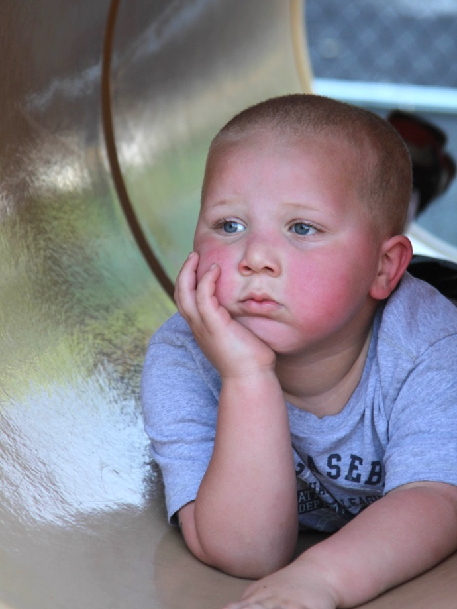
What Is
Emotional Literacy?

Slide 6
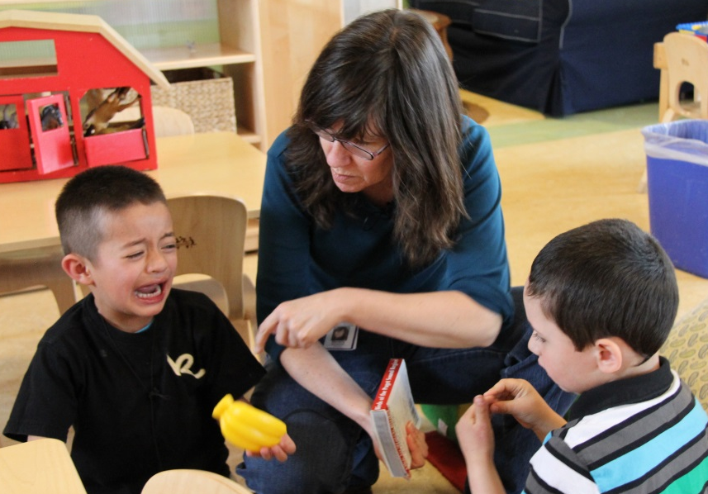
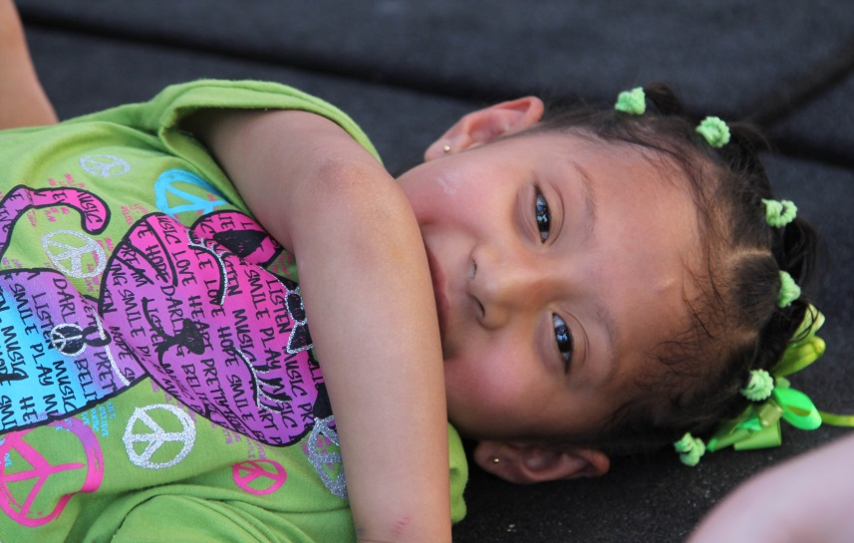
Emotional literacy is the ability to identify, understand, and express emotions in a healthy way.

Slide 7
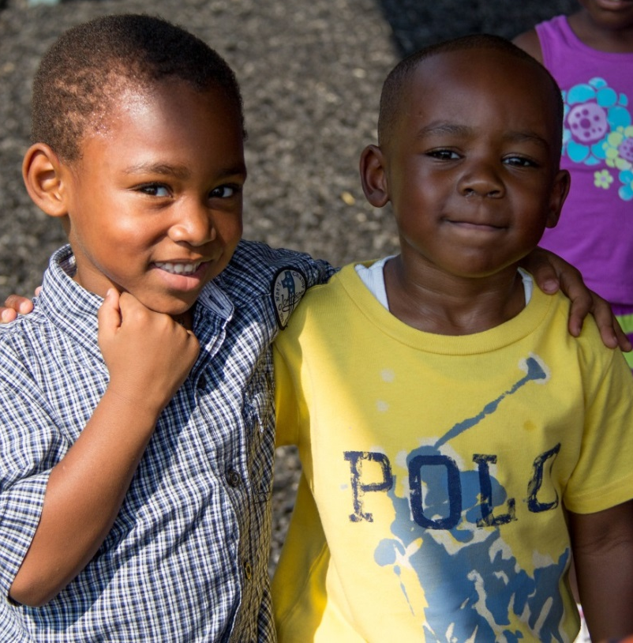
Benefits for Children
Manage frustration more successfully
Have fewer conflicts
Engage in more positive behavior
Are healthier
Control impulses better
Learn more in school

Slide 8
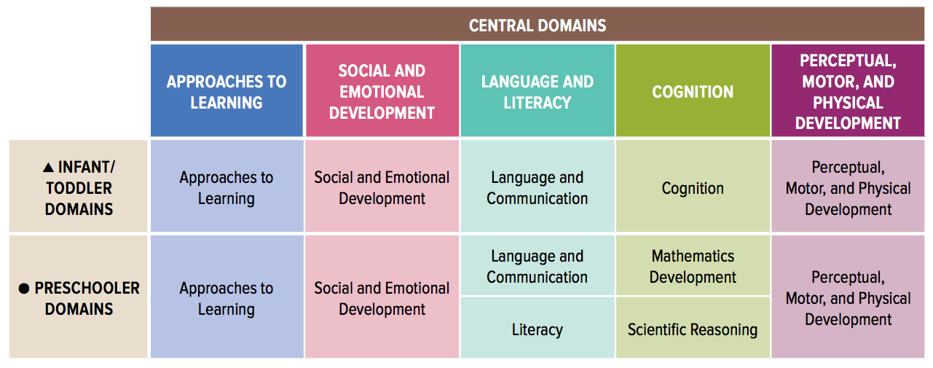
Head Start Early Learning Outcomes Framework
Image credit: Administration for Children and Families, Office of Head Start

Slide 9
Emotional Development from Birth

Slide 10
Emotions in First Year of Life
Birth to 6 Months | 6 Months to 1 Year
Contentment: Smiles after eating Interest: Tracks new objects Distress: Cries when left alone | Fear: Suddenly shows fear of strangers at 7 or 8 months when didn’t at 6 months

Slide 11
Infants and Others’ Emotions
Emotional
Contagion
When one infant starts crying, another joins in.
Social Referencing
At 8 to12 months, infants use caregivers’ facial expressions or vocal cues to decide how to deal with new situations.

Slide 12
Emotions Ages 2 to 4
Age | Emotional Development
2 | Begins to understand others’ emotions and to have empathy.
3 | Understands cause and effect in interactions with children and adults.
4 | Knows that others have separate feelings and desires.

Slide 13
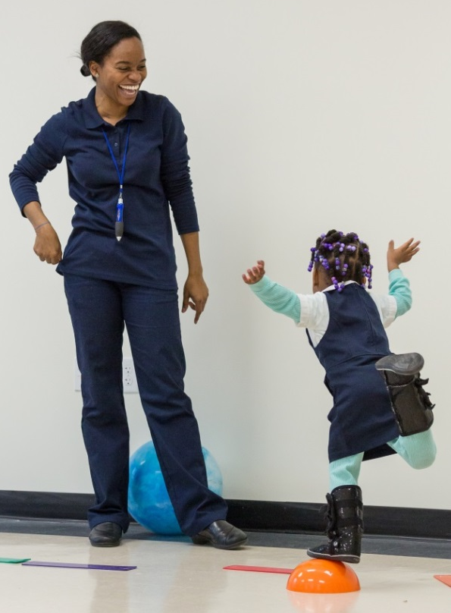
Self-Conscious Emotions
Embarrassment
Guilt
Shame
Pride
Around age 2, children start to understand that they are distinct from other people and begin to form a sense of self.

Slide 14
A Look at Guilt and Shame
Embarrassment
Guilt
Shame
Pride
Both guilt and shame can be painful emotions, but which one is likely to be more harmful to a child’s sense
of self? Why?

Slide 15
Multiple Emotions
Most preschoolers struggle to understand that people can experience more than one emotion at the same time.
  Example: During a wedding ceremony,
  Paul’s mother starts crying. When Paul tries
  to console her by saying, “It’s okay mommy, don’t be sad,” she says, “No, I’m happy because they are getting married” and smiles at him through her tears.

Slide 16
Teaching Emotional Vocabulary

Slide 17
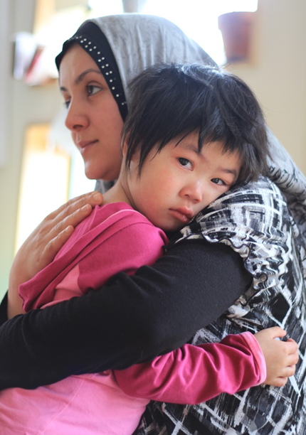
Emotional Vocabulary
Write a list of ten feeling words that you would like to teach young children.

Slide 18
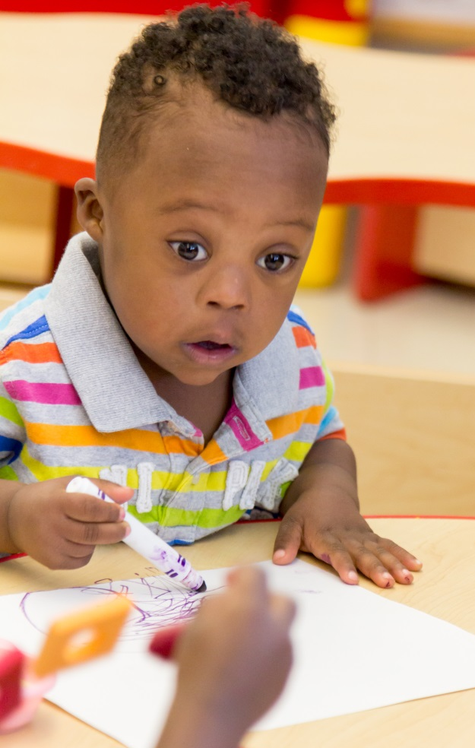
Share Many Emotion Words
Use happy, mad, and sad, but add in surprised, annoyed, excited and more...
“Like other forms of literacy, the richer the vocabulary, the more rewarding the experiences.”
(Joseph & Strain, 2003, p. 1)

Slide 19
Negative or Positive?
fascinated
reliable
daring
eager
quiet
peaceful
bright
clever
warm
overjoyed
gleeful
unique
angry
thankful
calm
keen
confident
uncomfortable
amazed
optimistic
bold
interested
snoopy
confident
merry
lucky
rebellious
fortunate
happy
brave

Slide 20
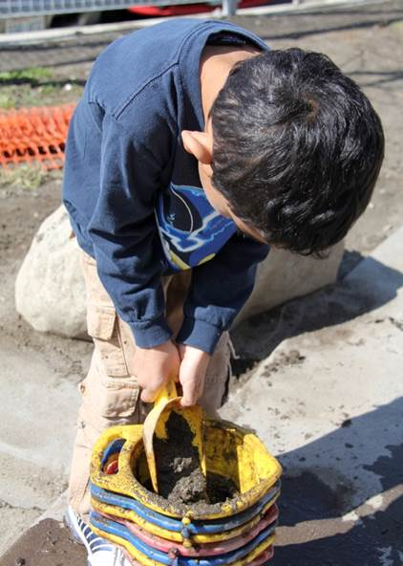
In one study, children who had fewer emotion words in their vocabulary also showed ongoing challenging behavior.

Slide 21
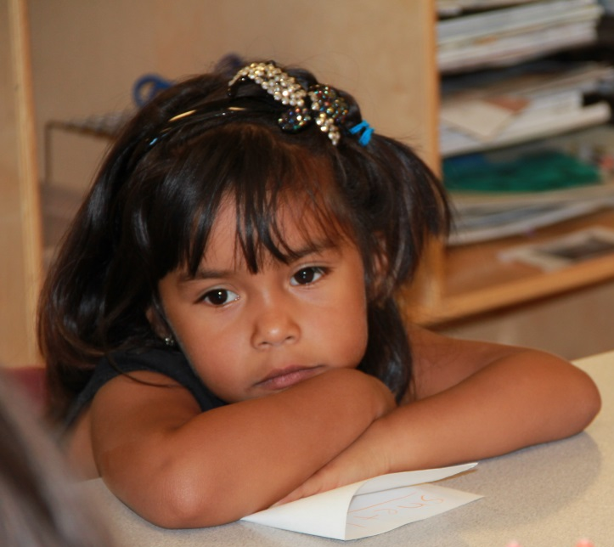
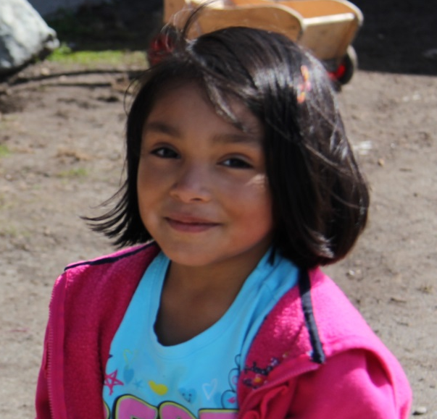
Make Plans to Teach Emotion Words
Discouraged
Joyful

Slide 22
Signs for Emotions
Think about these questions while watching this video:
How does the teacher teach emotional vocabulary?
How do the children respond?
What else could the teacher do to engage the children in learning?

Slide 23

VIDEO: Signs for Emotions

Slide 24
Video Debrief
What did you notice?
The teacher uses sign language in addition to the names of the emotions.
Some children join in and sign the emotions.
She could also ask children to share a time when they felt that emotion.

Slide 25
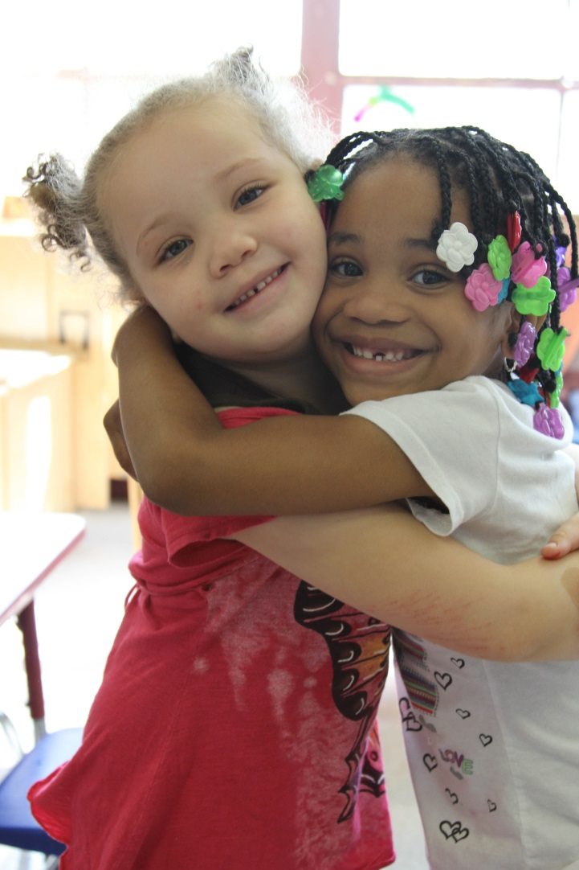
Label Throughout the Day
Describe what you notice about children’s moods.
“You two seem
really happy to be playing together! You keep hugging each other!”

Slide 26
Star Child
Think about these questions while watching this video:
How does this teacher label the child’s emotion?
How does the child respond?

Slide 27
VIDEO: Star Child

Slide 28
Video Debrief
What did you notice in this video?
The teacher asks if the girl is excited.
The girl nods her head yes.
The teacher describes the big smile on the girl’s face, which suggests she is excited.

Slide 29
Identifying Emotions

Slide 30
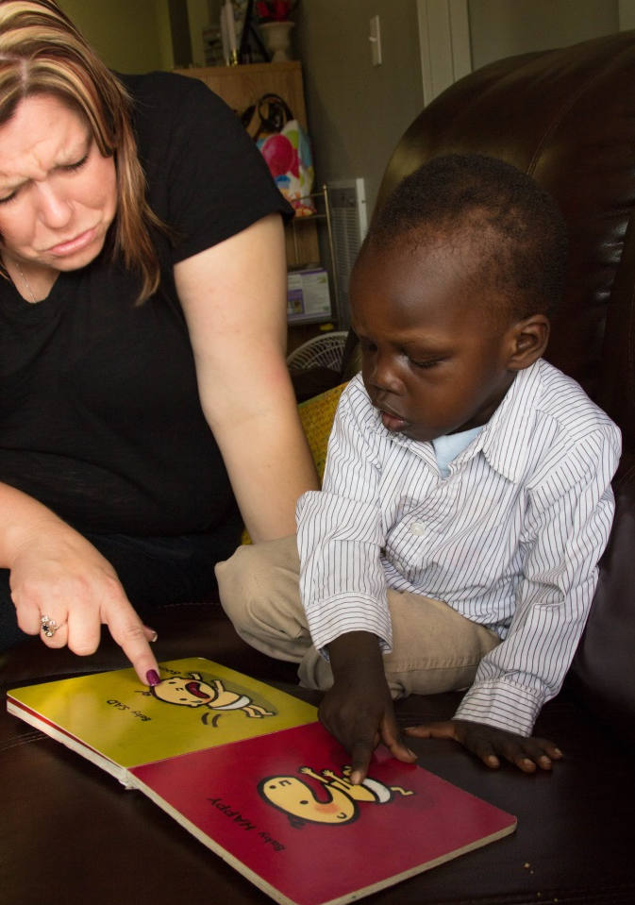
Help Children
Read Cues
Point out:
Expressions on faces
Body language
Tone of voice

Slide 31
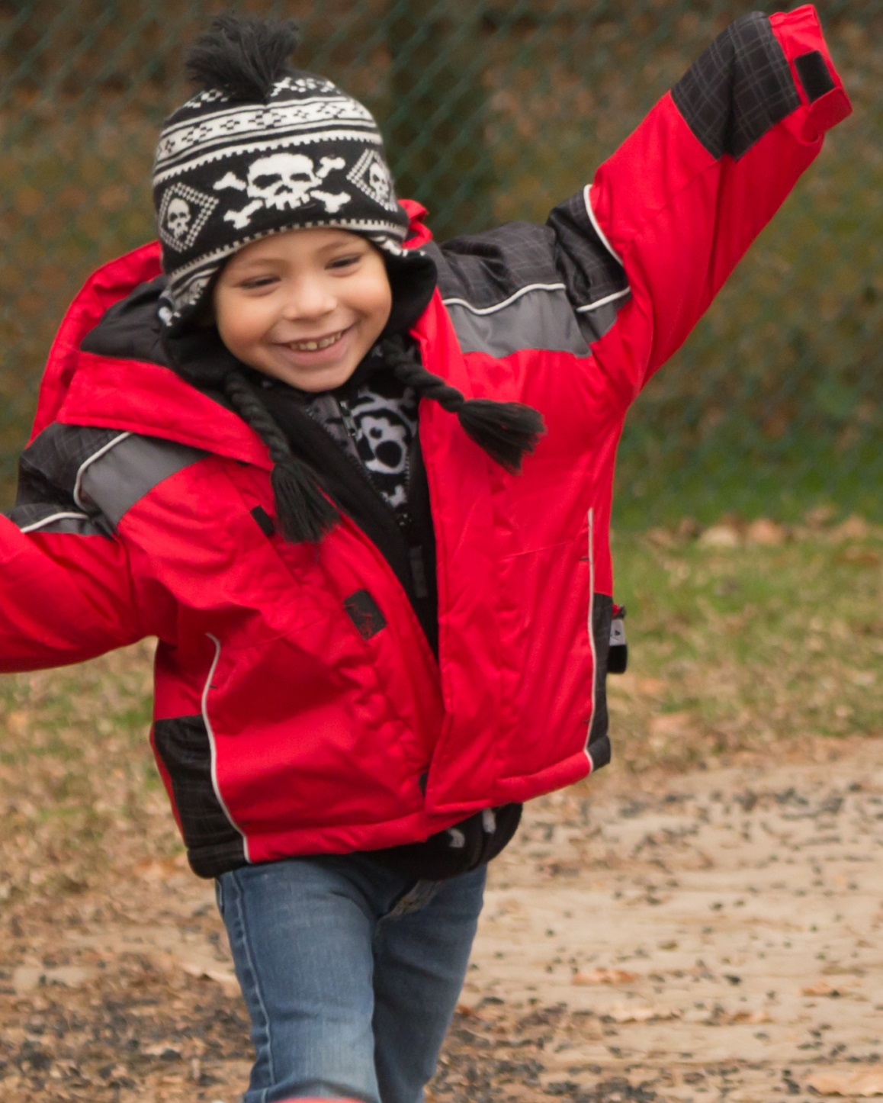
Teach them
to identify emotions in themselves and others.

Slide 32
Conversations: Accident
Think about these questions while watching this video:
What does the teacher do to help a child identify his feeling?
How does the child respond?
What else could the teacher have done to expand the child’s learning?

Slide 33
VIDEO: Conversations: Accident

Slide 34
Video Debrief
What did you notice?
The teacher asks the boy how he is feeling.
The teacher validates the child’s feeling by describing that he would also feel that way in a similar situation.

Slide 35
How Did You Feel?
Think about these questions while watching this video:
What does the teacher say and do to help children identify their feelings?
How do the children respond?
What else could the teacher do?

Slide 36
VIDEO: How Did You Feel?

Slide 37
Video Debrief
What did you notice?
The teacher asks children how they feel.
She brings children to a chart with feeling faces to help them identify their emotions.
She asks them what happened to change their feeling.

Slide 38
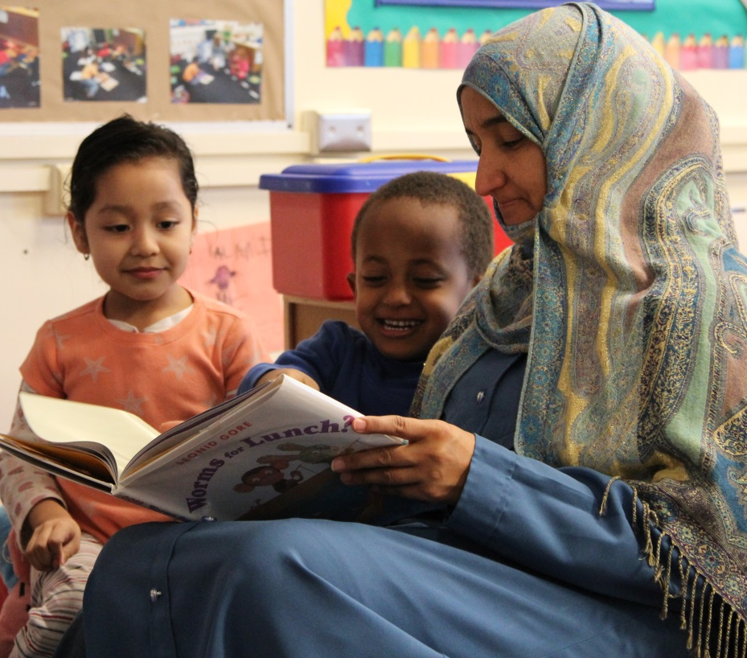
Using Story Books
Ask questions about what characters are feeling and why.
Share new emotion words and meanings.
Plan activities related to emotions that arise in the book.

Slide 39
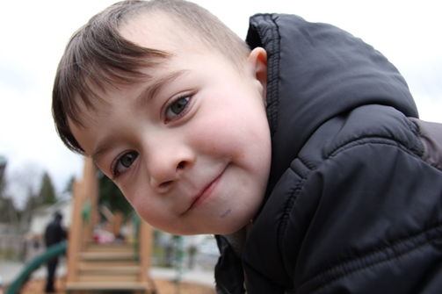
Sample Activity
“I feel proud when I reach the top of the climber.”
Example: Make a class book with children’s photos and stories about feelings.

Slide 40
Using Books: Emotional Literacy
Form small groups.
Look at a story book.
How would you use this book to support emotional literacy during group story time?
Plan questions to ask, emotion words to teach, and two activities that relate to the story and support emotional literacy.
Take a look at the Book Nooks on the website
http://csefel.vanderbilt.edu, but create your own activities.

Slide 41
Families and Culture

Slide 42
Ideal Emotions
Think about these questions while watching this video:
In what ways can cultures vary in the way they value emotions?
Why is this important for teachers to know?

Slide 43
VIDEO: Ideal Emotions
(Real to Reel: Exploring Culture and Emotions excerpt)

Slide 44
Video Debrief
Cultures may value different emotions such as excited or calm.
It is important to understand differences to avoid making assumptions about children’s behavior.

Slide 45
Impact on Self-Conscious Emotions
Situations that cause self-conscious emotions in children may vary across cultures.
  Example: Among Zuni Indians, standing out from others is discouraged. As a result, Zuni children who achieve an individual success, such as outdoing peers on a task, may feel embarrassment or shame.

Slide 46
Talking with Families
What questions would be helpful to ask families about what they teach their children about emotions?
What words can you use to indicate respect and equal partnership with families?
How can you share about practices you are using to teach emotional literacy and why?

Slide 47
Bringing It All Together

Slide 48
Teachers encourage emotional literacy when they:
Teach emotional vocabulary, including words that describe positive feelings.
Help children identify their feelings and those of others.
Talk with parents about values and practices related to emotions.

Slide 49
Teaching Emotion Words
Spend a couple hours observing children in your class and the emotions they express.
Based on your observation, make a plan to teach two feeling words to a small group of children.
Think about child-friendly definitions, ways to show children how to identify the emotions, and opportunities for children to share about times when they felt them.

Slide 50
Using Books to Teach Emotional Literacy
Make a plan to use a children’s story book to teach children about emotions.
Arrange to film your lesson with children.
Read the book and do the planned activities.
Review your recording and reflect on your use of practices and children’s responses.

