Slide 1
Supporting Children Who Are Dual Language Learners
Dual Language Learners: Program and Family Support
EarlyEdU Alliance®
© 2020 University of Washington. All rights reserved.
Notes:
Welcome to our Dual Language Learners: Program and Family Support module. Thank you for joining as we explore supports for children who are dual language learners (DLLs) and their families - including their interconnected identities and cultures. Every day early learning programs serve more a more culturally and linguistically diverse children and families and it is important to have the knowledge, apply the research, and use responsive practices that support the individual needs of all children.
I’m excited for us to learn from one another. In this module, the terms early learning professional, early childhood educator, and variations of these terms refer to educators who work with children ages birth to 5. Most of the core principles apply to educators working with children throughout that age range. Some parts of the module may have more examples, photos, or videos from one age range or type of early learning environment. Some practices may be more relevant to one age range or another. It is important to view the child and from a holistic, strengths-based perspective, including supporting not only their home language but their culture. We will explore this more throughout the module.
Presenter note:
You may need to alter the module activities to individualize this learning experience to match the needs of the participants in your early childhood setting, from center based to home visiting to home based programs. Some participants may be new to the field, others may have years of experience and are furthering their education. Some participants may be working in a family childcare with limited assessment procedures while others may be in Head Start programs with lengthy, structured requirements. The term “Head Start programs” also includes Early Head Start, Migrant Seasonal Head Start, and American Indian/Alaska Native programs.
Guidance for some of the learning activities may include possible participant responses. These are not intended to be comprehensive; they are merely suggestions to help you in leading the activity.
Finally, you will need Internet access to present this module as it contains links to outside content.

Slide 2
Objectives
By the end of this module, you should be able to:
Define Dual Language Learner (DLL).
Describe intentional language supports and explain why they are important.
Discuss the role of the family and how to engage them.
Discuss beliefs, positionality, and being an educator advocate for children who are dual language learners and their families.
Notes:
By the end of this module, you should be able to:
Define Dual Language Learner (DLL).
Describe intentional language supports and explain why they are important.
Discuss the role of the family and how to engage them.
Discuss beliefs, positionality, and being an educator advocate for children who are dual language learners and their families.

Slide 3
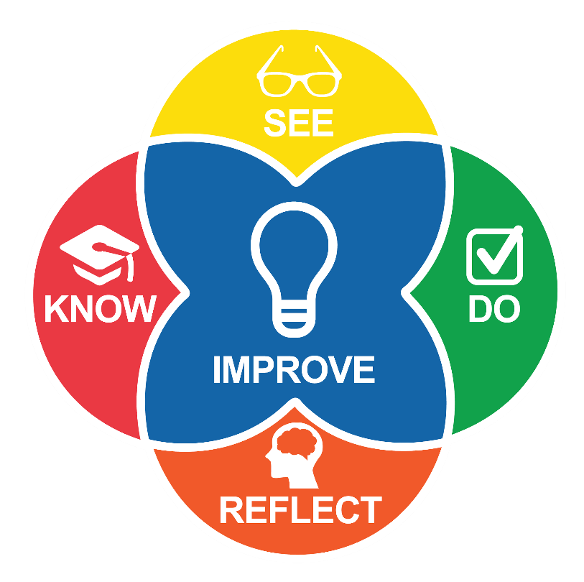
Intentional Teaching Framework
Notes:
We will begin by outlining the frameworks that will guide this module. EarlyEdU Alliance®’s (EarlyEdU) higher education courses and related modules such as this (EarlyEdUAlliance.org) use the Intentional Teaching Framework (Hamre, Downer, Jamil, & Pianta, 2012; Joseph & Brennan, 2013), which guides participants to:
Know—Learn about child development and effective teaching practices.
See—Identify teaching practices and children’s responses in participants’ videos, using specific behavioral language.
Do—Set goals, plan, and use strategies. (Do can also involve applying knowledge during in-class activities.)
Reflect—Participants observe and analyze their practices, using video recordings of their time in the classroom.
Improve—Plan for and implement positive, quantifiable change to teaching practices.
REFERENCES
Hamre, B. K., Downer, J. T., Jamil, F. M., & Pianta, R. C. (2012). Enhancing teachers’ intentional use of effective interactions with children. In R. C. Pianta (Ed.) (2012). Handbook of early childhood education (pp. 507–532). New York: The Guilford Press.
Joseph, G. E., & Brennan, C. (2013). Framing quality: Annotated video-based portfolios of classroom practice by preservice Teachers. Early Childhood Education Journal, 41, 423–430.

Slide 4
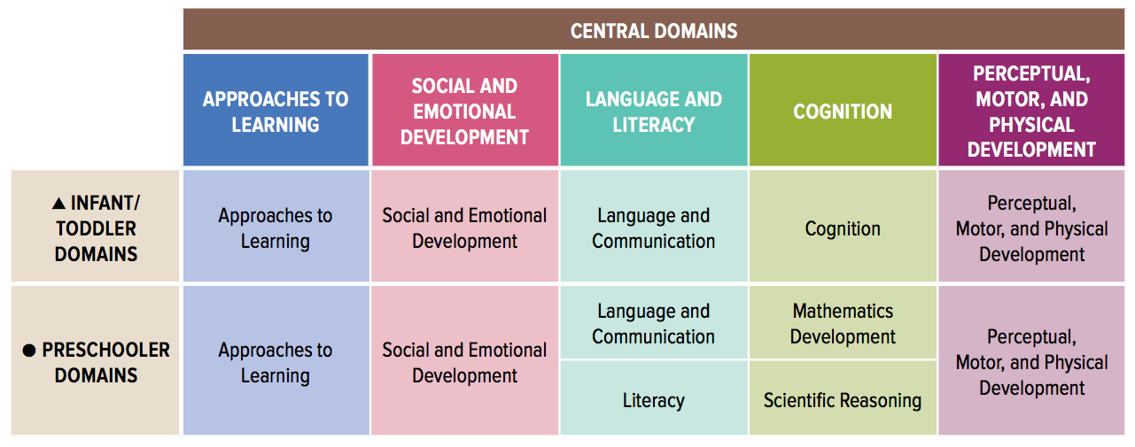
Head Start Early Learning Outcomes Framework
Image credit: Office of Head Start
Notes:
This Head Start Early Learning Outcomes Framework describes the skills, behaviors, and knowledge that educators should foster in children ages birth to 5, including children who are dual language learners or who have disabilities. In Head Start programs, the framework guides curriculum selection, implementation, and assessment and is useful when planning and assessing teaching and learning experiences and children's progress toward school readiness goals.
REFERENCE
U.S. Department of Health and Human Services, Administration for Children and Families, Office of Head Start. (2015). Head Start early learning outcomes framework: Ages birth to five. https://eclkc.ohs.acf.hhs.gov/hslc/hs/sr/approach/pdf/ohs-framework.pdf

Slide 5
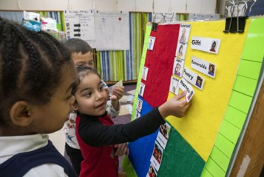
HSELOF Guiding Principles
Each child is unique and can succeed.
Learning occurs within the context of relationships.
Families are children's first and most important caregivers, teachers, and advocates.
Children learn best when they are emotionally and physically safe and secure.
Every child has diverse strengths rooted in their family’s culture, background, language, and beliefs
Image credit: EarlyEdU
Notes:
Guiding principles of the Head Start Early Learning Outcomes Framework include:
Each child is unique and can succeed
Learning occurs within the context of relationships
Families are children’s first and most important caregivers, teachers, and advocates
Children learn best when they are emotionally and physically safe and secure
Every child has diverse strengths rooted in their family’s culture, background, language, and beliefs
REFERENCES
Administration for Children and Families, Office of Head Start (n.d.). Head Start Early Learning Outcomes Framework [PDF]. Retrieved from https://eclkc.ohs.acf.hhs.gov/sites/default/files/pdf/elof-ohs-framework.pdf

Slide 6
First and Second Language Development
Notes:
As we begin talking about how to support children who are dual language learners, let’s discuss what we know about these children and how first and second languages develop.

Slide 7
Discussion: What we know about children who are DLLs
With a partner, discuss your understanding of children who are dual language learners.
In many parts of the world, learning multiple languages is typical and celebrated. However, in the United States, where the primary language is English, children who speak more than one language are often viewed from a deficit-based perspective.
Why might these different perceptions exist?
Be prepared to share your thoughts.
Notes:
With a partner, discuss your understanding of who a dual language learner is. How people perceive children who are dual language learners depends on context. For instance, in many parts of the world, learning multiple languages is typical and celebrated. However, in the United States, where the primary language is English, children who speak more than one language are often viewed from a deficit-based perspective.
Why might these different perceptions and/or beliefs exist?
Be prepared to share your thoughts with the whole class.
Presenter Notes:
Ask participants to first reflect on what they know about children who are dual language learners. After 2-3 minutes, encourage them to move on to the second question. Encourage participants to first discuss the prompts in pairs, then share out to the whole group.

Slide 8
Definition of a Dual Language Learner (DLL)
The Office of Head Start defines dual language learners as children who are learning two (or more) languages at the same time, or learning a second language while continuing to develop their first language.
—Other common terms used include bilingual, English language learner (ELL), Limited English Proficient (LEP), English learner, and children who speak a Language Other Than English (LOTE).
Notes:
For the purposes of this module, we will be using the term dual language learner, or DLL, using the definition given by the Office of Head Start, which says that children who are DLLs are those who are learning two (or more) languages at the same time, or learning a second language while continuing to develop their first language.
This definition is widely used across multiple sources and literature when referring to children who speak languages other than English at home and are learning English in the school setting. They can be immigrants or U.S. citizens who were born in the U.S. Their families usually speak the home language at home, but they may also speak English. Not all children who are DLLs have well-developed home language skills when entering the early childhood setting. Some children who are DLLs come to the early learning setting already speaking or understanding some English. As an important note, we use the term dual language learner, but the principles can apply to children learning more than two languages as well.
We use the term dual language learner to promote a strengths-based approach when working with children who speak a language other than English. The term “dual language learner” may encompass or overlap substantially with other terms frequently used, such as bilingual, English language learner (ELL), Limited English Proficient (LEP), English learner, and children who speak a Language Other Than English (LOTE). We avoid those terms in this module since they can imply a deficit perspective when talking about children who speak a language other than English.
REFERENCE
Office of Head Start. (n.d.) Head Start Performance Standards: 1302.31 Teaching and the learning environment. Retrieved from: https://eclkc.ohs.acf.hhs.gov/policy/45-cfr-chap-xiii/1302-31-teaching-learning-environment.

Slide 9
Video: Dual Language Learners
Watch the Dual Language Learners video from the Office of Head Start
As you watch, think about at least one new thing you learned about children who are dual language learners.
https://eclkc.ohs.acf.hhs.gov/culture-language/article/dual-language-learners-toolkit
Notes:
One of the key concepts that defines working with children who are dual language learners is the relationship between the home language and additional languages. Here’s a video by the Office of Head Start that gives details about dual language learners and maintaining their home language. As you watch, think about at least one new thing you learned about children who are dual language learners.
Presenter Notes:
The video is 4 minutes, 51 seconds long
REFERENCE
U.S. Department of Health and Human Services, Administration for Children and Families, Office of Head Start. (n.d.) Dual language learners [Video file]. https://eclkc.ohs.acf.hhs.gov/culture-language/article/dual-language-learners-toolkit

Slide 10
Debrief: Dual Language Learners
What did you learn about children who are dual language learners?
Notes:
Let’s share!
What is one new thing you learned about children who are DLLs?

Slide 11
Diversity Among DLLs
Children may have different types of access to their home language(s) and to English, such as different:
    Speakers
    Settings
    Amounts and types of experience with each language
Like all children, children who are DLLs demonstrate a wide range of characteristics such as ability, interests, and temperament.
Notes:
Just because there may be several children in our early childhood program whose families come from the same country, or even the same region or town within the same country, each child and family is different and unique. Each family has its own set of experiences and values which shape their culture. And, as we well know, each child is certainly an individual with his or her own interests, temperament, and abilities.
In the words of an Early Head Start teacher: “I see a lot of differences in language and customs among Mexican immigrant families depending on the region they are from, their socio-economic background, highest level of education, and whether they were in a rural or urban setting. I have worked with some families that are from rural areas where they grew up as DLLs, first learning an indigenous language such as Nahuatl, Mixteco, etc, and then learning Spanish.”

Slide 12
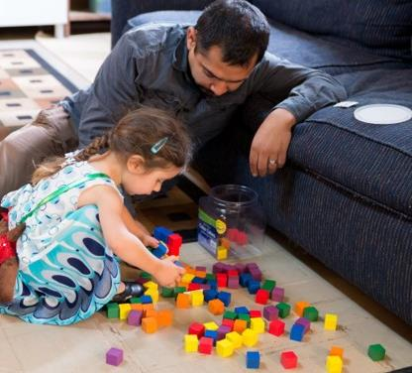
Language Development is Dynamic
The rate of both first and second language acquisition is influenced by both intrinsic and extrinsic factors.
Image credit: EarlyEdU
Notes:
There are various and multiple factors that contribute to the development of language in children who are dual language learners, such as individual differences in language skills (higher receptive than expressive language skills), age of exposure, or the quantity and quality of exposure.
For instance, the quantity and quality of exposure may cause children who are DLLs to experience a time lag between understanding a concept in two languages and having the words in both languages to express it. For example, children may feel and understand emotions in all the languages they are experiencing, but they may only have the words to express their emotions in the language(s) they hear at home. They need to learn the words to express their emotions in all the languages they hear.
As educators, it is important to foster an environment that supports children’s language development and sustenance.

Slide 13
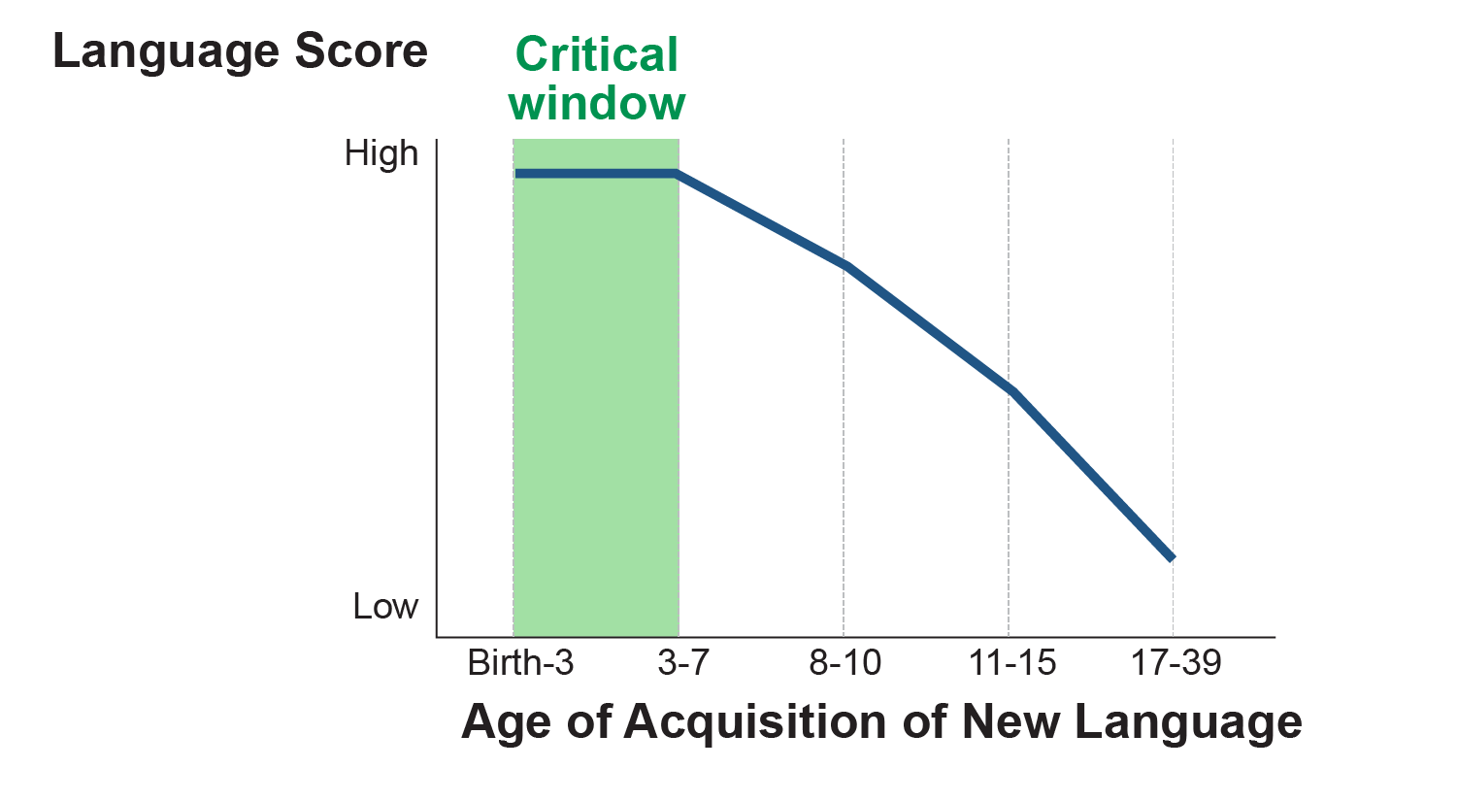
The Younger, the Better
Image credit: EarlyEdU
Notes:
Find your current age on this chart. How easy would it be for you to learn more than one language? How does this chart inform our work with young children?
According to research by Dr. Jonathan O’Muircheartaigh and colleagues in The Journal of Neuroscience (2013), “the brain has a critical window for language development” between the ages of two and four, which may explain why young children are so good at learning two or more languages. Environmental influences are the most powerful during a child’s early years when the brain’s wiring grows as it processes new vocabulary in all the languages that the child hears.” Though it is more difficult, it is definitely still possible to learn languages at various points in life, however. This is important to note for groups such as those seeking tribal languages revitalization, maintenance, and restoration.
REFERENCE
O’Muircheartaigh, J., Dean, D.C., Dirks, H., Waskiewicz, N., Lehman, K., Jerskey, B., & Deoni, S. (2013, Oct. 9). Interactions between white matter asymmetry and language during neurodevelopment. Journal of Neuroscience 33(41). https://doi.org/10.1523/JNEUROSCI.146

Slide 14
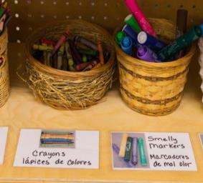
Language Development is Dynamic (continued)
Children may acquire a second language simultaneously or sequentially in relationship to the development of their home language.
Image credit: EarlyEdU
Image credit: EarlyEdU
Notes:
Children can acquire languages either simultaneously or sequentially in relationship to the development of their home language.
Some examples of how educators can support different ages include:
For an infant or toddler dual language learner, include teaching practices that focus on the development of the home language, when there is a teacher with appropriate language competency, and experiences that expose the child to English;
For a preschool age dual language learner, include teaching practices that focus on both English language acquisition and the continued development of the home language
The stages of second language development in the following slides refer to children who acquire a second language sequentially.
REFERENCE
Office of Head Start. National Center on Early Childhood Development Teaching and Learning. (2017). Head start program performance standards support young dual language learners: subpart C – education and child development program. Retrieved from: https://eclkc.ohs.acf.hhs.gov/sites/default/files/pdf/pla-webinar-3-28-2017-handout-2.pdf.

Slide 15
Stages of Second Language Development (Sequential)
Home language use
Nonverbal period
Telegraphic and formulaic speech
Productive language use
Image credit: EarlyEdU
Notes:
Here’s a diagram illustrating stages within sequential language development. Notice how each stage overlaps with the next. In the nonverbal period, we can acknowledge that a child who is a dual language learner is practicing receptive language development of their second language. When a child reaches the telegraphic and formulaic speech phase, they are using two-word phrases (e.g. “Go now.” “Mommy up.”). Finally, productive language use can be considered fluency in language.

Slide 16
Code Switching
The use of elements (phonological, vocabulary, syntactic) from two languages in the same utterance or stretch of conversation
Typical features of dual language development
Rule-governed, not at random
Sensitive to context, intentionally used.
Notes:
One of the most frequent behaviors children who are dual language learners demonstrate is called code switching. This is when a child uses the sounds, words, or sentence structures from one language in a message he is creating in another language. It shows that the child is beginning to internalize the rules of his or her new language by using the rules of his or her foundational language. It also provides children with more rich communication opportunities, since they have two languages at their disposal to use.
Code switching is rule-governed, in that it occurs at points in an utterance where the syntax of both languages is in agreement. It’s also sensitive to context. As early as 18 months, bilingual children make language choices based on their speakers/context, for instance when interacting with parents who speak different languages.
REFERENCES
Genesee, F. (2005). Bilingual first language acquisition in perspective. Childhood bilingualism: Research on infancy through school age. Retrieved from https://www.researchgate.net/publication/284316539_Bilingual_first_language_acquisition_in_perspective
Kuhl, P. K., & Ramirez, N. F. (2016). Bilingual language learning in children. Institute of Learning. Seattle, WA. Retrieved from http://ilabs.uw.edu/sites/default/files/2017_FerjanRamirez_Kuhl_NAEYC.pdf
Petitto, L. & Dunbar, K. (2009). Educational neuroscience: New discoveries from bilingual brains, scientific brains, and the educated mind. Mind Brain Education, 3(4), 185-197. Retrieved from https://www.ncbi.nlm.nih.gov/pmc/articles/PMC3338206/

Slide 17
Video: Creating Bilingual Minds
Watch the TED Talk, Creating Bilingual Minds.
As you watch, think about:
  How code switching shows linguistic sophistication.
  Your experiences with children who code switch and how you’ve handled it.
TEDx Talks (2017, February 8). Creating bilingual minds, Naja Ferjan Ramirez, TEDxLjubljana [Video file]. https://www.youtube.com/watch?v=Bp2Fvkt-TRM
Notes:
Let’s watch a video of a TED Talk by Dr. Ramirez from the Institute for Learning and Brain Sciences at the University of Washington. She explains the brain processing of language in infants and young children while providing evidence that all babies have the full potential to learn two languages at the same time. This video is labeled “bilingual minds” but consider that many children could be multilingual, and this applies to them as well.
As you watch, think about how code switching shows linguistic sophistication. Have you had any experiences with young children who are DLLs that code switch? How have you handled it?
Instructor Note: If you’re not able to show the whole video (17 minutes), you may start from minute 10:00 and watch to 13:35.
Alternative Video: 1-Minute Insight: Why Bilingual Brains Rock! https://www.youtube.com/watch?v=CwVh_5Estnw
REFERENCES
Latin American Association for Bilingual Education (September 17. 2016). 1 Minute Insight Why Bilingual Brains Rock! [Video file]. https://www.youtube.com/watch?v=CwVh_5Estnw
TEDx Talks (2017, February 8). Creating bilingual minds, Naja Ferjan Ramirez, TEDxLjubljana [Video file]. https://www.youtube.com/watch?v=Bp2Fvkt-TRM

Slide 18
Debrief: Creating Bilingual Minds
How does code switching show linguistic sophistication?
From your experience, how have you handled your children or students’ code switching?
Notes:
Now that you have watched the video, think about your responses to the following questions:
How does code-switching show linguistic sophistication?
From your experience, how have you handled your children or students’ code switching?

Slide 19
Word Mixing
Systematic borrowing of words by simultaneous
bilinguals from the dominant language into the non-dominant
It reveals a cognitive competence— filling in the gap
Notes:
Another common behavior of young children who are DLLs is word mixing. This is when they borrow words from one language to fill in the gap of what they are trying to communicate in another language. Again, this shows the young brain’s amazing desire to communicate as competently as possible! It often occurs out of necessity for children who are simultaneous bilinguals.
REFERENCES
Pettito, L. & Dunbar, K. (2009). Educational neuroscience: New discoveries from bilingual brains, scientific brains, and the educated mind. Mind, Brain, and Education 3(4), p. 185-197.https://onlinelibrary.wiley.com/doi/abs/10.1111/j.1751-228X.2009.01069.x
Riches, C. (2006). Literacy: Crosslinguistic and Crossmodal Issues. In F. Genesee, K. Lindholm-Leary, B. Saunders, & D. Christian (Authors), Educating English Language Learners: A Synthesis of Research Evidence (pp. 64-108). Cambridge: Cambridge University Press.. http://dx.doi.org/10.1017/CBO9780511499913.004

Slide 20
To recap...
Code Switching Done intentionally to create a particular social impact | Borrowing words from another language and mixing them into an utterance | Word Mixing Done unintentionally and out of necessity, usually because the child doesn’t remember the word in one language
Notes:
In other words, the difference between code switching and word mixing is in its purpose and intentionality.
Both involve borrowing words from another language and mixing them into an utterance. Code-switching is done intentionally to create a particular social impact. Word mixing is done unintentionally and out of necessity, usually because the child doesn’t remember the word in one language.
REFERENCE
Tay, M. W. (1989). Code switching and code mixing as a communicative strategy in multilingual discourse. World Englishes, 8(3), 407-417.

Slide 21
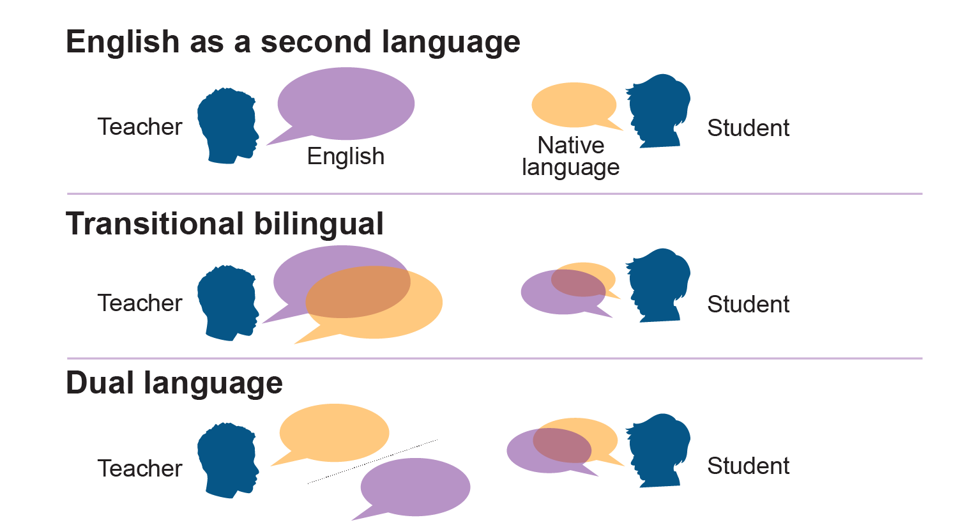
Program Models in a Nutshell
Image credit: EarlyEdU
Notes:
English as a second language (ESL), Transitional bilingual education (TBE), and Dual language (DL) are the three most common program models that exist, especially in the United States. While the TBE and DL program models both fall under the bilingual category, their goals are quite different since the TBE program’s goal is to reach English proficiency while the DL program is aimed at promoting proficiency in both languages.
As for the ESL approach, the primary goal is to accomplish English proficiency as soon as possible (or proficiency in whatever language students are being immersed in for instruction).

Slide 22
Video: Dual Language Programs Explained
Watch the video, Dual Language Programs Explained, by the American Institutes for Research on language program models.
As you watch, consider: What do you think about the challenges set forth for implementing dual language and transitional bilingual education program models?
  Have you personally experienced any of them?
American Institutes for Research (2016, April 5). Dual language programs explained [Video file]. https://www.youtube.com/watch?v=3dzO9upZO8I&feature=youtu.be
Notes:
Let’s watch this video, Dual Language Programs Explained, published by the American Institutes for Research. It discusses differences between bilingual programs, specifically one/two-way dual language programs and transitional bilingual education programs. It also discusses the results of a research review conducted by the managing researcher, Diane August, on the effectiveness of bilingual programs compared to ESL programs. Finally, the video discusses some challenges in the implementation of bilingual programs.
As you watch, consider: What do you think about the challenges August set forth for implementing dual language and transitional bilingual education program models? Have you personally experienced any of them?
Presenter Notes:
The video is 4 minutes, 30 seconds long.
REFERENCE
American Institutes for Research (2016, April 5). Dual language programs explained [Video file]. https://www.youtube.com/watch?v=3dzO9upZO8I&feature=youtu.be

Slide 23
Debrief: Dual Language Programs Explained
What do you think about the challenges set forth for implementing dual language and transitional bilingual education program models?
Have you personally experienced any of them?
Notes:
What do you think about the challenges set forth by August for implementing dual language and transitional bilingual education program models? Have you personally experienced any of them?

Slide 24
Intro: Sharing an English Book In Spanish
Watch this video from a Migrant Head Start program in California.
As you watch, identify characteristics that may indicate that this classroom is implementing a transitional bilingual education model.
Notes:
This video is from a Migrant Head Start program in California, therefore its student population is primarily Spanish-speaking children. Watch the video and identify some characteristics that may indicate that this is a Transitional Bilingual Education program.
Presenter Notes:
The video is 1 minute, 30 seconds long.

Slide 25
Video: Reading an English Book in Spanish
Video: Sharing an English Book in Spanish
Notes:
Presenter note:
This clip is 1 minute, 30 seconds long.
REFERENCE
Cultivate Learning, University of Washington. (2019). Sharing an English book in Spanish [Video file]. https://eclkc.ohs.acf.hhs.gov/video/sharing-english-book-spanish

Slide 26
Debrief: Sharing an English Book In Spanish
What characteristics might indicate that this classroom is implementing a transitional bilingual education model?
Notes:
What characteristics did you observe in the video that indicate that this classroom is implementing a transitional bilingual education model?
Possible Answers: Instruction is primarily in Spanish, but the teacher is using an English book. This might be intentional as the teacher may be trying to gradually incorporate English vocabulary into her instruction so children can become familiar with it. Over time, the teacher would switch instruction to English-only.

Slide 27
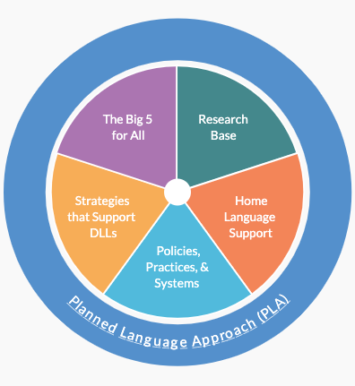
Head Start’s Planned Language Approach
Big 5 Early Literacy Components
Background knowledge
Vocabulary development
Phonological awareness
Alphabet and letter knowledge
Print awareness
Notes:
Background knowledge, vocabulary development, phonological awareness, alphabet and letter knowledge, and print awareness represent the five essential components of early literacy. Together, they’re known as the Big 5 as part of the planned language approach developed for the Office of Head Start.
Participants can look more in-depth at each one and learn about strategies to help children who are dual language learners develop these skills through the PLA page on the ECLKC.
REFERENCES
Office of Head Start. (2019, April 8). Planned language approach (PLA): Big 5 for all. https://eclkc.ohs.acf.hhs.gov/culture-language/article/planned-language-approach-pla-big-5-all
Summary of early literacy components. (2019). https://static1.squarespace.com/static/531bd3f2e4b0a09d95833bfc/t/59d67d15d7bdcefcc92f2511/1507228949898/10elcompsummary.pdf

Slide 28
Planning Across Domains
Head Start ELOF Domains
Approaches to Learning
Social and Emotional Learning
Language and Communication
Cognition/Mathematics and Scientific Reasoning
Perceptual, Motor, and Physical Development
Notes:
Though language is an area of focus for supporting children who are dual language learners, educators must consider unique ways that children learn across the multiple domains outlined earlier in the Head Start Early Learning Outcomes Framework. These are just a select few considerations – what other ways do you support children who are dual language learners in your program?
APPROACHES TO LEARNING Though the research is not all in agreement, some sources suggest that young children who are dual language learners (DLLs) may develop increased flexibility in thinking, working memory, and sustained attention as they learn multiple languages.
SOCIAL AND EMOTIONAL LEARNING Children who are dual language learners (DLLs) may demonstrate social and emotional skills in their home language, English, or in both languages. A sense of identity and belonging contributes to school readiness and learning by helping children gain self-confidence. When children feel good about themselves and what they can do, they engage more fully in learning opportunities. Children’s cultural backgrounds influence the ways that they demonstrate interests, imitate others, or engage in play situations. Some cultures encourage children to stand out as individuals, while other cultures emphasize group identity.
LANGUAGE AND COMMUNICATION Cultural expectations can influence adult-child interactions in many ways. For example, in some cultures, children are taught to show respect to adults by making direct eye contact when spoken to. In other cultures, children are taught that respect is demonstrated by avoiding direct eye contact.
COGNITION/MATHEMATICS AND SCIENTIFIC REASONING Because cognitive development encompasses a broad range of skills, behaviors, and concepts, children display great individual variation in their development from birth to 5. Prior experiences, cultural and linguistic backgrounds, temperament, and many other factors can impact the rate and course of cognitive development.
PERCEPTUAL, MOTOR, and PHYSICAL DEVELOPMENT Children can practice and refine both their fine and gross motor skills during a variety of learning experiences and while performing self-help routines, such as eating with a fork or putting on clothes. In some cultures, children use brushes to write their names or utensils to eat that require a great deal of hand-eye coordination. Their fine motor development may differ from other children because of their life experiences.
REFERENCES
Office of Head Start. (n.d.) Head Start Early Learning Outcomes Framework: Ages Birth to Five. https://eclkc.ohs.acf.hhs.gov/interactive-head-start-early-learning-outcomes-framework-ages-birth-five

Slide 29
Activity: Informing Curriculum
Consider your program’s daily schedule.
How might you support children who are DLLs in your program during each time frame?
Notes:
Draft your program’s schedule for the day, including approximate time frames. For each time frame, write one way you could provide support in terms of language development or across the Head Start domains we just discussed. For example, what would a culturally supportive snack time look like?
Presenter notes: Allow 5-8 minutes for participants to journal independently. Open up a class discussion for anyone that wants to share.

Slide 30
Family Engagement
Notes:
When we think of supporting children who are dual language learners, it is important to also consider their family context and how we can engage their families in our learning strategies. Let’s begin with reviewing our own perspectives on the role of family and how that impacts our how we as educators, involve families in our programs and learn about the families’ cultural context, diversity, ethnicity, and ways of life.

Slide 31
Activity: Message Received
Write down some messages you’ve received about how to raise children.
Have these messages changed over time?
Do you disagree with any of them?
Whom do you trust for information? Whom do you tend not to trust?
What does good parenting mean to you?
Who gets a say in how to raise a child? Who doesn’t?
Notes:
Take a few moments to jot down some of your ideas about the messages you’ve received at any point in life regarding how to raise a child, especially a child who is a dual language learner. These messages can be explicit or implicit. For instance, maybe your friend told you directly, or maybe it’s a common theme you have seen in movies.
It is very important that professionals reflect on their values about language and child-rearing to examine how it affects their work. It’s easy to be unintentionally prejudiced about raising and teaching young children. People can be very firm and rigid in their views and educators must be cognizant of how that influences their interactions and recommendations.
An example could be breastfeeding. Opinions vary regarding how long a child should breastfeed. However, sometimes professionals react negatively when they learn that a toddler is still breastfeeding. Mothers and families can view this reaction as disrespectful.
One way for professionals to communicate with families is to talk with them openly about their feelings surrounding various topics. To continue with the breastfeeding example, sometimes mothers enjoy breastfeeding and find it to be a positive aspect of their relationship with their child, while others desperately look forward to weaning their child as soon as possible. Based on their feelings, professionals can support the family as needed without imposing their personal beliefs.

Slide 32
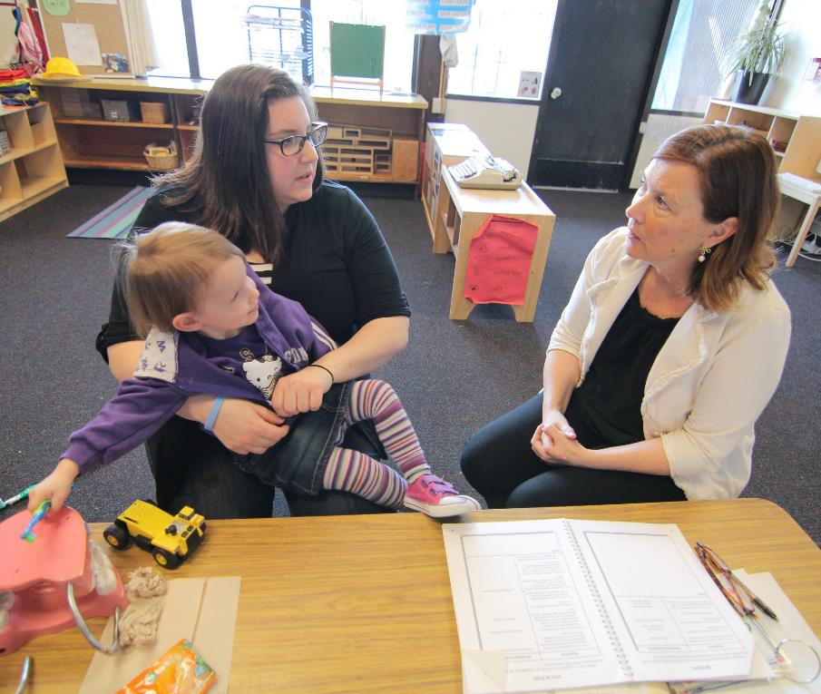
How to Engage in Family-Centered Practice
Focus on the child and the family.
Emphasize teamwork and mutual respect.
Consider family strengths, aspirations, priorities and resources.
Respect and support family choices and decisions.
Promote partnerships.
Image credit: EarlyEdU
Notes:
Educators team with families by listening to them and respecting what they know about their children and family culture. Educators also share information about supporting children to develop to their fullest potential and offer families home practice suggestions. This knowledge-sharing is essential when working with young children who are dual language learners and their families. Educators show families how their home language helps their children learn other oral and written languages, such as English.
Form mutually respectful partnerships that engage families in their child’s development. Find the resources to communicate effectively with family members who speak a different language and learn as much as possible about a family’s language and culture.
Respect different languages and cultures. Be aware of your facial expressions, body language, and time spent speaking versus listening in conversation. Allow families to speak completely and respect their boundaries (When they choose not to speak, when they seem uncomfortable about a certain topic, etc.)
Listen to listen, not to respond-- avoid giving unsolicited advice.
REFERENCES
Head Start ECLKC (2018). Partnering with families of children who are dual language learners. https://eclkc.ohs.acf.hhs.gov/publication/partnering-families-children-who-are-dual-language-learners
U.S. Department of Health and Human Services, Administration for Children and Families, Office of Head Start. National Center on Parent, Family and Community Engagement. (n.d.) Building partnerships: Guide to developing relationships with families. https://eclkc.ohs.acf.hhs.gov/sites/default/files/pdf/building-partnerships-developing-relationships-families.pdf

Slide 33
Intro: Welcoming and Communicating with Families
Watch the video Welcoming and Communicating with Families of DLL Children.
As you watch, think about what ideas stand out to you. How can we make families of children who are DLLs feel welcome in our programs?
Notes:
Watch this video featuring Dr. Lillian Duran, Welcoming and Communicating with Families.
As you watch, think about what ideas stand out to you. How can we make families of children who are DLLs welcome in our programs?

Slide 34
Video: Welcoming and Communicating with Families
Video: Welcoming and Communicating with Families
Notes:
Instructor Notes:
The video is 2 minutes, 43 seconds long.

Slide 35
Debrief: Welcoming and Communicating with Families
What ideas stood out to you in the video?
How can we make families of children who are DLLs feel welcome in our programs/settings?
Notes:
Let’s share:
What ideas stood out to you in the video?
How can we make families of children who are DLLs feel welcome in our programs and engage them in their children’s learning?

Slide 36
Language and Literacy Begins at Home
Experiences and relationships matter
Adults and peers nurture oral language development through meaningful conversations, singing, dramatic play, and many opportunities to tell stories and listen and respond to stories told and read by adults.
Notes:
Children develop their attitudes about literacy and reading in the very early years, at home and in care settings, through experiences and relationships with important people in their lives (Morrow, 2000). Children who are biliterate can develop important connections and a sense of belonging with their culture through literature such as traditional cultural stories.
Adults and peers nurture oral language development through meaningful conversations, singing, dramatic play, and many opportunities to tell stories and listen and respond to stories told and read by adults.
Educators can help children develop their language and literacy skills by partnering with families! Encourage families to use their home language to read, sing, talk, and play with their children.
REFERENCES
Morrow, L. M. (2000). Early literacy development: Research and practice. In Psychological perspectives on early childhood education. (Ed. Golbeck, S.). (253-279). NY: Erlbaum
Novick, R. (1998). Learning to Read and Write: A Place to Start. Washington, D.C., Northwest Regional Educational Laboratory Child and Family Program.

Slide 37
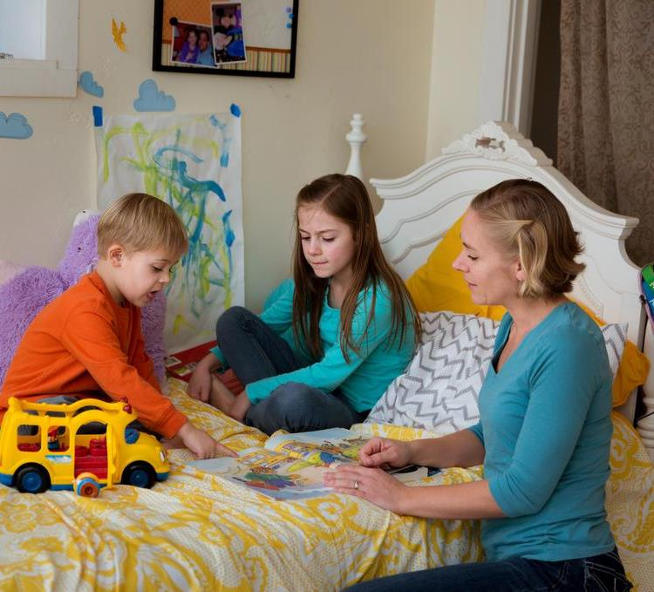
The Family’s Role in Literacy
Quantity of book reading is related to vocabulary and listening comprehension development.
Attention to teaching children to read and write words is related to reading skills at the end of Grade 1.
Image credit: EarlyEdU
Notes:
Again, families are educators’ partners in developing early literacy skills, especially with young dual language learners. Educators help families realize their important role in reading and talking with their children in their home language for future language and literacy development in subsequent language learning.
The quantity of book reading is related to vocabulary and listening comprehension development:
These skills are later related to reading achievement in
Grade 3.
Attention to teaching children to read and write words is related to reading skills at the end of Grade 1:
Word reading at the end of grade 1 predicts reading comprehension at the end of Grade 3.
REFERENCE
Sénéchal, M. & LeFevre, J. (2002). Parental involvement in the development of children’s reading skill: A five-year longitudinal study. Child Development, 73 (2), 445-460.

Slide 38
Activity: Asking Questions
Choose a partner and practice asking and answering questions.
One person is the educator, one person is the parent.
Notes:
Handout: Conversations to Gather Language Information
Work with a partner (preferably someone you don’t already know). Practice asking some of the questions suggested on the handout to learn more about the oral and written language experiences of young dual language learners. One person should pretend to be the educator and the other person should pretend to be the parent, then switch.
Presenter Notes:
Give participants 5-10 minutes to practice asking and answering questions.

Slide 39
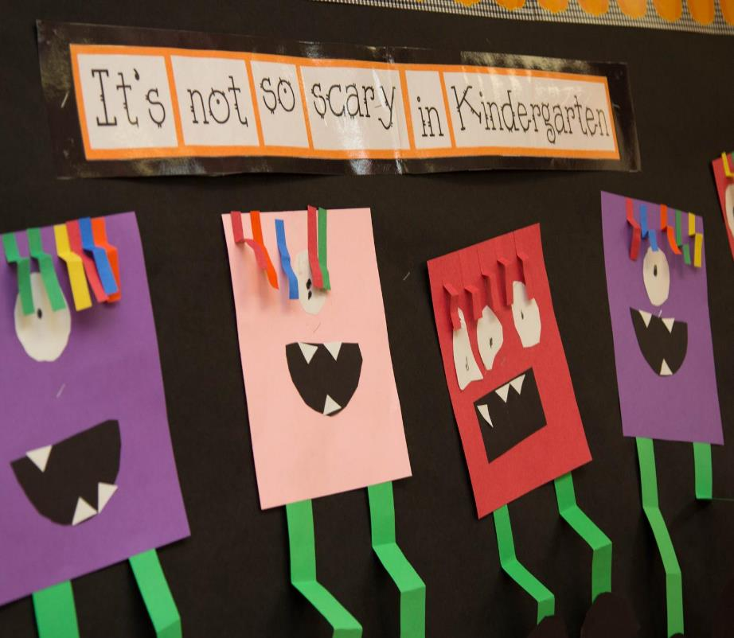
Establishing Transition Policies and Practices
Transitions into your program
Transitions out of your program
Transitions within your program
Image credit: EarlyEdU
Image credit: EarlyEdU
Notes:
It is also important to support children who are dual language learners and their families through transitions they may experience.
Transitions occur in multiple ways:
Transitions into your program (whether the child transitions from home or another program)
Transitions out of your program (whether the child transitions to another early education program or elementary school)
Transitions within your program (whether the child transitions from one age-group to another or between program options)
Transition practices are the daily interactions and activities informed by program policies that support children’s transition into and out of your program. They are implemented by educators, caregivers, home visitors, and family service workers. Working with a team, program leaders establish policies that lay the foundation for collaborative transition practices.

Slide 40
Transitions - Individualization Policies
Engage our families of children who are DLLS in conversations about school readiness and discuss specific strategies
Co-create individualized transition plans
Arrange for our children who are DLLs and families to visit prior to transition
Notes:
In terms of individualization policies, here are ideas around how staff can support families and children with unique backgrounds, strengths, and needs during transitions. This includes families who are recent immigrants or refugees, families experiencing homelessness, families who are fostering children, or families who have children with disabilities or other special needs.
Practices include:
Engage our families of children who are DLLs in conversations about school readiness and discuss specific strategies our families can use to support their children’s readiness for school
Co-create individual plans with each family for their child’s transition from Early Head Start to Head Start or from Head Start to the next program that include language and cultural considerations
Approach destination programs and arrange for our children who are DLLs and families to visit prior to transition
REFERENCE
Office of Head Start. (n.d.). Dual language learners program assessment. Retrieved from: https://eclkc.ohs.acf.hhs.gov/culture-language/guide-dual-language-learners-program-assessment-dllpa/download-dllpa

Slide 41
Transitions - Individualization Policies (cont.)
Share information with families on their rights under federal and state laws, including rights under the Individuals with Disabilities Education Act (IDEA) and rights related to bilingual education services
Notes:
Make sure families are aware of their rights and any changes in policies affecting their child.
REFERENCE
Office of Head Start. (n.d.). Dual language learners program assessment. Retrieved from: https://eclkc.ohs.acf.hhs.gov/culture-language/guide-dual-language-learners-program-assessment-dllpa/download-dllpa

Slide 42
Intentional Language Support
Notes:
We have discussed many concepts around children who are dual language learners and engaging their families. Now go even more in depth with strategies that educators can use in their programs to give intentional language support.

Slide 43
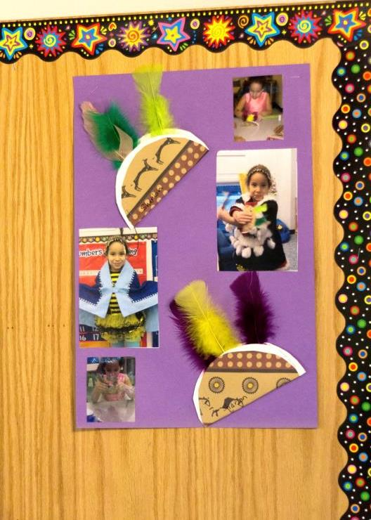
A Young Child’s Environment is
Physical and Social-Emotional
Physical environment:
  Objects and spaces
Social-emotional environment:
  People, relationships, values, beliefs
Image credit: EarlyEdU
Notes:
When we talk about a child’s environment, we are talking about the physical and social-emotional characteristics of the environment. Both are crucial to support learning for all students, and this is no different for children who are DLLs. Educators can use specific strategies so children who are DLLs feel most supported.

Slide 44
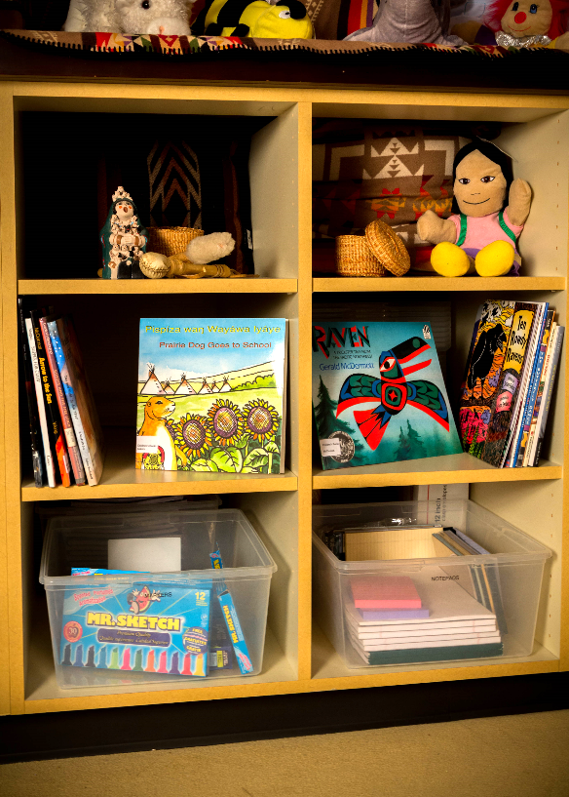
Relevant Cultural Materials and Artifacts
Are structured and intentionally mindful of children’s cultures.
Reflect not just diversity, but also the actual culture of the children.
Being able to identify with different cultural references in the environment helps children feel they belong and facilitates learning.
Image credit: EarlyEdU
Notes:
Welcoming and supportive physical environments are structured and intentionally mindful of children’s cultures. Early learning artifacts reflect not just diversity, but also the actual culture of the children.
Again, families are integral for educating their children because they help build upon their home language and culture as their child learns new languages. Families can let educators know when cultural artifacts they place in their classrooms do not accurately reflect their culture. This is easily stated, but challenging to ensure. It takes safe, trusting relationships and program policies/supports that enable families to feel welcomed/engaged to do this.
In addition to relevant cultural materials and artifacts, a sense of belonging and acceptance is nurtured both through caring and responsive adult-child relationships and by identification with different cultural reference points. For example, children who are dual language learners connect when they hear a peer or adult in the classroom speak their native language. They gain a sense of belonging when they see a traditional activity from their culture discussed in a book or during circle time. A sense of belonging can boost children’s self-esteem and confidence and motivate them to learn.
REFERENCE
Castro, D. C., Espinosa, L. M., & Paez, M. M. (2011). Defining and measuring quality in early childhood practices that promote dual language learners' development and learning. In M. Zaslow, I. Martinez-Beck, K. Tout, & T. Halle (Eds.), Quality measurement in early childhood settings (pp. 257-280). Baltimore, MD: Brookes.

Slide 45
Increase Predictability
Provide access to rules, expectations, and activity directions in English, as well as in home languages.
Increasing predictability for DLLs is crucial:
  Language barrier might impede children’s understanding of rules and expectations, which can produce anxiety.
  If children feel excessively anxious or unfamiliar with rules, they are more likely to shut down, withdraw, or act out
Notes:
Young children who are DLLs benefit from having classroom rules and expectations explained to them in their home languages, so they know how to interact and learn. When they clearly understand the rules and expectations, their environment is more predictable, and they feel safer and more comfortable.
When a language barrier impedes children’s understanding of the rules and behavioral expectations, they can grow anxious. If children feel excessive anxiety because they don’t understand the rules, they are more likely to shut down, withdraw, or act out.
REFERENCES
Castro, D. C., Espinosa, L. M., & Paez, M. M. (2011). Defining and measuring quality in early childhood practices that promote dual language learners' development and learning. In M. Zaslow, I. Martinez-Beck, K. Tout, & T. Halle (Eds.), Quality measurement in early childhood settings (pp. 257-280). Baltimore, MD: Brookes.
Goldenberg, C., Hicks, J., & Lit, I. (2013). Dual language learners: Effective instruction in early childhood. American Educator, 37(2) pp. 26-29. https://eric.ed.gov/?id=EJ1013928

Slide 46
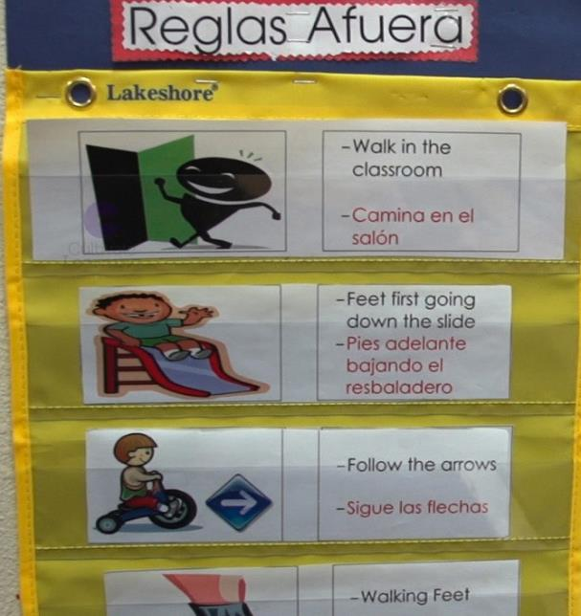
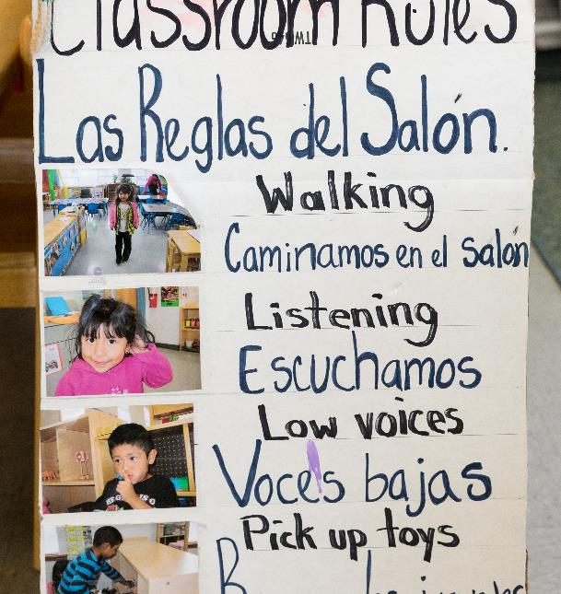
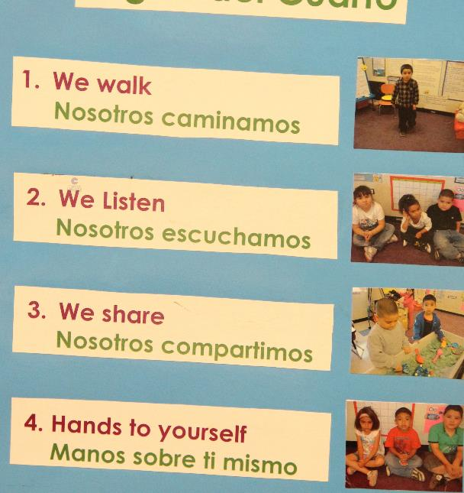
Example: Classroom Rules
Image credit: EarlyEdU
Image credit: EarlyEdU
Image credit: EarlyEdU
Notes:
Here’s an example of educators who made the classroom more predictable by making the rules explicit and accessible to children who are DLLs. They paired print with visuals and provided the information in children’s home language, in this case Spanish.
REFERENCE
Castro, D. C., Espinosa, L. M., & Paez, M. M. (2011). Defining and measuring quality in early childhood practices that promote dual language learners' development and learning. In M. Zaslow, I. Martinez-Beck, K. Tout, & T. Halle (Eds.), Quality measurement in early childhood settings (pp. 257-280). Baltimore, MD: Brookes.

Slide 47
Intro: Setting a Supportive Classroom Environment for DLL Children
Watch this video of an interview with Dr. Lilian Duran.
As you watch, identify the strategies she mentioned that support a classroom’s physical environment and those that support the social-emotional environment.
Notes:
Let’s watch a video featuring expert Dr. Lilian Duran about setting up a supportive classroom environment. Though some older videos like this one still reverse the order and say “DLL Children,” please note that as a field we have more consistently begun using person first language such as “Children who are Dual Language Learners” and that is the preferred strategy going forward. Also, the video title states “classroom,” but the strategies discussed can be applied directly or adapted for other early childhood settings.
As you watch this video, identify which strategies Dr. Duran mentioned that create a supportive physical environment and those that support the social-emotional environment.

Slide 48

Video: Setting a Supportive Classroom Environment for DLL Children
Video: Setting a Supportive Classroom Environment for DLL Children
Notes:
Instructor Notes:
The video is 3 minutes, 39 seconds long.

Slide 49
Debrief: Setting a Supportive Classroom Environment for DLL Children
Which strategies did Dr. Duran mention that support a classroom’s physical environment, and which ones support the social-emotional environment?
Did she mention any new strategies that are new to you?
Notes:
It’s time to debrief. Which strategies did Dr. Duran mention that support a program’s physical environment, and which ones support the social environment?
Possible Answers:
Physical environment: Having culturally familiar objects; encouraging communication by having one less paintbrush than the number of children at the art center, for instance
Social-emotional environment: One-on-one time individually or in small groups, peer interaction and play

Slide 50
Activity: Is my Early Learning Environment Supportive?
Use the “Supporting Emergent Bilingual Children in Early Learning Checklist”
Versions in multiple languages found at: https://www.edc.org/early-ed-tools
Notes:
Handout: Use the Supporting Emergent Bilingual Children in Early Learning Checklist
Some of you might already be using a measure that assesses the quality of your early care setting (physical and social) for all children, but not necessarily for children who are DLLs. Although these measures might be similar, as we have reviewed in today’s lesson, we need to take more factors into account when working with children who are DLLs.
The Education Development Center has developed a quality environment checklist to support emergent bilingual children. This checklist is available in English, Spanish, and Chinese, so feel free to use this to assess the quality of your early care setting for children who are DLLs. The link below also has access to other resources for your early care setting that you might want to explore.
Ask participants to take a few minutes to review the checklist and determine 2-3 items that they do well and 2-3 items they would like to do or improve upon. Participants can they pair and share their ideas with a partner.
REFERENCE
Education Development Center. (2019). Supporting Emergent Bilingual Children in Early Learning Checklist. Retrieved from https://www.edc.org/early-ed-tools

Slide 51
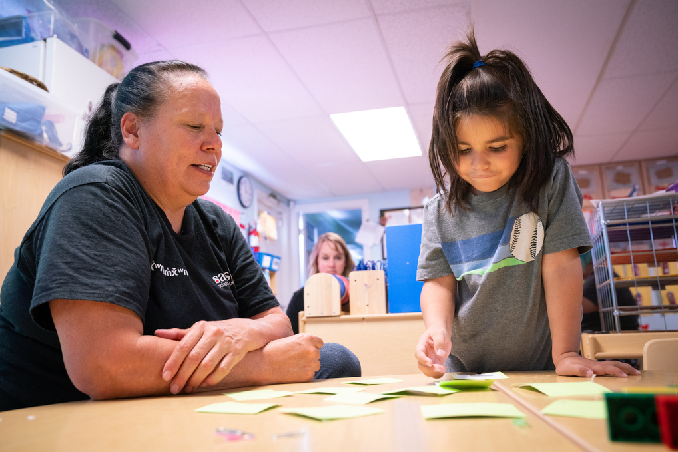
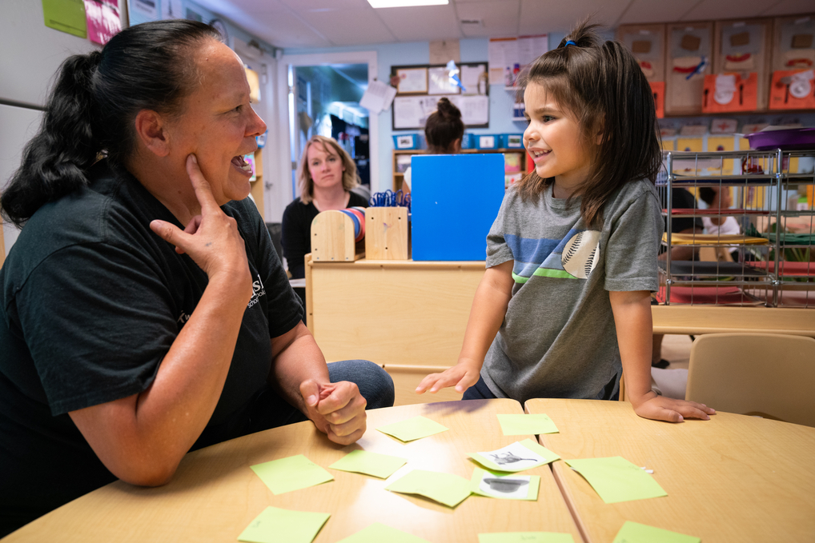
Joint Attention
Shared Attention
Attention focused on the same thing
Attention focused on each other
Image credits: EarlyEdU
Notes:
A very important way that educators engage with children and provide a high-quality environment is by being intentional in how they use joint or shared attention. In joint attention, the educator and child focus on the same thing, such as a book or an art project. In shared attention, the educator and child focus on each other. Intentional use of attention supports both relationship building and language development as educator and child explore language together, often naming objects and exploring meaning while the educator extends and enriches the child’s language.

Slide 52
Intro: Following a Child’s Lead
Watch the video and answer the following questions:
  What were the educator and child doing at the beginning?
  What happened next?
  Did the teacher redirect the child’s attention right away? If not, what did she do?
  How did the child react?
Notes:
Another way educators can support language development with children who are dual language learners is to follow the child’s lead. Instead of having a prescribed idea about how children should respond to your questions and comments, accept what they say and build upon it to further the conversation. It will help keep them engaged and allow for more practice using language in a way that is relevant to them.
Let’s watch an example. As you watch, think about the following questions:
What were the teacher and child doing at the beginning?
What happened next?
Did the teacher redirect the child’s attention right away? If not, what did she do?
How did the child react?

Slide 53
Video: Following a Child’s Lead—Example
Video: Following a Child’s Lead—Example
Notes:
Instructor Notes:
The video is 1 minute, 50 seconds long.
This video is from a bilingual preschool (English and Spanish), so the conversation is in Spanish and the captions are in English.

Slide 54
Debrief: Following a Child’s Lead
What were the educator and child doing at the beginning?
What happened next?
Did the educator redirect the child’s attention right away? If not, what did she do?
How did the child react?
Notes:
Now that we’ve watched an example, let’s discuss what you saw.
What were the educator and child doing at the beginning?
What happened next?
Did the educator redirect the child’s attention right away? If not, what did she do?
How did the child react?
Possible Answers: The educator and child were working on a number identification activity. A few minutes later, the child changed the topic, saying his mom needed to go to work to be able to get money. The educator followed the child's lead and asked follow-up questions about this (3:37). The educator built off the conversation and later used it to connect it to the original topic (math numbers; 4:02 to 4:34).

Slide 55
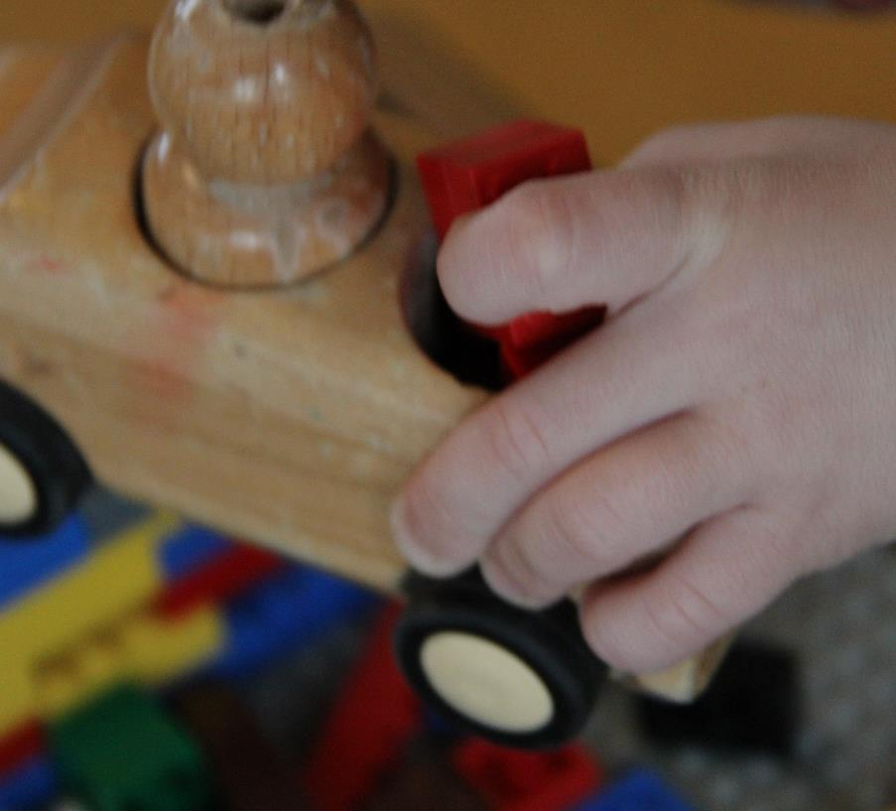
The CAR Strategy
Comment and wait.
Ask questions and wait.
Respond to extend the conversation.
Image credit: EarlyEdU
Notes:
One way to both follow a child’s lead and engage in conversation with young children who are dual language learners is to use the CAR strategy:
Comment and wait.
Ask questions and wait.
Respond to extend the conversation.
Educators can encourage young language learners to engage in longer conversations by following the child’s lead. Comment on what interests the child. Ask questions. Respond to the child by adding more to extend the conversation. With each step, allow adequate wait time so the child can participate in the conversation. The general guideline is 5 seconds. This depends on each child, because children who have special needs and children who are DLLs might need more time to process what you said in English. They might be making sense of it in their home language.
Presenter Notes:
You may want participants to take turns holding different types of conversations and using the “CAR” technique with their fellow module participants.
REFERENCE
Notari-Syverson, A., Maddox, M., Lim, Y.S., & Cole, K. (2002). Language is the key: A program for building language and literacy. Seattle, WA: Washington Research Institute

Slide 56
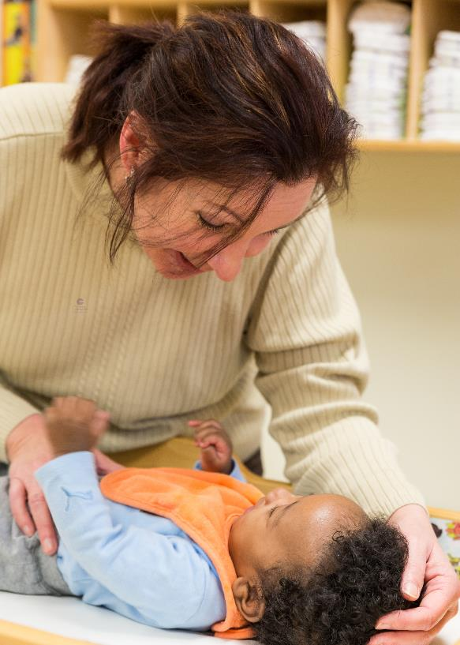
Conversation Strategies
OWL: Observe, Wait, Listen
Share the moment:
Get face-to-face.
Let the child know you are listening.
Comment on the child’s interests.
Ask real questions:
    What if? What next?
    What is that? Why did she do that?
Image credit: EarlyEdU
Notes:
With infants and toddlers, it is often more effective to wait quietly and let them come to you to interact. If they see their caregivers are watching and listening, then they will know that adults are interested in them. Then they will be more likely to interact.
Even with the youngest of our dual language learners, use authentic questions. Again, that is why they need essential “conversations” in their home language, the one in which the child and the adult feel most confident and comfortable using. These strategies, naturally, could also be used with infants and toddlers who are DLLs.

Slide 57
Intro: Talking with Infants
Watch the video
As you watch, identify conversation strategies the educator is utilizing while interacting with infants.
Make sure to identify areas where the educator could improve as well.
Notes:
Let’s look at an example. Watch the following video and identify the conversation strategies the educator is utilizing while interacting with the infants. Make sure to identify areas where the educator could improve as well.

Slide 58
Video: Talking with Infants
Video: Talking with Infants
Notes:
Instructor Notes:
The video is 1 minute, 9 seconds long.

Slide 59
Debrief: Talking with Infants
Identify conversation strategies the educator used while interacting with infants.
Identify areas where the educator could improve.
Notes:
Time to debrief! What conversation strategies did you see the educator use with the infants? In what areas might she improve her practice?
Possible Answers:
CAR Strategies
Comment and wait: The educator narrated what the child was doing or looking at from time to time. More descriptions of what the infants are doing would be great.
Ask and wait: The educator asked questions frequently and most of them were closed-ended questions, which is developmentally appropriate because infants do not have the ability to speak yet.
Respond to extend the conversation: Not much from this domain was seen because verbal exchanges were not feasible in this case. The educator could have elaborated more on what she was observing to add more to the interaction.
Areas to improve: The educator could comment more on what the children were doing, but other than that she is doing a great job, especially at following the children’s lead. In addition, the educator speaks Somali at different points (code switching). She is intentionally exposing children to a different language, which can help them identify different sounds across languages as early as a few months old.

Slide 60
Purpose of Ongoing Assessment
1) Establish baseline function
3) Look at performance across:
4) Establish goals for instruction/intervention
2) Identify areas of strength and need
Languages
Settings
5) Measure change that results from instruction/intervention
Communication Partners
Comfort Levels
Time of Day
Notes:
An important part of intentional language support is the use of ongoing assessment, with unique ongoing assessment strategies to support children who are dual language learners.
There are five reasons why educators may want to conduct an assessment.
Establish baseline function, which can include various developmental domains (e.g. expressive/ receptive language, vocabulary, etc.)
Identify areas of strength and areas of need. In order to identify these areas, we need to be able to describe strengths and weaknesses relative to the developmental sequence for children of similar age and socio-cultural conditions. Therefore, we need to compare the performance of children who are DLLs with the performance of other children who are DLLs in similar developmental and socio-cultural environments. To identify an area of weakness, we need to be able to determine if a lack of particular skills is impacting the child’s daily activities (family life, school, social well-being). This will also help us understand the degree or severity of the impairment.
Examine functional performance across:
Both languages
Different settings (home, school, community, etc.)
Communication partners (parents, day care providers, family members), as these communication partners may interact with the child in different languages
Comfort levels (with familiar vs. unfamiliar people)
Time of day (early morning vs. afternoon)
Establish goals for instruction/intervention. The assessment should yield information that is based on functional and developmental outcomes.
Measure change that results from instruction or intervention. This information could help us to best determine:
Whether the goals/objectives implemented in instruction/intervention have been met
When to change/modify goals
When to dismiss potential concerns

Slide 61

Assessment of DLLs Should Be:
Developmentally appropriate
Culturally and linguistically responsive
Supported by professional development
Inclusive of families
Image credit: EarlyEdU
Notes:
To be most useful, assessments should include tasks and questions that are developmentally appropriate, meaning they should match what a child can typically do and understand at their given age.
Young children, especially dual language learners, show a range of receptive and expressive linguistic behaviors on any given day. Children may seem to understand and express more when they are more interested or familiar with the topic. Therefore, it is more useful to note each child’s responsiveness and expressive use of language during daily activities, including play.
Observing and documenting how a child understands and uses language is a fine art. Educators need ongoing training to refine that art.
Educators should talk with family members about a child’s interests and how they learn best. With this knowledge, they can compare and confirm what they have observed and documented in class.

Slide 62
Important Considerations
Most standardized assessments do not compare children to a larger population that reflects their background and learning profile.
Notes:
Though we most often use the term “assessment” to refer to the ongoing cycle, a ”standardized assessment” or “screening tool” frequently refers to a single point in time evaluation of a child’s development. It is important to know the population of children the screening or assessment tool references so that it will yield valid results.
With standardized assessments, assessors compare children’s performance to the average performance of other children of the same age. With children who are DLLs, this sort of comparison often leads to inaccurate and unfair conclusions. This is because what is considered the “average” is frequently based on White, typically developing monolingual English-speaking children from middle income backgrounds.

Slide 63
Intro: Assessment Tools and DLLs
Watch the video of Dr. Linda Espinosa talking about issues with standardized assessment tools.
As you watch, think about the following:
  What is flawed with current standardized assessment measures?
  What does Dr. Espinosa suggest as an alternative procedure?
Notes:
Dr. Linda Espinosa, retired Professor of Early Childhood Education at the University of Missouri, talks about the assessment tools used with children who are dual language learners. As you watch, think about what Dr. Espinosa says about flaws in current standardized assessments. Also, think about the meaning of the phrase “tentative hypotheses.” When is it okay to make these “tentative hypotheses?”

Slide 64
Video: Assessment Tools and DLLs
Video: Assessment Tools and DLLs
Notes:
Presenter Notes:
The video is 1 minute, 42 seconds long.

Slide 65
Debrief: Assessment Tools and DLLs
  What is flawed with current standardized assessment measures?
  What does Dr. Espinosa suggest as an alternative procedure?
Notes:
According to Dr. Espinosa, what is flawed with the current standardized assessment measures?
What does Dr. Espinosa suggest as an alternative procedure?

Slide 66
Examining Beliefs
Notes:
Earlier in the module, we briefly discussed our beliefs about parenting and their impact on family engagement. Now let’s return to that self-reflection to explore how our general beliefs about culture and dual language learning, including implicit biases, impact our perspectives and work as educators.

Slide 67
Discussion: Brainstorm
What is culture?
What qualities make up a culture?
What counts? What doesn’t?
Notes:
Take two minutes to think about the following questions on your own:
What is culture?
What qualities make up a culture?
What counts? What doesn’t?
After two minutes, we will discuss your thoughts as a class.

Slide 68

Suggested Definition of Culture
A group of people who share common understandings, experiences, or skills attributed to an identity or identities they hold.
DLL
Specific language
Racial identity
Religion
Gender identity
Age
Socioeconomic Status (SES)
Dis/ability
Immigration status
Image credit: EarlyEdU
Notes:
Here’s one definition of culture: A group of people who share common understandings, experiences, or skills attributed to an identity or identities they hold.
This slide shows a list of identities that can be included in what constitutes a person’s culture, whether they are also dual language learners or not. Be aware that identities also part of a system of power. Many other identities or characteristics can be linked back to one of these identities listed on the slide that holds power.
For example, body shape and size can be seen as its own identity and is part of gender norms and roles, as well as racial identity. What other identities are important to include?
Presenter notes: Add to this slide based on your own ideas of culture and what participants said in the discussion on the previous slide.

Slide 69
Culture Continuously Shifts
“What is crucial is that we work to sustain Black, Latinx, Asian, Pacific Islander, and Indigenous languages and cultures in our pedagogies; we must be open to sustaining them in ways that attend to the emerging, intersectional, and dynamic ways in which they are lived and used by young people.”
Alim & Paris (2017), p. 9
Notes:
If educators are going to implement culturally sustaining care and education, there are a few things to keep in mind. First, culture continually shifts, especially when it comes to language. The term, culturally sustaining pedagogy, describes that how we teach "should support young people in sustaining the cultural and linguistic competence of their communities while simultaneously offering access to dominant cultural competence” (Paris, 2012, p. 94).
Later in their book Culturally Sustaining Pedagogies, Django Paris and Samy Alim state that “What is crucial is that we work to sustain Black, Latinx, Asian, Pacific Islander, and Indigenous languages and cultures in our pedagogies; we must be open to sustaining them in ways that attend to the emerging, intersectional, and dynamic ways in which they are lived and used by young people” (pp. 9).
As educators, we need to take deliberate actions to seek out resources to better understand the culture of young DLLs today. Again, even if you identify as a DLL yourself, you are an adult now, and culture surrounding young DLLs has shifted.
REFERENCE
Alim, S. & Paris, D., Eds. (2017). Culturally sustaining pedagogies: Teaching and learning for justice in a changing world. Teachers College Press.
Paris, D. (2012). Culturally Sustaining Pedagogy: A Needed Change in Stance, Terminology, and Practice. Educational Researcher, 41(3), 93–97.

Slide 70
Dominant Identities Have Culture
“Due to social power dynamics that define whiteness as the unmarked, invisible norm, they are like fish who have trouble seeing the water that they swim in-- and that extends to many others who have grown up in a homogenous environment.”
Dr. Gloria Ladson-Billings (2017)
Image credit: Marcus Miles, University of Wisconsin
Notes:
Second, it’s essential to recognize that dominant identities do have culture that are often sustained.
Sometimes it is difficult to identify what cultural aspects are present within a context because those aspects may function as the norm. For instance, often in the United States and abroad, English is seen as the norm and takes on linguistic supremacy.
By accepting that speaking in English is the norm, what cultures are sustained? What cultures may be discouraged?
In what ways can you challenge the dominant cultural norms in your program?
REFERENCES
Ladson-Billings, G. (2017). The R(E)volution will not be standardized: Teacher education, hip hop pedagogy, and culturally relevant pedagogy 2.0. In S. Alim & D. Paris (Eds.) Culturally Sustaining Pedagogies: Teaching and learning for justice in a changing world (145). New York: Teachers College Press.
Miles, M. (2019). Gloria Ladson-Billings [Image file]. In Renowned educator & education expert Gloria Ladson-Billings to moderate panel on race and trauma in education. University of Wisconsin-Madison. https://diversity.wisc.edu/renowned-educator-education-expert-gloria-ladson-billings-to-moderate-panel-on-race-and-trauma-in-education/

Slide 71
Discussion: Your Language Learning Experiences
Do you speak more than one language?
What were your language learning experiences growing up?
Notes:
First, take a minute or two to think about your own life experiences. Do you speak more than one language? Whether you speak one or more languages, what were your language learning experiences growing up? Write down your thoughts.
After a few minutes, you will share with a partner.

Slide 72
Activity: Individual Reflection, Part 1
When you hear a student speaking:
English
Spanish
French
Somali
Japanese
Notes:
Now we’re going to take about 5 minutes to independently bring to our awareness and write down messages you may have received throughout your lifetime about children who are dual language learners. Instead of thinking generally, we’re going to get specific.
Close your eyes or look at something as you keep a soft gaze. Imagine a student based on the language they speak.
Imagine a student who speaks English. What do they look like? What might you infer regarding their economic status, how well they’re doing in school, or how involved their parents are in the classroom?
Jot these ideas down. You will not be required to share your notes unless you wish to– these are for your own reflection.
Imagine a Spanish-speaking student. Who do you see? Guess their economic status. How well are they doing in school? How involved are their parents? Please jot these ideas down.
Repeat these steps with a French speaking student in your school.
How about a Somali speaker?
Japanese speaker?
Now take a minute and look over your own notes. Do you see any similarities across languages? How about any variability? Are there some students you guessed were doing better in school than others? Had more economic resources? More involved parents?
If you see variability in your responses, ask yourself why. Take a minute to respond to that question in your notes.
This activity is a practice of reflection of our own biases as educators. If we can recognize our own biases around race, language, and more, we can recognize areas that need growth within ourselves and focus on improving.

Slide 73
Activity: Individual Reflection, Part 2
  Where do these biases come from?
  How might systems of power support these biases?
    Media, schools, policies, social norms, employment, etc.
  How do/will you work against harmful biases?
Notes:
Now take about another 5 minutes to write down a response to these questions.
Where did you learn these biases?
What enforces these biases today?
What ways do/will you work against harmful biases?
Presenter Note: Allow 5 to 10 minutes for participants to discuss the last question: What can we do about it? Encourage them to get specific. For example, if someone says, “We need to treat all children with respect,” prompt for specificity. E.g. What does respect look like? How can we know for sure that we are being respectful? What does that look like in x context versus y context? What does that look like daily?

Slide 74
Program Reflection
What qualifications and qualities do educators in your program possess that applies to working with children, some or all of whom are DLLs?
Is there representation among your applicants and employees?
How are you held accountable, and how do you hold others accountable, for supporting children who are DLLs?
Notes:
Materials needed: pen/pencil, paper for writing
It is important that we reflect on how both individuals and our programs systemically support children who are dual language learners. Who your program brings on to be part of your team needs to be in service of the children in your classrooms. It is important to consider these critical questions.
As I read them aloud, take a few brief moments to reflect and journal your responses.
What are the qualifications and qualities of educators hired to work with children at your early childhood program, some or all of whom are DLLs?
Is there representation (racial, gender, sexual orientation, dis/ability, etc.) among your applicants and employees?
How are you being held accountable, and how do you hold others accountable, for supporting children who are DLLs?
Presenter Note: Read each question and allow time for participants to briefly journal responses.

Slide 75
The Dual Language Learners Program Assessment (DLLPA)
The Dual Language Learners Program Assessment (DLLPA) outlines strategies for a coordinated approach across management systems and program services, focusing on four areas for management systems:
  Communication
  Human Resources
  Training and Professional Development
  Program Planning and Service Systems
Notes:
One way that you can engage in program self-reflection is to complete the Dual Language Learners Program Assessment (DLLPA). The DLLPA is a comprehensive program assessment that also outlines strategies for a coordinated approach across management systems and programs and services. It focuses on four areas of management systems:
Communication
Human Resources
Training and Professional Development
Program Planning and Service Systems
You can explore this more and download the DLLPA on Head Start’s ECLKC website.
Presenter note: if time allows, you can open the link and show the participants around the website briefly.
REFERENCE
Office of Head Start. (n.d.). Dual language learners program assessment. https://eclkc.ohs.acf.hhs.gov/culture-language/guide-dual-language-learners-program-assessment-dllpa/download-dllpa

Slide 76
Being an Educator Advocate - You Can Do It!
We have a responsibility to disrupt systems of oppression, both inside and outside of the classroom.
Families and communities hold wisdom, knowledge, skills, and perspectives that are essential to curriculum & instruction, professional development, and transition services.
Notes:
We have talked about many direct strategies we can use to support children who are dual language learners and engage their families in the education process, but many children still continue to face systems of oppression both inside and outside the classroom. As early childhood educators, our goal is the best possible outcomes for children and families and that must include being an advocate for this population. Supporting families against systematic oppression is vital to child outcomes as families and communities hold wisdom, knowledge, skills, and perspectives that are essential to educators for successful implementation of curriculum & instruction, informing professional development, and supporting positive transitions.
To be an advocate for children who are DLLs, we must hold ourselves accountable and work to continue our advocacy wherever we can. This looks different for everyone; figure out what being an advocate looks like for you.
Does it mean showing up to vote to protect immigrants and refugees? Does it mean boycotting businesses that discriminate against Spanish-speaking customers? Does it mean confronting a loved one that makes a crude joke at the expense of Muslim communities? Think about actionable ways you can be an advocate in your everyday life.
Finally, collaborate with families and communities.

Slide 77
End of Module
EarlyEdU Alliance®
© 2020 University of Washington. All rights reserved.
Notes:
Thank you for participating today! This is the end of the module on Dual Language Learners: Program and Family Support. For more in-depth information, check out the Supporting Children Who Are Dual Language Learners course from the EarlyEdU Alliance. For a variety of resources, check out the Dual Language Learners page on Head Start’s ECLKC.

