Slide 1
Child Development: Brain Building
EarlyEdU Alliance®
© 2020 University of Washington. All rights reserved.
Notes:
This module presents information on child development and brain development for early childhood educators working with children from birth to age 5. The module covers the latest research on brain and child development to give participants’ foundational knowledge in development progressions for children from birth to age 5. An emphasis on brain development will provide participants with a unique lens to apply in an early learning program as an additional tool to identify developmental progressions.

Slide 2
Objectives
Demonstrate knowledge of brain development of children birth to age 5.
Demonstrate an understanding of the key roles that individual differences and family, program, and socio-cultural contexts play in development.
Apply strengths-based strategies to build positive relationships with and between children and families to support health brain development.
Notes:
On the slide is a brief version of the module objectives. The complete versions are:
Demonstrate knowledge of brain development of children birth to age 5.
Demonstrate an understanding of the key roles that individual differences and family, program, and socio-cultural contexts play in development.
Apply strengths-based strategies to build positive relationships with and between children and families to support health brain development.
REFERENCE
U.S. Department of Health and Human Services, Administration for Children and Families, Office of Head Start. (n.d.). Interactive Head Start early learning outcomes framework: Ages birth to five. https://eclkc.ohs.acf.hhs.gov/interactive-head-start-early-learning-outcomes-framework-ages-birth-five

Slide 3
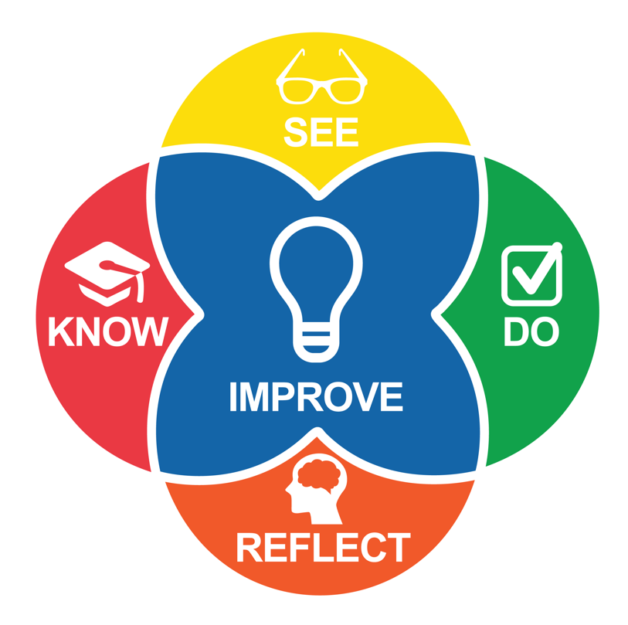
Intentional Teaching Framework
Image credit: EarlyEdU
Notes:
EarlyEdU Alliance®’s (EarlyEdU) higher education courses (EarlyEdUAlliance.org) use the Intentional Teaching Framework (Hamre, Downer, Jamil, & Pianta, 2012; Joseph & Brennan, 2013), which guides participants to:
Know—Learn about child development and effective teaching practices.
See—Identify teaching practices and children’s responses in participants’ videos, using specific behavioral language.
Do—Set goals, plan, and use strategies. (Do can also involve applying knowledge during in-class activities.)
Reflect—Participants observe and analyze their practices, using video recordings of their time in the classroom..
Improve—Plan for and implement positive, quantifiable change to teaching practices.
REFERENCES
Hamre, B. K., Downer, J. T., Jamil, F. M., & Pianta, R. C. (2012). Enhancing teachers’ intentional use of effective interactions with children. In R. C. Pianta (Ed.) (2012). Handbook of early childhood education (pp. 507–532). New York: The Guilford Press.
Joseph, G. E., & Brennan, C. (2013). Framing quality: Annotated video-based portfolios of classroom practice by preservice Teachers. Early Childhood Education Journal, 41, 423–430.

Slide 4
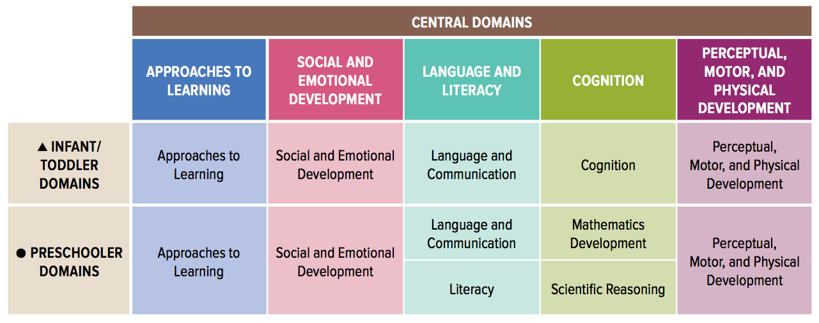
Head Start Early Learning Outcomes Framework
Image credit: Office of Head Start
Notes:
This Head Start framework, also known as “ELOF,” describes the skills, behaviors, and knowledge that educators should foster in children birth to age 5, including children who are dual language learners or who have disabilities. In Head Start programs, the framework guides curriculum selection, implementation, and assessment and is useful when planning and assessing teaching and learning experiences and children's progress toward school readiness goals.
REFERENCE
U.S. Department of Health and Human Services, Administration for Children and Families, Office of Head Start. (n.d.). Interactive Head Start early learning outcomes framework: Ages birth to five. https://eclkc.ohs.acf.hhs.gov/interactive-head-start-early-learning-outcomes-framework-ages-birth-five

Slide 5
Framework Guiding Principles
Each child is unique and can succeed.
Learning occurs within the context of relationships.
Families are children's first and most important caregivers, teachers, and advocates.
Children learn best when they are emotionally and physically safe and secure.
Areas of development are integrated, and children learn many concepts and skills at the same time.
Teaching must be intentional and focused on how children learn and grow.
Every child has diverse strengths rooted in their family's culture, background, language, and beliefs.
Notes:
Note: This slide is animated so that points appear one-by-one.
The Head Start Early Learning Outcomes Framework, based on the latest research in child development, includes the following guiding principles:
Each child is unique and can succeed. Children are individuals with different rates and paths of development. Each child is uniquely influenced by their prenatal envi­ronment, temperament, physiology, and life experiences. With the appropriate support, all children can be successful learners and achieve the skills, behaviors, and knowledge described in the framework.
Learning occurs within the context of relationships. Caring families, educators, and other adults matter in a young child's life. Responsive and supportive interactions with adults are essential to children's learning.
Families are children's first and most important caregivers, teachers, and advocates. Families must be respected and supported as the primary influence in their child's early learning and education. Their knowledge, skills, and cultural backgrounds contribute to children's school readiness.
Children learn best when they are emotionally and physically safe and secure. Nurturing, responsive, and consis­tent care helps create safe environments where children feel secure and valued. In these settings, children are able to engage fully in learning experiences.
Areas of development are integrated, and children learn many concepts and skills at the same time. Any single skill, behavior, or ability may involve multiple areas of development. For example, as infants gain fine motor skills, they can manipulate objects in new ways and deepen their understanding of cause and effect. As preschoolers gain new verbal skills, they can better manage their emotions and form more complex friendships.
Teaching must be intentional and focused on how children learn and grow. Children are active, engaged, and eager learners. Good teaching practices build on these intrinsic strengths by providing develop­mentally appropriate instruction and oppor­tunities for exploration and meaningful play.
Every child has diverse strengths rooted in their family's culture, background, language, and beliefs. Responsive and respectful learning environments welcome children from diverse cultural and linguistic backgrounds. Effective teaching practices and learning experiences build on the unique backgrounds and prior experiences of each child.
Note: Ask participants to choose one guiding principle that particularly resonates with them and then turn to a partner and explain why.
REFERENCE
U.S. Department of Health and Human Services, Administration for Children and Families, Office of Head Start (n.d.). Interactive Head Start early learning outcomes framework: Ages birth to five. https://eclkc.ohs.acf.hhs.gov/interactive-head-start-early-learning-outcomes-framework-ages-birth-five

Slide 6
What Is the Brain?

Slide 7
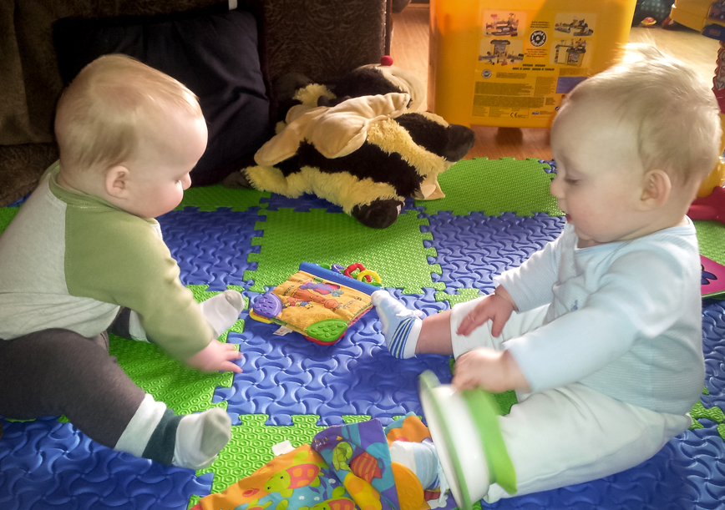
Discussion: Brain Definition
Turn to a partner and discuss the question: What is the brain?
Image credit: EarlyEdU
Notes:
Ask participants to turn to a partner and discuss the question: What is the brain?
Give them 2 minutes to discuss.
Ask participants to share their thoughts. Answers may vary and that is okay. The point is to encourage participants to think about the brain.
Note: This discussion will be revisited with an activity later.

Slide 8
Video Intro: How the Brain Works
Now we’ll review this information on how the brain works with a brief animation.
Notes:
Now we’ll review this information on how the brain works with a brief animation. Consider how this information connects to your brain definition in the previous discussion.

Slide 9
VIDEO: How the Brain Works
VIDEO: How the Brain Works
Notes:
This animation is called How the Brain Works. It is 3 minutes, 51 seconds long.

Slide 10
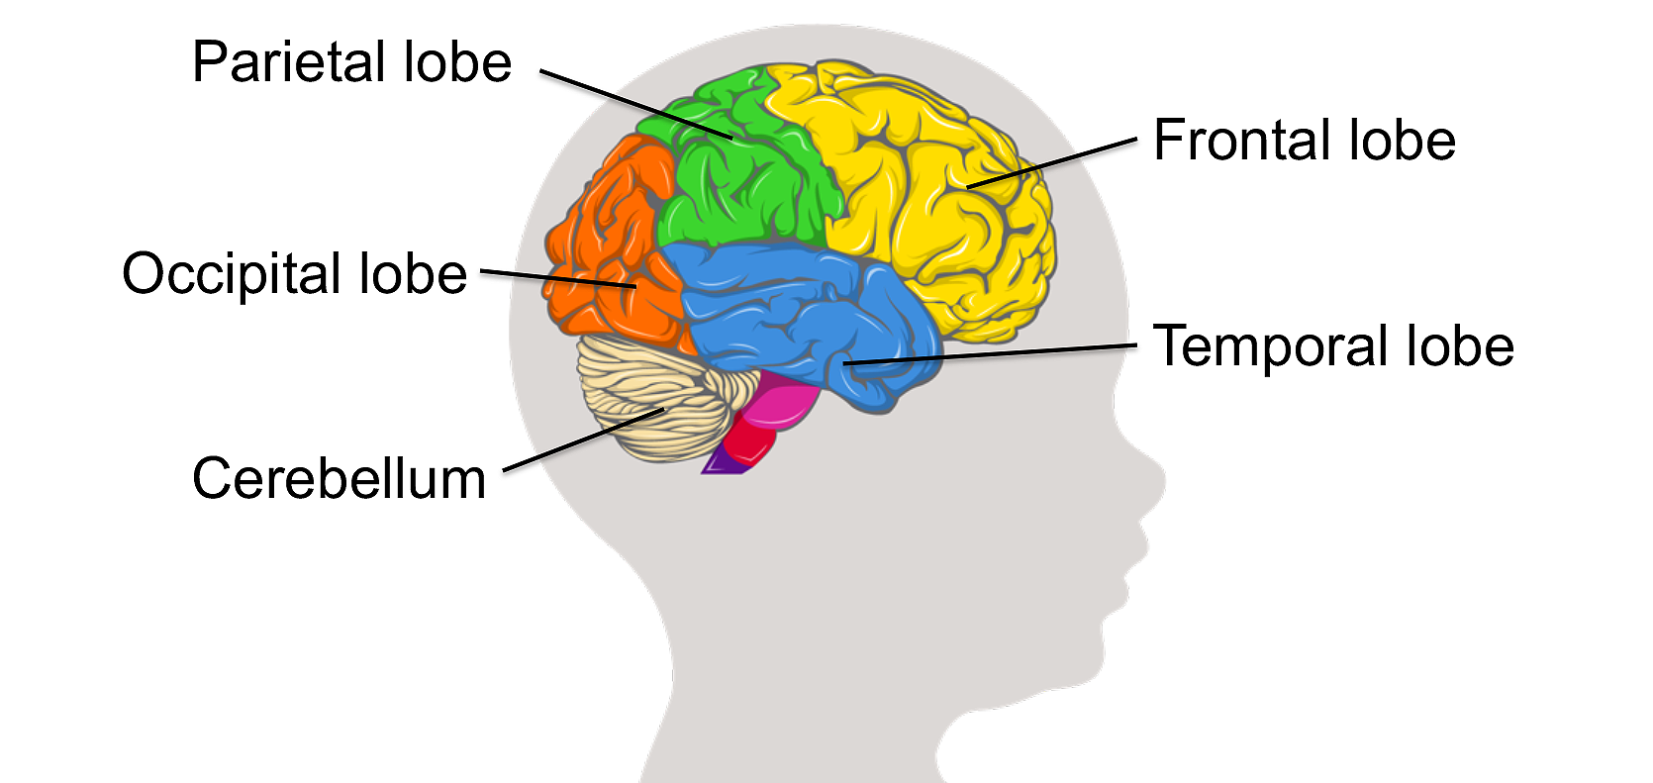
Regions of the Brain
Image credit: EarlyEdU
Notes:
The brain has different functional and structural regions. These regions are called lobes. Each lobe is specialized for a particular set of tasks.
For example, the occipital lobe processes visual information. The frontal lobe is involved in reasoning and planning, the ability to control emotions, and motor control.
We use all of our brain constantly. Your brain works continuously, rapidly sending information between these different regions via fiber tracts, determining what you should say, do, and feel at any given moment.
Looking at this illustration of the brain, imagine how the fiber tracts that connect these different regions may look.
REFERENCE
Berk, L. (2013). Child development (9th ed.). Boston: Pearson.

Slide 11
Video Intro: Colors on the Piano
As you watch the following video, identify which brain areas the child may be using.
Notes:
Materials: Brain Region handout
Note: give handout and allow a brief time to review
Take a moment to review the handout and notice some of the functions of each region. Next, we will watch a video of a child and an educator interacting.
While you are watching the upcoming video, think about which brain region(s) the child may be using. Use the handout as a reminder of what happens in each region.

Slide 12
VIDEO: Colors on the Piano
VIDEO: Colors on the Piano
Notes:
This slide contains the video Colors on the Piano. The video is approximately 1 minute long.

Slide 13
Video Debrief:
Colors on the Piano
Which of the child’s brain regions
do you think were active?
Notes:
Which part of the child’s brain regions do you think were active during the interaction on the video? Refer to the handout for ideas and reminders about lobe functions.
Participants may have a variety of answers. The possible responses below are meant to guide the discussion.
Frontal lobe: planning what to do next, motor control
Parietal lobe: sense of touch
Occipital: vision
Temporal lobe: learning language sounds
Cerebellum: coordinating motor movements
Limbic regions: remembering what to do with a piano

Slide 14
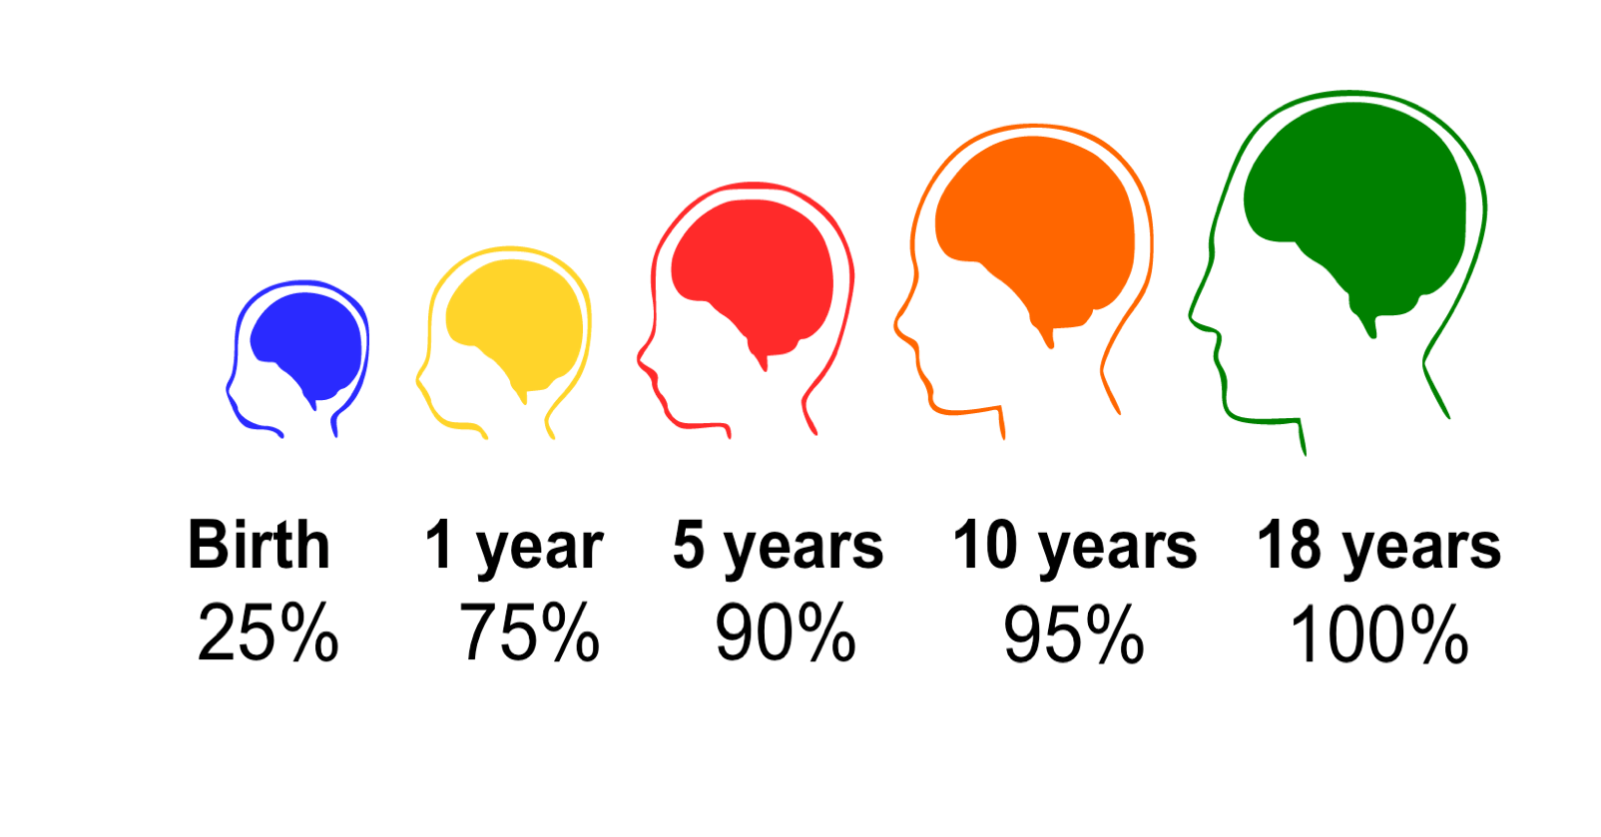
Brain Development
Notes:
Children’s brains grow faster in the first few months and years of life than they will at any other time. By the time they are born, an infant’s brain has all of the different regions that it will have as an adult and most of the neurons.
But the brain still has a huge period of growth and development to go through.
At birth, infants’ brains are about one-quarter of the volume of adult brains. The rest of a newborn’s tiny body is not even close to one-quarter of their adult size. If it were, the average newborn in North America would weigh about 40 pounds.
Children’s brains continue to grow, and quickly. A recent study calculated the rate, or how fast, infant brains grow. By the end of their first year of life, children’s brains are already 75 percent of adult size. By 5 years of age, a child’s brain has grown to about 90 percent of adult size.
Note that while 5-year-olds’ brains may be 90 percent of the size of adult brains, this does not mean that children’s brains are 90 percent developed by age 5. A 5-year-old has much, much more to learn.
For example, when 4 to 5 years old, children can only sometimes control their impulses and still need support from adults. The parts of the brain that control impulses, like the prefrontal cortex, still need more time and experience to develop. Scientists estimate that the brain doesn’t finish developing until well into the third decade of life. But by 5 years of age, children have most of the raw materials, such as brain cells or neurons, that build the brain.
Children’s brains are uniquely primed to learn from everyday experiences. At this stage, the brain is like a rough draft, ready for the experiences of life to continue shaping it into the specialized brain of an adult.
REFERENCE
Mancall, E. L., & Brock, D. G. (2011). Gray’s clinical neuroanatomy: The anatomic basis for clinical neuroscience. Philadelphia, PA: Elsevier/Saunders.

Slide 15
Video Intro: Brain Building Basics
As you watch the video linked below, listen and watch for five practices that adults can do to help young children’s brains grow.
Vroom. (2016, August 8). Brain building basics [Video file].
https://www.youtube.com/watch?v=WQNm4ASB7iY
Notes:
Next you will watch a short video introduction to concepts for building brains by Vroom, a set of resources for families developed by the Bezos Family Foundation. This video shows how parents can foster their children’s development. Many of these strategies can be used by home visitors and educators.
Let’s watch and listen for five practices that adults can do to help young children’s brains grow.
The video is about 3 minutes long.
Note: The PowerPoint presentation may need to be in Slide Show mode to link to the video.
REFERENCE
Vroom. (2016, August 8). Brain building basics [Video file]. https://www.youtube.com/watch?v=WQNm4ASB7iY

Slide 16
Video Debrief: Brain Building Basics
Name five practices you learned about that can help build young children’s brains.
Notes:
Ask participants to share what they learned about five practices to help build young children’s brains.
The video covers five brain building practices:
Look
Follow
Chat
Take turns
Stretch
These are simple concepts for how to interact with children in a way that is building brains. Our goal is to give parents and educators the confidence to use the skills they already have and to use everyday interactions to support children’s development.
REFERENCE
Vroom. (2016, August 8). Brain building basics [Video file]. https://www.youtube.com/watch?v=WQNm4ASB7iY].

Slide 17
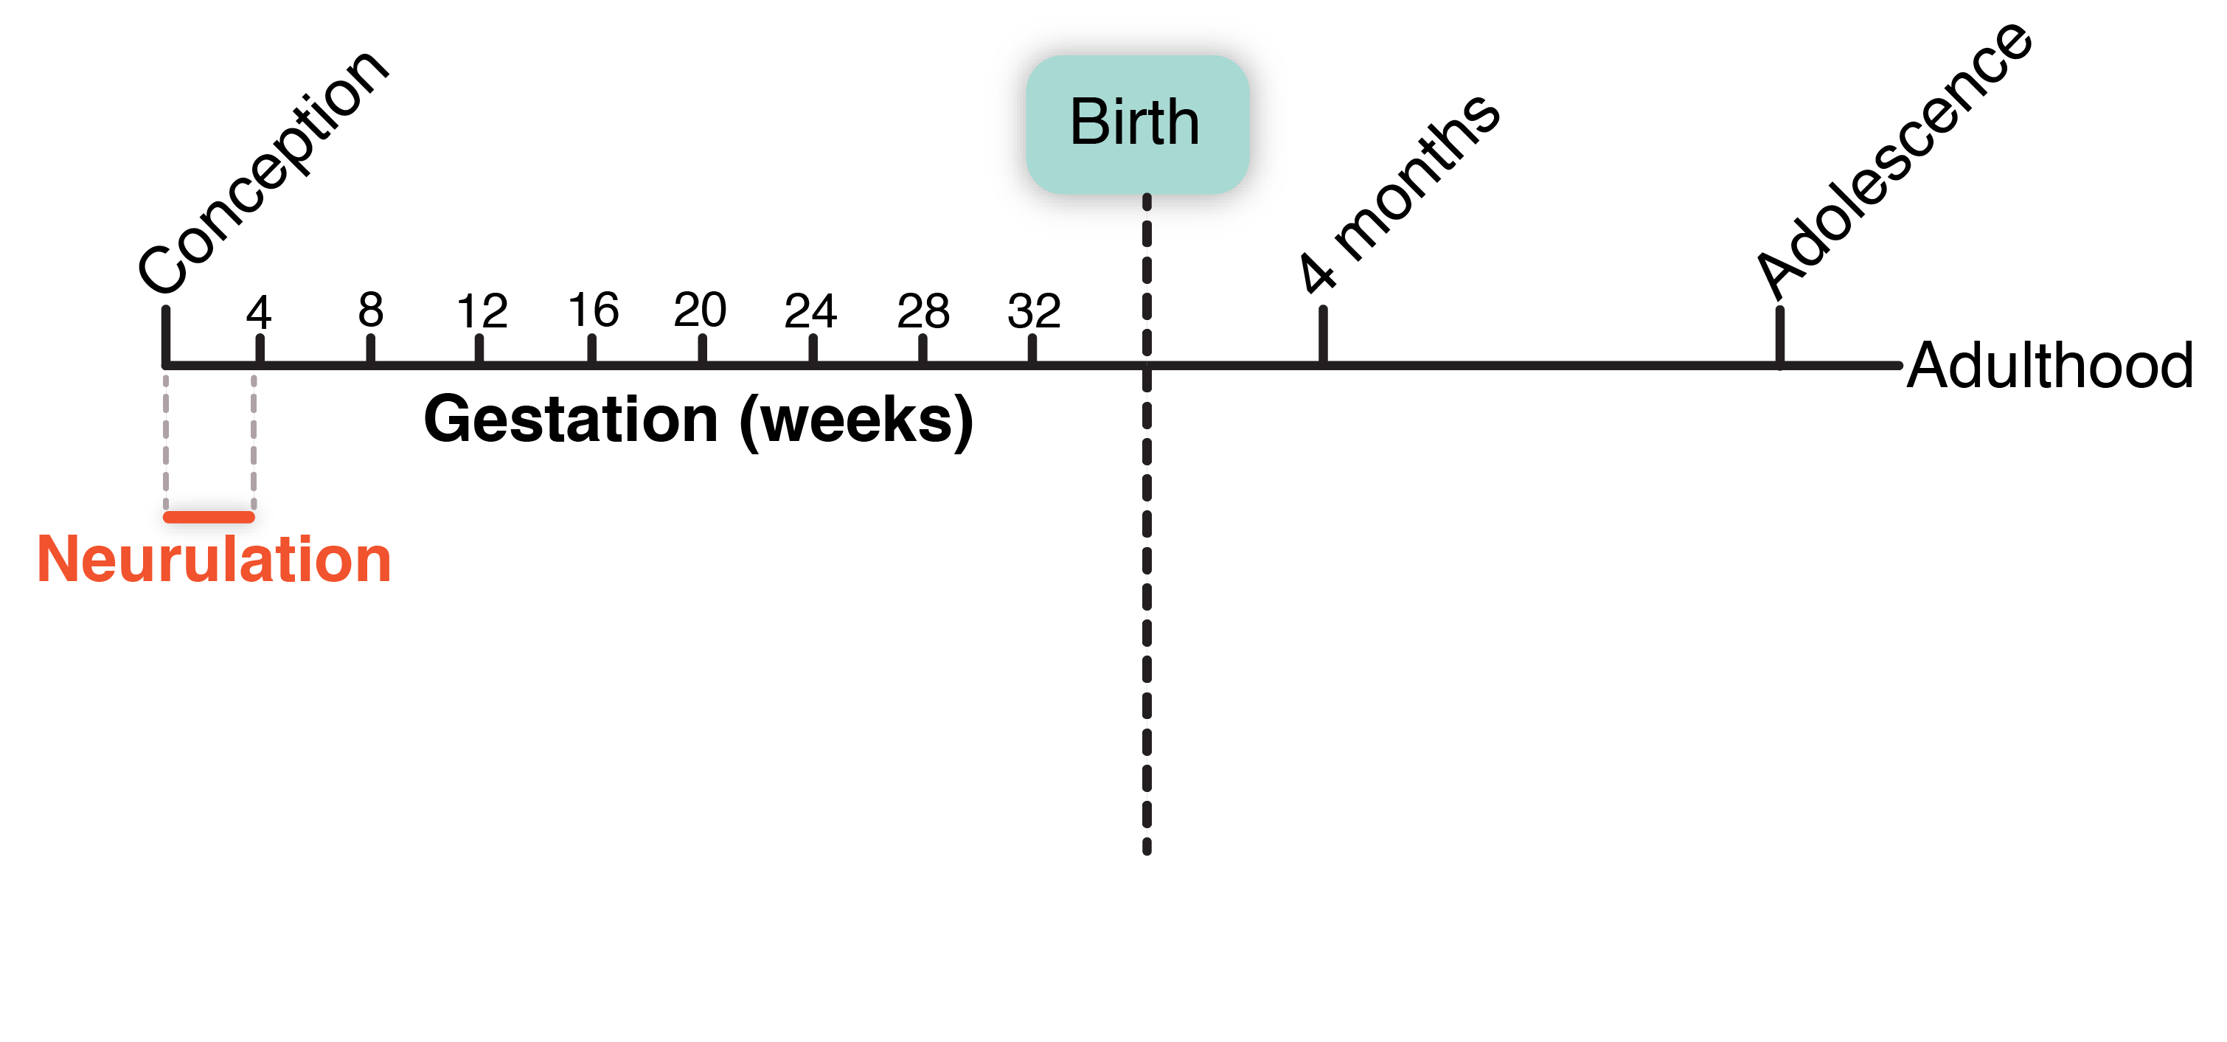
Early Formation of the Nervous System
(Adapted from Giedd, 1999, p. 4)
Notes:
Brain development begins long before birth. In fact, the first stage of brain development, the formation of the nervous system, begins within days of conception.
The nervous system is the body’s communication team. Networks of neural connections form an information superhighway. Rapid communication between the body and brain drives every single motion, intention, and thought. It is this network that allows people to learn and adapt to their ever-changing surroundings.
Early formation of the nervous system begins before most women know they are pregnant. From the earliest point in development, the brain is affected by its environment. The developing nervous system is very susceptible to recreational drugs, potentially causing connections forming within the brain to develop in atypical ways. It is very important that women who are pregnant avoid recreational drugs and alcohol so that their babies brains develop without the interference of psychoactive substances.
If you are an educator or home visitor working with pregnant women, this can be helpful information to support them.
REFERENCES
U.S. Department of Health and Human Services, Centers for Disease Control and Prevention. (2016). Alcohol and pregnancy [Web page]. https://www.cdc.gov/vitalsigns/fasd/index.html
Tau, G. Z., & Peterson, B. S. (2010). Normal development of brain circuits. Neuropsychopharmacology, 35(1), 147–168.

Slide 18
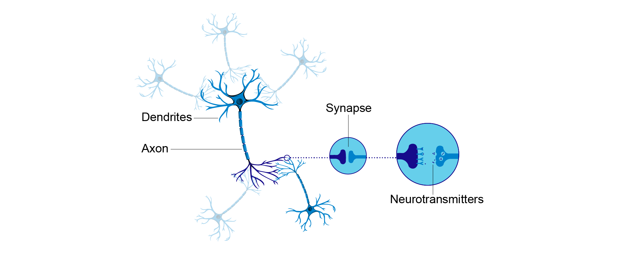
Neurons
Image credit: EarlyEdU
Notes:
Neurons make up the nervous system and transfer signals to other neurons through structures called synapses. A signal neuron may make thousands of synapses with other neurons.
Once the signal reaches the end of the axon, it triggers the release of chemical messengers at the synapse. These chemical messengers are called neurotransmitters.
Neurotransmitters travel through the tiny space between neurons and dock in special receptors on the receiving neuron’s synapse. This initiates a weak electrical signal in the dendrites of the receiving neuron and the process begins again.
When someone is talking about making connections in the brain, they are talking about synapses. When we learn new information, the number or structure of synapses changes in our brains as a result of repeated experiences.
REFERENCES
Berk, L. (2013). Child development (9th ed.). Boston: Pearson.

Slide 19

Trillions of Connections
Image via Pixabay
Notes:
It is important to note that neurons never work alone; each neuron is part of a network of other neurons.
Neurons have different jobs in the brain. Some connect to just a few other neurons, while others connect to thousands of other neurons. Typically, one neuron will make many connections to another neuron. Regardless of whether neurons connect to one or many neurons, the average neuron makes 7,000 synaptic connections.
We are born with most of the neurons we will ever have—about 86 billion. Imagine that each of those 86 billion neurons then has to make 7,000 connections with other neurons. That is an incredible amount of synaptic development that has to occur.
It is estimated that in the cortex alone there are about 20 billion neurons and that those 20 billion neurons make about a trillion synapses per cubic centimeter of cortex.
Although we are born with most of our neurons, our brains have not yet made all of those trillions and trillions of connections. This allows us to learn new things continuously and become experts at living our own lives.
REFERENCE
Drachman, D. A. (2005). Do we have brain to spare? Neurology, 64(12), 2004–2005.

Slide 20
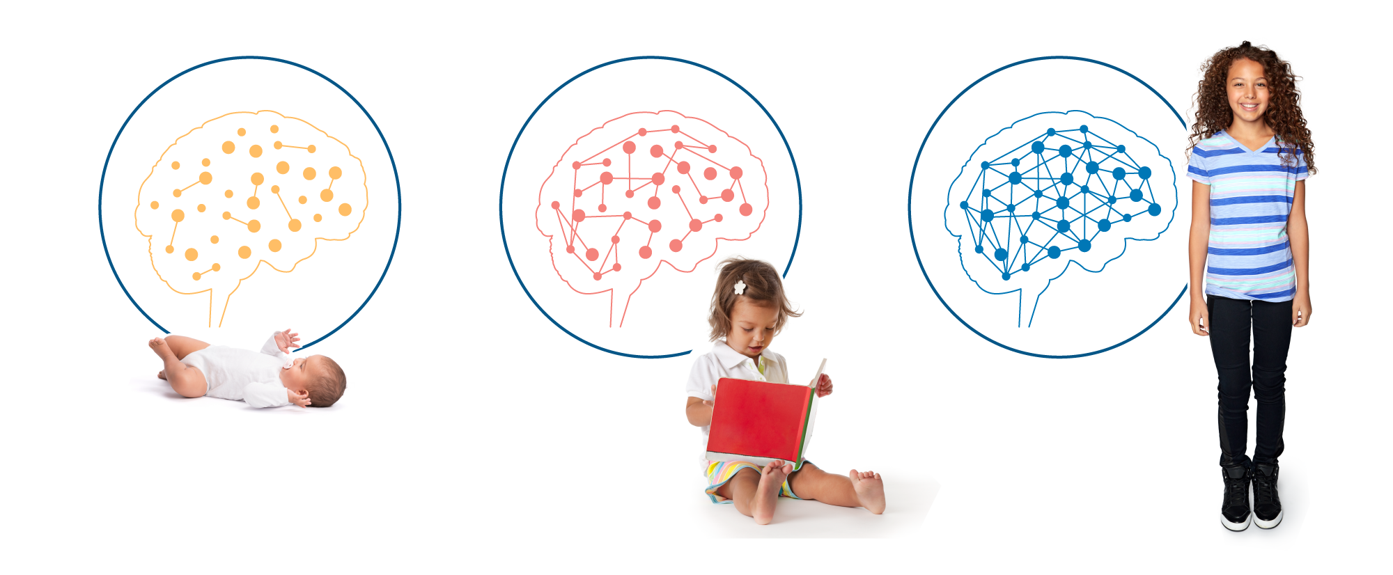
How Connections Develop
Image credit: EarlyEdU
Notes:
Synaptic development is sort of like a forest of young trees or saplings. All the trees are there, but they are small, and they haven’t filled in all their branches.
Neurons grow in a similar way. As the trees or neural connections grow, they mature into a dense network of connections—the ecosystem of the brain.
This is a good thing because the connections forming in our brains are the result of what we learn and the experiences that we have. When you learn something new, you are shaping the way neurons in the brain share information.
REFERENCE
Berk, L. (2013). Child development (9th ed.). Boston, MA: Pearson.

Slide 21
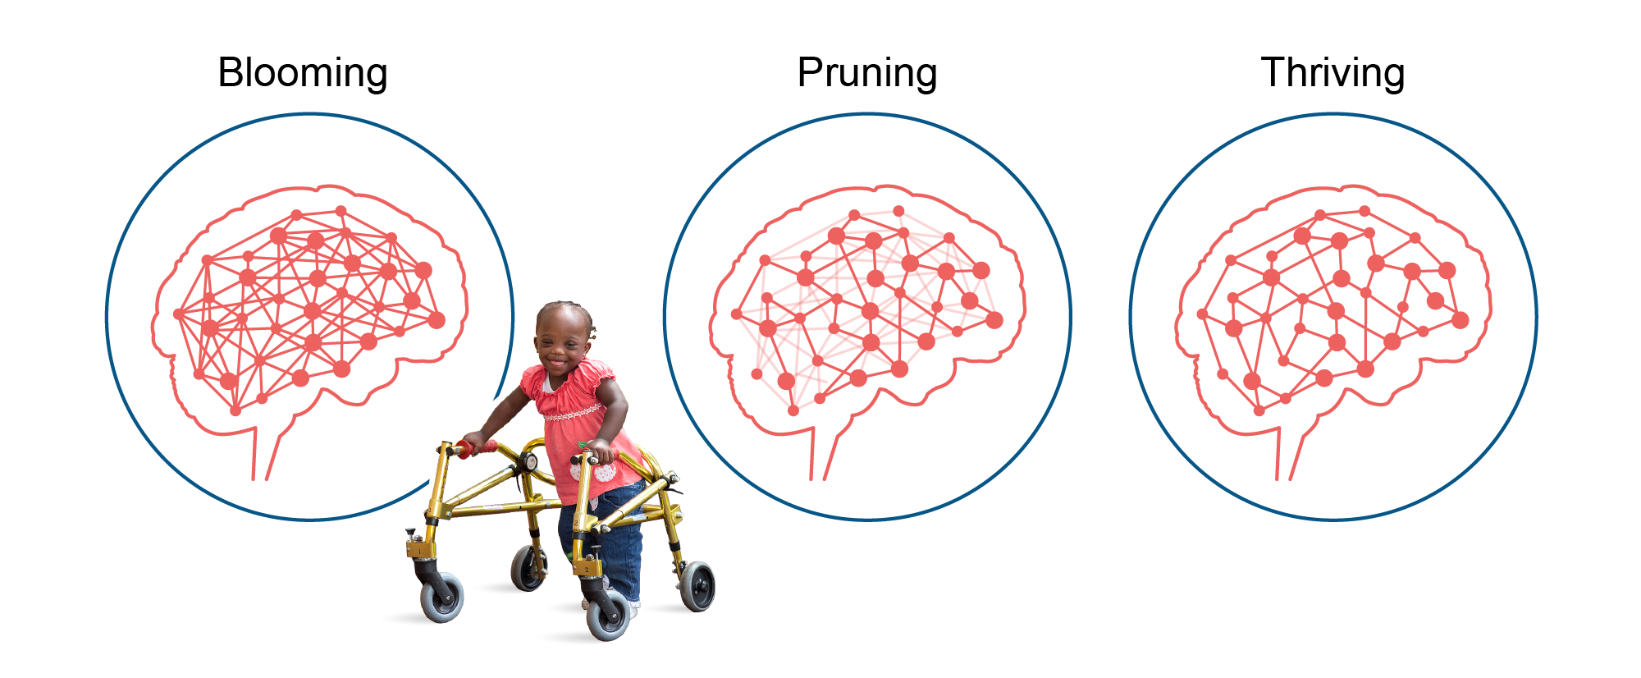
Pruning Connections
Image credit: EarlyEdU
Notes:
Like a forest of trees or bushes, some pruning is necessary to maintain a thriving brain.
The brain prunes synaptic connections by reducing the number of connections it has, keeping the frequently used connections and eliminating the infrequently used ones.
This process is a little bit like the process of caring for a blackberry bush. At first, there is a period of rapid growth when the brain is blooming. During this time, the brain makes many extra connections. These extra connections make the brain less efficient.
Just like after a period of rapid growth in the spring, a blackberry bush can become gangly, with too many branches going in different directions.
After the period of blooming in the brain, connections are refined, or pruned, based on the experiences that we have. Connections that we need and use are kept. Connections that we don’t need—ones that are actually making it more difficult for the brain to function—are removed.
The result of this process is a brain or a blackberry bush, that is healthy and thriving. The branches or connections that remain are stronger, and the brain is more efficient.
Throughout brain development, there are multiple periods of blooming and pruning. These bursts occur at different times and in different regions of the brain. Scientists think that these bursts of blooming and pruning align with sensitive periods in the brain. Sensitive periods are times when our brains are particularly open to new experiences and learning.
REFERENCE
Berk, L. (2013). Child development (9th ed.). Boston, MA: Pearson.

Slide 22
Nature AND Nurture

Slide 23
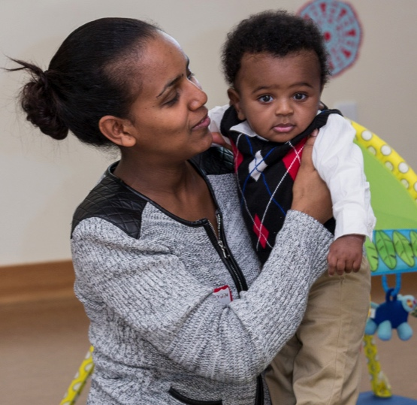
The Brain: Nature AND Nurture
“Heredity deals you the cards; environment plays them.”
(Myers, 2011, p. 112)
Notes:
The physical characteristics of the brain a child is born with are just one side of how the brain grows. There is a notion, attributed to Emeritus Professor of Psychology Charles Brewer of Furman University, that underscores another powerful factor in how the brain grows: Heredity deals you the cards; environment plays them. This widely used metaphorical description highlights how nature and nurture interact.
Common concepts in learning about development are nature and nurture. Nature is inherited genetic characteristics and tendencies. Nurture refers to the environmental conditions that surround a person. For example, nature is people’s height, weight, and hair color. Nurture is actions, political views, and clothing choice.
One thing missing in the quote is that the interaction between nature and nurture goes both ways—certain characteristics inherited through nature or genes and the way those genes or characteristics are expressed can change depending on children’s environments.
Children’s developmental outcomes evolve through the interaction between their genes and environment, not solely by one or the other. One example is a child’s physical characteristics like height and weight – these have strong biological determinants, but are also influenced by environmental factors such as nutrition, environmental toxins, and physical activity.
REFERENCE
Myers, D. (2011). Exploring psychology. New York, NY: Worth Publishers.

Slide 24
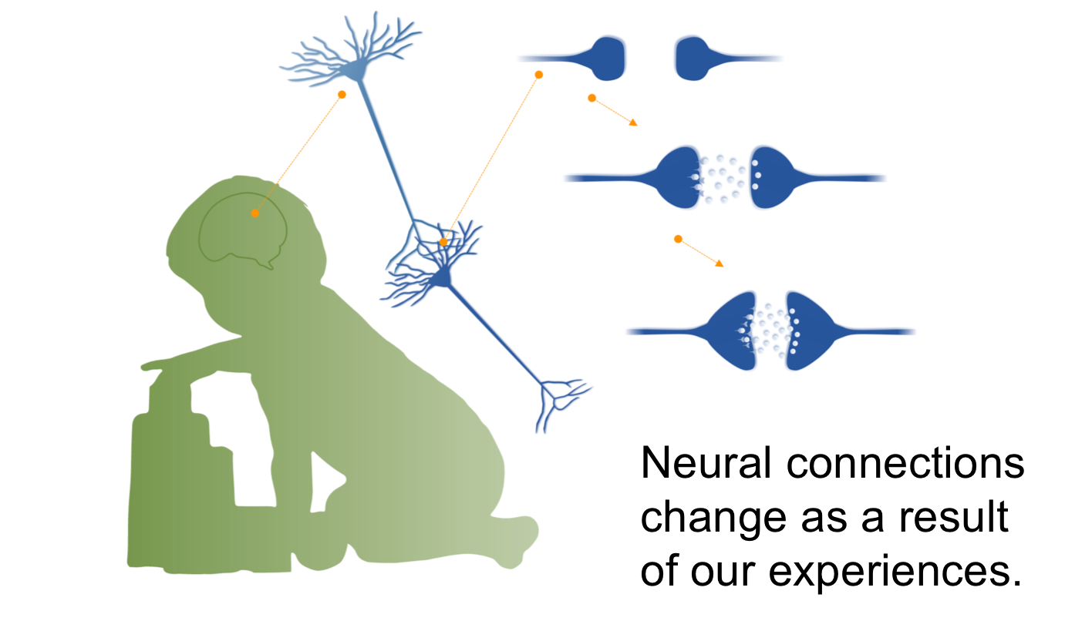
Experiences Shape Connections
Copyright © 2017 ILABS. All rights reserved.
Notes:
To a certain extent, which connections form between neurons, and how strong those connections are, is based on our experiences. The developing brain is establishing networks of neurons that work together.
The more often you have an experience, the more the neurons involved in processing that experience begin to work in unison. Perhaps you have heard the phrase: Cells that fire together, wire together. The idea being that the more often a certain neural pathway is stimulated, the stronger that neural pathway becomes.
Connections and communications between neurons grow stronger by increasing the number of synapses or increasing the size of existing synapses.
When we learn something new, and we practice what we have learned, we are shaping how the neurons in our brain connect and communicate.
With so much to learn in the first few years of life, our brains are forming new connections at an incredible rate.
Your work as an early childhood educator is quite literally shaping the architecture of the brain.
Discussion: Ask your participants to turn to a neighbor and talk about a skill that they have practiced repeatedly over time that is now second nature. Did anyone (e.g., an educator or parent) support this development and if so, how?
REFERENCE
Löwel, S., & Singer, W. (1992). Selection of intrinsic horizontal connections in the visual cortex by correlated neuronal activity. Science, 255(5041), 209–212.

Slide 25

Experience Expectant
Image credit: EarlyEdU
Notes:
Scientists William Greenough and James Black described the way the brain makes connections by lumping them into two main categories.
The first category they called experience-expectant synaptogenesis. This describes the process of forming connections in the brain based on the experiences to which typically developing children are exposed. For example, the visual parts of the brain expect or require exposure to light and pattern to form the correct connections in the brain. The brain is pre-programmed to collect this information and form the appropriate connections in the brain.
While exposure to these types of environmental input or experience is required for typical brain development, barring an extreme circumstance, every child will form these connections without intervention or need for extra stimulation.
REFERENCE
Greenough, W. T., Black, J. E., & Wallace, C. S. (1987, June). Experience and brain development. Child Development, 58(3), 539–559.

Slide 26
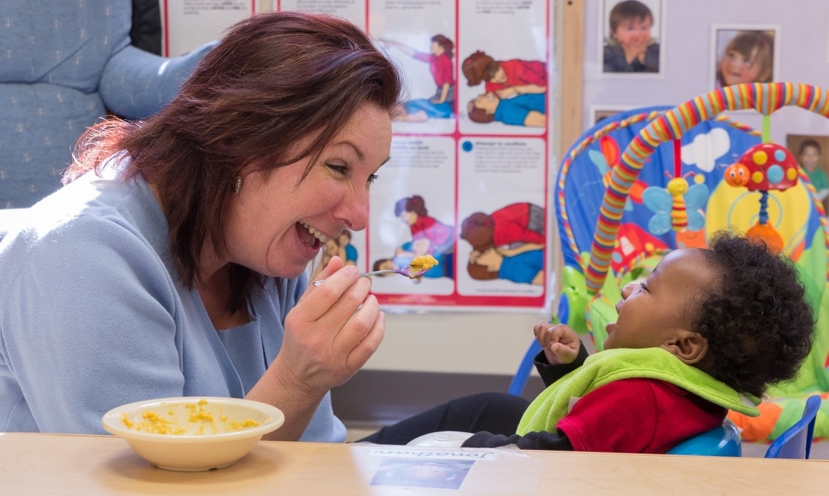
Experience Dependent
Image credit: EarlyEdU
Notes:
Greenough and Black referred to the second category of connection building as experience-dependent synaptogenesis.
This process describes the connections that form in our brains as a result of the unique experiences that we have in our lives. For example, we all learn to speak different languages.
The more exposure that we have to a particular experience or set of experiences, the stronger the connections between neurons become.
This is true of both positive and negative experiences in our lives. This process begins at birth. The experiences that we have as children shape the way our brains are connected and set the stage for the rest of our lives.
REFERENCE
Greenough, W. T., Black, J. E., & Wallace, C. S. (1987, June). Experience and brain development. Child Development, 58(3), 539–559.

Slide 27
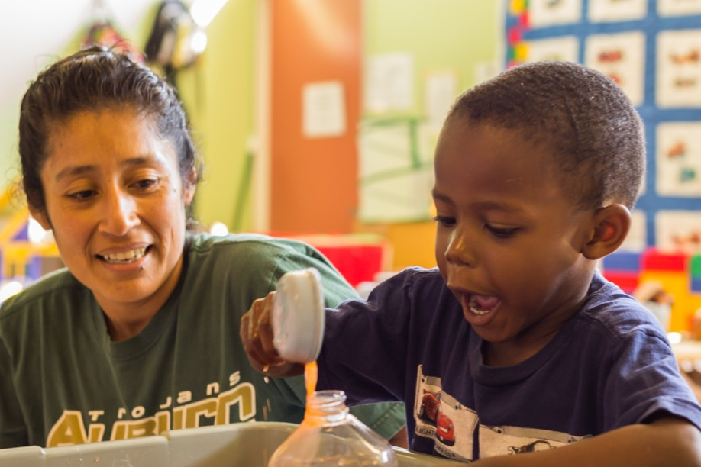
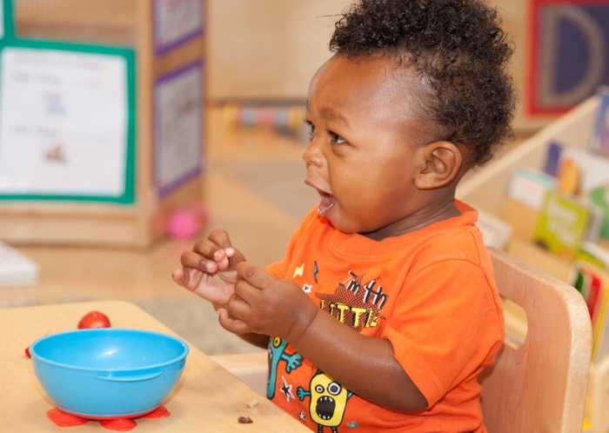
The Active Learner
Image credits: EarlyEdU
Notes:
It is important to note that children are active agents in their environment. They are not passive beings waiting to be taught. They are explorers and scientists who act on their world to learn.
In other words, children’s environments do affect them, but the opposite is also true—children affect the environment.
For example, when young children babble, they are practicing making noises. They often imitate sounds that they hear other people make, and they will use babbling to elicit reactions from the adults around them.
Similarly, when children drop objects from their highchair, they are exploring their world: Does the object make a noise when it falls? Can I still see it when it falls? Will someone pick it up and give it to me again?

Slide 28

Epigenetics
Image via Pixabay
Notes:
Epigenetics is the field of study that looks at mechanisms that regulate the activity of our genes. Epigenetics may provide insights as to why the environments that we grow up in as children may have lasting effects on our brains and bodies.
Until recently, scientists thought that very few environmental factors influenced the expression of genes inside our bodies.
But more recent scientific findings indicate that the experiences we have as children and the environments that we grow up in can and do influence the expression of genes inside our bodies. In addition, these changes can be inherited or passed along from one generation to the next. To continue our metaphor from earlier, the way your environment plays your cards can impact the cards your children are dealt.
Epigenetics is one way that we can see the influence of culture on brain development. As a child’s culture shapes their experiences of the world, it can also have an impact on how their genes are expressed.
The important takeaway here is that not only can our earliest experiences affect how connections form in our brains, they can also affect how some of our genes are expressed throughout our lives, which can have long-term impacts on our health and behavior. In essence, some genes can be activated and others inhibited through epigenetic changes.
For example, researchers have found evidence of epigenetic changes to a protein connected to stress responses in the brains of people who were abused as children.
As early childhood educators, when you provide a supportive environment for children and help children have access to healthy foods, rest, and exercise, you are helping children develop a healthy epigenome.
Note: If participants are interested in this topic, the reading referenced below provides more detail.
Institute of Medicine (IOM) and National Research Council (NRC). (2015). The interaction of biology and the environment. In L. Allen & B. B. Kelly (Eds.), Transforming the workforce for children birth through age 8: A unifying foundation (pp. 57–84). Washington, DC: The National Academies Press. https://www.nap.edu/read/19401/chapter/7
REFERENCE
Kundakovic, M., & Champagne, F. A. (2015). Early-life experience, epigenetics, and the developing brain. Neuropsychopharmacology Reviews, 40, 141–153.
McGowan, P. O., Sasaki, A., D’Alessio, A. C., Dymov, S., Labonté, B., Szyf, M., Turecki,G., & Meaney, M. J. (2009). Epigenetic regulation of the glucocorticoid receptor in human brain associates with childhood abuse. Nature Neuroscience, 12(3), 342–348.

Slide 29
Discussion: Early Experiences Matter
Choose a partner and talk about the daily experiences of children in their programs
What are the children learning from those experiences?
Would you change those experiences in any way to help support their learning?
What impact does the child’s culture have on their daily experiences?
Notes:
Ask participants to choose a partner and talk about the daily experiences of the children in their programs. Pose these questions:
What are children learning from those experiences?
Would you change those experiences in any way to help support their learning?
What impact does the child’s culture have on their daily experiences?
Participants may give a variety of answers to these questions. Help guide participants in thinking about how everyday, social, back-and-forth interactions support brain development.
The process of brain development is really the process of building the brain through experiences every day.
Because the brain is developing so rapidly in the first few years of life, the experiences that people have as children are particularly influential. The more a child has an experience, positive or negative, the more likely that experience is to shape the connections forming in their brains.

Slide 30
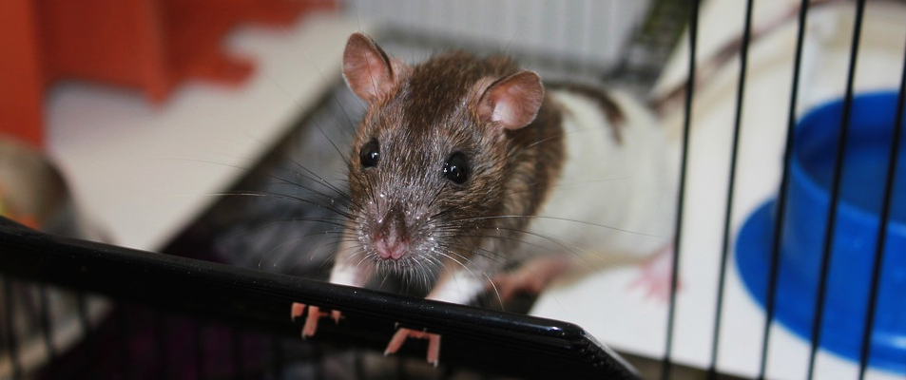
Neuroplasticity
Image via Pixabay
Notes:
The ability to change the way neurons in the brain connect and communicate is called neuroplasticity. Just as you can mold plastic, you can shape the way that neurons in your brain network.
We can’t change all the connections in our brains. Some are fixed, but many others can be altered, at least to some degree, by the result of experiences. Scientists didn’t always know that the brain could be shaped by experiences.
It wasn’t until the 1960s that groundbreaking work by Dr. Marian Diamond and her colleagues, David Krech and Mark Rosenzweig, revealed that experiences can change the physical structure of the brain.
In their original experiments, Dr. Diamond and her colleagues looked at the brains of rats that either lived in cages that had lots of fun toys, like ladders, wheels, and balls to keep them busy or lived in empty cages with nothing to do other than eat and drink.
The researchers found that the brains of rats that lived in cages with lots of opportunities to explore and be active were larger in size than the rats in the empty cages.
Dr. Diamond went on to discover that changes in experiences could lead to changes in the size of neurons and their number of connections.
REFERENCES
Bennett, E. L., Diamond, M. C., Krech, D., & Rosenzweig, M. R. (1964). Chemical and anatomical plasticity of brain. Science, 146(3644), 610–619.
Diamond, M. C., Krech, D., & Rosenzweig, M. R. (1964). The effects of an enriched environment on the histology of the rat cerebral cortex. Journal of Comparative Neurology, 123(1),111–120.

Slide 31
Activity: Supporting Brain Development
Form small groups and review the handout.
Choose one of the elements that are important for healthy brain development.
Discuss and respond to the questions.
Notes:
Materials: Supporting Brain Development handout, poster-sized paper, pens
ZERO TO THREE, a non-profit organization dedicated to ensuring that babies and toddlers get a strong start in life, has developed what they call the 5 R’s of healthy brain development: relationships, responsive interactions, respect, routines, and repetition.
Ask participants to divide into small groups and choose one of the elements that ZERO TO THREE has identified. You may want to make sure that each group chooses a different element so that participants will hear information on all of them.
Give groups 10-15 minutes to discuss and respond to the handout.
As children grow and develop, networks in their brains are developing. These networks will influence how they will interact with the world for the rest of their lives. As early childhood educators, you can help support children’s brain development by providing a rich and nurturing environment.
REFERENCE
Seibel, N. L., Britt, D., Gillespie, L.G., & Parlakian, R. (2009). Preventing child abuse and neglect: Parent-provider partnerships in child care. Washington, DC: Zero to Three Publishing.

Slide 32
Activity: The Brain
What is the brain and how does it learn?
Illustrate your responses with a drawing.
Notes:
In this module we have covered a lot of material. We’ve talked about what the brain is, how it functions, and the stages of brain development. We’ve talked about how the brain learns, and how early experiences matter.
For this activity, we are going to form groups of four. Let’s revisit the question from the beginning of the module: What is the brain? And now let’s add this second piece: How does it learn and what is one thing you can do when you return to your classroom/program/setting to support its learning?
In your groups, illustrate your responses with a drawing. The drawing can take any form—a diagram, a physical structure—as long as it answers the questions. Your group will make one drawing on a poster-sized sheet of paper.
You will have 10 minutes to draw your responses, and then you will share them with the larger group.

Slide 33
The Brain and Language
Notes:
What does this information about brain structure and development mean for early childhood educators? While brain functioning is important across many areas of development, for this section we will focus on:
The brain and learning language including dual language learning.
How the brain functions as children begin learning to read.
We will not only learn about these functions but how educators can support them through responsive interactions.

Slide 34
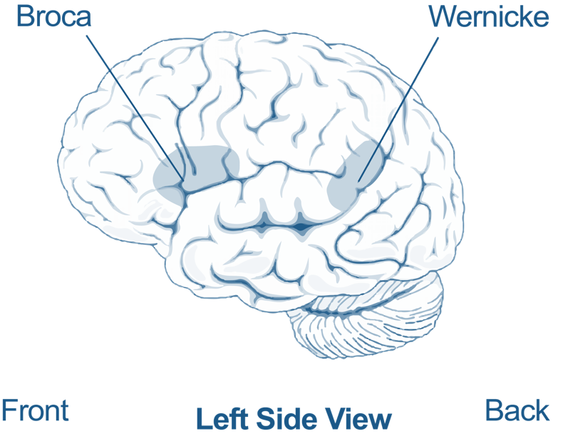
Wernicke’s and Broca’s Areas
Wernicke’s area:
Language perception
Broca’s area:
Language production
(Adapted from National Institute on Deafness and Other Communication Disorders, 2015, p. 1)
Notes:
What is happening in the young child’s brain as they learn language?
While there are many regions of the brain that are important for language, we will focus on two regions of the brain that are important for speaking and how these regions begin to work together.
Wernicke’s area is important for language perception, or how we recognize particular sounds as language. It is located in the temporal lobe.
Broca’s area is important for language production, or how we produce speech sounds. It is located in the frontal lobe.
In the adult brain, these regions closely coordinate with each other. As we listen to language and engage in conversations, these areas in our brains are actively working together and sharing information.
These regions also coordinate with the hearing or auditory regions of the brain and motor parts of the brain, which are important for directing the muscles we use to speak.
Early experiences with language are especially critical for infants. The infant’s brain is beginning to connect and coordinate these regions long before they utter their first word.
REFERENCES
Berk, L. (2013). Child development (9th ed.). Boston, MA: Pearson.
U.S. Department of Health and Human Services, National Institutes of Health, National Institute on Deafness and Other Communications Disorders. (2015, December). Voice, speech, and language aphasia. NIDCD Fact Sheet. Bethesda, MD: NIDCD Information Clearinghouse.
https://www.nidcd.nih.gov/sites/default/files/Documents/health/voice/Aphasia6-1-16.pdf

Slide 35
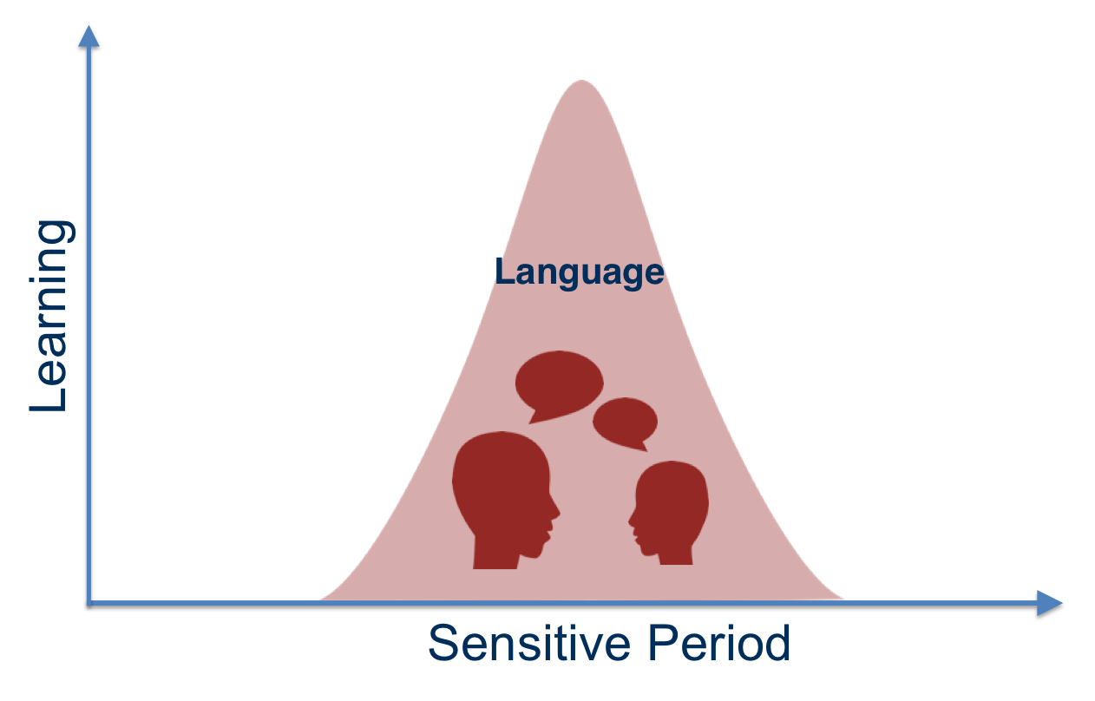
Sensitive Period
Copyright © 2017 ILABS. All rights reserved.
Notes:
Children are incredibly good at learning language.
Have you tried learning a new language as a child, an adolescent, or an adult? Think back on the experience. It might be surprising how much more difficult it is to start learning a new language in adulthood.
Research suggests that the brain has sensitive periods for learning different skills. A sensitive period is a time in development when the brain is especially primed to learn a particular skill. Sensitive periods for different skills occur at different times. The sensitive period for language learning is in early childhood. This doesn’t mean that we can’t learn a new language as an adult, but it does mean that it will likely be much harder.
When a child is young, connections form at a rapid rate, and the brain is particularly sensitive to new experiences.
But as we age, we stop making as many new connections between neurons. Our brains are less sensitive to the experiences we have in our everyday lives. While we can still learn new things as adults, we will likely have to try harder or repeat the task more times than we would if we were learning the same thing as a child.
REFERENCE
Johnson, J. S., & Newport, E. L. (1989). Critical period effects in second language learning: The influence of maturational state on the acquisition of English as a second language. Cognitive Psychology, 21(1), 60–99.

Slide 36
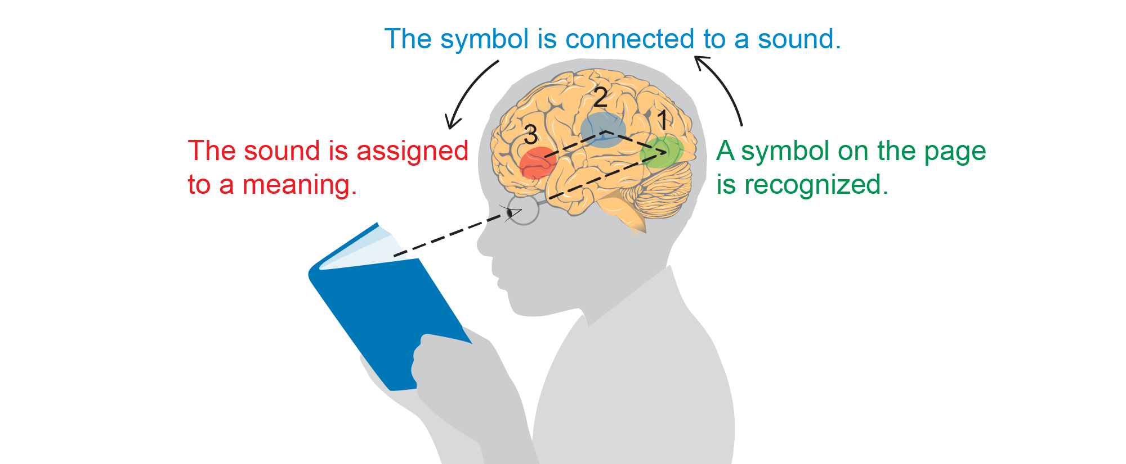
Reading and the Brain
Image credit: EarlyEdU
Notes:
Reading is a complex task for the brain. Think about all the tasks that your brain has to do to recognize and read a word.
First, our brains have to decode printed text. Information about the world comes in through our eyes and moves to visual areas of our brains, where we decode the complicated symbols and patterns.
Once our brains have recognized the symbols and patterns as a word, our brain has to match that image of a word to a sound—the sound that you hear internally when you read a word on a page. Then your brain has to figure out what this sound means. And this whole complex process happens in less than a second.
Children learn language through being surrounded by language and through everyday conversations with the people in their lives. While language skills develop over years of practice, it is a process that the brain is built to learn. Newborn babies are born ready to learn language.
Learning to read is different. Literacy skills, or the ability to decode written symbols and make meaning from them, are built on spoken language skills. Unlike language, the brain is not born to read. Learning to read takes years of tailored instruction and hours and hours of practice. Learning to read actually requires changing the wiring or connections between regions of our brains.
Reading requires the brain to combine visual, auditory, and language information in new ways. While this takes years of practice, just imagine all the new connections that are forming in children’s brains as they learn to read.
REFERENCE
Wandell, B. A., Rauschecker, A. M., & Yeatman, J. D. (2012). Learning to see words. Annual Review of Psychology, 63, 31–53.

Slide 37


What is Bilingualism?
Bilingualism is the ability to speak two or more languages.
Bilinguals, or children who are dual language learners (DLLs), are learning two or more languages at the same time.
Image credit: EarlyEdU
Notes:
As we mentioned previously, newborn babies are born ready to learn languages and their brains are wired to be capable of learning multiple languages.
Bilingualism is the ability to speak two or more languages. Bilingual and dual language learner (DLL) are both terms you may hear referencing children who speak more than one language.
In contrast, someone who speaks one language is called monolingual.
Children who are dual language learners are learning two or more languages at the same time, or learning a second language while continuing to develop their first or home language.
About 20 percent of people in the United States speak more than one language at home. Bilingualism is even more common around the world. Roughly two-thirds of the world's population is fluent in more than one language.
Bilingual speakers are diverse, learning languages at different ages and in different contexts.
REFERENCE
Berk, L. (2013). Child development (9th ed.). Boston, MA: Pearson.

Slide 38

Cognitive Benefits of Bilingualism
Image via Pixabay
Notes:
For children who are dual language learners, learning both languages is incredibly important to their culture and identity.
In addition to these benefits, research increasingly indicates that knowing and learning more than one language has cognitive benefits as well, including mental flexibility and cognitive control. Both of these have to do with something called cognitive flexibility. This is the ability of our brain to do things like quickly switch from one task to another, come up with creative solutions to problems, or multitask.
Children who are learning more than one language tend to be particularly good at doing these types of activities because they have a lot of practice switching between languages.
REFERENCE
Berk, L. (2013). Child development (9th ed.). Boston, MA: Pearson.

Slide 39
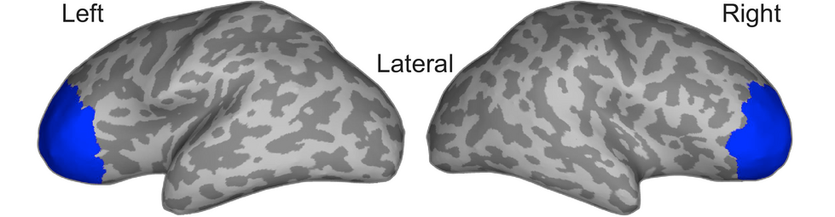
Activity in Prefrontal Cortex
(Ferjan-RamÍrez et al., 2016)
Notes:
Children who are dual language learners show increased activation in an area of the brain called the prefrontal cortex.
The prefrontal cortex is the area of the brain responsible for many important cognitive functions, like planning, paying attention, solving problems, and switching between tasks.
This is a brain imaging brain map showing the right and left hemispheres of the brain. The portion highlighted in blue is the area of infants’ brains that researchers measured as children heard the language stimuli. This is the prefrontal cortex of the brain.
Activity in the prefrontal cortex is associated with many important cognitive functions, such as the skills involved in mental flexibility and cognitive control, both of which have to do with cognitive flexibility. These skills also fall under the umbrella of executive function skills, which will be discussed later in this module.
REFERENCE
Ferjan Ramírez, N., Ramírez, R., Clarke, M., Taulu, S., & Kuhl, P. (2017). Speech discrimination in 11‐month‐old bilingual and monolingual infants: A magnetoencephalography study. Developmental Science, 20(1), 1–16

Slide 40
Discussion: Language and the Brain
Section review:
Children build their brains over the course of childhood.
Connections form in the brain through biology and experiences.
Children’s brains are primed to learn language.
Even children not yet talking are listening and forming connections in the brain’s language regions.
Discussion:
What are your favorite ways to support language development of young children?
Notes:
So, what does this information about language development and the brain mean for people who work with young children every day?
Connections form in children’s brains, and what they learn is a result of both their biology and their experiences.
Children’s brains are primed to learn language, and they often appear to be natural language learners.
Even if children are not yet talking, they are listening to what others are saying and forming connections in the language regions of their brains.
We can help children by making sure that they have plenty of rich language experiences to support their learning. Rich language experiences are most likely when the adult uses the language that they are most comfortable in while interacting with the child along with providing other supports for the child’s development in their home language. This is true whether a child is learning one language or more than one.
Discuss with a partner or small group: What are your favorite ways to support language development of young children?
Instructor Information
The possible responses below are meant to guide the discussion but not to be the right answers. Participants may have other observations and thoughts.
Talking a lot—for example, narrating what you are doing as you are changing a diaper or helping a child into their pajamas—is one of the best ways to support language growth.
Singing songs and reading books are also excellent ways to provide children with rich language experiences.
Even if a child is too young to understand the story, you can still point to pictures in a book, name them, and describe them. And being close to you during story time and listening to your voice will help them associate reading with being comfortable, safe, and enjoyable—setting the stage for later literacy.

Slide 41
The Brain and Executive Function Skills

Slide 42
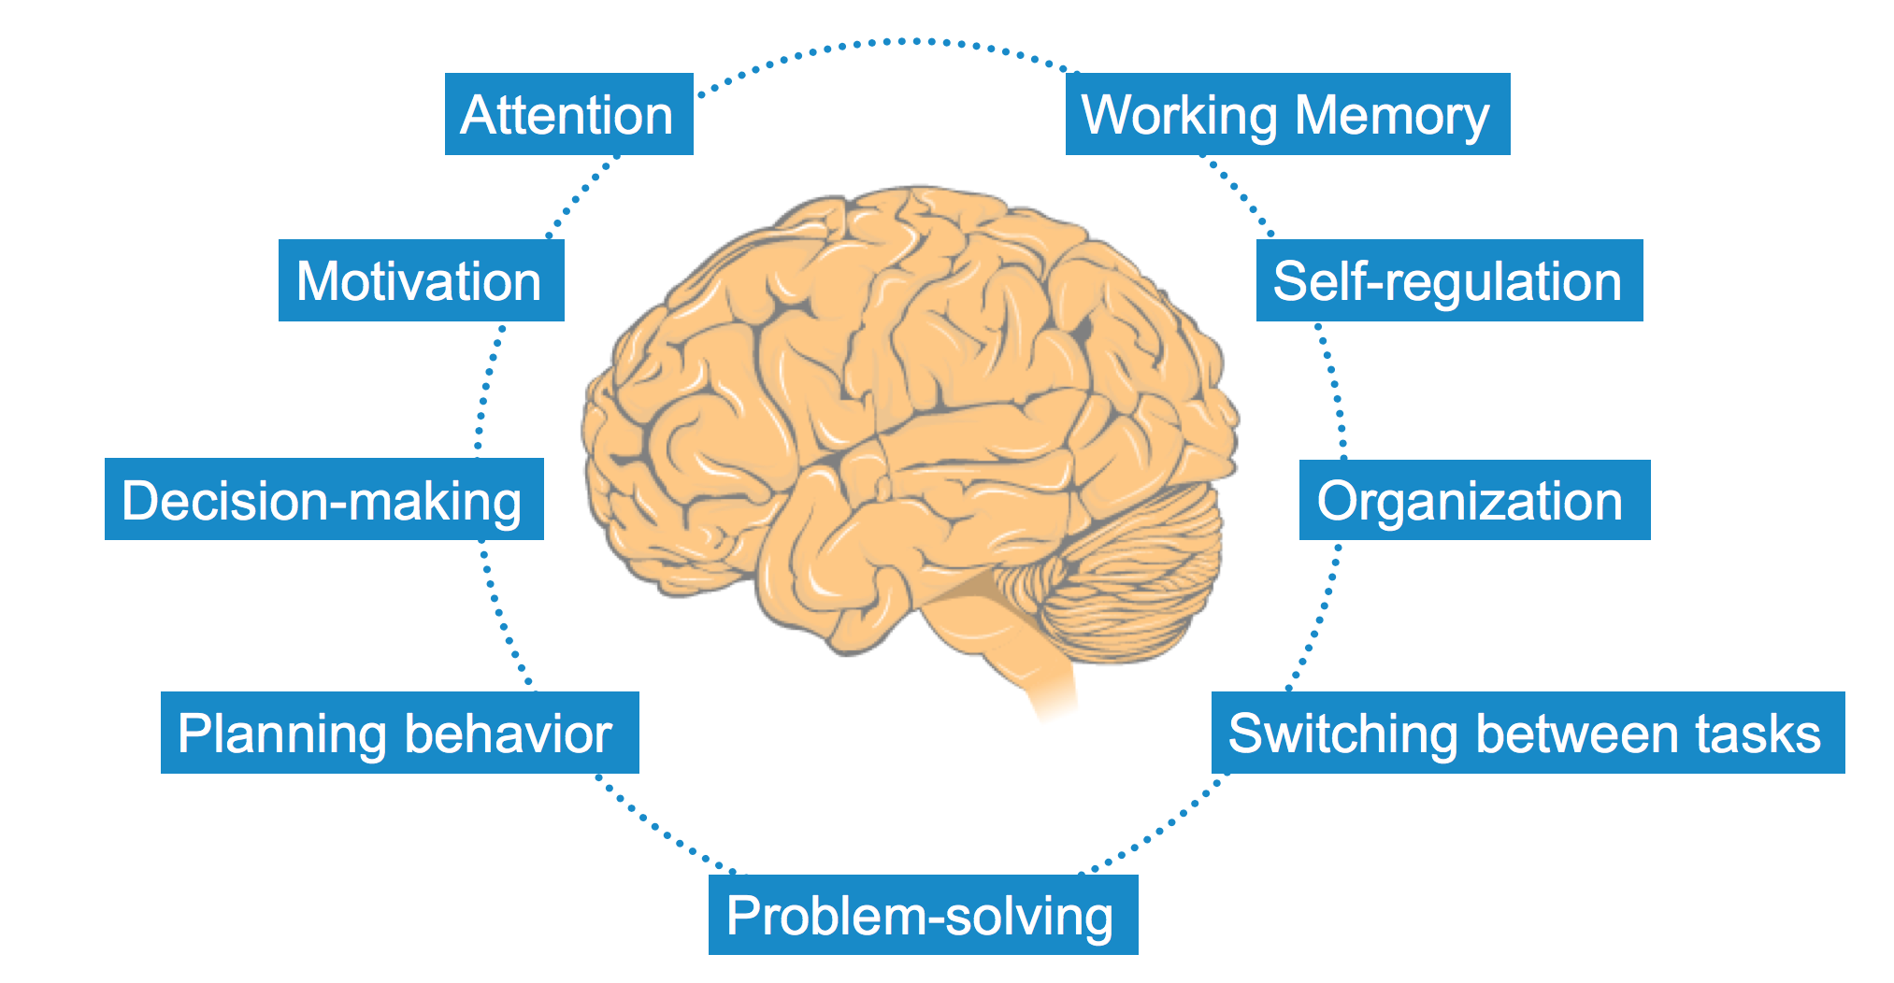
Executive Function
Image credit: EarlyEdU
Notes:
Executive function is an umbrella term for a whole host of skills, including focusing attention, motivation, decision-making, planning behavior, problem-solving, switching between tasks, organization, self-regulation, and working memory.
The foundations for these skills are set in the very early years of development.
Executive function skills are important for success in school and learning across domains. Self-regulation and executive function are strong predictors of academic achievement.
For example, one study that followed children during the entire course of their education found that a child’s ability at age 4 to pay attention and complete a task were the greatest predictors of whether they completed college by age 25.
Through supportive interactions with children, educators can help children build these fundamental skills.
REFERENCE
Mcclelland, M. M., Acock, A. C., Piccinin, A., Rhea, S. A., & Stallings, M. C. (2013). Relations between preschool attention span-persistence and age 25 educational outcomes. Early Childhood Research Quarterly, 28(2), 314-324.

Slide 43
Video Intro: Executive Function Skills
In the following video, Dr. Juliet Morrison, from Washington State’s Department of Early Learning, and Dr. Gail Joseph, from the University of Washington, discuss executive function skills.
Notes:
Let’s watch a video called Executive Function Skills. Dr. Juliet Morrison from Washington State’s Department of Early Learning and Dr. Gail Joseph, associate professor of educational psychology and director of Cultivate Learning and the EarlyEdU Alliance at the University of Washington, explain executive function skills in this 7-minute, 23-second video.

Slide 44
VIDEO: Executive Function Skills
VIDEO: Executive Function Skills
Notes:
This is an excerpt from a longer webinar by the former National Center on Quality Teaching and Learning.
REFERENCE
U.S. Department of Health and Human Services, Administration for Children and Families, Office of Head Start, National Center on Quality Teaching and Learning. (2013). Building executive function skills in children and adults. Front Porch Broadcast Series. https://eclkc.ohs.acf.hhs.gov/video/building-executive-function-skills-children-adults

Slide 45
Video Intro: The Timer
As you watch the video, identify when children are building executive functioning skills, including maintaining focus, persisting in an activity, and flexibility in thinking and behavior.
Notes:
Now let’s look at an example of a child using executive function and self-regulation skills in an early learning environment.
As you watch the video, think about: When are the children building executive function skills, including maintaining attention, persisting in an activity, and problem-solving?

Slide 46
VIDEO: The Timer
VIDEO: The Timer
Notes:
The video The Timer is 2 minutes, 47 seconds long.

Slide 47
Video Debrief: The Timer
What executive function skills were children working on?
Notes:
What executive function skills were children working on?
The possible responses below are meant to guide the discussion but not to be the right answers. Participants may have other observations and thoughts. Attention and focus—Filtering out ambient noise and responding to an educator while remembering where they were in their pretend play together.
Persistence—Continuing to play despite interruptions.
Flexible thinking/problem solving—Responding to each other’s changing ideas of the conditions of the pretend play world. For example, when one child has said that it is nighttime, the other responds by whispering. Then when the whispering child decides that it is daytime, the other child responds by waking up the animals.
An additional question may be: How might younger students behave differently?
Younger students might be more distracted and unable to react as quickly when peers change the pretend storyline. This could lead to disagreements about their pretend play.

Slide 48
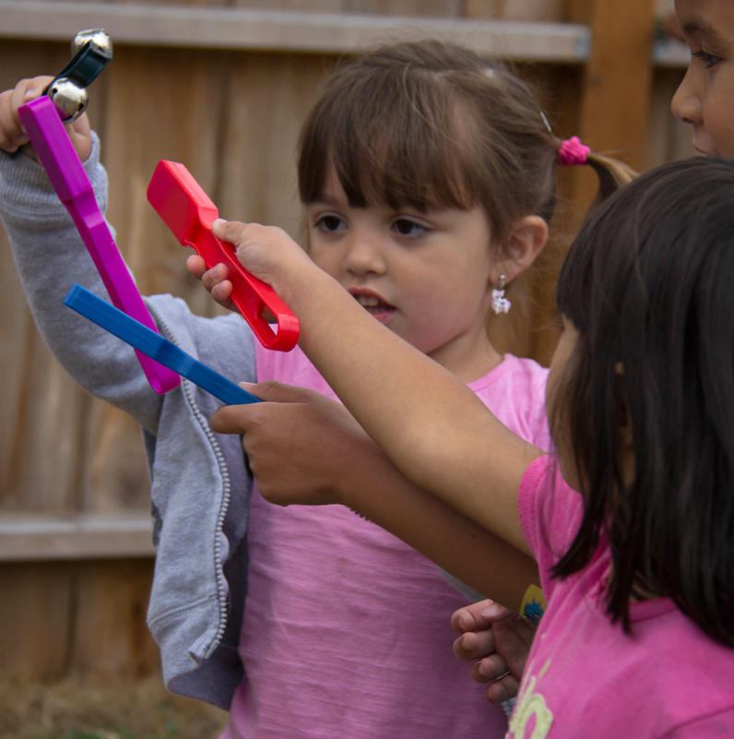
Play and Self-Regulation
Image credit: EarlyEdU
Notes:
One way to support children’s self-regulation and executive function skill-building is through play. Play provides a context for social growth, learning, and exploration (and makes kids happier, too).
There are many kinds of play, including social or cooperative play, object play, pretend play, and physical or rough-and-tumble play. Instances of social, cooperative, and pretend play surge during the preschool years. Children are now paying extra attention to their peers and attempting to engage them in play behaviors.
Through these play activities, children are learning a wealth of developmental skills, such as strategies for approaching others, social consequences, social problem-solving, and strategies for self-regulation. Play offers a myriad of opportunities to practice social skills and communication, build relationships, and try out ideas in a safe and protected way.
When preschool-age children engage in dramatic play, they learn how to see others’ perspectives and practice communicating thoughts and feelings. Through cooperative play activities, such as building blocks or trains, children learn how to coordinate their actions with others and how to navigate social exchanges.
Differences of opinion or planning typically arise and provide opportunities for children to learn how to solve social problems.
While infants and toddlers may not experience dramatic play in the same way, educators can support them in developing self-regulation through play by setting up a supportive environment and giving opportunities for pretend or symbolic play. Environmental supports may include having multiple copies of popular items, developing a predictable routine, modeling appropriate behaviors while playing with children, and scaffolding their development of self-regulation.
REFERENCES
Diamond, A., & Lee, K. (2011). Interventions shown to aid executive function development in children 4 to 12 years old. Science, 333(6045), 959–964. http://science.sciencemag.org/content/333/6045/959
Diamond, A., Barnett, W. S., Thomas, J., & Munro, S. (2007). Preschool program improves cognitive control. Science, 318(5855), 1387–1388. http://science.sciencemag.org/content/318/5855/1387

Slide 49
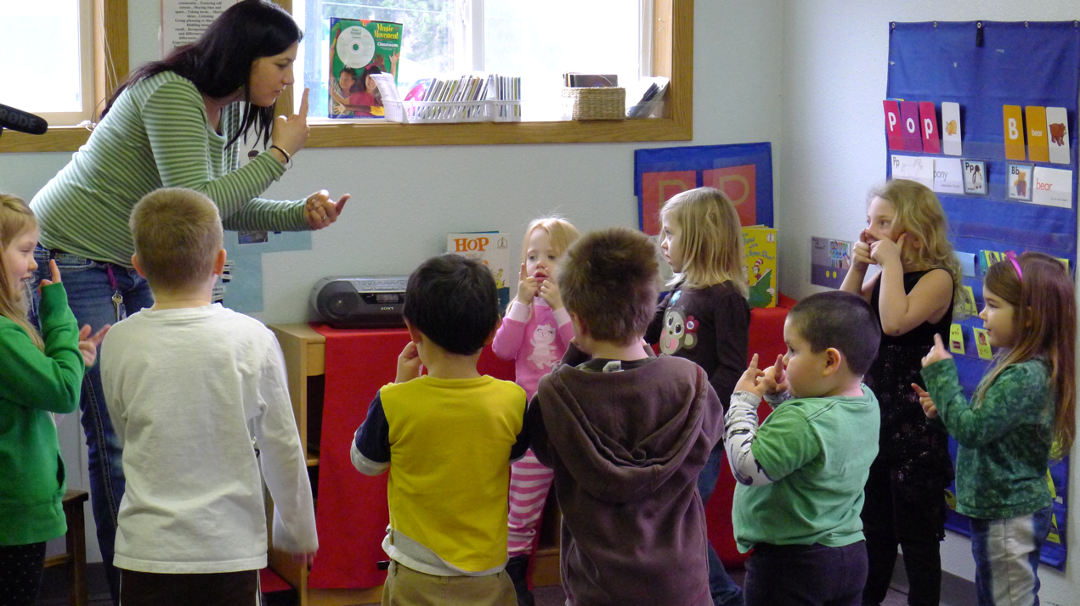
Rule-Based Play
Image credit: EarlyEdU
Notes:
In addition to providing many opportunities for dramatic free play, rule-based games like Simon Says, Red Light Green Light, or Head, Shoulders, Knees, and Toes are terrific ways to help children practice their cognitive skills.
These games all require behavioral control. They must use:
Working memory: Children must remember the rules of the game.
Attention: Children must pay attention to what the instructor or game leader is saying and doing.
In fact, recent research has found that how well children played a game that required these skills in kindergarten predicted growth across academic domains.
You can even use these games to practice mental flexibility—being able to switch tasks—which requires both emotional and cognitive self-regulation.
REFERENCE
McCllelland, M. M., Cameron, C. E., Duncan, R., Bowles, R. P., Acock, A. C., Miao, A., & Pratt, M. E. (2014). Predictors of early growth in academic achievement: The head-toes-knees-shoulders task. Frontiers in Psychology, 5.

Slide 50
Video Intro: Exploring Shapes and Sounds
As you watch the video, identify when children are building executive functioning skills including maintaining focus, persisting in an activity, and flexibility in thinking and behavior.
How does the educator support skill-building in these areas?
What more could the educator have done?
Notes:
Let’s look at an example of an educator scaffolding children’s exploration of different toys. As we watch, identify when children are building early executive function skills like maintaining focus, persisting in an activity, and demonstrating flexibility in their thinking and behavior.
Think about how the educator is working to support and scaffold learning in this area. How does the educator support skill-building in these areas? What more could the educator have done?
After we watch the video, we will discuss these questions as a group.

Slide 51
VIDEO: Exploring Shapes and Sounds
VIDEO: Exploring Shapes and Sounds
Notes:
The video Exploring Shapes and Sounds is 2 minutes, 9 seconds long. The clip focuses mostly on the interactions of one child and educator, although another child joins the activity toward the end of the video.

Slide 52
Video Debrief: Exploring Shapes and Sounds
When are children building executive functioning skills including maintaining focus, persisting in an activity, and flexibility in thinking and behavior?
How does the educator support skill-building in these areas?
What more could the educator have done?
Notes:
What did you notice? Which executive function skills were children working on, and how did the educator help support their learning? Is there anything the educator could have done to further their learning?
Help participants think about executive function skills the children were building. The possible responses below are meant to guide the discussion but not to be the right answers. Participants may have other observations and thoughts.
Attention and focus. One child was building attention and focus skills while working to stack the cups. The educator helped scaffold the child’s attention to the task by asking questions about the cups when the surrounding environment was distracting. The educator also helped the child transition to a new task—playing with the balls. Even though the child switched tasks, the child was still maintaining focus. The educator helped the child engage in the new task and explore the different properties of the balls.
Persistence. The one child persisted in stacking the cups, even when the child couldn’t quite figure out how to fit one inside the other. The educator provided scaffolding by asking leading questions to help the child think about what other strategies to try.
Flexible thinking/problem solving. The same child tried multiple strategies while playing with the cups, trying different shapes and sizes. When the child shifted attention to the balls, the child also experimented with different strategies, trying to figure out the best way to make noise with them—shaking or squeezing. The educator supported the child’s learning by making observations that helped the child think about what was happening and providing suggestions for other strategies to try like squeezing.
Areas of improvement. The educator guided the child’s learning in a busy environment. Given all the activity in the room, the child might have benefitted if the educator slowed down a little, waiting longer before asking a new question or suggesting a new strategy.

Slide 53
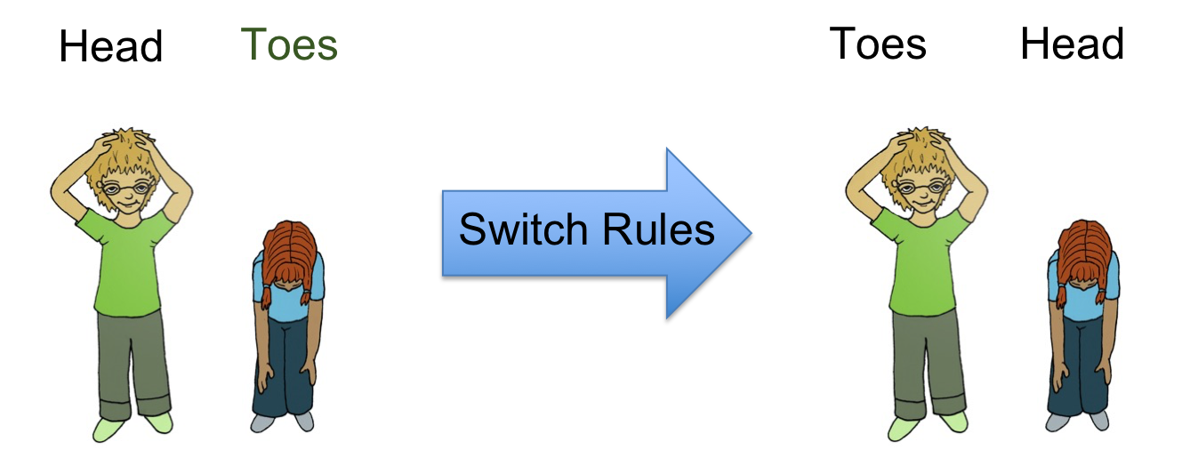
Activity: Head, Shoulders
Image credit: Head Start Center for Inclusion
Notes:
Let’s play a game that helps build executive function and self-regulation skills. Typically, in the children’s song Head, Shoulders, Knees, and Toes, you touch the part of your body that corresponds to the words in the song. So, if I say, “Head,” you touch your head. However, in this game, we’re going to switch the rules.
Now the rules are that when I say, “Head,” you will touch your toes, and when I say, “Toes,” you will touch your head. When I say, “Shoulders,” you will touch your knees, and when I say, “Knees,” you will touch your shoulders.
Now I’d like everybody to stand up—take a second and stretch if you need to. Say some combination of “head,” “shoulders,” “knees,” and “toes.”
Ask: “Did you find that easy or difficult?”
Debrief of the activity:
Researchers asked children to play this same game to measure their executive function skills, including:
Inhibitory control—A child must inhibit the dominant response and do the opposite of what the adult says.
Working memory—A child must remember the rules of the task.
Focused attention—A child must focus attention on the directions that the adult gives.
A recent study found that how well children performed this task in preschool predicted growth in mathematics.
Children’s level of proficiency at this game in kindergarten predicted growth in all academic outcomes.
ALTERNATE ACTIVITY: Stroop Test in Appendix
REFERENCES
McClelland, M. M., Cameron, C. E., Duncan, R., Bowles, R. P., Acock, A. C., Miao, A., & Pratt, M. E. (2014). Predictors of early growth in academic achievement: The head-toes-knees-shoulders task. Frontiers in Psychology, 5.
Ponitz, C. E., McClelland, M. M., Jewkes, A. M., Connor, C. M., Farris, C. L., & Morrison, F. J. (2008). Touch your toes! Developing a direct measure of behavioral regulation in early childhood. Early Childhood Research Quarterly, 23(2), 141-158.

Slide 54
The Brain and Stress
Notes:
In this section, we are going to be talking about difficult topics: childhood trauma and chronic, toxic stress, and their impact on the developing brain.
As we go through this section, notice the emotions that you may be feeling, or the reactions to the material that you are having. As we work through this material, be patient and kind with yourself, and others in the class.
Even if you have not personally experienced trauma, thinking about and sitting with pain that others have gone through is challenging and emotionally taxing. Please feel free to take a breather at any time.

Slide 55
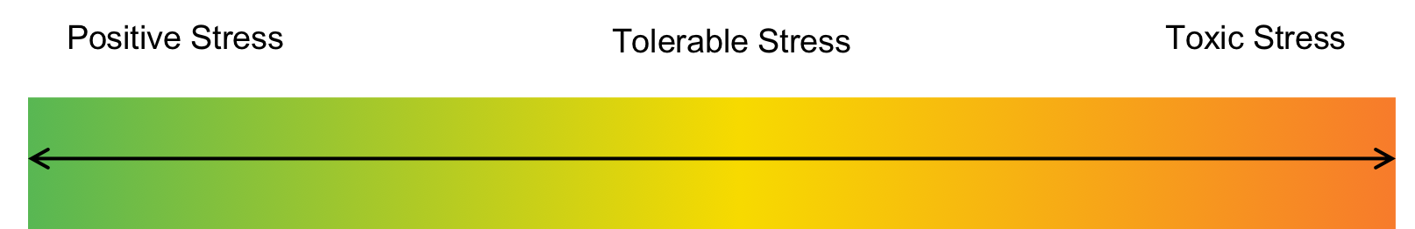
Stress Is a Continuum
Image credit: EarlyEdU
Notes:
Not all stress in a child’s life is toxic. Some stress is good stress. Positive stress is an important part of healthy development. Positive stress is the result of common experiences in a child’s life like starting school or going to the doctor’s office to get a shot.
These stressful experiences don’t last very long and are eased by the presence of a supportive adult. These early life experiences with positive stress help children learn how to cope with stressors that they will face throughout their life.
Tolerable stress is a longer stress response to a more intense situation like the loss of a loved one or experiencing a natural disaster like a tornado. If the child has the help of a supportive adult to buffer the stress, then these situations don’t necessarily lead to life-long, lasting effects.
Toxic stress is the result of prolonged experiences of adversity, such as emotional or physical abuse, neglect, exposure to violence, a caregiver who has a mental illness or abuses substances, or the combined effects of poverty in the absence of buffering by an adult.
Toxic stress can have a negative, life-long impact.
REFERENCE
Center on the Developing Child, Harvard University. (n.d.). Toxic stress: key concepts. Http://developingchild.harvard.edu/science/key-concepts/toxic-stress/

Slide 56
Discussion: Buffering Stress
Discuss these questions in small groups:
How would you buffer a child’s stress?
What could you do to support a child who is experiencing a stressful situation?
Notes:
Research indicates that the presence of a supportive and responsive adult during a stressful situation can help buffer and mediate the stress response. Supportive adults can buffer children’s stressful experiences, like a natural disaster, and prevent those experiences from eliciting a toxic stress response.
Form a small group and discuss:
How would you buffer a child’s stress?
What could you do to support a child who is experiencing a stressful situation?
The possible responses below are meant to guide the discussion but not to be the right answers. Participants may have other observations and thoughts.
Create and provide an environment where children feel safe. This may look different for each child but reminding children that they are safe and telling them that what you are doing to keep their bodies safe can help.
Be available and responsive, paying attention to children’s behavior, listening to what they say, and responding warmly and sensitively to their needs.
Maintain routines as much as possible. When children are going through a stressful situation, having some anchor like a routine can help them cope.
Model coping skills like taking deep breaths or a few minutes to calm down after experiencing big emotions and listening to others’ points of view.
Let children practice coping with some stresses like disappointments. If children never have the opportunity to practice their coping and self-soothing skills, then it will be more difficult for them to deal with larger stresses later in life. Letting children experience stress doesn’t mean that you aren’t there to help them. Help children cope by talking about ways to process their disappointment or sharing what you do to help yourself feel better when you are disappointed.
Exercise! Physical movement is helpful to children and adults who are experiencing stressful situations. Provide lots of opportunities for children to move their bodies during play.
REFERENCES
Nachmias, M., Gunnar, M. R., Mangelsdorf, S., Parritz, R., & Buss, K. A. (1996). Behavioral inhibition and stress reactivity: The moderating role of attachment security. Child Development, 67(2), 508-522.
National Scientific Council on the Developing Child. (2005/2014). Excessive stress disrupts the architecture of the developing brain: Working paper No. 3. Updated edition. http://developingchild.harvard.edu/index.php/resources/reports_and_working_papers/working_papers/wp3/
Bales, D. (2014). Building baby’s brain: Buffering the brain from toxic stress. https://secure.caes.uga.edu/extension/publications/files/pdf/C percent201053-12_1.PDF

Slide 57
ACEs Can Cause Toxic Stress
Persistent and acute stress from ACEs can:
Cause toxic stress.
Impact the developing brain.
Notes:
Adverse Childhood Experiences are also known as ACES and they are often related to, but not the same as toxic stress. A person’s reaction to ACEs depends on the person’s biological stress reactions, their protective characteristics, the intensity and duration of the ACE, and the strength of the person’s childhood bond to a stable, responsive, and nurturing caregiver.
Prolonged and intense stress from ACEs can:
Cause toxic stress.
Impact the developing brain.
REFERENCES
Minnesota Department of Public Health. (n.d.). Stress and ACEs: ACEs have an effect on the developing brain. https://www.health.state.mn.us/communities/ace/stress.html
Zero To Three. (2016, March 7). Trauma and toxic stress. https://www.zerotothree.org/resources/397-trauma-and-toxic-stress

Slide 58
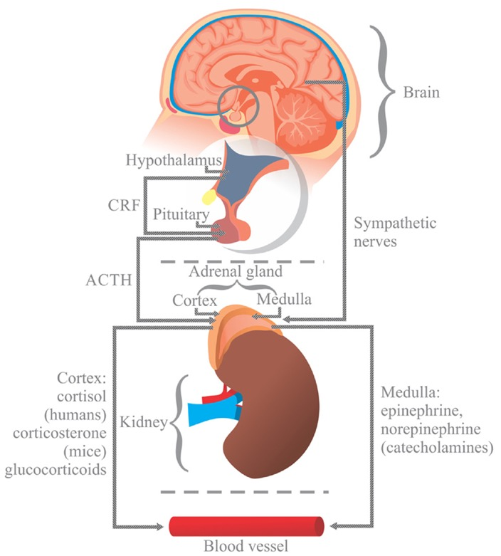
The Stress Response System
Image credit: Campos-Rodrίguez et al., distributed under a CC BY-3.0 license
Notes:
When we perceive a threat, a region in our brain called the hypothalamus sets off an alarm, triggering both the release of hormonal signals from the brain’s pituitary gland and neural signals. These signals, in turn, trigger the adrenal glands, which are located just above the kidneys, to release a sea of hormones. These hormones include both cortisol and adrenaline and they trigger a widespread response throughout our bodies.
During stressful situations, our hearts beat faster, our blood pressure rises, and our energy stores increase. For example, energy is made available to our muscles to help us jump quickly out of the car’s path.
Our body’s immune system, digestive system, and reproductive system are suppressed so that more energy is available to our bodies to deal with the potential threat.
Typically, our bodies regulate this stress response. Once the threat is gone, our hormone levels return to normal, and blood pressure, heart rate, and body systems also return to baseline. The biggest challenges to development occur when the threat experience continues over long periods.
REFERENCES
Campos-Rodríguez, R., Godínez-Victoria, M., Abarca-Rojano, E., Pacheco-Yépez, J., Reyna-Garfias, H., Barbosa-Cabrera, R. E., & Drago-Serrano, M. E. (2013). Stress modulates intestinal secretory immunoglobulin A. [Graphic]. Frontiers in Integrative Neuroscience, 7(86). https://www.ncbi.nlm.nih.gov/pmc/articles/PMC3845795/
Thompson, R. A., (2014). Stress and child development. Future Child; 24(1), 41-59.
The Mayo Clinic. (2016, April 21). Chronic stress puts your health at risk. http://www.mayoclinic.org/healthy-lifestyle/stress-management/in-depth/stress/art-20046037?pg=1

Slide 59
Video: How Does the Toxic Stress of Poverty Hurt the Developing Brain?
As you watch this video, think about:
What are examples of normal, everyday stress and examples of toxic stress?
What makes toxic stress so toxic?
PBS NewsHour. (2015, June 27). How does the ‘toxic stress’ of poverty hurt the developing brain? [Video file].
http://www.pbs.org/newshour/bb/toxic-stress-poverty-hurt-developing-brain/
Notes:
Poverty has the potential to create situations of toxic stress for children. To find out more about the impact of poverty on the developing brain, let’s watch a video about a family in Connecticut. During the video, the reporter will briefly discuss what defines toxic stress.
As you begin to get a sense of what toxic stress is, try to think of examples of everyday stresses that are toxic and those that are not toxic. Not all stressors are toxic. Also, consider: What makes toxic stress so toxic?
Watch the PBS NewsHour video:
http://www.pbs.org/newshour/bb/toxic-stress-poverty-hurt-developing-brain/
A commercial will play before the video begins. This video is How Does the Toxic Stress of Poverty Hurt the Developing Brain? It is about 10 minutes long.
Note: The presentation may need to be in presentation mode to play the video.
The video uses a case study, of a mom and four children from Honduras living in the U.S. and the father living abroad, to illustrate how toxic stress affects children’s development. Both the mother and the children experienced toxic stress that adversely affected them.
REFERENCE
PBS NewsHour. (2015, June 27). How does the ‘toxic stress’ of poverty hurt the developing brain? [Video file]. http://www.pbs.org/newshour/bb/toxic-stress-poverty-hurt-developing-brain/

Slide 60
Video Debrief: How Does the Toxic Stress of Poverty Hurt the Developing Brain?
What are examples of normal, everyday stress and examples of toxic stress?
What makes toxic stress so toxic?
Notes:
This video discussed the term toxic stress, and we learned about a family that experienced toxic stress. Take a moment to think about what the difference is between normal, everyday stress and toxic stress. What makes toxic stress so toxic?
Possible responses to these questions are:
Toxic stress can disrupt brain circuits and create a weaker foundation for circuitry that is essential for learning, memory, concentration, solving problems, and self-regulation.
Stress becomes toxic when it is unrelenting and children have little or no support from adults in their lives to help them manage stressful situations and build resilience.

Slide 61
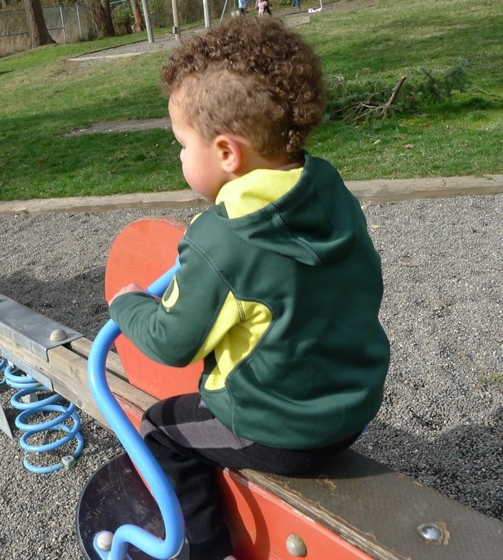
Impact on Development
Image credit: EarlyEdU
Notes:
Sometimes the perceived threat doesn’t go away. Imagine a child living with someone who abuses substances. This presents the possibility that there is always the threat of anger or violence, and the child’s stress response system stays active.
As adults, this chronic, long-term stress response system activation can lead to a host of health problems, such as anxiety, depression, digestive problems, weight gain, memory loss, and even heart disease.
In children, neural circuits involved in the stress response are still developing, and long-term exposure to stress can alter how the brain and body are wired. This can result in neural changes that can make it more difficult for children to concentrate, control emotions, and form stable, supportive relationships.
Combined with the other physical effects of prolonged exposure to stress, these early childhood experiences can have a life-long impact.
REFERENCES
Thompson, R. A. (2014). Stress and child development. Future Child, 24(1), 41-59.
The Mayo Clinic. (2016, April 21). Chronic stress puts your health at risk. http://www.mayoclinic.org/healthy-lifestyle/stress-management/in-depth/stress/art-20046037?pg=1

Slide 62
Video: Head Start -Trauma Smart
As you watch this video, observe how early childhood educators can help children who have experienced trauma.
Robert Wood Johnson Foundation. (2014, March 20). Head Start-Trauma Smart [Video file].
https://youtu.be/bXzKVpiSzH8
Notes:
As we watch this video featuring a Missouri Head Start program, observe how early childhood educators support children who have experienced trauma.
https://youtu.be/bXzKVpiSzH8
The video Head Start-Trauma Start is 5 minutes, 30 seconds long. It gives an overview of a Head Start program in Missouri specifically designed to support children who have experienced childhood trauma.
The presentation may need to be in presentation mode to view the video.
REFERENCE
Robert Wood Johnson Foundation. (2014, March 20). Head Start-Trauma Smart [Video file]. https://youtu.be/bXzKVpiSzH8

Slide 63
Video Debrief: Head Start - Trauma Smart
What are some ways that early learning professionals can support children who have experienced trauma?
Notes:
What can early learning childhood professionals do to support children who have experienced trauma?
The possible responses below are meant to guide the discussion but not to be the right answers. Participants may have other observations and thoughts. Possible responses based on the video are that educators can:
Notice children’s big feelings and identify and validate those for children.
Encourage children to ask one another what kind of help they need.
Teach stress-reduction strategies.
Collaborate with families and other program staff.
Take the time to care for themselves.

Slide 64
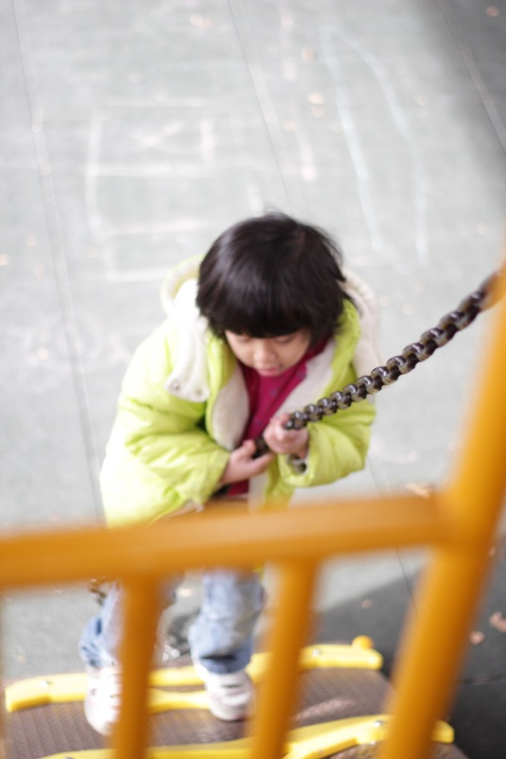
A Strengths-Based Approach
Image credit: EarlyEdU
Notes:
It is always best practice to take a strengths-based approach when working with children and their families, but it is particularly important to do so when a child and their family are experiencing or have experienced trauma.
A child and their support network need to know that this trauma is not their fault and be encouraged to continue to lean on their current resources.
Taking a strengths-based approach means shifting the focus away from What is wrong with you? to What has worked for you? This helps to move the focus from solely on the trauma to adaptive behaviors and individual strengths that a family can lean on as they work through their recovery process.

Slide 65
Activity: Resource Development
Identify 3-5 resources in your community that you can turn to or refer parents to when families are experiencing challenging circumstances.
Notes:
Materials: paper and pencils/pens OR chart paper and markers
For this activity, you will identify 3-5 resources in your community that you can turn to or refer parents to when families are experiencing challenging situations.
Explain how you might use these resources in your work as an early childhood educator. Use these questions and statements to guide your reflection:
How could you or a parent use this resource?
Are there any barriers to accessing this resource? If so, describe steps you could take to help eliminate or lower those barriers.
Describe how you might offer these resources to families and how you might follow up after providing them.

Slide 66
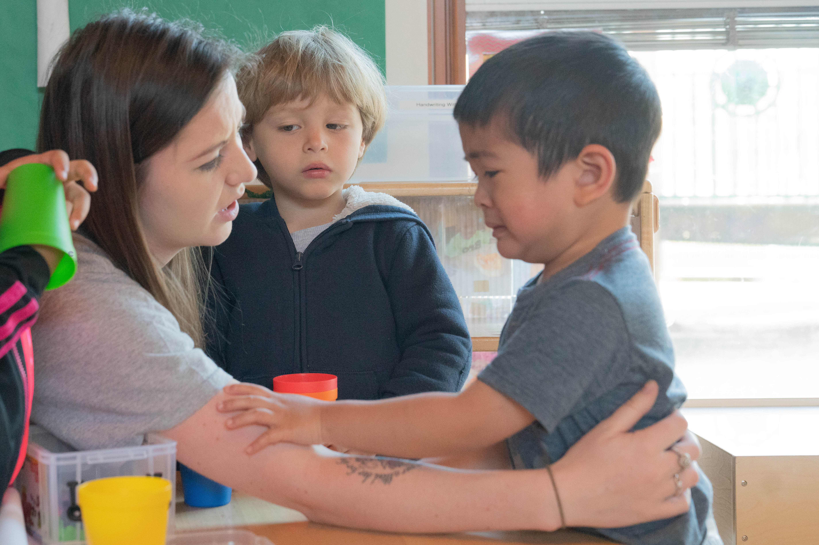
Responsive Interactions
Image credit: EarlyEdU
Notes:
It is important to use a strengths-based approach when working with families and especially with children. Children are learning how to manage their feelings and behavior with the support of adults. They are beginning to develop coping strategies to manage feelings and behaviors during routine early learning program activities, such as playtime or times when they need to follow rules. Responsive adults can help children handle strong feelings and guide their behavior when they have conflicts.
For example, when an attentive caregiver responds, children between birth and 9 months are learning to calm down or stop crying.
Between 8 and 18 months, children begin to look to familiar adults for help or guidance with their behavior and actions. They may begin to self-calm by sucking on their thumb or fingers.
By age 3, children are developing more tools, such as being able to say “no” or “stop” rather than hitting, during conflicts. They can tell adults if they are tired or hungry.
By age 5, children will be able to use words and control their actions in response to challenging situations, such as resource sharing, with minimal support from adults.
Development in this area prepares children for important, everyday tasks, including participating in routines with the support of familiar adults, communicating about basic needs, managing short delays in getting needs met, and following basic rules for managing their actions and behaviors.
REFERENCE
U.S. Department of Health and Human Services, Administration for Children and Families, Office of Head Start. (n.d.). Head Start Early Learning Outcomes Framework: Ages birth to five. https://eclkc.ohs.acf.hhs.gov/school-readiness/article/head-start-early-learning-outcomes-framework

Slide 67
Discussion: Importance of Responsive Care
What does attentive, responsive care look like?
Why is responsive care important for children’s emotional and behavioral self-regulation?
Notes:
We just talked about how children build emotional and behavioral self-regulation skills in the context of responsive caregiving. But what exactly is responsive caregiving?
What does it look like and why do you think it is important for children’s emotional and behavioral self-regulation?
Guide participants through a conversation about responsive caregiving.
Responsive caregiving requires an educator to carefully observe children, to learn from them, and to respond to their actions, behaviors, and communication in a supportive way.
Children who are cared for by adults who respond to their emotional and physical cues learn to self-regulate by eventually internalizing the methods adults use to comfort them.
The way in which adults deal with their emotions serves as a model for children who are learning to regulate emotions.

Slide 68
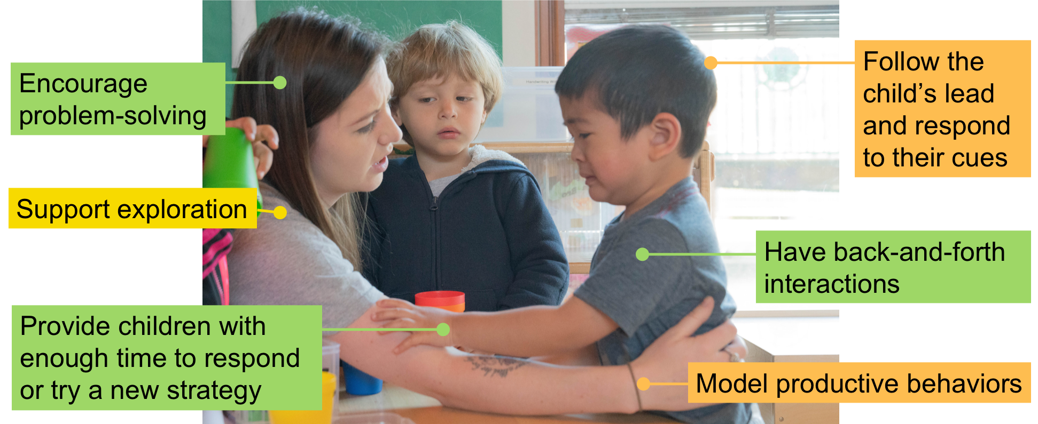
Scaffolding Through Responsive Interactions
Image credit: EarlyEdU
Notes:
The responsive caregiving given by adults can include support through scaffolding. Scaffolding is a term that describes techniques adults can use to support and help children in their learning. Scaffolding is offering the right level of learning support to take a child’s knowledge to the next level. Just as a scaffold supports the construction of a building, adults can scaffold children’s experiences as they are learning.
Adults scaffold children’s learning by providing cuing, prompting, questioning, modeling, discussing, and telling. Using these tools, adults can stretch children’s learning to a new level.
Adults can help scaffold children’s emotional and behavioral self-regulation by describing their emotions and the emotions that they think children might be feeling.
Adults can also model productive behaviors for children and talk them through challenging situations.
For example, in this situation, the educator may describe the children’s emotions by describing how they both want the book and talking about their feelings of frustration. She may then model how they can sit and read the book together or help one child give the book to the other. She could then help the first child find something else to play with, modeling a self-regulatory technique of finding another activity when a situation is frustrating.
Adults can also help children develop their flexible thinking skills by supporting them in their exploration of the world and asking leading questions.
As children puzzle through new experiences, it is important to wait and give children the opportunity to respond or try a new strategy on their own. Giving children time to process helps them focus on the task and gives them the opportunity to develop their unique strategies to solve a problem.

Slide 69

Closing Slide
© 2020 University of Washington. All rights reserved.
Notes:
-------------------------------------------------------
This is the end of the module on Child Development: Brain Building. We have discussed the structure of brain development, functions of the brain, the brain in multiple areas of development, and strengths-based, responsive strategies to support a child’s developing brain. More in-depth information can be found through the EarlyEdU Alliance and the University of Washington’s Institute for Learning and Brain Sciences (ILABS).

Slide 70
Appendix: OPTIONAL Stroop Test Activity
As fast as you can, instead of reading the word, name the color of each word on the following slides.
Notes:
To give you an idea of what cognitive flexibility feels like, let’s play a game together. A series of words will appear on the screen. As you see each word, say out loud the color of the word.
We’re going to do this as quickly as we can. Ready?

Slide 71
Stroop Test Slide 1
GREEN
Notes:
Participants should say, “Green.”

Slide 72
Stroop Test Slide 2
RED
Notes:
Participants should say, “Red.”

Slide 73
Stroop Test Slide 3
YELLOW
Notes:
Participants should say, “Yellow.”

Slide 74
Stroop Test Slide 4
BLUE
Notes:
Participants should say, “Blue.”

Slide 75
Stroop Test Slide 5
BLACK
Notes:
Participants should say, “Black.”

Slide 76
Stroop Test Slide 6
ORANGE
Notes:
Participants should say, “Orange.”

Slide 77
Stroop Test Slide 7
GREEN
Notes:
Participants should say, “Orange.”

Slide 78
Stroop Test Slide 8
RED
Notes:
Participants should say, “Blue.”

Slide 79
Stroop Test Slide 9
YELLOW
Notes:
Participants should say, “Black.”

Slide 80
Stroop Test Slide 10
BLUE
Notes:
Participants should say, “Red.”

Slide 81
Stroop Test Slide 11
BLACK
Notes:
Participants should say, “Yellow.”

Slide 82
Stroop Test Slide 12
ORANGE
Notes:
Participants should say, “Green.”

Slide 83
How Did You Do?
GREEN
RED
YELLOW
BLUE
BLACK
ORANGE
GREEN
RED
YELLOW
BLUE
BLACK
ORANGE
Notes:
How well did you do? What did you notice?
This test is called the Stroop Test, and it’s a common way that researchers measure cognitive flexibility in adults.
You may have noticed that at first, the written name of the color matched the color of the text. At some point, though, the written name of the color was different from the color of the text. This probably made it much harder to say the name of the color of the word quickly.
Tasks like the Stroop Test demonstrate the brain’s ability to switch between tasks. To be fast at the task, you have to ignore the word and focus on the color. This is hard to do since we are all used to reading automatically.
Your brain has to inhibit its natural tendency to read and focus on the colors instead. Because people who are learning more than one language have natural practice at switching between languages, they tend to complete Stroop tasks more quickly and accurately than people who are monolinguals, showing their mental flexibility.
However, practicing Stroop tasks and other mental flexibility games enable anyone to improve their cognitive flexibility.
REFERENCE
Stroop, J. R. (1935). Studies of interference in serial verbal reactions. Journal of Experimental Psychology, 18(6), 643–662. http://dx.doi.org/10.1037/h0054651

