Slide 1
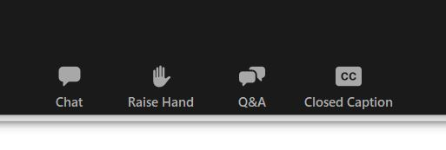
HOUSEKEEPING ITEMS
All participants are in listen-only mode.
Certificates of Attendance will not be provided.
Closed Captioning is optional.
Participate in discussion via chat.
Submit all questions via Q&A.
Ask your questions here.
Participate in discussion with the presenters here.
Closed Captions can be turned on or off here.
Notes:
All participants will be in a “listen-only” mode for the duration of this webcast. Please do not use the virtual “raise hand” option as participants will not be unmuted. Certificates of Attendance will not be provided at the conclusion of today’s event. If you are participating live with us, you will receive a “thank you” email 1 day after the event has ended.
Closed Captions are also available during today’s webcast. You can turn the captions on or off by clicking on the cc button near the bottom of your screen.
Also, to add to the discussion please use the Chat pod. To participate in chat, click on “Chat” and add your comment to the chat area.
To ask questions, please use the “Q&A” pod. To submit a question, click on Q&A and add your question to the pop up screen.

