Slide 1
Positive Behavior Support
Part 2
EarlyEdU Alliance®
© 2020 University of Washington. All rights reserved.
Notes:
What to say:
Welcome to Positive Behavior Support, Part 2! Let’s get started.
Presenter note:
As a reminder, you may need to alter the module activities to individualize this learning experience to match the needs of the participants in your class. Some participants may be new to teaching, others may have years of experience and are furthering their education. Some participants may be working in a family childcare environment with limited assessment procedures, while others may be in Head Start programs with lengthy, structured requirements.
Guidance for some of the learning activities may include possible participant responses. These are not intended to be comprehensive; they are merely suggestions to help you in leading the activity.
All clips are hyperlinked, so internet access that is fast enough to stream videos is important. When links are clicked on the slide, a new internet window will open up and automatically start playing the clip. You will need to click in the bottom right corner icon (expand arrows in a circle) to expand to full screen.

Slide 2
Learning Objectives – Part 2
Learn strategies for teaching about emotions.
Learn why problem solving is an important skill to teach children.
Learn strategies for teaching friendship skills.
Reflect on your perceptions of children’s behavior.
Discuss early intervention strategies.
Notes:
What to say:
For the second half of this Positive Behavior Support module, we will:
Learn strategies for teaching about emotions.
Learn why problem solving is an important skill to teach children.
Learn strategies for teaching friendship skills.
Reflect on your perceptions of children’s behavior.
Discuss early intervention strategies.

Slide 3
Hello and Welcome Back!
Take a moment to introduce yourself to someone new and share something that interested you from Part 1. What was one new thing you learned? One new or renewed strategy that you plan to use?
Image Credit: EarlyEdU
Notes:
What to say:
Take a moment to introduce yourself to someone new and share something that interested you from Part 1. Discuss: What was one new thing you learned? What was one new or renewed strategy that you plan to use?
Presenter note:
If Part 2 is being held on a different day, you can encourage participants to talk about a strategy that they may have tried from Part 1.

Slide 4
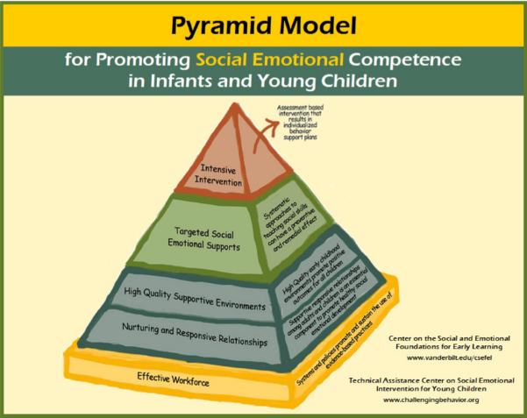
Noticing Feelings: Teaching Emotional Literacy and Regulation
Image Credit: Center on the Social and Emotional Foundations for Early Learning
Notes:
What to say:
The next level of our Pyramid Model focuses on teaching positive behavior strategies, shown here as Targeted Social Emotional Supports. We will specifically talk about noticing feelings: teaching emotional literacy and regulation. The ability to monitor our own and others’ emotions and to use emotions to guide our thinking and actions directly impacts our mental health.

Slide 5
Video: What is Emotional Literacy?
Video link: What is Emotional Literacy?
Watch for emotional literacy strategies you would like to use!
Notes:
What to say:
In this video clip, featured guest Dr. Gail Joseph returns to talk about emotional literacy and building more complex understanding and vocabulary.
Presenter note:
This video clip is 6 minutes long.

Slide 6
Discussion: Emotional Literacy
What do you do to teach children emotions?
Image Credits: EarlyEdU
Notes:
What to say:
As Gail discussed, somebody has taught those children the words to describe their emotions and emotional regulation skills. She begins with the question, “What do I do when I feel overwhelmed by one of these emotions?"
Turn to a partner and discuss: What do you do to teach children about emotions? If you don’t currently do this, what suggestions could you take from Gail’s strategies?
Presenter note:
Allow 3-5 minutes for this activity.

Slide 7
Video: Emotional Regulation
Video link: Emotional Regulation
Notes:
What to say:
Let’s continue the emotional literacy conversation as Gail shares the next step, helping children with emotional regulation. Higher levels of emotional regulation, for children and adults, is linked to better relationships and increased executive functioning skills. Learning about emotions and how to regulate them is also a protective factor for children and families. Increasing our abilities to regulate our emotions impacts our overall mental health.
Presenter note:
This video clip is 7 minutes, 20 seconds long.
REFERENCE
National Association for the Education of Young Children (NAEYC). (2017, March) Teaching Emotional Intelligence in Early Childhood.

Slide 8
Video: Social Stories
Video link: Social Stories
Let’s take a field trip!
Notes:
What to say:
Here is another circle time! Let's take a field trip to see an educator using social stories in their circle time. Keep in mind what we discussed previously about Teach, Practice, Reinforce.
Presenter note:
This video clip is 2 minutes, 5 seconds long.

Slide 9
Center for Social Emotional Foundations of Early Learning
Image Credit: Center on the Social and Emotional Foundations for Early Learning
Notes:
What to say:
Here are a couple of the resources that Gail mentioned to support emotional regulation, including the Tucker Turtle template for social stories. You can find many more on the website for the Center for Social Emotional Foundations for Early Learning (CSEFEL). Has anyone used these or other similar visuals? If so, how have you used them to teach, practice, and reinforce behavior?
Presenter note:
Show participants how to find materials on the CSEFEL website, which can be found at http://csefel.vanderbilt.edu/resources/strategies.html. You could also print visuals for participants and hand them out.

Slide 10
Video: Let’s Make It! Turtles!
Video link: Let’s Make It! Turtles!
Notes:
What to say:
Here is a quick video clip on how to make a Tucker the Turtle outfit of your own out of a grocery bag!
Presenter note:
This video clip is 27 seconds long. If desired, you could also bring a stack of paper bags and have participants use scissors and markers to make their own turtle at this time.

Slide 11
Video: Circle Time Magic – Movement
Video link: Circle Time Magic – Movement
As you watch, think about the ways that you do, or could, use movement to promote emotional regulation.
Notes:
What to say:
Let’s watch a video segment of Circle Time Magic that talks about how to use movement to promote emotional regulation.
Presenter note:
This video clip is 52 seconds long.

Slide 12
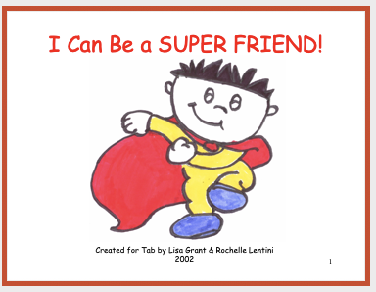
Social Stories
Social stories are brief descriptive stories that provide information regarding a social situation.
Image Credit: EarlyEdU
Image Credit: Center on the Social and Emotional Foundations for Early Learning
Notes:
What to say:
As we saw in the Circle Time Magic! segment, social stories are brief descriptive stories that provide information regarding an individual or group social situation. On this slide, you can see an example of a template you can find on the CSEFEL website, I Can Be a Super Friend and What Do We Do in Circle? These templates are most often created in PowerPoint, so you can personalize the pictures and words to fit your needs. Using pictures of the children in the program can help them see themselves in the situation!

Slide 13
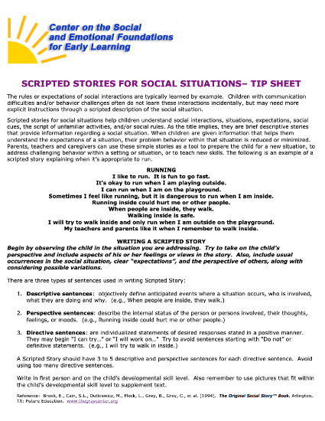
Making a Social Story
How to make and personalize
your own
Individual and class stories
Website
Image Credit: Center on the Social and Emotional Foundations for Early Learning
Notes:
What to say:
The rules or expectations of social interactions are typically learned by example. Children with communication difficulties and/or behavior challenges often do not learn these interactions incidentally, but may need more explicit instructions through scripted descriptions of social situations. Scripted stories for social situations help children understand social interactions, situations, expectations, cues, and/or rules. Social stories, as their name implies, are brief descriptive stories that provide information regarding social situations.
When children are given information that helps them understand the expectations of a situation, their problem behavior within that situation is reduced or minimized. Parents, educators, or caregivers can use these simple stories as a tool to prepare the child for a new situation, to address challenging behaviors within a setting or situation, or to teach new skills.
The following can be cut for time, if needed.There are three types of sentences used in writing a scripted story:
1. Descriptive sentences: objectively define anticipated events where a situation occurs, who is involved, and what they are doing and why they are doing it. (e.g., When people are inside, they walk.)
2. Perspective sentences: describe the internal status of the person or persons involved, their thoughts, feelings, or moods. (e.g., Running inside could hurt me or other people.)
3. Directive sentences: are individualized statements of desired responses stated in a positive manner. They may begin with “I can try…” or “I will work on….” Try to avoid sentences starting with “Do not” or definitive statements. (e.g., I will try to walk in inside.)
Check out the CSEFEL link shown here for more info on social stories!
REFERENCE
Vanderbilt University. Center on the Social and Emotional Foundations for Early Learning (CSEFEL). http://csefel.vanderbilt.edu/resources/strategies.html#scriptedstories

Slide 14
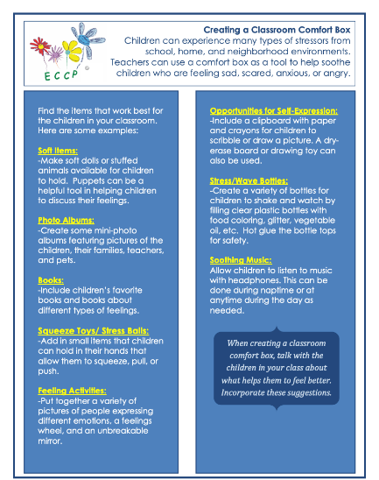
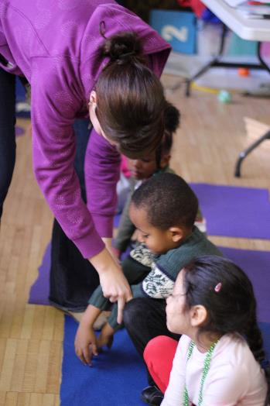
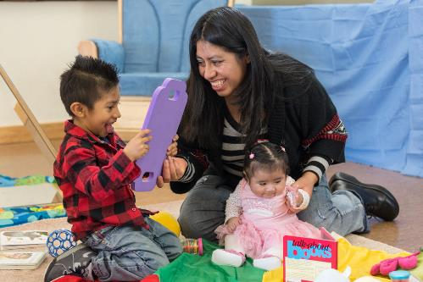
More Strategies
Website
Image Credits: EarlyEdU
Notes:
What to say:
Another great collection of resources and strategies for supporting children’s mental health can be found through the National Center on Early Childhood Health and Wellness (NCECHW). One of those resources, shown here, describes how to make a classroom comfort box.
We learned about several strategies for building emotional literacy and emotional regulation. Have you used any of the strategies mentioned? Discuss your experiences with a partner and share anything new you are interested in trying.
REFERENCE
Office of Head Start. National Center for Early Childhood Health and Wellness. Creating a Classroom Comfort Box. [PDF file]. https://eclkc.ohs.acf.hhs.gov/sites/default/files/learning-modules/mh-consultation-tool/story_content/external_files/ECCP%20Creating%20a%20Classroom%20Comfort%20Box._ECCP%20Comfort%20Box.pdf

Slide 15
Video: What do you with the mad that you feel?
Mr. Rogers discusses what to do with the emotions we feel.
Fred Rogers Productions. (1997). What do you do with the mad that you feel? [Video file]. https://www.misterrogers.org/articles/he-helped-us-with-our-feelings/
Notes:
What to say:
In this video from Mr. Roger’s Neighborhood, Mr. Rogers talks about what to do with the emotions we feel and gives children some ideas about how to handle feelings like anger. As you watch, consider what you do with your mad and how you model that for children.
Presenter note:
This video is 1 minute, 52 seconds long. You may need to click on the correct clip in the right column. The next video will auto play if not manually stopped.

Slide 16
Children’s Books – Emotions
What are your favorite children’s books that talk about emotions?
Let’s make a list together.
Notes:
What to say:
What are your favorite children’s books that talk about emotions? Let’s make a list together.
Presenter note:
This can be done with the participants shouting out ideas and the presenter making notes of suggestions or the presenter could put a couple of pieces of chart paper up and encourage participants to write down ideas. One benefit of using chart paper is that participants can take a picture of the ideas to take home with them.
Presenter may choose to bring in books on emotions to show participants. Note: any book with characters showing emotions will work.

Slide 17
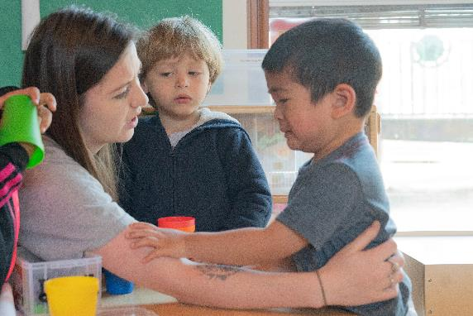
Emotional Literacy - Key Strategies
Teach and build new emotion words
Play games to identify emotions
Practice and model emotional regulation
Image Credit: EarlyEdU
Notes:
What to say:
We have heard many emotional literacy and emotional regulation strategies from the last couple of video clips, so let’s quickly review a few main strategies:
Teach and build new emotion words.
Play games to identify emotions.
Practice and model emotional regulation.
What is one thing you will try this week? (Shout out to the larger group or discuss with a partner.)

Slide 18
Video: It’s All About You – Telescope
Video link: It’s All About You – Telescope
Keep an eye out for ideas that could work for you!
Notes:
What to say:
In this It’s All About You segment, Gail uses telescopes to talk about how to get unstuck from negative feelings. Remember that supporting our emotional regulation strengthens our ability to lead with care and compassion and lowers stress and the likelihood of burnout while increasing our mental health.
Presenter note:
This video clip is 2 minutes, 41 seconds long.

Slide 19
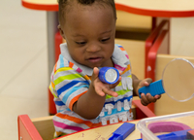
Discussion: It’s All About You – Telescopes
Talk to a partner: think about a recent time you were stuck in a negative frame of mind about something in your work. What could you say or do to turn it around?
Image Credit: EarlyEdU
Notes:
What to say:
Talk to a partner: Think about a recent time you were stuck in a negative frame of mind about something in your work. What could you say or do to turn it around?

Slide 20
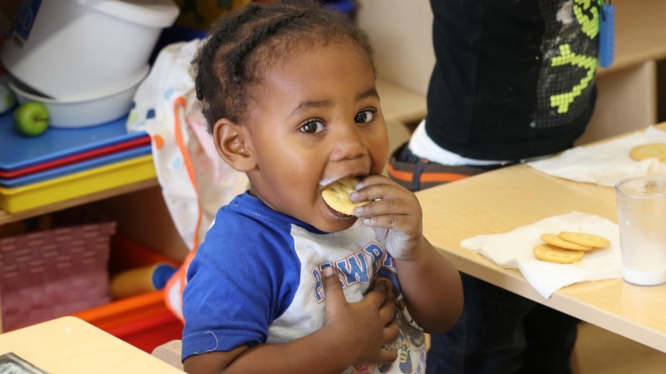
Break
Part 2
Break!
Image Credit: EarlyEdU
Notes:
What to say:
On that positive note, let’s take a quick break.
Presenter note:
This break can be adjusted shorter or longer depending on your timing needs.

Slide 21
Problems as Opportunities: Teaching Problem-Solving and Friendship Skills
Notes:
What to say:
The idea of reframing negative thoughts is a great way to transition to our next level of the Pyramid Model, as we talk about problems as opportunities: teaching problem-solving and friendship skills.

Slide 22
Video: The 4 Step Problem Solving Technique
Video link: The 4 Step Problem Solving Technique
Notes:
What to say:
This segment includes featured guest Dr. Angel Fettig from the University of Washington, discussing problem-solving in the early childhood classroom and the 4 Step Problem-Solving Technique. After our featured guest, we join Heather for some Circle Time Magic as she uses problem-solving.
Presenter note:
This video clip is 6 minutes, 22 seconds long.

Slide 23
Review and Discussion: The 4 Step Problem Solving Technique
Step 1: What is my problem? Identify the problem.
Step 2: Brainstorm solutions. Use tools for support.
Step 3: What will happen if I try this solution? Evaluate the option.
Step 4: Try it out. If it doesn’t work, try another solution.
Discuss: What other ways have you taught
problem solving?
Notes:
What to say:
Here is a quick recap of the 4-step problem solving technique.
Step 1: What is my problem? Identify the problem.
Step 2: Brainstorm solutions. Use tools for support.
Step 3: What will happen if I try this solution? Evaluate the option.
Step 4: Try it out. If it doesn’t work, try another solution.
Presenter note:
Ask participants to talk to find a new partner and discuss: what other ways have you taught problem- solving? If desired, you can ask for a couple of volunteers to share interesting ideas with the larger group. Allow 3-5 minutes for this discussion.

Slide 24
Video: Think 5
Video link: Think 5
Be ready to talk about how to apply Dr. Fettig’s Think 5 technique after the clip.
Notes:
Presenter note:
This video clip is 6 minutes, 54 minutes long.
What to say:
In this Featured Guest video segment, Dr. Angel Fettig continues to talk about problem-solving, including the Think 5 technique. As you watch, think about how you could incorporate Think 5 into your program and be prepared to discuss after the clip ends.

Slide 25


Think 5: Key Strategies
Think 5: Educator steps to problem solve in the moment.
Anticipate
Be close
Provide support
Multiple solutions
Celebrate success
This Photo by Unknown Author is licensed under CC BY-NC-ND
Notes:
Presenter note:
Turn to a partner and discuss: Which one of these items do you do really well? Which one would you like to work on and what could you do to improve your practice?
Allow 3-5 minutes for this discussion.

Slide 26
Video: From the Field - Social Problems and Biases
Video link: From the Field –
Social Problems and Biases
Notes:
What to say:
This slightly longer From the Field video segment features Dr. Maggie Beneke and Jordan Taitingfong from the University of Washington’s Haring Center discussing social problems and biases in the early childhood classroom, including their own experiences.
Presenter note:
This video clip is 10 minutes, 11 seconds long.

Slide 27
Reflect: Stop, Tuck, and Breathe
How might you use the Framework for Anti-Bias Teaching in your early learning setting?
Let’s practice!
Find a partner to pair with and share your ideas
Notes:
Materials needed:
Handout: Moving Beyond Anti-Bias Activities (This resource has multiple pages, if you don’t want to print every page, consider only printing 1-2 for each table to use as a resource.)
Handout: Framework for Anti-Bias Teaching Activity
Presenter note:
This topic can be a challenge to discuss, so as appropriate, you might encourage participants to stop and breathe before entering this activity. It might also be helpful to remind participants of healthy discussion guidelines such as, openness to other perspectives, honesty with ourselves, and respectful language.
What to say:
This can be a challenging topic to discuss, so before we begin, I encourage you to take a couple of deep breaths and a minute to reflect on your perspective and experiences with social problems in your early childhood program. I will keep the time. Let’s take a moment and complete the Framework for Anti-Bias Teaching Activity. After you have completed it for yourself, you will be encouraged to turn to a partner and talk about what you wrote and some of your ideas for addressing challenges.
Allow 5-10 minutes for this discussion and monitor non-verbal cues to ensure all participants are managing discussions and feeling comfortable.
REFERENCE
National Association for the Education of Young Children. (2016, March). Anti-Bias Teaching.
https://www.naeyc.org/resources/pubs/yc/mar2016/moving-beyond-anti-bias-activities

Slide 28
Discussion: Working with Families
How are we communicating our thinking with families?
What are some ways we can explore anti-bias with families?
Image Credit: EarlyEdU
Notes:
Presenter note:
This is suggested as a large group discussion with a few ideas from volunteers, but can also be conducted in pairs or small groups. Allow 2-3 minutes for this discussion.
What to say:
We’ve talked a little about how we deal with biases in our classrooms, but how are we communicating these strategies and beliefs with families? What are some ways we can explore anti-bias with families? If a few people are willing to share, we will discuss this as a large group.

Slide 29
Video: Children’s Books That
Support Friendship and Solving Problems
Video link: Children’s Books that
Support Friendship and Solving Problem
Notes:
What to say:
This library segment includes librarian Blythe showing some friendship books from the local library.
Presenter note:
This video clip is 6 minutes, 16 minutes long.

Slide 30

Part 2 – Wellness Activity
Image credit: Creative Commons
Notes:
What to say:
Caring for and educating young children is physically and emotionally demanding work. As we have discussed, by taking time to learn resiliency practices and for self-care, you can increase feelings of happiness and satisfaction. These positive emotions improve your ability to face daily stressors—such as challenging behaviors—with more empathy, patience, and intention.
Let’s take a moment and care for ourselves by resetting our gratitude meter. Think of something that you are grateful for and picture it in your mind. Now close your eyes and take three deep breaths with me: 1… .2… 3….

Slide 31
Video: Children's Interviews - Problem Solving
Video link: Children's Interviews –
Problem Solving
Notes:
What to say:
Let’s close out this section by hearing from the children! Watching videos like this is a great way to remind ourselves about why we do our work and to support our own resiliency! This clip shows a few children being interviewed by an older child about problem-solving.
Presenter note:
This video clip is 1 minute, 59 seconds long.

Slide 32
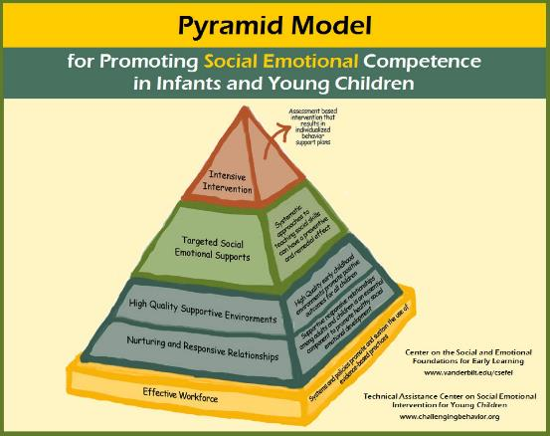
Addressing Challenging Behavior: Guidance and Support
Image Credit: Center on the Social and Emotional Foundations for Early Learning
Notes:
What to say:
In this module, we started from the bottom of the pyramid and covered information and strategies focused on relationships, environments, and teaching strategies. Now we will talk about the top section of the pyramid, as we focus on addressing challenging behavior: guidance and support. Please note, challenging behavior can be ultimately viewed as behavior that challenges adults with the focus on how adults adapt and help children learn.

Slide 33
Video: The Three R’s
Video link: The Three R’s
As you watch, consider something you found challenging recently and how the “Three R’s” might apply to that situation
Notes:
Presenter note:
This video clip is 9 minutes, 38 seconds long.
What to say:
In this featured guest segment, Jordan Taitingfong returns to talk about challenging behavior and the three Rs, reflect, review, and resiliency.

Slide 34
What is your go-to happy activity?
Take a moment to brainstorm ideas.
Image Credit: EarlyEdU
Notes:
What to say:
Did anyone identify with some or all of what Jordan was talking about? Many educators have the experience of feeling dejected and frustrated with challenging behavior. Jordan talked about her go-to happy activity, what is yours?
Presenter note:
Ask participants to discuss with an elbow partner their go-to happy activity then do a popcorn share-out with the larger group.es. Create a list on chart paper.

Slide 35
Video: The Behavior Equation
Video link: The Behavior Equation
Notes:
What to say:
In this video segment, Dr. Gail Joseph speaks about the behavior equation and its importance when working through challenging behavior. We talked earlier about behavior as a form of communication and this video goes more in-depth about interpreting that communication. Remember it is important to establish and maintain open communication with the family to understand how the child's history and context inform the function of the behavior.
Presenter note:
This video clip is 4 minutes, 51 seconds long.

Slide 36
Activity: Antecedent + Behavior
+ Consequence = Function
Use your ABC form to jot down observation notes from the following two videos.
Notes:
Materials needed:
Handout: ABC form – OR full document, PBS Behavior Plan Blank. It would be helpful to have several extra copies as well for participants to take back with them.
What to say:
Let’s try this out. Please get out your handout, the ABC Form, and take notes about your thoughts in the A, B, and C sections as we watch the following two video clips. We will discuss possible answers after viewing both videos. In a later slide, we will talk about the bottom sections of the form, preventing, teaching new skills, and responding.

Slide 37
Video: Outdoor Observation
Video link: Outdoor Observation
Notes:
Presenter note:
This video clip is 47 seconds long. Please replay if needed. Move to the next slide and allow participants a little time to take notes at the end of viewing the video clip.

Slide 38
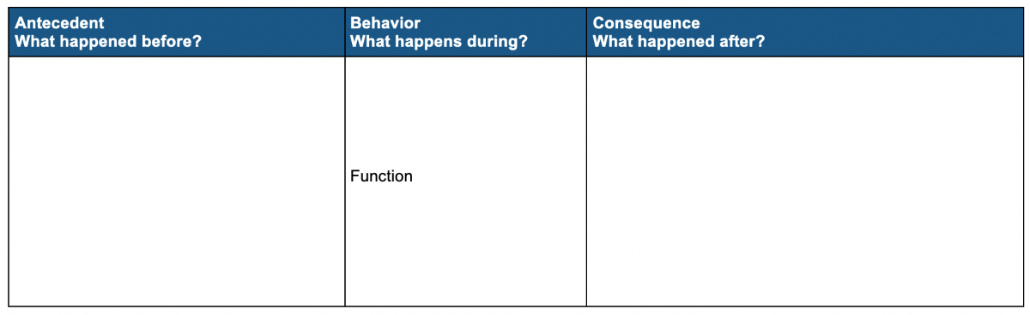
Antecedent + Behavior + Consequence = Function
Image Credit: EarlyEdU
Notes:
Presenter note:
Allow participants a little time to take notes, then move on to the next video clip, Free-Play Observation.

Slide 39
Video: Free-Play Observation
Video link: Free-Play Observation
Notes:
Presenter note:
This video clip is 34 seconds long and can be replayed if needed. Move on to the next slide and allow participants a couple of minutes to write their notes when they have finished viewing the video clip.

Slide 40
Antecedent + Behavior + Consequence = Function (continued)
Image Credit: EarlyEdU
Notes:
Presenter note:
Allow participants a little time to take notes, then move on to the next slide, Functions of Behavior.

Slide 41
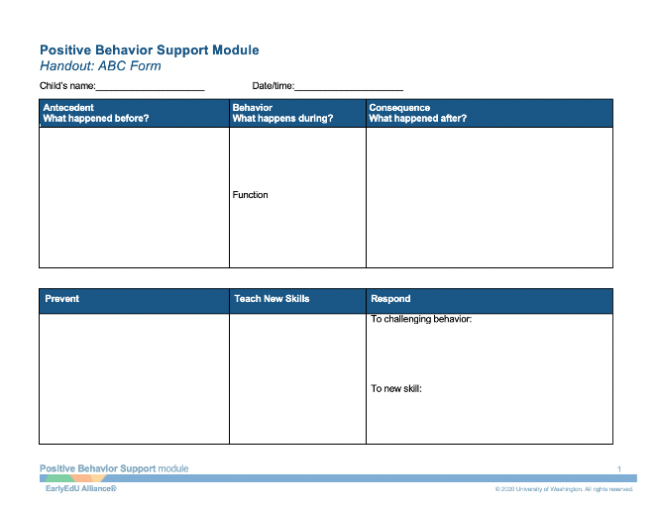
Functions of Behavior
Get something
Get away from something
Image Credit: EarlyEdU
Notes:
What to say:
Let’s take a moment to review our notes. I will ask for volunteers to share what they thought might be the antecedents, the behaviors, the consequences, and the possible function. Don’t worry if you have a different perspective than others, it can help to hear different interpretations of this and the many incidents of challenging behavior.
What do you think may be the:
Antecedent
Behavior
Consequence
Function
As you may already know, the function of a behavior is often described as to get something or to get away from something. Thinking of which category a function fits in can help us understand what the child is trying to communicate. This will allow us to do our best to help them find a positive way to deal with the situation.

Slide 42
Video: Observation Debrief
Video link: Observation Debrief
Compare your notes to Gail’s debrief of the video.
Image Credit: EarlyEdU
Notes:
Presenter note:
This video clip is 10 minutes, 53 seconds long.
What to say:
Now let’s see what the hosts and Gail think of each observation video. After the observation debrief video, Gail will address the bottom section of the ABC form, used to discuss how to prevent, teach new skills, and respond.

Slide 43
Video: Visit to the Library
Video link: Visit to the Library
Image Credit: EarlyEdU
Notes:
Presenter note:
This video clip is 8 minutes, 6 seconds long. This video is also a little long, so make sure to take a one-minute stretch break with participants, if needed.
What to say:
In this final visit to the library, Blythe talks about some books to support children and educators through challenging behavior, to help calm, to use strengths, and to build resilience.
This picture of children reading in different positions is a great way to illustrate engagement with the content, while challenging the notion that children must sit in a particular way to enjoy story time.

Slide 44

Early Intervention
Image Credit: Center on the Social and Emotional Foundations for Early Learning
Notes:
What to say:
We have discussed the multiple layers of the Pyramid Model, but there are times when additional intervention might be needed. In this final section of our module, we will go through a brief introduction to early intervention services. Season 3 of Circle Time Magazine, coming July 2020 to the Cultivate Learning website, will go deeper into inclusion and strategies to support children with disabilities in the early childhood classroom.

Slide 45
Video: Early Intervention Services
Video link: Early Intervention Services
Watch for new ideas that you could share with colleagues or families.
Notes:
What to say:
In this round table type of discussion, we hear from Sarah Foster and colleagues some of the typical steps for accessing early interventions services. Watch for new ideas that you could share with colleagues or families.
Presenter note:
This video clip is 3 minutes, 33 seconds long.

Slide 46
Video: Connecting Before Correcting
Video link: Connecting Before Correcting
As you watch the video, consider what strategies you might want to use in
your program.
Image Credit: EarlyEdU
Notes:
Presenter note:
This video clip is 2 minutes, 30 seconds long.
What to say:
In this continuation of the round table discussion, we hear some strategies that educators can use until, and even after, services begin.

Slide 47
Discussion: Connecting Before Correcting
What are one or two strategies discussed that you could use this week to “connect before you correct” with children?
Image Credit: EarlyEdU
Notes:
Presenter note:
Ask participants to turn to a partner or create small groups and discuss: what are one or two of the strategies discussed that you could use this week to “connect before you correct” with children?
Allow 3-5 minutes for this discussion.

Slide 48
Family Services
Early childhood mental health therapy
Circle of Security
Play therapy – often for children 3+
Occupational/speech therapy
Family preservation services
Movement – yoga, martial arts, sports
Social skills groups – often school age focused
Image Credit: EarlyEdU
Notes:
What to say:
Some services that families can seek out include:
Early childhood mental health therapy
Circle of Security – a multi-session parenting training for families
Play therapy – often for children 3+
Occupational/speech therapy – this is suggested if challenges may be related to a developmental, physical, or speech delay
Family preservation services – social services which are available if the family is involved in the child welfare system
Movement – yoga, martial arts, and sports
Social skills groups – often school age focused

Slide 49
Early Intervention Key Takeaways
Listen to your gut instinct (but check your biases)
Families can elect not to follow through
Families need to be comfortable
Early Intervention services can be key
Early Intervention is open and accessible to everyone
You do not need a referral to contact early intervention or district services
Self-care is necessary
Image Credit: EarlyEdU
Notes:
What to say:
A quick note – when we are discussing early intervention in this context, we mean the broad concept, including positive behavior support. This broad definition could also include the more specific identified guidance found in Part B or Part C of the Individuals with Disabilities Education Act (IDEA) for children with identified disabilities. Here are a few of the key takeaways the round table of presenters discussed:
Listen to your gut instinct. You are an experienced educator and know when something is wrong that should be followed up on, but make sure to check any potential implicit biases that might be influencing your perception. For more guidance, check out the Pyramid Model Equity Coaching Guide (linked in additional resources).
Families can elect not to follow through educator suggestions, but even if just a seed is planted, that can be helpful.
Families need to be comfortable to take next steps.
Early Intervention services can be key to children's development and the earlier the better.
Early Intervention is open and accessible to everyone.
You do not need a referral to contact early intervention or district services.
Self-care is necessary. Make sure your needs are fulfilled, this will better equip you to meet the child’s needs.
Additional Resources:
Pyramid Model Equity Coaching Guide
https://fpg.unc.edu/sites/fpg.unc.edu/files/resources/presentations-and-webinars/Pyramid-Model-Equity-Coaching-Guide.pdf

Slide 50


Summary
Circle Time Magazine
CSFEL
Head Start Center for Inclusion
Notes:
What to say:
As we discussed at the beginning of the module, Positive Behavior Supports and our process through this module has mirrored the pyramid topics.
We began with a strong foundation that is all about the importance of an effective workforce, social-emotional development, and establishing supportive relationships between educators and children.
Next, we built upon that foundation and shared proactive strategies that promote positive behaviors for all children, including environmental supports, routines, behavioral expectations, and classroom rules.
We continued up the pyramid to focus on the targeted social-emotional supports of emotional literacy and regulation, problem-solving strategies, and building friendship skills.
We looked at how to create highly individualized plans for some children who need more support for their challenging behaviors.
And finally, we briefly explored early intervention.
Additional information can be found on the Circle Time Magazine, Season 2 website, including resources, learning activities, printouts for your classroom, and more. We also encourage you to continue to explore the websites for the Head Start Center for Inclusion and CSEFEL.
Thank you for your time!

Slide 51

Closing Slide

