Slide 1

Positive Behavior Support
Part 1
EarlyEdU Alliance®
© 2020 University of Washington. All rights reserved.
Notes:
What to say:
Welcome to our module focused on Positive Behavior Support, also known as PBS. This module will use clips from Cultivate Learning’s Circle Time™ Magazine, season 2, as well as engaging discussions and activities to explore PBS through the framework of the Pyramid Model, which we will discuss shortly. This module teaches positive behavior support practices for early learning professionals working with children from birth to age 5 in a variety of early learning settings, from family programs to private programs to Early Head Start/Head Start. In this module, the terms early learning professional, early childhood educator, and their variations refer to educators who work with children ages birth to age 5.
Most of the core principles apply to educators working with children throughout that age range. Some parts of the module may have more examples, photos, or videos from one age range or type of early learning environment. Some practices may be more relevant to one age range than another.
The aim is for early childhood educators to learn and apply best practices in assessing children to help better guide their learning and development toward outcomes identified by programs, families, curriculum, and state or federal early learning guidelines, and to respond to children’s individual needs.
Presenter note:
You may need to alter the module activities to individualize this learning experience to match the needs of the participants in your class. Some participants may be new to teaching, others may have years of experience and are furthering their education. Some participants may be working in family child care with limited assessment procedures while others may be in Head Start programs with lengthy, structured requirements.
Guidance for some of the learning activities may include possible participant responses. These are not intended to be comprehensive; they are merely suggestions to help you in leading the activity.
All clips are hyperlinked, so internet access that is fast enough to stream videos is important. When links are clicked on the slide, a new internet window will open up and automatically start playing the clip. You will need to click the bottom right corner icon (expand arrows in a circle) to expand to full screen.

Slide 2
Hello and Welcome
Take a moment to introduce yourself to someone near you and share a memory from one of your favorite educators growing up. What was your relationship like with that educator? How did you feel in their class?
Image Credit: EarlyEdU
Notes:
What to say:
Take a moment to introduce yourself to someone near you and share a memory from one of your favorite educators growing up. What was your relationship like with that educator? How did you feel in their class? Talk with a partner and after a few minutes, I will ask for a couple of volunteers to share with the larger group.
Presenter note:
Take 2-3 minutes for this activity. Ask for 1-2 volunteers to share back with the larger group.

Slide 3
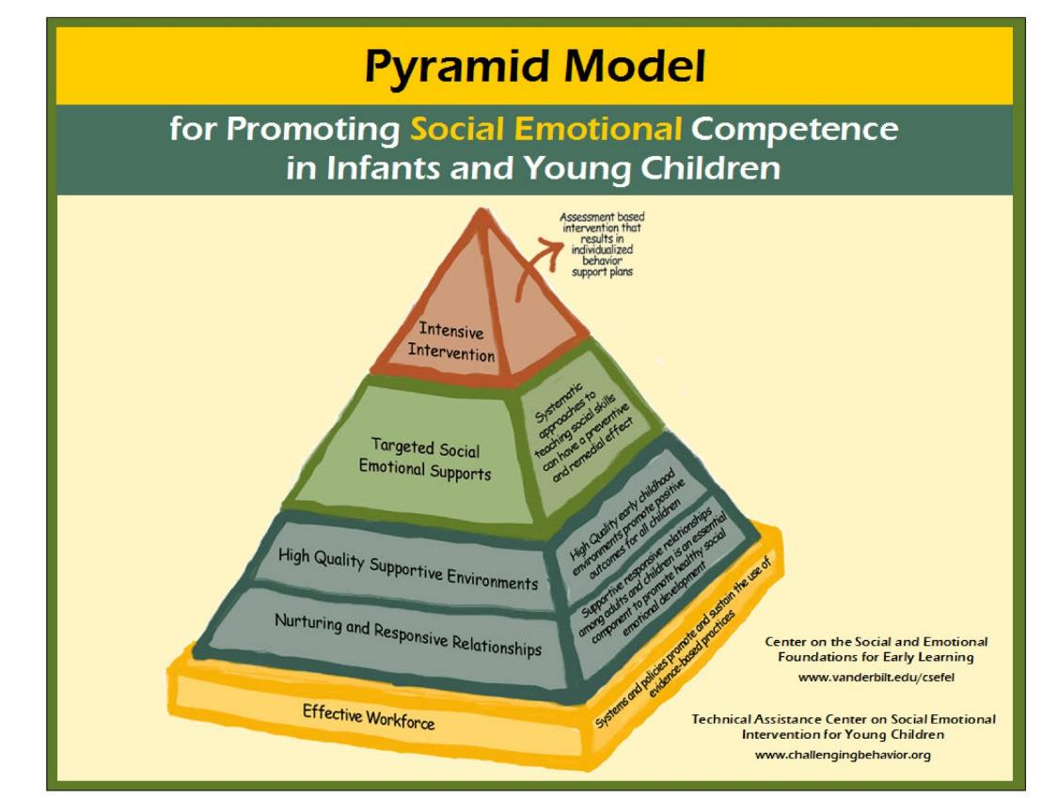
The Pyramid Model
Image Credit: Center on the Social and Emotional Foundations for Early Learning
Notes:
What to say:
Relationships are the foundation of positive behavior support and are vital to healthy social-emotional development. As you can see on the image above, relationships form the base of the Pyramid Model. Social-emotional skills are the core of mental well-being and success in life (however we choose to define success). Social emotional learning can be one of the most proactive initiatives to support mental wellness. Social-emotional learning in early childhood can help reduce anxiety, suicide, substance abuse, depression, and impulsive behavior in children, while increasing prosocial behavior, such as kindness, personal awareness, and empathy.
Some of you may be familiar with the Social and Emotional Foundations for Early Learning pyramid model. The Pyramid Model is a visual articulation of Positive Behavior Supports which is a tiered approach to promoting and fostering social-emotional development and addressing challenging behavior. Our process throughout this module mirrors the pyramid topics.
Throughout this module, we will focus on the Pyramid Model to share information and strategies and implement positive behavior supports. We begin with a strong foundation that is all about the importance of social-emotional development, establishing supportive relationships between educators and children, and supporting an effective workforce.
Next, we build upon that foundation and share prevention strategies that promote positive behaviors for all children, including environmental supports, routines, behavioral expectations, and classroom rules.
We continue to the next layer of the pyramid to focus on the targeted social-emotional supports of emotional literacy and regulation, problem-solving strategies, and building friendship skills.
Finally, we look at how to create highly individualized plans for some children who need more support for their challenging behaviors.
REFERENCE
Vanderbilt University. Center on the Social and Emotional Foundations for Early Learning (CSEFEL).http://csefel.vanderbilt.edu/.
National Center for Mental Health Promotion and Youth Violence Prevention by the Collaborative for Academic, Social, and Emotional Learning at the University of Illinois at Chicago. (January 2008)
Connecting Social and Emotional Learning with Mental Health. [PDF File] https://files.eric.ed.gov/fulltext/ED505361.pdf

Slide 4
What is Circle Time Magazine?
Image Credit: EarlyEdU
Notes:
What to say:
Throughout this module, we will use video clips from Circle Time Magazine to learn more about Positive Behavior Support (PBS) and to see it in action.
Circle Time Magazine is a dynamic professional development web series and magazine for early childhood educators, parents, and providers that seeks to make Cultivate Learning's research accessible, friendly, and fun. Each episode features guest experts sharing their knowledge, ideas for using everyday materials, favorite books, and high-quality examples of learning in action. Season 2 focuses on Positive Behavior Support and follows the Pyramid model to discuss social emotional development and early childhood mental health.

Slide 5
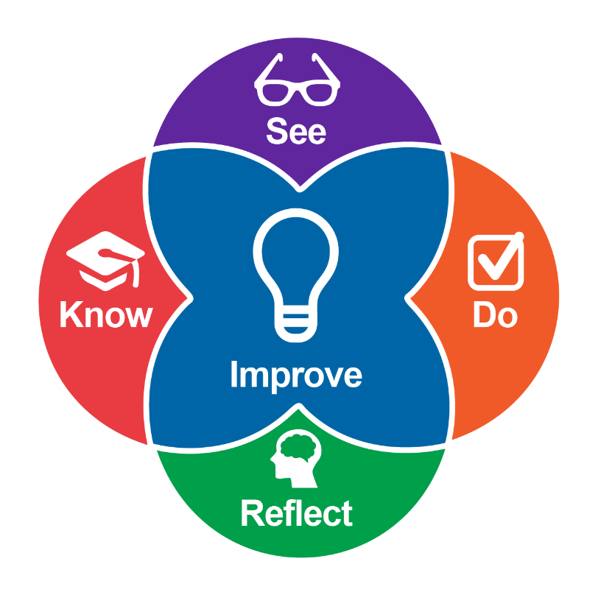
Intentional Teaching Framework
Image Credit: EarlyEdU
Notes:
What to say:
This module will present participants’ information about positive behavior support and the Pyramid Model using the Intentional Teaching Framework (Hamre, Downer, Jamil, & Pianta, 2012; Joseph & Brennan, 2013), which guides participants to:
Know—Learn about child development and effective teaching practices.
See—Identify teaching practices and children’s responses in videos, using specific behavioral language.
Do—Set goals, plan, and use strategies. (Do can also involve applying knowledge during activities.)
Reflect—Participants observe and analyze their practices.
Improve—Plan for and implement positive, quantifiable change to teaching practices.
REFERENCES:
Hamre, B. K., Downer, J. T., Jamil, F. M., & Pianta, R. C. (2012). Enhancing teachers’ intentional use of effective interactions with children. In R. C. Pianta (Ed.) (2012). Handbook of early childhood education (pp. 507–532). New York: The Guilford Press.
Joseph, G. E., & Brennan, C. (2013). Framing quality: Annotated video-based portfolios of classroom practice by preservice Teachers. Early Childhood Education Journal, 41(6), 423–430.

Slide 6
How We Will Use These Frameworks Together
Know – learn from our Featured Guests
See – watch educators in action (From the Field)
Do – use an activity to practice a strategy (Try it Out!)
Reflect – discuss the impact on your work (Stop, Tuck, and Breathe)
Improve – take the information and strategies back to your setting
Notes:
What to say:
Here’s how we will use these frameworks together to explore the pyramid model and learn about positive behavior support:
Know—learn from our Featured Guests
See—watch educators in action (From the Field)
Do—use an activity to practice a strategy (Try it Out!)
Reflect—discuss the impact on your work (Stop, Tuck, and Breathe)
Improve—take the information and strategies back to your setting

Slide 7
Objectives
Understand the importance of nurturing and responsive relationships and the strategies to foster them
Understand our emotional triggers and how to manage them
Understand that all behavior is communication
Share and practice foundational prevention strategies that benefit all children
Notes:
What to say:
Our objectives for Part 1 are that participants will:
Understand the importance of nurturing and responsive relationships and the strategies to foster them
Understand our own emotional triggers and how to manage them
Understand that all behavior is communication
Share and practice foundational prevention strategies that benefit all children

Slide 8
Fostering Social Emotional Skills: Relationships Are Key
Notes:
What to say:
Let’s start with a little information about why the topic of social emotional development is so important.

Slide 9
Video: Why Is Social Emotional Development So Important?
Video: Why Is Social Emotional Development So Important?
Notes:
What to say:
Featured Guest, Dr. Sarah Lytle from the University of Washington’s Institute for Learning and Brain Sciences (I-LABS), discusses why social-emotional development is so important. Research shows social-emotional learning is associated with a positive impact on mental health, which in turn increases children’s attachment to caregivers and peers and the motivation to learn. Teaching social-emotional skills provides protective factors for mental health.
Presenter Note: This clip is 6 minutes, 13 seconds long.

Slide 10
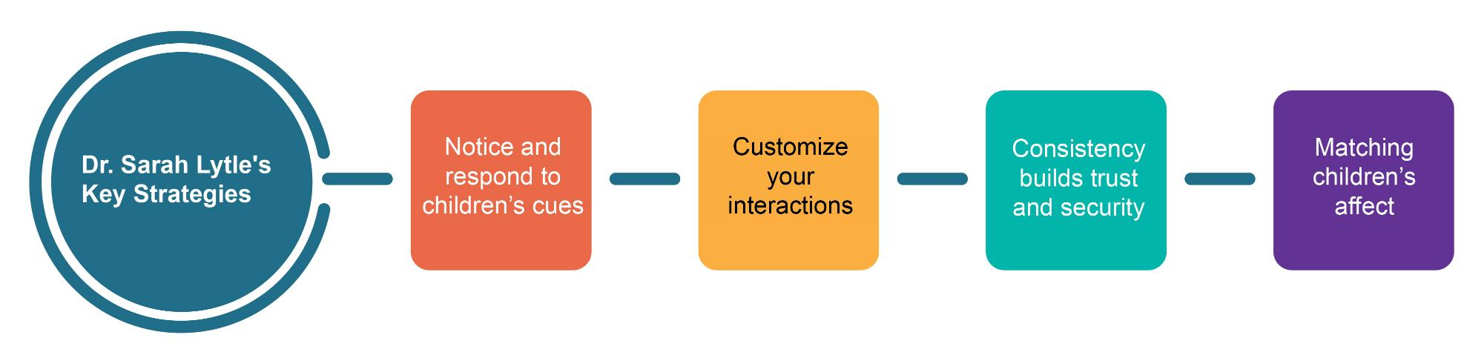
Dr. Sarah Lytle’s Key Strategies
Notes:
Presenter note:
Wait to click and bring in image until after the first request for review.
What to say:
Let’s take a moment to review some of the key strategies that Dr. Lytle discussed. Nurturing and responsive care is important for children, especially for children who have experienced adversities or trauma. A consistent and stable environment supports children, especially children who may benefit from increased predictability.
What did you notice from the video?
Presenter note:
Now click to bring in the images.
Here are the strategies that Dr. Lytle discussed in the clip. (Note any that participants missed.)
Notice and respond to children’s cues
Customize your interactions
Consistency builds trust and security
Matching children’s affect

Slide 11
Discussion: Supporting Social-Emotional Development
How do you support children’s social-emotional development?
Which of Dr. Lytle’s key strategies could you focus on using in your setting?
Notes:
What to say:
Thinking of the key strategies we just reviewed, as well as your own experiences, discuss these questions with a partner: How do you support children’s social-emotional development? Which of Dr. Lytle’s key strategies could you focus on using to improve your practices?
Presenter note:
Allow 5-8 minutes for this discussion. If time allows, ask for a limited number of volunteers to share their ideas with the larger group.

Slide 12
Video: From the Field – Strengthening Relationships
Video link: From the Field – Strengthening Relationships
Notes:
What to say:
Next up is Circle Time Magazine’s From the Field – Strengthening Relationships video. Let’s take a look at how one educator, Cecilia, supports social-emotional development by building relationships with infants and families.
Presenter note:
This video is 2 minutes, 34 seconds long.

Slide 13
Activity: Strengthening Relationships
What are some ways you strengthen relationships with children, families, and colleagues?
Notes:
What to say:
Before moving into the next activity, let’s talk about what you saw with Cecilia. What did you notice about how she built relationships?
Now let’s do an activity focused on how we strengthen our relationships with children, families, and colleagues.
Presenter note:
Place three pieces of chart paper up on the wall. Label each piece with: Children, Families, and Colleagues. For larger groups, you might need multiple pieces of each category.
Ask participants to find someone in the group they don’t know (or at least a different person from previous discussions) to discuss and take notes on scratch paper some of the ways they strengthen relationships with children, families, and colleagues. After discussing for 3-5 minutes, encourage participants to write 1-2 items down on the chart paper for each category.
Options for review:
Leave the chart paper on the walls for participants to read during a break.
Ask for three volunteers to read out strategies from each category.
Take a few minutes for all participants to do a gallery walk and read the strategies.
Materials needed:
Chart paper (that sticks to a wall)
Markers
Scratch paper
Pens/pencils
Additional Resource:
Checklist of Early Childhood Practices that Support Social Emotional Development and Trauma-Informed Care
https://challengingbehavior.cbcs.usf.edu/docs/Informed-Care-Checklist.pdf

Slide 14
Video: Building Strong, Positive Relationships With Children
Video link: Building Strong, Positive Relationships With Children
As you watch, think about how your relationships with children connect with behavior.
Notes:
What to say:
Next, we’ll hear from Dr. Gail Joseph from the University of Washington to elaborate on building relationships with children, particularly discussing connections to reduce challenging behavior and increase mental health.
As you watch, think about how your relationships with children connect with behavior.
Presenter note:
This video clip is 6 minutes, 42 seconds long.

Slide 15
Discussion: Hot Buttons
Consider…
  What are your hot buttons?
  How do you feel about them?
Notes:
What to say:
Dealing with our hot buttons can be a challenge but it is an important action to take on to become the best possible educator.
Presenter note:
Ask participants to take a moment to review the Center on the Social and Emotional Foundations for Early Learning’s CSEFEL Hot Button Activity handout, then allow them 3-5 minutes to fill it out. After completing at least 2-3 columns (hot buttons, how they make you feel, and their impact); encourage participants to discuss their conclusions with a partner.
Handout Instructions:
Row 1: On each circle going across, write down the behaviors that push your buttons.
Row 2: On each circle going across, write down your feelings when faced with these behaviors.
Row 3: On each circle going across, write down the impact your feelings have on your relationship with the children who exhibit these behaviors.
Materials needed:
Handout: CSEFEL Hot Button Activity
REFERENCE
Vanderbilt University. Center on the Social and Emotional Foundations for Early Learning (CSEFEL). http://csefel.vanderbilt.edu/.

Slide 16

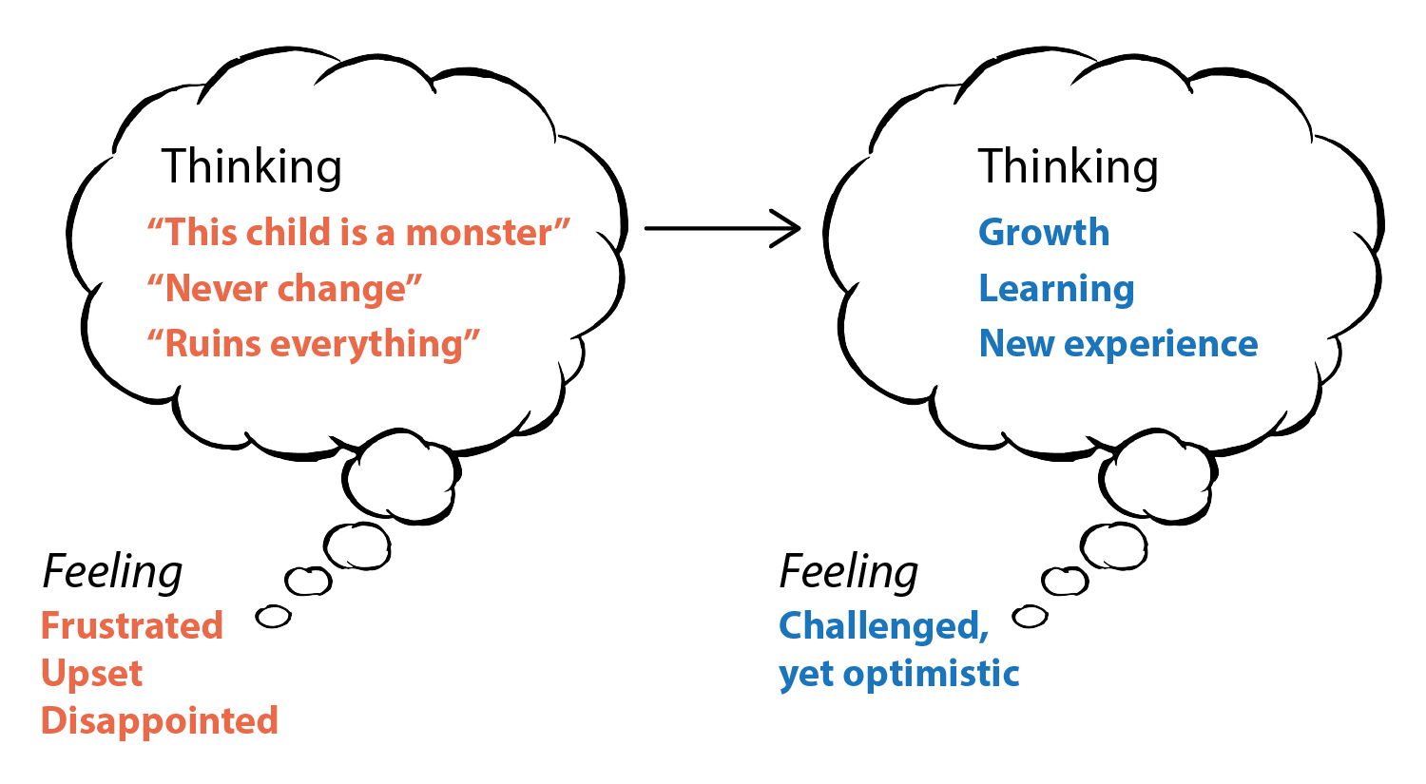
Discussion: Thought Control Strategy
Image Credit: EarlyEdU
Notes:
What to say:
We just talked about our hot buttons and how we feel about them, now let’s practice Gail’s strategy for managing our thinking and feeling when a child displays challenging behavior. In the old way of thinking, we might have experienced challenging behavior and thought, this child is a monster, nothing ever changes, and this behavior ruins everything. This could make us feel frustrated, upset, or disappointed.
When we reframe how we think about that behavior, we might think about how the child is growing and learning from what might be a new experience. This might leave us feeling challenged, yet optimistic.
Now let’s practice reframing. Turn to a partner and share a recent experience with challenging behavior and what negative thinking you might have had about it. This is not a zone of judgment, just a place to practice reframing. Discuss how that negative thinking made you feel. Then practice reframing your thinking and consider how that might change your feelings about the behavior. Make sure each person has an opportunity to share their thoughts.
Presenter note:
Allow 3-5 minutes for this discussion.
Optional:
If preferred, you can use the Handout: Reframing Activity to help guide participants through this discussion.

Slide 17
Video: Filling the Relationship Piggy Bank
Video link: Filling the Relationship
Piggy Bank
Notes:
What to say:
Next, let’s listen to Featured Guest, Dr. Gail Joseph, discuss some additional ways to strengthen relationships.
Presenter note:
This video clip is 3 minutes, 1 second long.

Slide 18
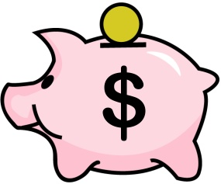
Writing Reflection: Piggy Bank
Think about your own piggy bank.
What fills your bank? Be as specific
as possible.
Now think about a child in your care. This could be a child that has behaviors you find challenging.
This Photo by Unknown Author is licensed under CC BY-NC-ND
Notes:
Presenter note:
Ask participants to take out a piece of paper and reflect on the following questions:
How is your relationship piggy bank?
How do you get it filled?
Now think of a child in your care. What will you do next time you see them to continue filling their piggy bank?
Allow 3-5 minutes for this reflection.
Materials needed:
Writing or scratch paper
Pens/pencils

Slide 19
Video: Creating Awareness and Checking Our Biases
Video link: Creating awareness and checking our biases
After the clip, we will take a few minutes to talk with a partner about our reactions and/or what we noticed in the video.
Notes:
What to say:
Our relationships children and adults are impacted by our awareness and potential biases. In this next video, we will continue to hear from featured guest Dr. Gail Joseph as she discusses the importance of creating awareness and checking our biases. After the clip, we will take a few minutes to talk with a partner about our reactions and/or what we noticed in the video.
Presenter note:
This video clip is 9 minutes, 15 seconds long. After the clip ends, give participants 5-6 minutes to talk with a partner about their reactions and/or what they noticed while viewing the video.

Slide 20
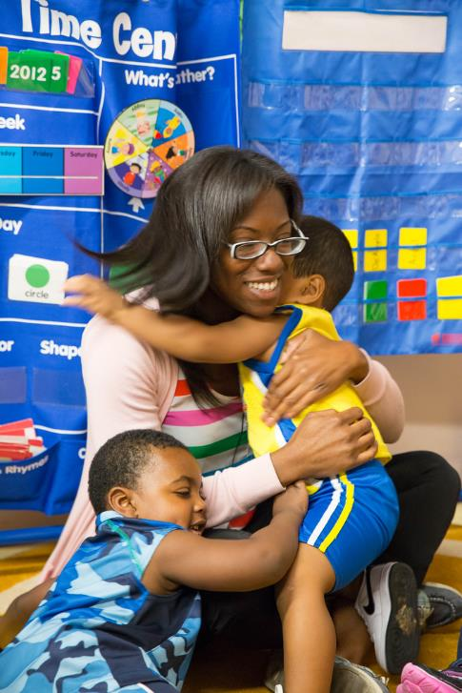
Review of Key Relationship Building Strategies
Reflect and acknowledge emotions
Build upon relationship piggy banks
Use tools to review implicit bias
Other suggestions?
Image Credit: EarlyEdU
Notes:
What to say:
Before we go on, let’s quickly review some of the key relationship building strategies that we have discussed today.
Acknowledge and reflect on emotions
It’s important to recognize our hot buttons
And then to reflect on the feelings that can occur after hot buttons happen
Practice thought control to transition how we think and how we act
Build upon relationship piggy banks
Use tools to review implicit bias
Initiate conversations with fellow educators
Use tools such as the Positive Attention Tracking Form
Are there any other ideas that you think we should note?

Slide 21
Video: Circle Time Magic
Video link: Circle Time Magic
As you watch, think about the tips you already use or tips you may want to use.
Notes:
What to say:
Next, let’s watch a video clip of Circle Time Magic! Circle Time Magic segments, as you might guess, focus on tips to improve your circle time based on each PBS topic.
Presenter note:
This clip is 1 minute, 6 seconds long. After playing the clip, continue to the talking points below.
What to say:
A note on the wedge seating arrangement: by improving posture and encouraging active sitting with a wedge cushion, children can sit and stay focused for longer as body awareness is improved and the need to fidget is reduced. A wedge cushion can be beneficial to children who shift around or rock in their seat. Active sitting supports vestibular and tactile sensory processing needs.
Additional Resource:
Sensory Processing 101
By Dayna Abraham, Claire Heffron, Pamela Braley, And Lauren Drobnjak

Slide 22
Video: Try It Out!
Video link: Try It Out!
During the clip, listen for ideas you could use in your own setting.
Notes:
What to say:
Next, we will check out some materials you could use to continue to support relationship building. During the video clip, listen for ideas you could use in your own setting, and we will discuss them after.
Presenter note:
This video is 4 minutes, 12 seconds long.

Slide 23
Discussion: Circle Time Magic and Try it Out!
What is one strategy from either the Circle Time Magic or Try it Out! segment that you will try in the next week with the children in your care?
Notes:
What to say:
Turn and talk to a partner, discuss making a commitment to one strategy from either the Circle Time Magic or Try it Out! videos that you will try this week with the children in your care.
Presenter note:
Allow 2-3 minutes for this discussion. If time allows and there is interest, you could also have a few people shout out their plans.

Slide 24
Video: It’s All About You
Video link: It’s All About You
Let’s watch for ideas about building our resilience.
Notes:
Presenter note:
This video clip is 5 minutes, 17 seconds long.
What to say:
Next, we will watch a video segment called “It’s All About You, it is about how educators can focus on their own well-being and self-care in order to be the best educator possible. It is important for educators to be mindful of their own self-care because it allows them to be more present for the children. When we feel our best, we lead with care and compassion. Equally important is organizational support of self-care. Programs must provide opportunities for self-care and a culture that supports staff in self-care. Let’s watch the video for ideas about building our resilience.

Slide 25
Reflection: Gratitude
What are you grateful
for today?
What is one appealing strategy that Gail discussed or that you already use to focus on and/or express gratitude?
Image Credit: EarlyEdU
Notes:
What to say:
Did you know that gratitude could be so powerful? Let’s take a moment for a writing reflection. Think and write about the following questions:
What are you grateful for today?
What is one appealing strategy that Gail discussed or you already use to focus on and/or express gratitude?
Presenter note:
Allow 2-4 minutes for this reflection.

Slide 26
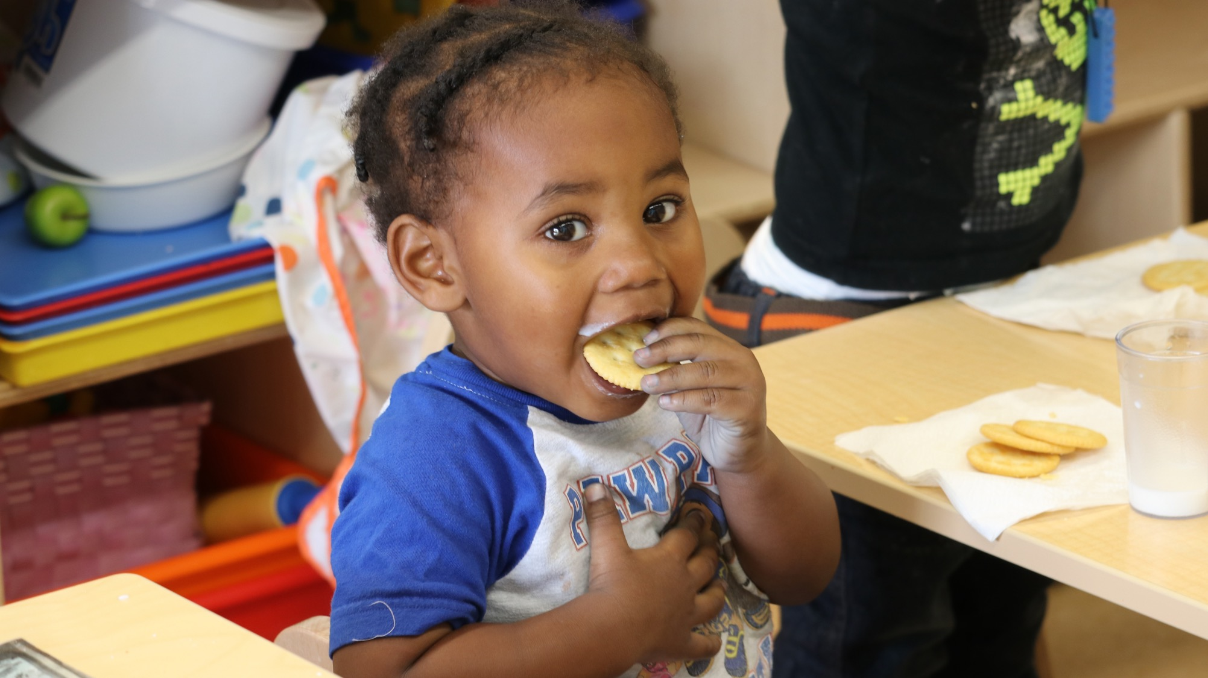
Break
Part 1
Break!
Image Credit: EarlyEdU
Notes:
What to say:
On that positive note, let’s take a quick break. When we return, we will focus on the next level of the Pyramid – Environments.
Presenter note:
Depending on your timing needs, this break can be adjusted to shorter or longer.

Slide 27
Planning Ahead: Environments That Support Positive Behavior
Notes:
What to say:
Thinking back to our introduction to the Pyramid Model, you will remember that the next level of the Pyramid focuses on planning our environments to support positive behavior. Let’s explore more.

Slide 28
Video: Behavior Is Communication
Video link: Behavior Is Communication
As you watch, think about challenging behavior that you might have observed recently and what the child was trying to communicate.
Notes:
Presenter note:
This video clip is 3 minutes, 16 seconds long.
What to say:
In this clip, our hosts Kristin and Dawn discuss the idea and examples of behavior as a form of communication.
As we begin to wonder what the child is communicating with their behavior, keeping an open conversation with the family is key to understand how the child's history and context inform the function of the behavior.

Slide 29
Activity: Anticipating Behaviors
Handout: CQEL Anticipating Behaviors
Let’s take a moment to reflect on our own environments and how we could plan ahead for behavior.
Notes:
What to say:
Sometimes our early learning environment can contribute to challenging behaviors, for example, a large open space encouraging running, having only a single copy of a popular toy leading to conflict. The learning environment can also contribute to positive behavior, such as creating clearly defined spaces which helps children to understand expectations. Let’s take a moment to complete an activity about behavior, specifically anticipating behaviors and planning for positive behavior. Take out your handout titled CQEL Anticipating Behaviors.
Think about your own environment and fill out the handout noted below, as you consider the following questions:
What behaviors do you expect to see from the children?
What behaviors have children already learned?
What behaviors would you like to see less of?
What behaviors would you like to see more of?
It may be helpful to think through your daily schedule and routines to identify potential challenges.
Presenter note:
Allow 8-10 minutes for this activity. After participants fill out the form, it may be helpful to talk through their ideas with a partner.
Materials needed:
Handout: CQEL Anticipating Behaviors
Pens/pencils

Slide 30
Video: What is Positive
Behavior Support?
Video link: What is Positive Behavior Support?
As you watch, listen for something new about positive behavior support that you didn’t know before.
Notes:
What to say:
In the next video clip, featured guest Dr. Kathleen Artman Meeker digs deeper into the concepts around Positive Behavior Support.
Presenter note:
This clip is 4 minutes, 2 seconds long.

Slide 31
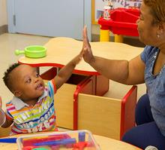
Key Concepts of PBS
PBS promotes positive behaviors
  Educators notice positive behaviors and build on them
PBS is proactive not reactive
  Teach and practice positive behaviors
    In other words, teach children how to ask for what they need.
Image Credit: EarlyEdU
Notes:
What to say:
Dr. Meeker had a lot of great things to say, so let’s review a couple of the key concepts of PBS.
PBS promotes positive behaviors
Educators notice positive behaviors that they want to see.
Educators build on these positive behaviors continuously over time.
PBS is proactive not reactive
Educators both teach and, very importantly, practice positive behaviors with children.
In other words, educators teach children how to ask for what they need.

Slide 32
Video: Prevention Strategies
Video link: Prevention Strategies
Watch for a strategy you would like to incorporate in your program.
Notes:
What to say:
This video segment includes Jordan Taitingfong, early childhood behavior specialist, discussing prevention strategies focusing on the physical environment.
Presenter note:
This video is 3 minutes, 4 seconds long.

Slide 33
REFLECTION
“Children at the young ages of 3 or 4 often test boundaries and act out, particularly when adjusting to new social environments such as preschool. According to the American Academy of Pediatrics, it is perfectly normal for a preschooler’s frustration or anger to manifest as physical conflict. When caregivers correct this ordinary behavior in a way that promotes empathy, it’s a healthy part of a child’s social development. Labelling a young child as violent or disruptive and calling parents to pick up their child send the wrong message to the child, and it could even lead to unnecessary medical or psychological interventions.”
–Rasheed Malik, Early Childhood Policy, Center for American Progress
Notes:
Presenter note:
Suggestion: since this is a lot of text, it could be helpful for accessibility to print out a few copies to place on tables for participants.
Take a moment to allow participants to read this quote, or if more appropriate, read it aloud.
Ask participants to turn to a partner and discuss: What do you think about this statement? If desired, you can ask for 1-2 volunteers to share their thoughts with the larger group.

Slide 34
Video: Teach Practice Reinforce
Video link: Teach Practice Reinforce
Notes:
What to say:
In this Circle Time Magic video segment, we will hear some tips about when to teach, practice, and reinforce behavior. Jordan will discuss how the environment can support positive behavior.
Presenter note:
This video is 4 minutes, 1 second long.

Slide 35
Discussion: Teach Practice Reinforce
What behavior strategy are you currently teaching, practicing, or reinforcing?
Teach
Practice
Reinforce
Notes:
Presenter note:
Ask participants, “What behavior strategy are you teaching, practicing, or reinforcing? Feel free to shout out ideas.
Answers may vary. Possible answers may include taking turns, sharing, entering play, or expectations.

Slide 36
Video: From the Field – Visuals
Video link: From the Field – Visuals
Watch and think, how are you using visuals in your early learning setting?
Notes:
What to say:
In this segment of From the Field, we get to see inside the program of educator Debra Walter, as she discusses and shows the use of visuals to support behavior.
Presenter note:
This clip is 2 minutes, 28 seconds.

Slide 37
Discussion: From the Field – Visuals
How are you using visuals in your early learning setting?
How do you support children having choice and control within their day?
Notes:
Presenter note:
After playing the video clip From the Field – Visuals, with educator Debra Walter, ask participants:
How are you using visuals in your early learning setting?
How do you support children having choice and control in their day?
Where do you find visuals, or if you make them, do you have any tips to share?
This can be a partner discussion or have volunteers to share with the larger group.
Suggestion: Have some examples of visuals available for participants to pass around. If time and materials allow, you could also add an opportunity to make visuals here too.

Slide 38
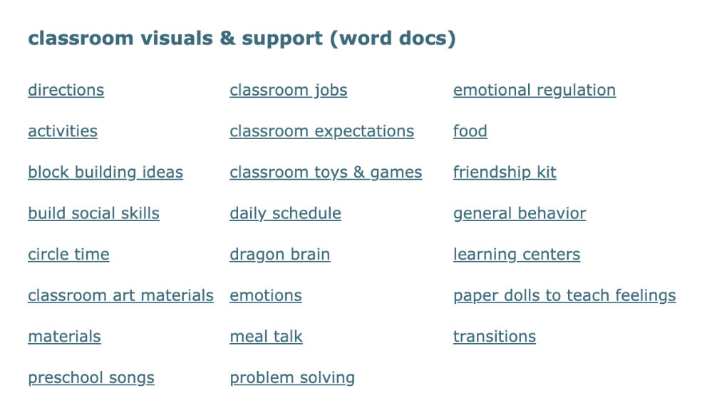
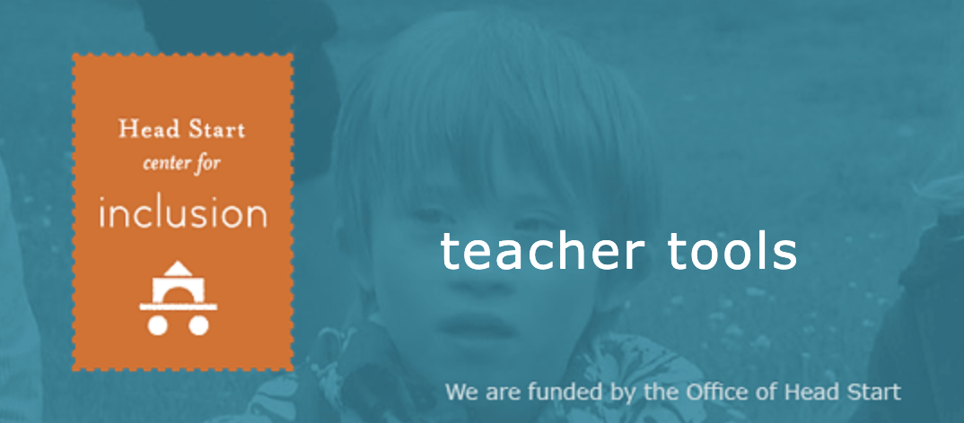
Head Start Center for Inclusion
Notes:
What to say:
For additional ideas and printouts, you can check out the Head Start Center for Inclusion shown here*. Visuals and supports are linked as word documents and cover a variety of topics from directions to transitions to friendship kits. This website is undergoing renovation, so don’t be surprised if it looks a little different from the snapshots shown here!
Presenter note:
*The image is hyperlinked: http://headstartinclusion.org/teacher-tools#visual, the website can be shown here if desired.

Slide 39
Video: Books to Support Positive Behavior
Video link: Books to Support Positive Behavior
Watch for any books you have used successfully and/or any you would like to check out!
Notes:
What to say:
In this video segment, hosts Dawn and Kristin visit a public library to discuss with Librarian Blythe, the support educators can get from their local library, as well as some books that specifically support positive behavior.
Presenter note:
This video is 6 minutes, 8 seconds long.
Suggestion: If able, bring some books to share/show after this clip (or have at the back of the room for review during breaks). Participants often love to look through these to determine if they might want to seek them out for their own program.

Slide 40

Part 1 – Wellness Activity
Image credit: Creative Commons
Notes:
What to say:
As we have discussed, by taking the time to learn resiliency practices and care for yourself, you can increase feelings of happiness and satisfaction. These positive emotions improve your ability to face daily stressors—such as challenging behaviors—with more empathy, patience, and intention.
Before we watch our next video, let’s take a moment and care for ourselves by resetting our gratitude meter. Think of something that you are grateful for and picture it your mind. Now close your eyes and take three deep breaths with me... 1… 2… 3….

Slide 41
Video: Red or Green Light Thinking
Video link: Red or Green Light Thinking
Watch and think, was there anything Gail mentioned that surprised you? Confirmed what you already knew?
Notes:
What to say:
In this It’s All About You video segment, Gail returns to talk about red or green light thinking.
Presenter note:
This slide and the following can be cut if extra time is needed. This video is 4 minutes, 30 seconds long.

Slide 42
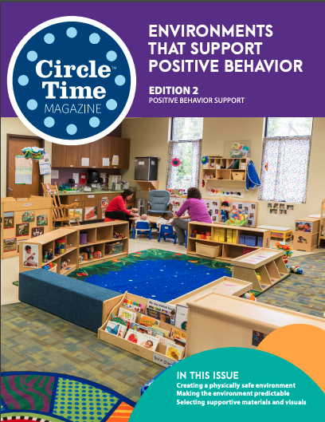
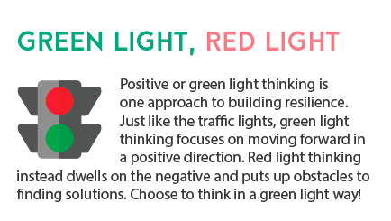
Activity: Red or Green Light Thinking
Image Credit: EarlyEdU
Notes:
Materials needed:
Handout: CTM Red Light, Green Light
What to say:
You can find even more information, activities, and reflections in the print version of Circle Time Magazine. Let’s try something from it now!
Positive, or green light, thinking is one approach to building resilience. Just like the traffic light, green light thinking focuses on moving forward in a positive direction. Red light thinking instead dwells on the negative and puts up obstacles to finding solutions. Choose to think in a green light way!
Acknowledge how you are feeling.
Reflect and think.
Are your thoughts red light or green light?
Choose green light thinking. Look for the positives and find a solution.
Take out your handout, CTM Red Light, Green Light. Let’s take a moment and fill out a couple of items in ideas to try. We encourage you to keep this and return to it to reflect on how the ideas went later!
Suggestion: If time allows, take a couple of minutes to play Red Light, Green Light with the participants. Adapt the game rules by substituting a negative comment for red light and a neutral or positive comment for green light.

Slide 43

Closing Slide
© 2020 University of Washington. All rights reserved.
Notes:
Presenter note:
This is the end of Part 1 of Positive Behavior Support. This may be an opportunity for a break or you may continue on, as best fits your timing.

