Slide 1

Head Start A to Z, 2.0 Leadership and Governance
The Foundation for Successful Head Start Programs
Notes:
Slide 1
Facilitator Notes:
Welcome participants to the session and introduce yourself. If you have co-facilitators, invite them to introduce themselves as well. Begin by taking a quick poll. Ask participants to raise their hands if they are a:
Governing body or Tribal Council member
Policy Council or policy committee member
Executive director
Head Start director
Management staff
Other
Make the point that, regardless of each participants’ role, they have key responsibilities within leadership and governance.
Then, explain the following.
Say to Participants: “The National Center on Program Management and Fiscal Operations (PMFO) has updated Head Start A to Z to align with the revised Head Start Program Performance Standards (HSPPS) that became effective November 2016. Head Start A to Z was originally designed to support new leaders in their Head Start roles. The term ‘leaders’ ensures anyone at the management level, or in some cases the governing body, Tribal Council, or Policy Council level, can attend the sessions or use the materials for independent learning.
“The updated Head Start A to Z, 2.0, learning modules provide baseline-level information primarily through a leadership and management systems lens. The presentations are modeled on ‘learning organization’ concepts. In each of the modules, we recognize key characteristics of learning organizations, including a supportive learning environment, openness to new ideas, and time dedicated for reflection.
“Each attendee has an important role to play in the success of this session. Those with experience remind us where we’ve come from and what we must do to maintain our identity and uniqueness. New members bring a fresh perspective and remind us what we must do to prepare for the future. All roles are essential for Head Start programs to be learning organizations that continue to grow and flourish.
“Head Start A to Z, 2.0, is most successful when it helps us share the best of what we have to offer with a strength-based focus. As you engage in this session, we hope you will support one another in the learning process by generously sharing your knowledge, experience, and perspective.”

Slide 2
Six Guiding Principles for A to Z Trainings
1
3
4
Successful programs are learning organizations.
Sound decision-making is informed by quality data.
Relationship-building is at the heart of transformational leadership.
2
5
6
The effective delivery of services grows out of strong systems.
School readiness for all is our driving goal.
Culturally and linguistically diverse organizations rely on intentional, specific, and coordinated approaches.
Notes:
Slide 2
Facilitator Notes:
Distribute the Head Start A to Z Guiding Principles handout.
Say to Participants: “Head Start A to Z, 2.0, is based on six guiding principles. These guiding principles are foundational to the design of the modules and have been aligned with the HSPPS.
“Head Start directors and managers come from all walks of life with a wealth of employment experiences. However, we all share a commitment to a comprehensive, high-quality early childhood experience. We recognize that, to promote school readiness and be responsive to the needs of our communities, we must engage in ongoing professional development. Head Start A to Z, 2.0, was created to support professional growth and development for Head Start leaders.”
Guide the participants to the Head Start A to Z Guiding Principles handout. Review the six principles below. You may paraphrase or slightly summarize.
Successful programs are learning organizations. Head Start is a dynamic organization with high expectations, values, and traditions. Programs are constantly responding to changing community needs and evolving best practices. To cultivate a learning organization that thrives in this environment, program leaders must support all staff in becoming life-long learners who embrace challenges as opportunities for collective problem-solving and innovation.
The effective delivery of services grows out of strong systems. Program leaders must regularly refine their program’s management and fiscal systems. To target community needs and deliver comprehensive services, leaders need to understand systems thinking and view their program through a systems lens. They also need to recognize the relationship between systems, services, and child and family outcomes.
Sound decision-making is informed by quality data. Used in planning, evaluating, and communicating information, quality data is integral to cultivating a culture of continuous quality improvement. To this end, it is critical for leaders to establish efficient processes for collecting, aggregating, analyzing, and synthesizing data. This involves training teachers, home visitors, family advocates, health services workers, and other staff how to integrate data management into their day-to-day work.
Relationship-building is at the heart of transformational leadership. Robust Head Start communities build on authentic relationships between all of their stakeholders, from children, families, staff, and managers to governing bodies, Tribal Councils, and Policy Councils. To cultivate these communities, leaders need to communicate effectively, empower others, foster teambuilding, and nurture collaboration.
School readiness for all is our driving goal. Head Start leaders play an integral role in conceiving and promoting an inclusive vision of school readiness. To support children with diverse abilities and backgrounds to develop the skills, knowledge, and attitudes needed to be successful in school, effective leaders must stay informed on developments in early childhood education. They also must actively collaborate with parents, staff, governing bodies, local education agencies, and community partners in embedding these best practices into services and programming.
Culturally and linguistically diverse organizations rely on intentional, specific, and coordinated approaches. To ensure the full and effective participation of dual language learners and their families, Head Start leaders must coordinate program-wide plans that involve all service areas and multiple staff. This includes staying connected to the communities served, implementing targeted strategies, and articulating how programs and services address specific linguistic and cultural needs.
Say to Participants: “In addition to anchoring the content in Head Start A to Z, 2.0, you will revisit these guiding principles in all of the trainings offered by PMFO.”

Slide 3
Introductory Activity
What is currently working well within your program's leadership and governance structure?
What challenges are you experiencing?
What do you hope to learn about building on your strengths and addressing your challenges?
Notes:
Slide 3
Facilitator Notes:
Conduct the following introductory exercise.
Say to Participants: “Before we review this session’s learning objectives, I’d like you to discuss the following questions with your tablemates.
What is currently working well within your program’s leadership and governance structure?
What challenges are you experiencing?
What do you hope to learn in this session about how to build on what’s working well and address any challenges you’re having?
“You’ll have seven minutes to do this exercise.”
After seven minutes, call the group back together and ask each table to report their answers. Write them down on three sheets of chart paper, one for each question. Post these at the front of the room so you can reference them during the session.
Question 1 responses might include:
The conversations include all perspectives—the governing body or Tribal Council, Policy Council, and management staff
Our governing body/Tribal Council and Policy Council members are actively involved in program planning
Our governing body or Tribal Council members practice effective fiscal and legal oversight on behalf of the agency
Agency reports are informative and sent out in a timely manner
Question 2 responses might include:
Our governing body and Policy Council aren’t always included in key conversations
Our Tribal Council and Policy Council should have more conversations about the implications of financial and operations reports
Our governing entities don’t have enough time to absorb agenda items and supporting materials before they meet
Question 3 responses might include:
My responsibilities as a governing body, Tribal Council, or Policy Council member
How to communicate with my Head Start executive director
How to get parents engaged in Policy Council meetings

Slide 4
Learning Objectives
As a result of this session, participants will:
Learn the foundational elements of systems and systems thinking
Recognize how Head Start management systems support leadership and governance
Explore Head Start leadership and governance through the lenses of structure, processes, and relationships
Identify strategies and resources for strengthening leadership and governance capacity
Notes:
Slide 4
Facilitator Notes:
Distribute the Reflective Practice Tool handout.
Say to Participants: “In this session, participants will:
Learn the foundational elements of systems and systems thinking
Recognize how Head Start management systems support leadership and governance
Explore Head Start leadership and governance through the lenses of structure, processes, and relationships
Identify strategies and resources for strengthening leadership and governance capacity”
Guide participants to the Reflective Practice Tool handout.
Say to Participants: “At the end of our session, you will be asked to use this Reflective Practice Tool to write down some key thoughts based on what you’ve learned. We encourage you to jot down some preliminary thoughts as we move through the session.”

Slide 5
Leadership and Governance
Set program direction
Exercise fiscal and legal oversight
Create a balanced representation of voices that ensure stakeholder input, diversity, and accountability to the community
Notes:
Slide 5
Facilitator Notes:
Say to Participants: “Head Start leadership and governance:
Set the direction for Head Start and Early Head Start programs
Exercise fiscal and legal oversight
Create a balanced representation of voices that ensure stakeholder input, diversity, and accountability to the community
“Now, let’s take a look at how leadership and governance is reflected in systems and systems thinking.”

Slide 6
A system is…
"…a group of interacting, interrelated, or interdependent parts
that form a complex and unified whole with a specific purpose."
Source: Daniel H. Kim, Introduction to Systems Thinking. Westford, MA: Pegasus Communications, Inc., 1999.
Notes:
Slide 6
Facilitator Notes:
Begin this section on systems and systems thinking.
Say to Participants: “Please take a few moments to read the statement on the slide and reflect on its meaning.”
Give participants about 15 seconds.
Say to Participants: “We see from the statement that systems have three primary characteristics. First, a system is a group of interacting, interrelated, or interdependent parts. The parts form a complex and unified whole that has a specific purpose.”¹
¹ Daniel H. Kim. Introduction to Systems Thinking. Westford, MA: Pegasus Communications, Inc., 1999.

Slide 7
Characteristics of Systems
  Interrelated parts
  Form complex whole
  Specific purpose
Notes:
Slide 7
Facilitator Notes:
Call participants’ attention to the slide.
Say to Participants: “As we think more deeply about these three characteristics, we should note that:
Often, parts of a system are systems themselves
Most nonprofits are made up various systems that combine to form the organization
The organization exists for a specific purpose: to achieve its vision and mission
“Let’s take a look at how these concepts apply to Head Start and Early Head Start programs.”

Slide 8
Core Concepts of Systems Thinking
Explores how various elements within a system influence one another
Studies relationships between interacting parts over time
Looks for patterns and seeks root causes of problems
Notes:
Slide 8
Facilitator Notes:
Continue this section on systems thinking.
Say to Participants: “Systems thinking focuses on how a system’s constituent parts work together. It’s an analytic tool that allows us to see the big picture and solve problems. Systems thinking:
Explores how various elements within a system influence one another
Studies relationships between interacting parts over time
Looks for patterns and seeks root causes of problems
“Systems thinking is not a new concept. Many organizations use it as a way to better understand themselves. As Head Start programs pursue continuous improvement, systems thinking has become foundational to our success.”

Slide 9
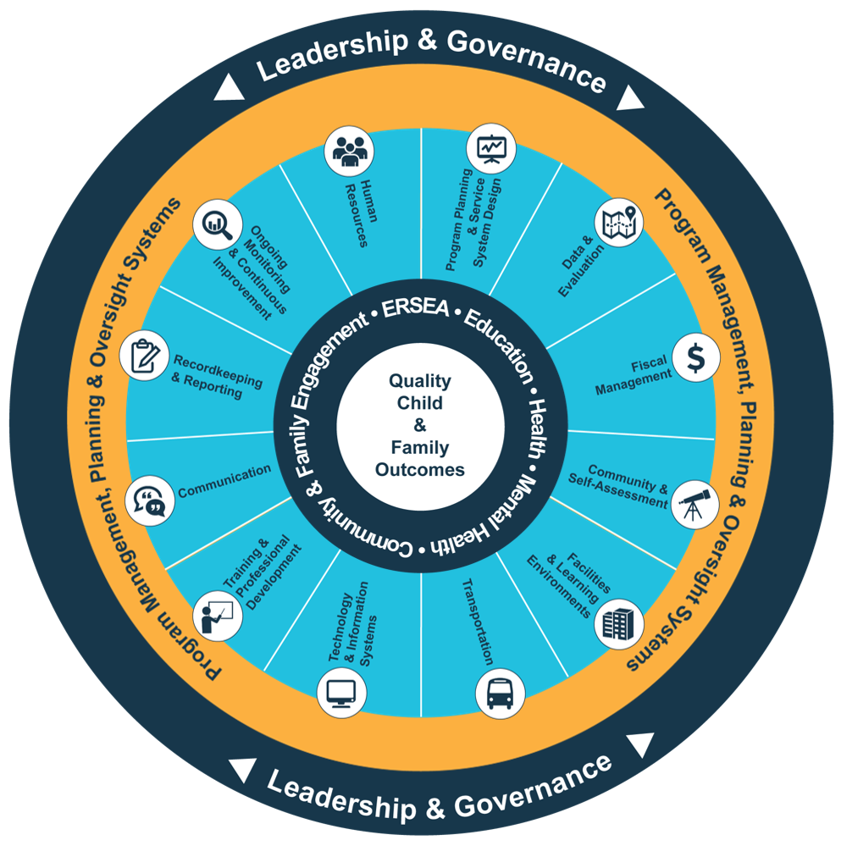
Head Start Management Systems Wheel
Five-Year Project Period
Notes:
Slide 9
Facilitator Notes:
Call participants’ attention to the slide.
Say to Participants: “The Head Start Management Systems Wheel can help us understand how leadership and governance fit into the overall picture.”
In your own words, explain the graphic on the slide by pointing to its various elements and describing each, basing your descriptions on the bullet points below.
The dark blue outer circle includes the functions of leadership and governance, which we’re focusing on in this session. Leadership and governance are the bedrock of effective management, encompassing and informing the 12 management systems.
The yellow circle outlines the scope of these systems.
The segmented aqua blue ring outlines each of the 12 management systems. These systems work together to inform and influence the program’s service delivery. These services include education, health, mental health, community partnerships, family engagement, and eligibility, recruitment, selection, enrollment, and attendance (ERSEA).
Say to Participants: “In Head Start programs, all of these systems work together to inform and influence the program’s service delivery, which you see in the dark blue inner circle. That’s the overarching framework we’re exploring in this session. When innovative leadership, strong management systems, and well-designed services are working together, we produce quality child and family outcomes.
“Before we move on, let’s ask ourselves how the Management Systems Wheel reflects the characteristics of a system.
“You’ll recall the first characteristic of a system is that it’s a group of interrelated parts. In the wheel, we’ve pointed out the various parts—the 12 management systems, their scope in the yellow circle, their functions in the outer blue circle, and comprehensive services in the dark blue inner circle.
“The second characteristic of a system is that its parts form a unified whole. Again, as we can see, the various parts of the Management Systems Wheel work together to form the structure of a Head Start program.
“Finally, the parts combine for a specific purpose. That purpose is described in the inner circle of the wheel—quality child and family outcomes.”

Slide 10
Inclusive Leadership: Head Start Perspective
Management staff's day-to-day activities and operating reports inform decisions made by the Policy Council and governing body or Tribal Council.
The Policy Council determines program direction.
Inclusive Leadership
The governing body or Tribal Council's legal and fiscal oversight builds on the management staff and Policy Council's unique insight and perspectives.
The three entities of Head Start leadership—management staff, Policy Council, and governing body or Tribal Council—work together to support grantees on their five-year journeys, particularly around program planning.
Notes:
Slide 10
Facilitator Notes:
Distribute the Inclusive Leadership: Head Start Perspective handout.
Say to Participants: “According to scholars at the Research Center for Leadership in Action, inclusive leadership ’carefully includes the contributions of all stakeholders in the community or organization. Inclusion means being at the table at all levels of the organization, being a valued contributor, and being fully responsible for your contribution to the ultimate result.’²
“In Head Start programs, inclusive leadership is evident in many ways.
Management staff generate information from day-to-day activities that informs the decision-making activities of the Policy Council and governing body or Tribal Council
The Policy Council determines the direction of the program (e.g., program structure, options, and locations)
The Policy Council and governing body or Tribal Council use information from the management team to provide legal and fiscal oversight to
the program
These three entities collaborate to support Head Start grantees on their five-year journeys
“This structure allows each entity to contribute its unique perspective. When combined, these perspectives shape program operations, direction, and oversight. This comprehensive leadership lens promotes decision-making that reflects the needs of the entire community.”
Say to Participants: “Turn to a neighbor. To build on this understanding of inclusive leadership, use the handout to describe how your program reflects these key elements. You have five minutes.”
After five minutes, bring the group back together and debrief.
² Sonia Ospina, Waad El Hadidy, Grisel Caicedo, and Amanda Jones. Leadership, Diversity and Inclusion: Insights from Scholarship. Research Center for Leadership in Action: NYU Robert F. Wagner Graduate School of Public Service, April 2011.

Slide 11
Keep in Mind
While Head Start program leadership is an inclusive process, the ultimate responsibility
lies with the governing body or Tribal Council.
Notes:
Slide 11
Facilitator Notes:
Call participants’ attention to the slide and give them a moment to read it.
Say to Participants: “Head Start leadership is intentionally structured to seek the voices and perspectives of all three governing entities. Ultimately, though, the governing body or Tribal Council has legal and fiduciary responsibility for the program. That includes responsibility for program compliance and effectiveness.”

Slide 12
Management vs. Leadership
Management
Leadership
Working within boundaries
Controlling resources
Planning to reach goals
Designing how and when work will be done
Emphasizing reason and logic
Deciding actions based on the past
Waiting for all relevant data before deciding
Measuring performance against plans
Expanding boundaries
Influencing others
Creating a vision of a possible future
Committing to get the work done no matter what
Emphasizing intuition
Deciding actions based on the envisioned future
Pursuing enough data to decide now
Assessing accomplishment against vision
Notes:
Slide 12
Facilitator Notes:
Distribute the Management and Leadership handout.
Say to Participants: “We’ve spent time discussing leadership. Now, let’s talk about how leadership differs from management.
“As you see on the slide, leadership has a strong inspirational component. It’s about intentionally using your power as a leader to motivate your staff toward achieving goals—sometimes big or even visionary goals. Management is about using your standard toolbox of rules, protocols, and procedures to support staff in their day-to-day work. Do you see the difference?”
Ask for a show of hands and lead a brief discussion.
Say to Participants: “With the shift from compliance to continuous quality improvement, Head Start programs need leaders who are good at both. Effective leaders use management techniques to move the program through its day-to-day activities. They also use the principles of leadership to inspire the program to perform at an optimum level.
“I’d like each of you to turn to a neighbor and review the handout. Spend seven minutes identifying facets of your program relating to leadership and facets relating to management.”
After seven minutes, ask for volunteers to share highlights of their discussions.

Slide 13
Leadership and Governance: Structure
Notes:
Slide 13
Facilitator Notes:
Distribute the Structure, Processes, and Relationships handout.
Say to Participants: “The next part of this session looks at Head Start leadership and governance through the lenses of structure, processes, and relationships. As we move through each of these topics, take a moment to reflect on the experiences you’ve had in your program. Use the Structure, Processes, and Relationships handout to record your thoughts and take home ideas.”

Slide 14
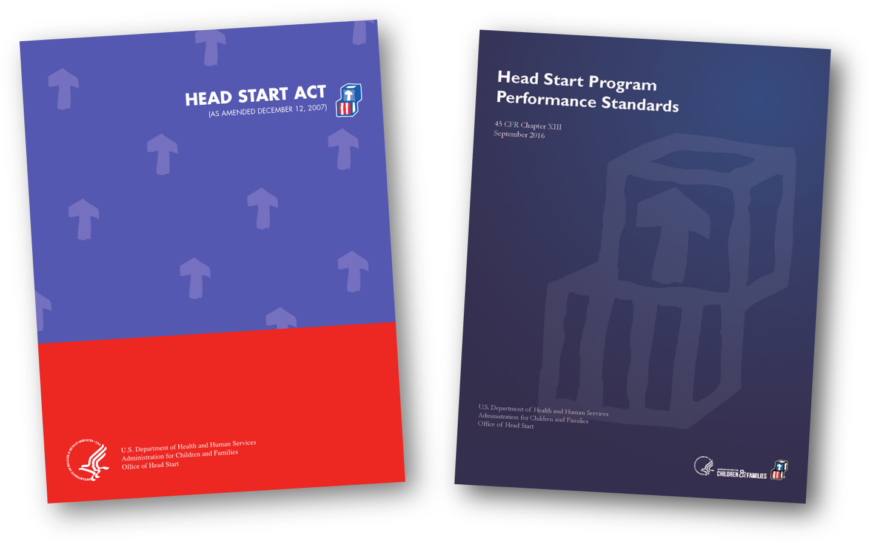
Head Start Act and HSPPS Requirements
Notes:
Slide 14
Facilitator Notes:
Distribute the Head Start Program Governance Reference Book, either one for each participant or one for each table.
Say to Participants: “First, let’s touch down on the federal regulations related to this topic. Leadership and governance are addressed in the Head Start Act and the HSPPS. These documents should be used together for guidance on requirements and policy. The Head Start Act and HSPPS are both available online from the Early Childhood Learning and Knowledge Center, which we more commonly call the ECLKC.
“The Head Start Program Governance Reference Book is a simple, single-source reference you should keep handy.
“We’re going to delve into some of the regulations as we move through this session. Now, let’s look at governance through the contexts of structure, processes, and relationships.”

Slide 15
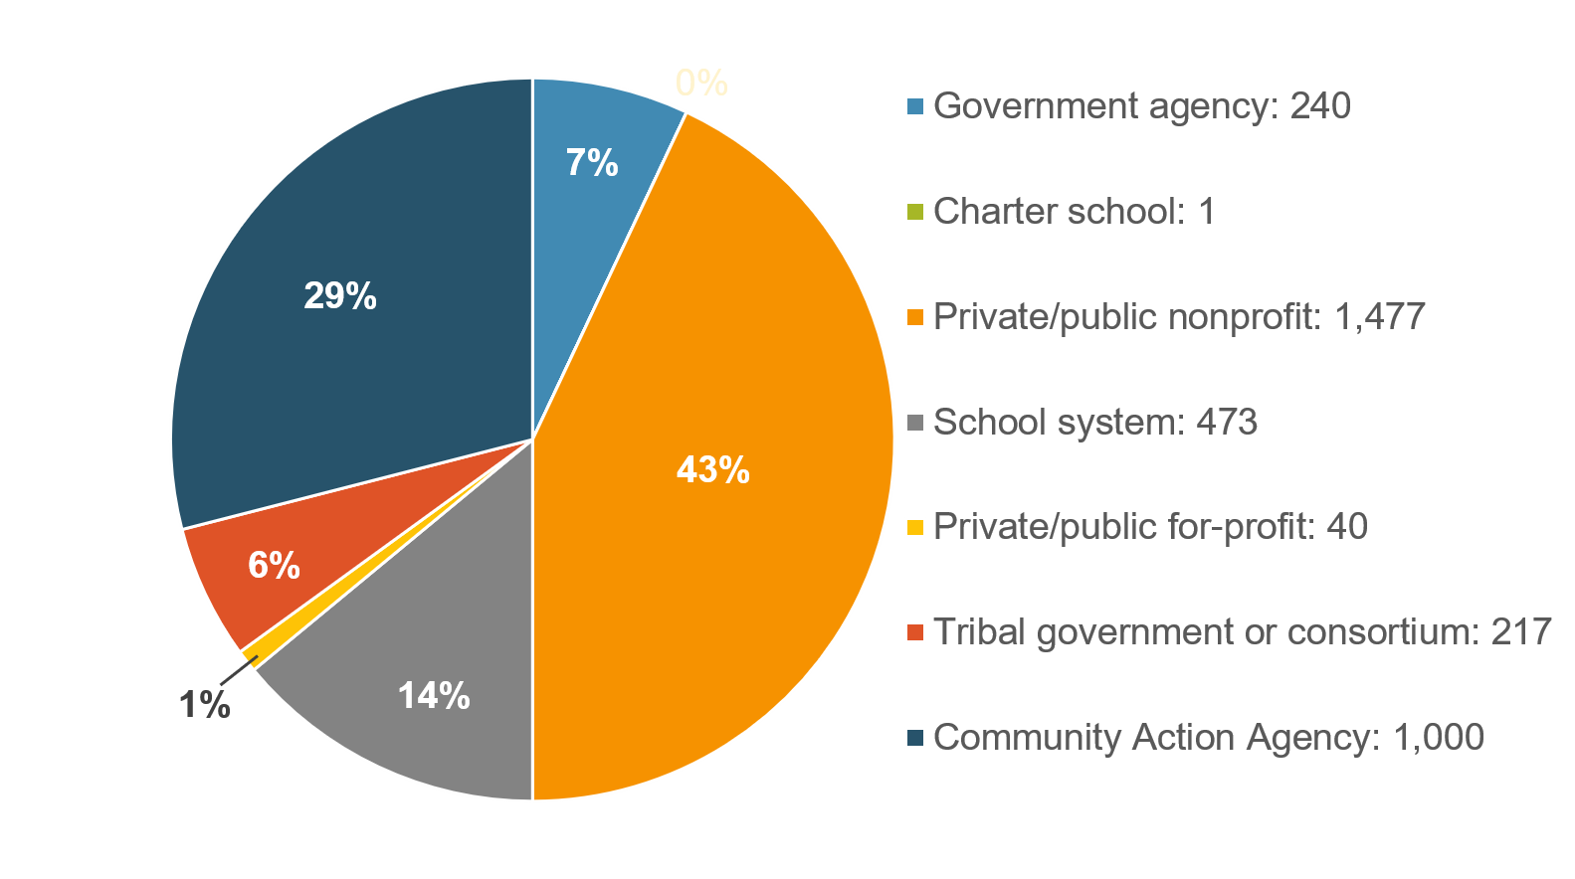
Auspices (Organizational Hosts)
Head Start Programs by Type of Auspice (n=3,448)
Source: Program Information Report, Summary Report, 2019
Notes:
Slide 15
Facilitator Notes:
Begin this section on governance through the lens of structure.
Say to Participants: “Head Start programs have a variety of organizational hosts, also known as ‘auspices.’ These include public or private nonprofits, Community Action Agencies, and school districts. Head Start and Early Head Start agencies are encouraged to shape their leadership and governance structures to their particular auspices. We will revisit this issue later as we discuss the use of advisory committees in governance structures.”

Slide 16
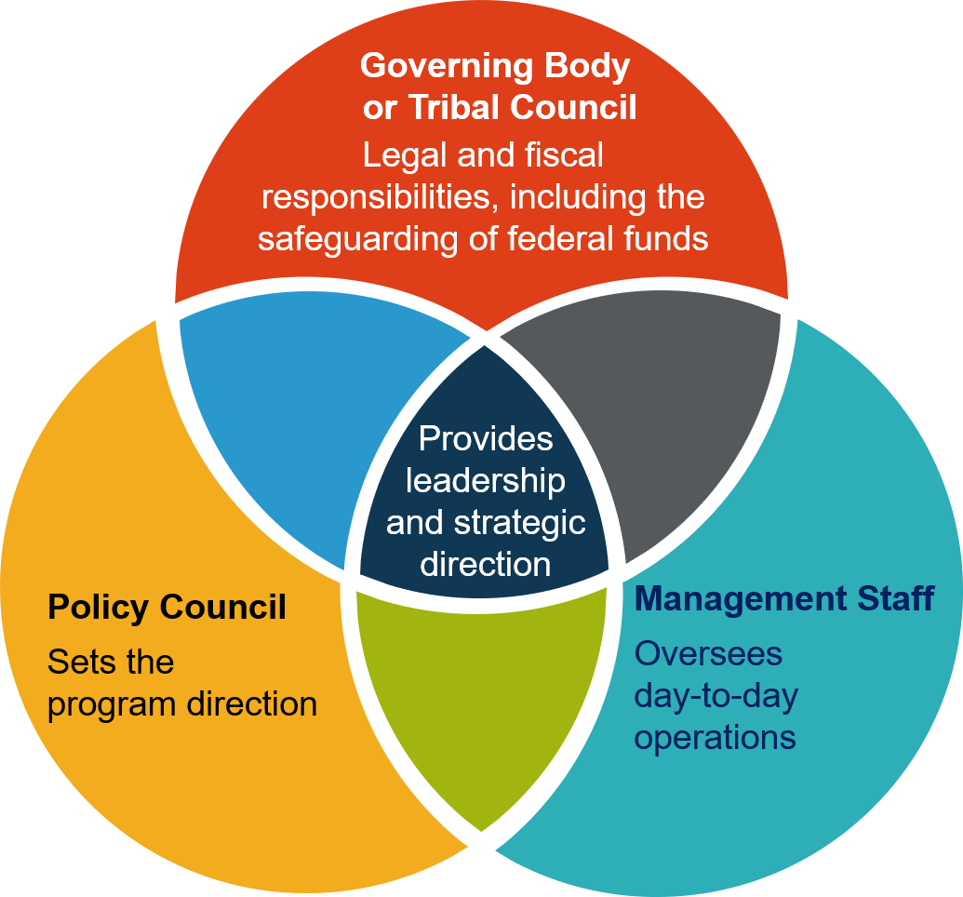
Head Start Leadership and Governance
Notes:
Slide 16
Facilitator Notes:
Direct participants’ attention to the slide, pointing out relevant sections of the diagram as you move through the bullet points.
Say to Participants: “This diagram depicts Head Start’s leadership and governance structure. It consists of:
The governing body or Tribal Council, which exercises legal and fiscal oversight; its duties include the safeguarding of federal funds
The Policy Council, which sets the program direction
Management staff, which oversees day-to-day operations of the program
“In the center of the diagram, we see how these three entities come together to jointly move the program forward.
“It is very important that everyone working in these three areas knows their role and responsibilities, and understands how to work together to make decisions on behalf of the program.”

Slide 17
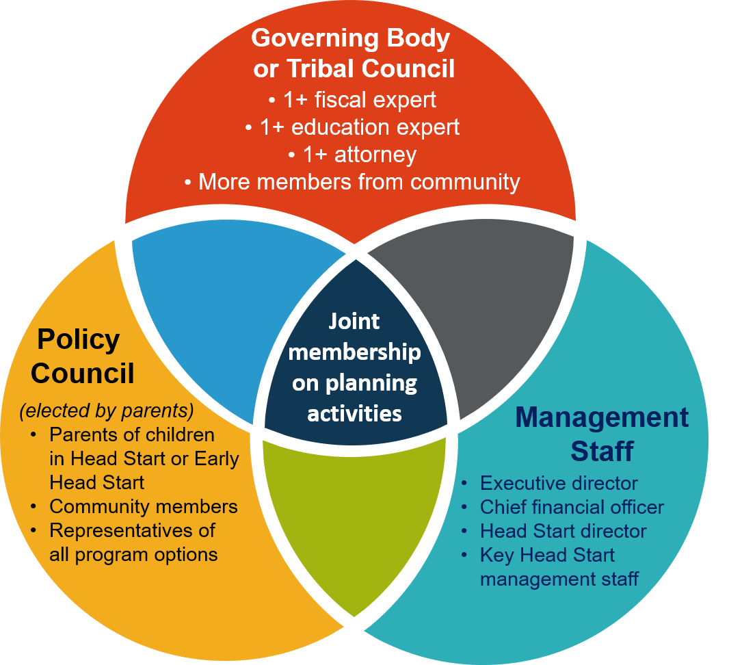
Leadership and Governance Composition
Notes:
Slide 17
Facilitator Notes:
Continue the section on structure.
Say to Participants: “The Head Start Act says that governing bodies and Tribal Councils must include one or more members:
With expertise in fiscal management or accounting
With expertise in early childhood education and development
Who are licensed attorneys familiar with legal issues that come before the governing body
“Additional members must:
Reflect the community being served
Include parents of children who are currently, or were formerly, enrolled in Head Start programs
Be selected for their expertise in education, business administration, or community affairs
“The Head Start Act spells out circumstances in which exceptions can be made to the rules. Refer to the Act or check with your Regional Office for details.
“According to the Head Start Act and HSPPS, the Policy Council must:
Be elected by parents of children currently enrolled in the Head Start program
Be composed of parents of children currently enrolled in the Head Start program, who must constitute a majority of the council
Include community members at large, some of whom may be parents of formerly enrolled children
Proportionally represent parents of children enrolled in all program options
“The Policy Council should also include parents and community-at-large representatives from delegate agencies.
“Grantees with delegate agencies should ensure those partners establish a policy committee. Policy committees must be composed according to the same rules as the Policy Council.”

Slide 18
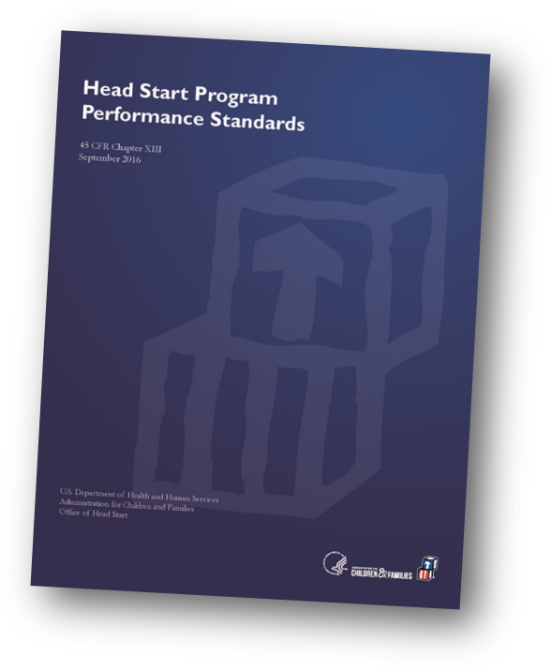
Use of Advisory Committees
  If a governing body uses an advisory committee to oversee its program governance responsibilities, it must:
  Establish the structure, communication, and oversight in such a way that the governing body/Tribal Council maintains its legal and fiscal responsibility
  Notify the responsible HHS official of its intent to establish such a committee
Notes:
Slide 18
Facilitator Notes:
Call participants’ attention to the slide.
Say to Participants: “Earlier, we discussed how Head Start programs may operate under a variety of auspices. If the auspice is a large organization or a regional or state entity, the program may choose to use advisory committees to oversee some aspects of program governance.
“If a program does use advisory committees, the HSPPS say they must:
Establish the structure, communication, and oversight in such a way that the governing body or Tribal Council continues to maintain its legal and fiscal responsibilities
Notify the Regional Office of its intent to establish such an advisory committee”

Slide 19
Lessons
Required expertise can be located within the governing body/Tribal Council or advisory committee.
Staff are sometimes used to fulfill legal and fiscal responsibilities while the advisory committee is being established.
Policy Council functions must be integrated into whatever alternative structure is designed.
TA can help inform structural decisions.
Notes:
Slide 19
Facilitator Notes:
Continue the section on structure.
Say to Participants: “We can learn from the experiences of large Head Start agencies that have used advisory committees in alternative governance structures. Those agencies have found that:
Required expertise can be located within either the governing body or the advisory council
Policy Councils are important, and their function must be integrated into whatever alternative structure is designed
Staff can sometimes fulfill legal and fiscal responsibilities while the advisory committee is being established
TA can be helpful in informing structural decisions
“Large programs considering using an advisory committee in alternative governance structures should ask:
Would an advisory committee improve administration of the program? If so, how will it relate to the governing body or Tribal Council? How will the governing body or Tribal Council’s ultimate responsibility for the Head Start grant be maintained?
How will required expertise be represented in the alternative governance structure?
How will the Policy Council function be represented in the alternative structure? How will it be supported?
How can TA support us in developing the alternative governance structure?
“Large Head Start programs developing an alternative governance structure should consult with their Regional Office before finalizing plans.”

Slide 20
Leadership and Governance: Processes
Notes:
Slide 20
Facilitator Notes:
Begin the section on leadership and governance processes.
Say to Participants: “As we move from considering structure to processes, take a moment to reflect on what you’re learning. Record your thoughts on your Structure, Processes, and Relationships handout.”

Slide 21
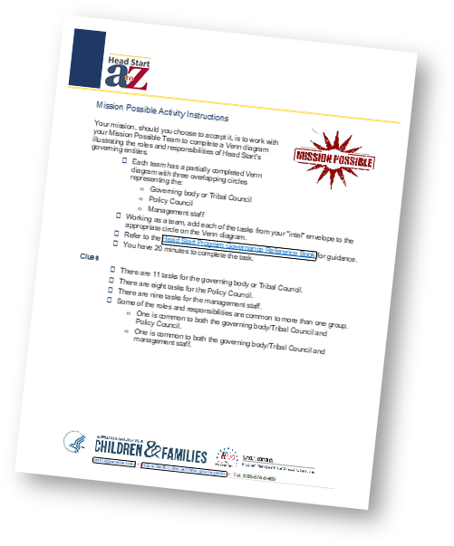
Mission Possible Activity
Draw tasks from your envelope one at a time
Place them where they go on the handout
Use Head Start Program Governance Reference Book for guidance
Take 20 minutes
Notes:
Slide 21
Facilitator Notes:
Distribute the blank Head Start Program Leadership Responsibilities and Mission Possible Activity Instructions handouts to each table. Make sure you’ve prepared for this exercise in advance by cutting apart the tasks on the Intel for Mission Possible Activity handout and placing them in envelopes, one for each table. Have copies of the completed Head Start Program Leadership Responsibilities handout to distribute at the end. You may wish to play Mission Impossible music at the beginning and end of the exercise.
Say to Participants: “Now that we have discussed the structural considerations that impact leadership and governance, let’s do an activity to identify the responsibilities of the governing body/Tribal Council, Policy Council, and management staff.
“I’d like each table to complete the blank Mission Possible handout. Do this by drawing one task at a time out of the envelope on your table and figuring out together where on the handout the task belongs. Note that a bit of information has already been filled in for you. Use the Head Start Program Governance Reference Book as a guide. You’ll have 20 minutes.”
After 20 minutes, distribute the Program Leadership Responsibilities (Completed) handout.
Say to Participants: “Take a look at the completed diagram. How does it look compared to yours?”
Give participants about a minute to review the completed handout.
Say to Participants: “What did you learn in this exercise that you didn’t know before?”
Solicit responses.

Slide 22
Key Activities: Developing Bylaws
Activity | Management Team | Policy Council/Committee | Governing Body/Tribal Council
Policies and Procedures
Developing Bylaws | Draft governing body/Tribal Council and Policy Council bylaws and amendments | Submit decisions regarding Policy Council bylaws to governing body/Tribal Council | Adopt bylaws and amendments for governing body/Tribal Council and Policy Council
Developing Governance Structure | Draft policies and procedures for consideration by Policy Council and governing body/Tribal Council Continued… | Approve and submit to the governing body/Tribal Council decisions regarding: Continued… | Select delegate agencies and service areas Continued…
Providing Leadership and Strategic Direction | Outline planning process and protocols for planning committee, including staffing considerations Continued… | Work with staff to select planning committee with focus on parent engagement Continued… | Work with management staff to select planning committee, including governing body/Tribal Council representation Continued…
Monitoring Program Performance | Generate reports to monitor compliance and goal attainment that include: Continued… | Review related reports Continued… | Review related reports Continued…
Ensuring Consensus | Develop procedures with governing body/Tribal Council and Policy Council and facilitate selection of mediator and arbitrator Continued… | Jointly establish written procedures for resolving internal disputes between governing body/Tribal Council and Policy Council in a timely manner that include impasse procedures. These procedures: Continued… | Jointly establish written procedures for resolving internal disputes between governing body/Tribal Council and Policy Council in a timely manner that include impasse procedures. These procedures: Continued…
Notes:
Slide 22.1
Facilitator Notes:
This slide is animated. Follow the prompts in this script to progress through the images. Distribute the Head Start Leadership and Governance Key Activities handout.
Say to Participants: “The next five slides show key activities that shape the foundation of leadership and governance within Head Start programs. These activities are a combination of governance best practices and functions required by the Head Start Act and HSPPS. As we look at these slides, we’ll consider how activities are connected to one another and how information flows back and forth. The handout has the same information; use it as a reference when you go back to your programs.”
Advance to the next image.
Say to Participants: “The management staff supports the Policy Council and governing body or Tribal Council in their respective responsibilities. For state-level grantees, decisions have to be made about which management departments will serve in this role.”
Advance a second time to the next image.
Say to Participants: “As stated earlier, the Policy Council sets the direction for the program. Policy Councils for state-level grantees should explore how to best represent parents’ voices given a large service area.”
Advance a third time to the final image.
Say to Participants: “The governing body or Tribal Council has legal and fiscal responsibility for administering the grant.”

Slide 23
Key Activities: Developing Bylaws
Activity | Management Team
Policies and Procedures
Developing Bylaws | Draft governing body/Tribal Council and Policy Council bylaws and amendments
Notes:
Slide 22.2
Facilitator Notes:
This slide is animated. Follow the prompts in this script to progress through the images. Distribute the Head Start Leadership and Governance Key Activities handout.
Say to Participants: “The next five slides show key activities that shape the foundation of leadership and governance within Head Start programs. These activities are a combination of governance best practices and functions required by the Head Start Act and HSPPS. As we look at these slides, we’ll consider how activities are connected to one another and how information flows back and forth. The handout has the same information; use it as a reference when you go back to your programs.”
Advance to the next image.
Say to Participants: “The management staff supports the Policy Council and governing body or Tribal Council in their respective responsibilities. For state-level grantees, decisions have to be made about which management departments will serve in this role.”
Advance a second time to the next image.
Say to Participants: “As stated earlier, the Policy Council sets the direction for the program. Policy Councils for state-level grantees should explore how to best represent parents’ voices given a large service area.”
Advance a third time to the final image.
Say to Participants: “The governing body or Tribal Council has legal and fiscal responsibility for administering the grant.”

Slide 24
Key Activities: Developing Bylaws
Activity | Management Team | Policy Council/Committee | Governing Body/Tribal Council
Policies and Procedures
Developing Bylaws | Draft governing body/Tribal Council and Policy Council bylaws and amendments | Submit decisions regarding Policy Council bylaws to governing body/Tribal Council | Adopt bylaws and amendments for governing body/Tribal Council and Policy Council
Developing Governance Structure | Draft policies and procedures for consideration by Policy Council and governing body/Tribal Council Continued… | Approve and submit to the governing body/Tribal Council decisions regarding: Continued… | Select delegate agencies and service areas Continued…
Providing Leadership and Strategic Direction | Outline planning process and protocols for planning committee, including staffing considerations Continued… | Work with staff to select planning committee with focus on parent engagement Continued… | Work with management staff to select planning committee, including governing body/Tribal Council representation Continued…
Monitoring Program Performance | Generate reports to monitor compliance and goal attainment that include: Continued… | Review related reports Continued… | Review related reports Continued…
Ensuring Consensus | Develop procedures with governing body/Tribal Council and Policy Council and facilitate selection of mediator and arbitrator Continued… | Jointly establish written procedures for resolving internal disputes between governing body/Tribal Council and Policy Council in a timely manner that include impasse procedures. These procedures: Continued… | Jointly establish written procedures for resolving internal disputes between governing body/Tribal Council and Policy Council in a timely manner that include impasse procedures. These procedures: Continued…
Notes:
Slide 22.3
Facilitator Notes:
This slide is animated. Follow the prompts in this script to progress through the images. Distribute the Head Start Leadership and Governance Key Activities handout.
Say to Participants: “The next five slides show key activities that shape the foundation of leadership and governance within Head Start programs. These activities are a combination of governance best practices and functions required by the Head Start Act and HSPPS. As we look at these slides, we’ll consider how activities are connected to one another and how information flows back and forth. The handout has the same information; use it as a reference when you go back to your programs.”
Advance to the next image.
Say to Participants: “The management staff supports the Policy Council and governing body or Tribal Council in their respective responsibilities. For state-level grantees, decisions have to be made about which management departments will serve in this role.”
Advance a second time to the next image.
Say to Participants: “As stated earlier, the Policy Council sets the direction for the program. Policy Councils for state-level grantees should explore how to best represent parents’ voices given a large service area.”
Advance a third time to the final image.
Say to Participants: “The governing body or Tribal Council has legal and fiscal responsibility for administering the grant.”

Slide 25
Key Activities: Developing Bylaws
Activity | Policy Council/Committee
Policies and Procedures
Developing Bylaws | Submit decisions regarding Policy Council bylaws to governing body/Tribal Council
Notes:
Slide 22.4
Facilitator Notes:
This slide is animated. Follow the prompts in this script to progress through the images. Distribute the Head Start Leadership and Governance Key Activities handout.
Say to Participants: “The next five slides show key activities that shape the foundation of leadership and governance within Head Start programs. These activities are a combination of governance best practices and functions required by the Head Start Act and HSPPS. As we look at these slides, we’ll consider how activities are connected to one another and how information flows back and forth. The handout has the same information; use it as a reference when you go back to your programs.”
Advance to the next image.
Say to Participants: “The management staff supports the Policy Council and governing body or Tribal Council in their respective responsibilities. For state-level grantees, decisions have to be made about which management departments will serve in this role.”
Advance a second time to the next image.
Say to Participants: “As stated earlier, the Policy Council sets the direction for the program. Policy Councils for state-level grantees should explore how to best represent parents’ voices given a large service area.”
Advance a third time to the final image.
Say to Participants: “The governing body or Tribal Council has legal and fiscal responsibility for administering the grant.”

Slide 26
Key Activities: Developing Bylaws
Activity | Management Team | Policy Council/Committee | Governing Body/Tribal Council
Policies and Procedures
Developing Bylaws | Draft governing body/Tribal Council and Policy Council bylaws and amendments | Submit decisions regarding Policy Council bylaws to governing body/Tribal Council | Adopt bylaws and amendments for governing body/Tribal Council and Policy Council
Developing Governance Structure | Draft policies and procedures for consideration by Policy Council and governing body/Tribal Council Continued… | Approve and submit to the governing body/Tribal Council decisions regarding: Continued… | Select delegate agencies and service areas Continued…
Providing Leadership and Strategic Direction | Outline planning process and protocols for planning committee, including staffing considerations Continued… | Work with staff to select planning committee with focus on parent engagement Continued… | Work with management staff to select planning committee, including governing body/Tribal Council representation Continued…
Monitoring Program Performance | Generate reports to monitor compliance and goal attainment that include: Continued… | Review related reports Continued… | Review related reports Continued…
Ensuring Consensus | Develop procedures with governing body/Tribal Council and Policy Council and facilitate selection of mediator and arbitrator Continued… | Jointly establish written procedures for resolving internal disputes between governing body/Tribal Council and Policy Council in a timely manner that include impasse procedures. These procedures: Continued… | Jointly establish written procedures for resolving internal disputes between governing body/Tribal Council and Policy Council in a timely manner that include impasse procedures. These procedures: Continued…
Notes:
Slide 22.5
Facilitator Notes:
This slide is animated. Follow the prompts in this script to progress through the images. Distribute the Head Start Leadership and Governance Key Activities handout.
Say to Participants: “The next five slides show key activities that shape the foundation of leadership and governance within Head Start programs. These activities are a combination of governance best practices and functions required by the Head Start Act and HSPPS. As we look at these slides, we’ll consider how activities are connected to one another and how information flows back and forth. The handout has the same information; use it as a reference when you go back to your programs.”
Advance to the next image.
Say to Participants: “The management staff supports the Policy Council and governing body or Tribal Council in their respective responsibilities. For state-level grantees, decisions have to be made about which management departments will serve in this role.”
Advance a second time to the next image.
Say to Participants: “As stated earlier, the Policy Council sets the direction for the program. Policy Councils for state-level grantees should explore how to best represent parents’ voices given a large service area.”
Advance a third time to the final image.
Say to Participants: “The governing body or Tribal Council has legal and fiscal responsibility for administering the grant.”

Slide 27
Key Activities: Developing Bylaws
Activity | Governing Body/Tribal Council
Policies and Procedures
Developing Bylaws | Adopt bylaws and amendments for governing body/Tribal Council and Policy Council
Notes:
Slide 22.6
Facilitator Notes:
This slide is animated. Follow the prompts in this script to progress through the images. Distribute the Head Start Leadership and Governance Key Activities handout.
Say to Participants: “The next five slides show key activities that shape the foundation of leadership and governance within Head Start programs. These activities are a combination of governance best practices and functions required by the Head Start Act and HSPPS. As we look at these slides, we’ll consider how activities are connected to one another and how information flows back and forth. The handout has the same information; use it as a reference when you go back to your programs.”
Advance to the next image.
Say to Participants: “The management staff supports the Policy Council and governing body or Tribal Council in their respective responsibilities. For state-level grantees, decisions have to be made about which management departments will serve in this role.”
Advance a second time to the next image.
Say to Participants: “As stated earlier, the Policy Council sets the direction for the program. Policy Councils for state-level grantees should explore how to best represent parents’ voices given a large service area.”
Advance a third time to the final image.
Say to Participants: “The governing body or Tribal Council has legal and fiscal responsibility for administering the grant.”

Slide 28
Key Activities: Developing Governance Structure
Activity | Management Team | Policy Council/Committee | Governing Body/Tribal Council
Policies and Procedures
Developing Bylaws | Draft governing body/Tribal Council and Policy Council bylaws and amendments | Submit decisions regarding Policy Council bylaws to governing body/Tribal Council | Adopt bylaws and amendments for governing body/Tribal Council and Policy Council
Developing Governance Structure | Draft policies and procedures for consideration by Policy Council and governing body/Tribal Council Continued… | Approve and submit to the governing body/Tribal Council decisions regarding: Continued… | Select delegate agencies and service areas Continued…
Providing Leadership and Strategic Direction | Outline planning process and protocols for planning committee, including staffing considerations Continued… | Work with staff to select planning committee with focus on parent engagement Continued… | Work with management staff to select planning committee, including governing body/Tribal Council representation Continued…
Monitoring Program Performance | Generate reports to monitor compliance and goal attainment that include: Continued… | Review related reports Continued… | Review related reports Continued…
Ensuring Consensus | Develop procedures with governing body/Tribal Council and Policy Council and facilitate selection of mediator and arbitrator Continued… | Jointly establish written procedures for resolving internal disputes between governing body/Tribal Council and Policy Council in a timely manner that include impasse procedures. These procedures: Continued… | Jointly establish written procedures for resolving internal disputes between governing body/Tribal Council and Policy Council in a timely manner that include impasse procedures. These procedures: Continued…
Notes:
Slide 23.1
Facilitator Notes:
This slide is animated. Progress through it while reading the paragraph below. You will advance a total of three times.
Say to Participants: “This slide focuses on governing body responsibilities with fiscal and legal implications. The average Head Start grant is about $5 million. This amount includes contractual obligations related to facilities and transportation management, as well as grant activities such as Early Head Start-Child Care Partnerships. Therefore, it is important to highlight these key legal and fiscal expectations.”
As you advance through the animation, comment on how tasks relate to one another.

Slide 29
Key Activities: Developing Governance Structure
Activity | Management Team
Policies and Procedures
Developing Governance Structure | Draft policies and procedures for consideration by Policy Council and governing body/Tribal Council Oversee the implementation of approved policies and procedures Provide training to governing body/Tribal Council and Policy Council Focus on continuous quality improvement Oversee management and protection of program data Maintain automated accounting and recordkeeping system Monitor goals, objectives, and regulatory compliance Establish and manage parent committees to: Advise staff on parent engagement activities Communicate with Policy Council/Committee Participate in the recruitment and screening of Head Start employees
Notes:
Slide 23.2
Facilitator Notes:
This slide is animated. Progress through it while reading the paragraph below. You will advance a total of three times.
Say to Participants: “This slide focuses on governing body responsibilities with fiscal and legal implications. The average Head Start grant is about $5 million. This amount includes contractual obligations related to facilities and transportation management, as well as grant activities such as Early Head Start-Child Care Partnerships. Therefore, it is important to highlight these key legal and fiscal expectations.”
As you advance through the animation, comment on how tasks relate to one another.

Slide 30
Key Activities: Developing Governance Structure
Activity | Management Team | Policy Council/Committee | Governing Body/Tribal Council
Policies and Procedures
Developing Bylaws | Draft governing body/Tribal Council and Policy Council bylaws and amendments | Submit decisions regarding Policy Council bylaws to governing body/Tribal Council | Adopt bylaws and amendments for governing body/Tribal Council and Policy Council
Developing Governance Structure | Draft policies and procedures for consideration by Policy Council and governing body/Tribal Council Continued… | Approve and submit to the governing body/Tribal Council decisions regarding: Continued… | Select delegate agencies and service areas Continued…
Providing Leadership and Strategic Direction | Outline planning process and protocols for planning committee, including staffing considerations Continued… | Work with staff to select planning committee with focus on parent engagement Continued… | Work with management staff to select planning committee, including governing body/Tribal Council representation Continued…
Monitoring Program Performance | Generate reports to monitor compliance and goal attainment that include: Continued… | Review related reports Continued… | Review related reports Continued…
Ensuring Consensus | Develop procedures with governing body/Tribal Council and Policy Council and facilitate selection of mediator and arbitrator Continued… | Jointly establish written procedures for resolving internal disputes between governing body/Tribal Council and Policy Council in a timely manner that include impasse procedures. These procedures: Continued… | Jointly establish written procedures for resolving internal disputes between governing body/Tribal Council and Policy Council in a timely manner that include impasse procedures. These procedures: Continued…
Notes:
Slide 23.3
Facilitator Notes:
This slide is animated. Progress through it while reading the paragraph below. You will advance a total of three times.
Say to Participants: “This slide focuses on governing body responsibilities with fiscal and legal implications. The average Head Start grant is about $5 million. This amount includes contractual obligations related to facilities and transportation management, as well as grant activities such as Early Head Start-Child Care Partnerships. Therefore, it is important to highlight these key legal and fiscal expectations.”
As you advance through the animation, comment on how tasks relate to one another.

Slide 31
Key Activities: Developing Governance Structure
Activity | Policy Council/Committee
Policies and Procedures
Developing Governance Structure | Approve and submit to the governing body/Tribal Council decisions regarding: Activities to actively involve parents and ensure responsive services Recruitment, selection, and enrollment priorities Funding applications and amendments Budget planning, including policies supporting Policy Council activities Policy Council bylaws and election procedures Head Start program personnel policies and decisions, including criteria for employment and dismissal of program staff Recommendations on delegates and service areas
Notes:
Slide 23.4
Facilitator Notes:
This slide is animated. Progress through it while reading the paragraph below. You will advance a total of three times.
Say to Participants: “This slide focuses on governing body responsibilities with fiscal and legal implications. The average Head Start grant is about $5 million. This amount includes contractual obligations related to facilities and transportation management, as well as grant activities such as Early Head Start-Child Care Partnerships. Therefore, it is important to highlight these key legal and fiscal expectations.”
As you advance through the animation, comment on how tasks relate to one another.

Slide 32
Key Activities: Developing Governance Structure
Activity | Management Team | Policy Council/Committee | Governing Body/Tribal Council
Policies and Procedures
Developing Bylaws | Draft governing body/Tribal Council and Policy Council bylaws and amendments | Submit decisions regarding Policy Council bylaws to governing body/Tribal Council | Adopt bylaws and amendments for governing body/Tribal Council and Policy Council
Developing Governance Structure | Draft policies and procedures for consideration by Policy Council and governing body/Tribal Council Continued… | Approve and submit to the governing body/Tribal Council decisions regarding: Continued… | Select delegate agencies and service areas Continued…
Providing Leadership and Strategic Direction | Outline planning process and protocols for planning committee, including staffing considerations Continued… | Work with staff to select planning committee with focus on parent engagement Continued… | Work with management staff to select planning committee, including governing body/Tribal Council representation Continued…
Monitoring Program Performance | Generate reports to monitor compliance and goal attainment that include: Continued… | Review related reports Continued… | Review related reports Continued…
Ensuring Consensus | Develop procedures with governing body/Tribal Council and Policy Council and facilitate selection of mediator and arbitrator Continued… | Jointly establish written procedures for resolving internal disputes between governing body/Tribal Council and Policy Council in a timely manner that include impasse procedures. These procedures: Continued… | Jointly establish written procedures for resolving internal disputes between governing body/Tribal Council and Policy Council in a timely manner that include impasse procedures. These procedures: Continued…
Notes:
Slide 23.5
Facilitator Notes:
This slide is animated. Progress through it while reading the paragraph below. You will advance a total of three times.
Say to Participants: “This slide focuses on governing body responsibilities with fiscal and legal implications. The average Head Start grant is about $5 million. This amount includes contractual obligations related to facilities and transportation management, as well as grant activities such as Early Head Start-Child Care Partnerships. Therefore, it is important to highlight these key legal and fiscal expectations.”
As you advance through the animation, comment on how tasks relate to one another.

Slide 33
Key Activities: Developing Governance Structure
Activity | Governing Body/Tribal Council
Policies and Procedures
Developing Governance Structure | Select delegate agencies and service areas Establish procedures and criteria for recruitment, selection, and enrollment Review results and follow-up from federal monitoring Review and approve: Funding applications and amendments Major policies and procedures, including self-assessment and financial audit Progress on implementing the Head Start grant, including corrective actions Personnel policies regarding the hiring, evaluation, termination, and compensation of agency employees, including the Head Start director and management team Financial management, accounting, and reporting policies Major expenditures and operating budget Selection of an auditor and actions to correct audit findings Adopt: Procedures for accessing and collecting information Standards of conduct, including conflicts of interest and complaints Procedures for selecting Policy Council members Procedures for utilizing advisory committees
Notes:
Slide 23.6
Facilitator Notes:
This slide is animated. Progress through it while reading the paragraph below. You will advance a total of three times.
Say to Participants: “This slide focuses on governing body responsibilities with fiscal and legal implications. The average Head Start grant is about $5 million. This amount includes contractual obligations related to facilities and transportation management, as well as grant activities such as Early Head Start-Child Care Partnerships. Therefore, it is important to highlight these key legal and fiscal expectations.”
As you advance through the animation, comment on how tasks relate to one another.

Slide 34
Key Activities: Providing Leadership and Strategic Direction
Activity | Management Team | Policy Council/Committee | Governing Body/Tribal Council
Policies and Procedures
Developing Bylaws | Draft governing body/Tribal Council and Policy Council bylaws and amendments | Submit decisions regarding Policy Council bylaws to governing body/Tribal Council | Adopt bylaws and amendments for governing body/Tribal Council and Policy Council
Developing Governance Structure | Draft policies and procedures for consideration by Policy Council and governing body/Tribal Council Continued… | Approve and submit to the governing body/Tribal Council decisions regarding: Continued… | Select delegate agencies and service areas Continued…
Providing Leadership and Strategic Direction | Outline planning process and protocols for planning committee, including staffing considerations Continued… | Work with staff to select planning committee with focus on parent engagement Continued… | Work with management staff to select planning committee, including governing body/Tribal Council representation Continued…
Monitoring Program Performance | Generate reports to monitor compliance and goal attainment that include: Continued… | Review related reports Continued… | Review related reports Continued…
Ensuring Consensus | Develop procedures with governing body/Tribal Council and Policy Council and facilitate selection of mediator and arbitrator Continued… | Jointly establish written procedures for resolving internal disputes between governing body/Tribal Council and Policy Council in a timely manner that include impasse procedures. These procedures: Continued… | Jointly establish written procedures for resolving internal disputes between governing body/Tribal Council and Policy Council in a timely manner that include impasse procedures. These procedures: Continued…
Notes:
Slide 24.1
Facilitator Notes:
This slide is animated. Progress through it while reading the script below. You will advance a total of three times.
Say to Participants: “This slide shows key reporting requirements for the Policy Council and governing body or Tribal Council. We can also see some suggested planning activities, which are the overlapping ‘sweet spot’ in the Venn diagram.”
As you advance through the animation, call attention to how tasks are related. Invite questions and comments.

Slide 35
Key Activities: Providing Leadership and Strategic Direction
Activity | Management Team
Policies and Procedures
Providing Leadership and Strategic Direction | Outline planning process and protocols for planning committee, including staffing considerations Review key reports and recommend program and school readiness plans Prepare goals and objectives Use program plans to support reporting, ongoing monitoring, and self-assessment Outline required adjustments to goals and objectives
Notes:
Slide 24.2
Facilitator Notes:
This slide is animated. Progress through it while reading the script below. You will advance a total of three times.
Say to Participants: “This slide shows key reporting requirements for the Policy Council and governing body or Tribal Council. We can also see some suggested planning activities, which are the overlapping ‘sweet spot’ in the Venn diagram.”
As you advance through the animation, call attention to how tasks are related. Invite questions and comments.

Slide 36
Key Activities: Providing Leadership and Strategic Direction
Activity | Management Team | Policy Council/Committee | Governing Body/Tribal Council
Policies and Procedures
Developing Bylaws | Draft governing body/Tribal Council and Policy Council bylaws and amendments | Submit decisions regarding Policy Council bylaws to governing body/Tribal Council | Adopt bylaws and amendments for governing body/Tribal Council and Policy Council
Developing Governance Structure | Draft policies and procedures for consideration by Policy Council and governing body/Tribal Council Continued… | Approve and submit to the governing body/Tribal Council decisions regarding: Continued… | Select delegate agencies and service areas Continued…
Providing Leadership and Strategic Direction | Outline planning process and protocols for planning committee, including staffing considerations Continued… | Work with staff to select planning committee with focus on parent engagement Continued… | Work with management staff to select planning committee, including governing body/Tribal Council representation Continued…
Monitoring Program Performance | Generate reports to monitor compliance and goal attainment that include: Continued… | Review related reports Continued… | Review related reports Continued…
Ensuring Consensus | Develop procedures with governing body/Tribal Council and Policy Council and facilitate selection of mediator and arbitrator Continued… | Jointly establish written procedures for resolving internal disputes between governing body/Tribal Council and Policy Council in a timely manner that include impasse procedures. These procedures: Continued… | Jointly establish written procedures for resolving internal disputes between governing body/Tribal Council and Policy Council in a timely manner that include impasse procedures. These procedures: Continued…
Notes:
Slide 24.3
Facilitator Notes:
This slide is animated. Progress through it while reading the script below. You will advance a total of three times.
Say to Participants: “This slide shows key reporting requirements for the Policy Council and governing body or Tribal Council. We can also see some suggested planning activities, which are the overlapping ‘sweet spot’ in the Venn diagram.”
As you advance through the animation, call attention to how tasks are related. Invite questions and comments.

Slide 37
Key Activities: Providing Leadership and Strategic Direction
Activity | Policy Council/Committee
Policies and Procedures
Providing Leadership and Strategic Direction | Work with staff to select planning committee with focus on parent engagement Review recommendations for planning committee Approve goals and objectives Respond to progress reports Use data for ongoing oversight and correction Approve adjusted goals and objectives
Notes:
Slide 24.4
Facilitator Notes:
This slide is animated. Progress through it while reading the script below. You will advance a total of three times.
Say to Participants: “This slide shows key reporting requirements for the Policy Council and governing body or Tribal Council. We can also see some suggested planning activities, which are the overlapping ‘sweet spot’ in the Venn diagram.”
As you advance through the animation, call attention to how tasks are related. Invite questions and comments.

Slide 38
Key Activities: Providing Leadership and Strategic Direction
Activity | Management Team | Policy Council/Committee | Governing Body/Tribal Council
Policies and Procedures
Developing Bylaws | Draft governing body/Tribal Council and Policy Council bylaws and amendments | Submit decisions regarding Policy Council bylaws to governing body/Tribal Council | Adopt bylaws and amendments for governing body/Tribal Council and Policy Council
Developing Governance Structure | Draft policies and procedures for consideration by Policy Council and governing body/Tribal Council Continued… | Approve and submit to the governing body/Tribal Council decisions regarding: Continued… | Select delegate agencies and service areas Continued…
Providing Leadership and Strategic Direction | Outline planning process and protocols for planning committee, including staffing considerations Continued… | Work with staff to select planning committee with focus on parent engagement Continued… | Work with management staff to select planning committee, including governing body/Tribal Council representation Continued…
Monitoring Program Performance | Generate reports to monitor compliance and goal attainment that include: Continued… | Review related reports Continued… | Review related reports Continued…
Ensuring Consensus | Develop procedures with governing body/Tribal Council and Policy Council and facilitate selection of mediator and arbitrator Continued… | Jointly establish written procedures for resolving internal disputes between governing body/Tribal Council and Policy Council in a timely manner that include impasse procedures. These procedures: Continued… | Jointly establish written procedures for resolving internal disputes between governing body/Tribal Council and Policy Council in a timely manner that include impasse procedures. These procedures: Continued…
Notes:
Slide 24.5
Facilitator Notes:
This slide is animated. Progress through it while reading the script below. You will advance a total of three times.
Say to Participants: “This slide shows key reporting requirements for the Policy Council and governing body or Tribal Council. We can also see some suggested planning activities, which are the overlapping ‘sweet spot’ in the Venn diagram.”
As you advance through the animation, call attention to how tasks are related. Invite questions and comments.

Slide 39
Key Activities: Providing Leadership and Strategic Direction
Activity | Governing Body/Tribal Council
Policies and Procedures
Providing Leadership and Strategic Direction | Work with management staff to select planning committee, including governing body/Tribal Council representation Review recommendations for planning committee Ratify goals and objectives Respond to progress reports Use data for ongoing oversight and correction Ratify adjusted goals and objectives
Notes:
Slide 24.6
Facilitator Notes:
This slide is animated. Progress through it while reading the script below. You will advance a total of three times.
Say to Participants: “This slide shows key reporting requirements for the Policy Council and governing body or Tribal Council. We can also see some suggested planning activities, which are the overlapping ‘sweet spot’ in the Venn diagram.”
As you advance through the animation, call attention to how tasks are related. Invite questions and comments.

Slide 40
Key Activities: Monitoring Program Performance
Activity | Management Team | Policy Council/Committee | Governing Body/Tribal Council
Policies and Procedures
Developing Bylaws | Draft governing body/Tribal Council and Policy Council bylaws and amendments | Submit decisions regarding Policy Council bylaws to governing body/Tribal Council | Adopt bylaws and amendments for governing body/Tribal Council and Policy Council
Developing Governance Structure | Draft policies and procedures for consideration by Policy Council and governing body/Tribal Council Continued… | Approve and submit to the governing body/Tribal Council decisions regarding: Continued… | Select delegate agencies and service areas Continued…
Providing Leadership and Strategic Direction | Outline planning process and protocols for planning committee, including staffing considerations Continued… | Work with staff to select planning committee with focus on parent engagement Continued… | Work with management staff to select planning committee, including governing body/Tribal Council representation Continued…
Monitoring Program Performance | Generate reports to monitor compliance and goal attainment that include: Continued… | Review related reports Continued… | Review related reports Continued…
Ensuring Consensus | Develop procedures with governing body/Tribal Council and Policy Council and facilitate selection of mediator and arbitrator Continued… | Jointly establish written procedures for resolving internal disputes between governing body/Tribal Council and Policy Council in a timely manner that include impasse procedures. These procedures: Continued… | Jointly establish written procedures for resolving internal disputes between governing body/Tribal Council and Policy Council in a timely manner that include impasse procedures. These procedures: Continued…
Notes:
Slide 25.1
Facilitator Notes:
This slide is animated. Progress through it while reading the script below. You will advance a total of three times.
Say to Participants: “This slide shows the areas where each entity has responsibilities around monitoring program performance.”

Slide 41
Key Activities: Monitoring Program Performance
Activity | Management Team
Policies and Procedures
Monitoring Program Performance | Generate reports to monitor compliance and goal attainment that include: U.S. Department of Health and Human Services (HHS) secretary communication Financial statements Program information summaries Ongoing monitoring results Data on school readiness Enrollment U.S. Department of Agriculture (USDA) nutrition reports Financial audit Self-assessment Community assessment Program Information Report (PIR)
Notes:
Slide 25.2
Facilitator Notes:
This slide is animated. Progress through it while reading the script below. You will advance a total of three times.
Say to Participants: “This slide shows the areas where each entity has responsibilities around monitoring program performance.”

Slide 42
Key Activities: Monitoring Program Performance
Activity | Management Team | Policy Council/Committee | Governing Body/Tribal Council
Policies and Procedures
Developing Bylaws | Draft governing body/Tribal Council and Policy Council bylaws and amendments | Submit decisions regarding Policy Council bylaws to governing body/Tribal Council | Adopt bylaws and amendments for governing body/Tribal Council and Policy Council
Developing Governance Structure | Draft policies and procedures for consideration by Policy Council and governing body/Tribal Council Continued… | Approve and submit to the governing body/Tribal Council decisions regarding: Continued… | Select delegate agencies and service areas Continued…
Providing Leadership and Strategic Direction | Outline planning process and protocols for planning committee, including staffing considerations Continued… | Work with staff to select planning committee with focus on parent engagement Continued… | Work with management staff to select planning committee, including governing body/Tribal Council representation Continued…
Monitoring Program Performance | Generate reports to monitor compliance and goal attainment that include: Continued… | Review related reports Continued… | Review related reports Continued…
Ensuring Consensus | Develop procedures with governing body/Tribal Council and Policy Council and facilitate selection of mediator and arbitrator Continued… | Jointly establish written procedures for resolving internal disputes between governing body/Tribal Council and Policy Council in a timely manner that include impasse procedures. These procedures: Continued… | Jointly establish written procedures for resolving internal disputes between governing body/Tribal Council and Policy Council in a timely manner that include impasse procedures. These procedures: Continued…
Notes:
Slide 25.3
Facilitator Notes:
This slide is animated. Progress through it while reading the script below. You will advance a total of three times.
Say to Participants: “This slide shows the areas where each entity has responsibilities around monitoring program performance.”

Slide 43
Key Activities: Monitoring Program Performance
Activity | Policy Council/Committee
Policies and Procedures
Monitoring Program Performance | Review related reports Use data for ongoing oversight, correction, and self-assessment
Notes:
Slide 25.4
Facilitator Notes:
This slide is animated. Progress through it while reading the script below. You will advance a total of three times.
Say to Participants: “This slide shows the areas where each entity has responsibilities around monitoring program performance.”

Slide 44
Key Activities: Monitoring Program Performance
Activity | Management Team | Policy Council/Committee | Governing Body/Tribal Council
Policies and Procedures
Developing Bylaws | Draft governing body/Tribal Council and Policy Council bylaws and amendments | Submit decisions regarding Policy Council bylaws to governing body/Tribal Council | Adopt bylaws and amendments for governing body/Tribal Council and Policy Council
Developing Governance Structure | Draft policies and procedures for consideration by Policy Council and governing body/Tribal Council Continued… | Approve and submit to the governing body/Tribal Council decisions regarding: Continued… | Select delegate agencies and service areas Continued…
Providing Leadership and Strategic Direction | Outline planning process and protocols for planning committee, including staffing considerations Continued… | Work with staff to select planning committee with focus on parent engagement Continued… | Work with management staff to select planning committee, including governing body/Tribal Council representation Continued…
Monitoring Program Performance | Generate reports to monitor compliance and goal attainment that include: Continued… | Review related reports Continued… | Review related reports Continued…
Ensuring Consensus | Develop procedures with governing body/Tribal Council and Policy Council and facilitate selection of mediator and arbitrator Continued… | Jointly establish written procedures for resolving internal disputes between governing body/Tribal Council and Policy Council in a timely manner that include impasse procedures. These procedures: Continued… | Jointly establish written procedures for resolving internal disputes between governing body/Tribal Council and Policy Council in a timely manner that include impasse procedures. These procedures: Continued…
Notes:
Slide 25.5
Facilitator Notes:
This slide is animated. Progress through it while reading the script below. You will advance a total of three times.
Say to Participants: “This slide shows the areas where each entity has responsibilities around monitoring program performance.”

Slide 45
Key Activities: Monitoring Program Performance
Activity | Governing Body/Tribal Council
Policies and Procedures
Monitoring Program Performance | Review related reports Use data for ongoing oversight, correction, and self-assessment
Notes:
Slide 25.6
Facilitator Notes:
This slide is animated. Progress through it while reading the script below. You will advance a total of three times.
Say to Participants: “This slide shows the areas where each entity has responsibilities around monitoring program performance.”

Slide 46
Key Activities: Ensuring Consensus
Activity | Management Team | Policy Council/Committee | Governing Body/Tribal Council
Policies and Procedures
Developing Bylaws | Draft governing body/Tribal Council and Policy Council bylaws and amendments | Submit decisions regarding Policy Council bylaws to governing body/Tribal Council | Adopt bylaws and amendments for governing body/Tribal Council and Policy Council
Developing Governance Structure | Draft policies and procedures for consideration by Policy Council and governing body/Tribal Council Continued… | Approve and submit to the governing body/Tribal Council decisions regarding: Continued… | Select delegate agencies and service areas Continued…
Providing Leadership and Strategic Direction | Outline planning process and protocols for planning committee, including staffing considerations Continued… | Work with staff to select planning committee with focus on parent engagement Continued… | Work with management staff to select planning committee, including governing body/Tribal Council representation Continued…
Monitoring Program Performance | Generate reports to monitor compliance and goal attainment that include: Continued… | Review related reports Continued… | Review related reports Continued…
Ensuring Consensus | Develop procedures with governing body/Tribal Council and Policy Council and facilitate selection of mediator and arbitrator Continued… | Jointly establish written procedures for resolving internal disputes between governing body/Tribal Council and Policy Council in a timely manner that include impasse procedures. These procedures: Continued… | Jointly establish written procedures for resolving internal disputes between governing body/Tribal Council and Policy Council in a timely manner that include impasse procedures. These procedures: Continued…
Notes:
Slide 26.1
Facilitator Notes:
This slide is animated. Progress through it while reading the script below. You will advance a total of two times.
Say to Participants: “This slide shows the areas where the Policy Council and governing body or Tribal Council share roles and responsibilities.
“We should note that in cases where the governing body/Tribal Council and Policy Council cannot reach agreement on key decisions, the HSPPS outlines impasse procedures.”

Slide 47
Key Activities: Ensuring Consensus
Activity | Management Team
Policies and Procedures
Ensuring Consensus | Develop procedures with governing body/Tribal Council and Policy Council and facilitate selection of mediator and arbitrator
Notes:
Slide 26.2
Facilitator Notes:
This slide is animated. Progress through it while reading the script below. You will advance a total of two times.
Say to Participants: “This slide shows the areas where the Policy Council and governing body or Tribal Council share roles and responsibilities.
“We should note that in cases where the governing body/Tribal Council and Policy Council cannot reach agreement on key decisions, the HSPPS outlines impasse procedures.”

Slide 48
Key Activities: Ensuring Consensus
Activity | Management Team | Policy Council/Committee | Governing Body/Tribal Council
Policies and Procedures
Developing Bylaws | Draft governing body/Tribal Council and Policy Council bylaws and amendments | Submit decisions regarding Policy Council bylaws to governing body/Tribal Council | Adopt bylaws and amendments for governing body/Tribal Council and Policy Council
Developing Governance Structure | Draft policies and procedures for consideration by Policy Council and governing body/Tribal Council Continued… | Approve and submit to the governing body/Tribal Council decisions regarding: Continued… | Select delegate agencies and service areas Continued…
Providing Leadership and Strategic Direction | Outline planning process and protocols for planning committee, including staffing considerations Continued… | Work with staff to select planning committee with focus on parent engagement Continued… | Work with management staff to select planning committee, including governing body/Tribal Council representation Continued…
Monitoring Program Performance | Generate reports to monitor compliance and goal attainment that include: Continued… | Review related reports Continued… | Review related reports Continued…
Ensuring Consensus | Develop procedures with governing body/Tribal Council and Policy Council and facilitate selection of mediator and arbitrator Continued… | Jointly establish written procedures for resolving internal disputes between governing body/Tribal Council and Policy Council in a timely manner that include impasse procedures. These procedures: Continued… | Jointly establish written procedures for resolving internal disputes between governing body/Tribal Council and Policy Council in a timely manner that include impasse procedures. These procedures: Continued…
Notes:
Slide 26.3
Facilitator Notes:
This slide is animated. Progress through it while reading the script below. You will advance a total of two times.
Say to Participants: “This slide shows the areas where the Policy Council and governing body or Tribal Council share roles and responsibilities.
“We should note that in cases where the governing body/Tribal Council and Policy Council cannot reach agreement on key decisions, the HSPPS outlines impasse procedures.”

Slide 49
Key Activities: Ensuring Consensus
Activity | Policy Council/Committee
Policies and Procedures
Ensuring Consensus | Jointly establish written procedures for resolving internal disputes between governing body/Tribal Council and Policy Council in a timely manner that include impasse procedures. These procedures: Demonstrate the governing body/Tribal Council considers proposed decisions from the Policy Council and vice versa Require the governing body/Tribal Council and the Policy Council to notify the other in writing why it does not accept a decision Describe a decision-making process and a timeline to resolve disputes and reach decisions that are not arbitrary, capricious, or illegal If the agency's decision-making process does not result in a resolution and an impasse continues, governing body/Tribal Council and Policy Council must select a mutually agreeable third-party mediator and participate in a formal process of mediation that leads to a resolution of the dispute If no resolution is reached with a mediator, governing body and Policy Council must select a mutually agreeable arbitrator whose decision is final. This does not apply to American Indian and Alaska Native (AIAN) programs
Notes:
Slide 26.4
Facilitator Notes:
This slide is animated. Progress through it while reading the script below. You will advance a total of two times.
Say to Participants: “This slide shows the areas where the Policy Council and governing body or Tribal Council share roles and responsibilities.
“We should note that in cases where the governing body/Tribal Council and Policy Council cannot reach agreement on key decisions, the HSPPS outlines impasse procedures.”

Slide 50
Key Activities: Ensuring Consensus
Activity | Governing Body/Tribal Council
Policies and Procedures
Ensuring Consensus | Jointly establish written procedures for resolving internal disputes between governing body/Tribal Council and Policy Council in a timely manner that include impasse procedures. These procedures: Demonstrate the governing body/Tribal Council considers proposed decisions from the Policy Council and vice versa Require the governing body/Tribal Council and the Policy Council to notify the other in writing why it does not accept a decision Describe a decision-making process and a timeline to resolve disputes and reach decisions that are not arbitrary, capricious, or illegal If the agency's decision-making process does not result in a resolution and an impasse continues, governing body/Tribal Council and Policy Council must select a mutually agreeable third-party mediator and participate in a formal process of mediation that leads to a resolution of the dispute If no resolution is reached with a mediator, governing body and Policy Council must select a mutually agreeable arbitrator whose decision is final. This does not apply to American Indian and Alaska Native (AIAN) programs
Notes:
Slide 26.5
Facilitator Notes:
This slide is animated. Progress through it while reading the script below. You will advance a total of two times.
Say to Participants: “This slide shows the areas where the Policy Council and governing body or Tribal Council share roles and responsibilities.
“We should note that in cases where the governing body/Tribal Council and Policy Council cannot reach agreement on key decisions, the HSPPS outlines impasse procedures.”

Slide 51

Head Start Leadership and Governance
Notes:
Slide 27
Facilitator Notes:
Continue the section on leadership and governance processes.
Say to Participants: “Let’s revisit the Program Leadership diagram to remind ourselves how entities work together to provide leadership and strategic direction. This level of coordination is possible because the governing body or Tribal Council, Policy Council, and management staff all engage in ongoing planning. That process is outlined in the next slide.”

Slide 52
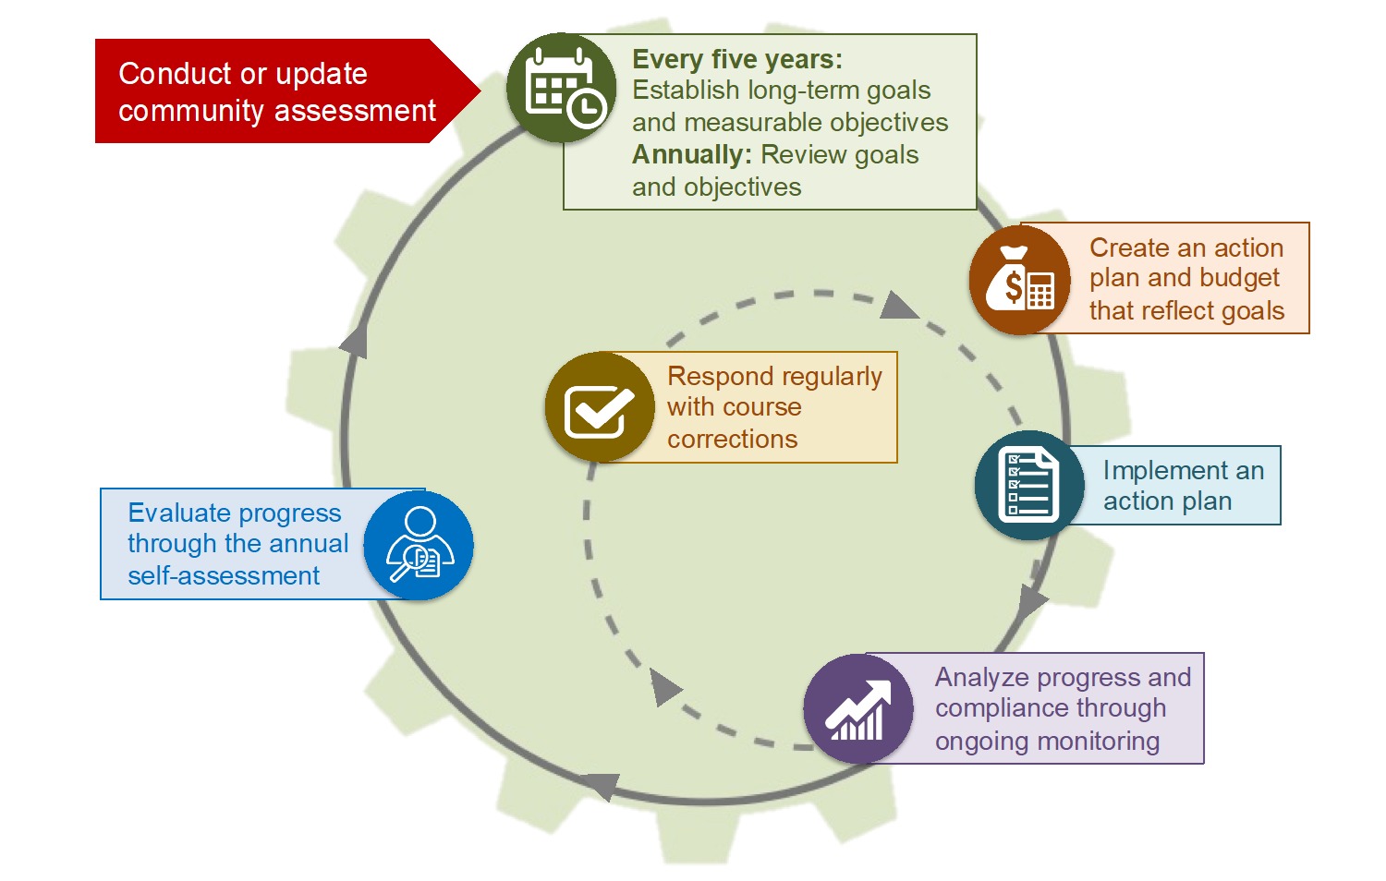
Program Planning for Continuous Improvement
Notes:
Slide 28
Facilitator Notes:
Distribute the Program Planning Cycle handout.
Say to Participants: “Program planning is essential to all Head Start and Early Head Start programs. Members of governing bodies/Tribal Councils and Policy Councils receive updates on goals and objectives supporting their program’s five-year plan. They also have an opportunity to be part of the planning teams responsible for developing those goals and objectives. Given that members may be involved in activities related to the planning cycle, we want to spend some time describing how it works.
“Take a close look at the slide. Notice that planning is a circular process that continues to build and evolve over time. Think of the cycle as a slow-moving wheel with forward momentum. Since we’re looking at the planning cycle through a systems lens, note that each of the planning activities we’ll be talking about is embedded in one of the 12 Head Start management systems.”
In your own words, point out the following elements of the planning cycle and describe each briefly.
Community Assessment (red arrow): The first step in the planning process is conducting the community assessment, which evaluates needs in the community. This occurs at least once during the five-year grant cycle and is reviewed and updated annually.
Program Goal Development (green box): As a result of the community assessment, your Head Start program develops and updates key program goals that establish a blueprint for what you want to accomplish in the next five years.
Action Plan and Budget Development (orange and blue boxes): You implement action plans and a corresponding budget that logistically and financially support the program goals you’ve developed.
Ongoing Monitoring (purple and yellow boxes): This system helps you determine if your planning activities are having the intended results, and if not, the changes that need to be made.
Self-Assessment (blue box): Just as the community assessment process takes stock of the external environment, the annual self-assessment examines how well your program’s internal functions are helping you achieve program goals.
Say to Participants: “As you can see, the program planning cycle requires different management systems to work together to inform the development of goals and monitor whether the program is achieving them. Program leadership and governance entities analyze the connections and relationships between the management systems on an ongoing basis. In that way, they are actively applying systems thinking.
“I have a question. How many of you can name at least some of the five-year goals that were articulated in your last grant?”
Ask for a show of hands.
Say to Participants: “They may or may not readily come to mind. If they’re not all easy to recall, ask for a refresher on them at your next meeting. It’s helpful to keep them in mind as you move through your various tasks.”

Slide 53
Risk Assessment: Key Considerations
Fiscal policies and procedures
Financial audits
Reporting and disclosure
Board composition
Notes:
Slide 29
Facilitator Notes:
End this section on leadership and governance processes.
Say to Participants: “As a reminder, governing body and Tribal Council members are charged with fiscal and legal oversight of the Head Start or Early Head Start program. This includes risk management. Risk management is the forecasting and evaluation of financial risks, and the identification of procedures to avoid or minimize the fiscal impact of risks.
“In Head Start programs, this means:
Working with key management staff on approving fiscal policies and procedures that safeguard federal funds (e.g., requirements on signing checks)
Being responsive to issues raised in financial audits (e.g., exercising internal controls)
Addressing issues that arise in Head Start reports and implementing ways to avoid repeat issues
Making sure the governing body or Tribal Council includes members with adequate fiscal expertise”

Slide 54
Leadership and Governance: Relationships
Notes:
Slide 30
Facilitator Notes:
Begin this section on the importance of relationships in leadership and governance.
Say to Participants: “Let’s move on to the importance of developing respectful and productive relationships among the governance entities. Remember to jot down ideas on your Structure, Processes, and Relationships handout as we move through this section.”

Slide 55
Foundation of Effective Partnerships
Good communication across and within organizations
Mutual respect
Feeling that each is a full partner
Ability to call one another when needed
Notes:
Slide 31
Facilitator Notes:
Call participants’ attention to the slide.
Say to Participants: “In the article ‘Child Care/Head Start Partnership Snapshot: What the Research Says About Establishing and Sustaining Partnerships,’ author Diane Schilder says communication is key to making partnerships work.
“Successful partnerships report they have:³
Good communication across and within organizations
Mutual respect among individuals working in the partnership
The feeling that each is a full partner and everyone’s voice is heard
Ability to call one another when needed”
³ Diane Schilder. Child Care/Head Start Partnership Snapshot: What the Research Says About Establishing and Sustaining Partnerships. Waltham, MA: Education Development Center, Inc., 2014.

Slide 56
Factors in Effective Communication
Committed leadership
Trust between Head Start director and fiscal officer
A common vision and goal
Joint training sessions for staff
A plan for ongoing communication
Notes:
Slide 32
Facilitator Notes:
Call participants’ attention to the slide.
Say to Participants: “As you can see from the list on the slide, it is very important to foster a working partnership between the program director and fiscal officer. This partnership should extend to program and fiscal staff members. To have a positive working partnership, you need:
Committed leadership
Trust between the Head Start director and fiscal officer
A common vision and goal
Joint training sessions for staff
A plan for ongoing communication
“You can learn more about the fundamentals of strong communication in the Learning for New Leaders: Head Start A to Z, 2.0.”

Slide 57
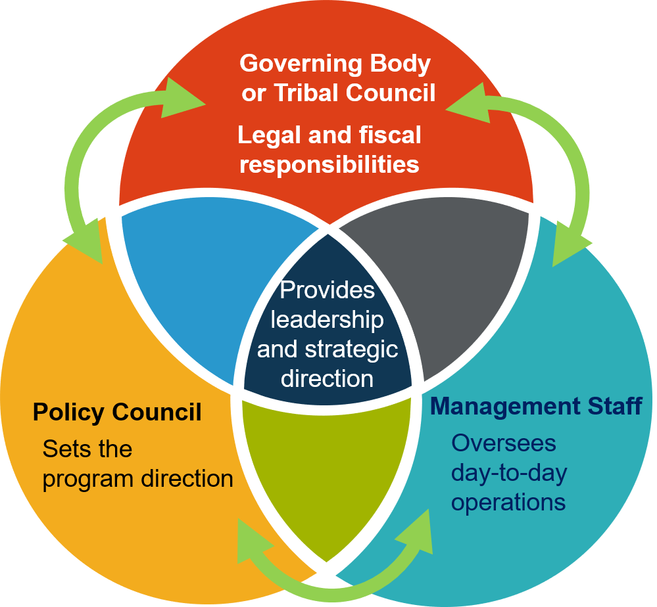
Leadership and Governance Communication
Notes:
Slide 33
Facilitator Notes:
Call participants’ attention to the slide.
Say to Participants: “As we take a final look at this diagram, note how the arrows on the slide suggest constant communication among the three entities. When these three entities operate in sync with one other, your Head Start program is better positioned to move from compliance to excellence.”

Slide 58

Assessing Your Readiness
Structural
Fiduciary
Strategic direction
Leadership
Community relations
Decision-making
Notes:
Slide 34
Facilitator Notes:
If members of governing bodies or Tribal Councils constitute more than half of your trainee group, proceed with the activity below. Otherwise, skip this slide and activity.
Distribute the Governance Readiness Assessment handout.
Say to Participants: “How ready is your governing body or Tribal Council to fulfill its many responsibilities? It’s a complicated question, and there are many factors to consider before you can answer it. Let’s do an exercise that may give you some insight.”
Review the handout with participants. Then, ask them to form teams of two to four people.
Say to Participants: “Take a look at the Governance Readiness Assessment handout. We’re going to focus on Section 2, which begins on page 10. This section provides a framework for assessing the governing body or Tribal Council’s practices in six categories:
Structural
Fiduciary
Strategic direction
Leadership
Community relations
Decision-making”
Assign each team one of the categories. Depending on the number of teams, you may need to assign some categories twice.
Say to Participants: “Working with your team, review each indicator in your assigned category and complete the worksheet. When you’re finished, select which stage of development best applies to your governing body or Tribal Council. Write comments where indicated that explain why you think so. You have 10 minutes for this exercise.”
After 10 minutes, bring the group back together and ask volunteers to share how they scored themselves. Ask them what areas their governing body or Tribal Council was particularly strong in, and where challenges remain.
Say to Participants: “Consider charting the results of your assessment on your Structure, Processes, and Relationships handout to prioritize the issues you want to address when you return to your program.”

Slide 59
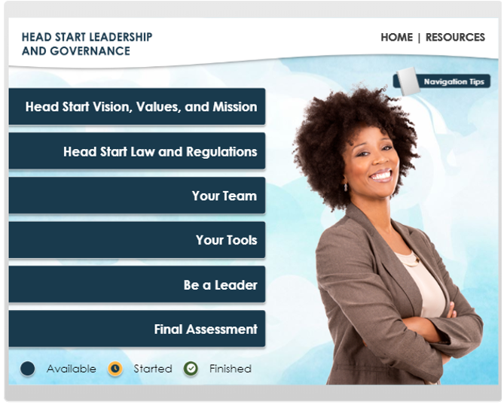
Head Start Leadership and Governance Training
https://eclkc.ohs.acf.hhs.gov/organizational-leadership/learning-module/head-start-leadership-governance-training
Notes:
Slide 35
Facilitator Notes:
Call participants’ attention to the slide.
Say to Participants: “The interactive Head Start Leadership and Governance training module is an additional resource you can access through the ECLKC.
“This module is self-paced and features many activities and real-world scenarios. It’s an excellent way for management staff and members of governing bodies, Tribal Councils, Policy Councils, and policy committees to refine their governance knowledge and leadership skills.
“The training is organized around five learning modules, as you can see. Take a moment to jot down the link on the slide. Alternatively, you can search for the module on ECLKC.”

Slide 60
Key Messages
Individuals in leadership and governance roles must view their work through a systems lens.
Head Start management systems support leadership and governance functions.
Leaders should proactively work to strengthen leadership and governance capacity.
Head Start leadership and governance rely on effective structures, processes, and relationships.
Notes:
Slide 36
Facilitator Notes:
Review key messages with participants.
Say to Participants: “As we wrap up this session, let’s review key takeaways.
Individuals in leadership and governance roles must view their work through a systems lens
Head Start management systems support leadership and governance functions
Head Start leadership and governance relies on effective structures, processes, and relationships
Leaders should proactively work to strengthen leadership and governance capacity”

Slide 61
Closing Reflections
What have I learned?
What excites or concerns me about what I learned?
What will I do with what I've learned?
Adapted from Professional Development Guides for Implementing PFCE
Notes:
Slide 37
Facilitator Notes:
The final exercise is intended to help participants reflect on and reinforce what they’ve learned. Guide participants to the Reflective Practice Tool handout.
Say to Participants: “Now, let’s take some time to turn inward, to digest and reflect honestly on what we’ve learned and how we will use this information to benefit our Head Start work after we leave.”
Using the handout, direct participants to take a few minutes to reflect and write down their thoughts about the following questions on the handout:
What have you learned?
What excites or concerns you about what you have learned?
What will you do with what you’ve learned?
If time permits, allow volunteers to share their responses aloud, and process the activity using the following questions:
What themes are emerging?
What insights do you need to remember?
How can you use these insights?

Slide 62
Related ECLKC Resources
About Us
https://eclkc.ohs.acf.hhs.gov/about-us/article/office-head-start-ohs
Head Start Programs
https://eclkc.ohs.acf.hhs.gov/programs/article/head-start-programs
Head Start Act
https://eclkc.ohs.acf.hhs.gov/policy/head-start-act
Notes:
Slide 38
Facilitator Notes:
Direct participants’ attention to the slide.
Say to Participants: “We’ve already mentioned some resources available to you on the ECLKC. Here are some additional resources. You can learn about others by going to the site and typing topics into the search bar.”

Slide 63





Contact PMFO
pmfo@ecetta.info
https://eclkc.ohs.acf.hhs.gov/ncpmfo
Call us: 888-874-5469
Notes:
Slide 39
Facilitator Notes:
Contact information.

