Slide 1
HSPPS Supports STEAM
Subpart C - Education and Child Development Program Services
1302.30 Purpose
All programs must provide high-quality early education and child development services, including for children with disabilities, that promote children’s cognitive, social, and emotional growth for later success in school….
Notes:
OPTIONAL

Slide 2
The Inquiry Cycle
Observe
What do you see/hear?
How do they sound/smell?
How are they the same?
How are they different?
What happens when you try?
You seem curious about...
Predict
What do you think will happen?
What are your predictions?
Why do you think that?
How could we find out?
Explore / Experiment
Let’s investigate!
What do you notice?
What is changing?
What did you try?
Let’s draw what we see.
Reflect
What were your predictions?
What happened?
What did you notice?
Why do you think that happened?
What could we investigate next?
Question
What are you curious about?
What do you want to know?
Are you wondering if…?
Notes:
OPTIONAL

Slide 3
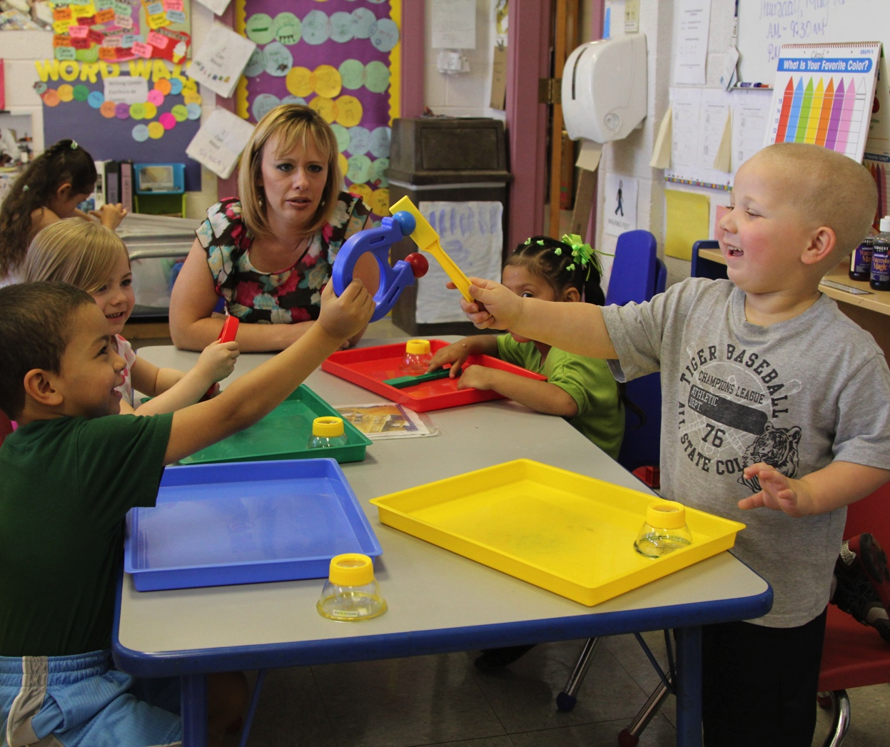
Create a Culture of Inquiry
Foster children’s curiosity and questioning.
Guide children in exploring their questions.
Be an active observer.
Talk to children and engage them in conversations.
Know when to intervene and when to stand back.
Give children time.
Engaging Social Environment
Notes:
OPTIONAL

Slide 4
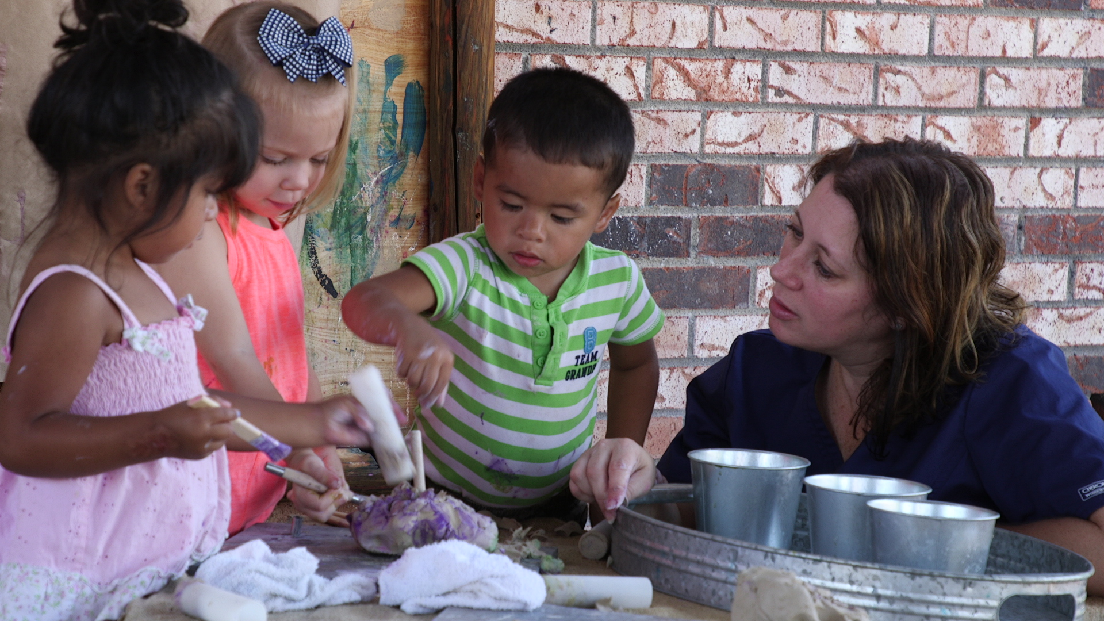
Being an Expert vs. Exploring Together
BE AN EXPERT
EXPLORE TOGETHER
“I am the expert and I need to have answers to all the questions they ask.”
“I can say, I don’t know.
Let’s find out together.”
“I am going to teach children lots of information about
this topic.”
“I listen to children’s questions
and model a questioning mind.
We explore together.”
Notes:
OPTIONAL

Slide 5
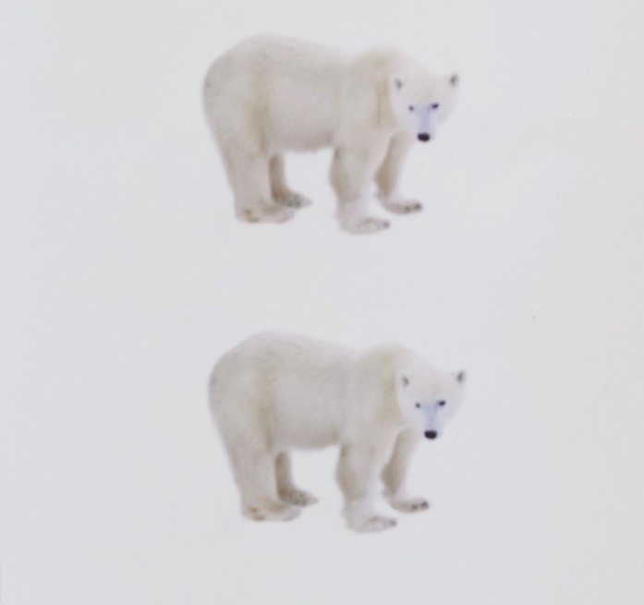
Turn a Question Into an Experiment
How do polar bears stay warm?
Notes:
OPTIONAL

Slide 6


Inquiry in Action: Blubber Experiment
Notes:
OPTIONAL

