Slide 1
HSPPS Support STEAM
Subpart C - Education and Child Development Program Services
1302.30 Purpose
A program must deliver developmentally, culturally, and linguistically appropriate learning experiences in language, literacy, mathematics, social and emotional functioning, approaches to learning, science, physical skills, and creative arts…
Notes:
OPTIONAL

Slide 2
HSPPS Support Language and Culture
Subpart C – Education and Child Development Program Services
1302.36 Tribal language preservation and revitalization
A program that serves American Indian and Alaska Native children may integrate efforts to preserve, revitalize, restore, or maintain the tribal language for these children into program services. Such language preservation and revitalization efforts may include full immersion in the tribal language for the majority of the hours of planned class operations.
Notes:
Optional Slide 2

Slide 3
HSPPS Support Language and Culture
ACF-IM-HS-15-02 Native Language Preservation, Revitalization, Restoration, and Maintenance in Head Start and Early Head Start Programs
“OHS strongly supports the full integration of AIAN languages and culture in their Head Start and Early Head Start programs, including the use of language immersion, dual language, and other proven approaches…”
Notes:
Optional Slide 4

Slide 4
The Inquiry Cycle
Observe
What do you see/hear? How do they sound/smell? How are they the same?
How are they different? What happens when you try? You seem curious about...
Predict
What do you think will happen?
What are your predictions?
Why do you think that? How could we find out?
Explore / Experiment
Let’s investigate! What do you notice? What is changing?
What did you try?
Let’s draw what we see.
Reflect
What were your predictions?
What happened?
What did you notice?
Why do you think that happened?
What could we investigate next?
Question
What are you curious about? What do you want to know? Are you wondering if…?
Notes:
Optional Slide 4

Slide 5
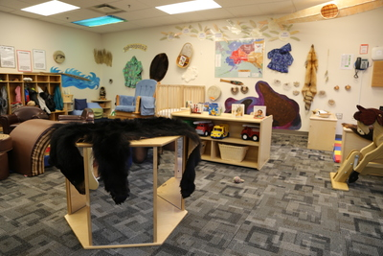
Creating A Learning Environment
To ensure that you are fully supporting children’s learning, you must understand what is valued, honored, and expected in each child’s home culture and be able to explain exactly how and what you are doing to support and take advantage of each child’s optimal ways of learning.
Notes:
Slide 24

Slide 6
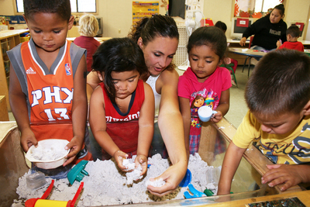
Create a Culture of Inquiry
Foster children’s curiosity and questioning.
Guide children in exploring their questions.
Be an active observer.
Talk to children and engage them in conversations.
Know when to intervene and when to stand back.
Give children time.
Engaging Social Environment
Notes:
Optional Slide 5

Slide 7

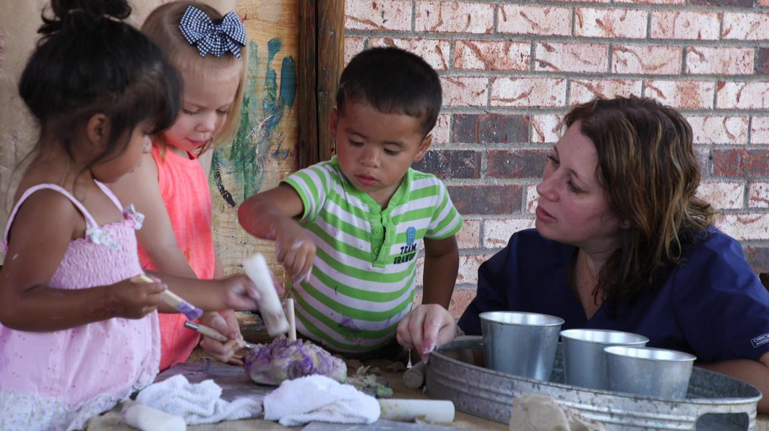

Being an Expert vs. Exploring Together
BE AN EXPERT
EXPLORE TOGETHER
“I am the expert and I need to
have answers to all the
questions they ask.”
“I can say, I don’t know. Let’s find out together.”
“I am going to teach children
lots of information about
this topic.”
“I listen to children’s questions
and model a questioning mind.
We explore together.”
Notes:
Optional Slide 6

Slide 8



Turn a Question Into an Experiment
Notes:
Slide 29

Slide 9


Inquiry in Action: Blubber Experiment
Notes:
Slide 30

