Slide 1
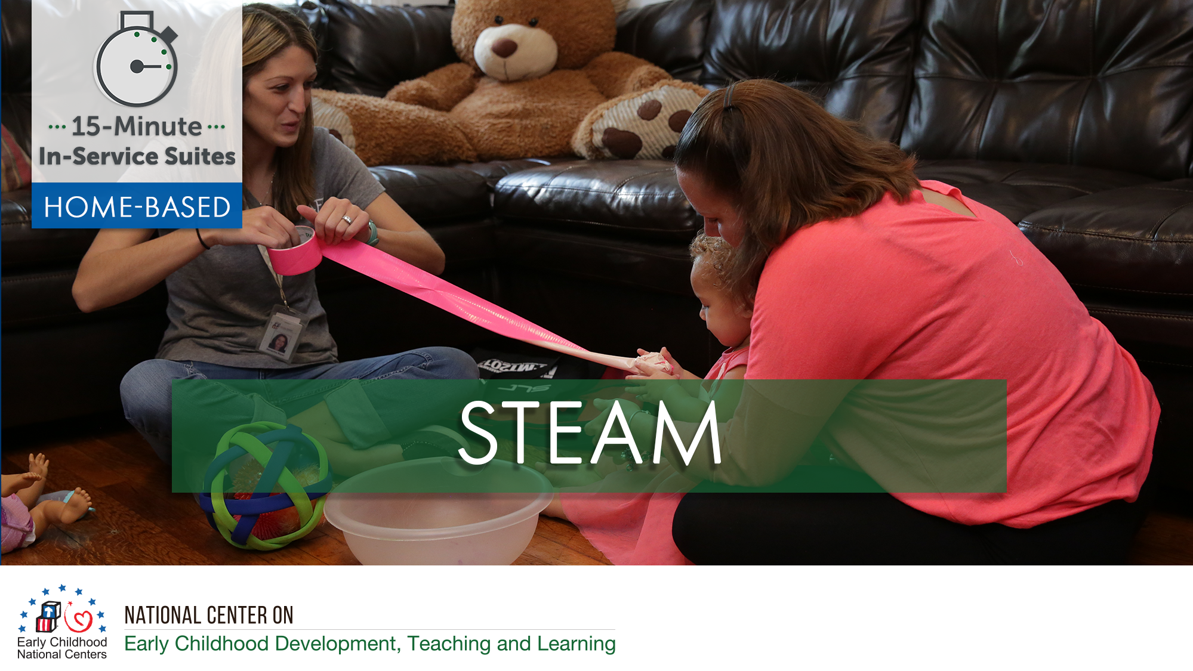

Slide 2
HSPPS Supports STEAM
Subpart C - Education and Child Development Program Services
1302.30 Purpose
All programs must provide high-quality early education and child development services, including for children with disabilities, that promote children’s cognitive, social, and emotional growth for later success in school….
Notes:
OPTIONAL

Slide 3
HSPPS Supports STEAM
Subpart C - Education and Child Development Program Services
    1302.35 Education in Home-Based Programs
    A home-based program must provide home visits and group socialization activities that promote secure parent-child relationships and help parents provide high-quality early learning experiences in language, literacy, mathematics, social and emotional functioning, approaches to learning, science, physical skills, and creative arts. A program must implement a research-based curriculum…
Notes:
OPTIONAL

Slide 4
Center-Based and Family Child Care Practices
Effective Teaching Practices
Child Development

Slide 5
Home Visiting Practices
Effective Home Visiting and Socialization Practices
Positive Parenting Practices
Child Development

Slide 6
What’s Different for a Home Visitor?
Effective Home Visiting Practices
Positive Parenting Practices
Child Development

Slide 7
Theory of Change for Home-Based
THEORY OF CHANGE FOR INFANT-TODDLER PROGRAMS
HOME-BASED AND CLASSROOM
Source: Roggman et al, 2016

Slide 8
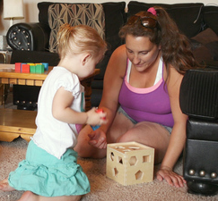
Support Parents in Learning About STEAM
Help parents understand that STEAM is about how children and adults explore the world, not which facts you know.

Slide 9
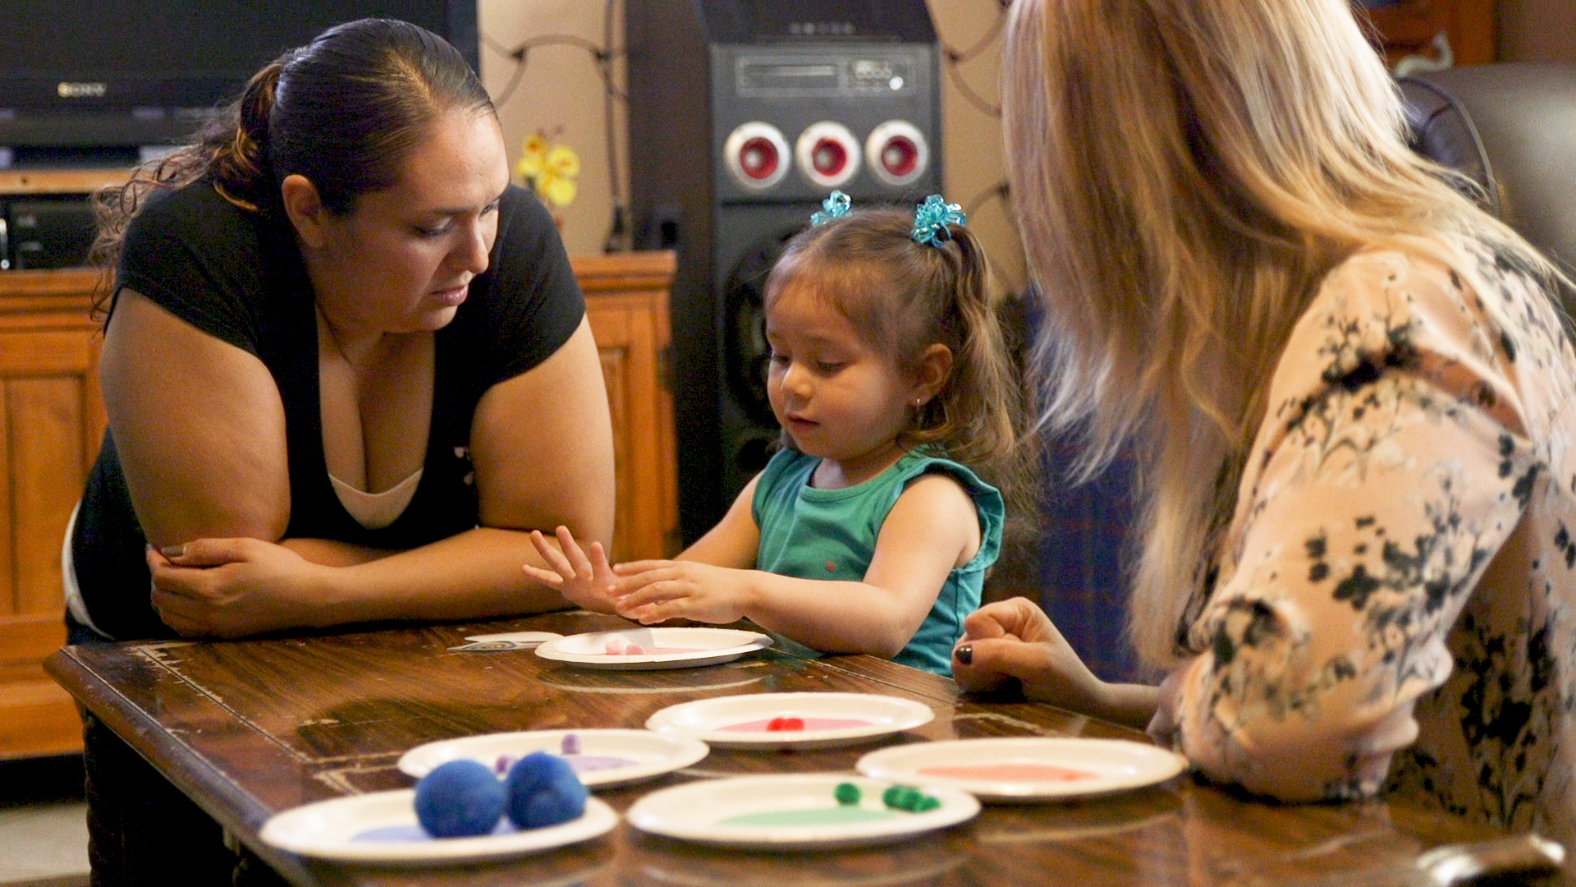
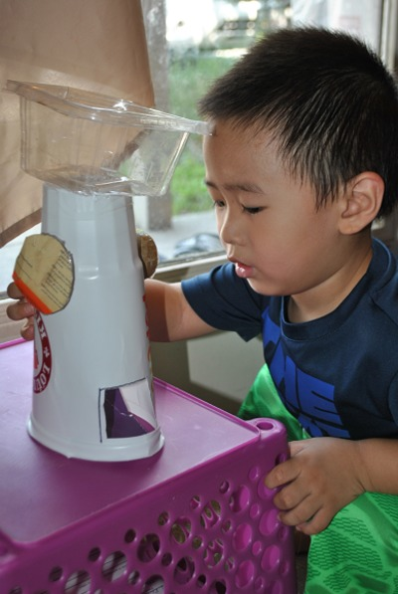
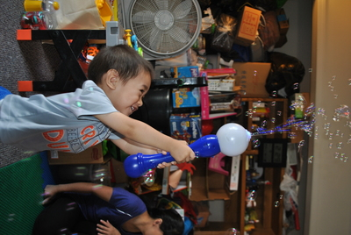
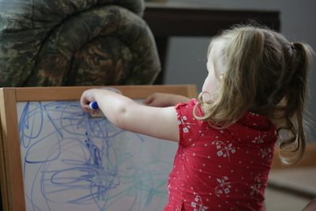
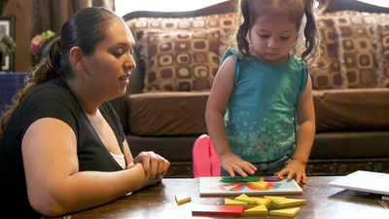
Learning Activity: STEAM is All Around
Science
Technology
Engineering
Art
Math

Slide 10
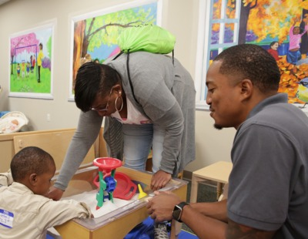
Home Visitors Can Support Families in
Building STEAM

Slide 11
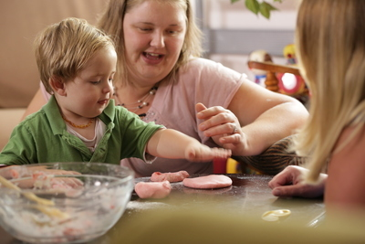
Show Parents How to
Speak the Language of STEAM
Encourage parents to introduce STEAM vocabulary as children are exploring inside and outside the home.
Share the benefits of using STEAM language with children.

Slide 12
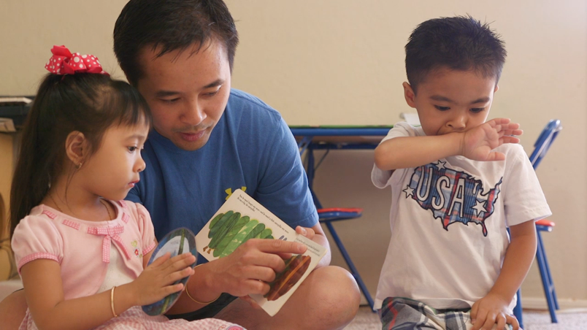

Learning Activity/Experiences

