Slide 1
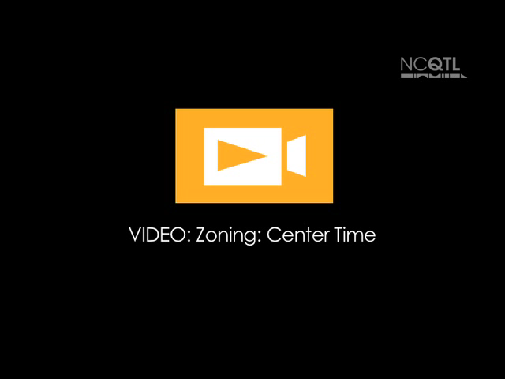
Notes:
Name of video: Zoning: Center Time
Key idea: Scanning the classroom
Summary: A teacher walks into the classroom and looks around the room. She sees a group of children and an adult in the block area and joins them, kneeling down next to the children.
Length of video: 23 seconds
Suite name: Zoning to Maximize Learning

Slide 2
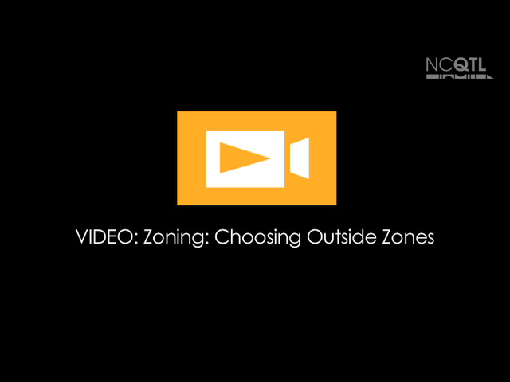
Notes:
Name of video: Zoning: Choosing Outside Zones
Key idea: Talking with staff members about choosing zones
Summary: During a transition, three teachers decide which zones to oversee during outdoor play.
Length of video: 33 seconds
Suite name: Zoning to Maximize Learning

Slide 3
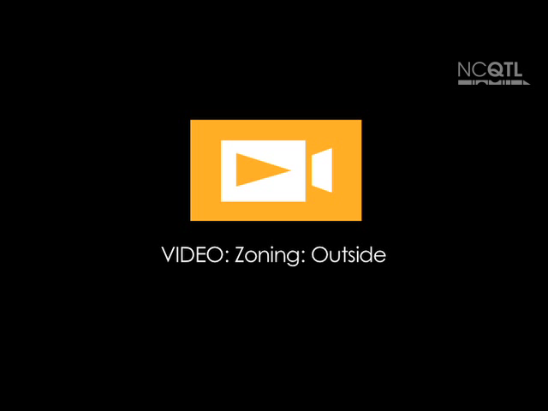
Notes:
Name of video: Zoning: Outside
Key idea: Assigning zones
Summary: A teacher assigns zones to classroom team members on the playground. She asks the last adult whether she would like to “float” or follow particular children.
Length of video: 28 seconds
Suite name: Zoning to Maximize Learning

