Slide 1
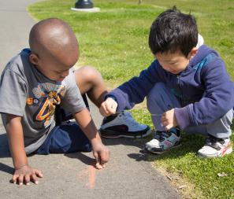
Staffing: zoning to Maximize Learning
FALL 2012

Slide 2
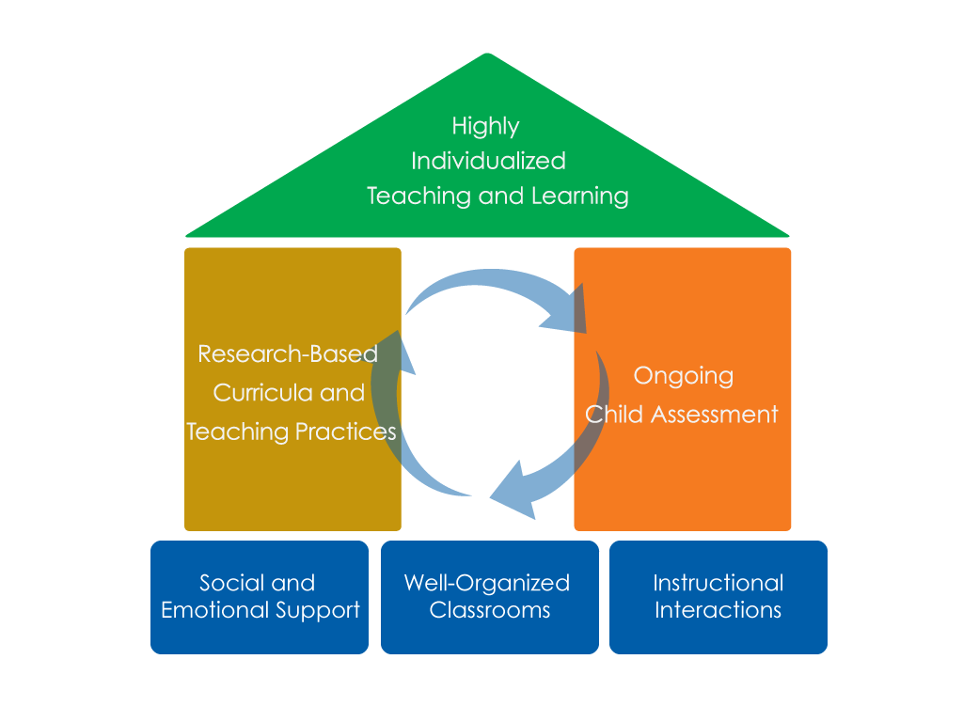
FRAMEWORK FOR EFFECTIVE PRACTICE SUPPORTING SCHOOL READINESS FOR ALL CHILDREN
FOCUS ON
FOUNDATION

Slide 3
Objectives
To understand the definition of zoning
To learn the different types of zoning
To understand the benefits of zoning in the classroom

Slide 4
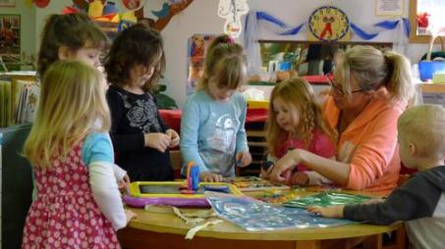
What is Zoning?
Zoning is an effective practice used to support children's active participation and engagement in the classroom.
Zoning is a tool used to organize classroom staff.

Slide 5
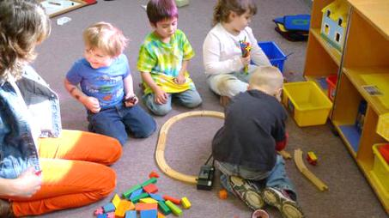
Why use Zoning?
Zoning can increase engagement behaviors.
Zoning can increase staff efficiency.
Zoning helps build confidence in preschool staff.
Zoning is flexible and can help make communication between staff members easier.
McWilliam, R.A. & Casey, A.M. (2008). Engagement of every child in the preschool classroom. Baltimore, MD: Paul H. Brookes Publishing Co.

Slide 6
Types of Zoning
Zone: Each staff member is responsible for a separate area or “zone” of the classroom
One-to-One: Staff members are responsible for staying near or “zoning” with a child who has more significant challenges.

Slide 7
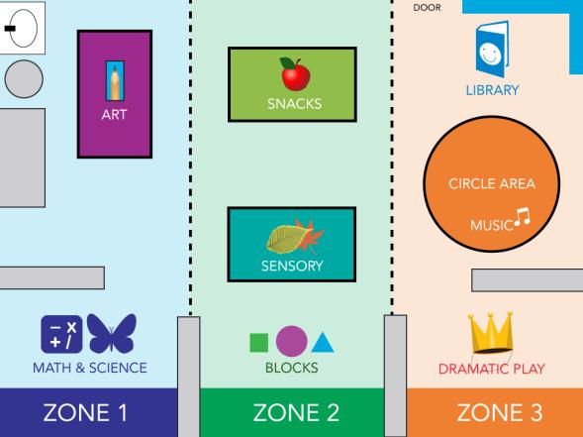
Classroom Map with Zoning Areas

Slide 8
Staff schedule
Activities/ transitions | Staff person A | Staff person B | Staff person C
Arrival | Greet children and parents | Help children put away backpacks | Get tables ready for breakfast
Breakfast | At red table | At blue table | At green table
Transition to outside | Signal transition/blow bubbles | Clean up breakfast tables | Help children to transition
Outside | At big toy | In the field | Clean and sanitize tables
Transition to classroom | Help children transition to circle time | Signal transition | Help children wash hands
Circle time | Support children at circle | Lead circle | Break
Centers | Zone 1 | Zone 2 | Zone 3
Activities/ transitions | Staff person A | Staff person B | Staff person C
Arrival | Greet children and parents | Help children put away backpacks | Get tables ready for breakfast
Breakfast | At red table | At blue table | At green table
Transition to outside | Signal transition/blow bubbles | Clean up breakfast tables | Help children to transition
Outside | At big toy | In the field | Clean and sanitize tables
Transition to classroom | Help children transition to circle time | Signal transition | Help children wash hands
Circle time | Support children at circle | Lead circle | Break
Centers | Zone 1 | Zone 2 | Zone 3
Activities/ transitions | Staff person A | Staff person B | Staff person C
Arrival | Greet children and parents | Help children put away backpacks | Get tables ready for breakfast
Breakfast | At red table | At blue table | At green table
Transition to outside | Signal transition/blow bubbles | Clean up breakfast tables | Help children to transition
Outside | At big toy | In the field | Clean and sanitize tables
Transition to classroom | Help children transition to circle time | Signal transition | Help children wash hands
Circle time | Support children at circle | Lead circle | Break
Centers | Zone 1 | Zone 2 | Zone 3

Slide 9
How to Use Zoning in the Classroom
Specify the teacher roles, zones, and responsibilities at the beginning of the week.
Make sure everyone understands their roles and zones.
Post a chart in a visible location in the classroom.

Slide 10
Video Example

Slide 11
Tips for Zoning
Position your body so you can see your whole zone.
Scan your zone and the classroom or outside area often.
Practice talking to the other teacher or teachers in the classroom as children move between areas.

Slide 12
Video example

Slide 13
Oops! Clumping

Slide 14
Classroom Map with Zoning Areas

Slide 15
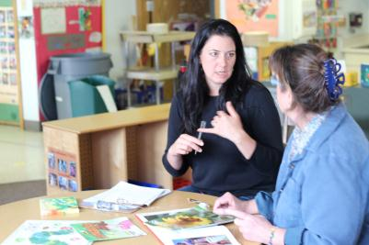
“I don’t know what to do!”
“We never know who should be doing what.”
“Who should be cleaning up?”
“Who should be setting up?”
“Who is available to take kids to the bathroom?”

Slide 16
Staff Schedule
Activities/ transitions | Staff person A | Staff person B | Staff person C
Arrival | Greet children and parents | Help children put away backpacks | Get tables ready for breakfast
Breakfast | At red table | At blue table | At green table
Transition to outside | Signal transition/blow bubbles | Clean up breakfast tables | Help children to transition
Outside | At big toy | In the field | Clean and sanitize tables
Transition to classroom | Help children transition to circle time | Signal transition | Help children wash hands
Circle time | Support children at circle | Lead circle | Break
Centers | Zone 1 | Zone 2 | Zone 3

Slide 17
REVIEW
Zoning helps to encourage child engagement and maximize learning time.
Zoning is an easy way to organize and utilize staff members.
Zoning takes the guesswork out of classroom duties.
Zoning can build staff confidence and create a sense of teamwork.

Slide 18
FALL 2012

