Slide 2
Math Stretches Across the ELOF Domains

Slide 3
Math Stretches Across the ELOF Domains
Cognition (Infant/Toddler)
Reasoning and Problem-Solving
Emergent Mathematical Thinking
Cognition/Mathematics Development (Preschooler)
Counting and Cardinality
Approaches to Learning
Cognitive Self-Regulation
Language and Communication
Communicating and Speaking

Slide 4
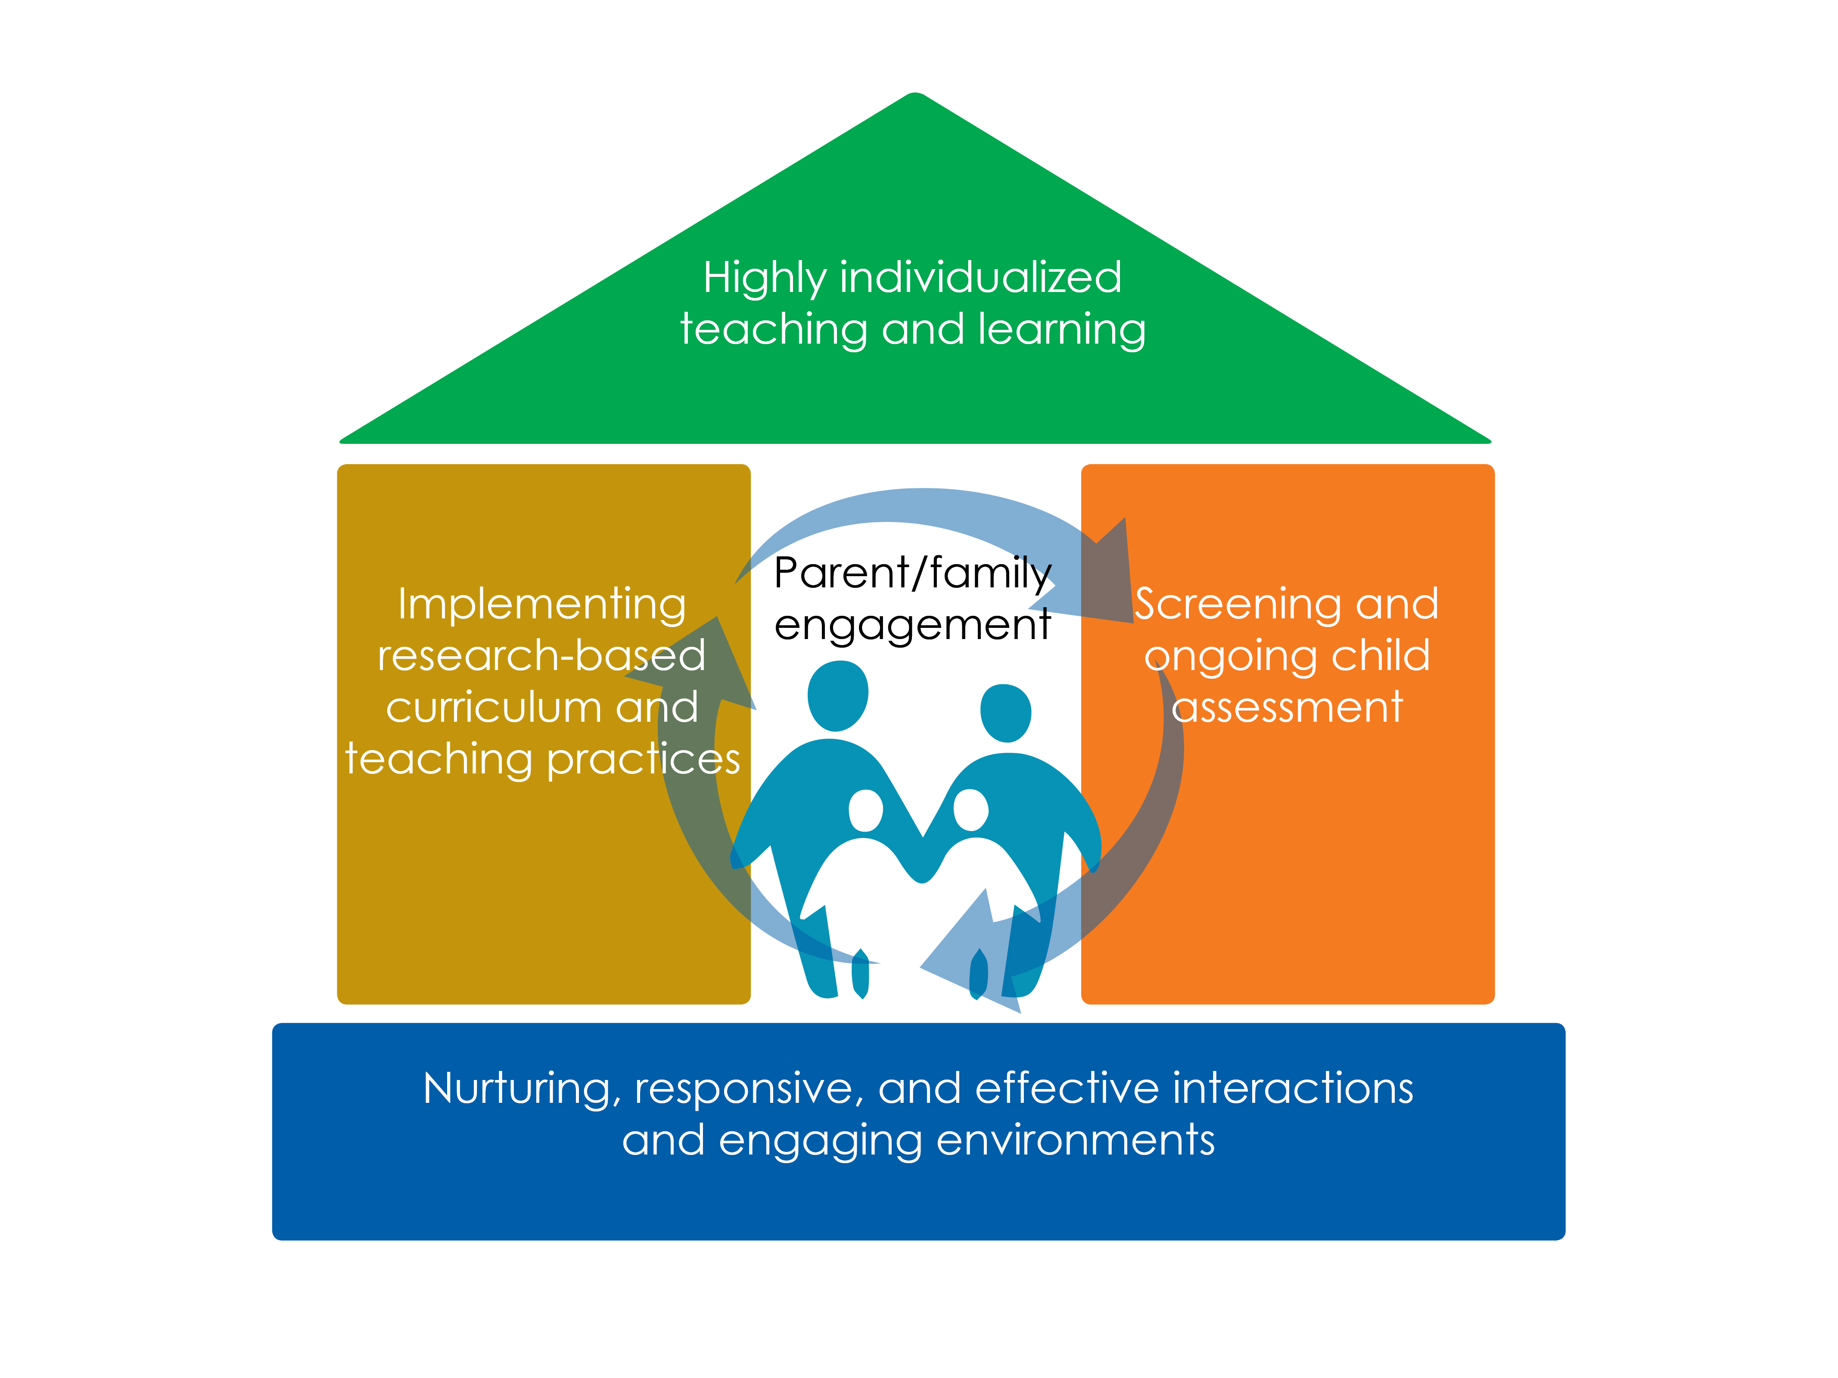

Slide 5
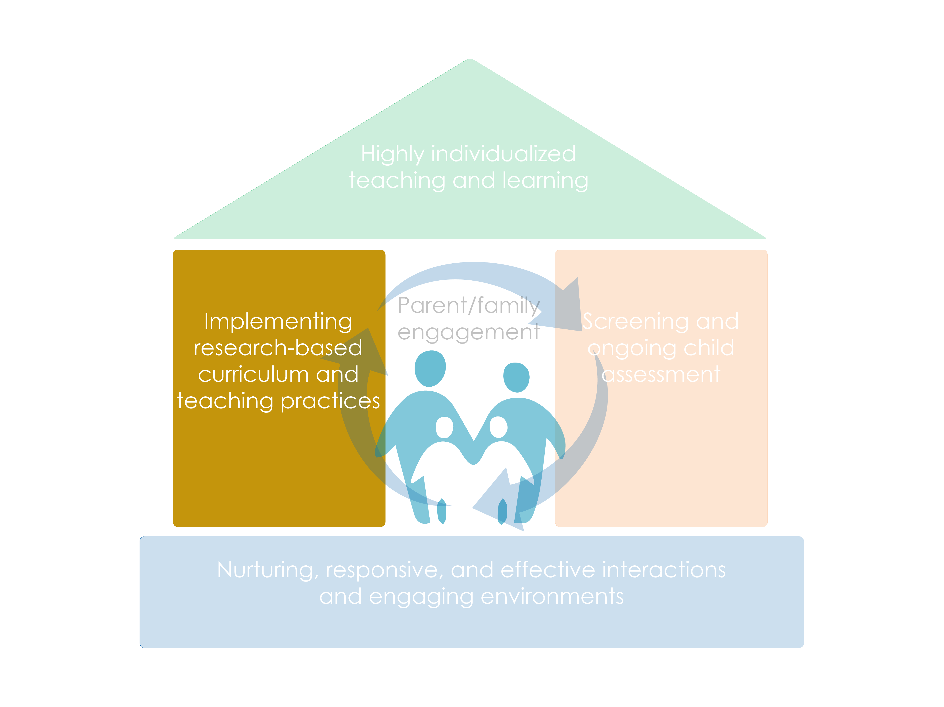

Slide 6
Session Objectives
Explain number recognition and subitizing for young children (the goal)
Identify the developmental progression for number recognition and subitizing
List ways to incorporate subitizing into in everyday educational activities, routines, and instruction

Slide 7
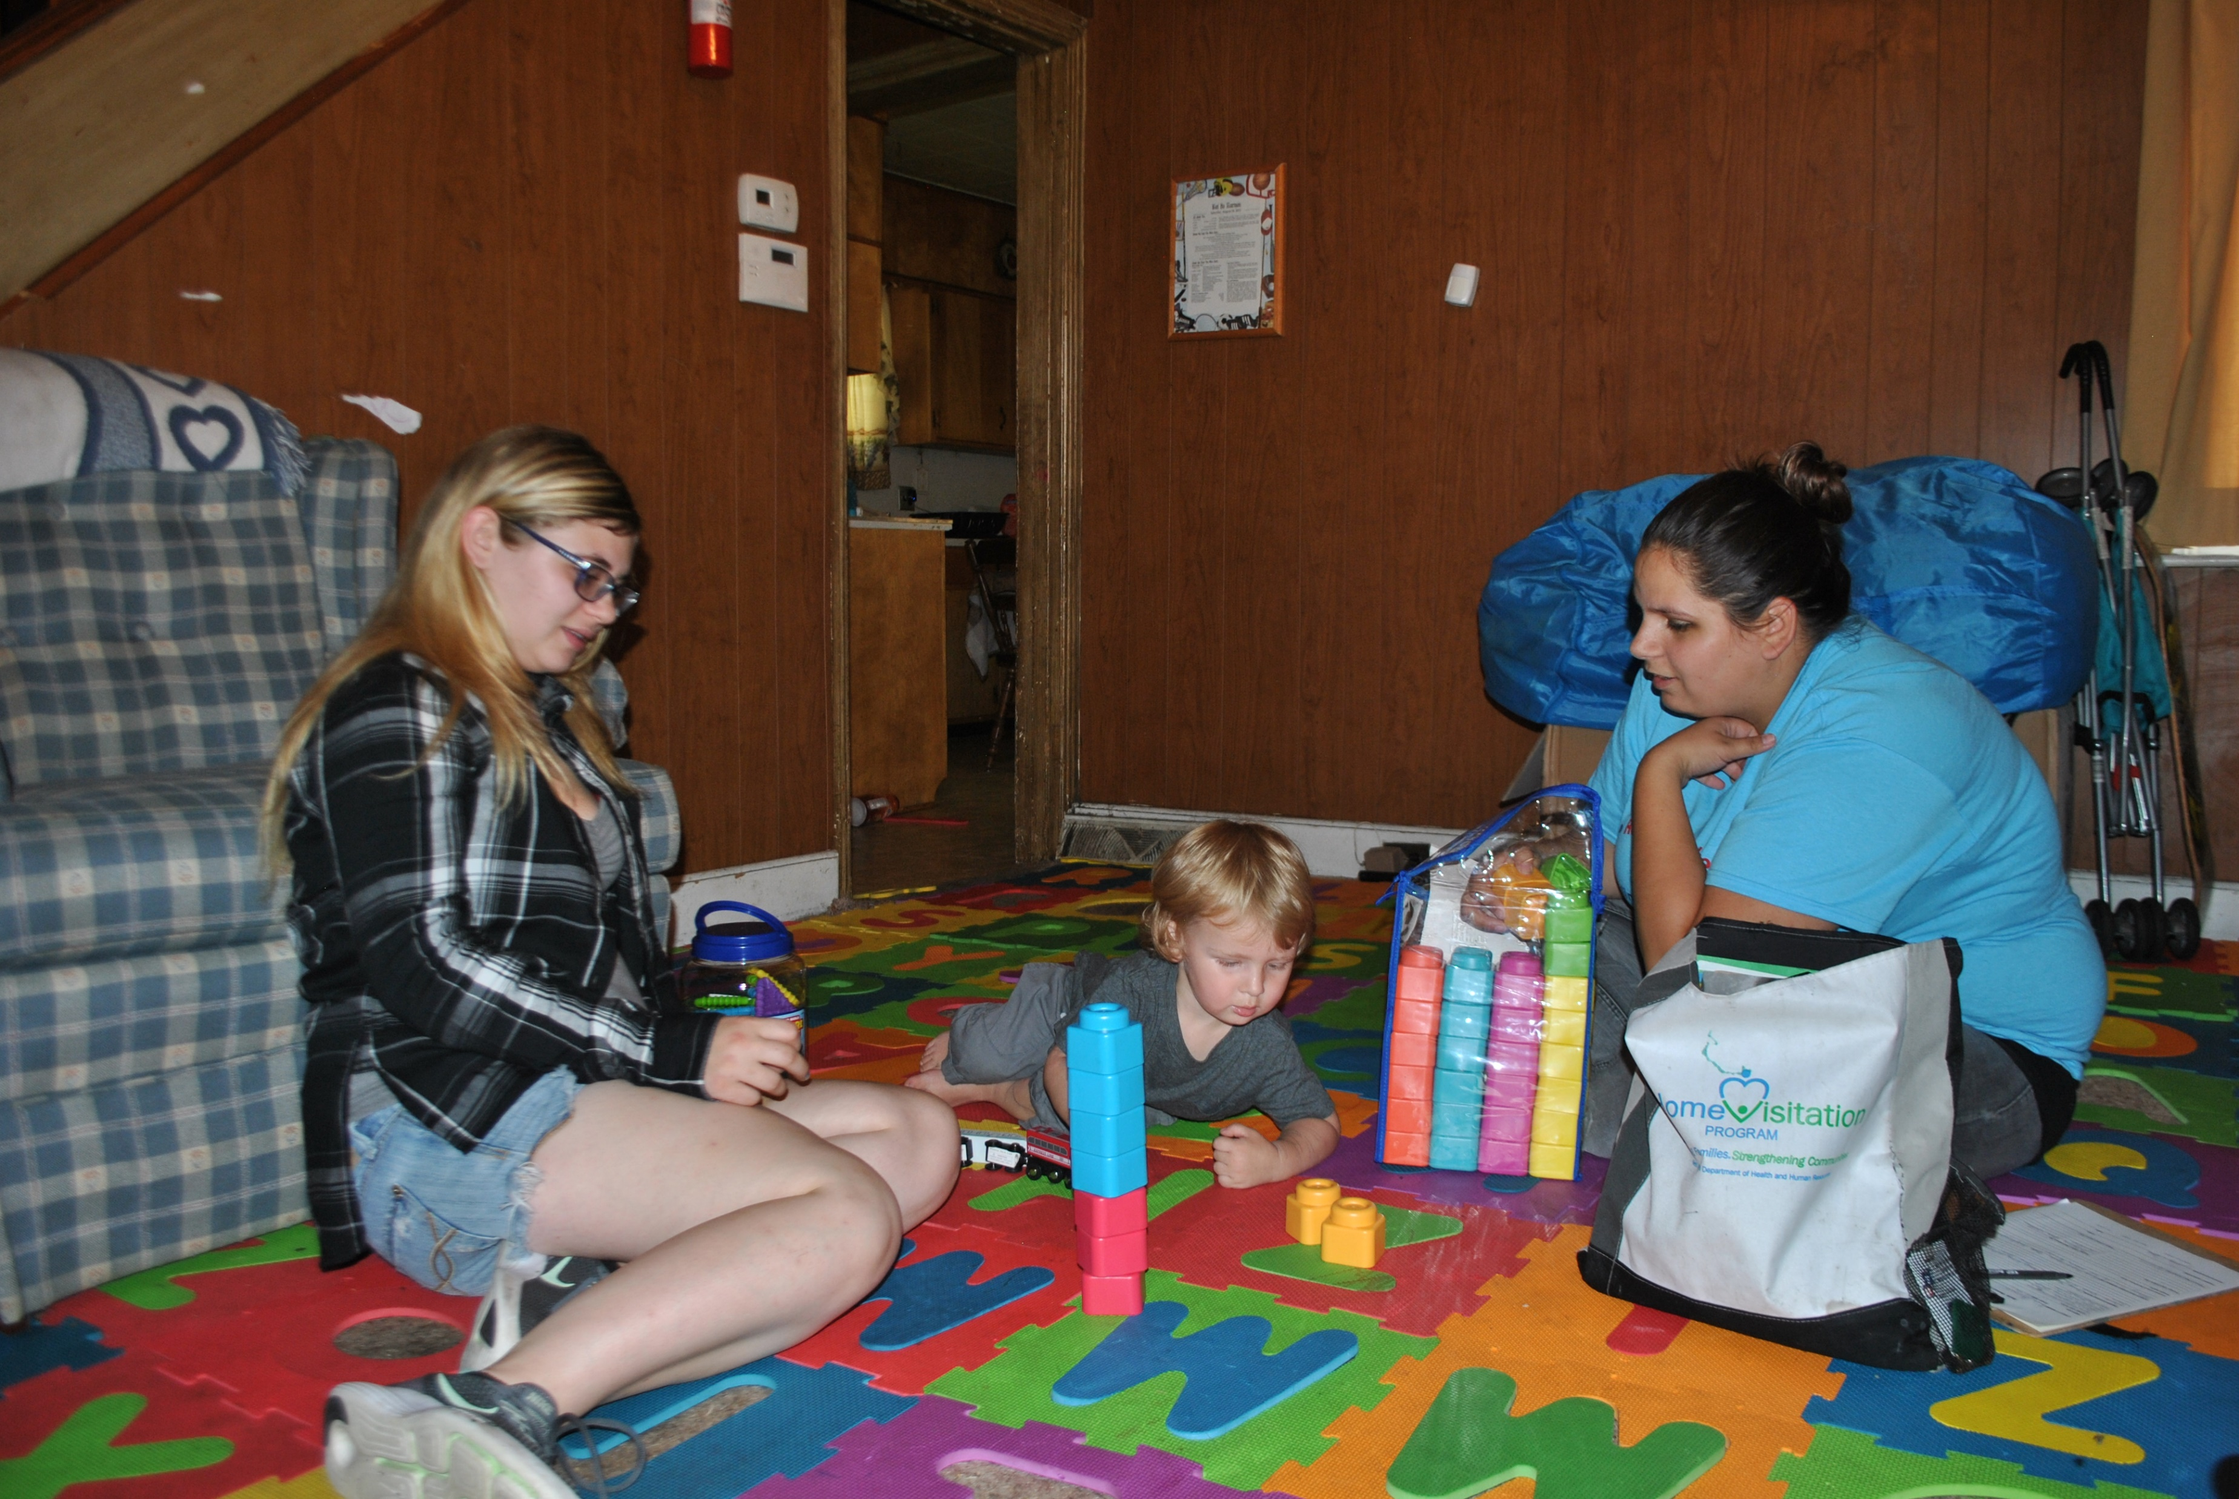
Learning Trajectory
Three Parts:
Goal
Developmental Progression
Educational Activities

Slide 8
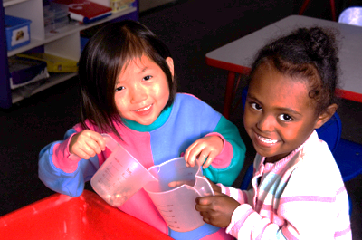
Part 1 of the Learning Trajectory
Goal
Developmental Progression
Educational Activities

Slide 9
LT Goal for Number Recognition/Subitizing
Children recognize and then subitize (recognize quickly) the number in a group without counting.
“Look! I have three blocks!”

Slide 10
Not this!
5

Slide 11
Number Recognition
Early number recognition is not (yet!) subitizing.
Subitizing is the rapid recognition of numbers without needing to count.
Children can first recognize the number in small groups, then they get better and faster and can subitize.

Slide 12
Why Is this Goal Important?
Number recognition
Builds upon the earliest developing number sense
Infants begin to notice the number of objects in a small group
Supports learning how to count
Cardinality (knowing how many you counted)
Supports learning arithmetic
Even after accounting for IQ and language

Slide 13
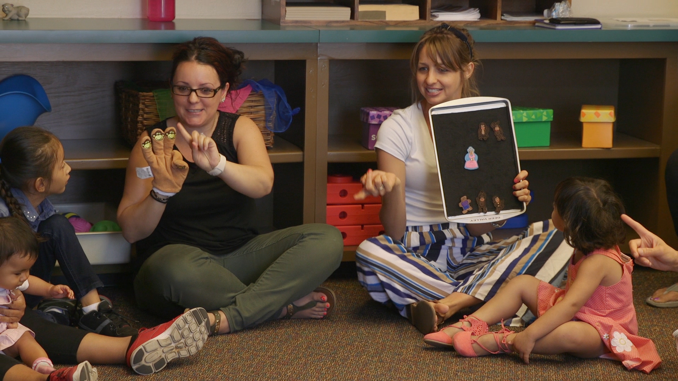
Part 2 of the Learning Trajectory
Goal
Developmental Progression
Educational Activities

Slide 14
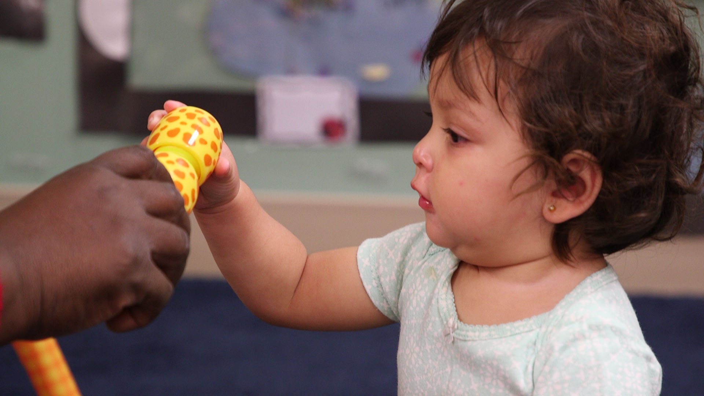
Young Children and Number
Infant competencies
“Habituation” research

Slide 15
Child getting “bored”

Slide 17
Perceptual Subitizing
What is it?
The ability to “just see” how many objects in a small collection.
Let’s actually do some perceptual subitizing.
Ready?

Slide 18
What did you see?

Slide 19
Conceptual Subitizing
What is it?
The ability to see the parts of multiple small sets and putting together the whole.
Now, let’s try some conceptual subitizing.
Ready?

Slide 20
What did you see?

Slide 21
What Did You See?
How did you know?
Think-pair-share!

Slide 22
LT Level: Foundations
Within the ﬁrst year, sensitive (dehabituates) to number, but does not have explicit knowledge of number. For infants, this begins with very small numbers (1 or 2).
Foundations

Slide 23
LT Level: Small Collection Namer
Names groups of 1 to 2, sometimes 3.
“Two doggies!”
Small Collection Namer
Pre-Explicit Number

Slide 24
LT Level: Maker of Small Collections
Makes a small collection (no more than 4, usually 1–3) with the same number as another collection or from the number word.
Maker of Small Collections
Small Collection Namer
Pre-Explicit Number

Slide 25
LT Level: Perceptual Subitizer to 4
Quickly recognizes collections up to 4 brieﬂy shown and names the number.
Perceptual Subitizer to 4
Maker of Small Collections
Small Collection Namer
Pre-Explicit Number

Slide 26
LT Level: Perceptual Subitizer to 5
Quickly recognizes collections up to 5 brieﬂy shown and names the number.
Perceptual Subitizer to 5
Perceptual Subitizer to 4
Maker of Small Collections
Small Collection Namer
Pre-Explicit Number

Slide 27
LT Level: Conceptual Subitizer to 5
Names the total in all arrangements to about 5, when shown only brieﬂy.
Conceptual Subitizer to 5
Perceptual Subitizer to 5
Perceptual Subitizer to 4
Maker of Small Collections
Small Collection Namer
Pre-Explicit Number

Slide 28
LT Level: Conceptual Subitizer to 10
Extends to 10. For the advanced!
Conceptual Subitizer to 10
Conceptual Subitizer to 5
Perceptual Subitizer to 5
Perceptual Subitizer to 4
Maker of Small Collections
Small Collection Namer
Pre-Explicit Number

Slide 29
Part 3 of the Learning Trajectory
Goal
Developmental Progression
Educational Activities

Slide 30
Math Language
When children make a math utterance, teachers:
60% of the time ignore it
only 10% of the time respond mathematically
This has important implications for children, particularly dual language learners.

Slide 31
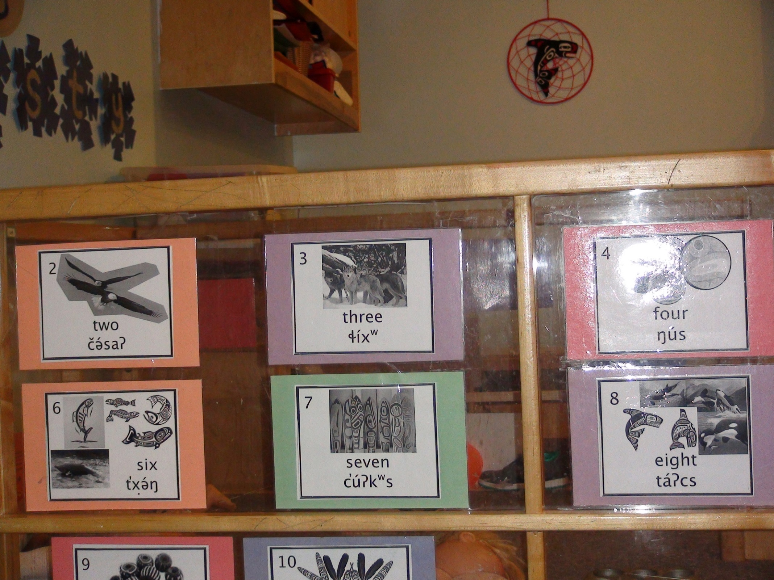
What To Do to Help Children Learn Subitizing
Simple but continuous teaching strategy
Use small numbers in everyday talk and cultural storytelling
You can make a huge difference
planned curricular experiences
spontaneous experiences

Slide 32
Support Subitizing for Children who are Dual Language Learners
Choose culturally meaningful and familiar materials
Connect math terms to child’s home language
Can the child can subitize in home or Tribal language?
Embed the child’s language in the activity.
Multiple representations
Emerging competence versus struggles with expressive vocabulary
Tiered levels of questions

Slide 33
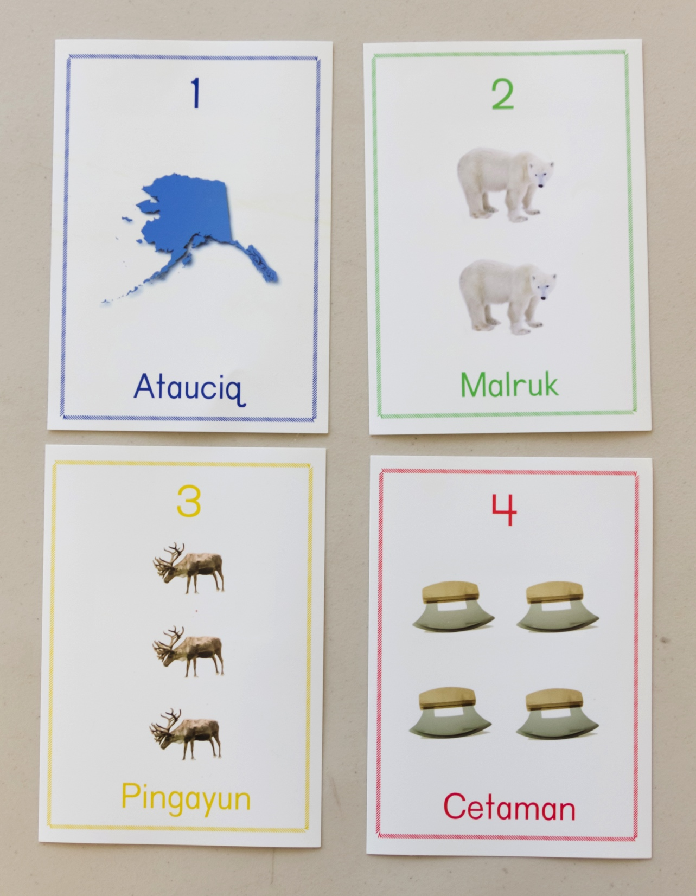
What To Do?
Quick Images or Snapshots
Show a set for 2 seconds or less, then hide it
Ask children to say how many they saw
How would you need to alter these cards to play this game?

Slide 34
Rhythmic Subitizing
Subitizing can also be rhythmic.

Slide 35
Supporting Children with Suspected Delays or Identified Disabilities
Subitizing is especially important for children with special needs.
Follow the learning trajectory with patience!
Use number names all day, naturally but intentionally.
Play a lot of dice and domino games.

Slide 36
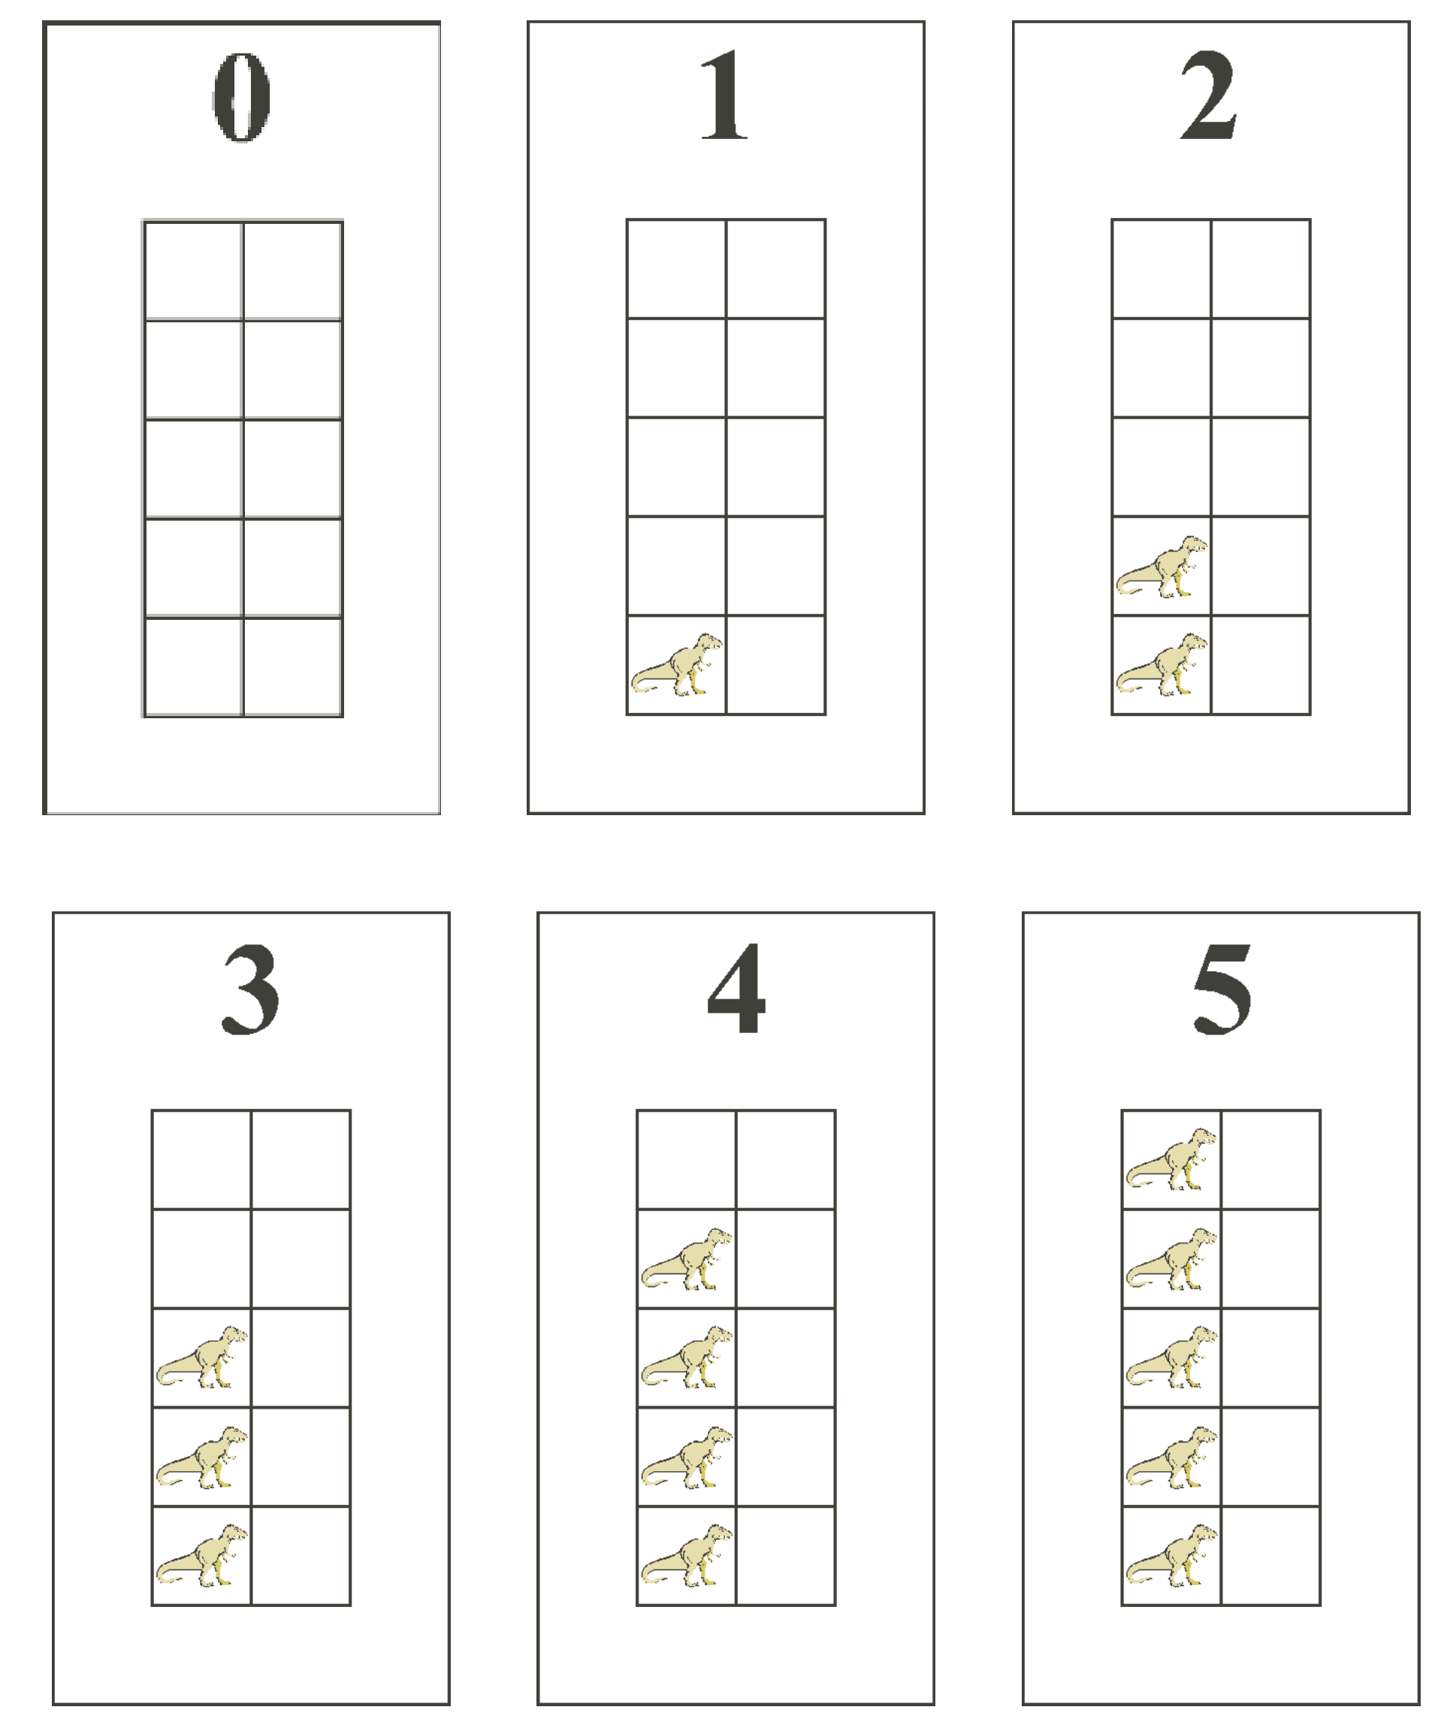
Supporting Children with Suspected Delays or Identified Disabilities
Work toward use of fives and tens frames, a powerful representation (Flexer, 1989).
For those with perceptual issues, such as visual impairment:
use manipulatives
include lots of rhythmic subitizing

Slide 37
Subitizing
“Subitizing is a fundamental skill in the development of [children’s] understanding of number.” (Baroody, 1987)

Slide 38
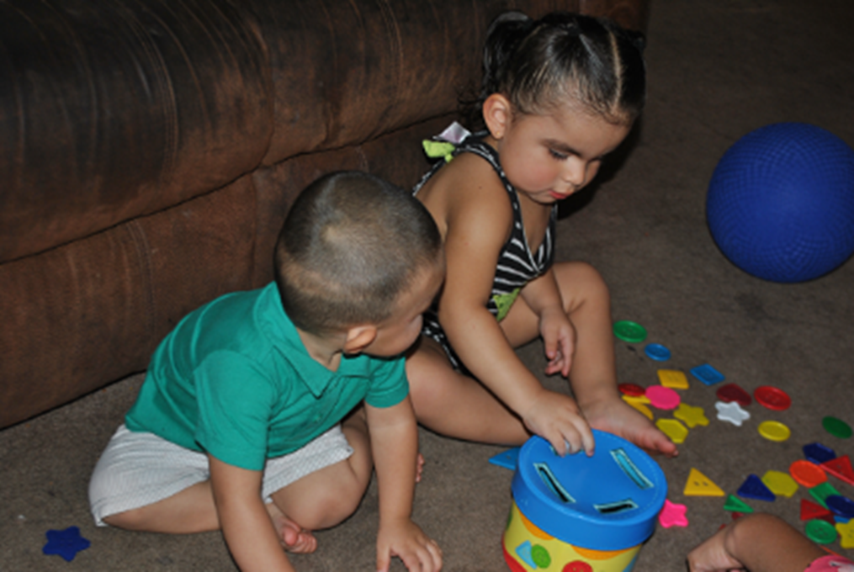
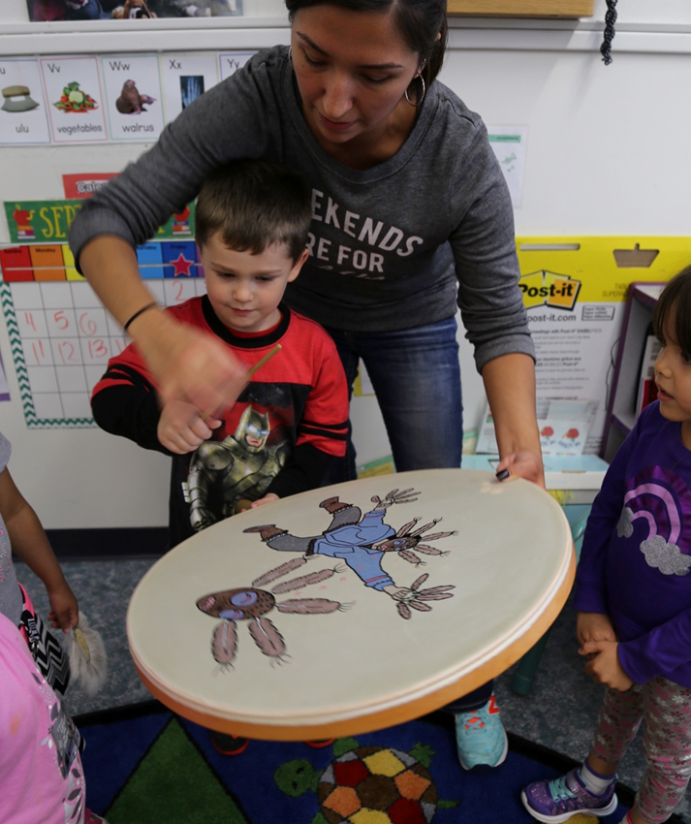
Review

