Slide 1
HSPPS Support Math
Subpart C - Education and Child Development Program Services
1302.30 Purpose
A program must deliver developmentally, culturally, and linguistically appropriate learning experiences in language, literacy, mathematics, social and emotional functioning, approaches to learning, science, physical skills, and creative arts…
Notes:
OPTIONAL

Slide 2
HSPPS Support Language and Culture
Subpart C – Education and Child Development Program Services
1302.36 Tribal language preservation and revitalization
A program that serves American Indian and Alaska Native children may integrate efforts to preserve, revitalize, restore, or maintain the tribal language for these children into program services. Such language preservation and revitalization efforts may include full immersion in the tribal language for the majority of the hours of planned class operations.
Notes:
Optional Slide 2

Slide 3
HSPPS Supports Language and Culture
ACF-IM-HS-15-02 Native Language Preservation, Revitalization, Restoration, and Maintenance in Head Start and Early Head Start Programs
“OHS strongly supports the full integration of AIAN languages and culture in their Head Start and Early Head Start programs, including the use of language immersion, dual language, and other proven approaches…”
Notes:
Optional Slide 4

Slide 4
HSPPS Support Math
Subpart C - Education and Child Development Program Services
1302.31 Teaching and the Learning Environment
A center-based and family child care program must ensure teachers and other relevant staff provide responsive care, effective teaching, and an organized learning environment that promotes healthy development and children’s skill growth aligned with the Head Start Early Learning Outcomes Framework: Ages Birth to Five, including for children with disabilities….
Notes:
OPTIONAL

Slide 5
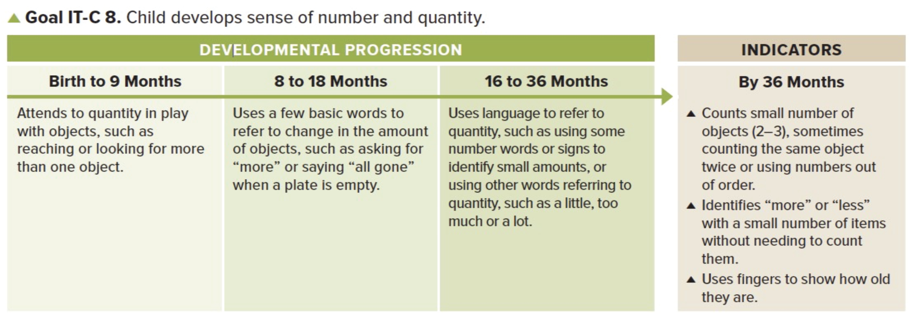
Sensitive to numbers small
and large.
Some use “two”….
Notes:
For each ELOF slide, start by briefly discussing the boxed text. Then move to the presenter notes, in synchrony with clicking to prompt each note. That is: one click/one note on screen/one paragraph to present.
[Click]
Goal IT-C 8. Child develops sense of number and quantity.
[Click]
Let us add that children are sensitive to numbers and can intuitively compare numbers both small and large (if one group is a lot more numerous than the other) in their first year of life.
[Click]
Some children learn their first number words by 18 months. They usually learn “two” first.
They can recognize very small numbers without counting…

Slide 6
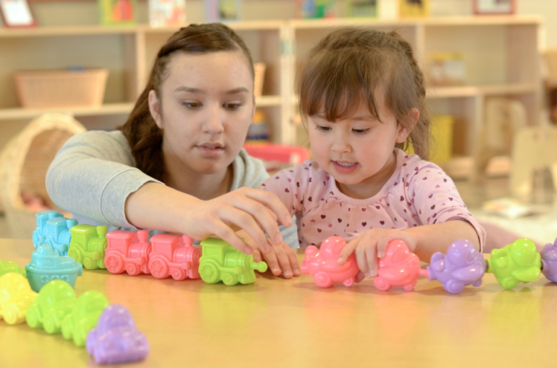
Notes:
Here is where the ELOF first presents recognition and number and subitizing. However, the foundations for this ability actually begins much sooner.
Also, it is important that we distinguish between a developmental progression and a learning trajectory—which includes a developmental progression at its core, but also includes the goal and linked instructional activities.
Let’s now turn to describing number recognition and subitizing through the lens of a development progression and then through the lens of the complete learning trajectory.

Slide 7
LT^{2:} Foundation
LearningTrajectories.org
Example…click here.
Notes:
Supplemental Video Slide
Use the link in the 2nd bullet to see a video example (click on here). Read and discuss the text around the video.
If there is time, show other videos of children at that level at LearningTrajectories.org (click on LearningTrajectories.org).
Important note: Do not show the actual URL in the link or share it with anyone. It should not be downloaded or disseminated in any form to maintain privacy agreements.

Slide 8
LT²: Small Collection Namer
LearningTrajectories.org
Example…click here.
Notes:
Supplemental Video Slide
Use the link in the 2nd bullet to see a video example (click on here). Read and discuss the text around the video.
If there is time, show other videos of children at that level at LearningTrajectories.org (click on LearningTrajectories.org).
Important note: Do not show the actual URL in the link or share it with anyone. It should not be downloaded or disseminated in any form to maintain privacy agreements.

Slide 9
LT²: Maker of Small Collections
LearningTrajectories.org
Example…click here.
Notes:
Supplemental Video Slide
Use the link in the 2nd bullet to see a video example (click on here). Read and discuss the text around the video.
If there is time, show other videos of children at that level at LearningTrajectories.org (click on LearningTrajectories.org).
Important note: Do not show the actual URL in the link or share it with anyone. It should not be downloaded or disseminated in any form to maintain privacy agreements.

Slide 10
LT²: Perceptual Subitizer to 4
LearningTrajectories.org
Example…click here.
Notes:
Supplemental Video Slide
Use the link in the 2nd bullet to see a video example (click on here). Read and discuss the text around the video.
If there is time, show other videos of children at that level at LearningTrajectories.org (click on LearningTrajectories.org).
Important note: Do not show the actual URL in the link or share it with anyone. It should not be downloaded or disseminated in any form to maintain privacy agreements.

Slide 11
LT²: Perceptual Subitizer to 5
LearningTrajectories.org
Example…click here.
Notes:
Supplemental Video Slide (to be placed after slide 25)
Use the link in the 2nd bullet to see a video example (click on here). Read and discuss the text around the video.
If there is time, show other videos of children at that level at LearningTrajectories.org (click on LearningTrajectories.org).
Important note: Do not show the actual URL in the link or share it with anyone. It should not be downloaded or disseminated in any form to maintain privacy agreements.

Slide 12
LT²: Conceptual Subitizer to 5
LearningTrajectories.org
Example…click here.
Notes:
Supplemental Video Slide
Use the link in the 2nd bullet to see a video example (click on here). Read and discuss the text around the video.
If there is time, show other videos of children at that level at LearningTrajectories.org (click on LearningTrajectories.org).
Important note: Do not show the actual URL in the link or share it with anyone. It should not be downloaded or disseminated in any form to maintain privacy agreements.

Slide 13
LT²: Conceptual Subitizer to 10
LearningTrajectories.org
Example…click here.
Notes:
Supplemental Video Slide
Use the link in the 2nd bullet to see a video example (click on here). Read and discuss the text around the video.
If there is time, show other videos of children at that level at LearningTrajectories.org (click on LearningTrajectories.org).
Important note: Do not show the actual URL in the link or share it with anyone. It should not be downloaded or disseminated in any form to maintain privacy agreements.

Slide 14
Creating A Learning Environment
To ensure that you are fully supporting children’s learning, early childhood staff must understand what is valued, honored, and expected in each child’s home culture and be able to explain exactly how and what they are doing to support and take advantage of each child’s optimal ways of learning.

Slide 15
LT²: Learning and Teaching with Learning Trajectories
See the Learning and Teaching with Learning Trajectories website for more trajectories, videos, and instructional math activities!
LearningTrajectories.org

