Slide 1
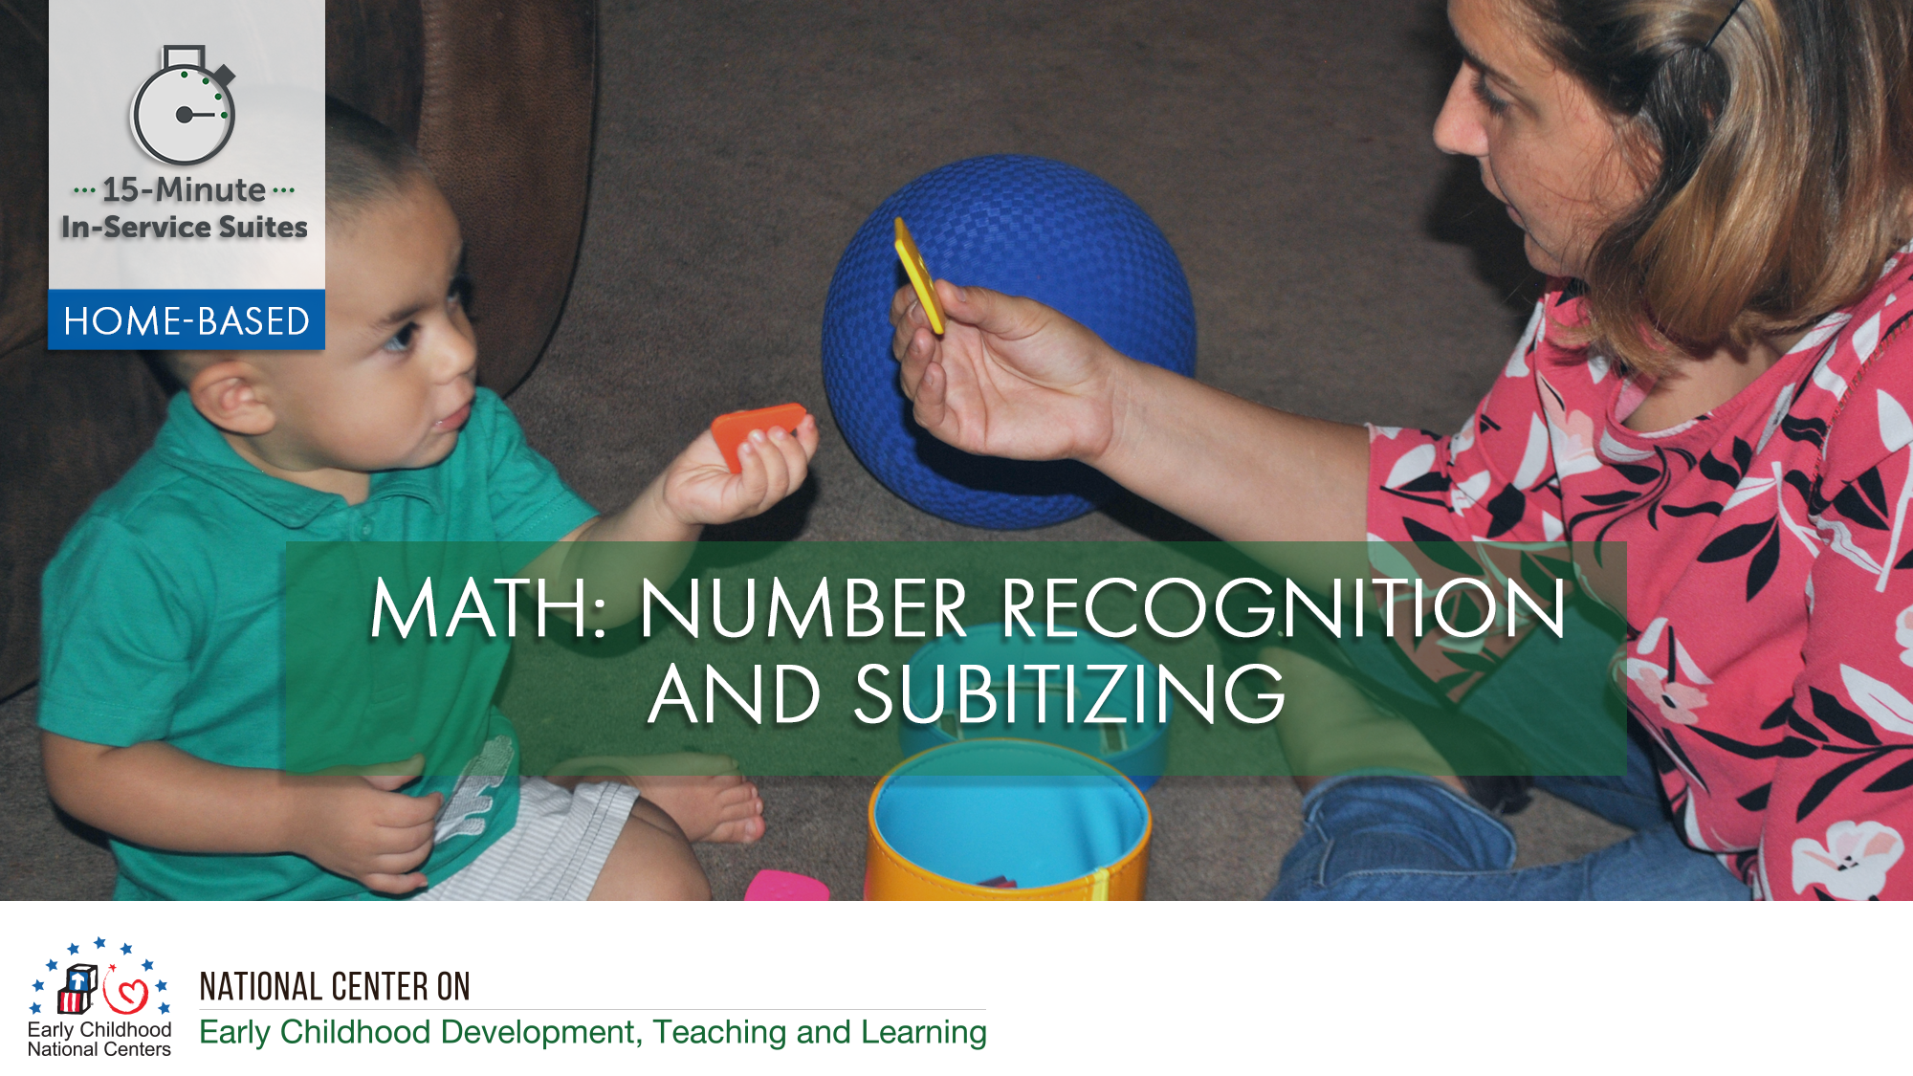
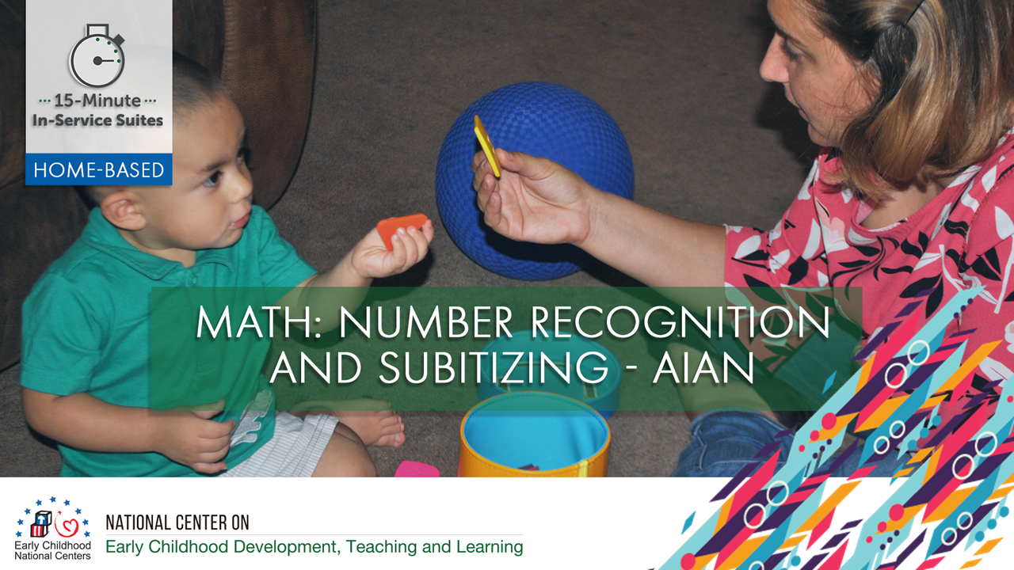
Notes:
Optional Slide 1
Opening Slide for HB

Slide 2
HSPPS Support Math
Subpart C – Education and Child Development Program Services
1302.30 Purpose
A program must deliver developmentally, culturally, and linguistically appropriate learning experiences in language, literacy, mathematics, social and emotional functioning, approaches to learning, science, physical skills, and creative arts.
Notes:
Optional Slide 2

Slide 3
HSPPS Support Language and Culture
Subpart C – Education and Child Development Program Services
1302.36 Tribal language preservation and revitalization
A program that serves American Indian and Alaska Native children may integrate efforts to preserve, revitalize, restore, or maintain the tribal language for these children into program services. Such language preservation and revitalization efforts may include full immersion in the tribal language for the majority of the hours of planned class operations.
Notes:
Optional Slide 2

Slide 4
HSPPS Support Language and Culture
ACF-IM-HS-15-02 Native Language Preservation, Revitalization, Restoration, and Maintenance in Head Start and Early Head Start Programs
“OHS strongly supports the full integration of AIAN languages and culture in their Head Start and Early Head Start programs, including the use of language immersion, dual language, and other proven approaches…”
Notes:
Optional Slide 4

Slide 5
HSPPS Support Math
Subpart C - Education and Child Development Program Services
    1302.35 Education in Home-Based Programs
    A home-based program must provide home visits and group socialization activities that promote secure parent-child relationships and help parents provide high-quality early learning experiences in language, literacy, mathematics, social and emotional functioning, approaches to learning, science, physical skills, and creative arts. A program must implement a research-based curriculum…
Notes:
Optional Slide 5

Slide 6
Center-Based and Family Child Care Practices
Effective Teaching Practices
Child Development
Notes:
Optional Slide 6

Slide 7
Home Visiting Practices
Effective Home Visiting and Socialization Practices
Positive Parenting Practices
Child Development
Notes:
Optional Slide 7

Slide 8
What’s Different for a Home Visitor?
Effective Home Visiting Practices
Positive Parenting Practices
Child Development
Notes:
Optional Slide 8

Slide 9
Theory of Change for Home-Based
THEORY OF CHANGE FOR INFANT-TODDLER PROGRAMS
HOME-BASED AND CLASSROOM
Source: Roggman et al, 2016
Notes:
Optional Slide 9

Slide 10
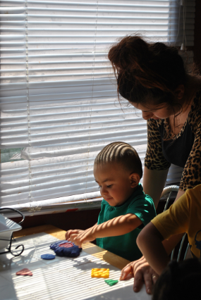
Support Parents in Speaking Math
Encourage parents to use math language as children are exploring inside and outside the home in the following ways:
  Explore materials around the house that can be used to recognize numbers and subitize
  Sing counting songs and nursery rhymes
  Use subitizing vocabulary
  Play “guess how many” games and games using dice
  Use hand drum to count beats
  Count and subitize while eating berries, etc.
Notes:
Optional Slide 10

Slide 11
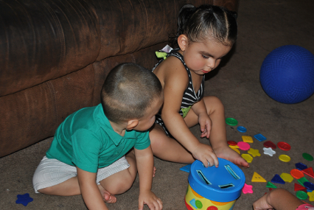
Home Visitors Can Support Children's Subitizing
Notes:
Optional Slide 11

