Slide 1
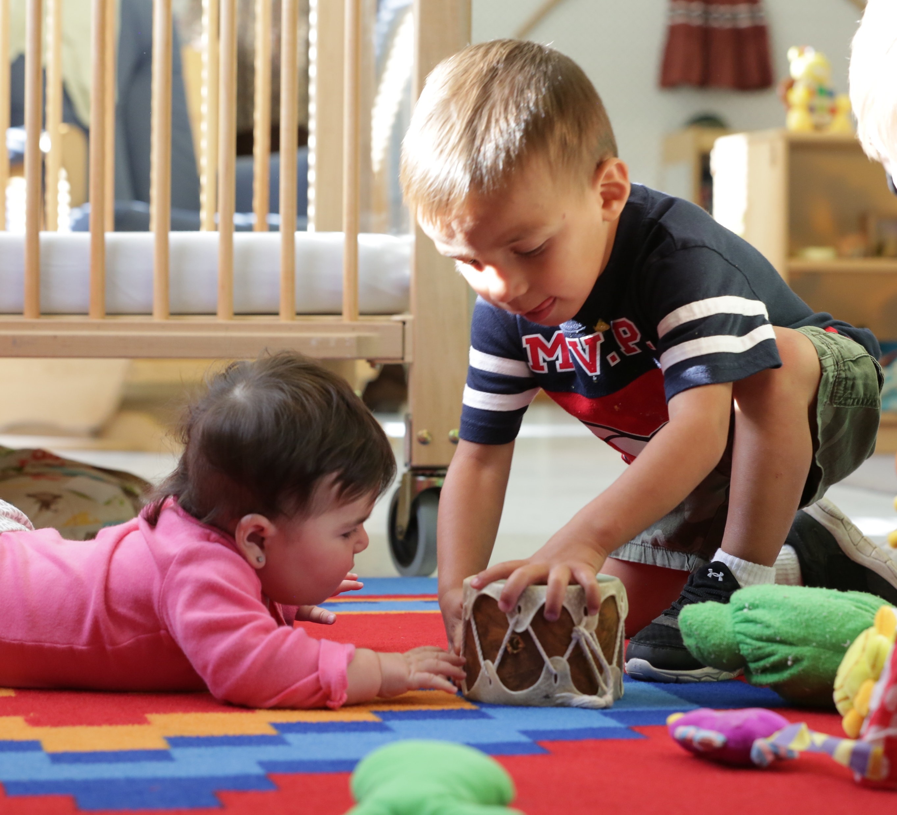
MATH: NUMBER RECOGNITION AND SUBITIZING

Slide 2
Every Individual is Rooted in Culture
Notes:
Slide 2
Graphic is from Multicultural Principles https://eclkc.ohs.acf.hhs.gov/sites/default/files/pdf/multicultural-principles-learning-extensions-principle-01.pdf

Slide 3
Two-Eyed Seeing
“Two-Eyed Seeing asks us to see our strengths, the best in our ways of knowing, while also asking us to respect and celebrate our differences. Two-Eyed Seeing acknowledges the necessity of formal structure yet that it must be preamble to and receptive of new understandings and opportunities, i.e., understandings associated with ‘Spirit of the East’ which brings the ‘gift of newness, of transformation.’”

Slide 4
Math Stretches Across the ELOF Domains

Slide 5
Math Stretches Across the ELOF Domains
Cognition (Infant/Toddler)
Reasoning and Problem-Solving
Emergent Mathematical Thinking
Cognition/Mathematics Development (Preschooler)
Counting and Cardinality
Approaches to Learning
Cognitive Self-Regulation
Language and Communication
Communicating and Speaking

Slide 6
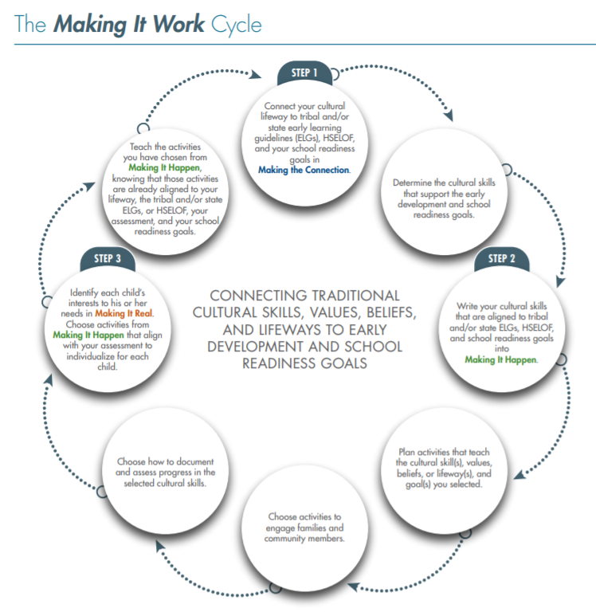
Making It Work
We were always trying to integrate culture into the curriculum—the science domain, the math domain, etc. Then we realized that culture should be at the base, serving as the foundation, the building block for curriculum development. It was an amazing paradigm shift! We are now making huge gains in integrating language and culture into our early childhood programming.
—The Red Cliff Early Childhood Center

Slide 7
Language and Culture Matter
Without language, the canoe, paddle, water, seat, the birds you hear are different than what our ancestors experienced. If you know the language, then you know what our ancestors heard, saw, felt, and experienced.
—Zalmai “Zeke” Zahir, University of Oregon

Slide 8
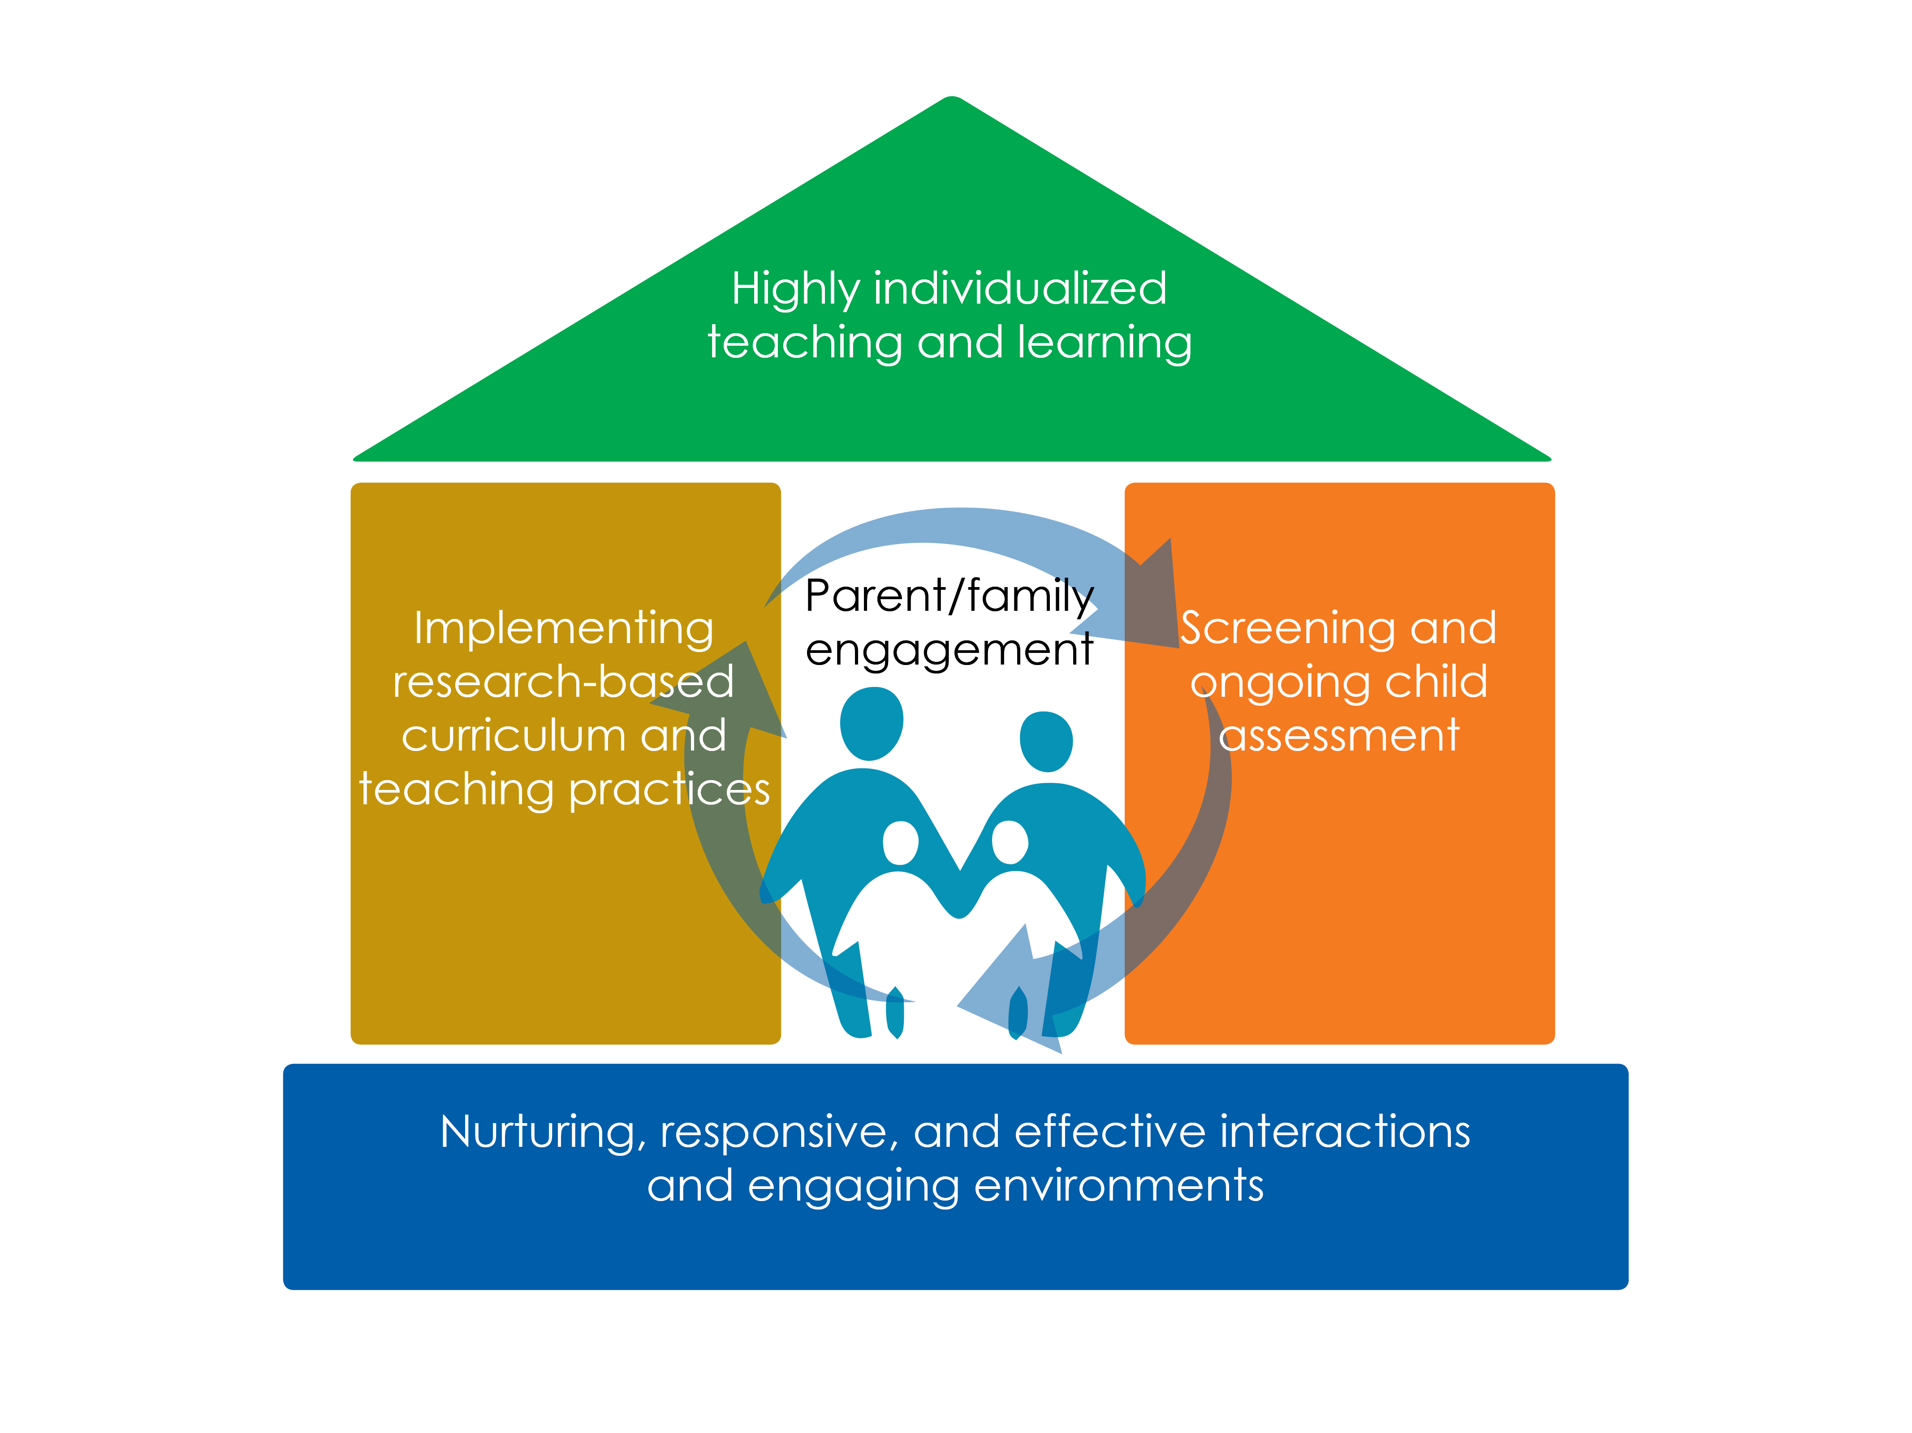

Slide 9
Parent, Family, and Community Engagement
Culturally and linguistically responsive environments can only be created by engaging and partnering with families, Elders, and the community. Establishing a partnership with families and the community is crucial for children’s learning and later success in life.

Slide 10
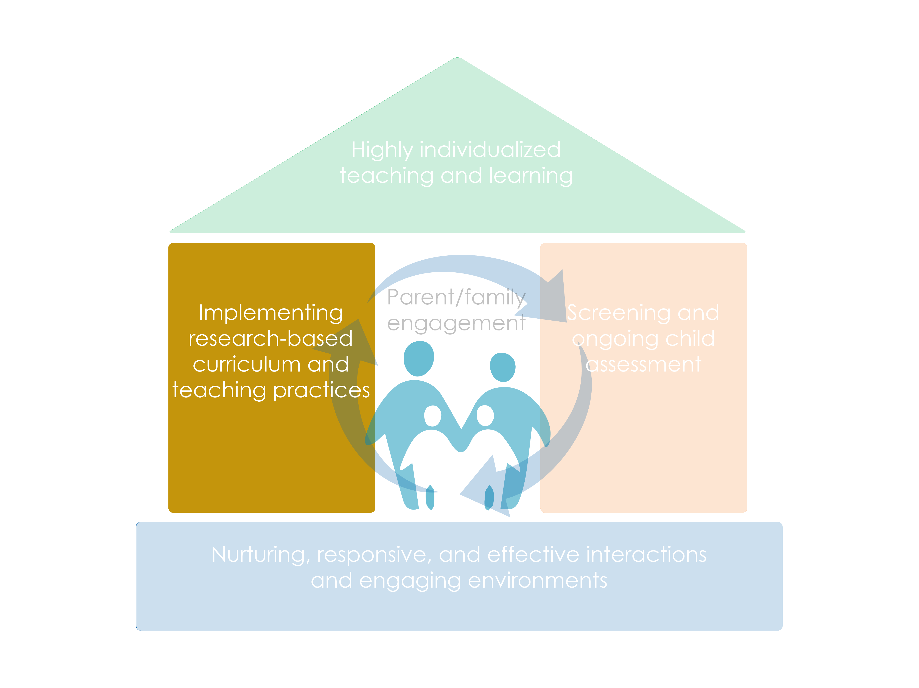

Slide 11
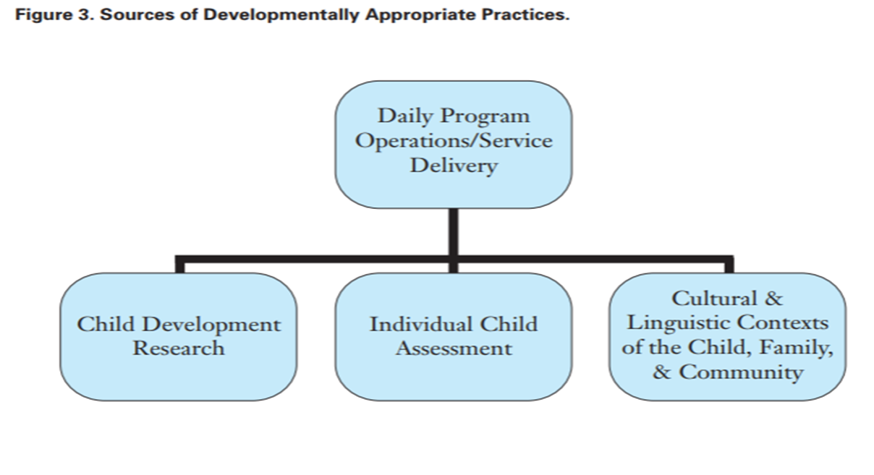
Culturally and Linguistic Responsive Practices
Sources of Developmentally Appropriate Practices

Slide 12
Session Objectives
Explain number recognition and subitizing for young children (the goal)
Identify the developmental progression for number recognition and subitizing
List ways to incorporate subitizing into in everyday educational activities, routines, and instruction
Use the Steps and Introduction to Making It Work Guide to integrate culture and language in lesson plans for math skills

Slide 13
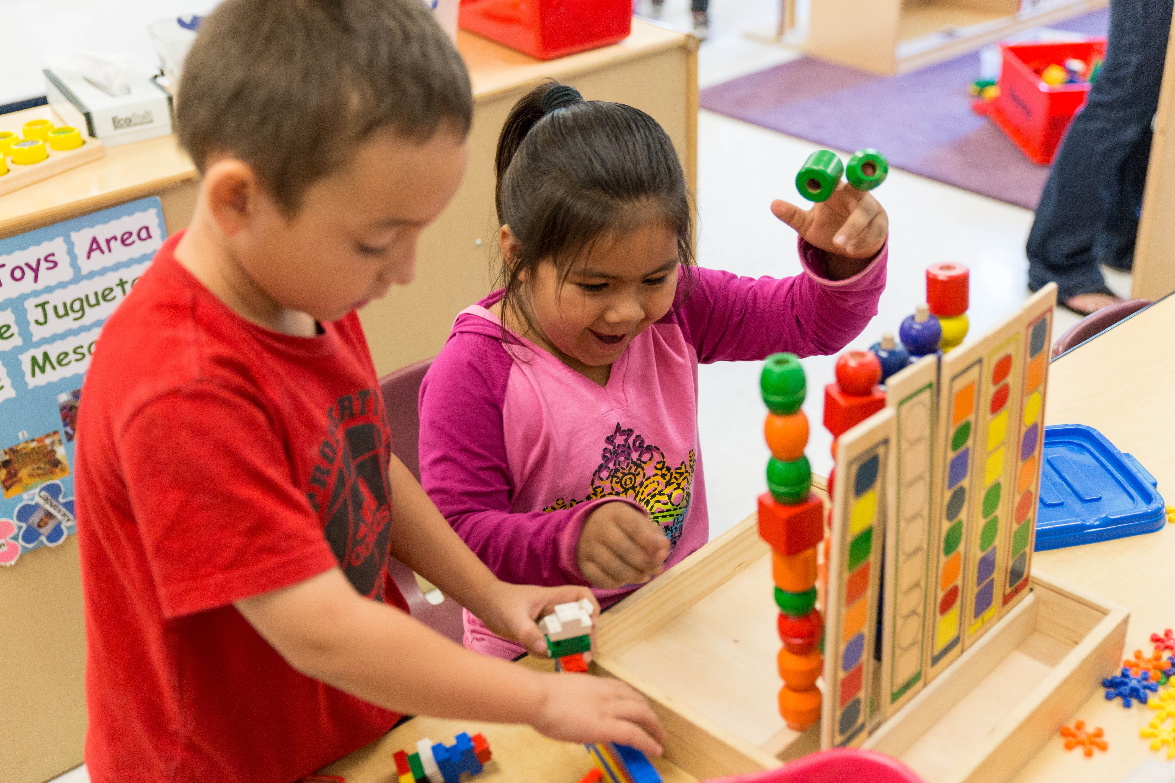
Subitizing
“Subitizing is a fundamental skill in the development of [children’s] understanding of number.” (Baroody, 1987)

Slide 14
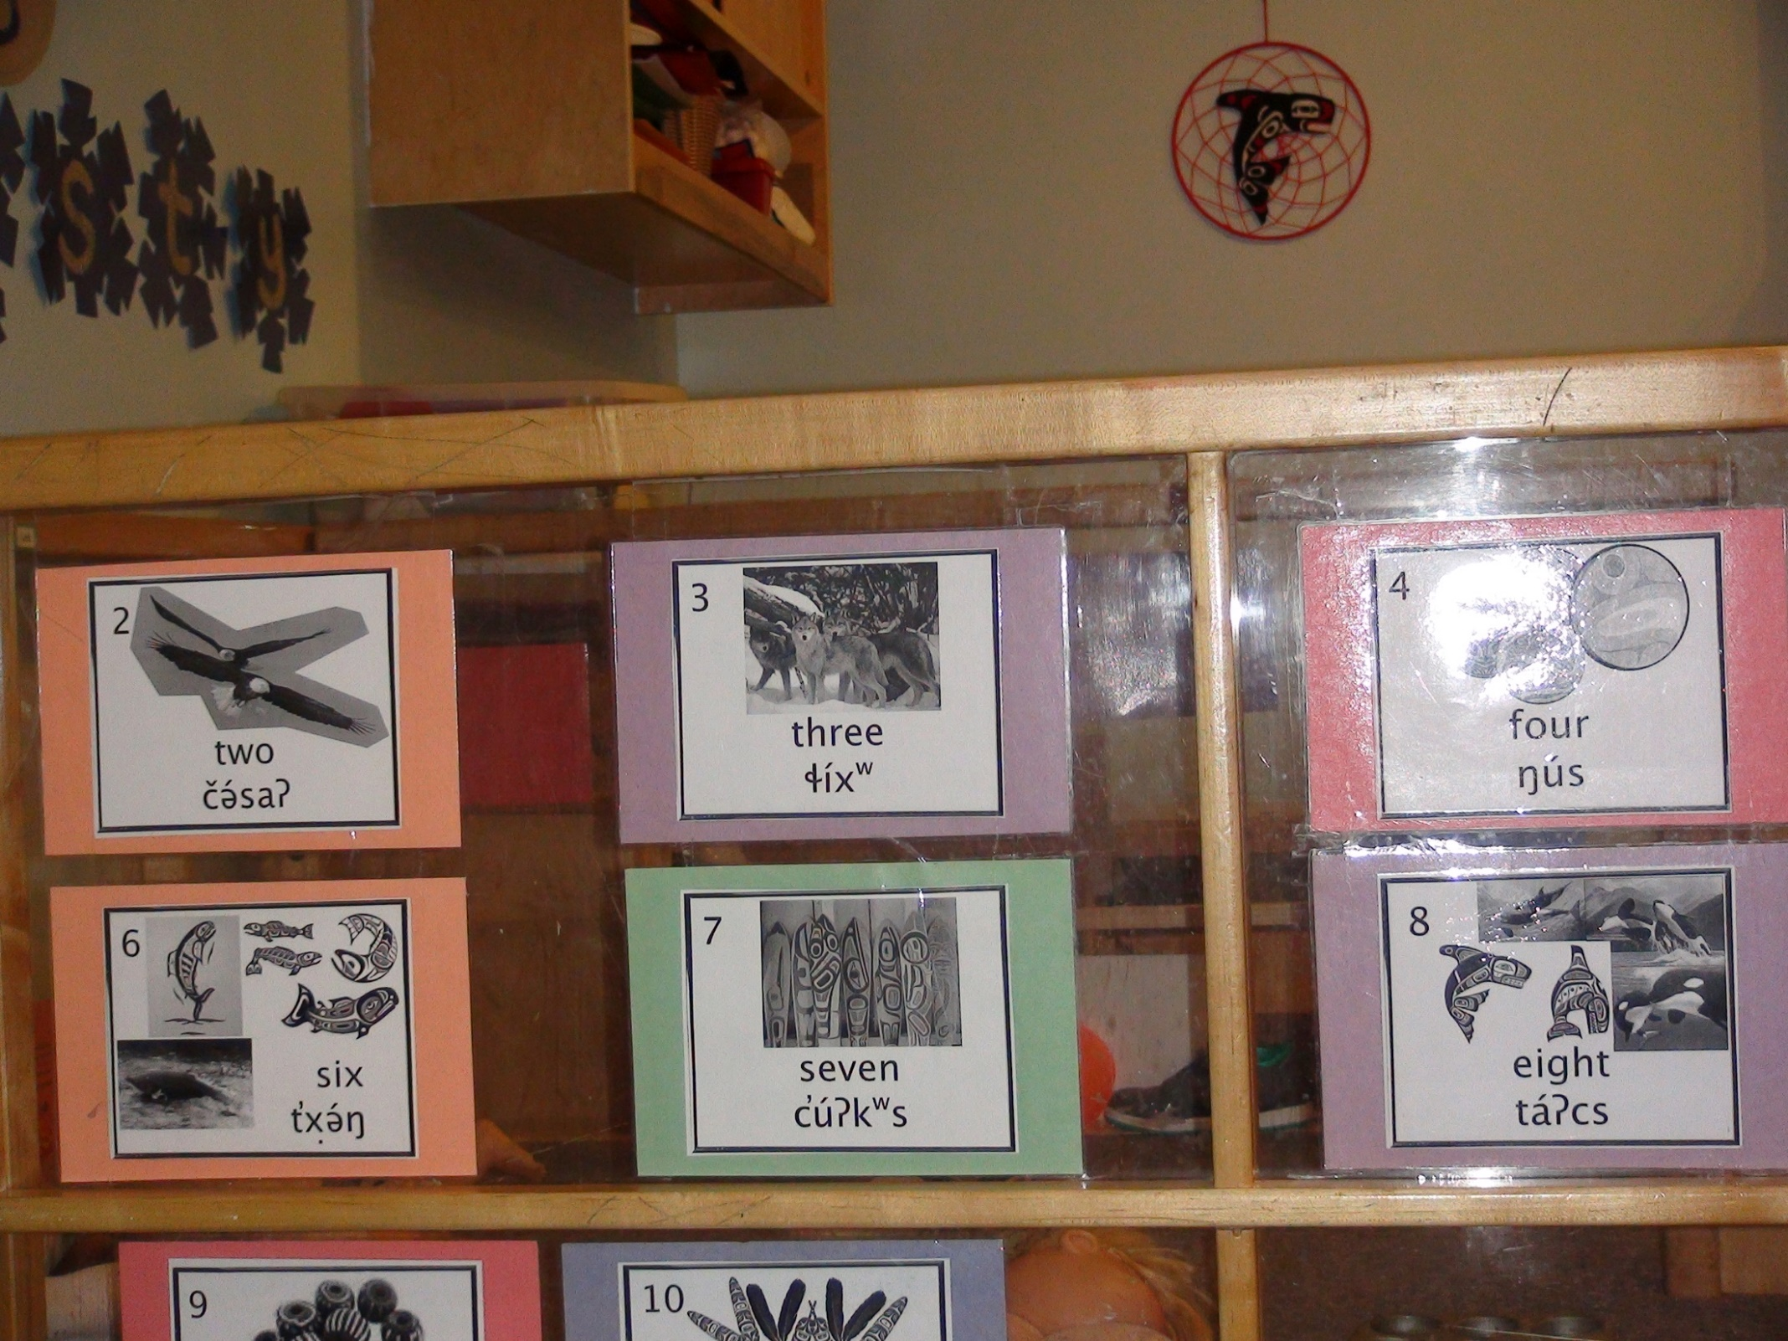
Some Examples of Subitizing in the Classroom
Simple but continuous teaching strategy
Use small numbers in everyday talk and cultural storytelling
You can make a huge difference
planned curricular experiences
spontaneous experiences

Slide 15
Learning Trajectory
Three Parts:
Goal
Developmental Progression
Educational Activities

Slide 16
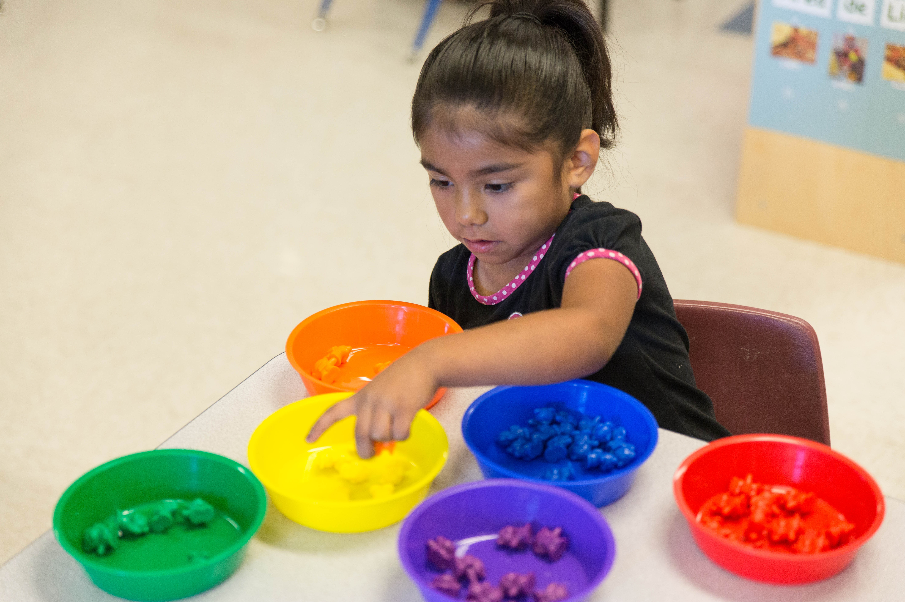
Part 1 of the Learning Trajectory
Goal
Developmental Progression
Educational Activities

Slide 17
LT Goal for Number Recognition / Subitizing
Children recognize and then subitize (recognize quickly) the number in a group without counting.
“Look! I have three blocks!”

Slide 18
Not this!
5

Slide 19
Number Recognition
Early number recognition is not (yet!) subitizing.
Subitizing is the rapid recognition of numbers without needing to count.
Children can first recognize the number in small groups, then they get better and faster and can subitize.

Slide 20
Why Is this Goal Important?
Number recognition builds upon the earliest developing number sense
Infants begin to notice the number of objects in a small group
Supports learning how to count
Cardinality (knowing how many you counted)
Supports learning arithmetic
Even after accounting for IQ and language

Slide 21
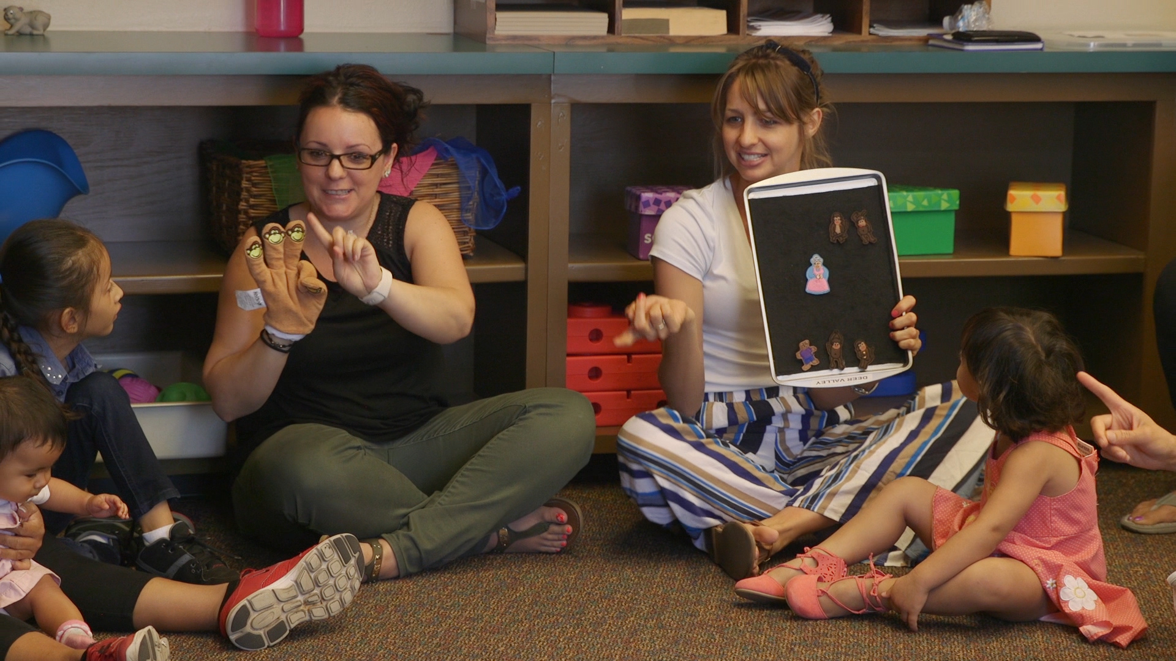
Part 2 of the Learning Trajectory
Goal
Developmental Progression
Educational Activities

Slide 22
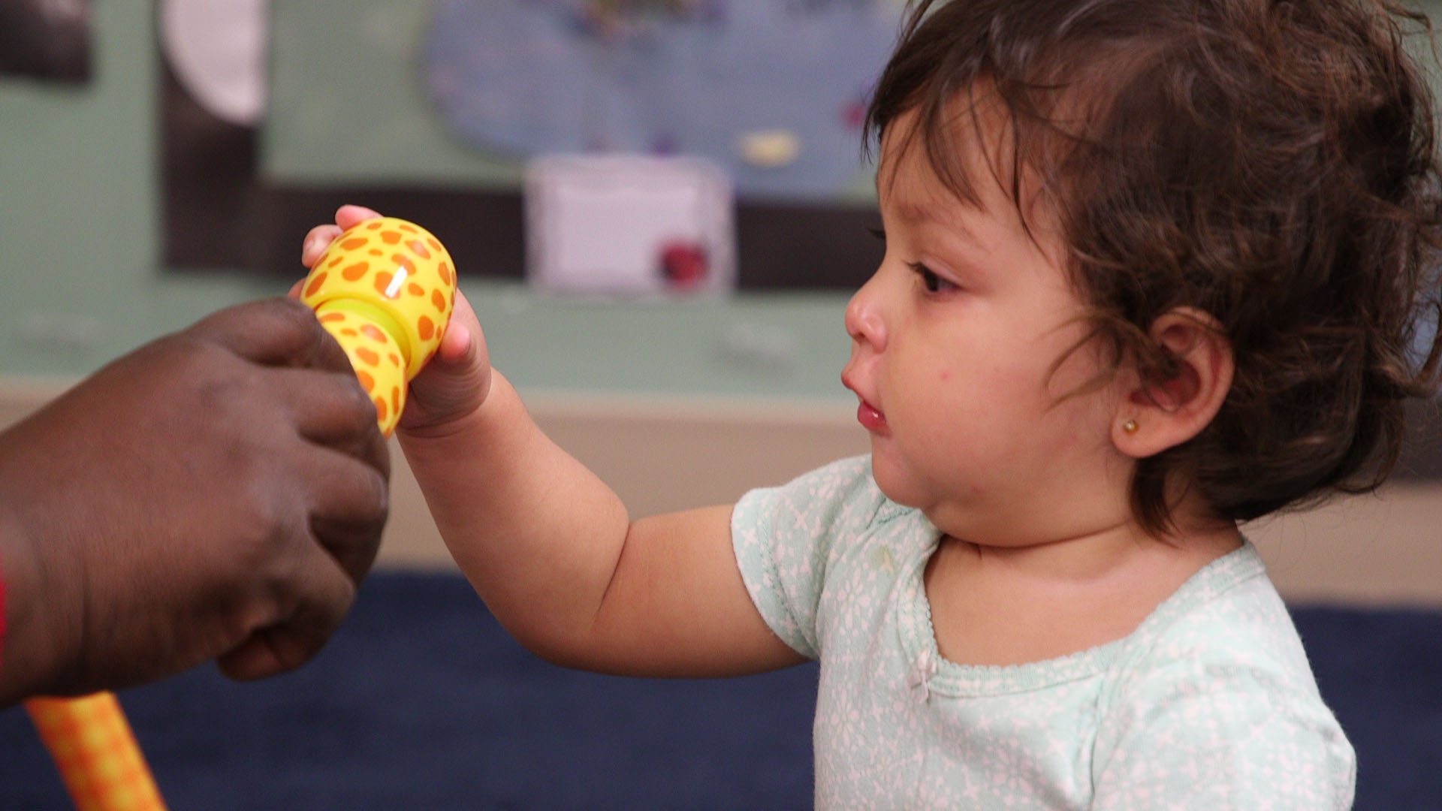
Young Children and Number
Infant competencies
“Habituation” research

Slide 23
Child getting “bored”

Slide 25
Perceptual Subitizing
What is it?
The ability to “just see” how many objects in a small collection.
Let’s actually do some perceptual subitizing.
Ready?

Slide 26
What did you see?

Slide 27
Conceptual Subitizing
What is it?
The ability to see the parts of multiple small sets and putting together the whole.
Now, let’s try some conceptual subitizing.
Ready?

Slide 28
What did you see?

Slide 29
What Did You See?
How did you know?
Think-pair-share!

Slide 30
LT Level: Foundations
Within the ﬁrst year, sensitive (dehabituates) to number, but does not have explicit knowledge of number. For infants, this begins with very small numbers (1 or 2).
Foundations

Slide 31
LT Level: Small Collection Namer
Names groups of 1 to 2, sometimes 3.
“Two fish!”
Small Collection Namer
Pre-Explicit Number

Slide 32
LT Level: Maker of Small Collections
Makes a small collection (no more than 4, usually 1–3) with the same number as another collection or from the number word.
Maker of Small Collections
Small Collection Namer
Pre-Explicit Number

Slide 33
LT Level: Perceptual Subitizer to 4
Quickly recognizes collections up to 4 brieﬂy shown and names the number.
Perceptual Subitizer to 4
Maker of Small Collections
Small Collection Namer
Pre-Explicit Number

Slide 34
LT Level: Perceptual Subitizer to 5
Quickly recognizes collections up to 5 brieﬂy shown and names the number.
Perceptual Subitizer to 5
Perceptual Subitizer to 4
Maker of Small Collections
Small Collection Namer
Pre-Explicit Number

Slide 35
LT Level: Conceptual Subitizer to 5
Names the total in all arrangements to about 5, when shown only brieﬂy.
Conceptual Subitizer to 5
Perceptual Subitizer to 5
Perceptual Subitizer to 4
Maker of Small Collections
Small Collection Namer
Pre-Explicit Number

Slide 36
LT Level: Conceptual Subitizer to 10
Extends to 10. For the advanced!
Conceptual Subitizer to 10
Conceptual Subitizer to 5
Perceptual Subitizer to 5
Perceptual Subitizer to 4
Maker of Small Collections
Small Collection Namer
Pre-Explicit Number

Slide 37
Part 3 of the Learning Trajectory
Goal
Developmental Progression
Educational Activities

Slide 38
Math Language
When children make a math utterance, teachers:
60% of the time ignore it
only 10% of the time respond mathematically
This has important implications for children, particularly children speaking or learning their tribal language.

Slide 39
Support Subitizing for AIAN Children
Choose culturally meaningful and familiar materials
Connect math terms to child’s tribal language
Learn if the child can subitize in their tribal language?
Embed language of child in activity
Use one or two words and phrases
Multiple representations
Emerging competence versus struggles with expressive vocabulary
Tiered levels of questions

Slide 40
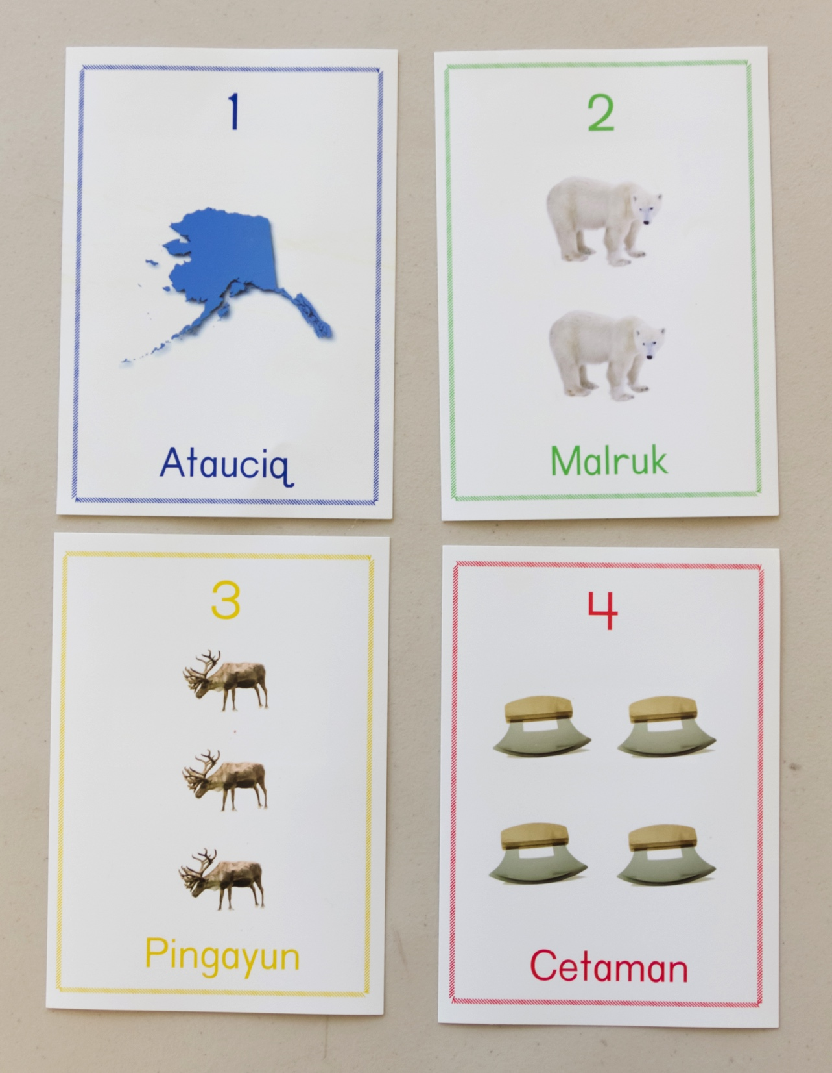
What To Do?
Quick Images or Snapshots
Show a set for 2 seconds or less, then hide it
Ask children to say how many they saw
How would you need to alter these cards to play this game?

Slide 41
Rhythmic Subitizing
Subitizing can also be rhythmic
Subitizing can also be
rhythmic

Slide 42
Supporting Children with Suspected Delays or Identified Disabilities
Subitizing is especially important for the mathematical development of children with special needs.
Follow the learning trajectory with patience!
Use number names all day, naturally but intentionally.
Play a lot of dice and domino games.

Slide 43
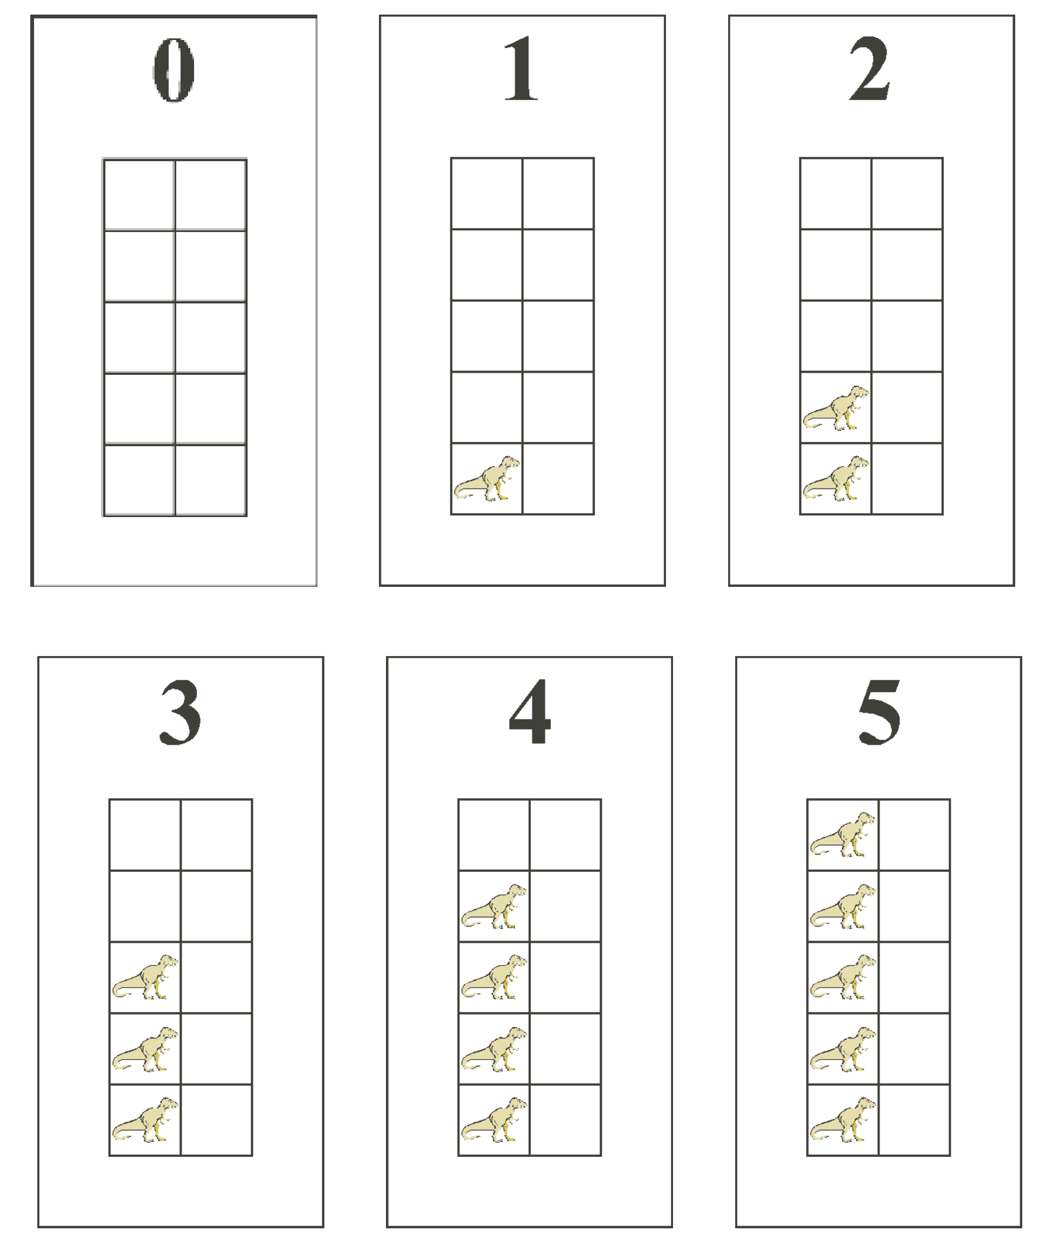
Children with Disabilities
Work toward use of fives and tens frames, a powerful representation (Flexer, 1989)
For those with perceptual issues, such as visual impairment:
use manipulatives that can be held
include lots of rhythmic subitizing

Slide 44
Review

