Slide 1
Schedules and Routines Optional Slides Examples of individualized schedules and routines

Slide 2
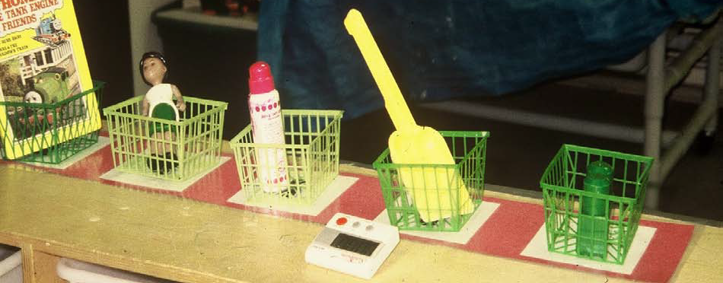
Object Schedule Example

Slide 3
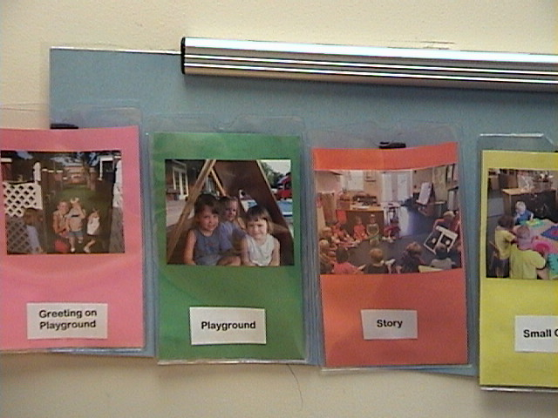
Visual Schedule Examples
A
IT’S TIME FOR… | Choice Time
B

Slide 4
Mini-Schedule

Slide 5
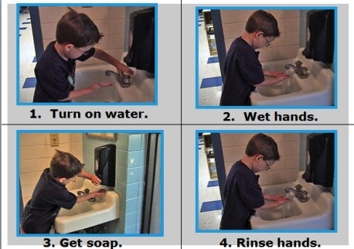
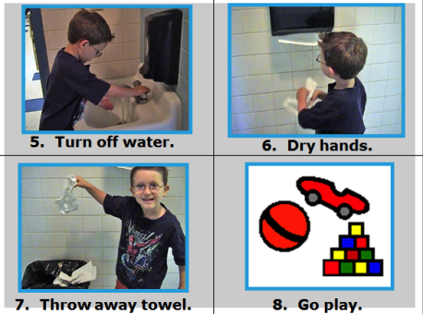
HAND WASHING: DETAILED STEPS

Slide 6
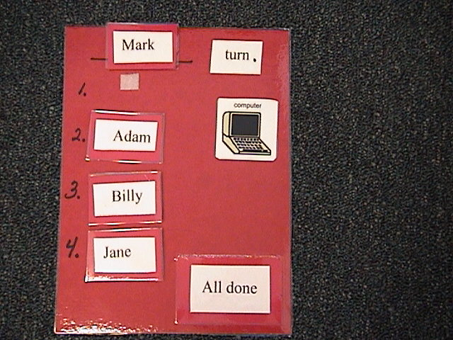
Turn-Taking Schedule

