Slide 1
Universal design FOR learning
A set of principles for curriculum development that give all individuals equal opportunities to learn.

Slide 2
Multiple meanS of…
The WHAT of learning
Representation
Learners differ in the ways
that they perceive and
comprehend information
that is presented to them.
Magnification
custom text
colors
highlight
layout

Slide 3
Multiple means of…
Action
Expression
Physical action
Example – large materials such as paint brushes, crayons, etc.
The HOW of learning
Skills
Tell a story instead of writing.
Executive function
Assist in planning ahead.

Slide 4
Multiple means of…
Engagement
Learners differ in the ways in which they can be engaged or motivated to learn.
The same learner will differ over time and circumstance.
Optimize choice, relevance, foster collaboration.
Interests change as children develop and gain new knowledge and skills.
The WHY of learning

Slide 5
Where does it fit?
Learning activity
View the following pictures of classroom materials.
Use the Head Start Child Development and Early Learning Framework to determine which domains can be addressed with the classroom materials shown in the picture.

Slide 6
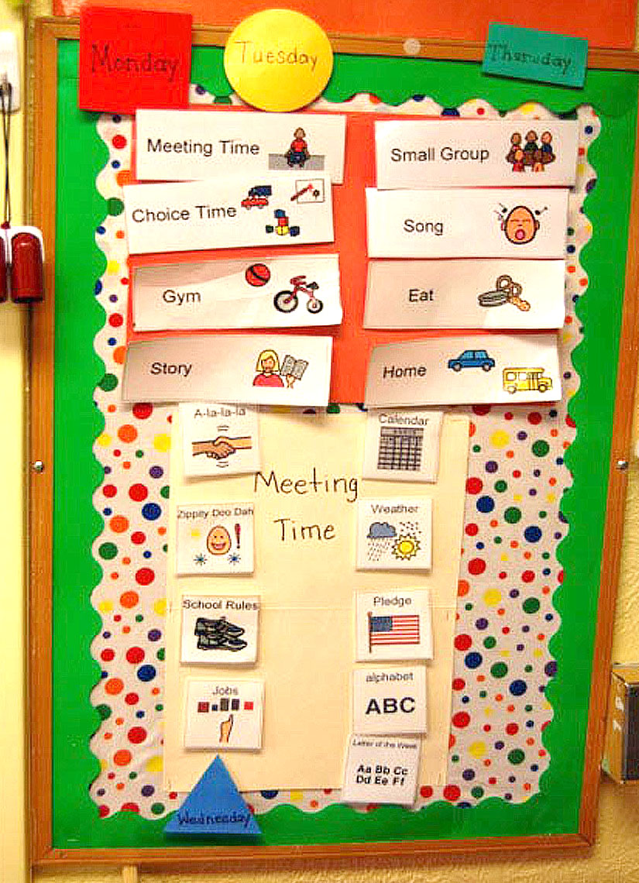
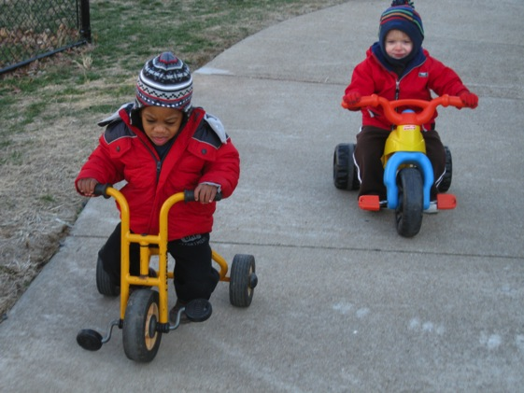
Where do they fit?
Schedule Board
Tricycles

Slide 7
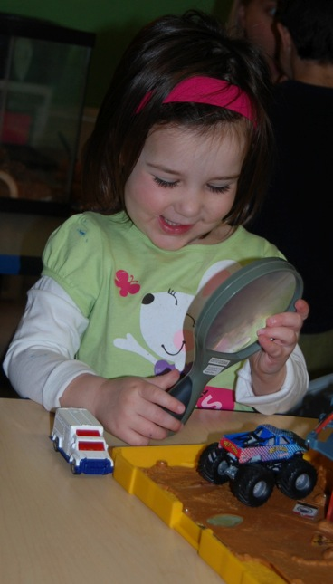
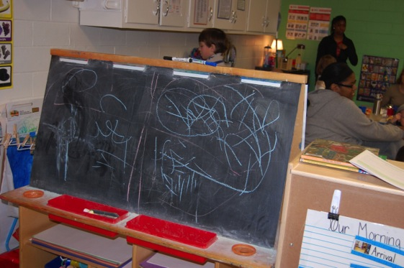
Where do they fit?
Magnifying glass
Chalkboard

Slide 8
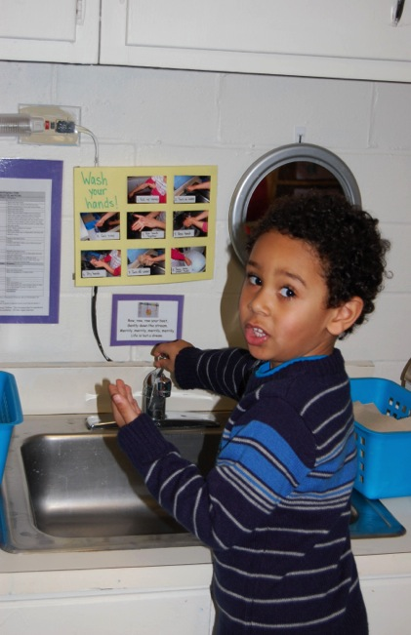
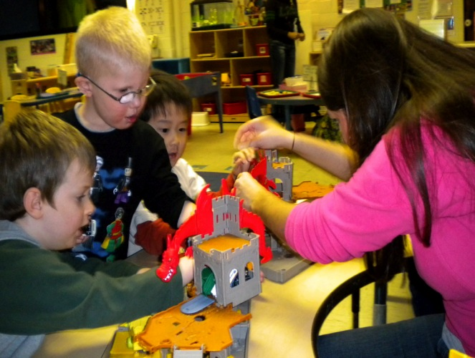
Where do they fit?
Hand Washing Station
Castle Building Components

Slide 9
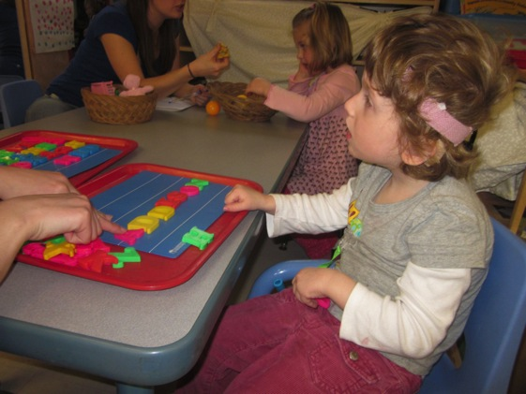
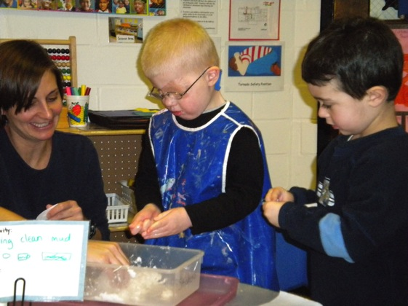
Where do they fit?
Magnetic letters
Sensory bins

Slide 10



Strengths and needs
Learning activity
View the following learning centers and areas for routines…
  What are the strengths and needs of the learning centers and areas for routines?
    What might you add, take away, modify?

Slide 11
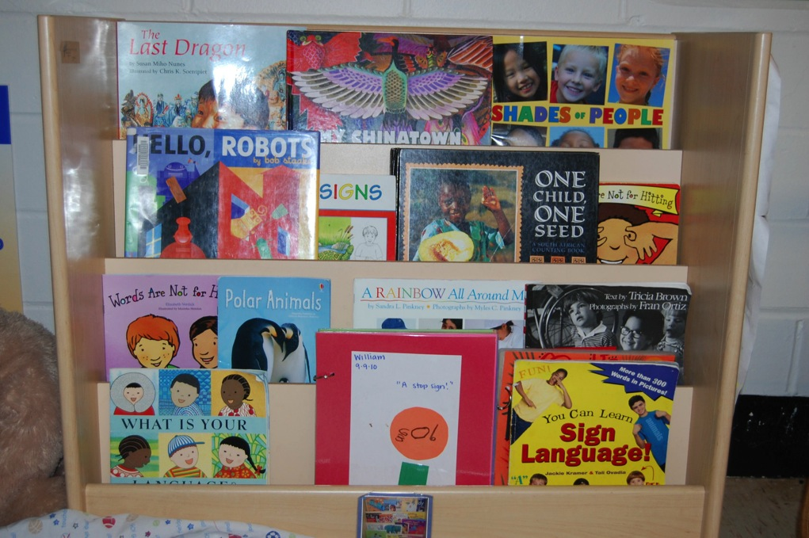

Book area

Slide 12
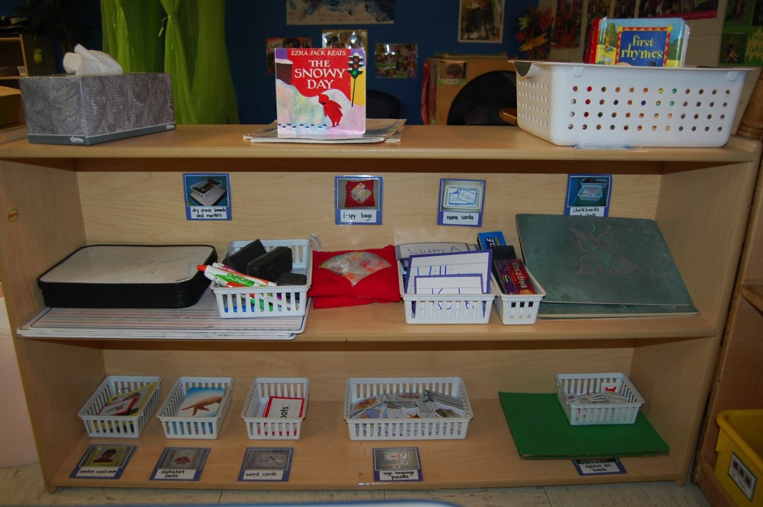

Writing area

Slide 13
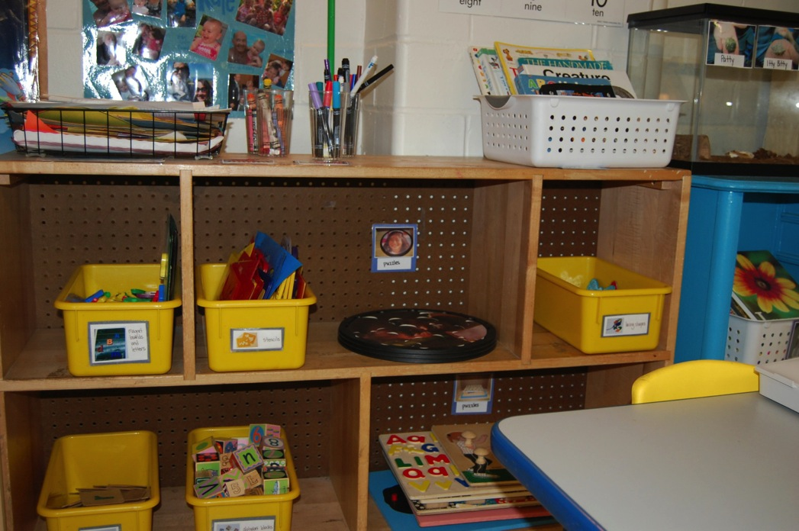
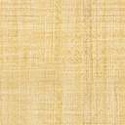
Manipulative Area

Slide 14
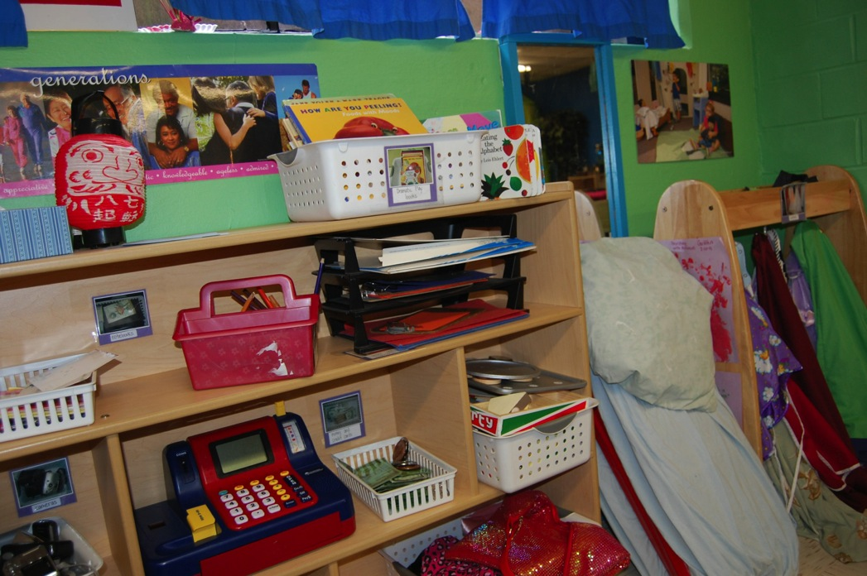
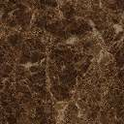
Dramatic play AREA

Slide 15
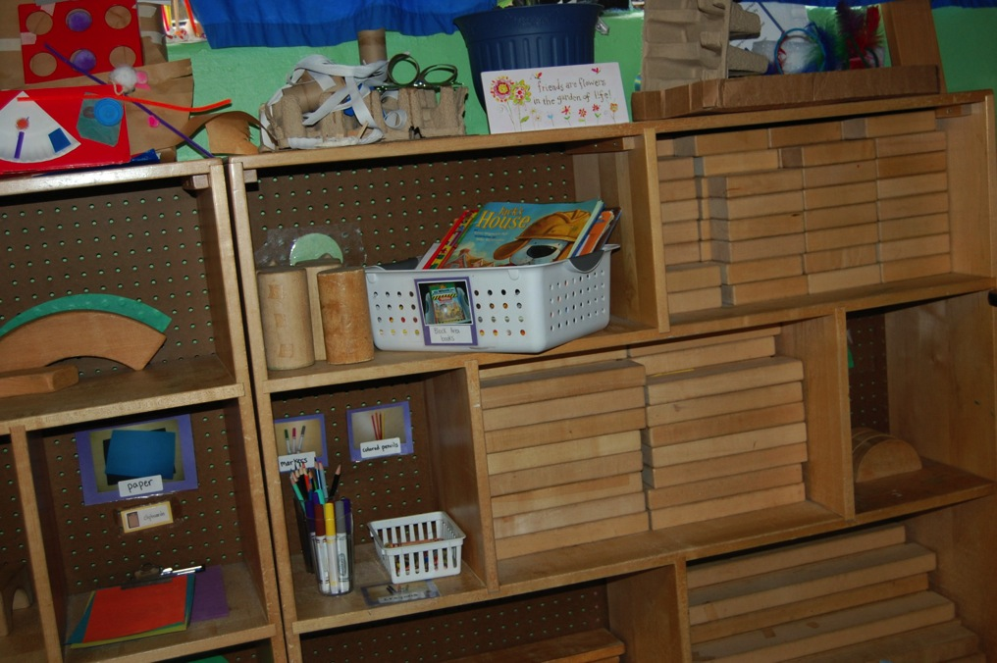

Block area

Slide 16
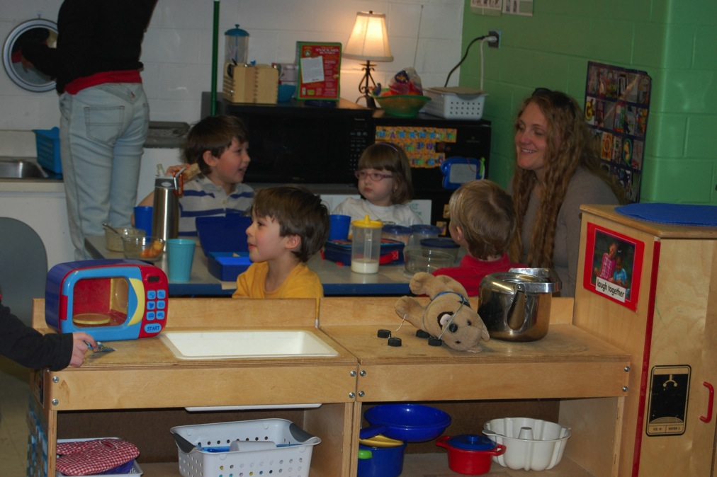
Meal time AREA

