Slide 1
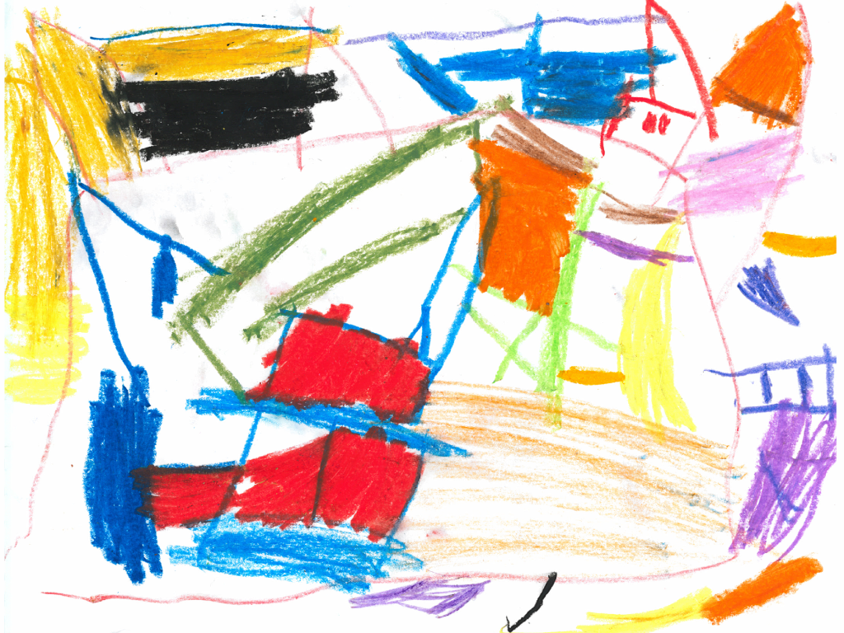
Filling-In Children’s Phrases

Slide 2
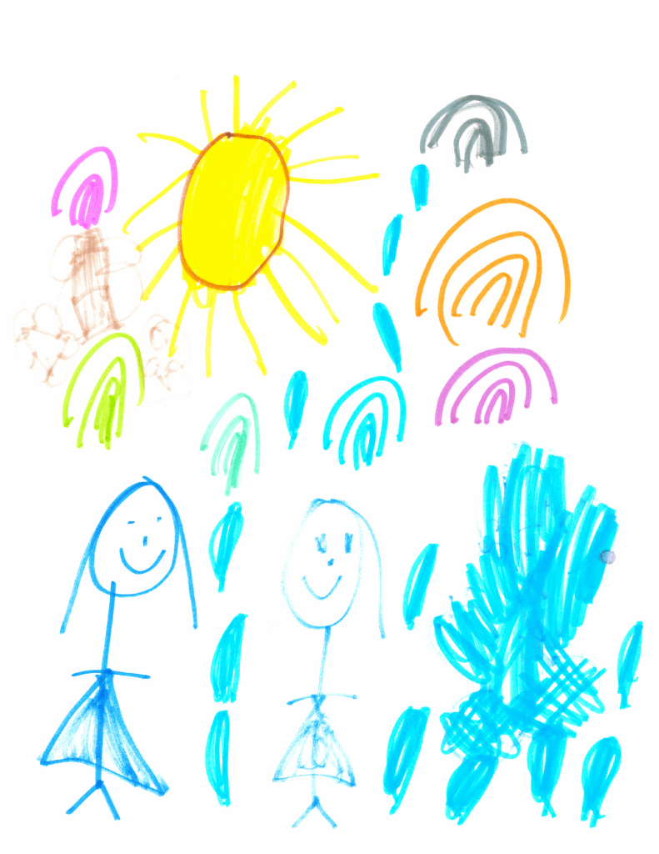
Filling-In Children’s Phrases

