Slide 1
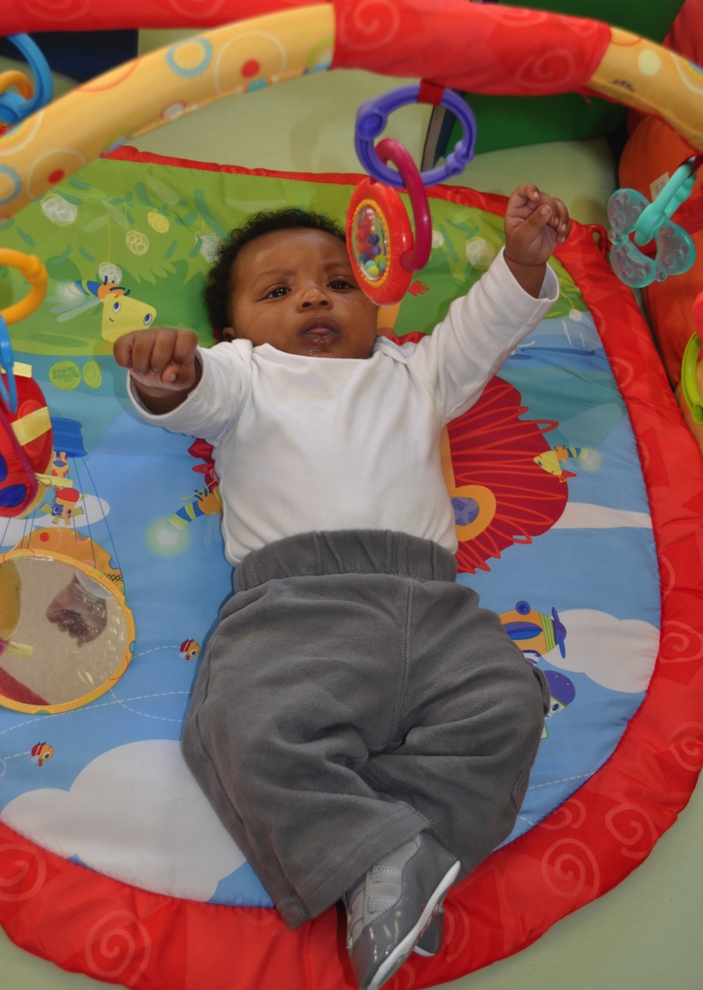
Filling In CHILDREN’S PHRASES
(YOUNG INFANT)
Photo courtesy of EHS NRC

Slide 2
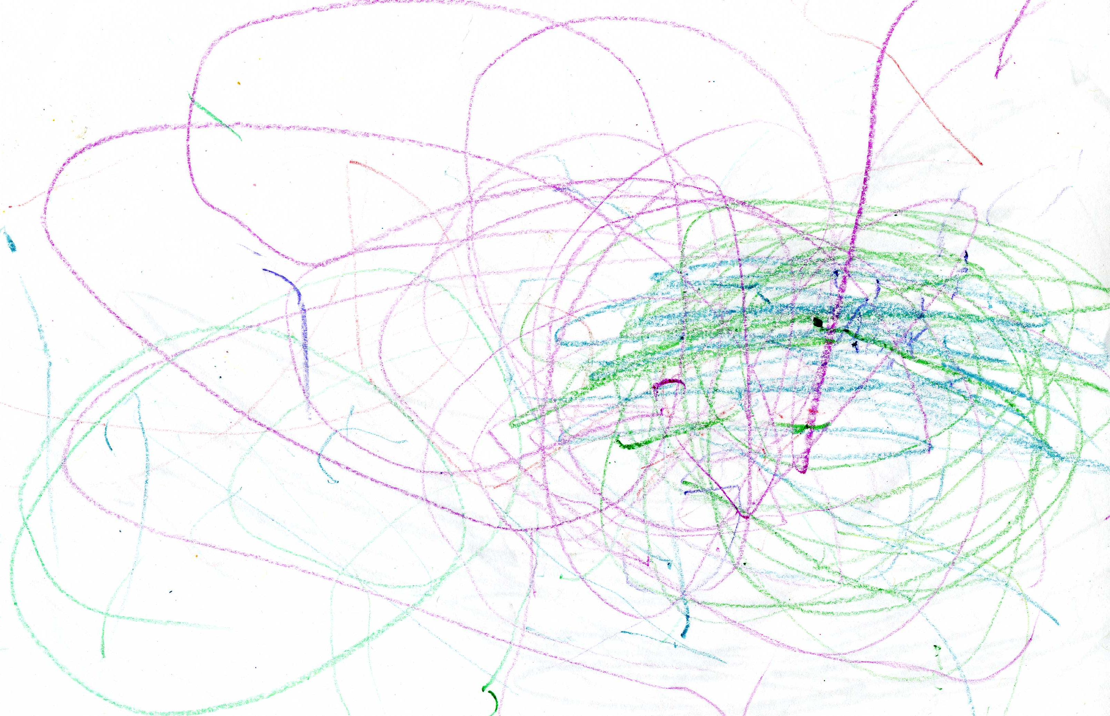
Filling In CHILDREN’S PHRASES
(TODDLER)

Slide 3
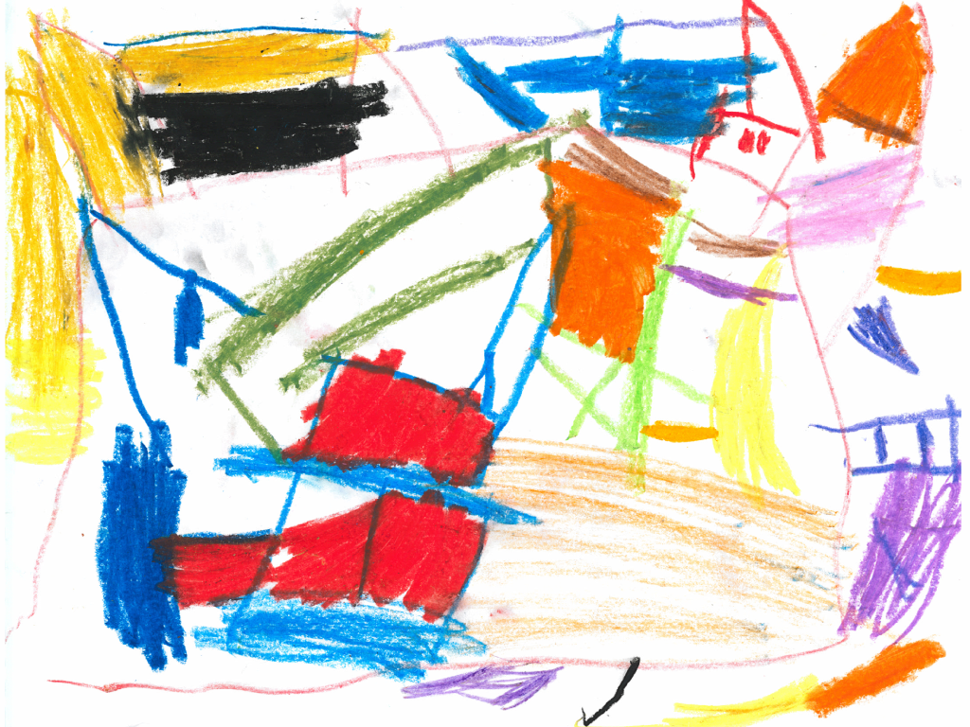
Filling In CHILDREN’S PHRASES
(PRESCHOOLer)

Slide 4
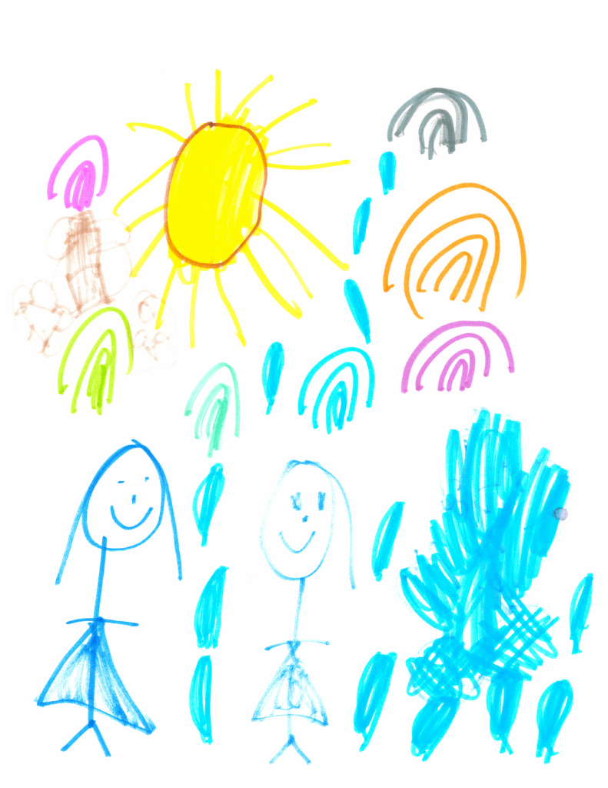
Filling In CHILDREN’S PHRASES
(PRESCHOOLer)

