Slide 1
LANGUAGE MODELING AND CONVERSATIONS: EXPANSIONS
FALL 2014

Slide 2
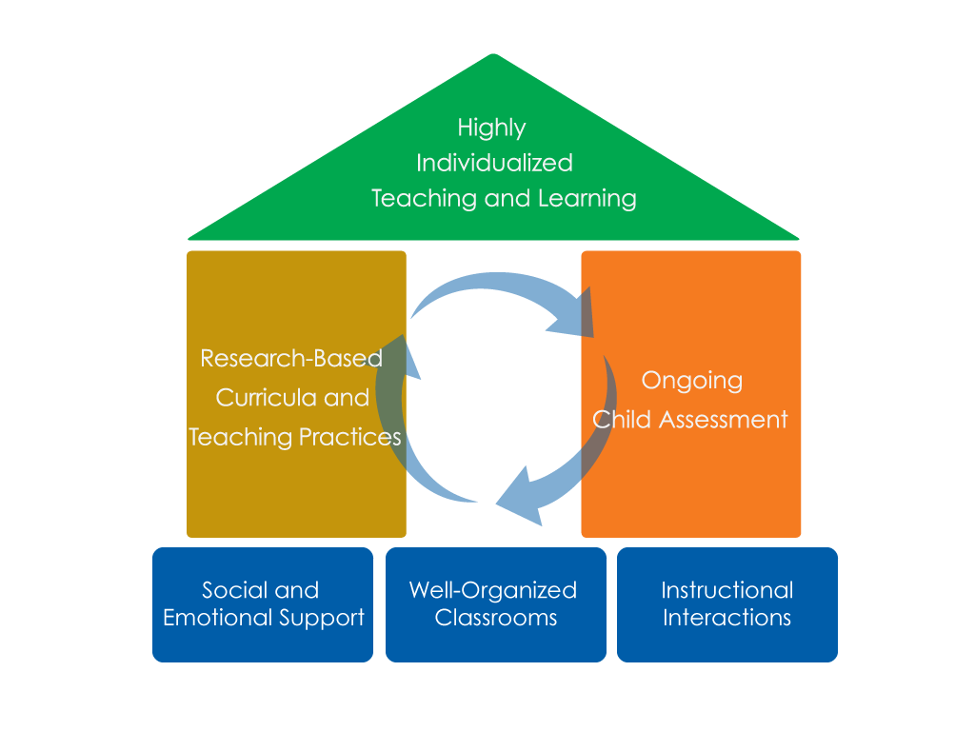
FRAMEWORK FOR EFFECTIVE PRACTICE SUPPORTING SCHOOL READINESS FOR ALL CHILDREN
FOCUS ON
FOUNDATION

Slide 3
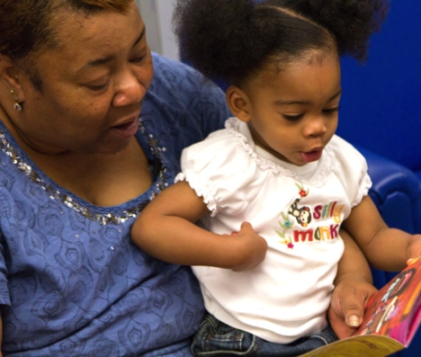
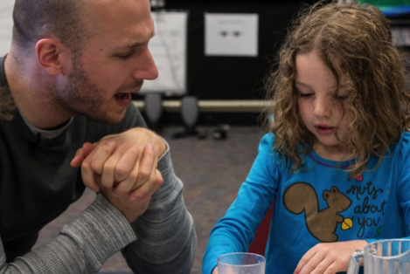
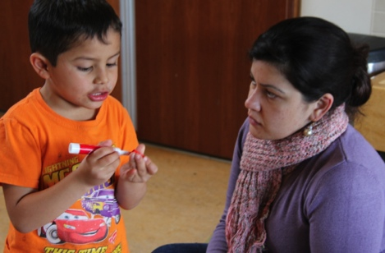
OBJECTIVES
To understand how expansions create opportunities for extended conversation
To learn how expansions promote children’s language and thinking
To identify strategies used to expand on what children say

Slide 4
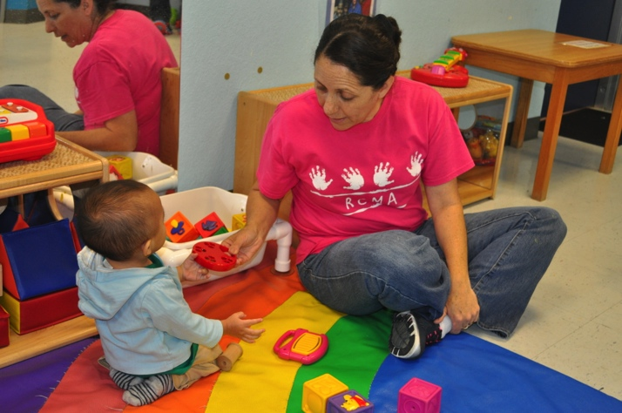
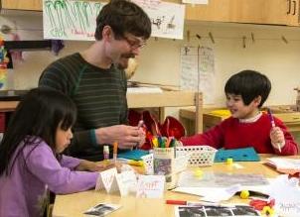
WHAT ARE EXTENDED CONVERSATIONS?
Extended conversations are rich back-and-forth exchanges that help children develop more complex language, thinking, and social skills.
Adults take a more active role with infants and toddlers.
Photo courtesy of EHS NRC

Slide 5
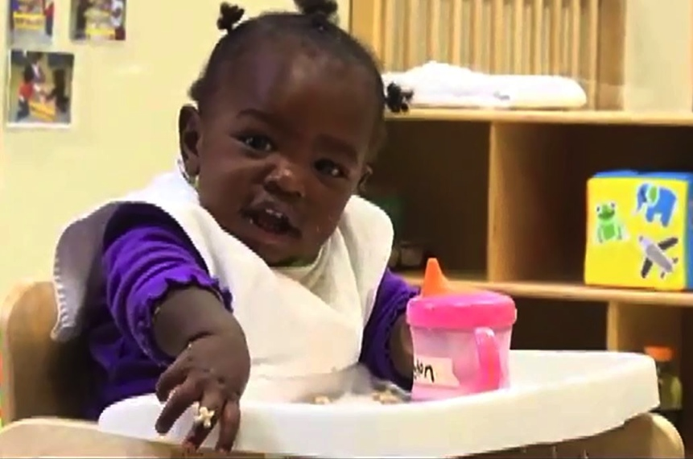
Expanding on what children SAY scaffolds conversations
Listen to the child.
Match tone of voice and emotion.
Repeat or reword and then expand.
Follow the child’s lead.
Give her time to respond.
Engage in several back-and-forth exchanges.

Slide 6
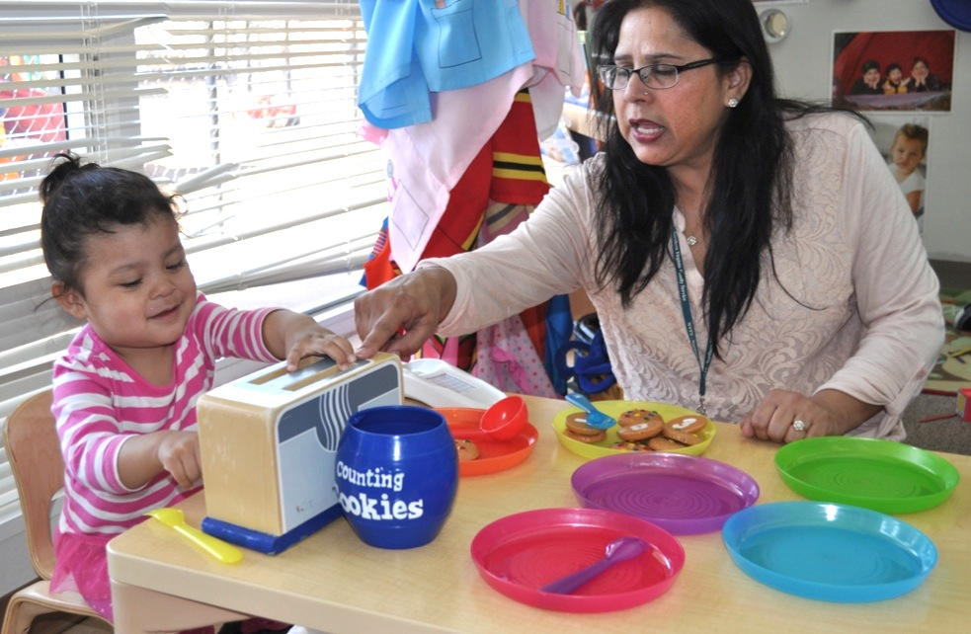
expanding Conversations
INFANTS AND TODDLERS
Expansions provide additional language in response to children’s communications to extend conversations.
Child: Bwed in!
Teacher: Yes! The bread goes in the toaster to make toast.
Child: Bwed up up?
Teacher: Yes! When the bread is done toasting, it pops up. What would you like to put on your toast?
Photo courtesy of EHS NRC

Slide 7
EXPANDING Conversations
PRESCHOOLERS
Expansions provide additional language in response to children’s words to extend conversations.
Child: Look a plane!
Teacher: I see a plane flying high in the sky.
Child: I go on a plane with my grandma before.
Teacher: You went on a plane with your grandma. Where did the plane take you?
Photo courtesy of EHS NRC

Slide 8
INSERT
VIDEO: Expansions: A Wet Sleeve

Slide 10
How does EXPANDING ON WHAT CHILDREN SAY benefit all children?
Introducing Novel Words
Engaging in Thick Conversations
Models back-and-forth exchanges
Assists children in learning how to communicate more clearly and accurately
Increases vocabulary
Helps children learn more language to understand their actions and to express their ideas
Extended Conversations
Expanding on What Children Say
Asking Questions
Develops knowledge of new concepts and skills
Enhances children’s understandings throughout the conversation
Expands higher level thinking skills
Provides opportunities for children to think about their thinking and evaluate their understandings

Slide 11
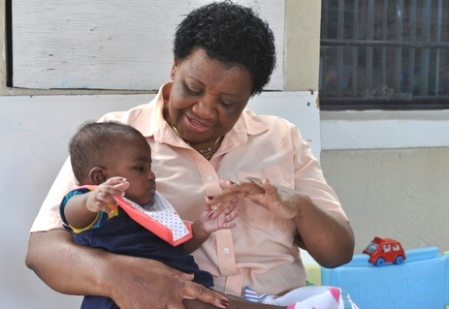
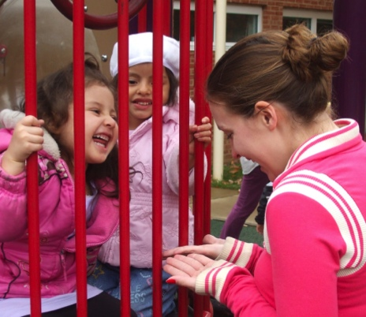
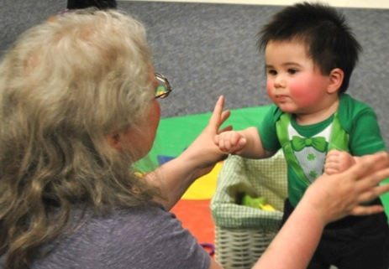
How does Expanding on what children say benefit teachers?
I can add new information to the conversation.
Provides me with great opportunities for ongoing child assessment and ideas for individualized curriculum planning.
Helps me understand what each child knows.
Photos courtesy of EHS NRC

Slide 12
EXPAND ON CHILDREN’S COMMUNICATIONS TO SCAFFOLD LANGUAGE
INFANTS AND TODDLERS
Give meaning to my nonverbal and verbal communications.
Make my communications more complete and complex.
Use more precise and interesting words.
Photo courtesy of EHS NRC

Slide 13
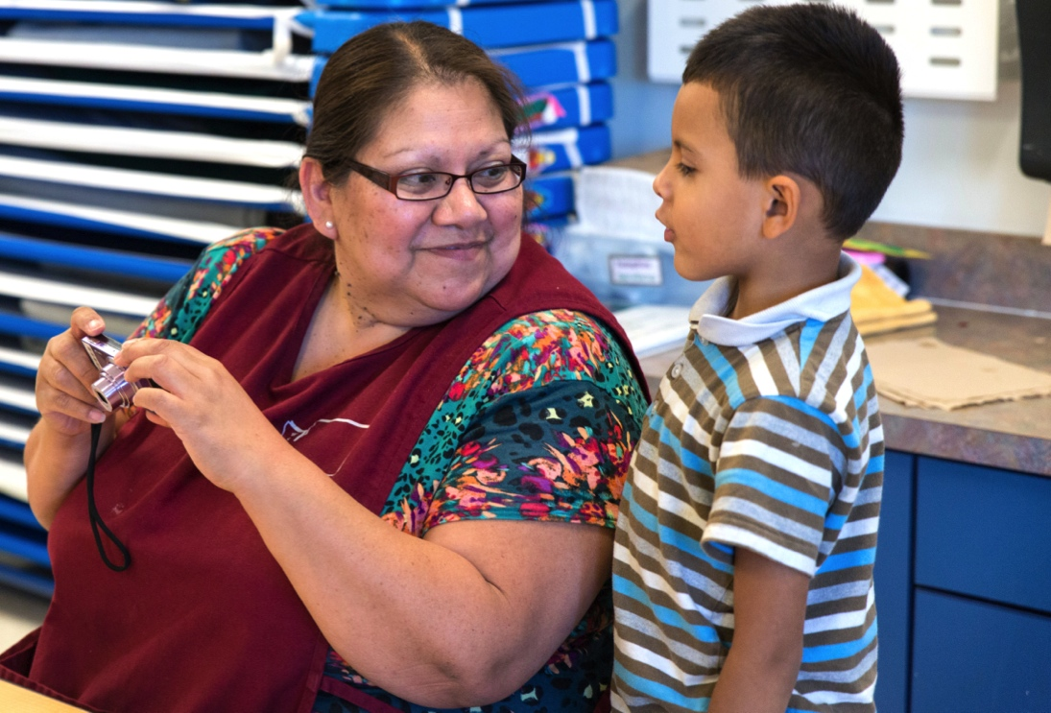
EXPAND ON CHILDREN’S WORDS TO SCAFFOLD LANGUAGE
PRESCHOOLERS
Make my phrase more complete.
Make my phrase more complex.
Add novel and interesting words.

Slide 14
EXPAND ON CHILDREN’S COMMUNICATIONS to scaffold thinking
INFANTS AND TODDLERS
Clarify and summarize my thoughts.
Link to what I already know.
Apply to my world.
Connect concepts.
Relate to my life.
Relate to my actions.
Explain thinking.
Ask open-ended questions.
Photo courtesy of EHS NRC

Slide 15
EXPAND ON CHILDREN’S WORDS to scaffold thinking
PRESCHOOLERS
Summarize my thoughts.
Link to what I already know.
Apply to my world.
Connect concepts.
Relate to my life.
Relate to my actions.
Explain thinking.
Invite me to think deeper.

Slide 16
INSERT VIDEO:
A WET SLEEVE, CONTINUED

Slide 18
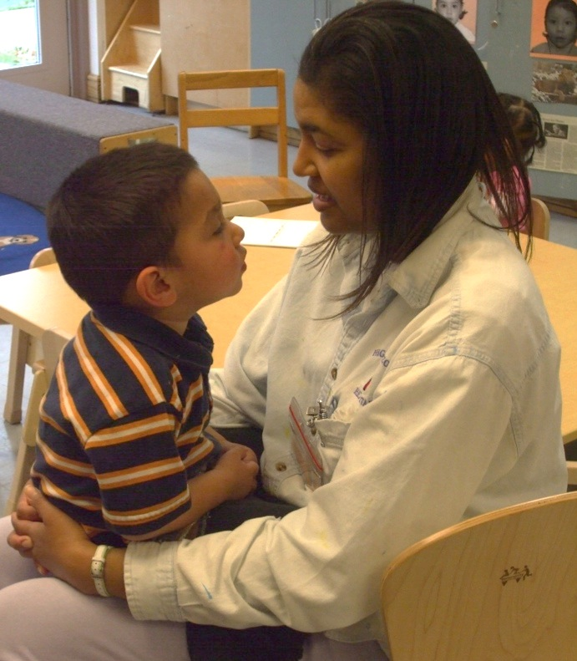
SUMMARY
Expand on children’s actions, vocalizations, and words.
Add more complex language.
Add new information to support higher-level thinking.
Photo courtesy of EHS NRC

Slide 19
This document was prepared for the U.S. Department of Health and Human Services, Administration for Children and Families, Office of Head Start, by the National Center on Quality Teaching and Learning under Grant #90HC0002 in collaboration with the Early Head Start National Resource Center under Grant #HHSP23320100009YC.
FALL 2014

