Slide 1
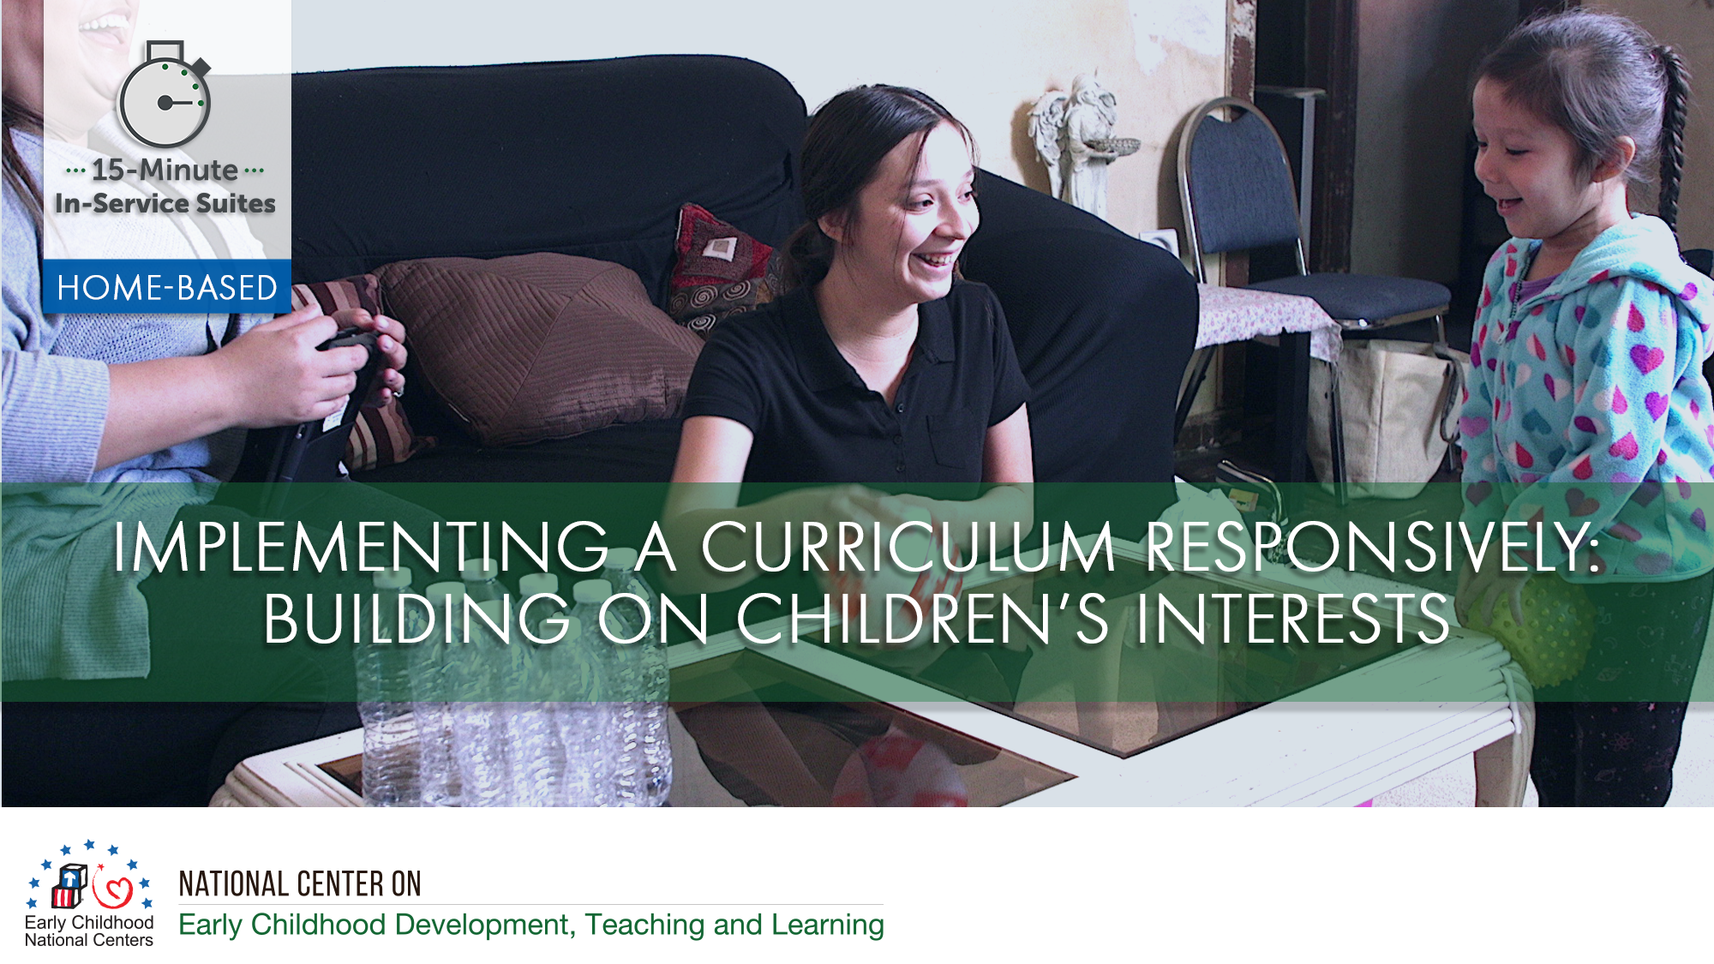

Slide 2
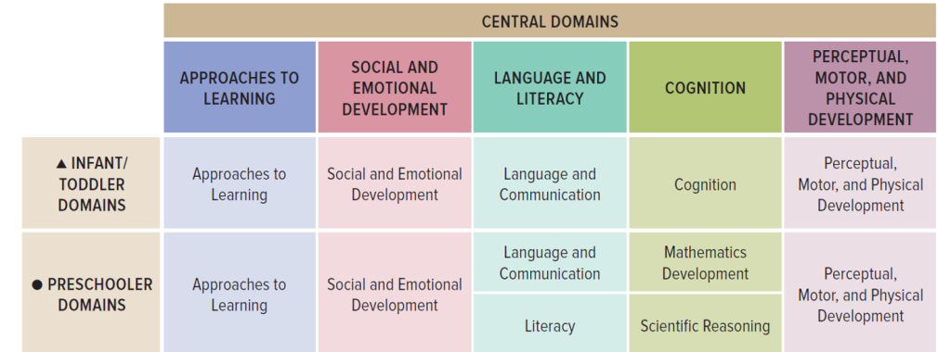
Connections to the ELOF

Slide 3
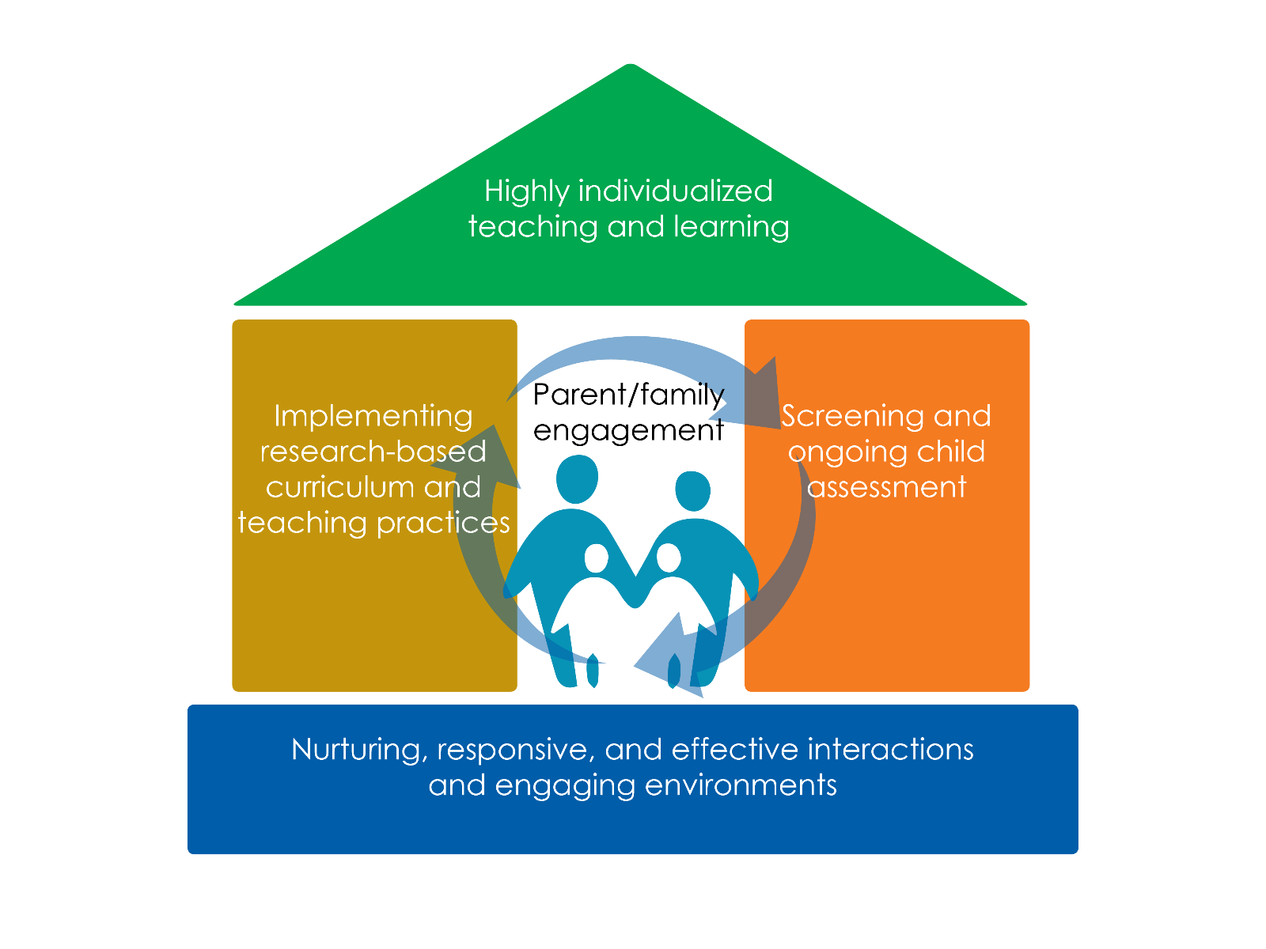

Slide 4
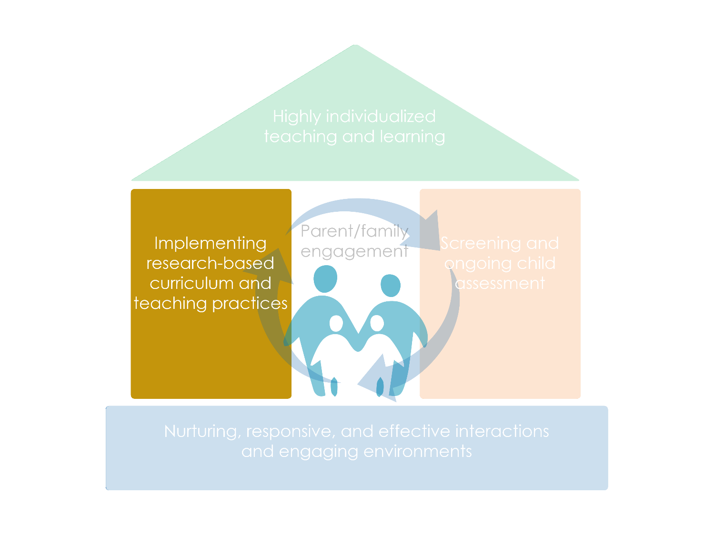

Slide 5
Objectives
Discuss the importance of learning with families about children’s interests.
Explore ways curricula provide guidance on the home and socializations as environments, learning experiences, and parent-child interactions.
Learn to work with families to use a curriculum responsively and build on a child’s interests.
Notes:
.

Slide 6
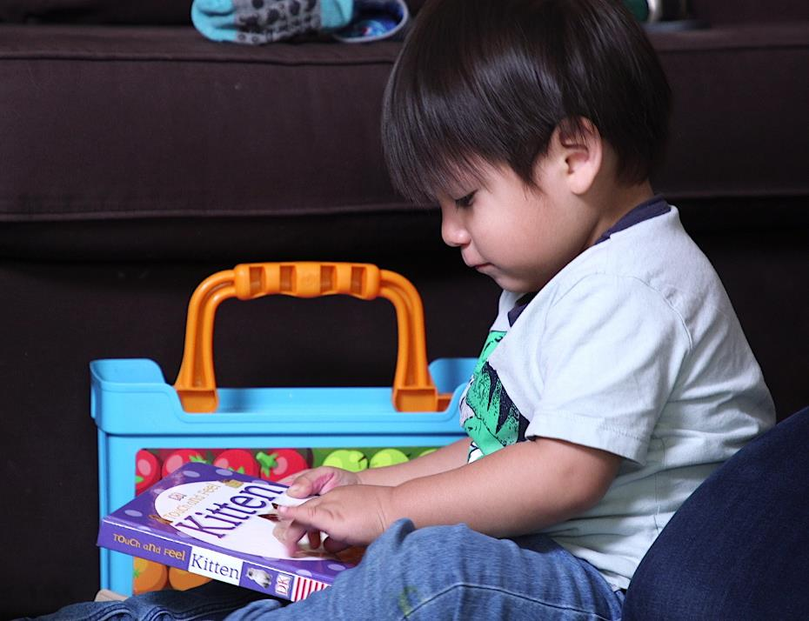
Why Care About Children’s Interests?
Notes:
.
.

Slide 7
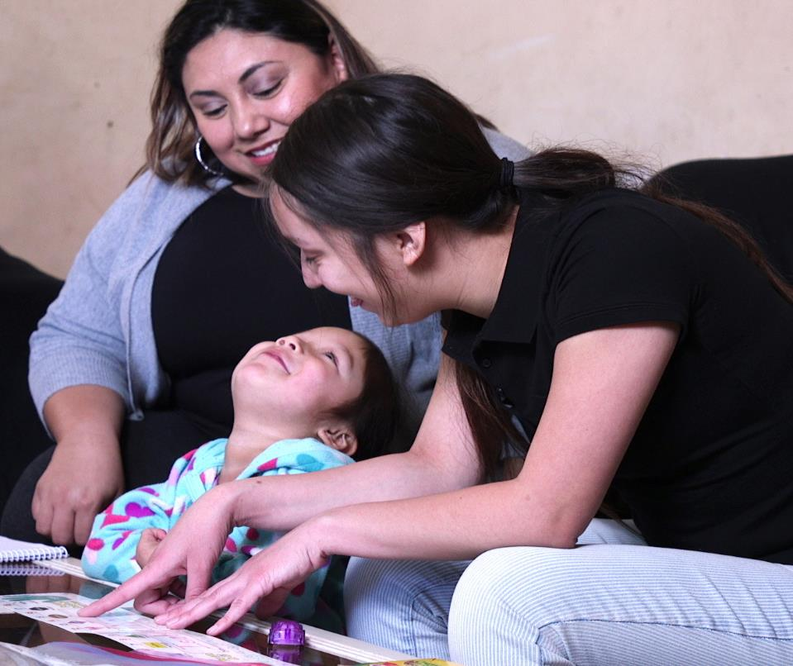
Relationships: The Heart of Responsiveness

Slide 8

Active Role of Home Visitors
What do we know about the child’s interests? | What does my program’s curriculum offer? | How do I use the curriculum responsively with this family and child?

Slide 9
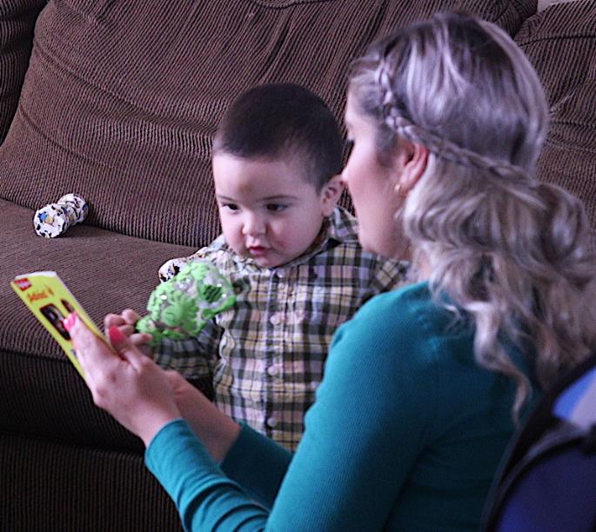
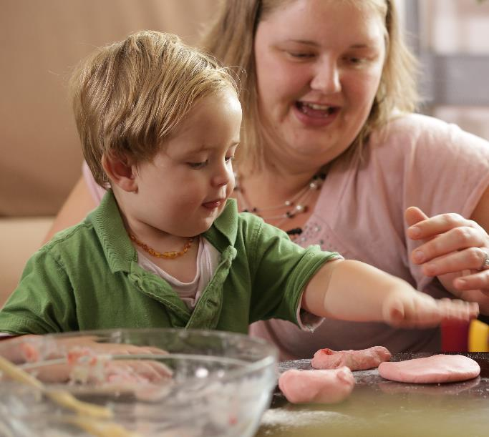
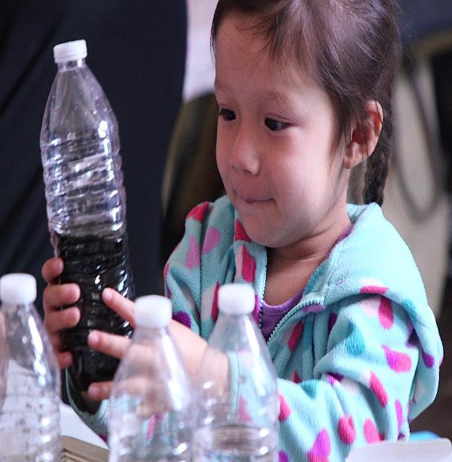
Observing and Learning About Children’s Interests

Slide 10
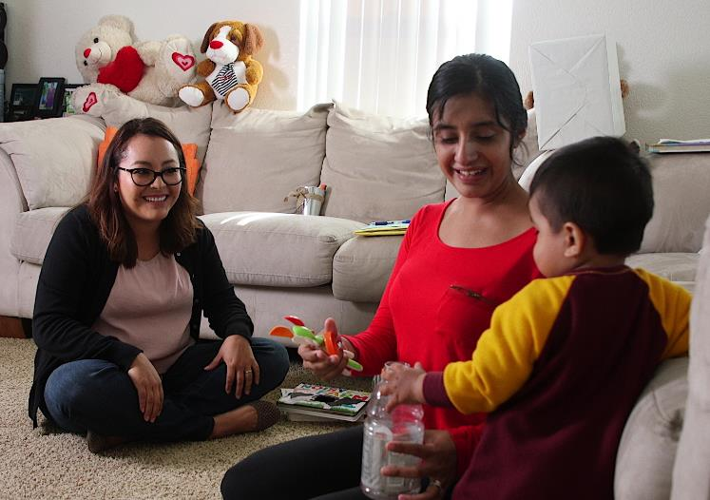
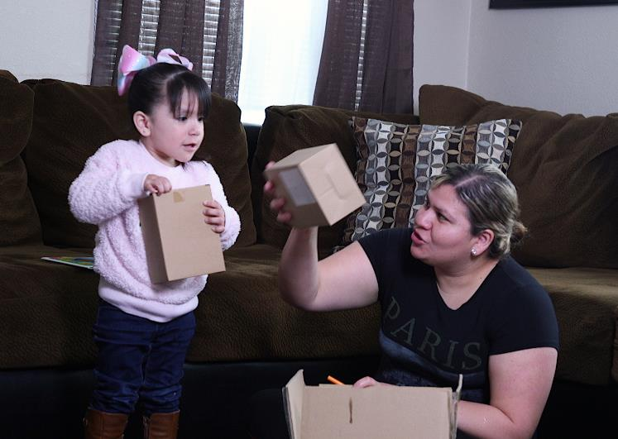
Partnering with Families to Learn About Children’s Interests: Personal Interests

Slide 11
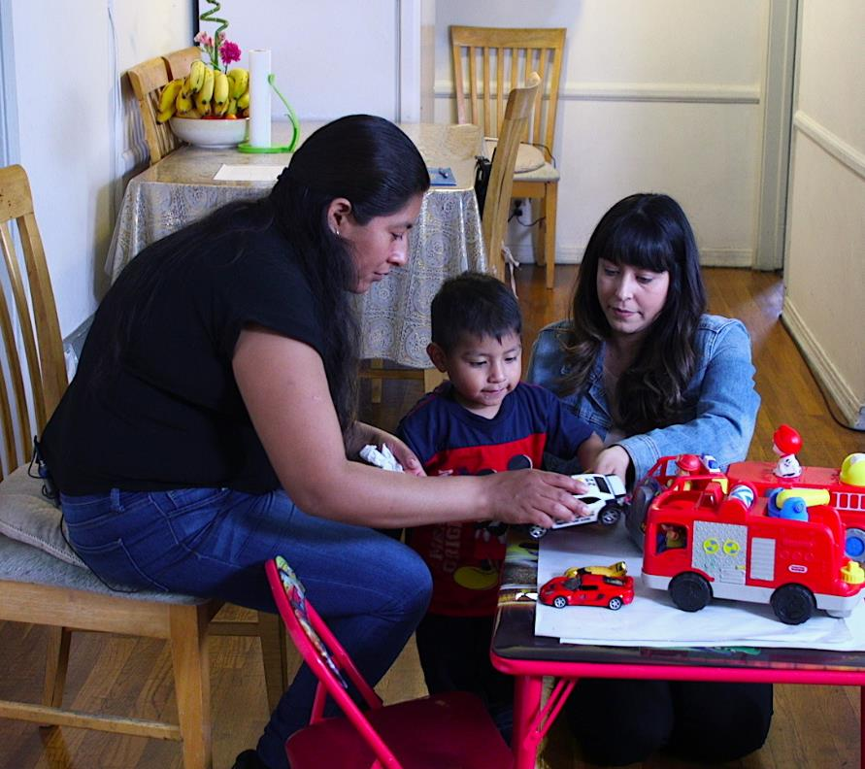
Partnering with Families to Learn About Children’s Interests: Situational Interests

Slide 12
Home-Based Curricula Support
Learning experiences during play and routines
Home as a learning environment
Parent-child interactions

Slide 13
Home as a Learning Environment
Making It Count All Day Long for Toddlers
Did you know that children enjoy counting their way across the day? Here are some ways to incorporate counting throughout daily routines.
Rise and Shine : Use number words as you help your child get dressed – “You have one shirt and one pair of pants. You put one leg in each side of your pants – one! Two! And now two socks for your two feet.
Outside: While playing outdoors, count with your child the number of birds or trees you see or the number of times you push them on the swing.
Meal Time: Count with your child the number of people in your family and count out enough plates, cups, and utensils to set the table. Ask your child to count the number of items on their plate
Clean-Up Time: As you and your child clean-up, count the toys as you put them away.
Bed Time: Look for things in your bedtime story that can be counted – such as the number of characters or items on a page.

Slide 14
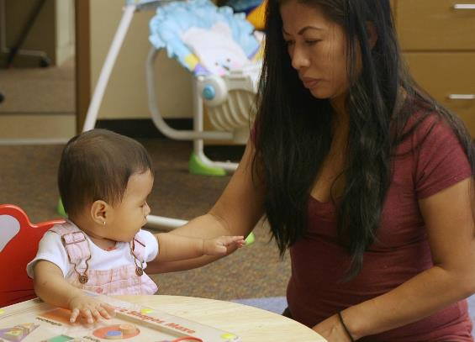
Learning Experiences
AT SIX MONTHS
Action and Reaction
Goals: Support fine motor development, attempts to repeat actions.
Suggested materials: small toys
Drop a toy and watch your baby’s reaction.
What does he do if you hand it back to him?
If he drops the toy again, watch for his reaction.
  What do you think he’s feeling?
  What happens when you hand him the toy again?
If one of you drops the toy again, what does he do?
This Photo by Unknown Author is licensed under CC BY-ND

Slide 15
Parent-Child Interactions
HELPFUL HINT: LOOK, LISTEN, LEARN, and TALK THROUGHOUT THE DAY
LOOK: What does your child look at, reach for, point to or play with? What makes him smile?
LISTEN: What makes your child laugh or squeal with delight? What does he like to talk about?
LEARN: Your child communicates with you in different ways.
TALK: Talk to your child about what he’s doing while he is doing it. Ask questions about what he’s doing. This talk gives him the words for his actions, and it shows how interested you are in what he’s doing.

Slide 16
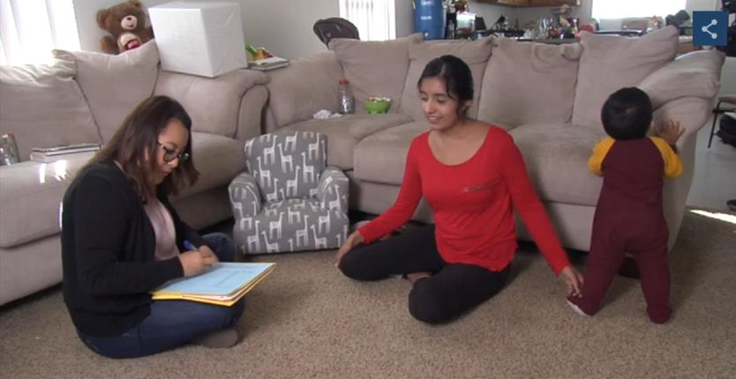


Activity: Building on a Toddler’s Personal Interests
How do I use my program’s home-based curriculum responsively with this family and child?

Slide 17

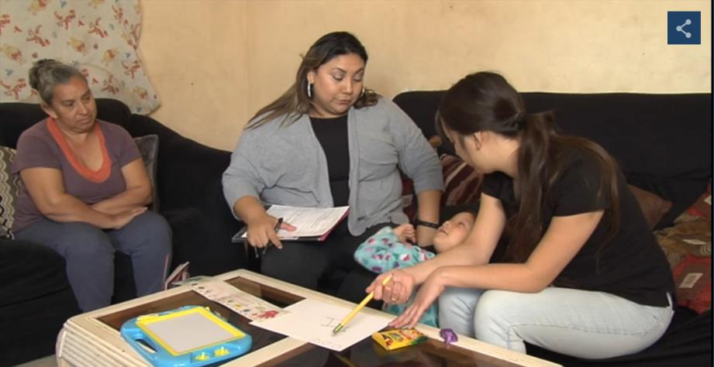

Activity: Following a Preschooler’s Situational Interests
How do I use my program’s home-based curriculum responsively with this family and child?

Slide 18
Review
What do we know about the child’s interests?
What does my program’s home-based curriculum offer?
How do I use my program’s curriculum responsively with this family and child?

