Slide 1
engaging interactions: PROVIDING FEEDBACK
Supporting Quality Teaching and Learning in AI/AN Head Start Classrooms
FALL 2013

Slide 2
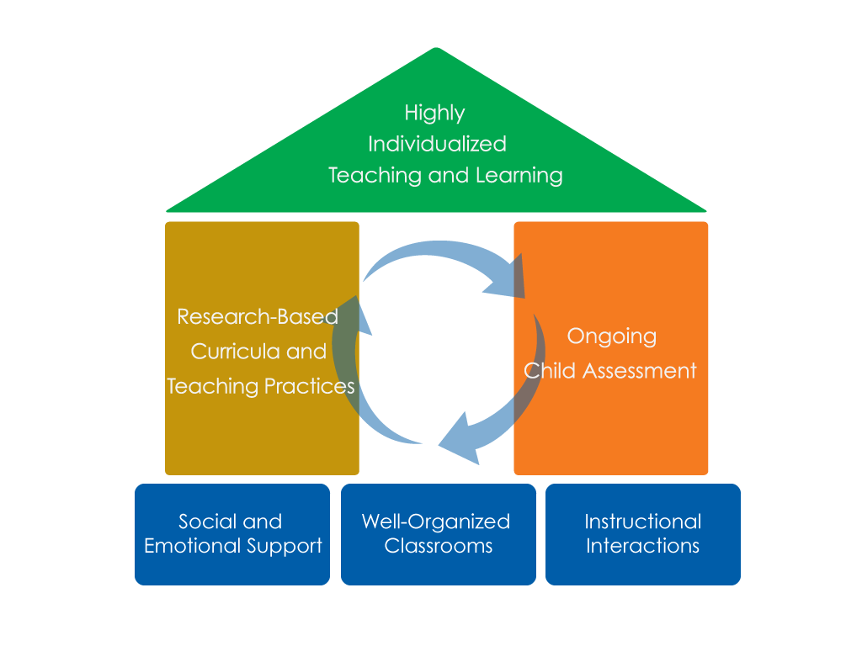
FRAMEWORK FOR EFFECTIVE PRACTICE SUPPORTING SCHOOL READINESS FOR ALL CHILDREN
FOCUS ON
FOUNDATION

Slide 3
Objectives
Provide a definition of providing feedback that supports engagement and learning.
Give examples and strategies for how teachers can provide feedback to children.
Connect providing feedback that supports engagement and learning to the Head Start Child Development and Early Learning Framework
Provide suggestions for teachers on how to improve their ability to provide feedback to children.

Slide 4
PROVIDING FEEDBACK THAT SUPPORTS ENGAGEMENT AND LEARNING
What does it look like?
Teachers:
Engaging in back-and-forth exchanges with children that expand their understanding.
Asking children to explain their thinking.
Encouraging children’s efforts.
What does it NOT look like?
Teachers providing children with simple yes/no or wrong/right responses.

Slide 5
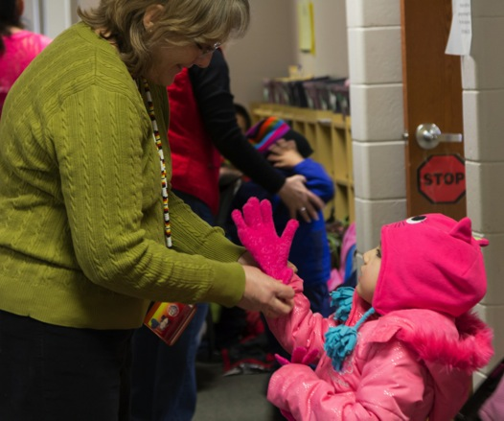
BACK-AND-FORTH EXCHANGES
Engage in back-and-forth exchanges that expand and elaborate on children’s learning.
For example:
Teacher: I can see you are all
enjoying playing with bears.
Who can tell me something
special about bears?
Child: They sleep for a long time!
Teacher: That’s right, they hibernate!
When do they hibernate?
Child: In the winter time.
Teacher: Yes, during the winter season!
Who knows where they go to hibernate?
Exchanges continue…

Slide 6
EXPLAIN THINKING
Ask children to explain their thought processes.
For example:
Teacher: How do you think the boy feels in this picture?
Child: I think he’s sad.
Teacher: Why do you think that?
Child: Because his friends are in the water having fun and he can’t swim.
Teacher: Yes, he might feel a little frustrated.

Slide 7
ENCOURAGE EFFORTS
Encourage children’s efforts and help them stick with challenging activities.
For example:
Teacher: I can see how hard you are working to put that pattern together. Keep going, you almost have it!
Child: I’m done!
Teacher: You did it! Friends, look at Maria’s pattern. She worked so hard to complete it.

Slide 8
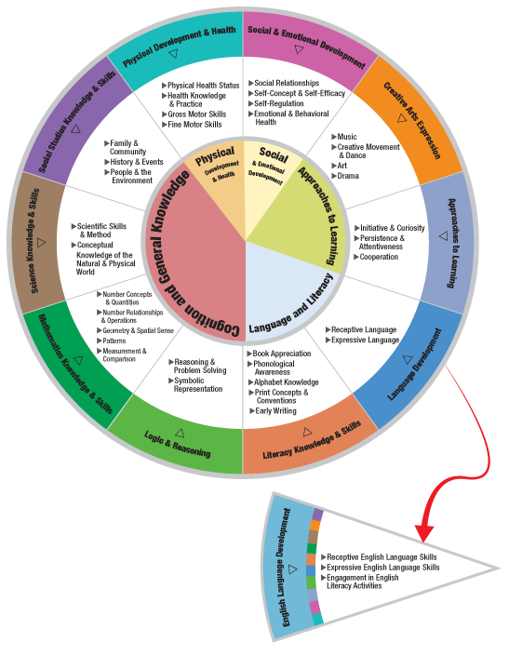
THE HEAD START CHILD DEVELOPMENT AND EARLY LEARNING FRAMEWORK
Providing feedback that supports engagement and learning is important across many areas of the framework.
Some examples are:
Logic & Reasoning
Literacy Knowledge & Skills
Mathematical Knowledge & Skills
Social & Emotional Development
Science Knowledge & Skills

Slide 10
IN THIS CLIP, THE TEACHER…
Encourages child’s initiative and helps her stick with challenging activities
Supports children’s
Persistence and Attentiveness and encourages Initiative and Cooperation
Encourages child’s efforts and recognizes children’s effort when they read along with the book

Slide 12
IN THIS CLIP, THE TEACHER…
Engages in back-and- forth exchanges to engage children in learning about trees.
Supports children’s
Science Knowledge & Skills

Slide 13
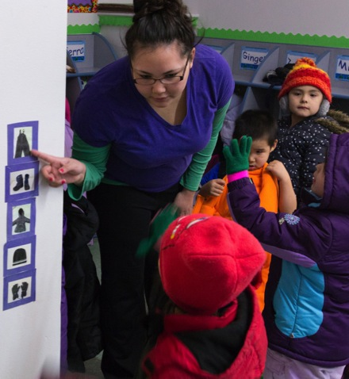
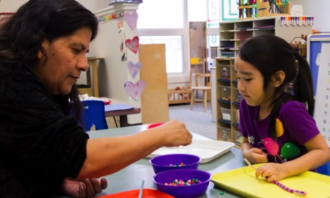
WHEN CAN I PROVIDE FEEDBACK THAT SUPPORTS ENGAGEMENT & LEARNING?
Teachers may provide feedback throughout the school day in all classroom activities.
Small group is an optimal forum for focused back-and-forth exchanges.

Slide 14
Improving practice
Video record and review your own teaching.
Practice with a peer.
Watch a “master teacher” in action.

Slide 15
SUMMARY
Teachers can provide feedback that supports engagement and learning by:
Engaging in back-and-forth exchanges
Asking children to explain their thought processes
Encouraging children’s efforts.
Teachers may provide feedback throughout the school day.
Teachers can improve the quality and frequency of the feedback they provide to children.

Slide 16
FALL 2013

