Slide 1
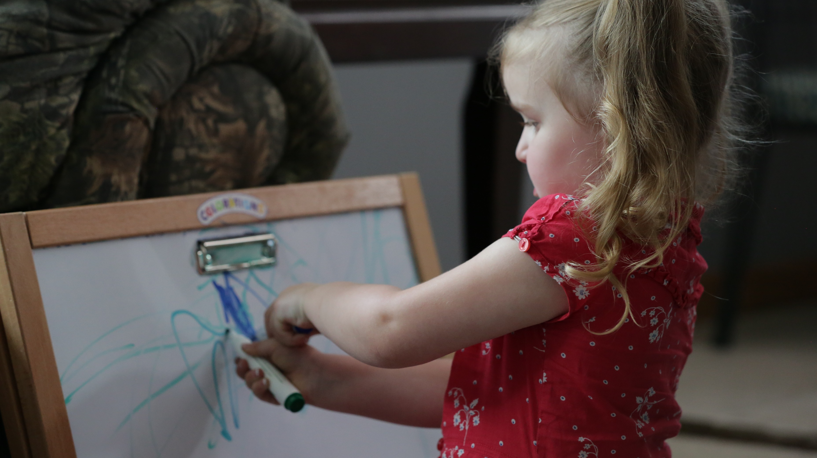

EMERGENT WRITING

Slide 2
HSPPS Support Emergent Writing
Subpart C - Education and Child Development Program Services
1302.30 Purpose
All programs must provide high-quality early education and child development services, including for children with disabilities, that promote children’s cognitive, social, and emotional growth for latter success in school….

Slide 3
HSPPS Support Emergent Writing
Subpart C - Education and Child Development Program Services
    1302.35 Education in Home-Based Programs
    (a) Purpose. A home-based program must provide home visits and group socialization activities that promote secure parent-child relationships and help parents provide high-quality early learning experiences in language, literacy, mathematics, social and emotional functioning, approaches to learning, science, physical skills, and creative arts. A program must implement a research-based curriculum…

Slide 4
Center-Based and Family Child Care Practices
Effective Teaching Practices
Child Development

Slide 5
Home Visit Practices
Effective Home Visiting & Socialization
Positive Parenting
Child Development

Slide 6
What’s Different for a Home Visitor?
Effective Home Visiting
Positive Parenting
Child Development

Slide 7
Theory of Change for Home-Based
Theory of change model for infant/toddler home visiting vs. classroom.
Source: Roggman et al, 2016

Slide 8

Parents Can Support Early Writing
Help parents foster their child’s pre-drawing, early drawing, and scribbling. Have them:
  Provide writing materials for children and encourage their use
  Ask their child to talk about their drawing (when possible)
  Revisit children’s drawings between home visits and explain what it is or says

Slide 9
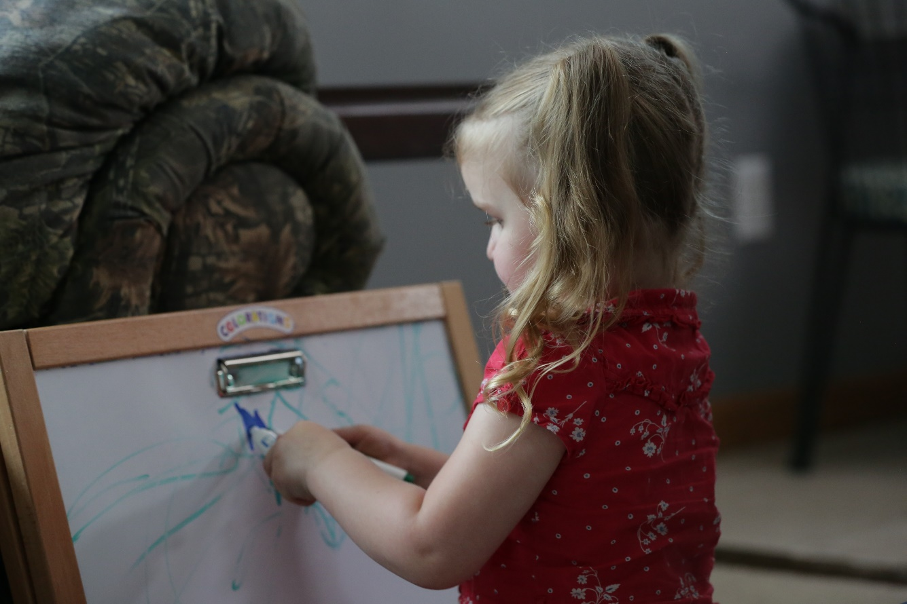
Parents Can Support Later Writing
Support parents in:
Starting with name writing with their child
Modeling writing throughout the day and in different contexts
Engaging in shared and independent writing with children
Including authentic opportunities for writing throughout the day
Finding opportunities to practice writing with peers

Slide 10
Learning Activity: Writing in Your Setting
Have parents select samples of their child’s writing or drawing, and review with them.
Work with parents to identify which stage(s) of emergent writing their child is in.
  Do the sample shows children’s parent-supported or independent writing?
How can you support this parent during writing activities with their child?
What activities can you offer parents to provide additional opportunities to practice writing?

