Slide 1
What am I breaking DowN?
Goals set the broad direction for a child’s learning.
Objectives are goals broken down into smaller parts for everyday teaching.

Slide 2
Goals and Objectives
Goal: Cooperates
with peers.
Objective: Engages in an activity with a peer for five minutes.
Goal: Engages
in storytelling.
Objective: Retells two events from a story.

Slide 3
Break it down by smaller amounts
Plays with one toy for at least 5 minutes
3
Plays with one toy for 3 minutes
2
Plays with one toy for 2 minutes
1
Plays with one toy for 1 minute

Slide 4
Break it down by smaller amounts
Plays throughout the day with 4 different peers
3
Plays with 3 peers
2
Plays with 2 peers

Slide 5
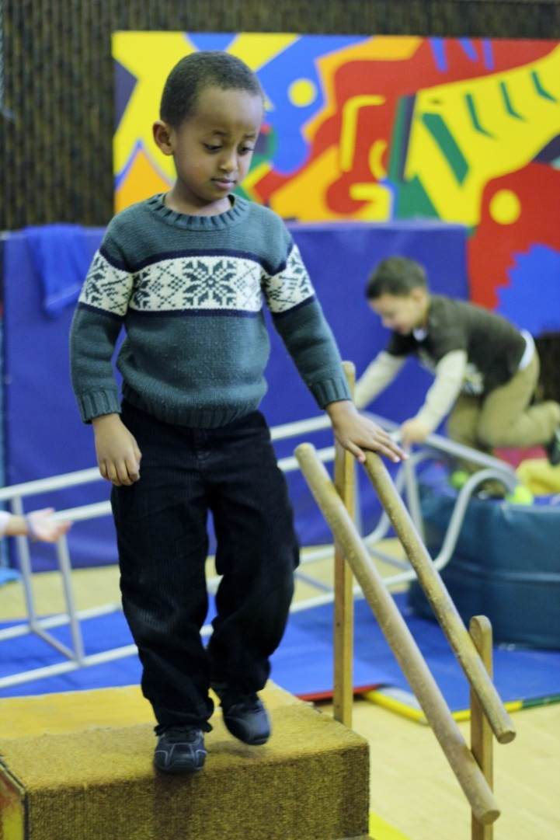
Break it down by smaller amounts
Walks up and down stairs in a variety of school locations
4
Uses stairs in classroom, playground, and bus
3
Uses stairs in classroom and playground
2
Uses stairs in the classroom

Slide 6
Break it down by providing help
First, I’ll help by putting my hand over his hand to help cut.
Next time, I’ll remind him how to hold the scissors.
Finally, I’ll wait to see if he can hold the scissors before I help.

Slide 7
Break it down by providing help
I’ll hang up a picture on her cubby and remind her to hang her backpack!
Then I’ll just leave the visual reminder on her cubby.
After a few days, I’ll take away the picture to see if she is ready to hang her backpack up on her own!

Slide 8
Break it down Step by step
Washing Hands
TURN ON WATER
TURN OFF WATER
GET SOAP
GET PAPER TOWEL
RUB SOAP INTO HANDS
DRY HANDS
RINSE HANDS
PAPER TOWEL INTO GARBAGE

Slide 9
Break it down Step by step
Putting on a coat
GET COAT
LIFT OVER HEAD
PUT ON THE FLOOR
SLIDE ARMS THROUGH HOLES
PUT ARMS IN COATHOLES
SLIDE COAT DOWN BACK

Slide 10
Break it down by Logical order
USES NUMBER TO SOLVE PROBLEMS
IDENTIFIES PATTERNS
IDENTIFIES CAUSE AND EFFECT
COMPARES OBJECTS
COUNTS 10 OBJECTS

Slide 11
Break it down by Logical order
Identifies 6 size concepts
Identifies 5 shapes
Identifies 8 colors

