Slide 1
Break it down:
Turning Goals into Everyday Teaching Opportunities
SUMMER 2014

Slide 2
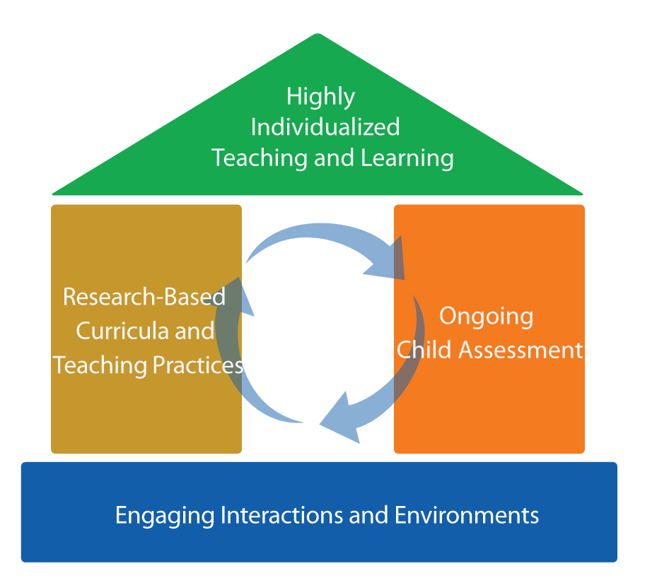
Focus on the roof
Break it Down: Turning Goals into Teaching Opportunities

Slide 3
Objectives
Identify children
Determine goals to teach
Break down goals

Slide 4
Break it down－why?
All staff understand the skill they are teaching.
Each broken-down step can be accomplished within a few weeks.
Progress on objectives means progress toward the annual goal!

Slide 5



Identify Children
Children with IEPs
Children with behavior support plans
Children who are not making progress on their learning goals

Slide 6
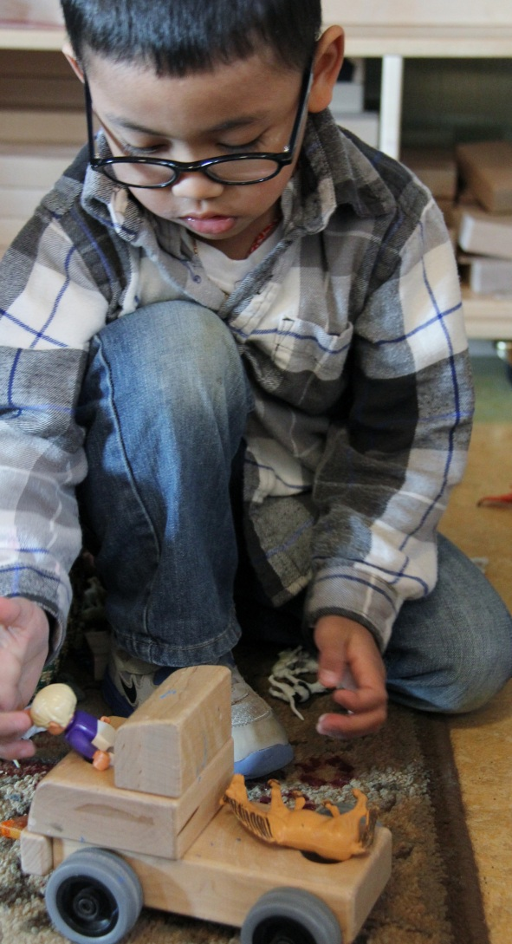
Determine the Goals TO TEACH
Identify the child’s current goals.
Identify goals that need clarification.

Slide 7
Break Down Goals
3
Order the parts for teaching, starting at the current level of progress.
2
1
Determine the child’s progress on the goal.
Break down the goal into smaller parts.

Slide 8

Break it down by smaller amounts
Make goals easier by specifying smaller amounts of items, time, people, or locations.
Hi! I’m Mia.
I’m going to put all the red toys together and play with friends.

Slide 9

smaller amounts
Yeah!
Sorts a collection by color
4
Sorts a collection into 4 colors
3
Sorts a collection into 3 colors
2
Sorts a collection into 2 colors

Slide 10


Break it down by providing help
Make goals easier by providing help.
Hi again!
I’m Mia’s teacher!

Slide 11

provide help
Mia, Say hi to Zoe
Oh look, Zoe wants to play.
Mia, do you want to play?
Mia, do you want to play again?
Hi!
Hi!

Slide 12

Break it down Step by step
Make goals easier by breaking a complex task into individual steps.
Hi! I’m Addie.
I want to play with my friends!

Slide 13


Step by step
I did it!
Invites a peer to play
Identifies toy or game to play
Identifies a peer to play with
Approaches peer
Gets peer’s attention

Slide 14


Break it down by Logical Order
Make goals easier by identifying related skills and ordering in a teaching sequence.
Hi! I’m Carlos.
I want to write the letters in my name!

Slide 15


Logical order
Yeah!
Writes the letters
of first name
Writes mock letters or letter-like forms
Writes using pictures and squiggles

Slide 16
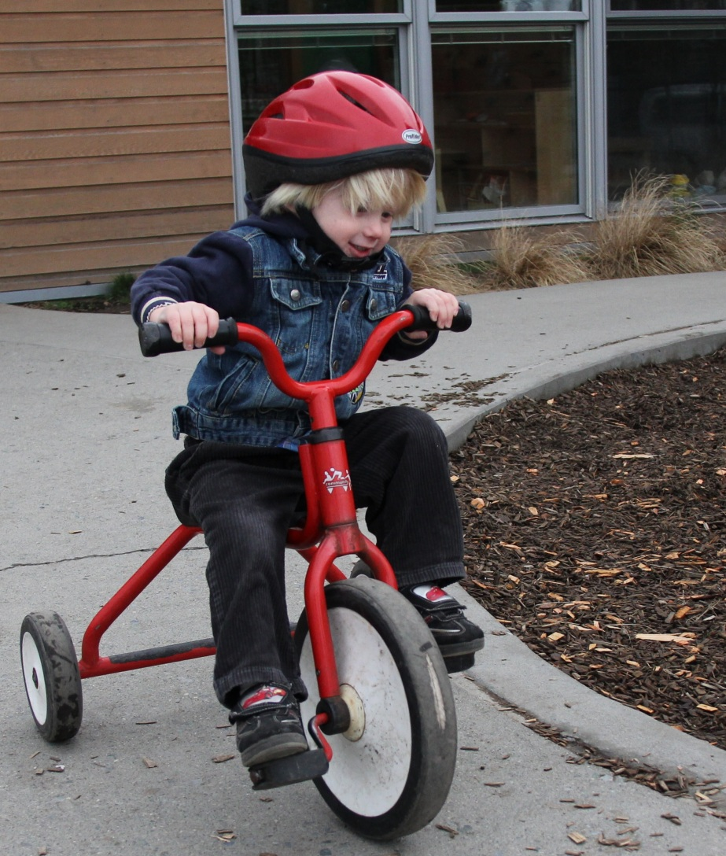
Break-it-down activity
1. Adult pushes bike forward, holding on.
Rides a tricycle
2. Adult pushes bike forward with one big push.
3. Adult waits for child to try, then pushes forward, as needed.

Slide 17
REVIEW – Steps to Success!
Identify children
Determine goals to teach
Break down goals

Slide 18
SUMMER 2014

