Slide 1
Activity matrix: organizing learning throughout the day
SUMMER 2014

Slide 2
Focus on the roof
FRAMEWORK FOR EFFECTIVE PRACTICE SUPPORTING SCHOOL READINESS FOR ALL CHILDREN
Activity Matrix: Organizing Learning throughout the Day

Slide 3
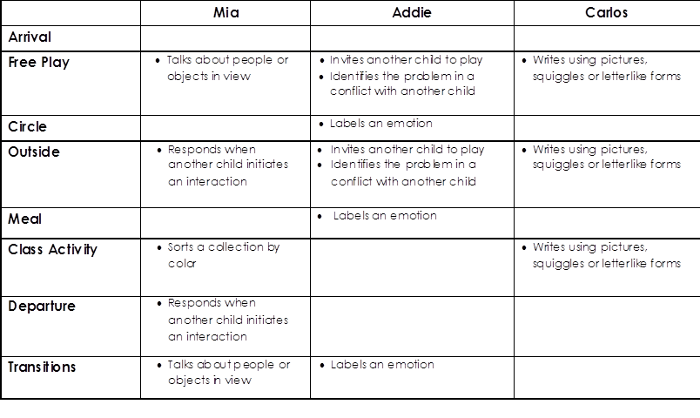
Activity Matrix
Mia
Addie
Carlos
Arrival
Free Play
Circle
Labels an emotion
Outside
Meal
Labels an emotion
Class Activity
Departure
Transitions
Labels an emotion

Slide 4
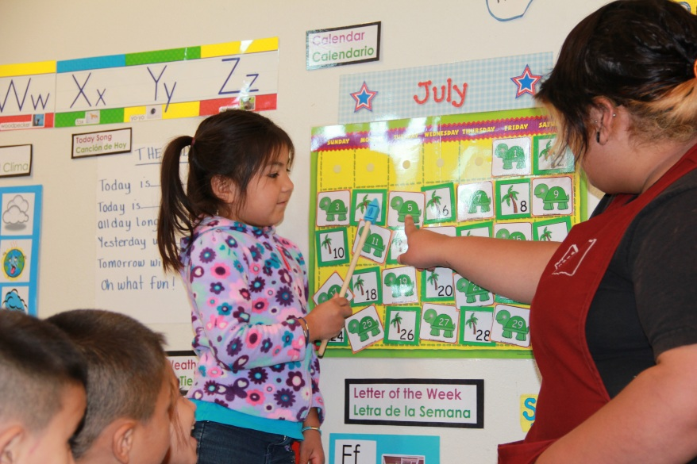
An Activity Matrix
1. Is an effective way to organize teaching and learning opportunities.
2. Maximizes learning time by planning for teaching to occur throughout all activities, routines, and transitions.
3. Helps all staff be aware of individual child learning objectives.
4. Matches the child’s learning objective to the activity.
5. Can be implemented for any child, but is especially useful for those who need extra support.

Slide 5
Creating an Activity Matrix
Step 1: List the activities and times of day in the left-hand column of the chart.
Step 2: List children in the top row.
 | Mia | Addie
Arrival
Free Play
Circle
Outside
Meal
Class Activity
Departure
Transitions
Talks about people or objects in view
Responds when another child initiates an interaction
Invites another child to play
Identifies the problem in a conflict with another child
Talks about people or objects in view
Labels an emotion
Notes:
8/13/08

Slide 6
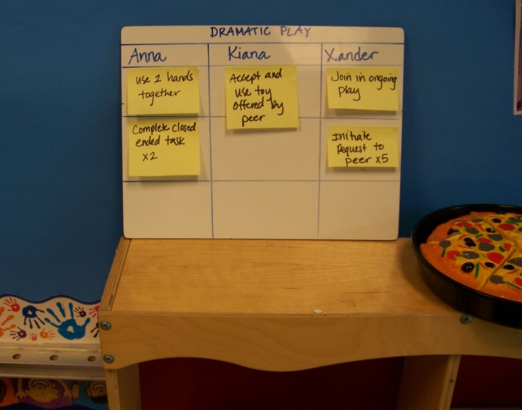
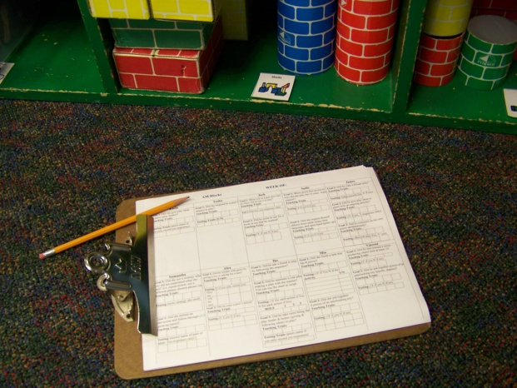
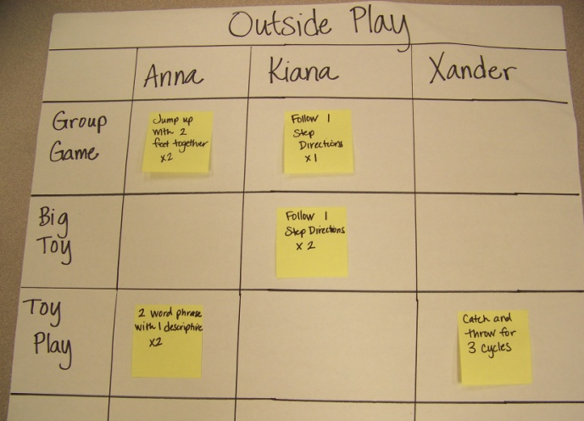
Make it your own
Notes:
8/13/08

Slide 7
video
Notes:
7

Slide 8
Tips for implementing: Start small
 | Mia
Arrival
Free Play | Talks about people or objects in view
Circle
Outside | Responds when another child initiates an interaction
Meal
Class Activity | Sorts a collection by color
Departure | Responds when another child initiates an interaction
Transitions | Talks about people or objects in view
Addie
Invites another child to play Identifies the problem in a conflict with another child
Labels an emotion
Invites another child to play Identifies the problem in a conflict with another child
Labels an emotion
Labels an emotion
Carlos
Writes using pictures, squiggles or letterlike forms
Writes using pictures, squiggles or letterlike forms
Writes using pictures, squiggles or letterlike forms

Slide 9
Tips for implementing: start small
 | Mia | Addie | Carlos
Arrival
Free Play | Talks about people or objects in view | Invites another child to play Identifies the problem in a conflict with another child | Writes using pictures, squiggles or letterlike forms
Circle |  | Labels an emotion
Outside | Responds when another child initiates an interaction | Invites another child to play Identifies the problem in a conflict with another child | Writes using pictures, squiggles or letterlike forms
Meal |  | Labels an emotion
Class Activity | Sorts a collection by color |  | Writes using pictures, squiggles or letterlike forms
Departure | Responds when another child initiates an interaction
Transitions | Talks about people or objects in view | Labels an emotion

Slide 10
Tips for implementing: Make it work for you!
 | Mia | Addie | Carlos
Arrival
Free Play | Talks about people or objects in view | Invites another child to play Identifies the problem in a conflict with another child | Writes using pictures, squiggles or letterlike forms
Circle |  | Labels an emotion
Outside | Responds when another child initiates an interaction | Invites another child to play Identifies the problem in a conflict with another child | Writes using pictures, squiggles or letterlike forms
Meal |  | Labels an emotion
Class Activity |  |  | Writes using pictures, squiggles or letterlike forms
Departure | Responds when another child initiates an interaction
Transitions | Talks about people or objects in view | Labels an emotion
Sorts a collection by color
Sorts a collection by color

Slide 11
Tips for implementing: Provide the right materials
 | Mia | Addie | Carlos
Arrival
Free Play | Talks about people or objects in view | Invites another child to play Identifies the problem in a conflict with another child | Writes using pictures, squiggles or letterlike forms
Circle |  | Labels an emotion
Outside | Responds when another child initiates an interaction | Invites another child to play Identifies the problem in a conflict with another child | Writes using pictures, squiggles or letterlike forms
Meal |  | Labels an emotion
Class Activity | Sorts a collection by color |  | Writes using pictures, squiggles or letterlike forms
Departure | Responds when another child initiates an interaction
Transitions | Talks about people or objects in view | Labels an emotion

Slide 12
Tips for implementing: Review Learning Opportunities

Slide 13
Review
Maximize learning time by organizing opportunities for learning.
All staff are able to participate in teaching.
Format can be made in various ways to better work for your classroom.

Slide 14
SUMMER 2014

