Slide 1
Curriculum modifications: putting it into action

Slide 2
Focus on the roof
FRAMEWORK FOR EFFECTIVE PRACTICE SUPPORTING SCHOOL READINESS FOR ALL CHILDREN

Slide 3
Curriculum Modification
Intensive, Individualized Teaching
Embedded Teaching
Curriculum Modification

Slide 4
objectives
Review curriculum modifications.
Discuss a plan for action.
Organize a plan based on an individual child’s needs.

Slide 5
What is curriculum modification?

Slide 6
Why modify the curriculum?
Increased learning!
Access
Participation

Slide 7
Types of Curriculum Modifications
Environmental Support
Special Equipment
Materials Adaptation
Adult Support
Simplify the Activity
Peer Support
Child Preferences
Invisible Support

Slide 8
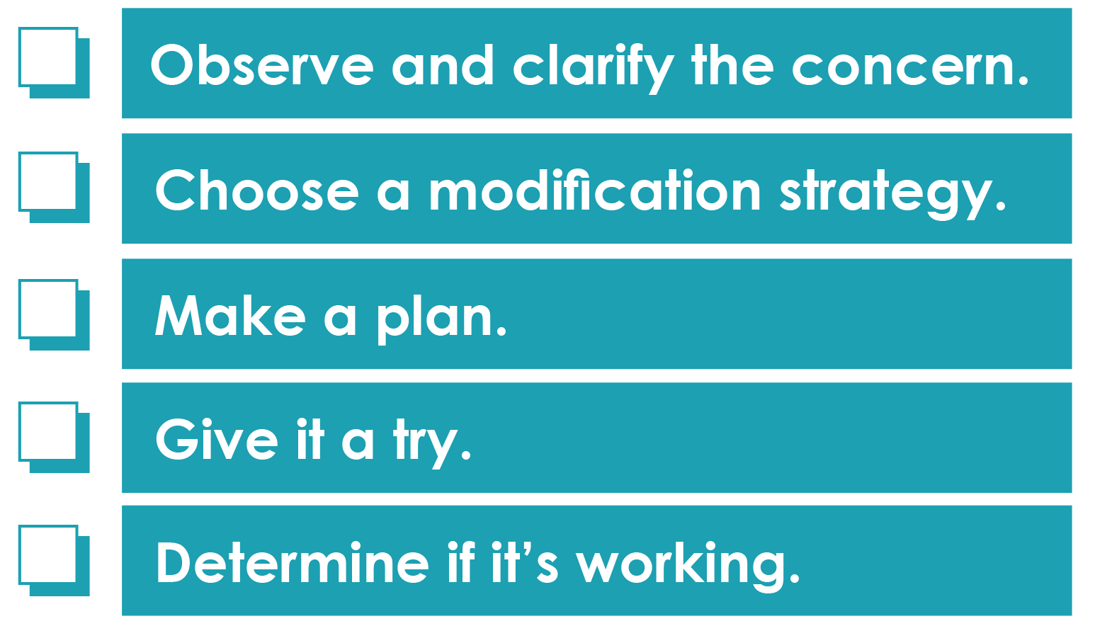
Putting it into action

Slide 9
Observe and Clarify
When do you see confidence?
When do you see withdrawal?

Slide 10
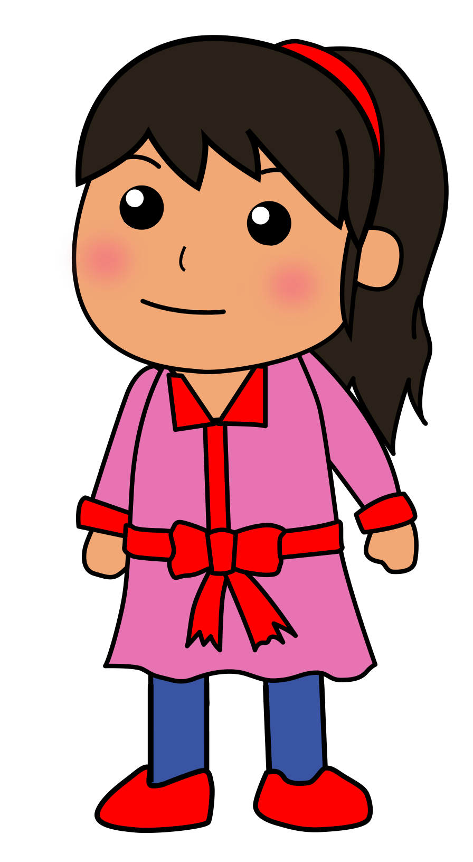
CHOOSE a modification strategy
Match supports with the child’s needs.
Keep it simple.
You can try more than one.
Don’t be afraid to experiment.
If at first you don’t succeed…

Slide 11
Make a plan
WHAT needs to be done?
WHO will
do it?
HOW will everyone stay informed?
WHEN will it
be ready?

Slide 12
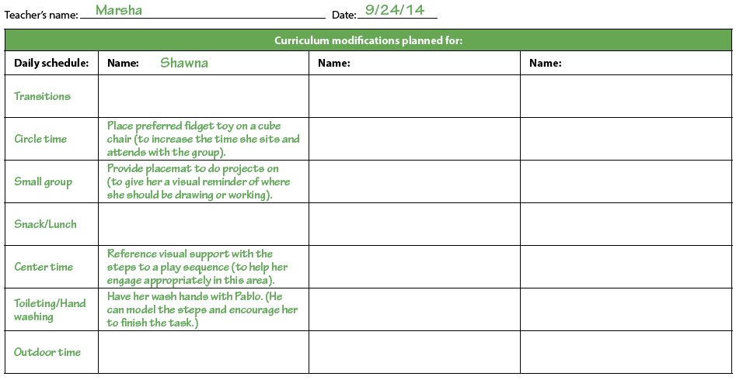
Use a matrix

Slide 13
Video: Modifications in action
A review- selected from the 8 suites.
(NDrive/CurrMod-Putting It Into Action/Video)

Slide 14
Determine if it’s working
Is it working?
Improving—Keep it up!
Fully participating— Phase out support.
YES
No improvement— Try something else.
Still no improvement— Consider increasing support.
NO

Slide 15
Any concerns?

Slide 16
Video: Making an impact
Susan, Ilene, Gail, Laurie- emphasizing the benefits of using curriculum modifications to support individual children
(Ndrive/CurrMod-Putting It Into Action/Video)

Slide 17
review
Let’s put it into action!
Observe and clarify the issue.
Identify a modification strategy.
Make a plan and give it a try.
Determine if it’s working.
If at first you don’t succeed…

Slide 18
Every child is worth it!

