Slide 1
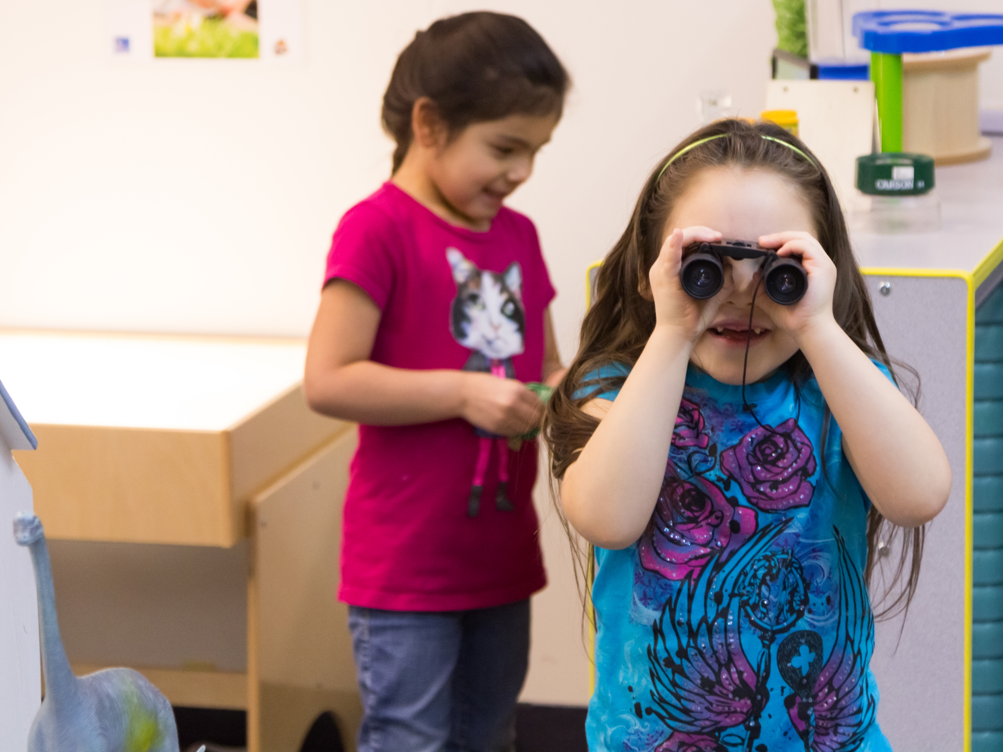
I SPY
Learning Activity Slides

Slide 2
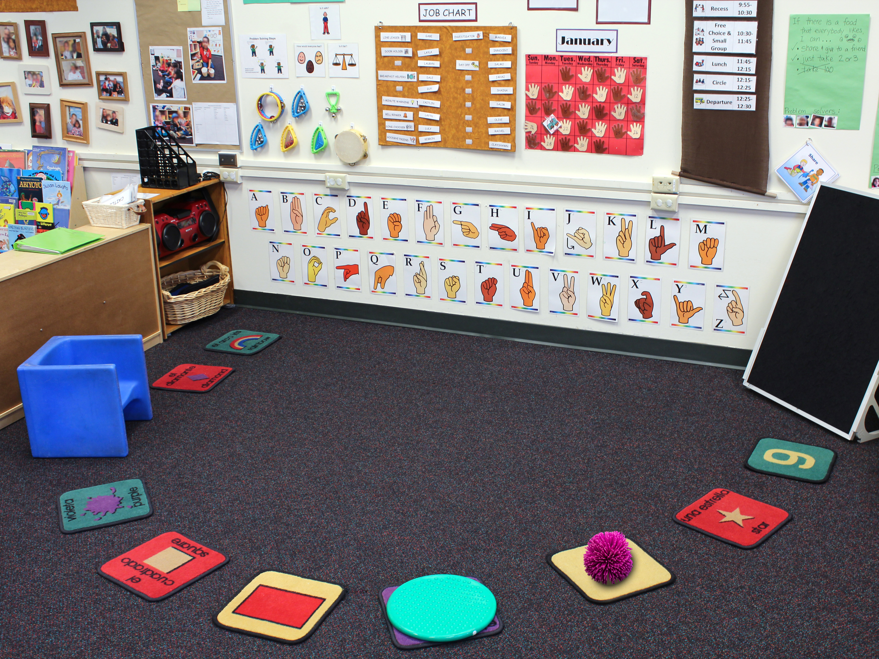
1
Visual supports—
to help dual language learners and children in need of support increase their understanding and level of independence
Cube chair—to give a child more support
Felt board (with felt shapes)—to involve children by allowing them to hold and move the felt pieces
Preferred toy on a child’s carpet square—to encourage a child’s successful transition from outside to
circle time
Bumpy cushion—
to give a wiggly child a way to
move their body while still attending to the teacher
Carpet squares—to define each child's personal space

Slide 3
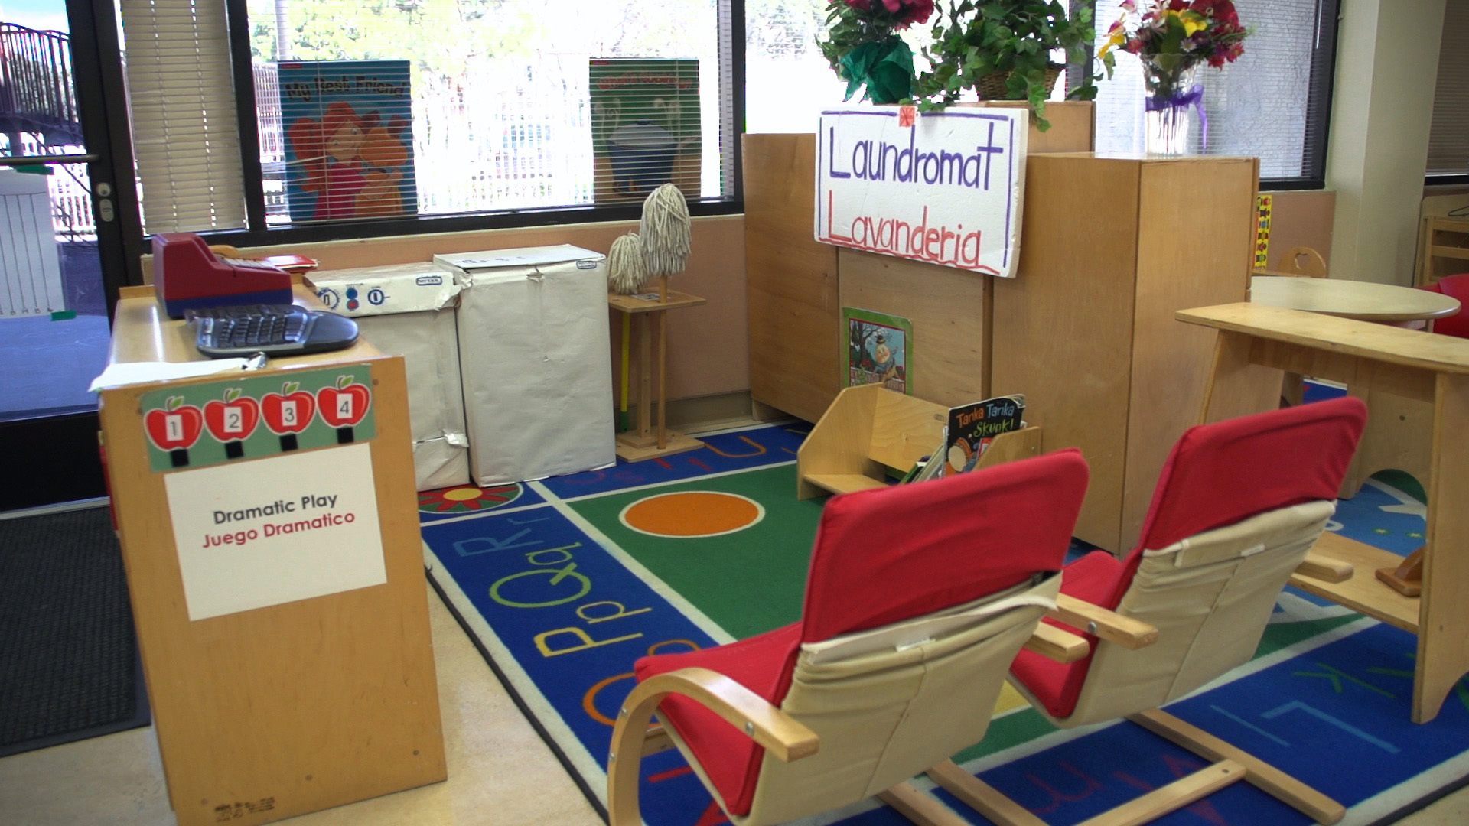
2
Chairs placed as
a barrier—to deter
a child from wandering in and out of centers without staying
to play
Poster for turn-taking—to encourage some children to expand their play by exploring other centers
Limited materials and stimulation—
to relax a child
who becomes overwhelmed by too many choices

Slide 4
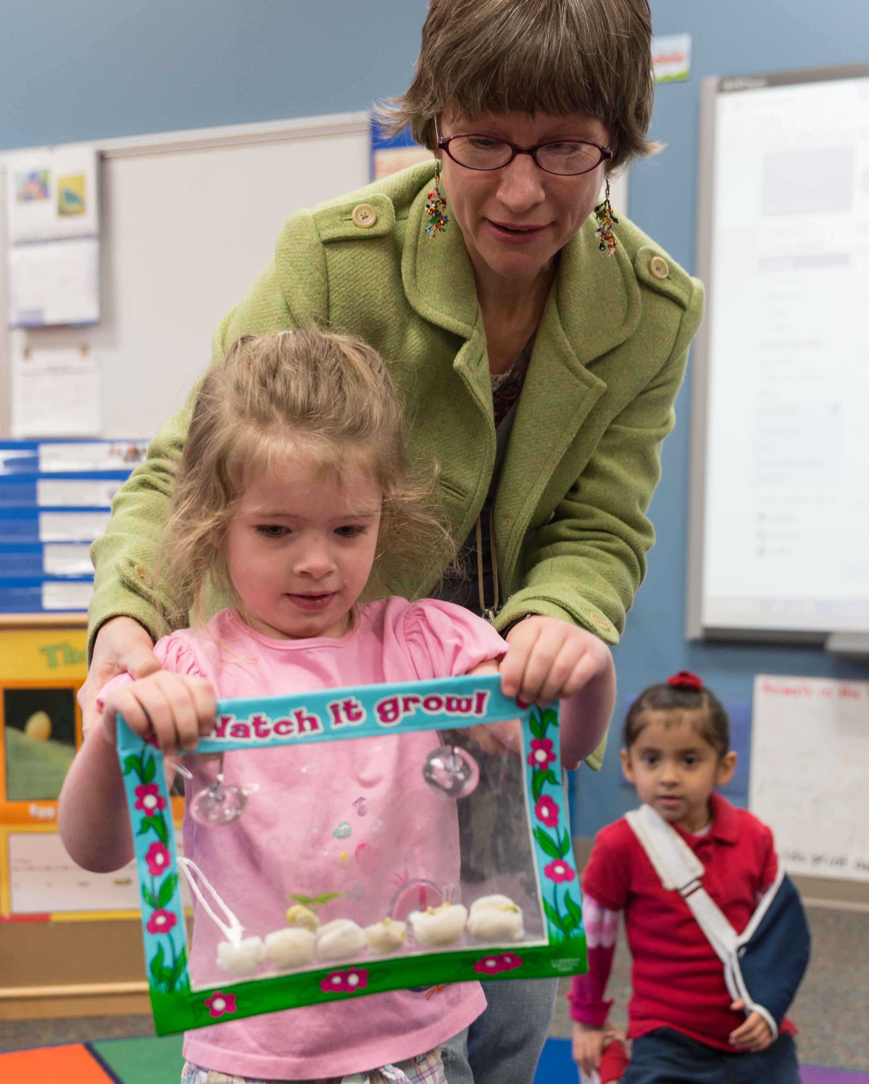
3
Teacher helps
child—to support
a child who gets overwhelmed
by transitions
Object for the next activity—to help a child stay on task during transitions

Slide 5
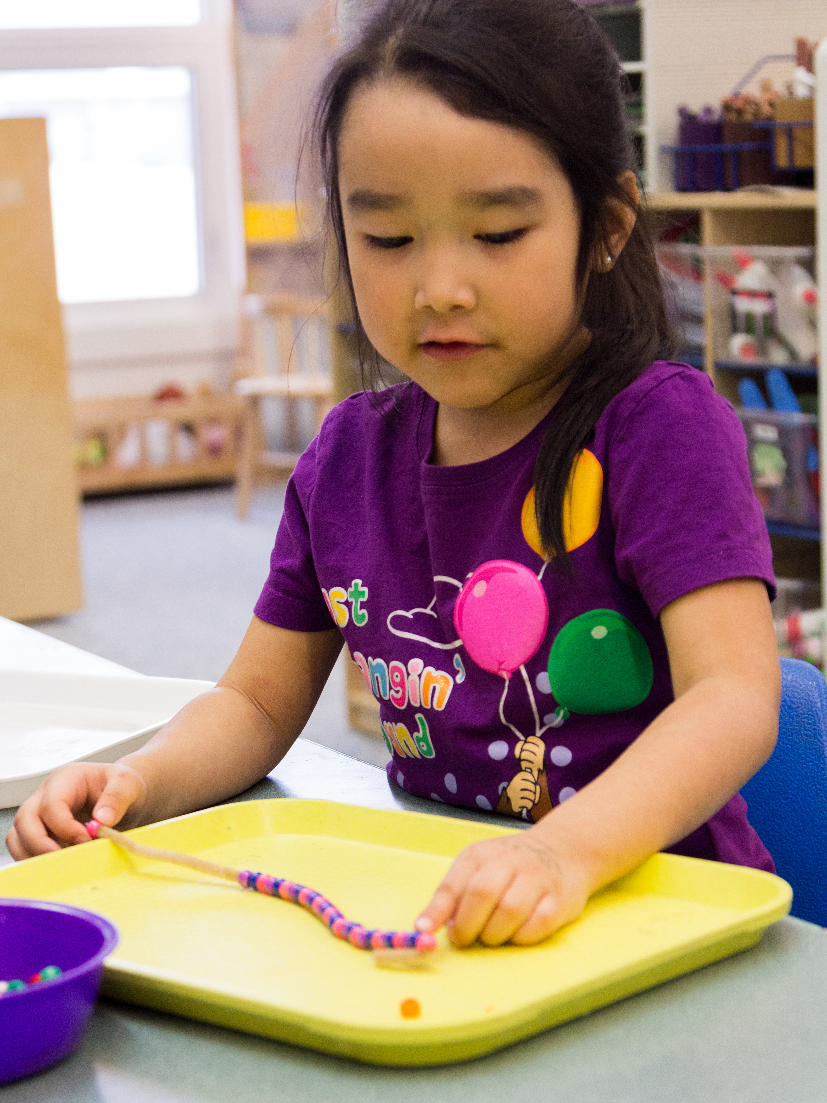
4
Favorite colors—
to motivate a child to engage in
the activity
Pipe cleaner instead of string—to help a child who struggles with fine motor tasks
Tray—to help a child manage materials
Pattern start—for a child who is not ready to make one independently

Slide 6
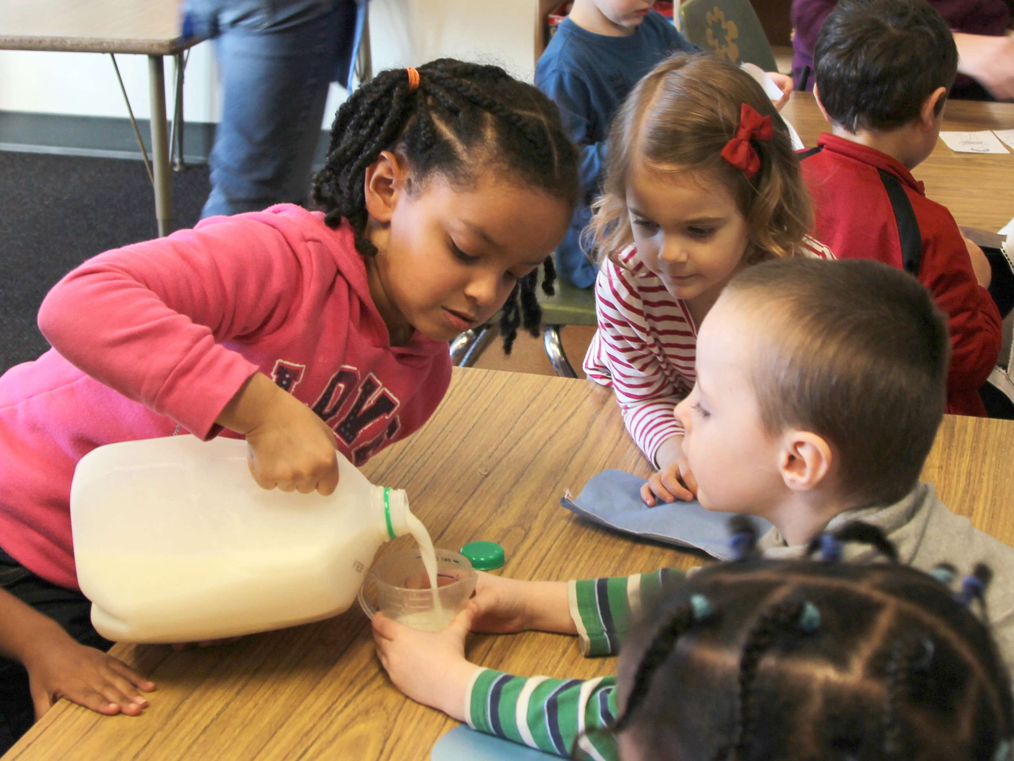
5
Peer helps peer—a child pours milk for one child
and models for another
Teacher gives the full container to an older child with more motor strength before the younger child takes a turn

