Slide 1
Curriculum modifications:
ADULT SUPPORT
WINTER 2014

Slide 2
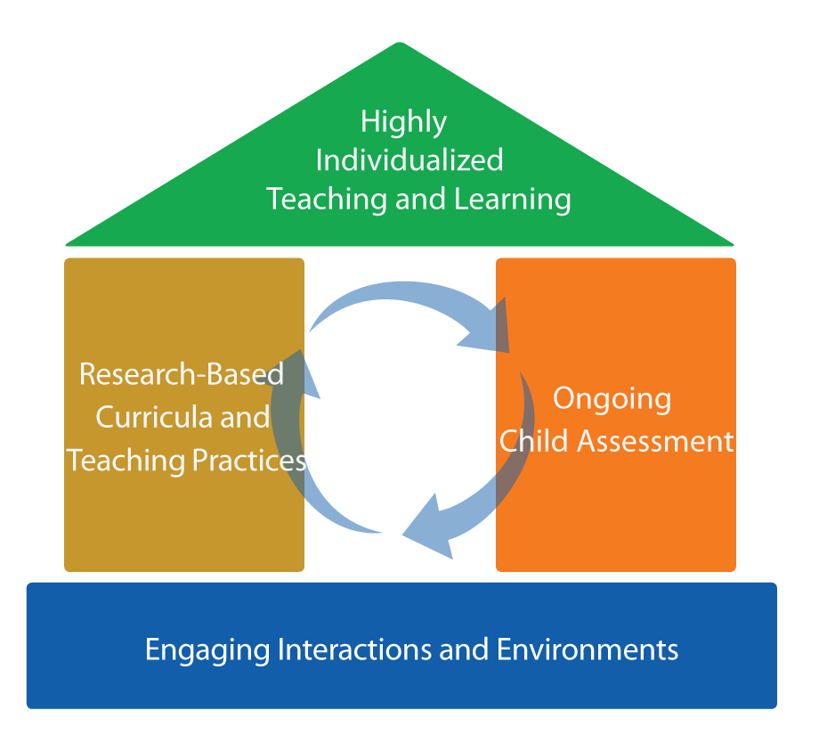
Focus on the roof
FRAMEWORK FOR EFFECTIVE PRACTICE
SUPPORTING SCHOOL READINESS FOR ALL CHILDREN

Slide 3


Curriculum Modification
Intensive,
Individualized
Teaching
Embedded Teaching
Curriculum Modification

Slide 4
objectives
Define adult support.
Provide strategies and examples.
Discuss application based
on individual children’s needs.

Slide 5
What is curriculum modification?

Slide 6
Types of Curriculum Modifications
Environmental Support
Special Equipment
Materials Adaptation
Adult Support
Simplify the Activity
Peer Support
Child Preferences
Invisible Support

Slide 7
Adult support
“
Having an adult intervene to support
the child’s participation and learning.
“
— Sandall & Schwartz, 2008

Slide 8
Why use adult support?
Increased learning!
Access
Participation

Slide 9
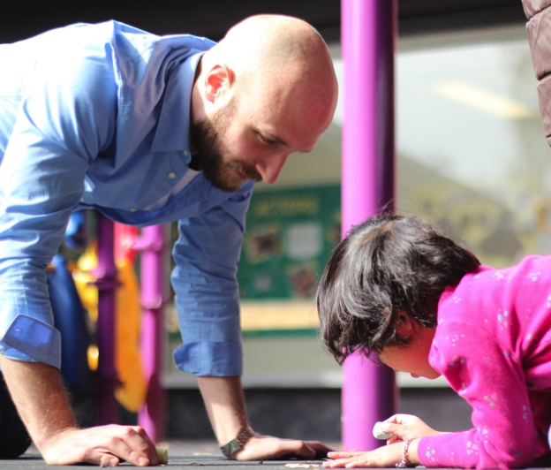
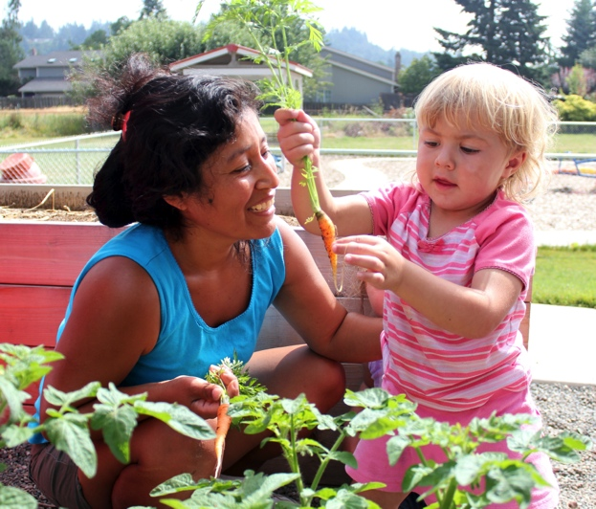
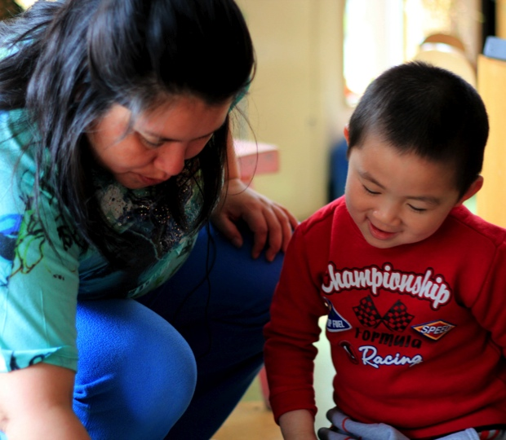
Adult support strategies
Join in the
child’s play.
Use praise and encouragement.
Provide a
model.

Slide 10
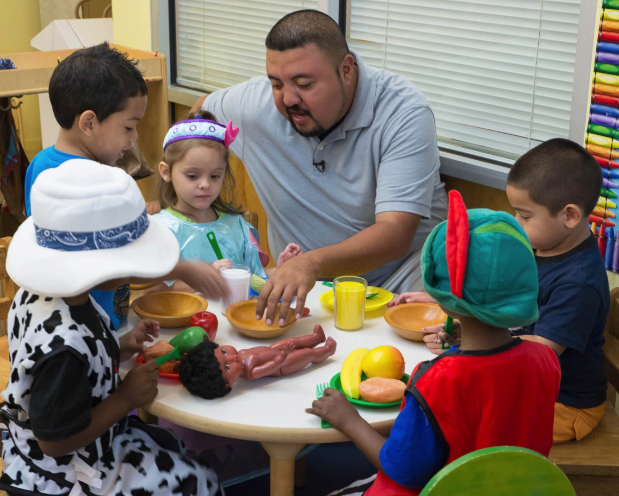
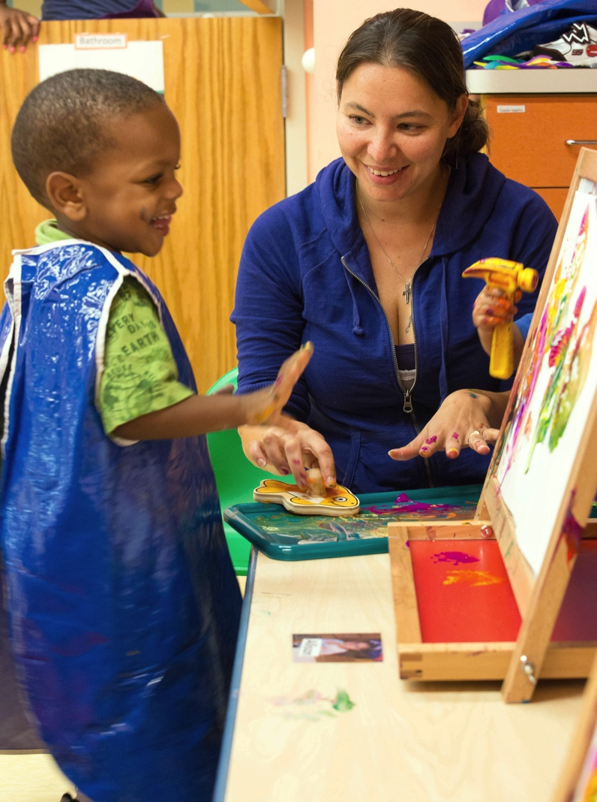
Join in the child’s play

Slide 11

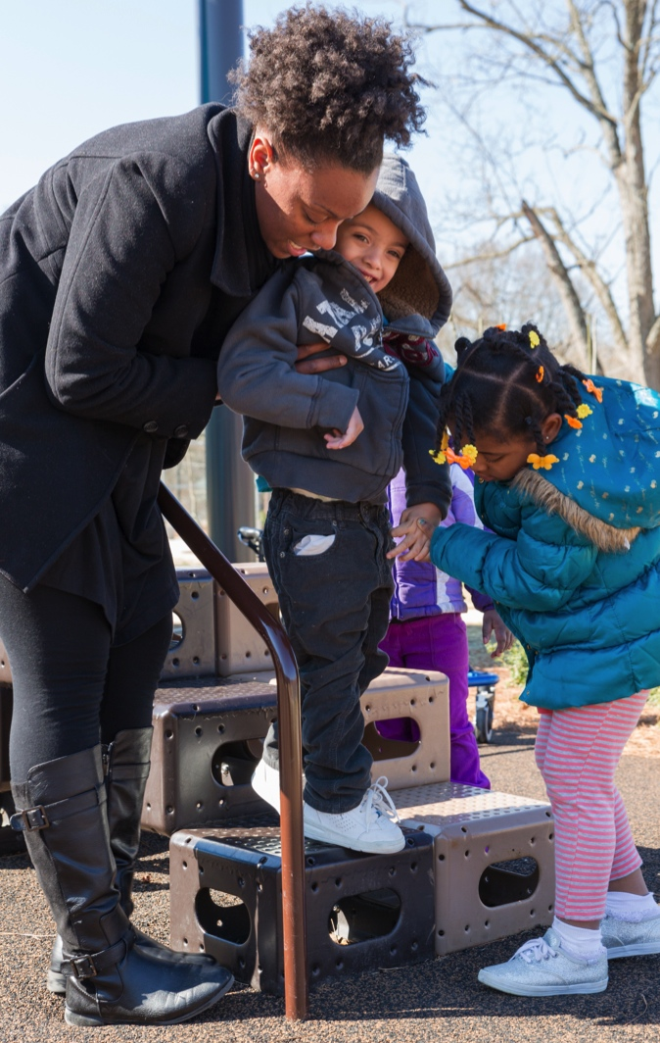
Use praise AND encouragement

Slide 12
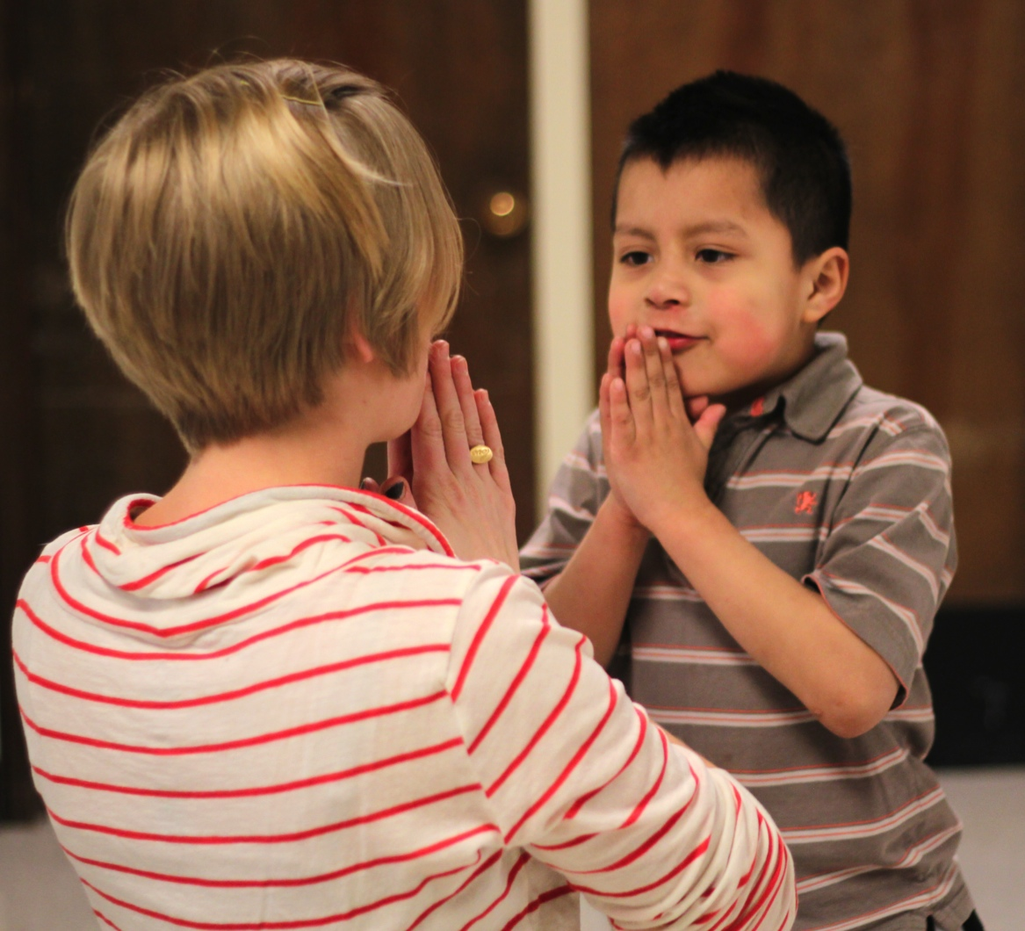

Provide a model

Slide 13

Video: Supporting Sonia’s Play
Curriculum Modifications-Adult Support/Video/Supporting Sonia's Play SUBS DRAFT 11.wmv

Slide 14

Video Learning activity:
What would you do?
This video is on the N Drive
Curriculum Modifications-Adult Support/Video
Curriculum Modifications-Adult Support/Video/What Would You Do Draft 3

Slide 15
Just the right amount of support
Facilitate independence.
Look for signs
of progress.
Decrease support
as skill level
improves.
Be prepared
for variable behavior.

Slide 16

Video: Adjusting in the Moment
Curriculum Modifications-Adult Support/Video/Adjusting in the Moment

Slide 17
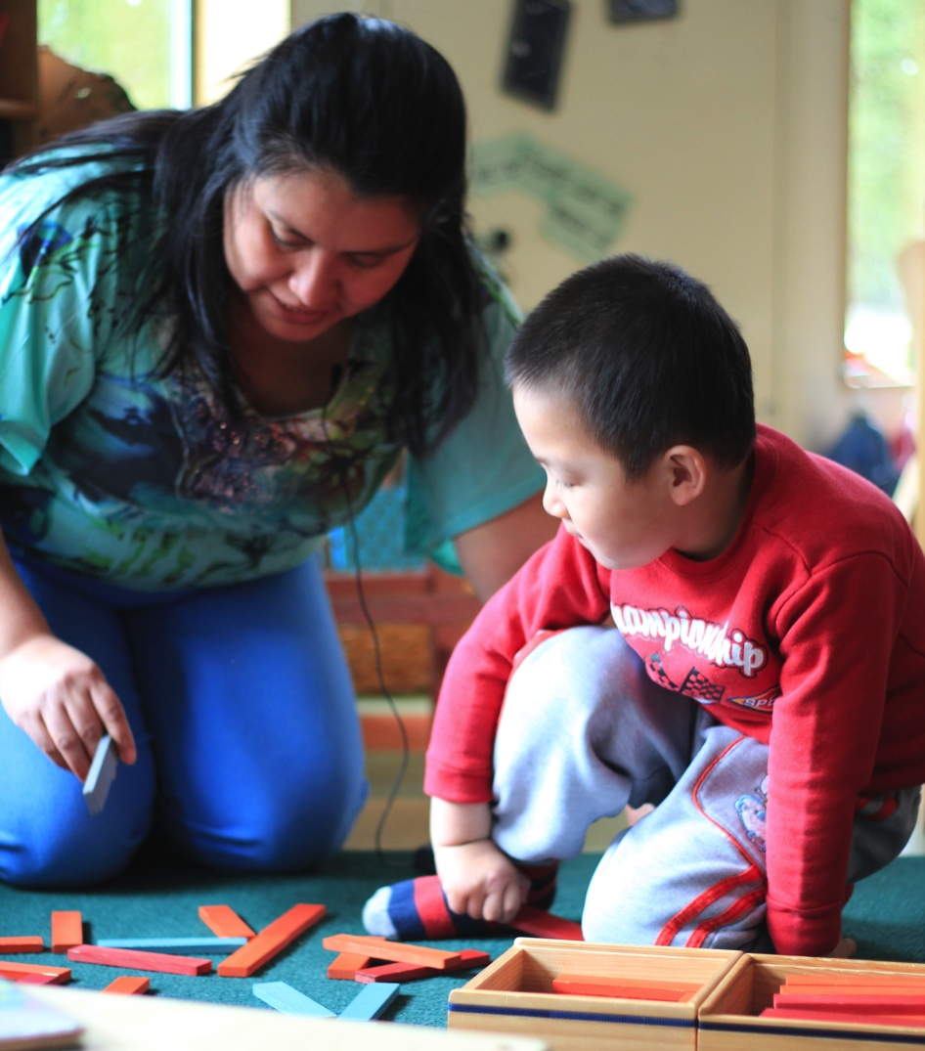
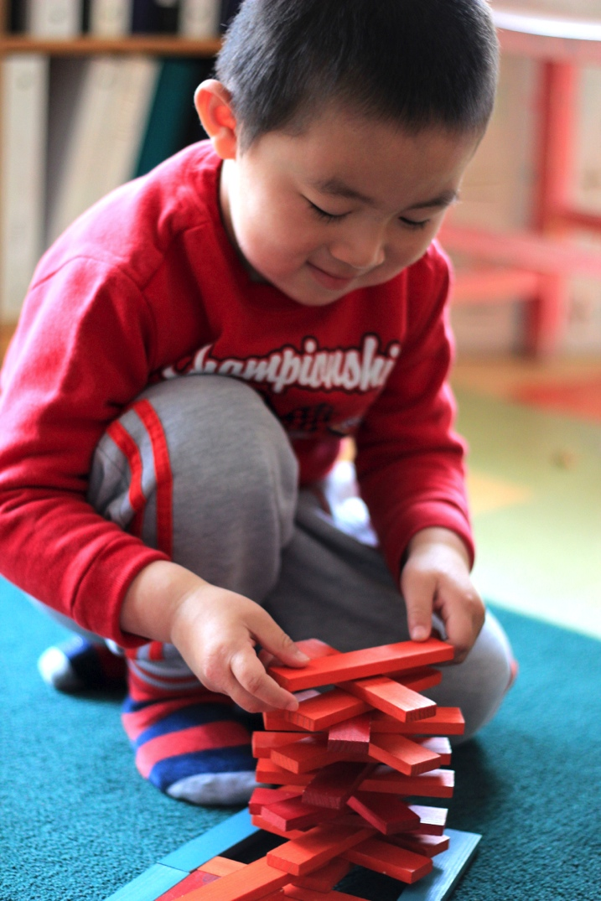
Daniel: SUPPORT AND EMPOWER

Slide 18
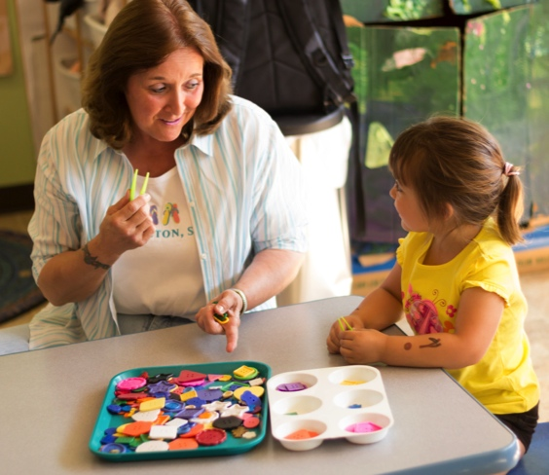


SADIE: SUPPORT AND EMPOWER

Slide 19
review
Curriculum modifications promote participation.
Adult support:
  Join the child’s play.
  Use praise and encouragement.
  Provide a model.
Support and Empower

