Slide 1
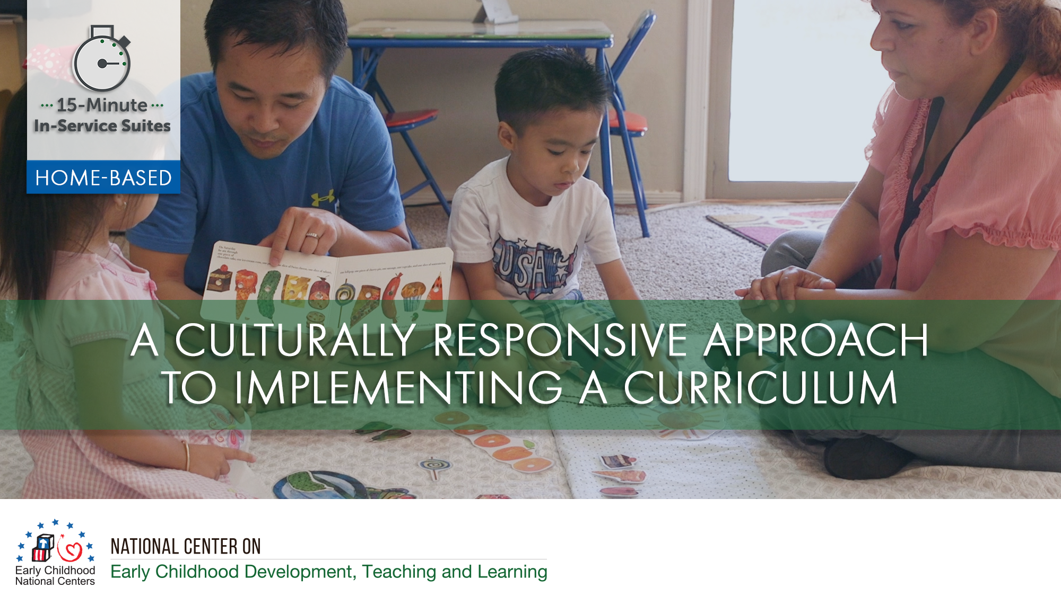

Slide 2
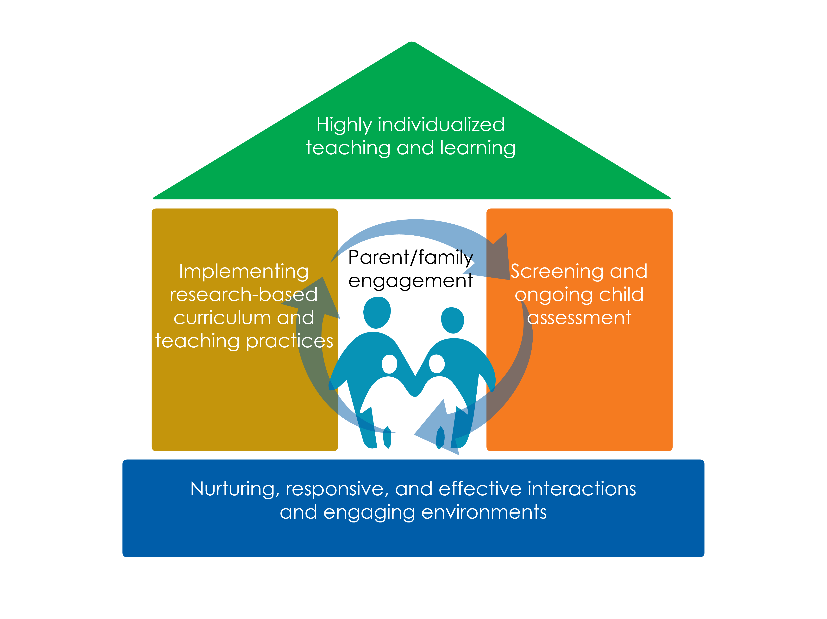

Slide 3
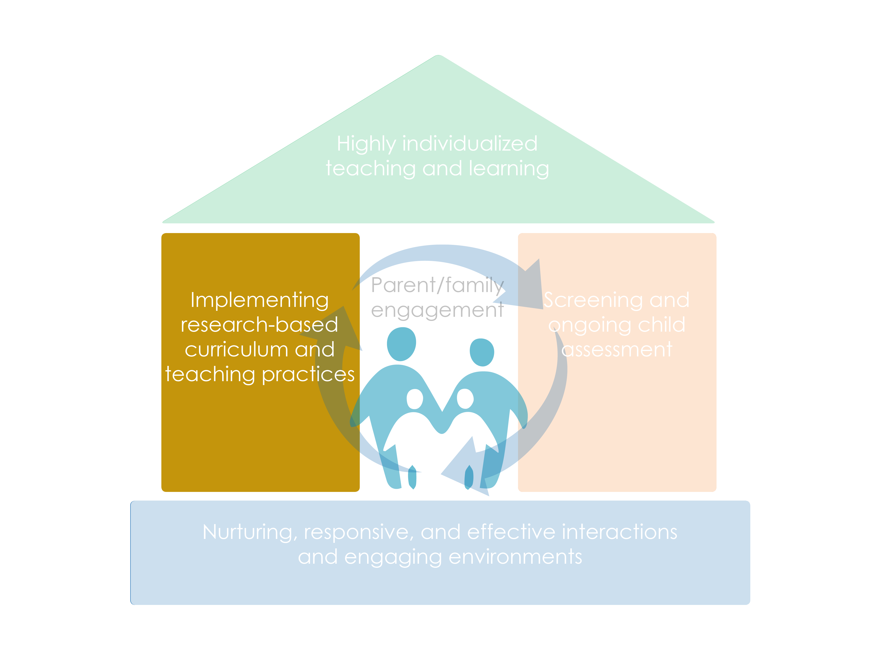

Slide 4
Objectives
Identify how culture influences and informs relationships, caregiving, and learning
Provide practices for learning about families’ cultures with respect and appreciation for their cultural values, practices, and traditions
Describe a culturally responsive approach to implementing a curriculum that builds on the families’ cultures

Slide 5
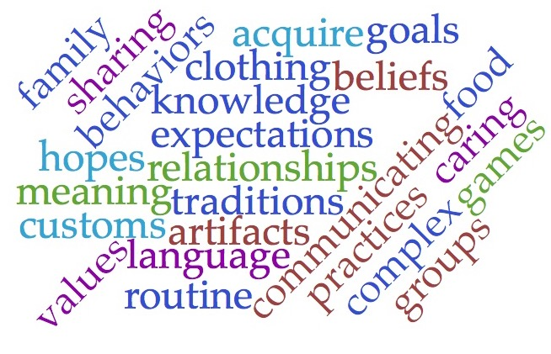
What is culture?

Slide 6




Learning Activity: The Role of Culture
When was the first time you realized that the way your family did something was different from how others did it?
What was something special your family liked to do together?
What were some of your favorite foods growing up?
How have you been influenced by where you grew up?

Slide 7
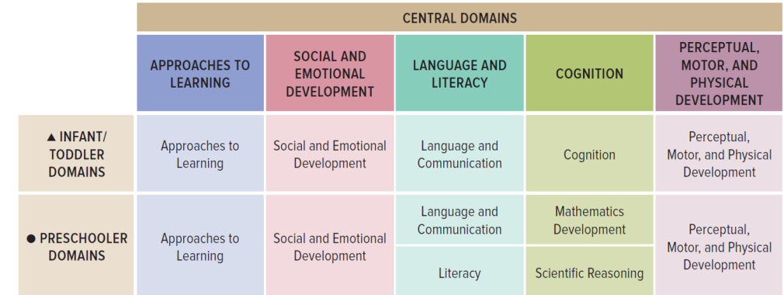
Cultural Responsiveness Threads Through the ELOF

Slide 8
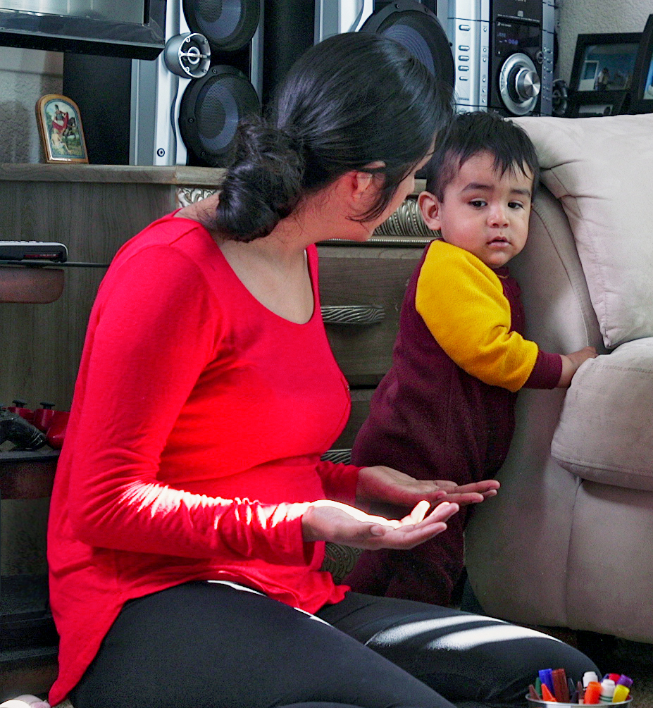
  Culture Influences Learning and Development
Express and manage emotions
Attend to others
Show respect
Seek comfort
Engage with stories or songs

Slide 9
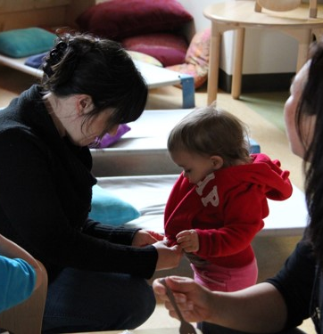
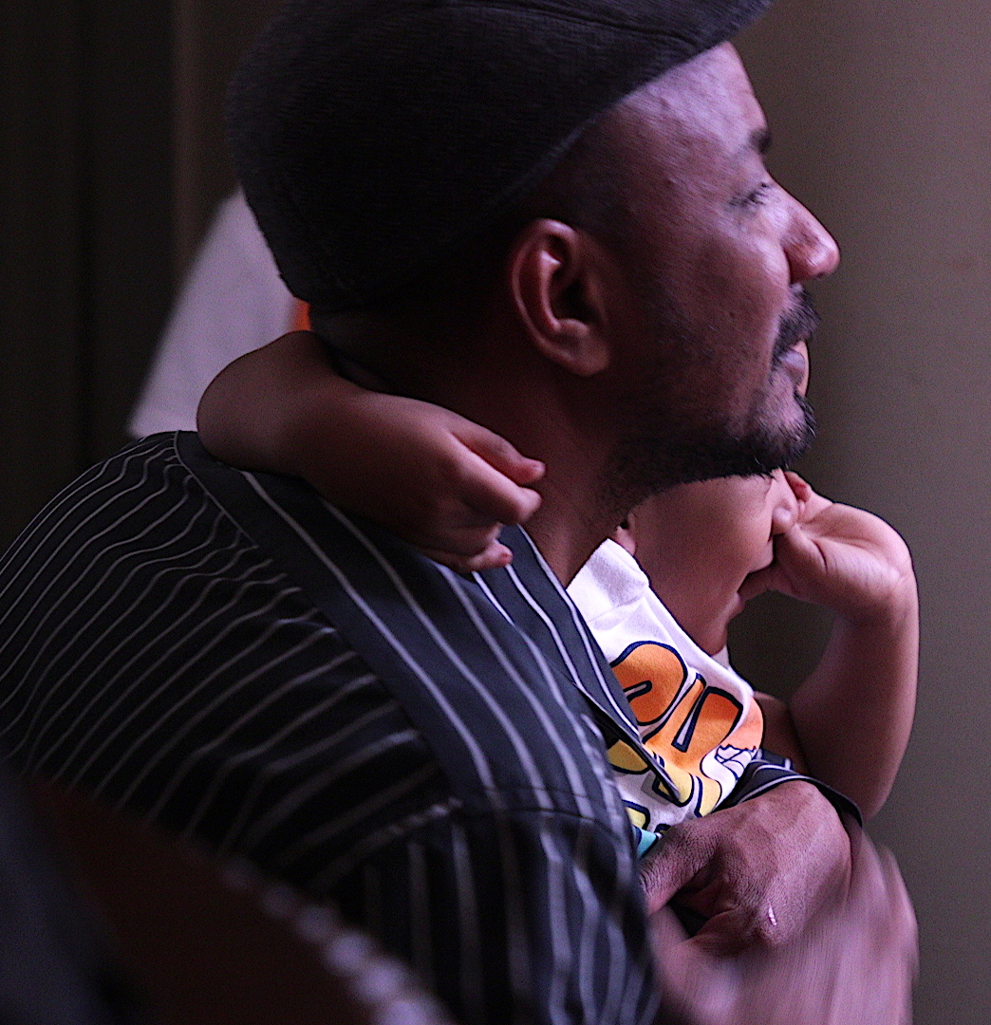
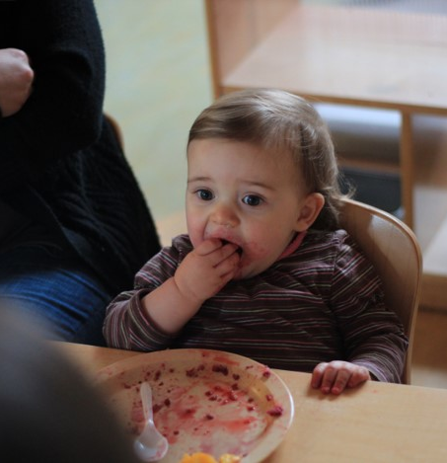
Culture Influences Caregiving

Slide 10
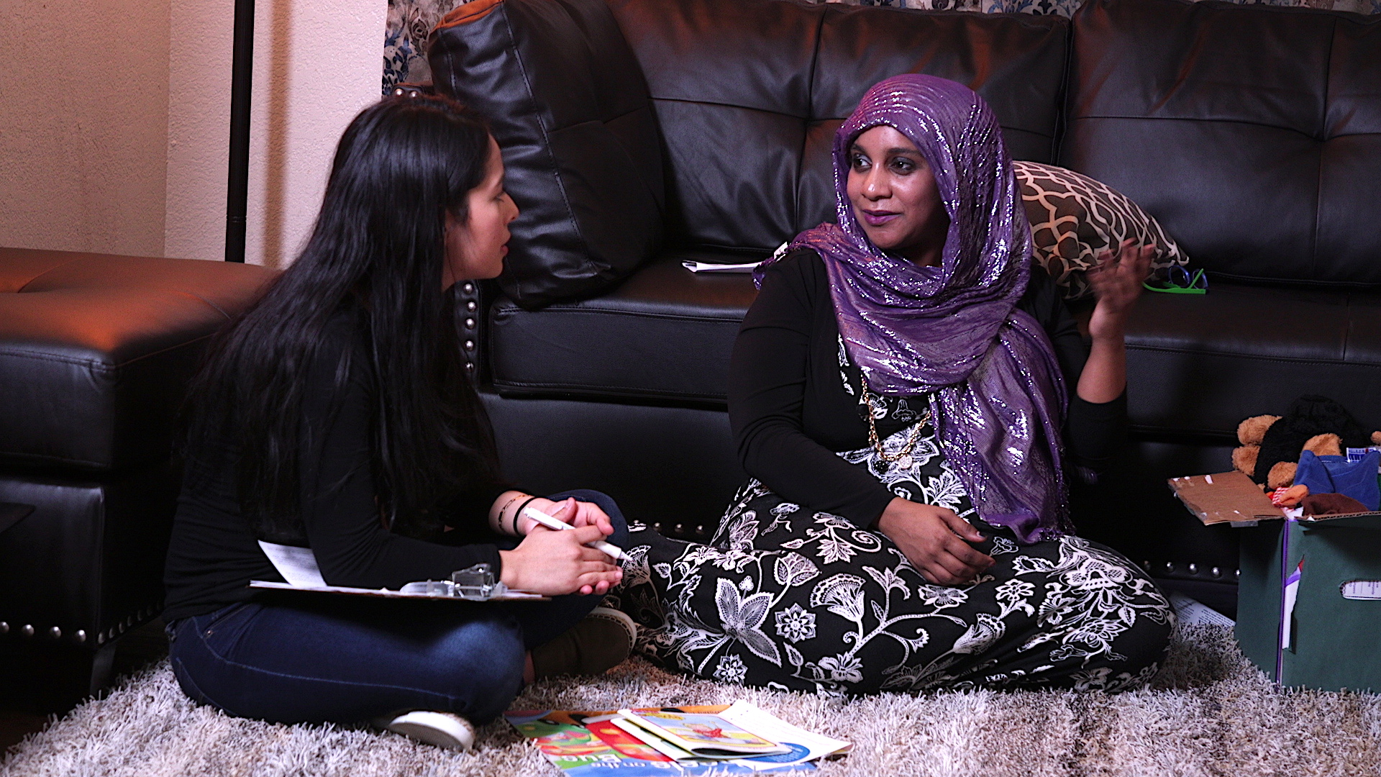
How Do Curricula Support a Culturally Responsive Approach?
Supports staff as they build relationships with families of different cultural backgrounds
Integrates opportunities to learn about and build on families’ cultures

Slide 11
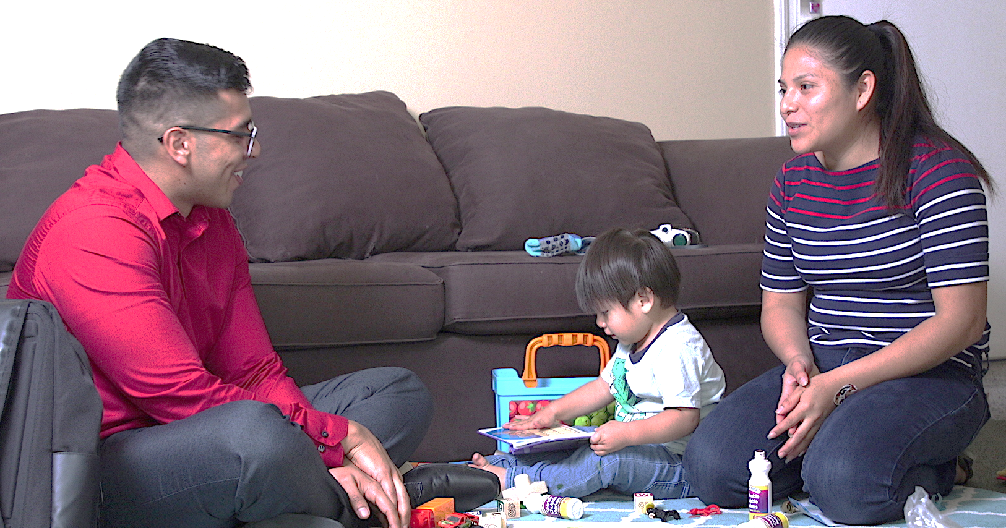
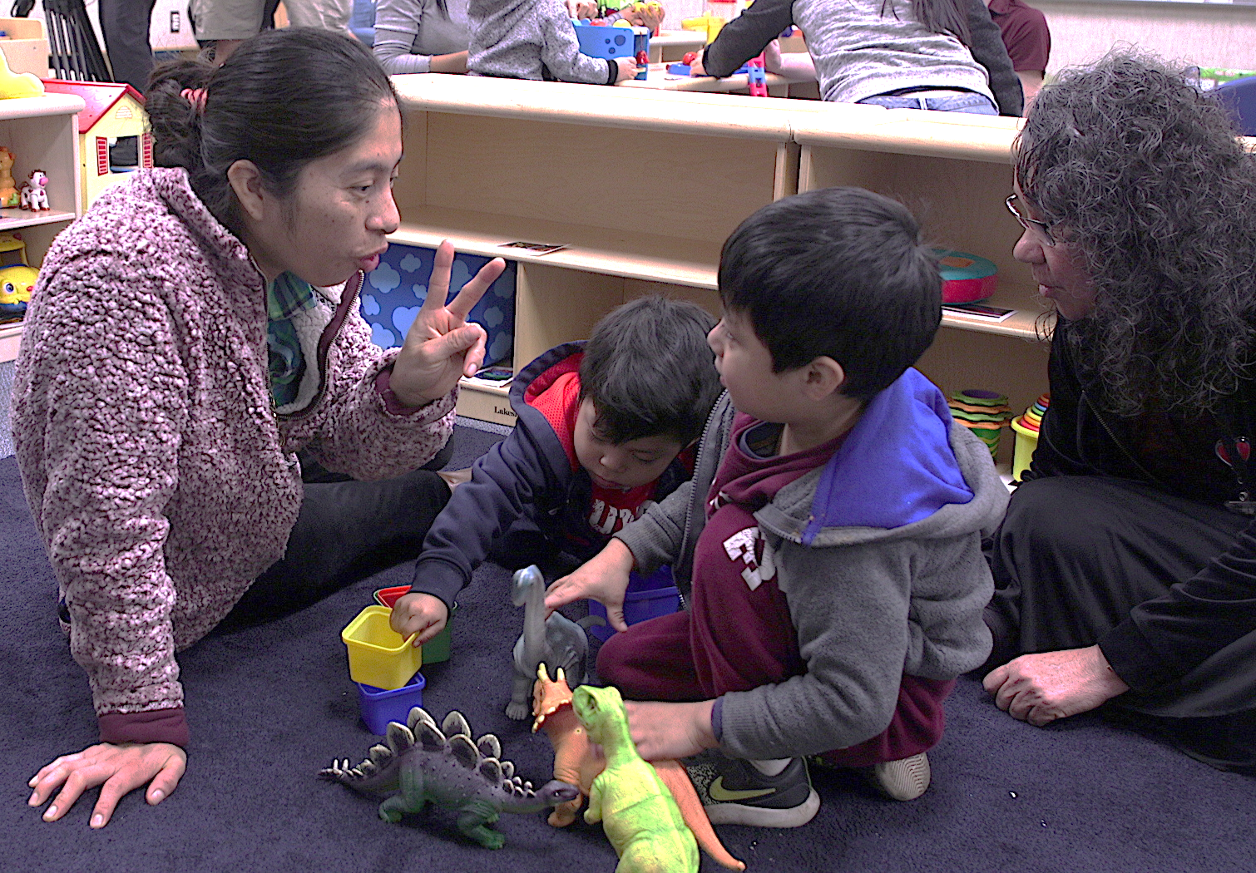
Cultural Responsiveness as Developmentally Appropriate
Practice
“Addressing cultural relevance in making curriculum choices and adaptations is a necessary, developmentally appropriate practice."
Multicultural Principle 4, Head Start Multicultural Principles

Slide 12
Avoiding Stereotypes and Tokenism
AVOID making assumptions about people based on their culture
AVOID using only one picture or activity to represent a whole culture
AVOID reducing culture to celebrations, food, clothes, and art
LEARN from people about their cultures
EMPHASIZE diversity within as well as across cultures
INFUSE culture in meaningful ways throughout your curriculum

Slide 13
A Culturally Responsive
Approach to Curriculum
Learning From Families
Interactions with Families
Interactions with Children
Learning Experiences
Home as Learning Environment
Engaging
Environments

Slide 14
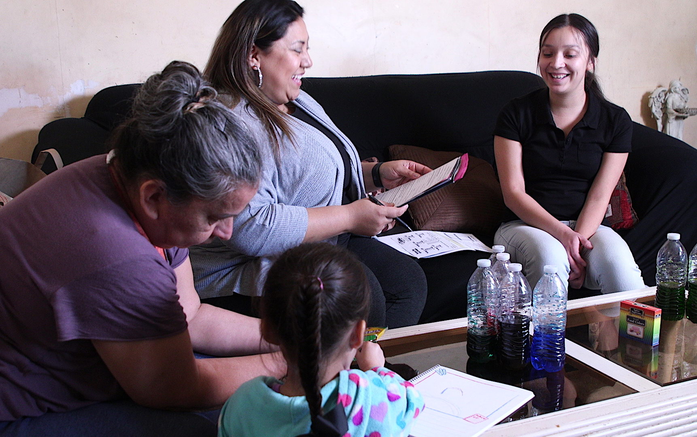
A Culturally Responsive Approach:
Learning from Families
How families prefer to communicate​
How their children are cared for within their families and community​
Their goals and hopes for their children

Slide 15
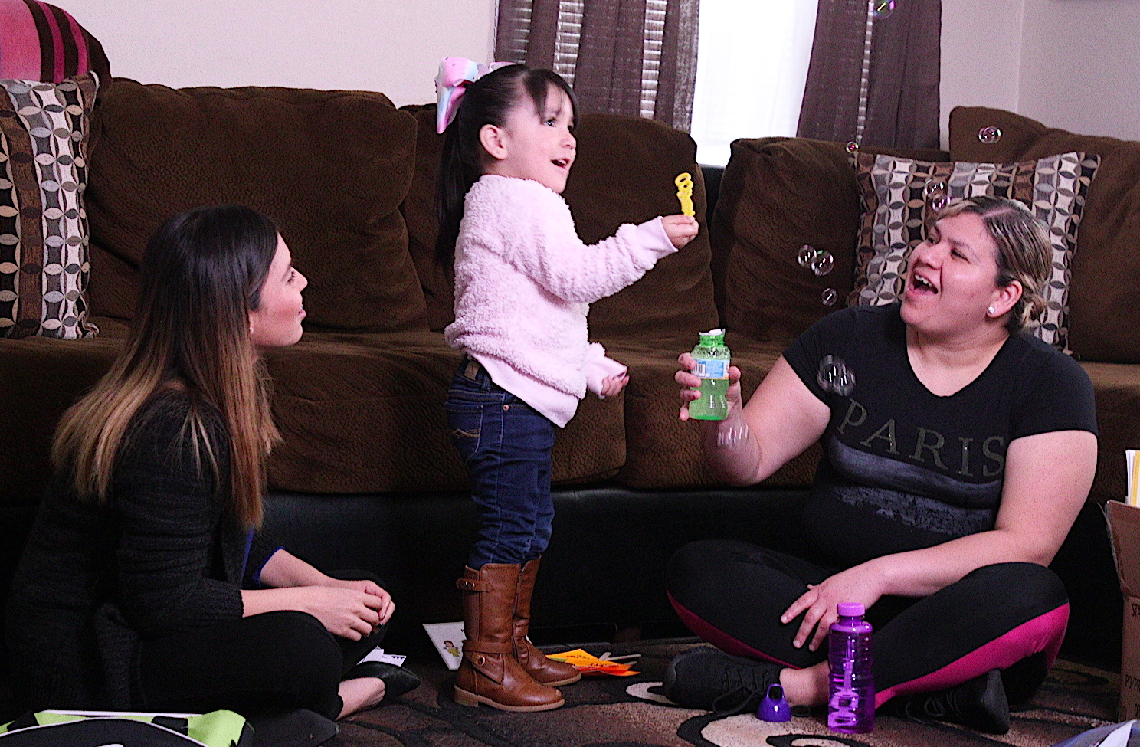

A Culturally Responsive Approach:
Interactions with Families
Follow household customs, practices, and routines during home visits.
Show respect for household cultural items.
Use a family’s preferred language whenever possible, and use interpreters as needed.

Slide 16
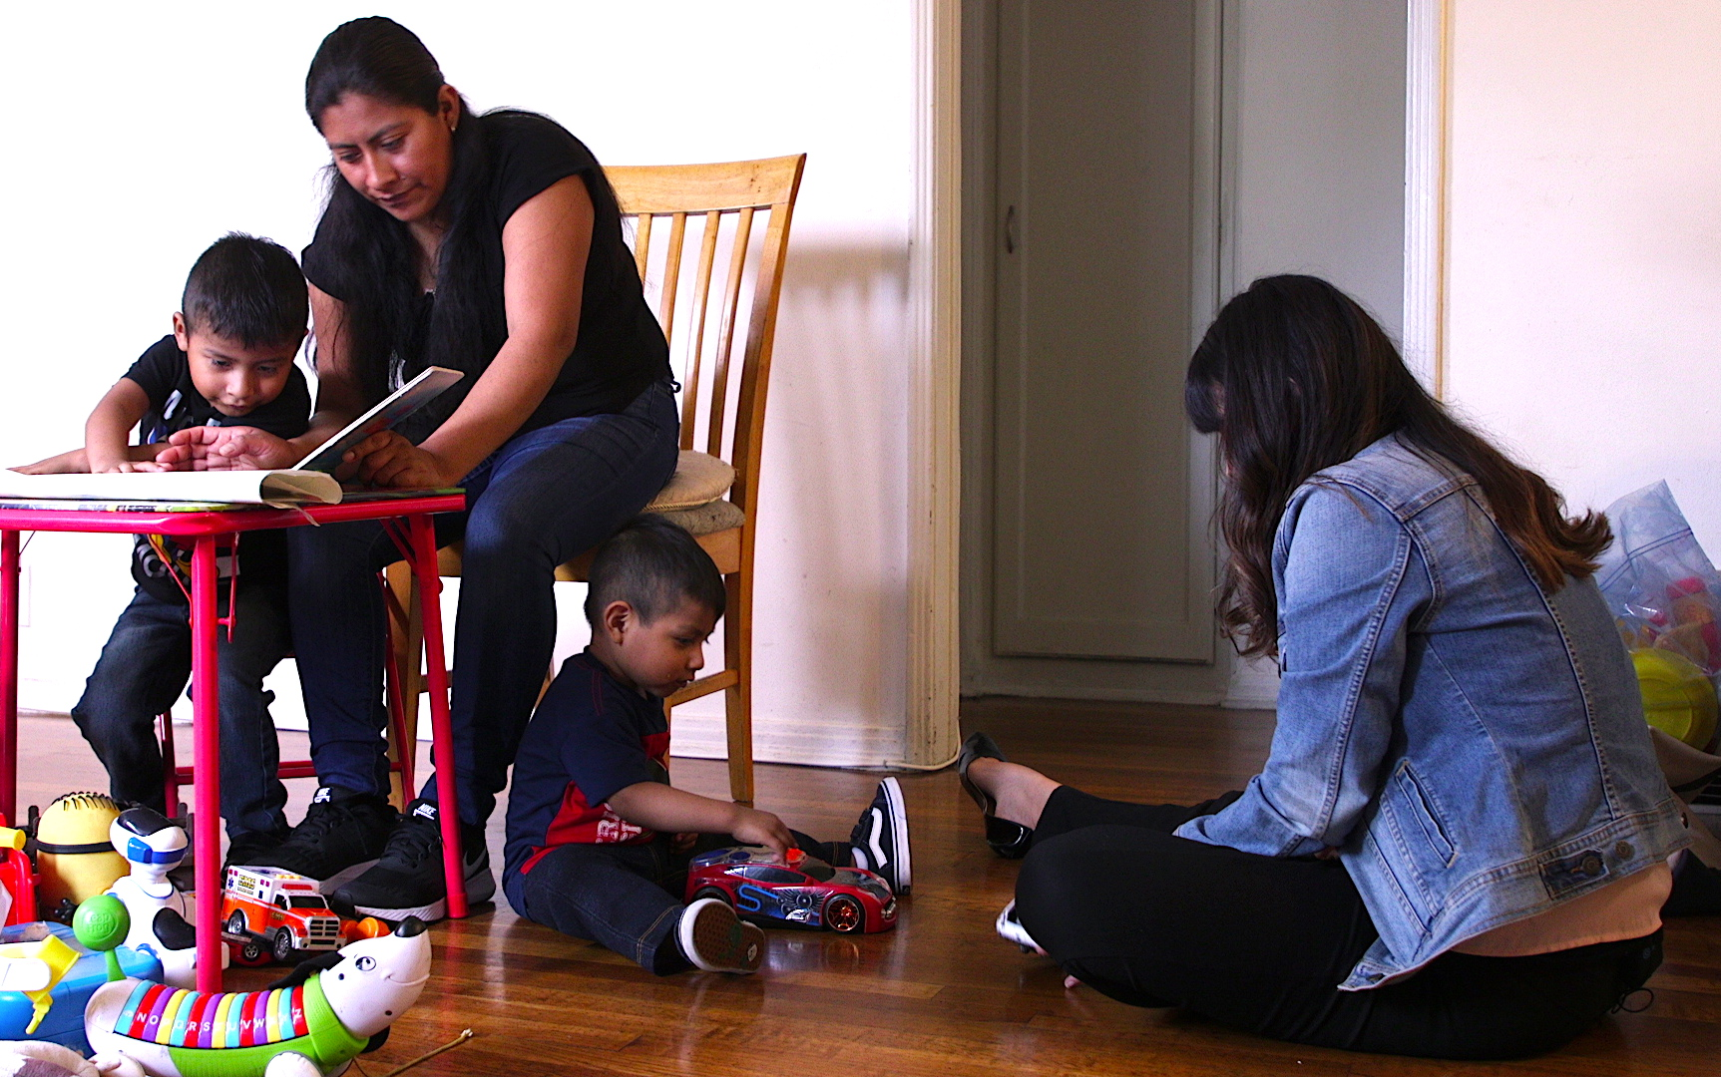
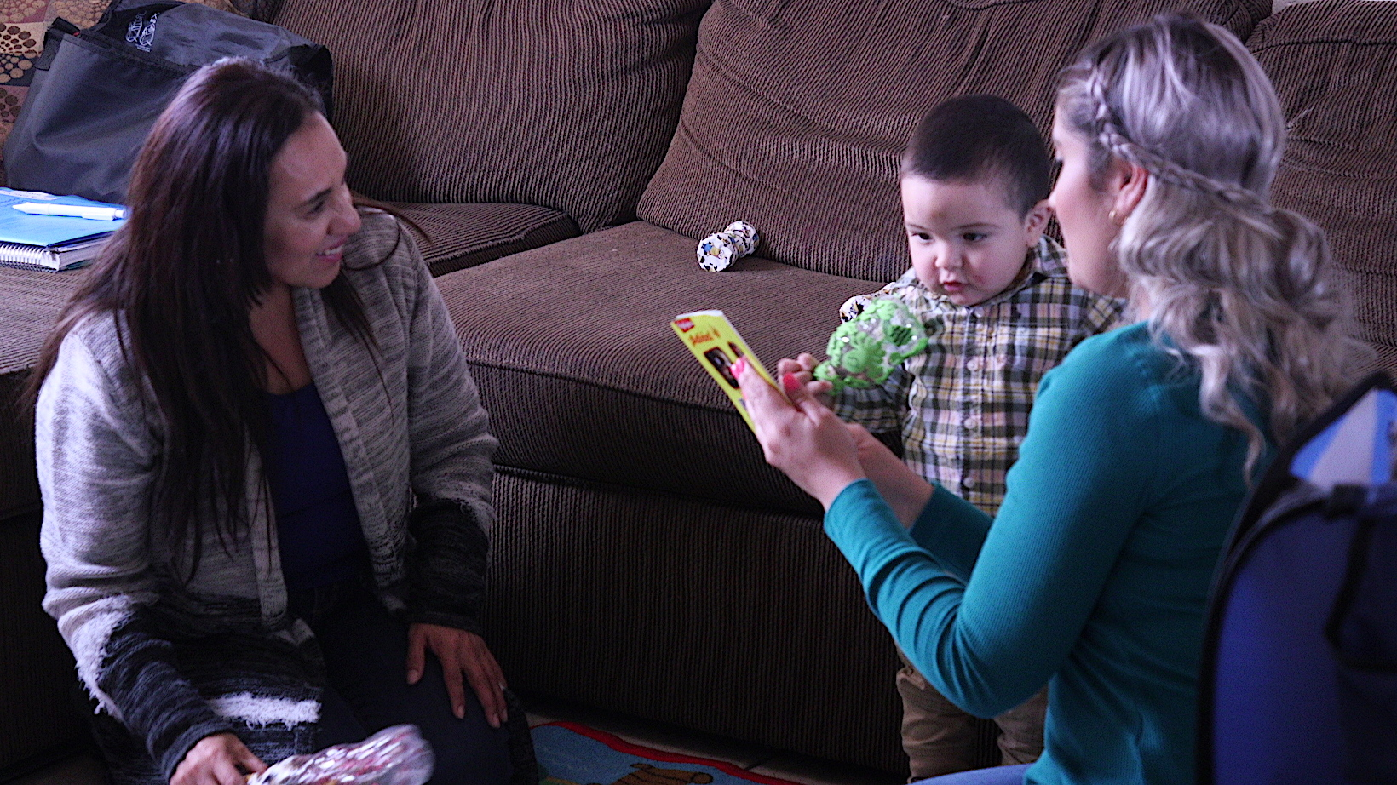
A Culturally Responsive Approach:
Interactions with Children

Slide 17
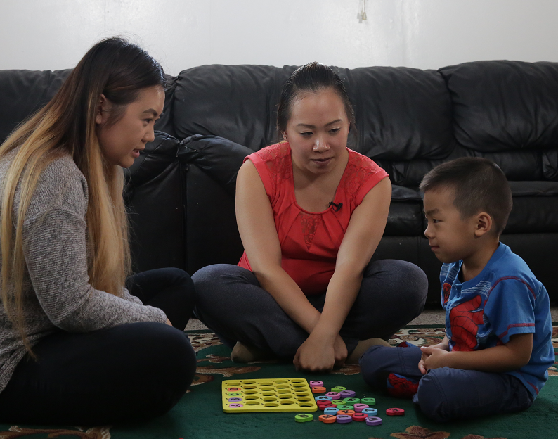
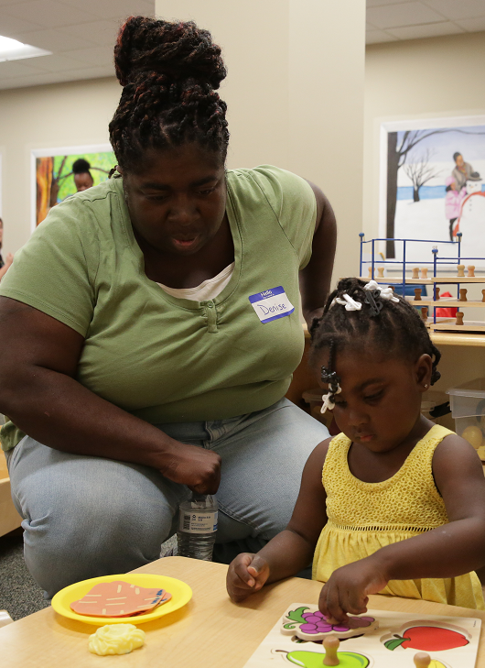
A Culturally Responsive Approach:
Learning Experiences

Slide 18
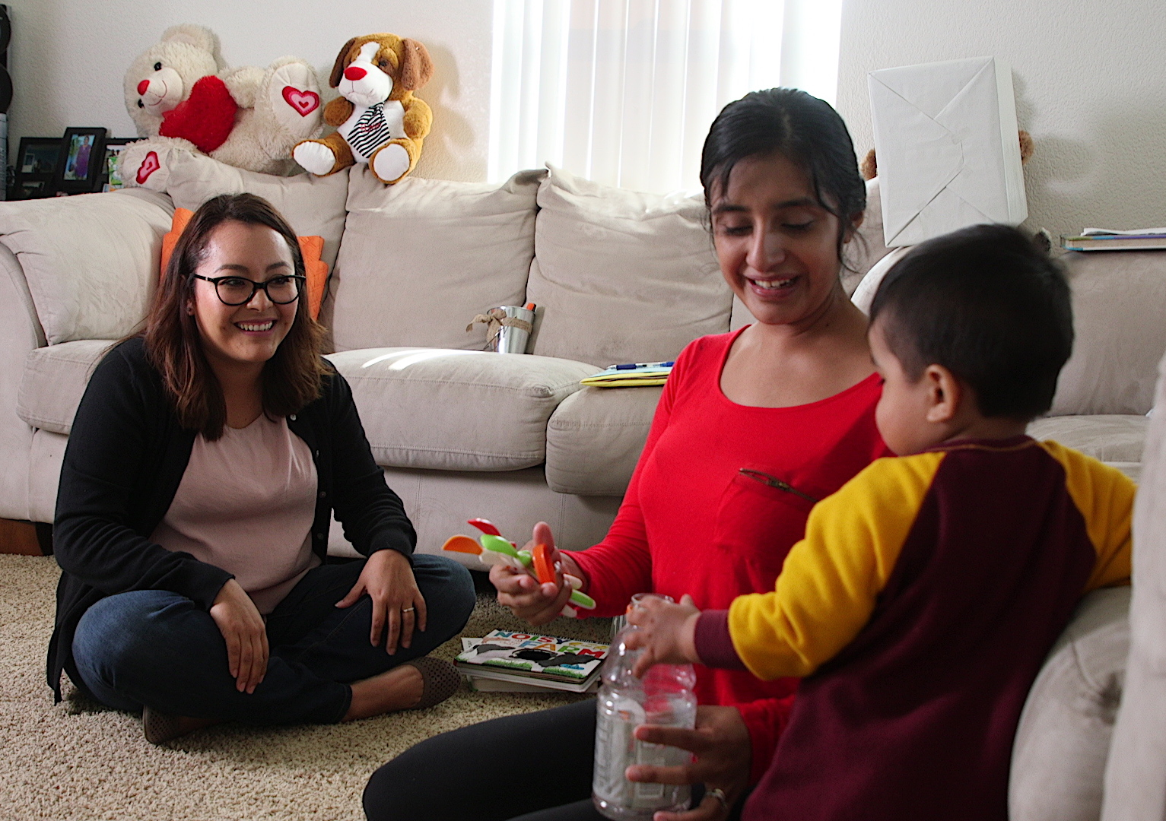
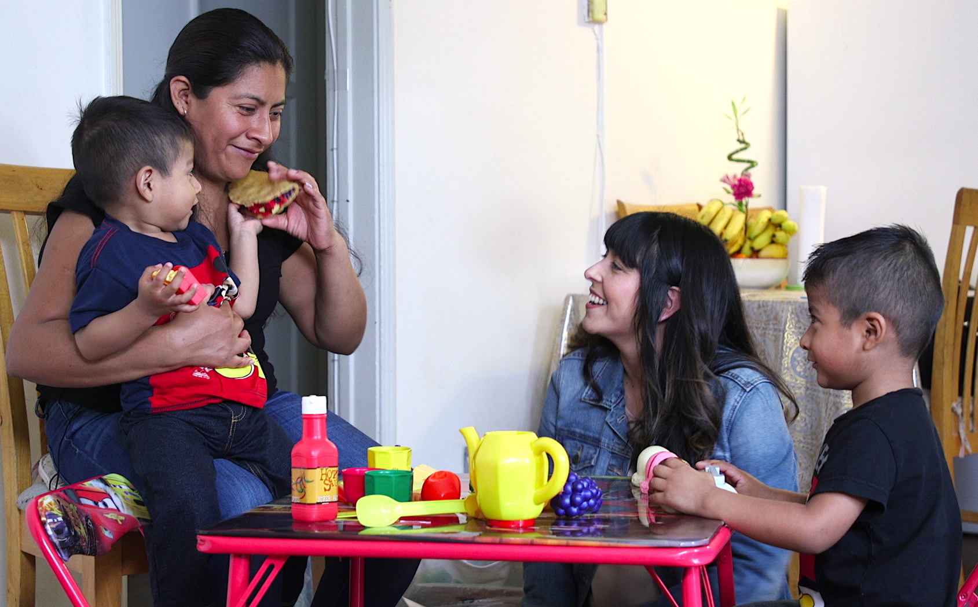
A Culturally Responsive Approach:
Home as a Learning Environment

Slide 19
Review
What do I know about children’s culture?
What does my program’s curriculum offer?
How do I implement the curriculum responsive to children’s culture?

