Slide 1
HSPPS Supports Cultural Responsiveness
1302 Subpart C - Education and Child Development Program Services 1302.35
(a) A program must implement a research-based curriculum that delivers developmentally, linguistically, and culturally appropriate home visits and group socialization activities that support children’s cognitive, social, and emotional growth for later success in school.
(d) A program that operates the home-based option must:
(1) Ensure home-visiting and group socializations implement a developmentally appropriate research-based early childhood home-based curriculum that:
(i) Promotes the parent’s role as the child’s teacher through experiences focused on the parent-child relationship and, as appropriate, the family’s traditions, culture, values, and beliefs.

Slide 2
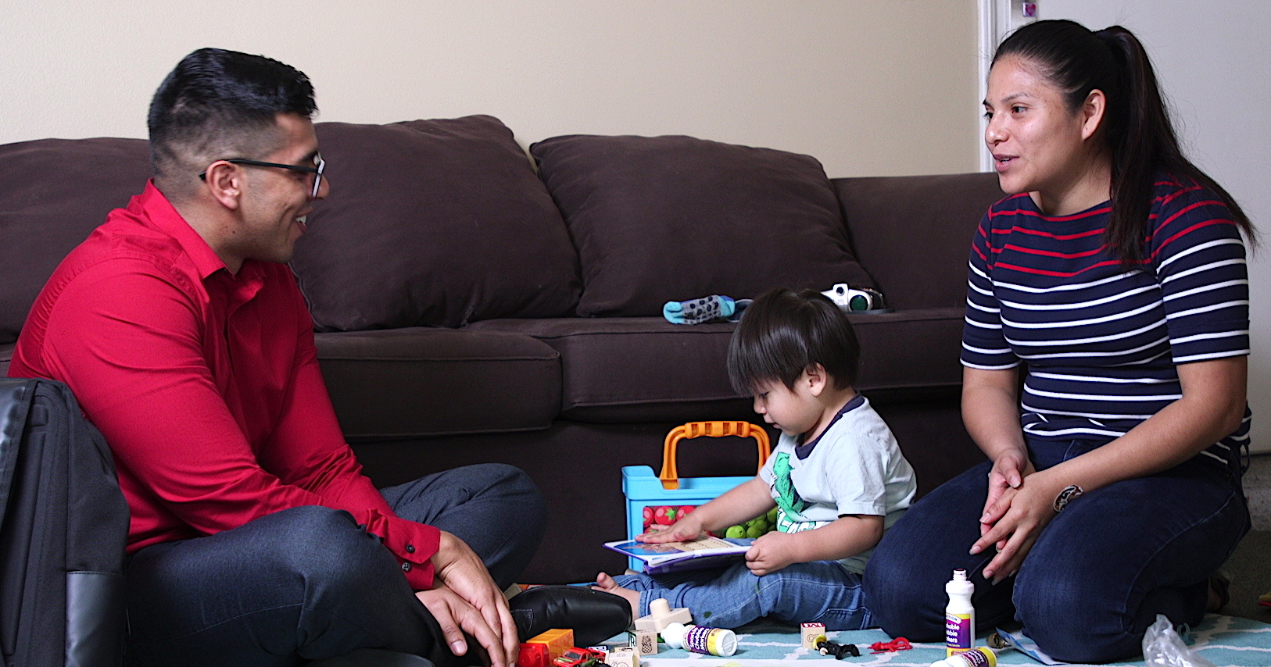
Inviting Families to Share Their Cultures with Home Visitors

