Slide 1
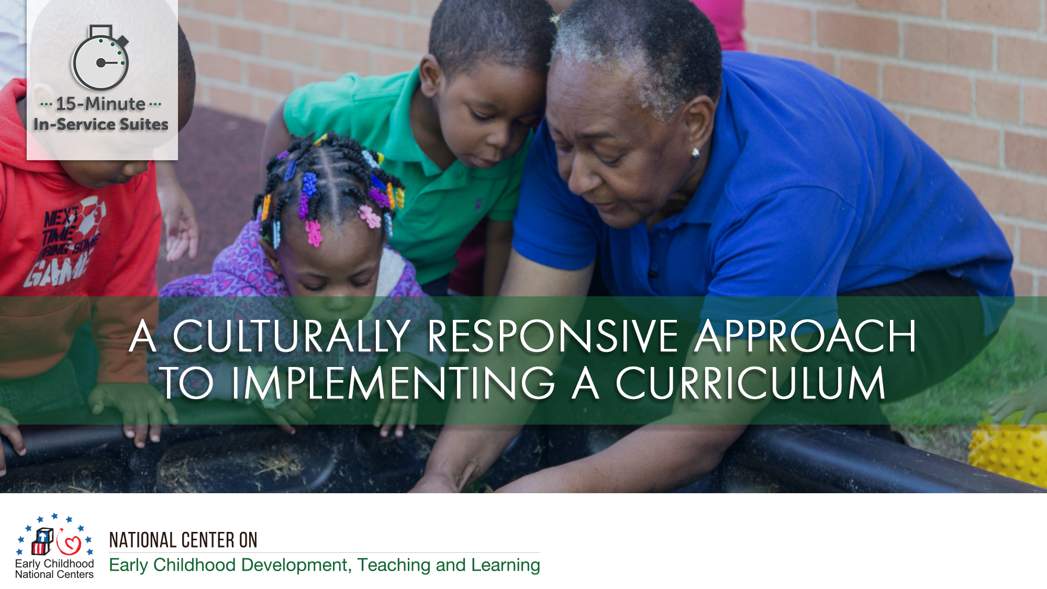

Slide 2
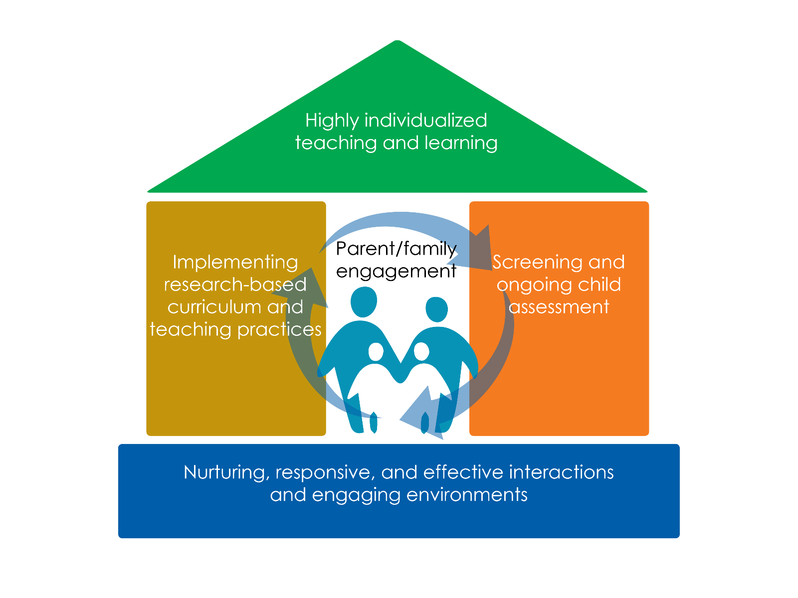

Slide 3
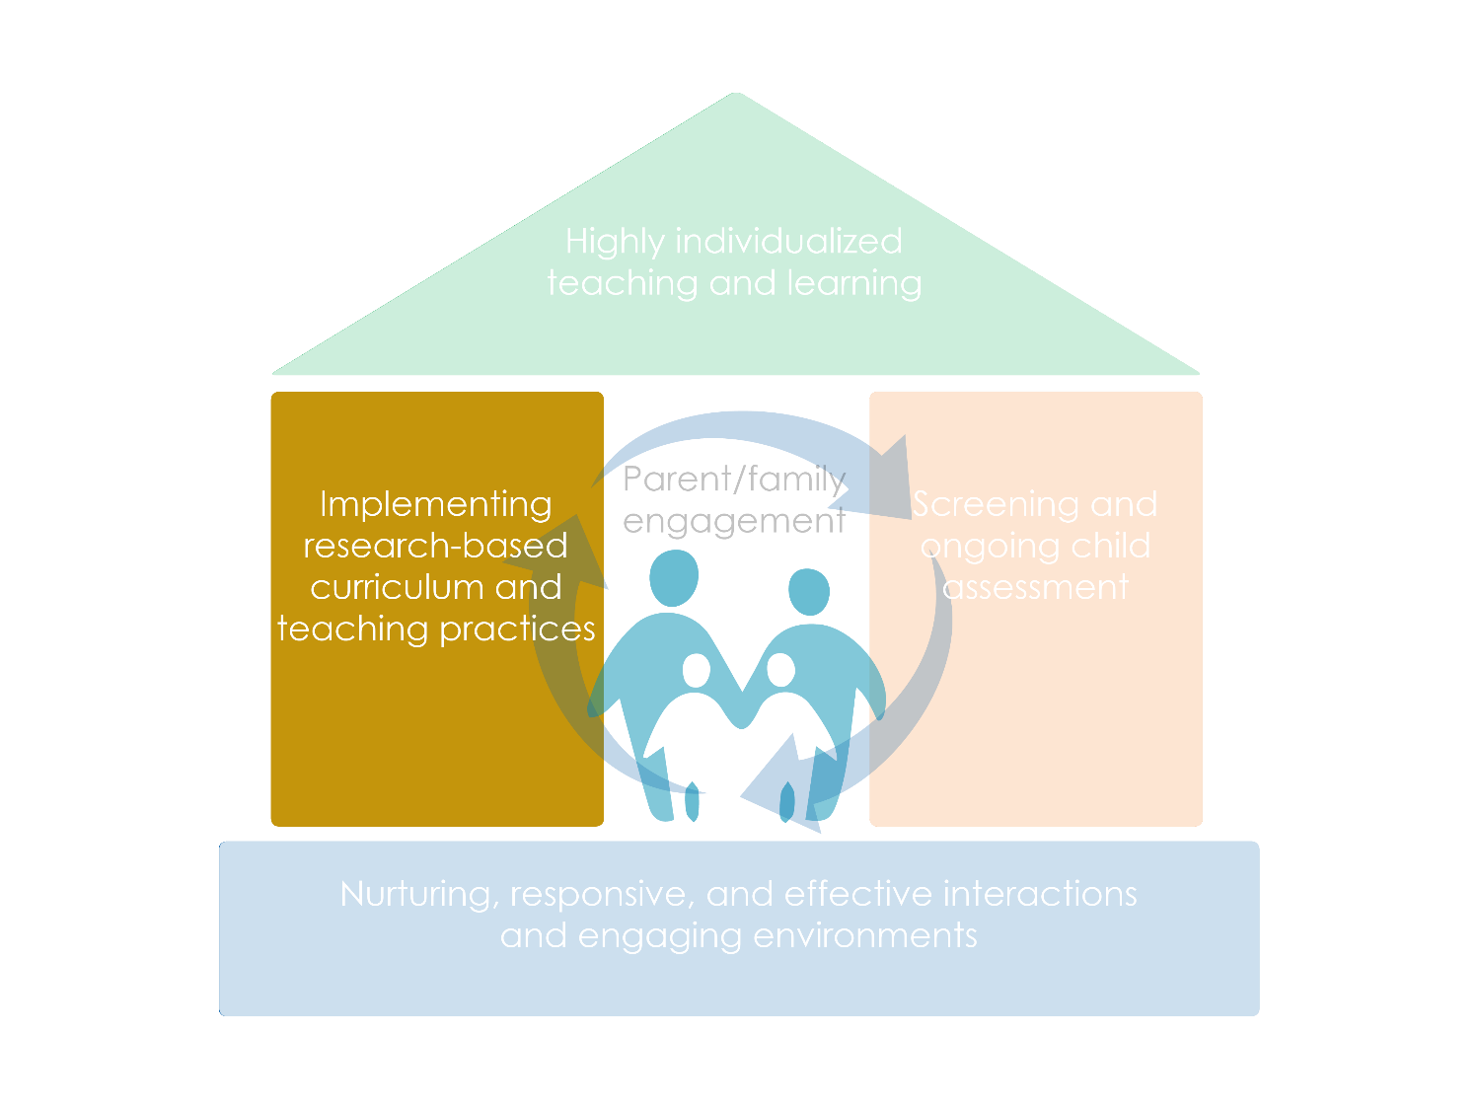

Slide 4
Objectives
Identify how culture influences and informs caregiving, teaching, and learning
Provide practices for learning about children’s and families’ cultures, with respect and appreciation for cultural values, practices and traditions
Describe a culturally responsive approach to implementing a curriculum that builds on children’s and families’ cultures

Slide 5

What is culture?

Slide 6




Learning Activity: The Role of Culture
When was the first time you realized that the way your family did something was different than how others did it?
What was something special your family liked to do together?
What were some of your favorite foods growing up?
How have you been influenced by where you grew up?

Slide 7
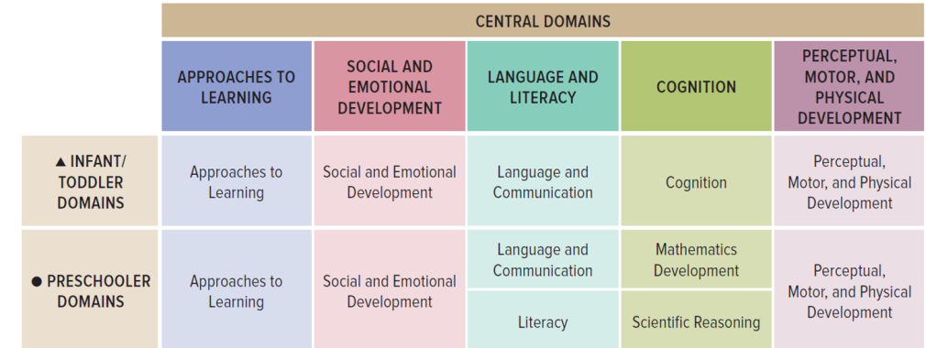
Cultural Responsiveness and the ELOF

Slide 8
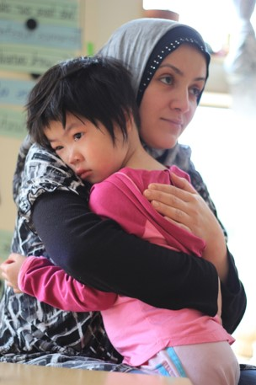
  Culture contributes to learning and development
Express and manage emotions
Attend to others
Show respect
Seek comfort
Engage with stories or songs

Slide 9
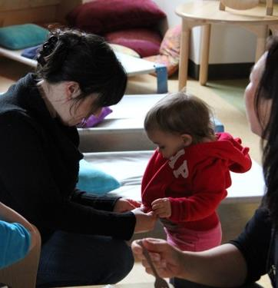
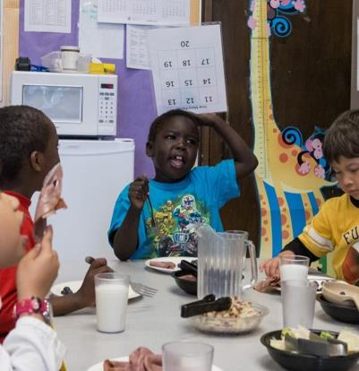
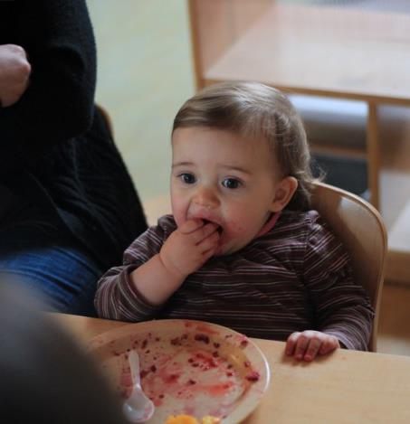
Culture contributes to caregiving and teaching

Slide 10
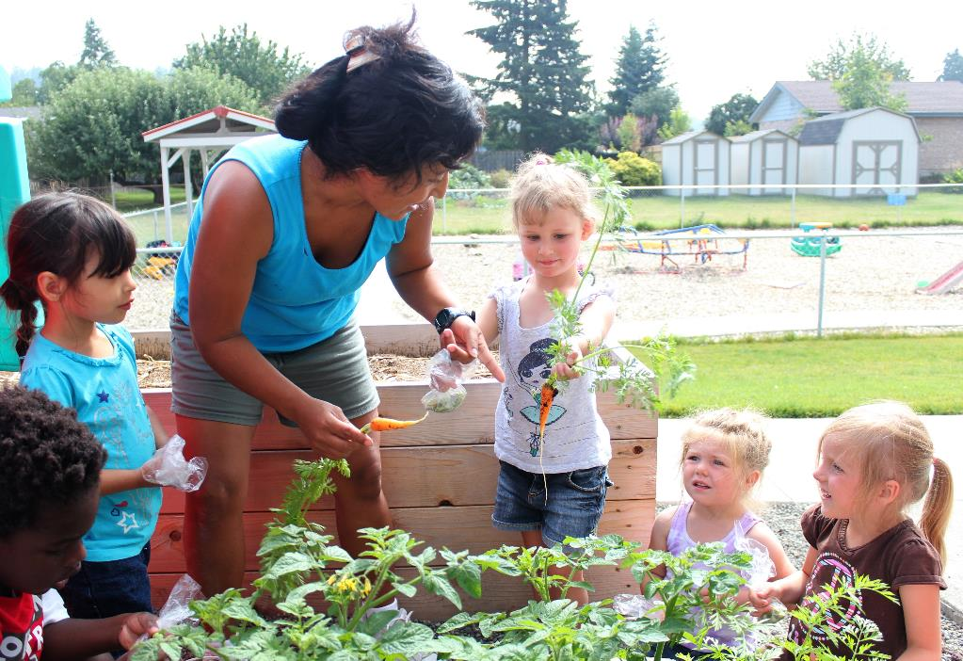
How does your curriculum support a culturally responsive approach?
A curriculum should include guidance for culturally responsive:
Interactions
Learning Experiences
Learning Environments

Slide 11
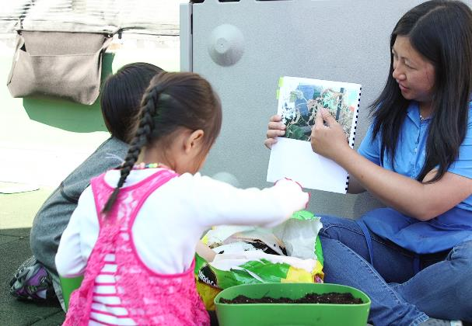
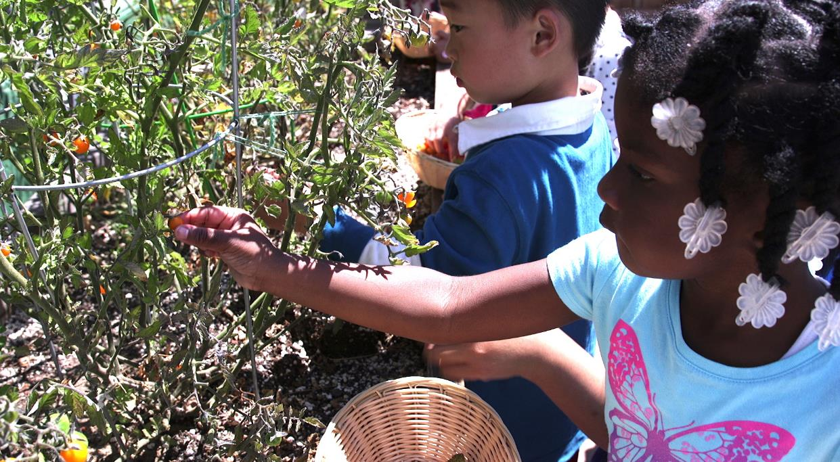
Developmentally Appropriate
Practice
“Addressing cultural relevance in making curriculum choices and adaptations is a necessary, developmentally appropriate practice."
Multicultural Principle 4, Head Start Multicultural Principles

Slide 12
Avoiding stereotypes and tokenism
AVOID making assumptions about people based on their culture
AVOID using only one picture or activity to represent a whole culture
AVOID reducing culture to celebrations, food, clothes and art
LEARN from people about their cultures
EMPHASIZE diversity within as well as across cultures
INFUSE culture in meaningful ways throughout your curriculum

Slide 13
A Culturally Responsive Approach to Curriculum
Learning From Families
Learning Experiences
Learning Environ-ments
Interactions with Families
Interactions with Children
Engaging
Environments
Learning Experiences / Activities

Slide 14
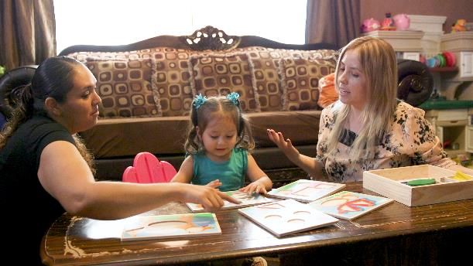
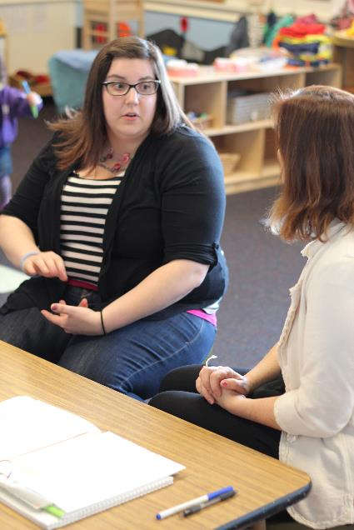
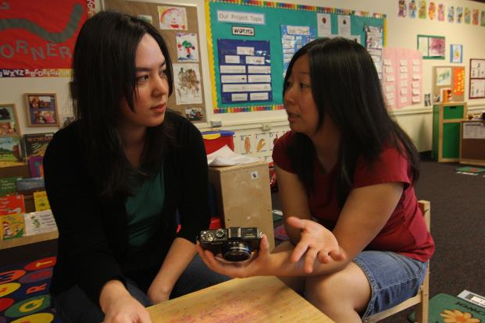
A Culturally Responsive Approach:
Learning from Families
How families prefer to communicate
How their children are cared for within their families and community
Their goals and hopes for their children

Slide 15
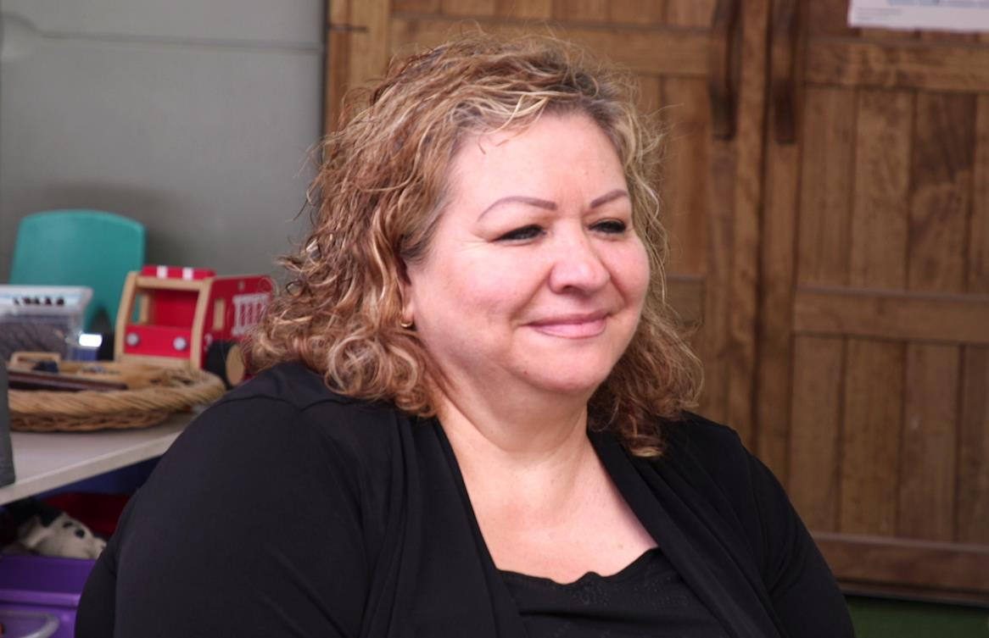

A Culturally Responsive Approach:
Interactions with Families

Slide 16
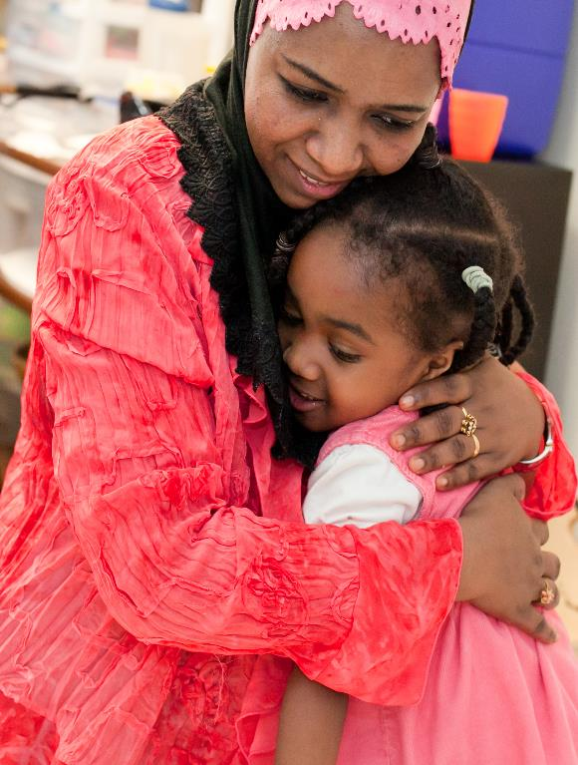
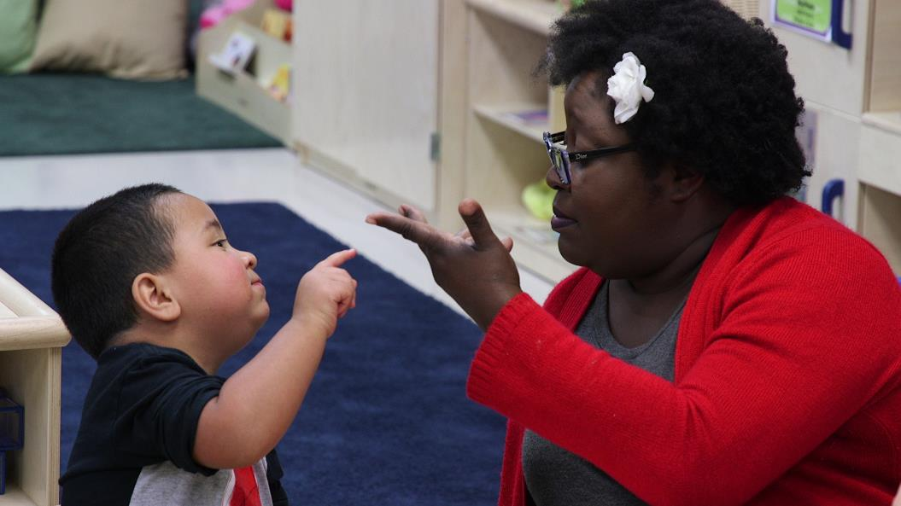
A Culturally Responsive Approach: Interactions with Children
Engage in interactions that are familiar to children, nurturing, and supportive.

Slide 17
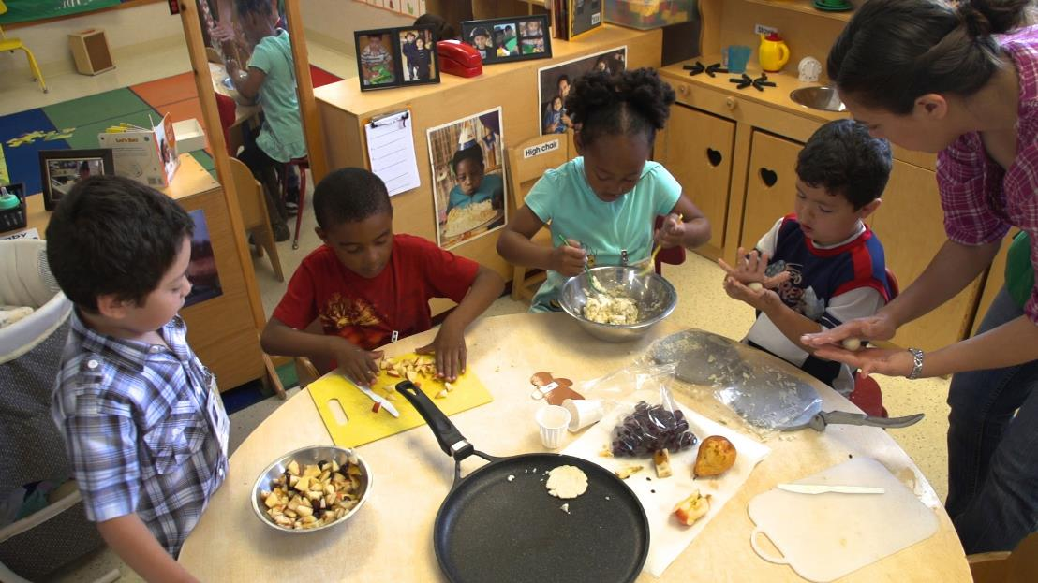
A Culturally Responsive Approach:
Learning Experiences
Build on children’s cultures and languages
Engage families and communities in making connections between learning experiences and their cultures
Respect children’s expressions of culture

Slide 18
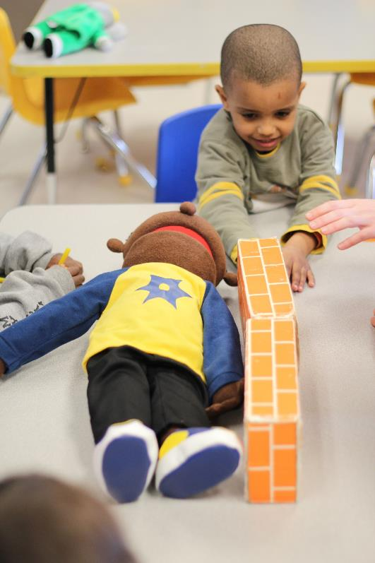
A Culturally Responsive Approach:
Learning Environments
Provide environments and materials that reflect children’s cultures and languages.
Invite families and community members to suggest or provide culturally relevant materials
Integrate home and tribal languages into the learning environment in meaningful ways.

Slide 19
Review
What do I know about children’s culture?
What does my program’s curriculum offer?
How do I implement the curriculum responsive to children’s culture?

