Slide 1


Slide 2
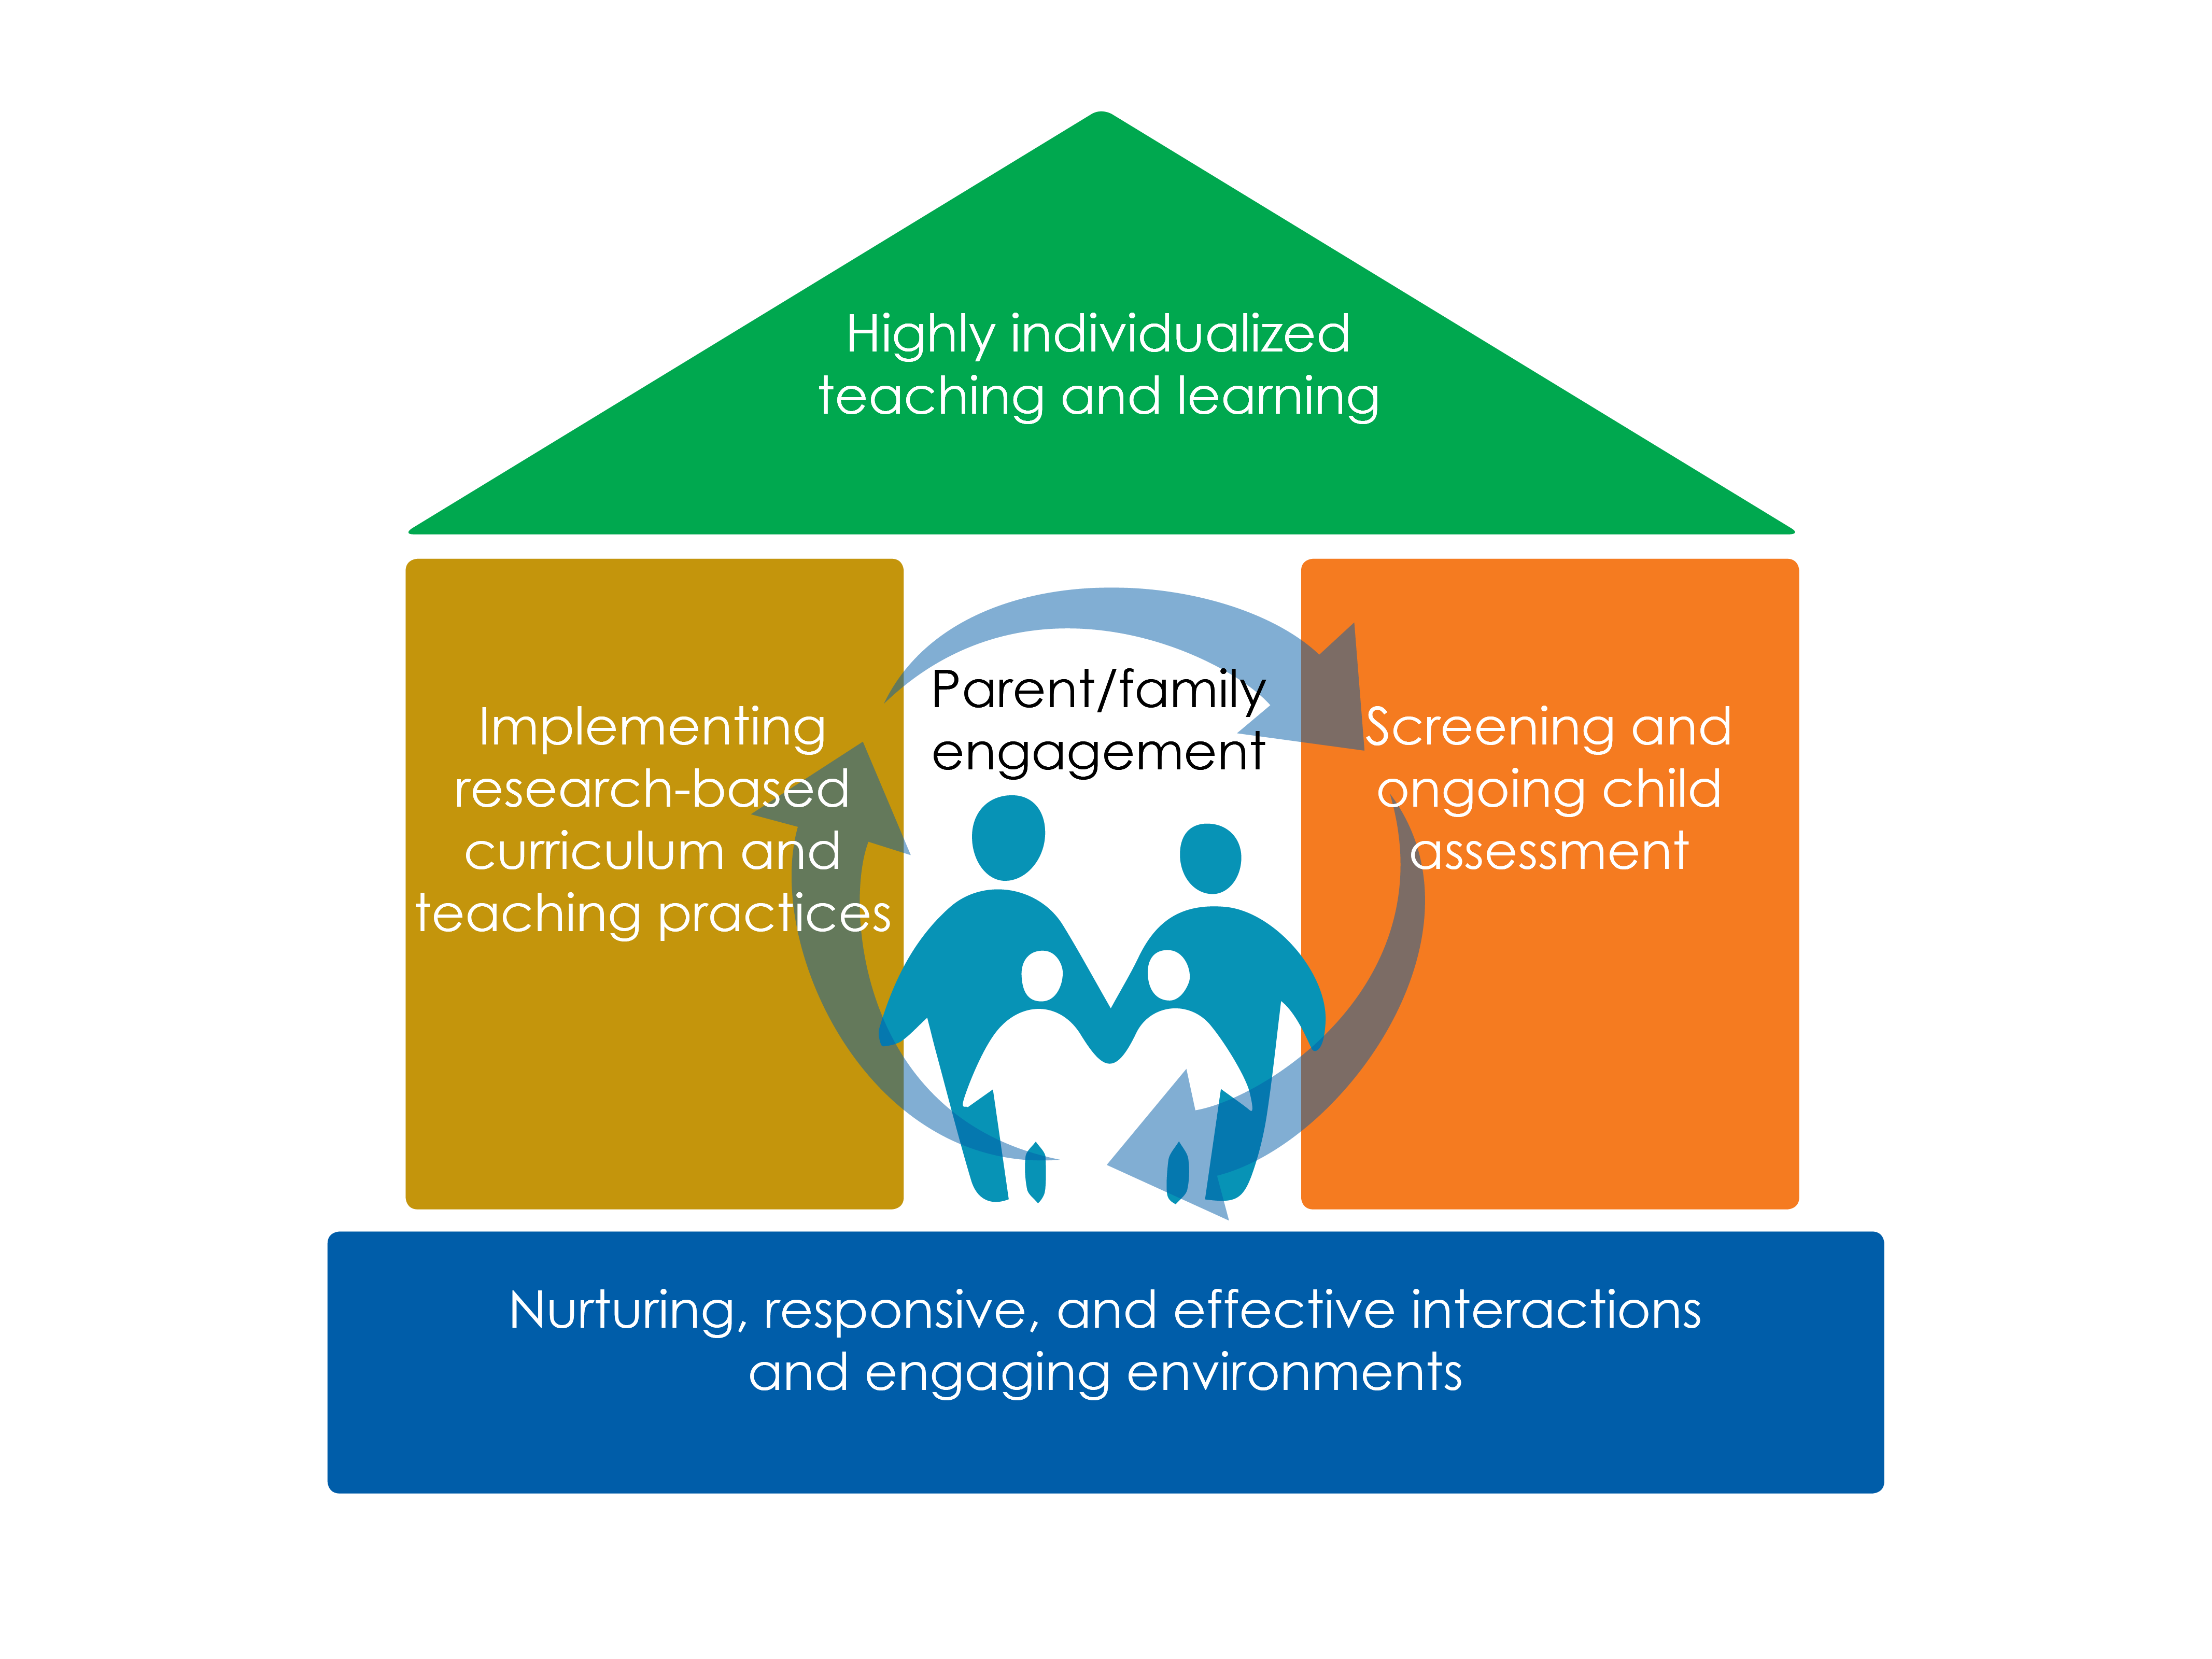

Slide 3
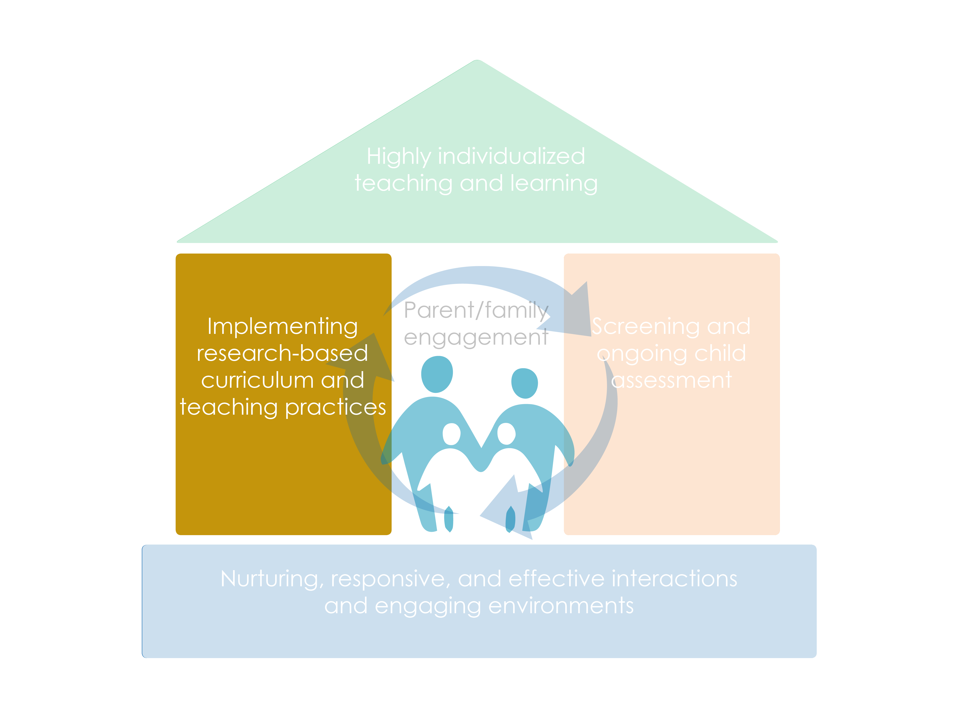
Framework for Effective Practice

Slide 4
Objectives
Understand why Practice-Based Coaching (PBC) is a powerful approach to professional development
Understand how PBC components can be used to coach education staff on early math teaching practices
Understand and practice methods for engaging in effective PBC cycles around early math teaching practices

Slide 5
Why Use Coaching?
Coaching is an evidence-based professional development strategy that has been shown to:
  Effectively support education staff in improving their practices
  Result in increased learning in young children

Slide 6

What is Practice-Based Coaching?
An approach that uses a cyclical process to support effective teaching practices that lead to positive outcomes for children

Slide 7
Practice-Based Coaching Components
Collaborative coaching partnership
Shared goals and action planning
Focused observation
Reflection and feedback

Slide 8
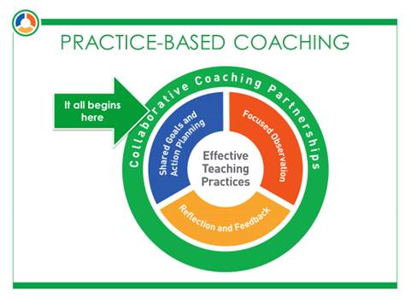
Collaborative Coaching Partnerships

Slide 9
Establishing a Collaborative Partnership
A collaborative partnership involves a teacher, family child care provider or home visitor (a coachee) and a coach planning and working together.
It is developed over time by developing reciprocal and respectful relationships, shared vision, and trust.
Establishing a collaborative partnership includes:
  sharing professional experiences and backgrounds,
  developing shared expectations, and
  reaching a mutual understanding of the coaching process and purpose.

Slide 10
Sharing Math Experiences
What is the earliest math experience that you can remember?
  What did you feel during this experience?
How has that influenced how you feel about math now?
How do you think your feelings and previous experiences might be expressed in the classroom?
SHARE
THINK
PAIR
As a coach, how would you use this activity with coachees?

Slide 11

Shared Goals and Action Planning

Slide 12

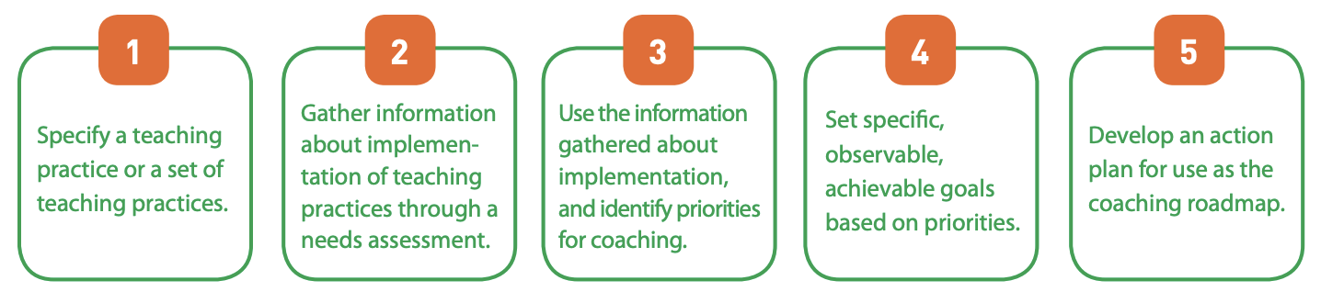
Shared Goals and Action Planning

Slide 13

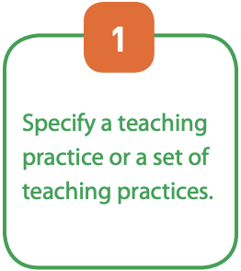
Teaching Practices
I understand how children’s counting and cardinality skills progress.
I include materials in every learning center that encourage children to count and write numbers.
I offer a wide range of materials that children can use to compare quantities.
I use teachable moments as opportunities to build counting skills and understanding of cardinality.
I lead small group activities and discussions focused on counting and cardinality.
I ask questions that invite children to make predictions.

Slide 14
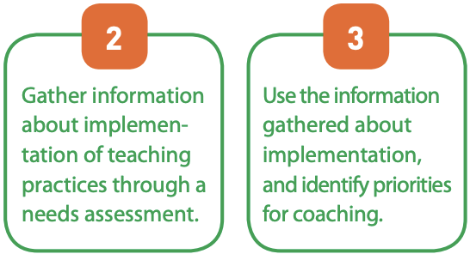
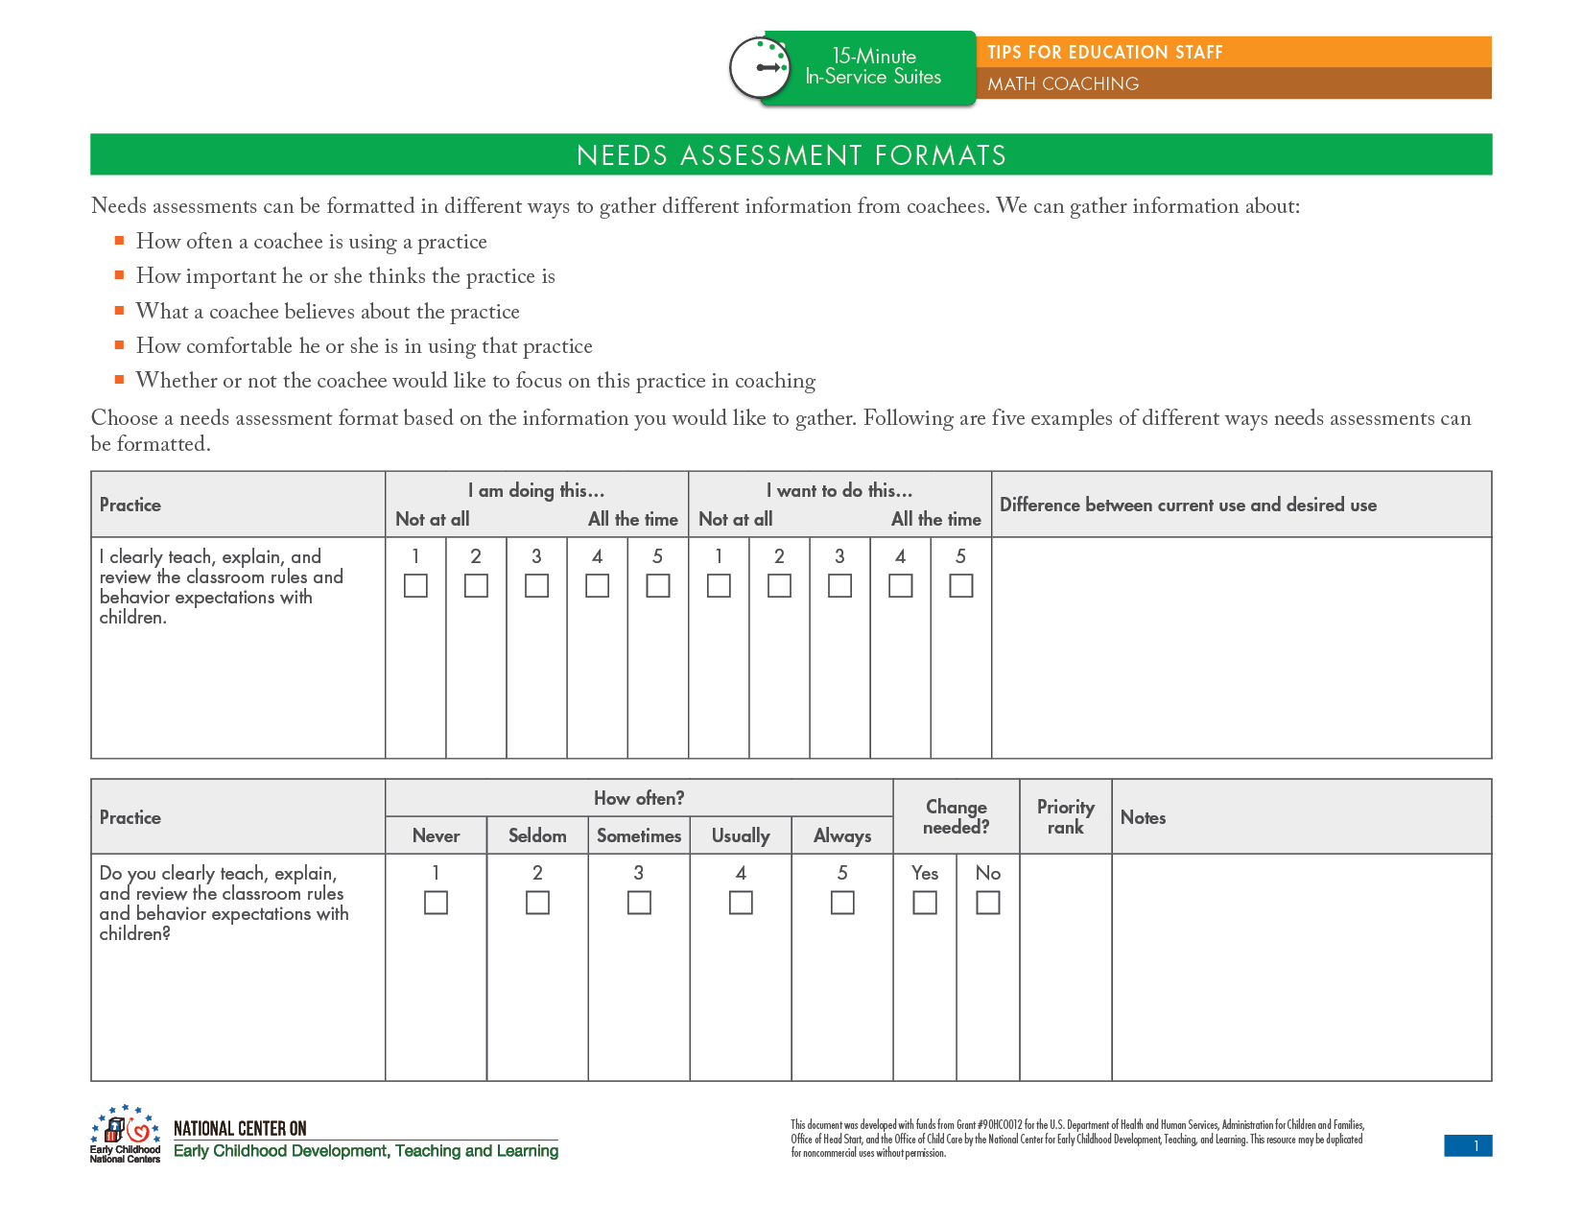
Needs Assessment

Slide 15
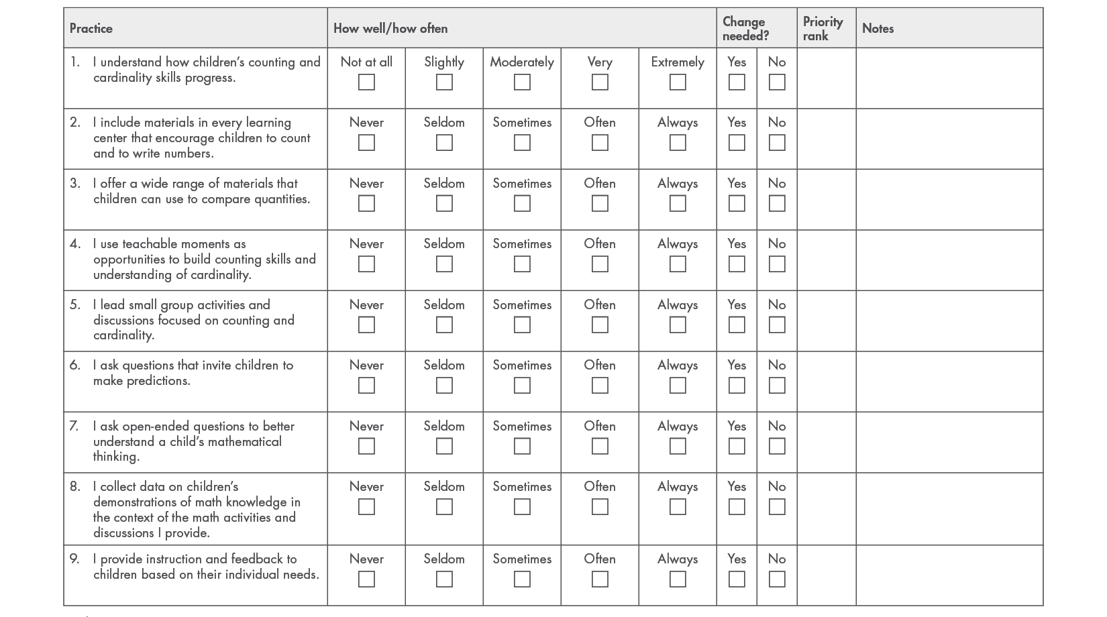

Slide 16
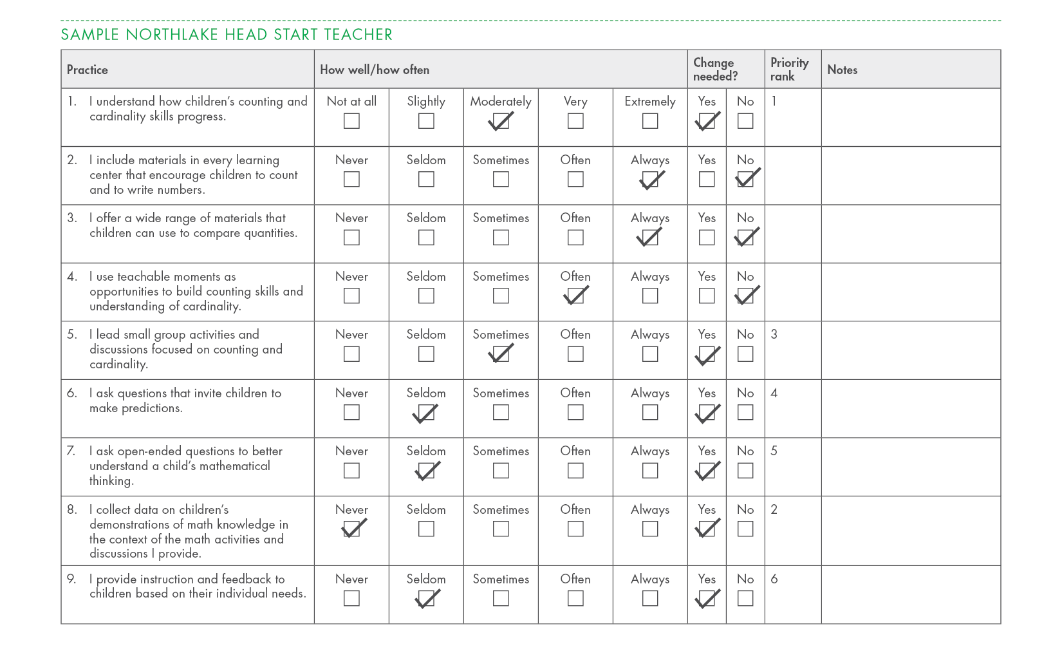

Slide 17

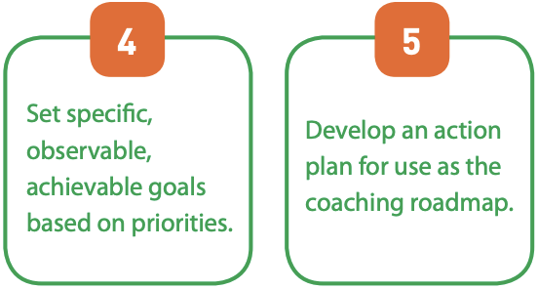
Identify Priorities and Set Goals

Slide 18
Develop Action Plan

Slide 19
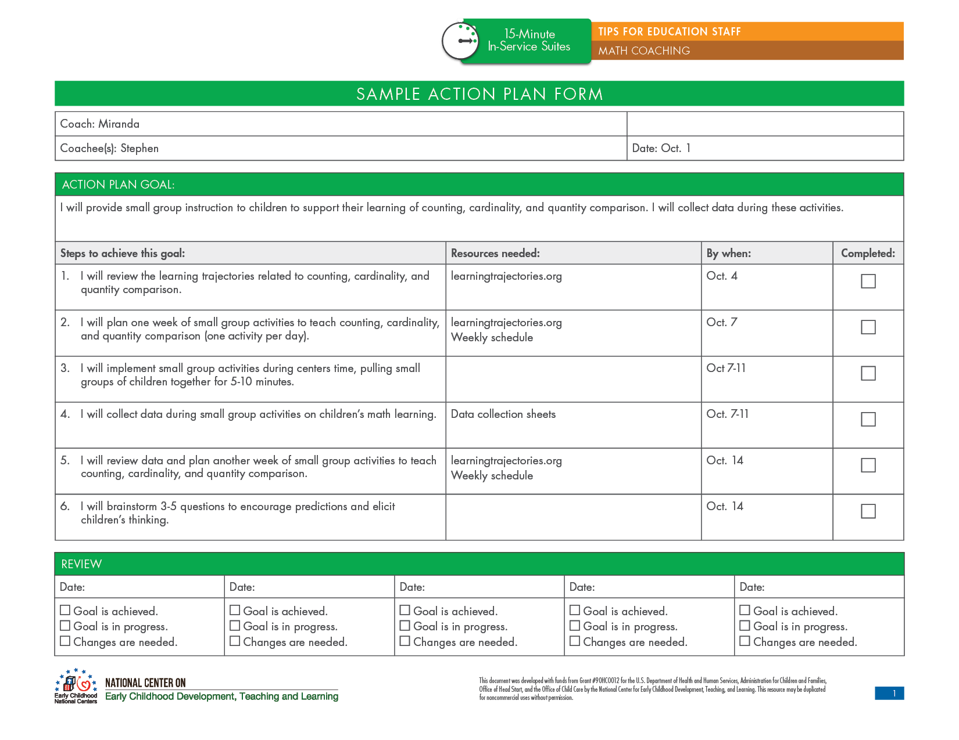
Action Plan

Slide 20

Focused Observation

Slide 21

Focused Observation
Observations centered on action plan
Coach collects notes/data
Coach uses other coaching strategies as needed (and agreed to by coachee)

Slide 22
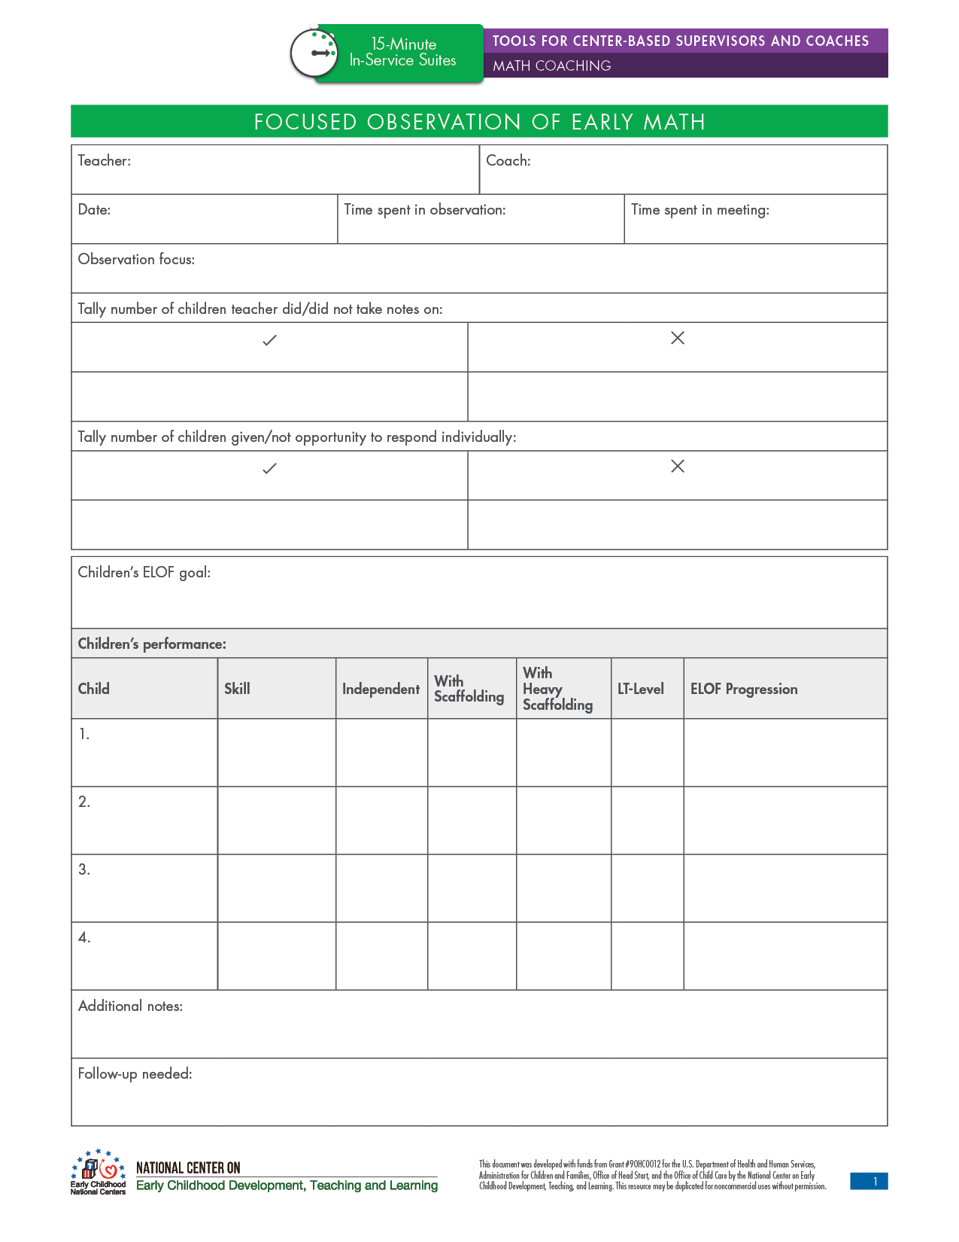
Focused Observation
Make a plan!
Collect data
  Notes
  Checklists
  Behavior counts

Slide 23
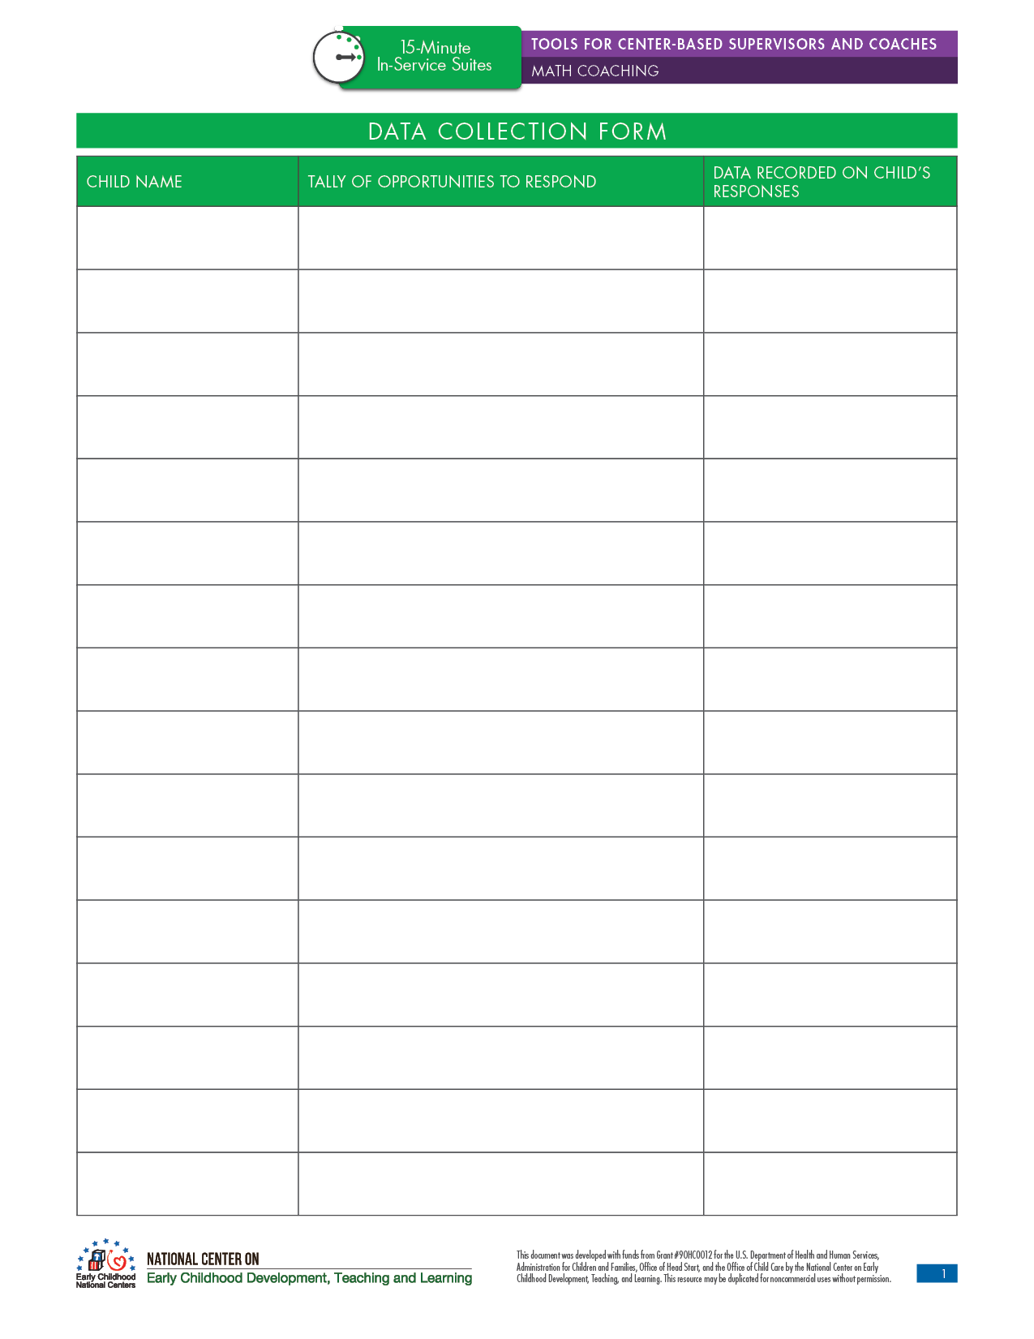
Focused Observation

Slide 24

Reflection and Feedback

Slide 25

Reflection and Feedback
Reflection
Supportive feedback
Constructive feedback

Slide 26
Reflection and Feedback
Reflection questions:
  “How did math small groups go today?”
  “What happened when Birdie made an error when counting?”
  “What could you share with her mom to help’s Birdie count with greater accuracy?”
  “What do you think you could do to support Tyrone in learning from his peers?”

Slide 27
Reflection and Feedback
Supportive feedback should be:
  Related to the action plan
  Specific
  Data-based
  Non-attributive
Examples:
  “I noticed that when Robbie counted incorrectly, you reminded him to touch each object only one time as he counted. You suggested he move the objects so he could keep track of the ones he already touched. After you gave him that suggestion, he was able to count correctly without help! When you gave him a high five, he had a big smile on his face!”
  “Wow—you did a really nice job collecting data on each child’s counting skills during small groups today. That will really help you plan your next small group activity and the type of instruction you will provide!”

Slide 28
Reflection and Feedback
Constructive feedback should be:
  Related to action plan
  Specific
  Data-based
  Non-attributive
Examples:
  “I observed you giving at least three opportunities to respond to almost every child in your small groups today. Tabitha and William both engaged in some disruptive behavior during the small groups, and I noticed that they each got only one opportunity to respond. Next time, make sure all children get several opportunities to respond. That can help keep them more engaged and prevent challenging behavior.”
  “I noticed that when you played the counting game in one of your small groups, Arnie counted eight objects correctly. However, when you then asked him how many buttons there were (to assess his cardinality understanding), he said, “Five,” and you didn’t respond. It would be helpful to provide Arnie with specific feedback when he makes a mistake. You could say, “The last number you said was ‘eight’. That means there are eight buttons.”).

Slide 29
Reflection and Feedback Practice Scenario
Consider this scenario:
  Mary, a toddler classroom teacher, has an action plan related to providing more teaching related to one-to-one correspondence. During snack time in this classroom, the teachers work to set the table—giving each child one bowl, one spoon, one cup, and one napkin. Tyson notices that there aren’t enough spoons for every child and says, “More spoons!” The teacher smiles and says, “Yes, we need more spoons.”
What questions could you ask Mary to promote reflection?
What supportive feedback could you give Mary?
What constructive feedback could you give Mary?

Slide 30
The Cycle Continues!

Slide 31
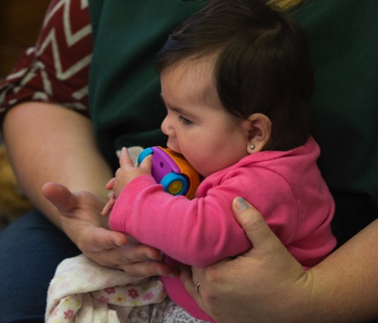

Review

