Slide 1
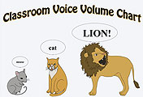
Preparing Children: voice volume chart

Slide 2
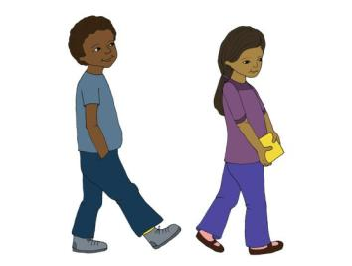
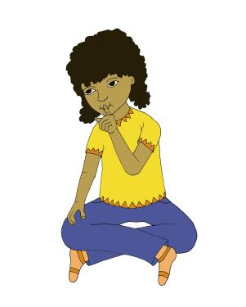
Posting expectations
Walking
Feet
Quiet Mouth

