Slide 1
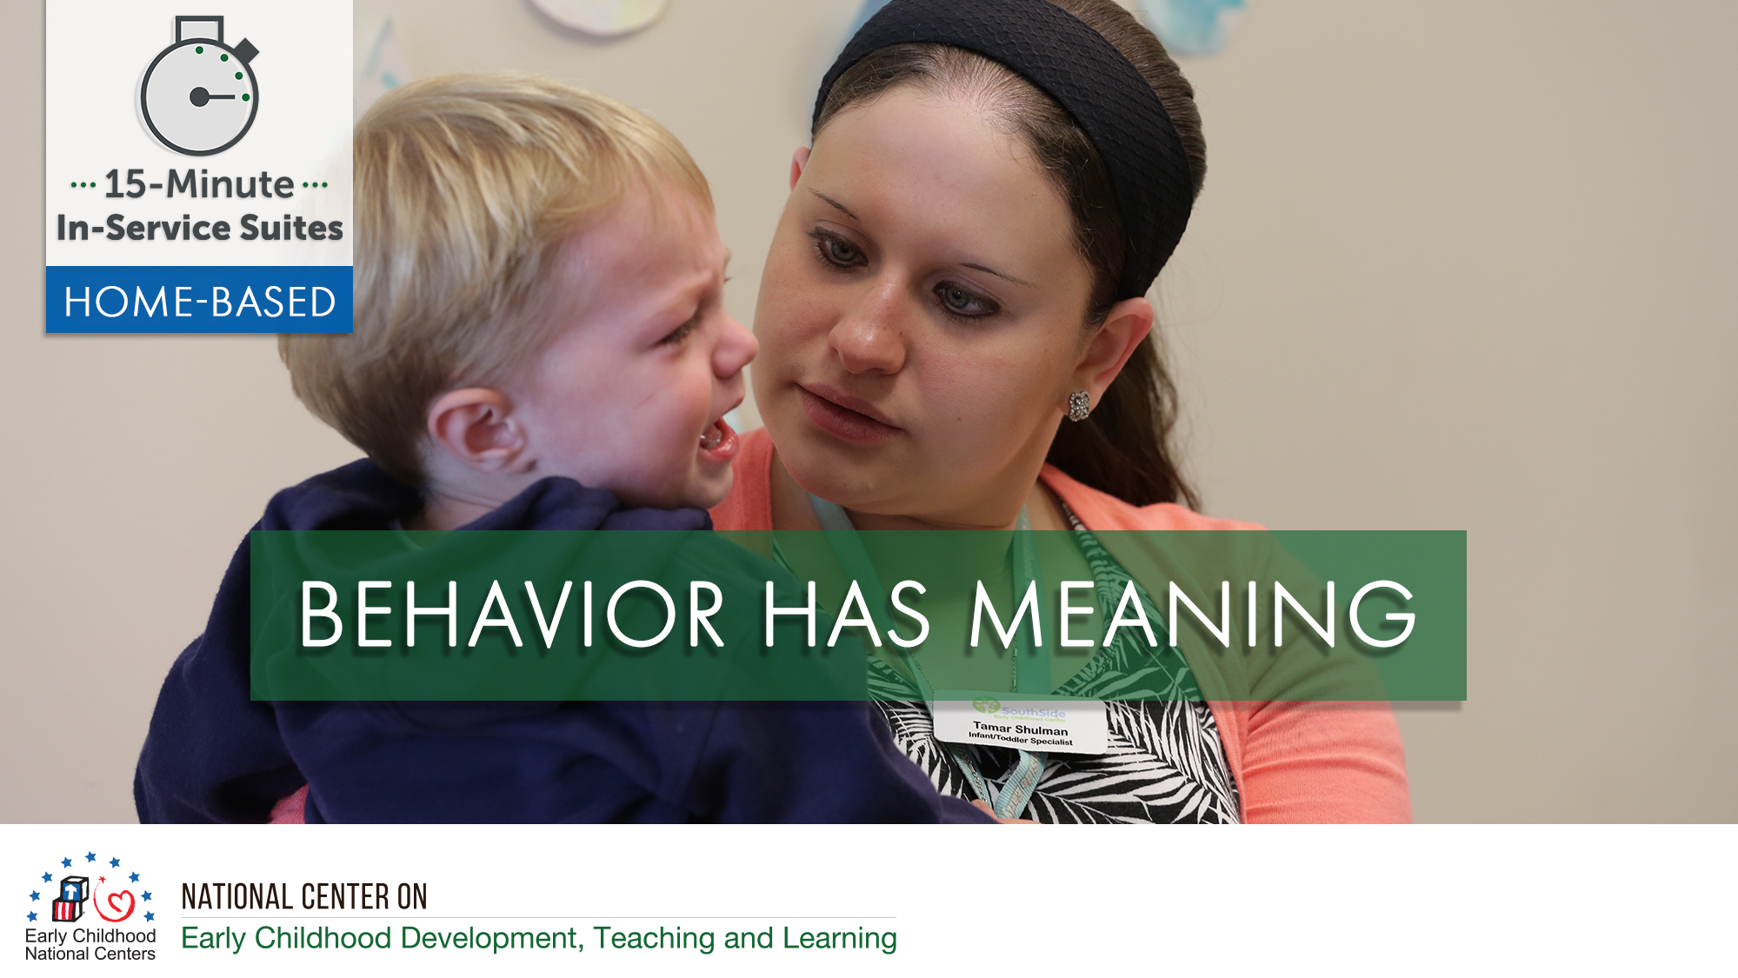

Slide 2
HSPPS Support Children’s Behaviors
Subpart C - Education and Child Development Program Services
    1302.35 Education in Home-Based Programs
    A home-based program must provide home visits and group socialization activities that promote secure parent-child relationships and help parents provide high-quality early learning experiences in language, literacy, mathematics, social and emotional functioning, approaches to learning, science, physical skills, and creative arts. A program must implement a research-based curriculum…

Slide 3
Center-Based and Family Child Care Practices
Effective Teaching Practices
Child Development

Slide 4
Home Visitor Practices
Effective Home Visiting and Socialization
Positive Parenting
Child Development

Slide 5
What’s Different for a Home Visitor?
Effective Home Visiting and Socialization
Positive Parenting
Child Development

Slide 6
Theory of Change for Home-Based
THEORY OF CHANGE MODEL FOR INFANT/TODDLER HOME VISITING VS CLASSROOM
Source: Roggman et al, 2016

Slide 7
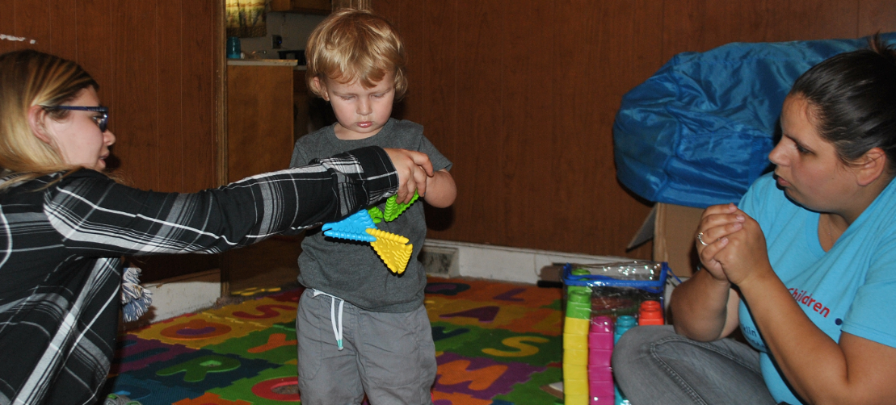
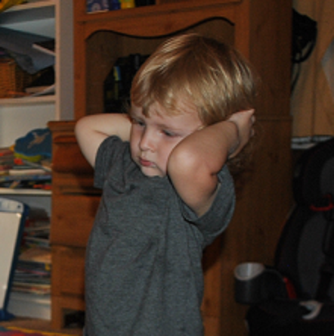
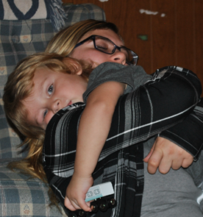
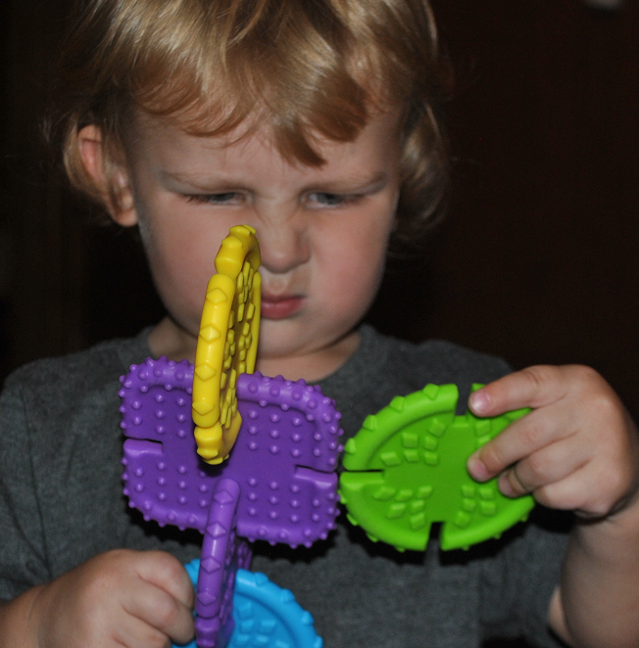
Form and Function

Slide 8
Behavior Has Meaning
Evan’s mom, Bella, and the family’s home visitor, Yolanda, had planned to focus on simple shapes as the activity for this week. Bella has a 4-piece shape puzzle and a shape sorter to play with. 18-month old Evan does not want to sit down on the floor with the two adults and instead, runs around the room singing a song.
What might Evan’s behavior be telling us?
What is the form?
What might be the possible function(s)?

Slide 9
Behavior Has Meaning
What can we do?
  Observe Bella and Evan’s interactions
  Talk through form and function
  Brainstorm strategies to use with Evan

Slide 10
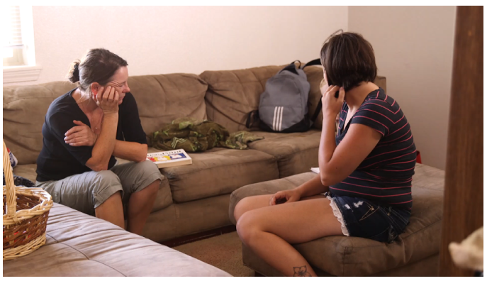

Behavior Has Meaning

