Slide 2
Children’s Behaviors
Stretch Across the ELOF Domains

Slide 3
Children’s Behaviors
Stretch Across the ELOF Domains
Approaches to Learning
Emotional and Behavioral Self-Regulation (Infant/Toddler & Preschool)
Social and Emotional Development
Relationships with Adults (Infant/Toddler)
Emotional Functioning (Preschool)
Language and Communication
Attending and Understanding (Infant/Toddler)
Vocabulary (Preschool)
Notes:
OPTIONAL

Slide 4
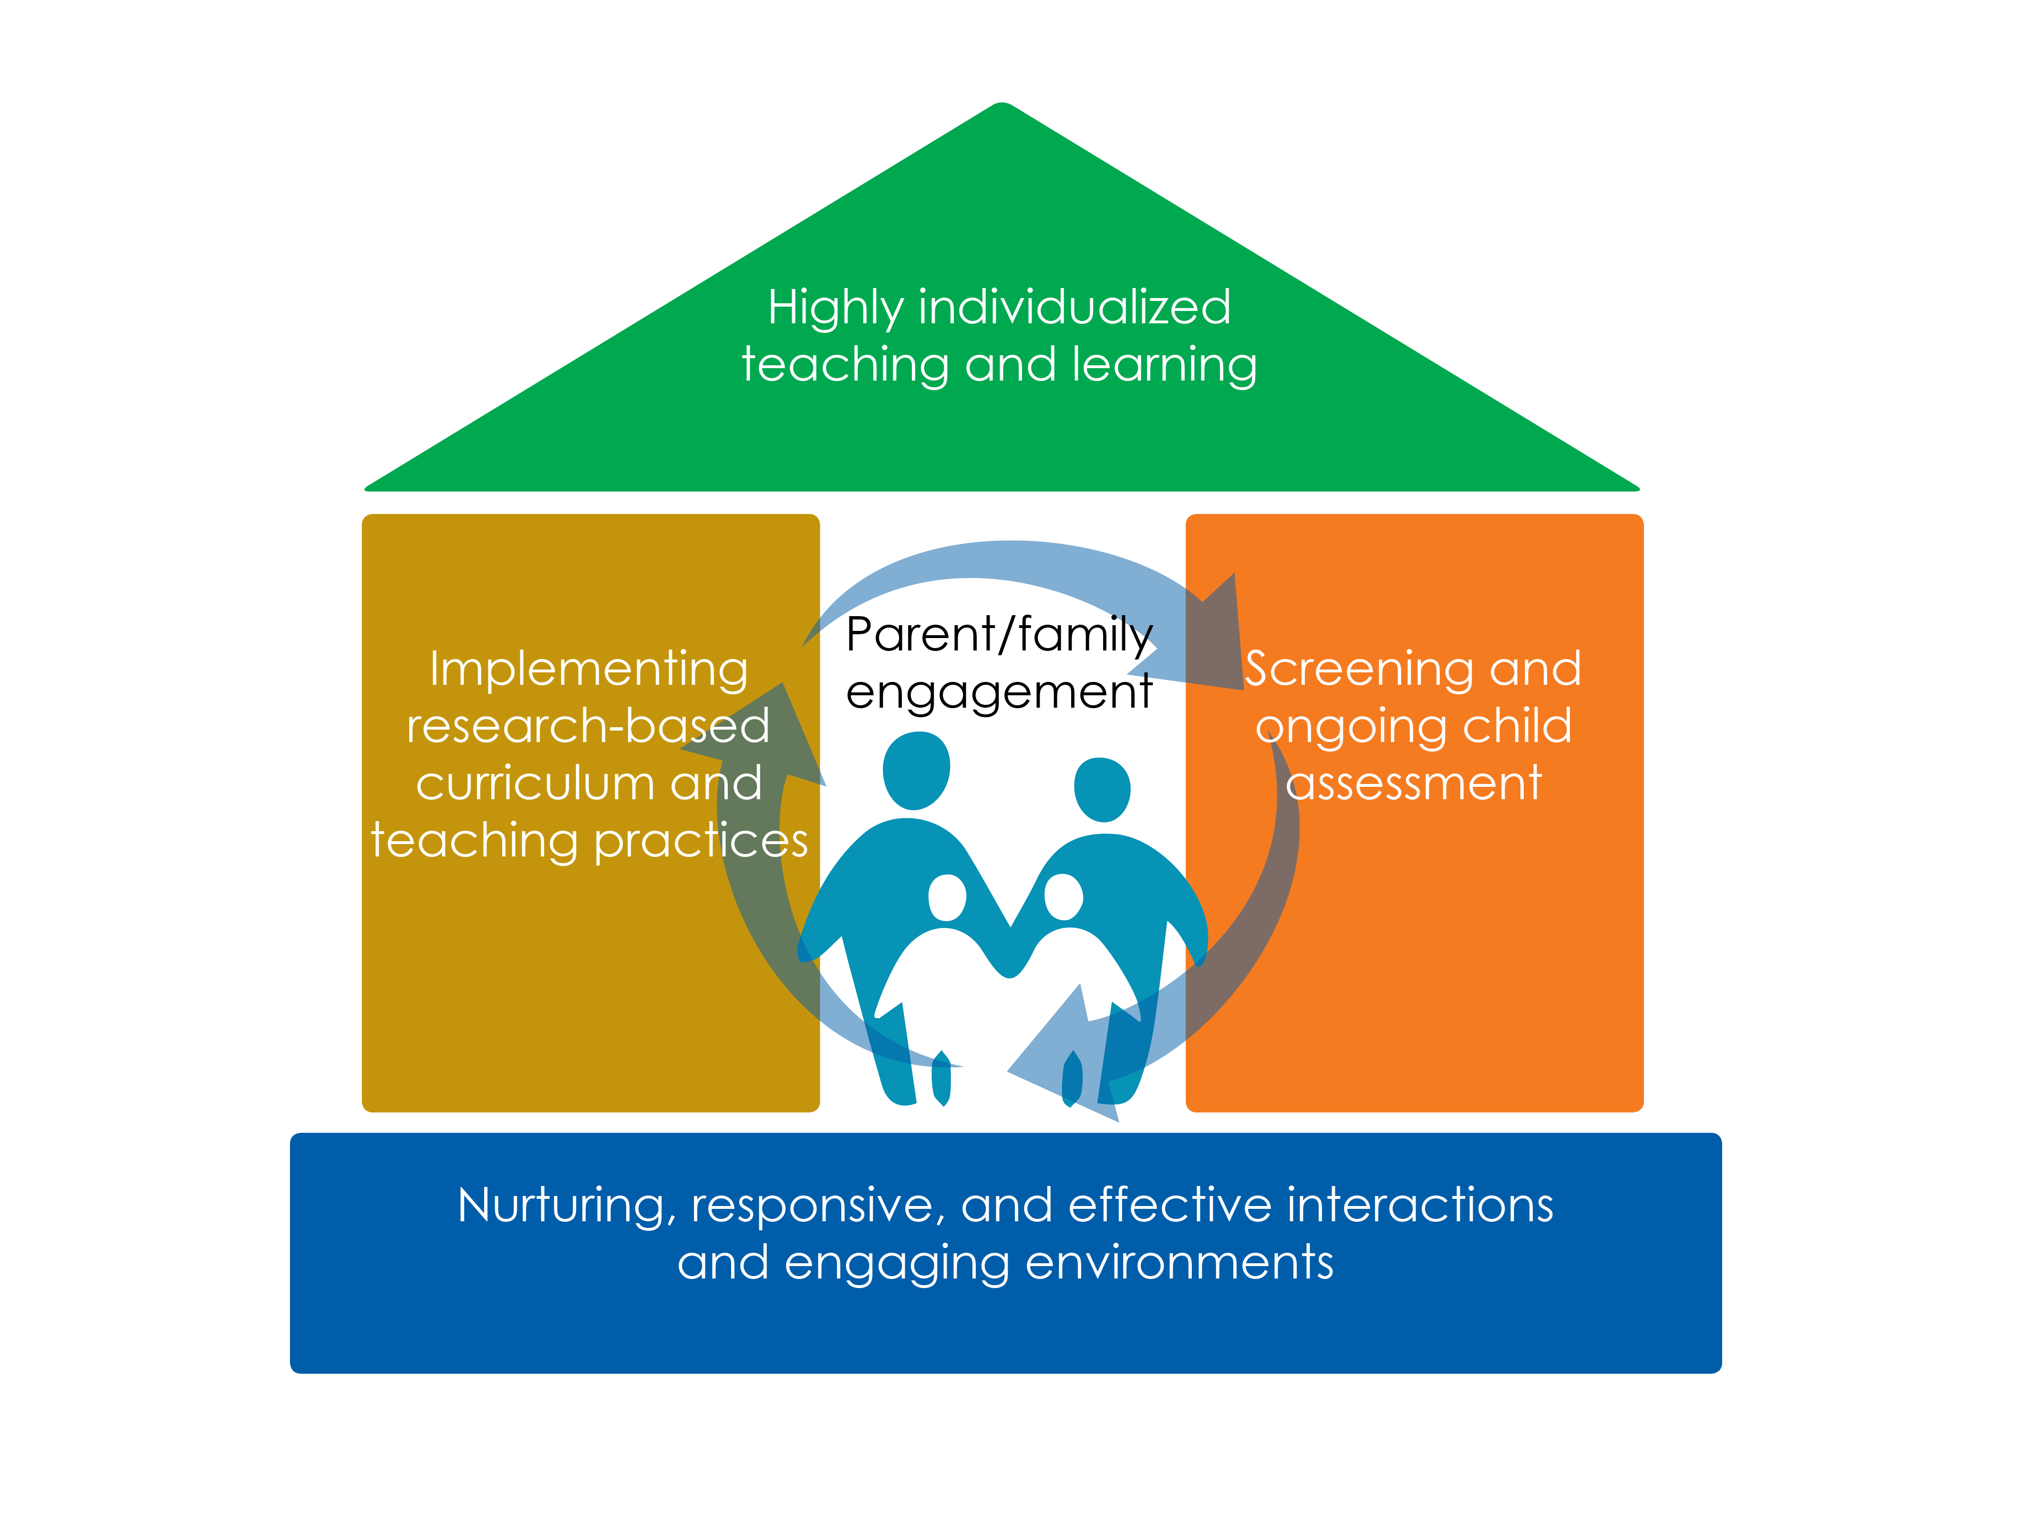
Framework for Effective Practice Supporting school readiness for all children

Slide 5
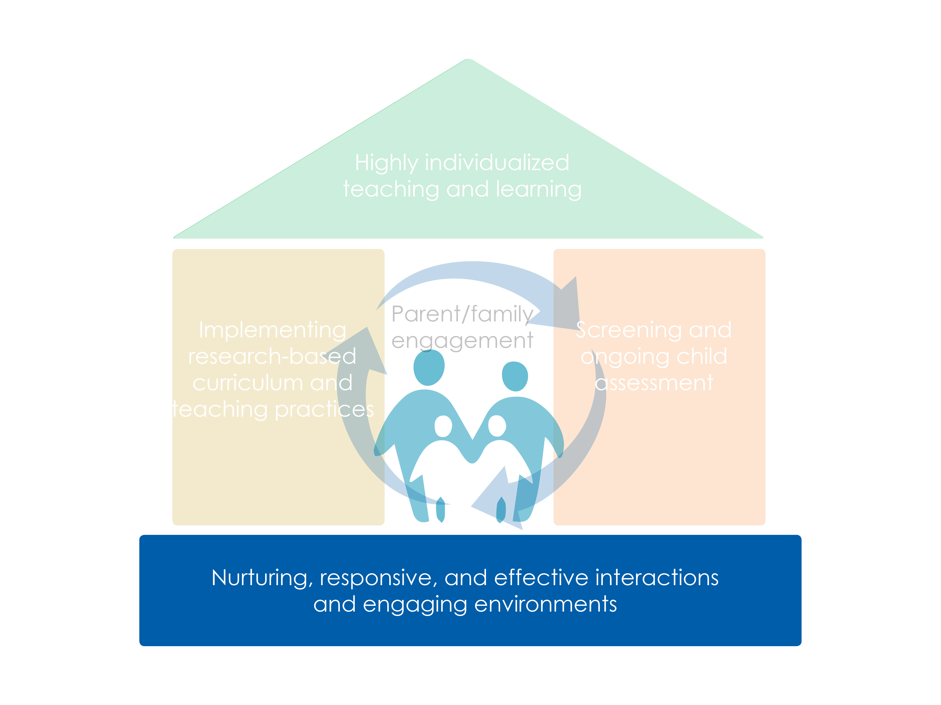
Framework for Effective Practice Supporting school readiness for all children

Slide 6
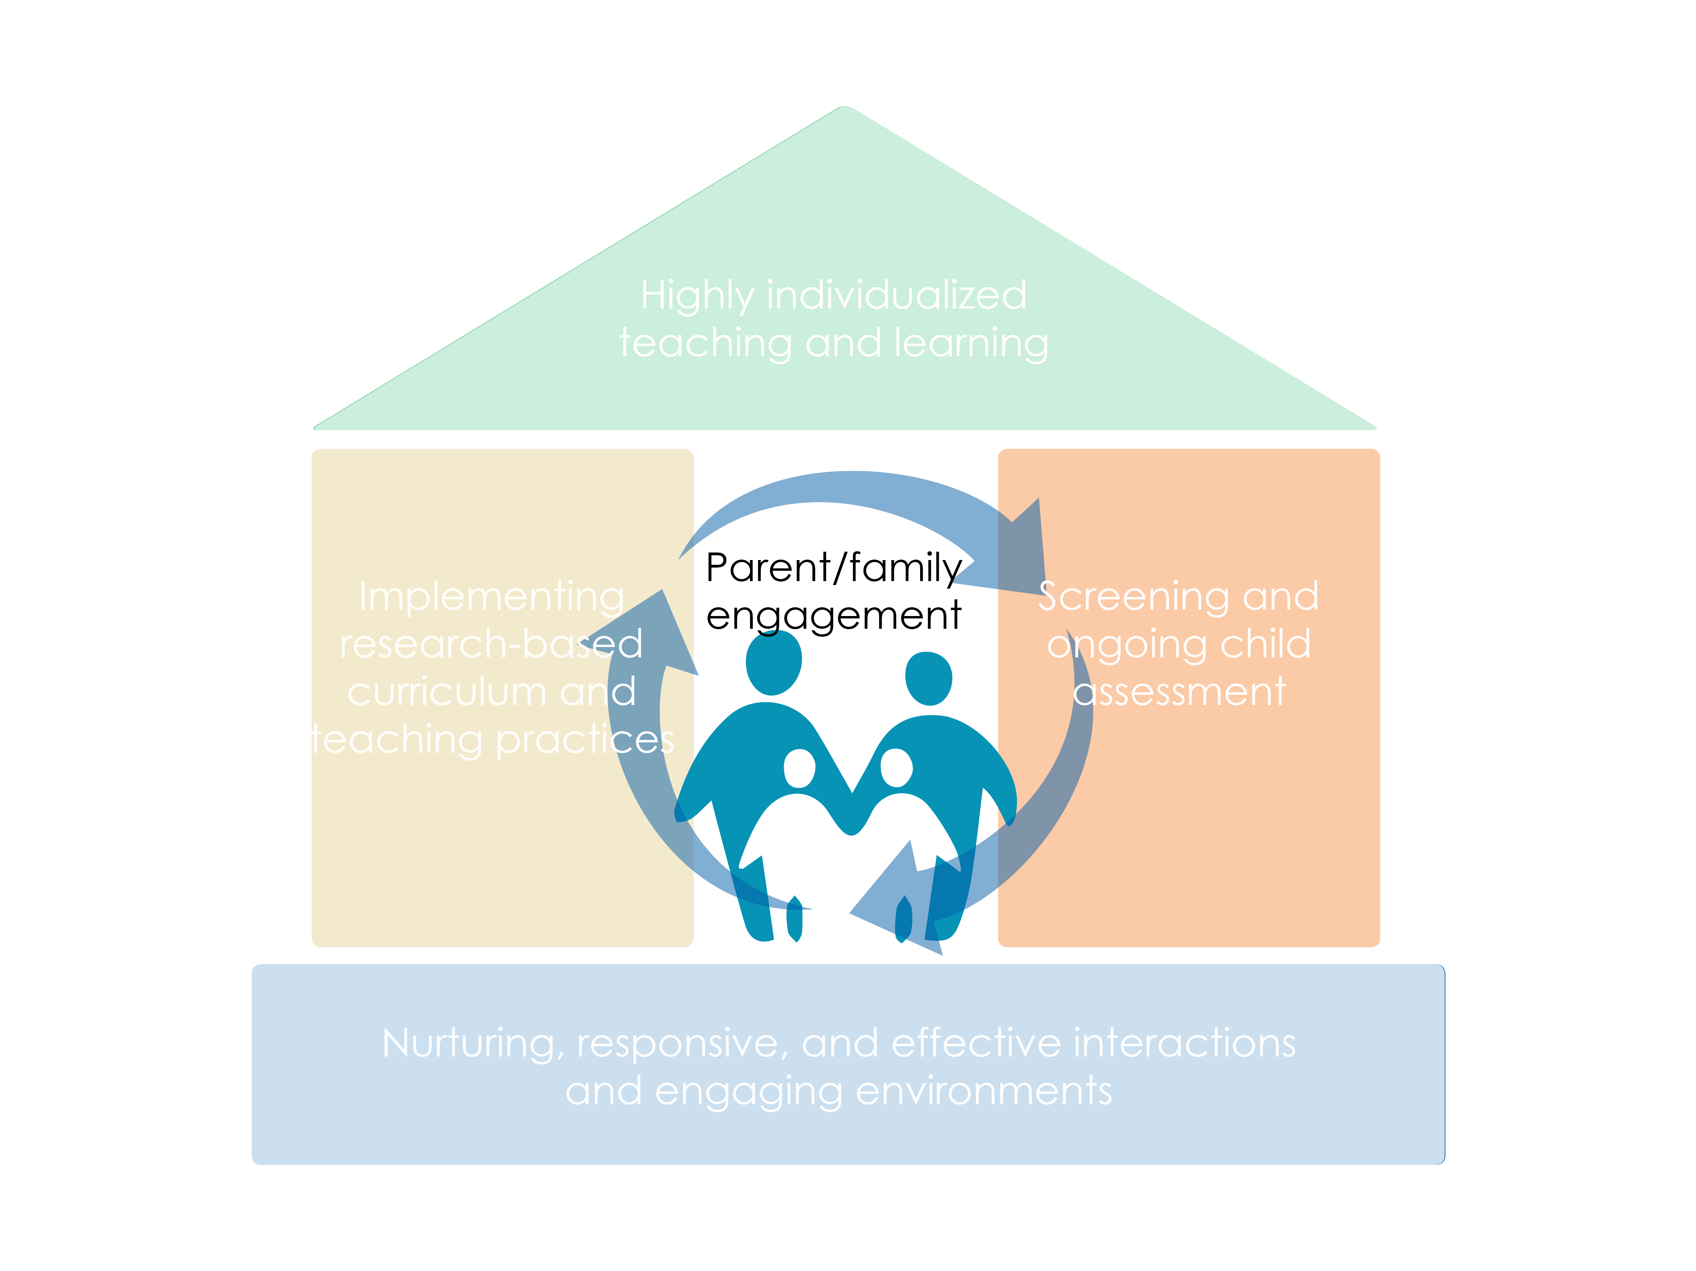
Framework for Effective Practice Supporting school readiness for all children

Slide 7
Objectives
Explain the importance of children’s behavior as communication
Analyze and interpret the meaning of children’s behaviors
Cover strategies that address children’s behaviors and build a supportive learning environment

Slide 8
Behavior
What is the behavior?
What do you believe about young children and their behavior?

Slide 9
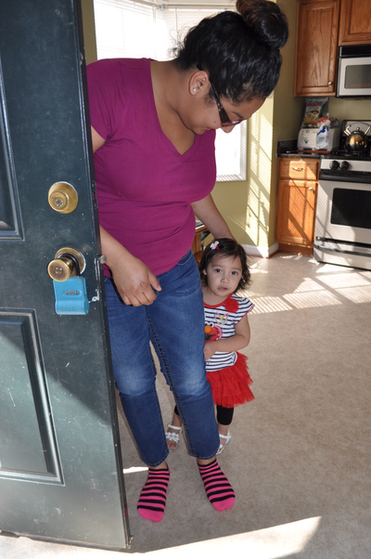
You Can’t Not Communicate
All behavior is a form of communication and has meaning
Children give us cues to help us understand what they want to communicate long before they have words

Slide 10
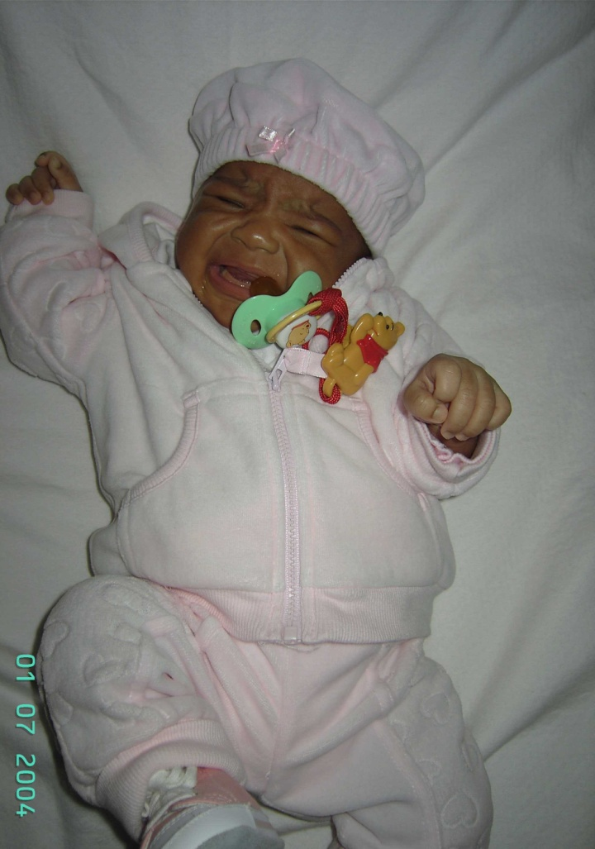
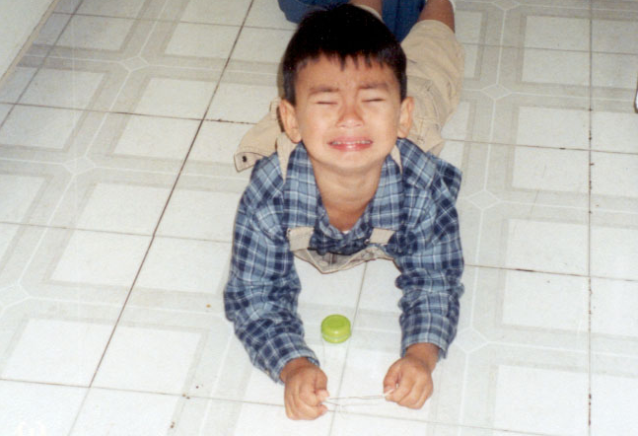
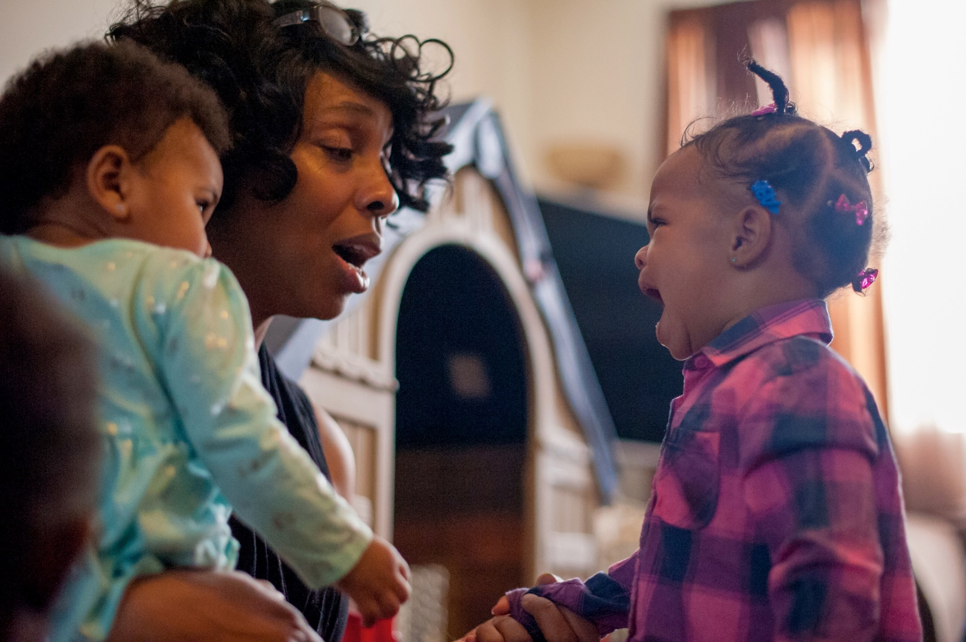
“I’m trying to tell you something!”

Slide 11
Behavior
Every communicative behavior can be described by its form and function.
Form vs. Function
Form: the behavior used to communicate
What is the behavior?
Function: the reason behind the communicative behavior
What is the purpose of the behavior from the child’s perspective?

Slide 12
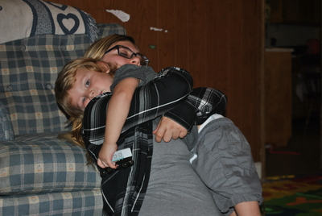
Forms of Communication
Crying
Cooing
Reaching for caregiver
Kicking their legs
Gaze aversion (looking away)
Squealing
Biting
Tantrums
Pointing
Smiling
Pulling adult
Clapping
Words
Jumping

Slide 13
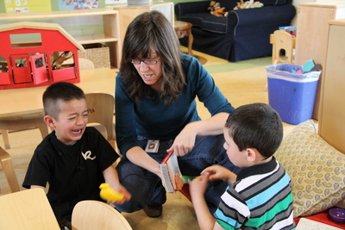
Functions of Communication
Obtain an object, activity, person
Request help
Initiate social interaction
Request information
Seek sensory stimulation
Escape demands
Escape activity
Avoid a person
Escape sensory stimulation
Express emotion
Express pain or illness

Slide 14
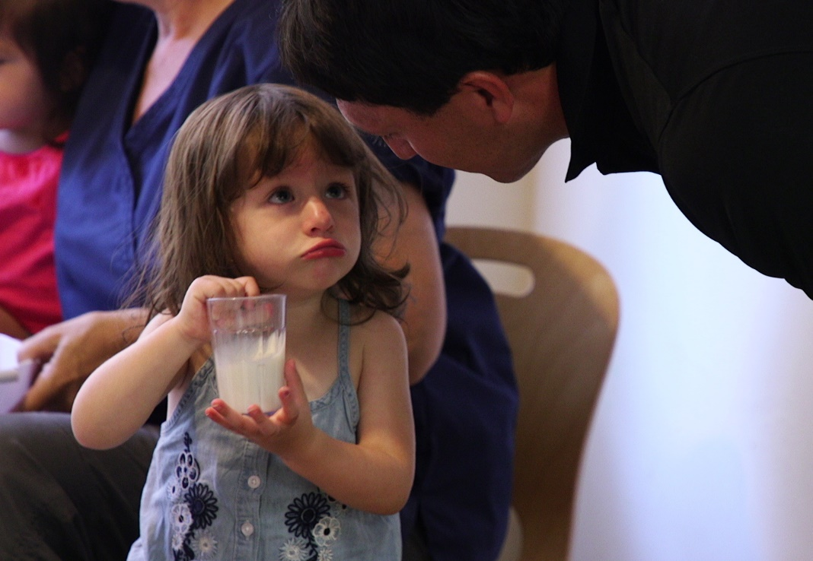
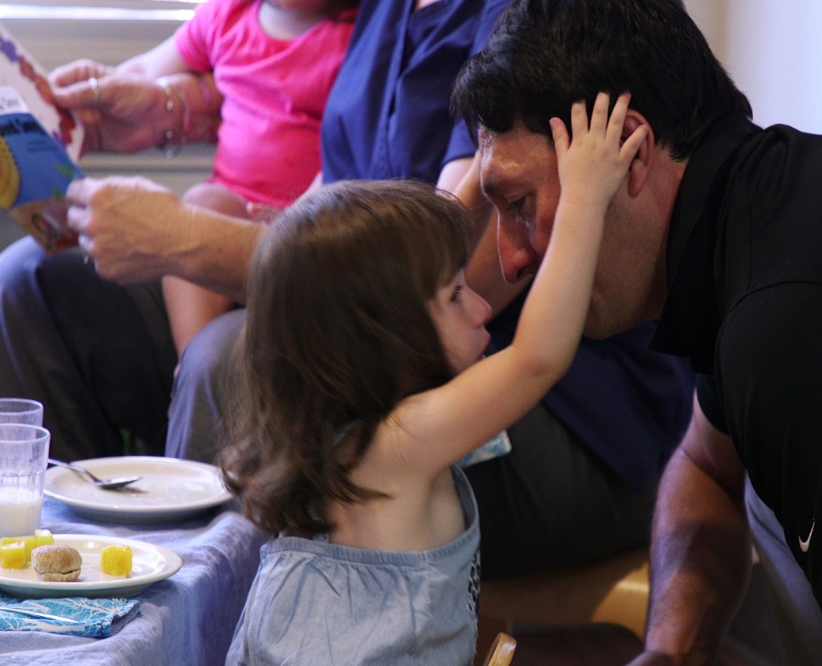
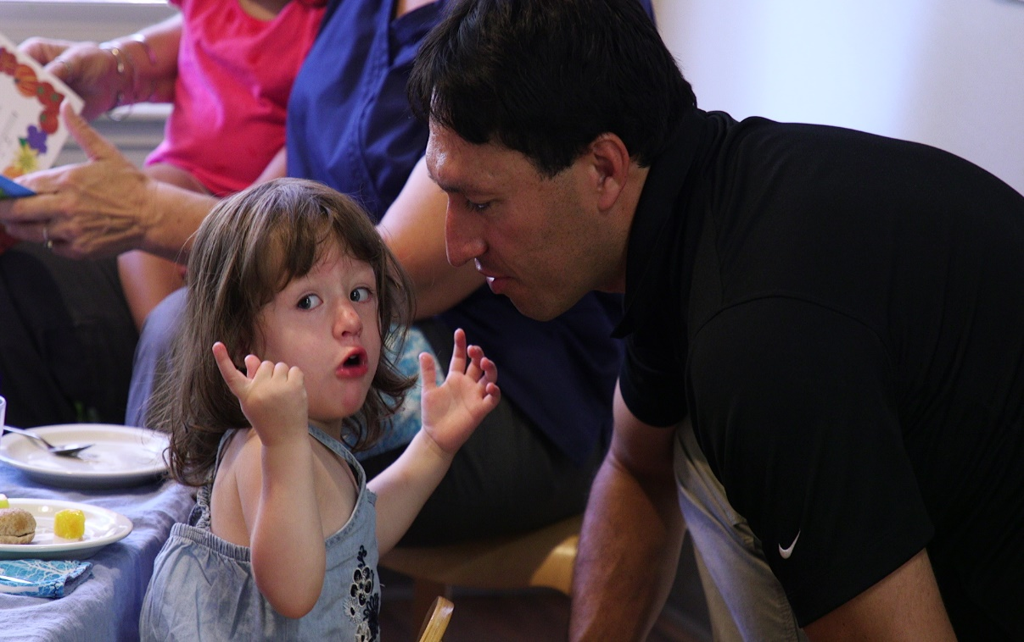
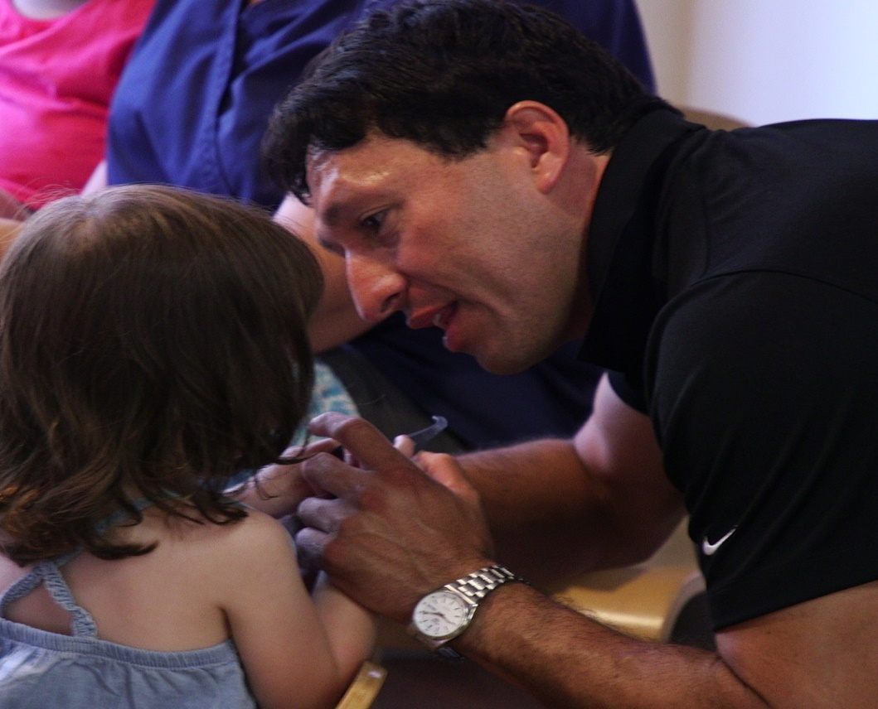
Form and Function

Slide 15
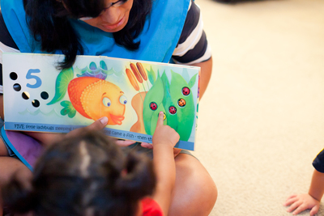
Form and Function
A single form of behavior may serve multiple functions
Multiple forms of behavior may serve a single function

Slide 16
Behavior Has Meaning
Why is it important to understand children’s behaviors?
Children feel valued and important
Children feel like competent and confident communicators
Children learn to communicate their intentions, feelings, and emotions

Slide 17
Behavior Has Meaning
Why is it important to understand children’s behaviors?
Adults build nurturing and responsive relationships with children
Adults pause before they react
Adults determine what skills we need to teach children

Slide 18
Behavior Has Meaning: Scenario
Mom has left five-month-old Jenna in center care for the first time. It’s been a rough two weeks so far for mom, baby, and the caregivers. When mom leaves, Jenna bursts into tears and screams. She only calms down when held by a teacher. Whenever they need to put her down, she immediately starts crying.
What might Jenna’s behavior be telling us?
What is the form?
What might be the function?

Slide 19
Behavior Has Meaning: Scenario
What can we do?
Observe Jenna’s behaviors before she gets upset
Pause and reflect on what Jenna is trying to communicate
Communicate with Jenna’s parents about strategies used at home to soothe her

Slide 20
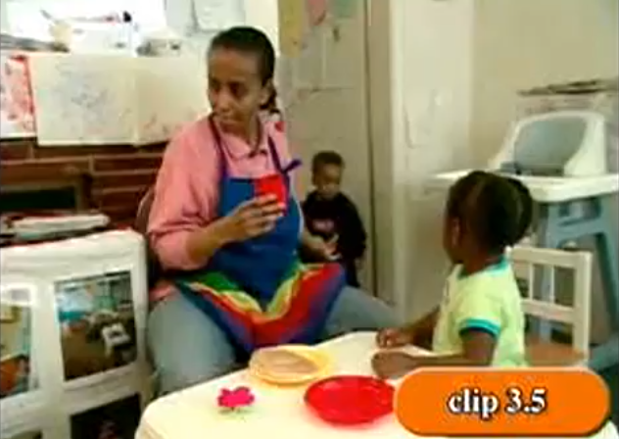
Behavior Has Meaning: Video Example 1

Slide 21
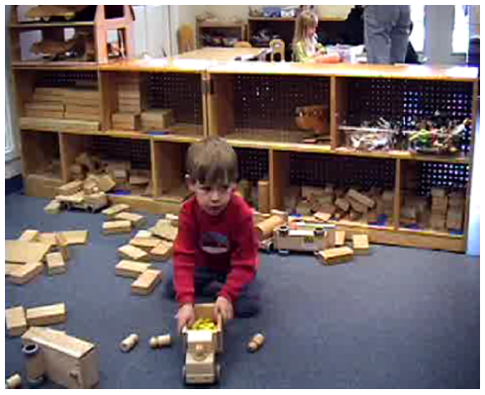
Behavior Has Meaning: Video Example 2

Slide 22
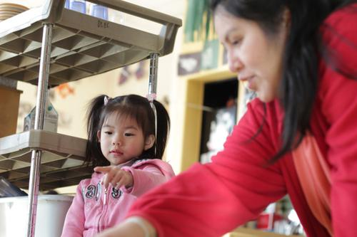
Children Who Are Dual Language Learners
During free play, Lucia wanders around the room. She stands and watches children play for a few minutes, but doesn’t join in their play. Lucia doesn’t stay at circle time longer than a few minutes and doesn’t respond when asked to come back to circle time. What does her behavior mean? Is she acting this way because she doesn't understand what the expectations are during activities and in circle time? How do you know?

Slide 23
Children Who Are Dual Language Learners
Talk with families to learn common words used at home
Have families visit the classroom to become familiar with the routines and expectations
Build the children’s strengths and interests into the curriculum
Interact with the child during classroom routines to help them engage

Slide 24
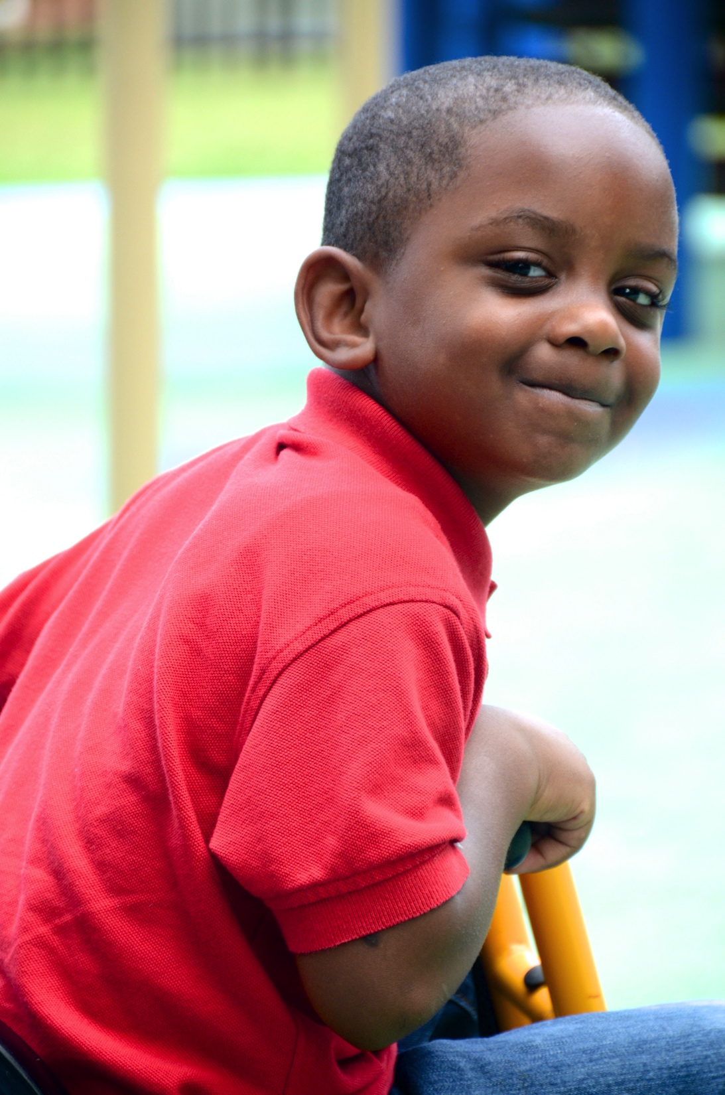
Be a “Behavior Has Meaning” Detective

Slide 25
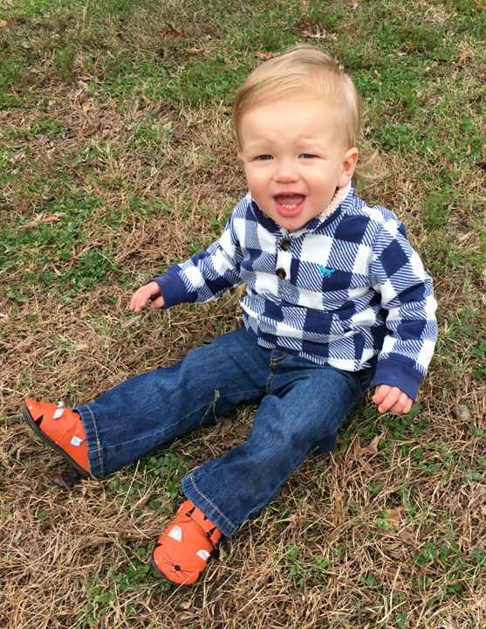
Review

