Slide 1
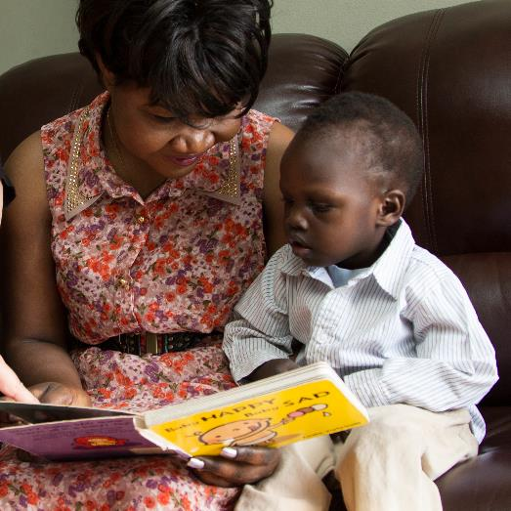

Family Engagement in
Early Care and Education
Partnerships That Foster Development
and Learning

Slide 2
Overview
This module will focus on:
The importance of relationships for children’s learning and development.
Responsive interactions that build
children’s abilities.
Ways to partner with parents to boost children’s learning outcomes.
Identifying community resources with families to encourage children’s learning.

Slide 3
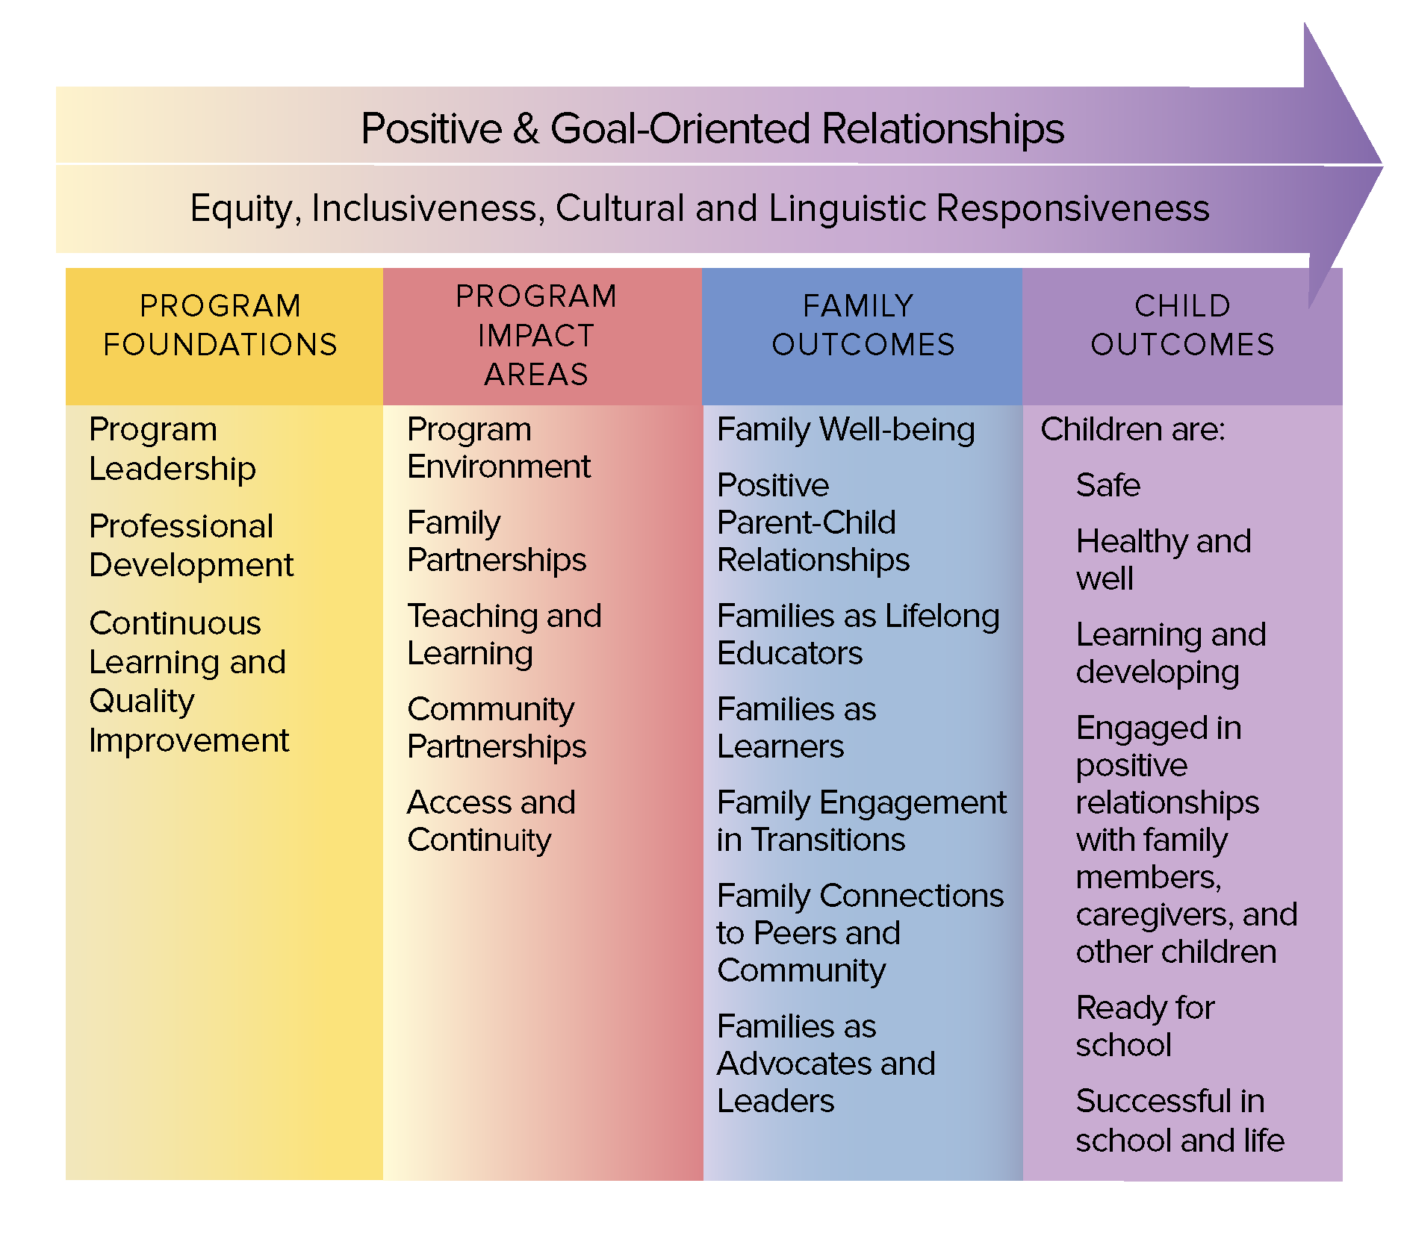
The Head Start Parent, Family, and
Community Engagement Framework
Image credit: Office of Head Start

Slide 4
Partnering for
Children’s Learning
Four pieces of chart paper with prompts are hanging around the room.
Move around the room and write your responses to each prompt.
There are no right or wrong answers.

Slide 5
By the end of this module, you should
be able to:
Describe the impact of positive relationships on children’s learning and development.
Identify and model responsive interactions to build children’s abilities.
Partner with families to boost children’s learning and development in the early learning environment and at home.
Identify community resources with families to enhance children’s learning.

Slide 6
Relationships and Learning

Slide 7
Seeking Understanding
What do you think families
want from you?
What do you expect from families?
How might these interests, desires, needs, and
wants overlap?
How might they differ?

Slide 8
Influences on Relationships
The interactions, conversations, and experiences that you have with families are shaped by:
  Personal stories and individual experiences in families and school
  Identities
  Values and beliefs
  Culture

Slide 9
Seeing Families’ Perspectives
When educators and families have different cultural perspectives, they can learn to:
See and value each other’s perspectives.
Work toward shared goals for children’s learning and development.

Slide 10
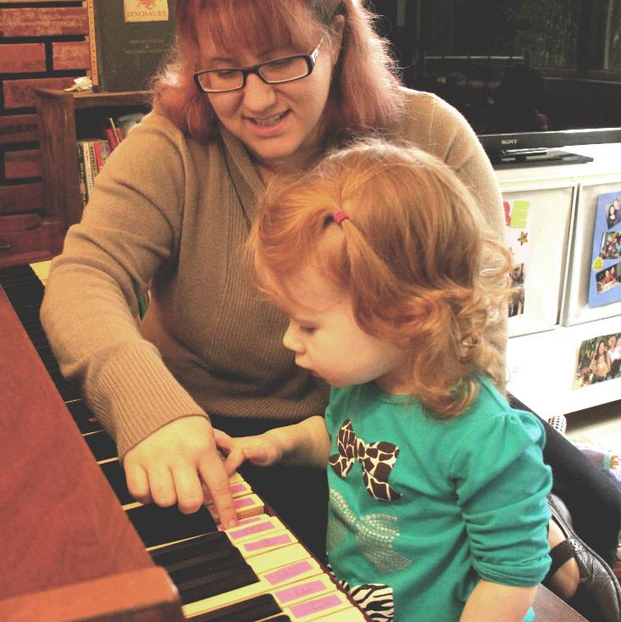
A Strengths-Based Approach
Families . . .
Are our partners in supporting children’s development.
Are experts on their children.
Have something valuable to contribute.
Image credit: EarlyEdU

Slide 11
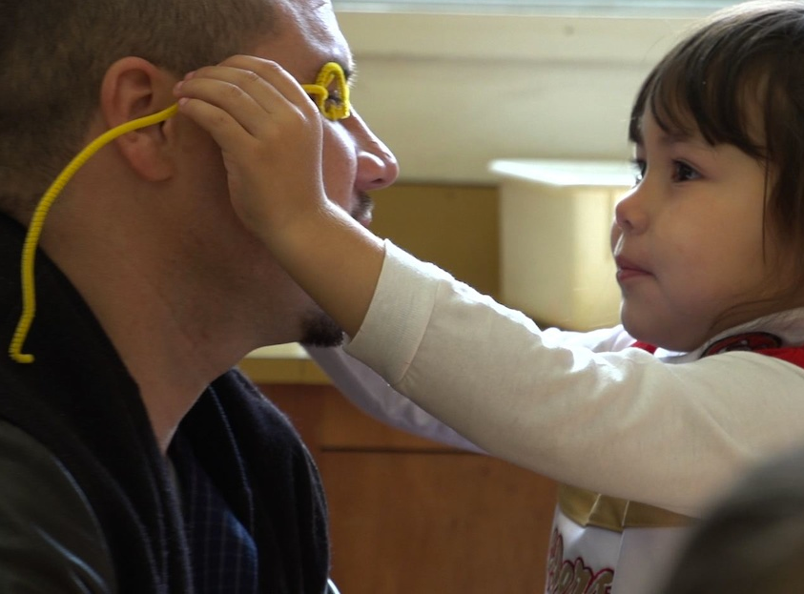
Parents are their children’s
first and most important teacher.
Image credit: EarlyEdU

Slide 12
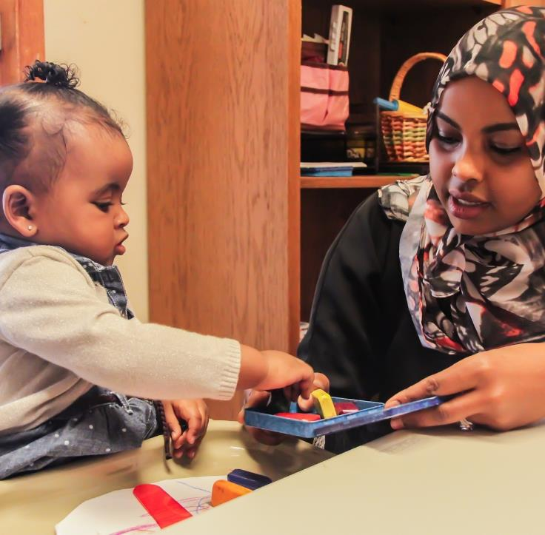
When parents and other family members have strong, trusting relationships with those who support them, including educators, they are more likely to actively participate in young children’s learning and development.
Image credit: EarlyEdU

Slide 13
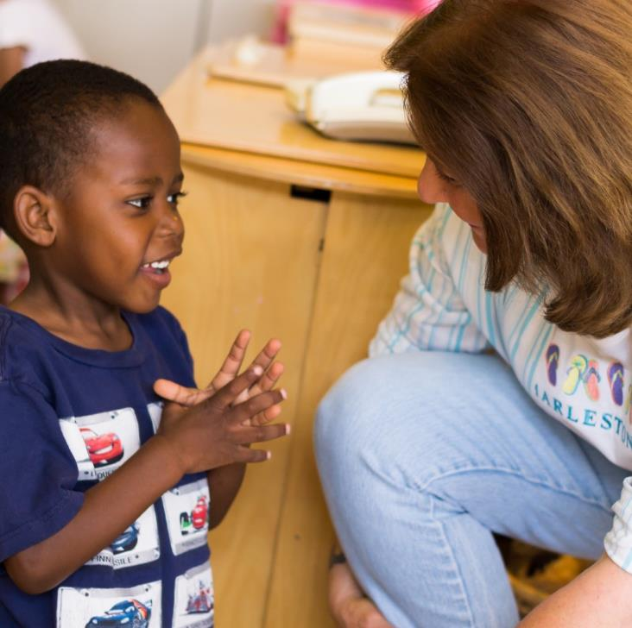
Effect on Children’s Learning
Children’s learning and development depend on the quality of the interactions with important adults
in their lives.
Image credit: EarlyEdU

Slide 14
Me and You
As you watch this video,
think about:
What types of interactions lead to children’s healthy development and learning?

Slide 15

VIDEO: Me and You

Slide 16
Video Debrief
Types of interactions that encourage healthy development and learning include:
Making eye contact
Talking
Encouraging communication
Responding with interest
and respect

Slide 17
Everyday Interactions

Slide 18
“The day-to-day interactions between infants and young children and their parents help drive their emotional, physical, and intellectual development (Brazelton & Cramer, 1990).”
(Office of Head Start, Early Childhood Learning and Knowledge Center, 2013, p. 2)

Slide 19
Serve and Return
Watch this video carefully about everyday interactions and brain development.

Slide 20
VIDEO: Serve and Return

Slide 21
Video Debrief
Healthy brain architecture depends on a strong foundation built by consistent, responsive relationships with caring adults.
Serve-and-return interactions help shape brain architecture.
Healthy brain architecture is essential for young children’s learning and development.

Slide 22
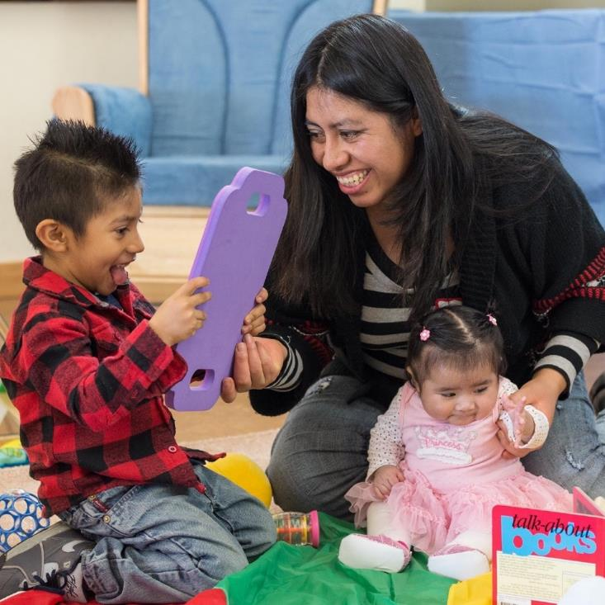
Responding to Children
Three strategies
in responding to children are to:
Describe
Repeat
Add something new
Image credit: EarlyEdU

Slide 23

Describe
“You’re looking in the mirror.”
Image credit: EarlyEdU

Slide 24
Repeat
“Mira!”
“Mira!”
Image credit: EarlyEdU

Slide 25
Add Something New
“Mira!”
“Mira!
You look happy.”
Image credit: EarlyEdU

Slide 26
Real to Reel: Everyday Talk
As you watch this video:
Identify strategies that families use to support their children’s language development.
Consider ways you can support and encourage families in
their everyday interactions with their children.

Slide 27
VIDEO: Real to Reel: Everyday Talk

Slide 28
Video Debrief
Adults can support children’s development and learning by joining in their play, connecting to their interests, and sharing ideas.
It’s important to respond to children’s vocalizations, words, gestures, and eye contact.
Building engaging and fun interactions helps make communication with a child easier.

Slide 29
Partnering for Children’s Learning

Slide 30
How Would You . . .
Partner with families to
boost children’s development and learning?
Support the relationships
and interactions of parents
and children?
Recognize and encourage parents’ roles as lifelong educators of their children?

Slide 31
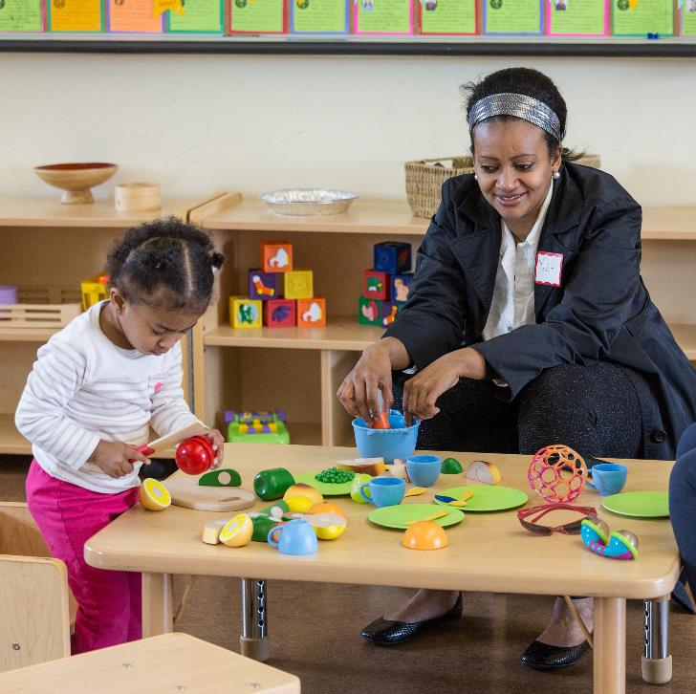
Share Learning Ideas
Adopt an approach of collaborating with families to share learning goals and ideas to support children’s learning both at home
and in the early learning program.
Image credit: EarlyEdU

Slide 32
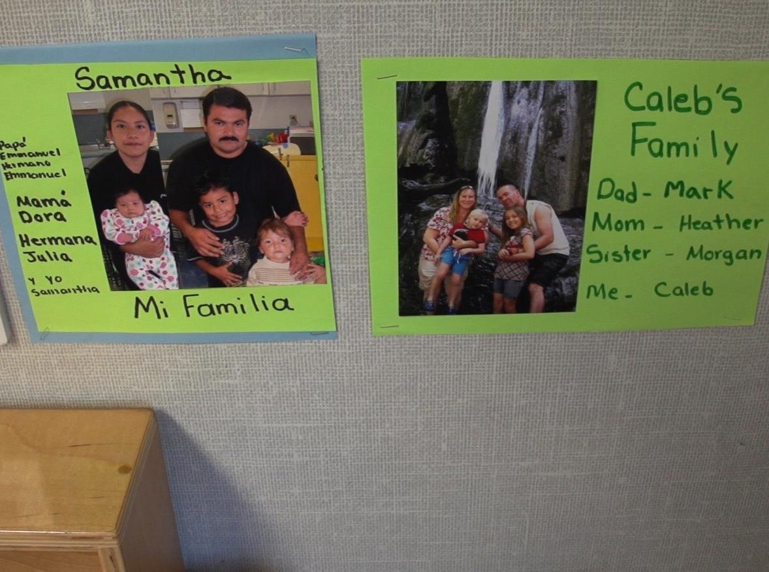
Culture influences what and how families teach children.
Image credit: EarlyEdU

Slide 33
Influences of Culture
In small groups, discuss:
What are some of the ways
that culture can influence
families’ approaches to teaching their children?
Draw from your own experiences, if possible.

Slide 34
Welcoming Families’ Cultures
When parents and educators have different cultural perspectives, parents are more likely to partner with educators and advocate for their children when they are able to discuss culture openly.
Children can have enhanced brain development when they continue to learn their home language in addition to English.

Slide 35

Inviting Families to Share
Educators can
invite families to bring stories, songs, and other activities from their culture
and childhood to share in the early learning program.
Image credit: EarlyEdU

Slide 36
Families May Want To . . .
Lead activities for groups of children
Volunteer or help with activities
Read and play with children
Sit with children and observe

Slide 37
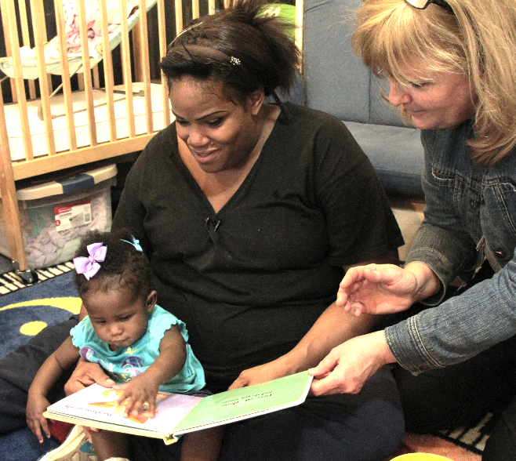
Tell Me A Story Series
Image credit: EarlyEdU

Slide 38
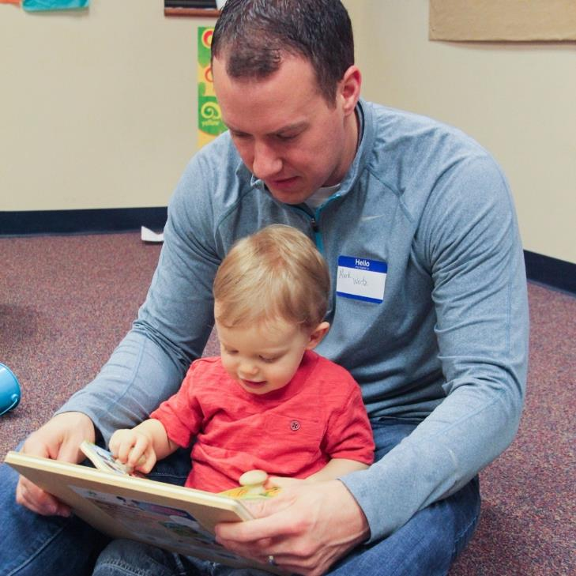
Enjoying Books Together
Invite families to
share approaches to engaging children with books.
Some strategies are:
Look at the pictures.
Act out parts or skim the book.
Ask questions.
Image credit: EarlyEdU

Slide 39
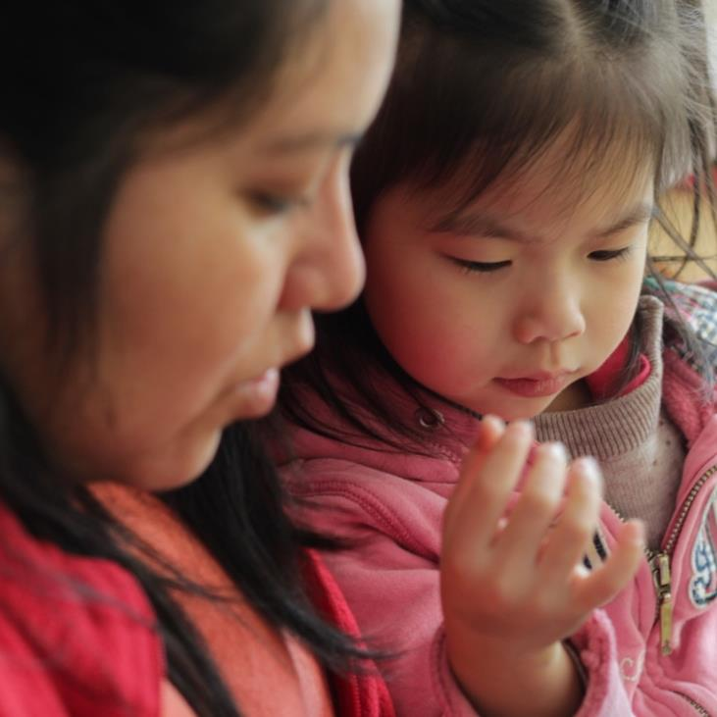
Look at the Pictures
Look at the cover:
  What do you think this book is about?
Turn to the first page:
Describe what
you see.
Respond to children’s comments.
Image credit: EarlyEdU

Slide 40
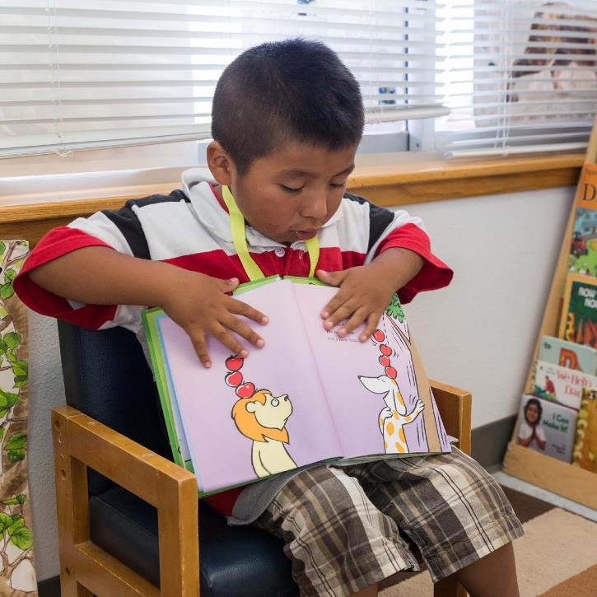
Act It Out
Recreate scenes.
Say the words in characters’ imagined voices.
Use loud and soft voices and pauses for drama.
Create a new ending or add a plot twist to keep it fun.
Image credit: EarlyEdU

Slide 41
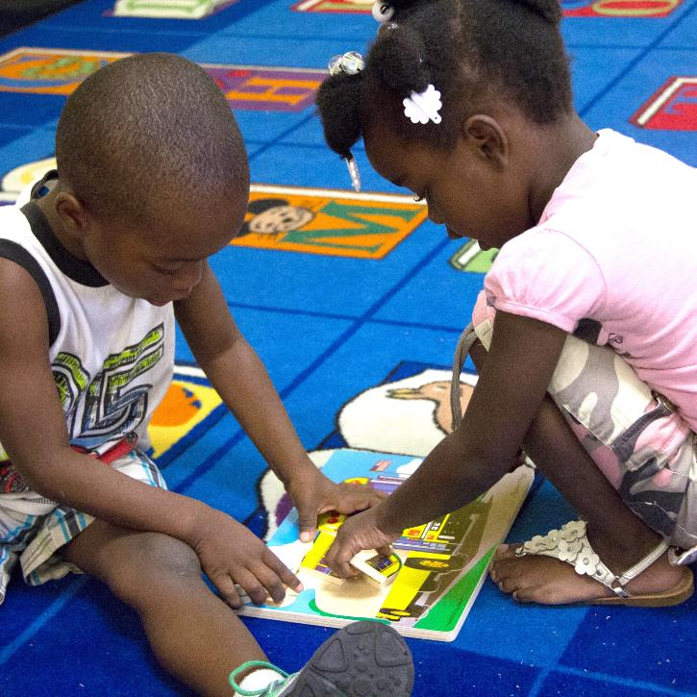
Skim It
Choose select
words to emphasize.
Look for important ideas and focus
on those.
Follow the child’s lead—if they start
to lose interest, take
a break.
Image credit: EarlyEdU

Slide 42
Let’s Practice (Optional)
Find a partner and one children’s book for your pair.
Practice the strategies from the previous slides.

Slide 43
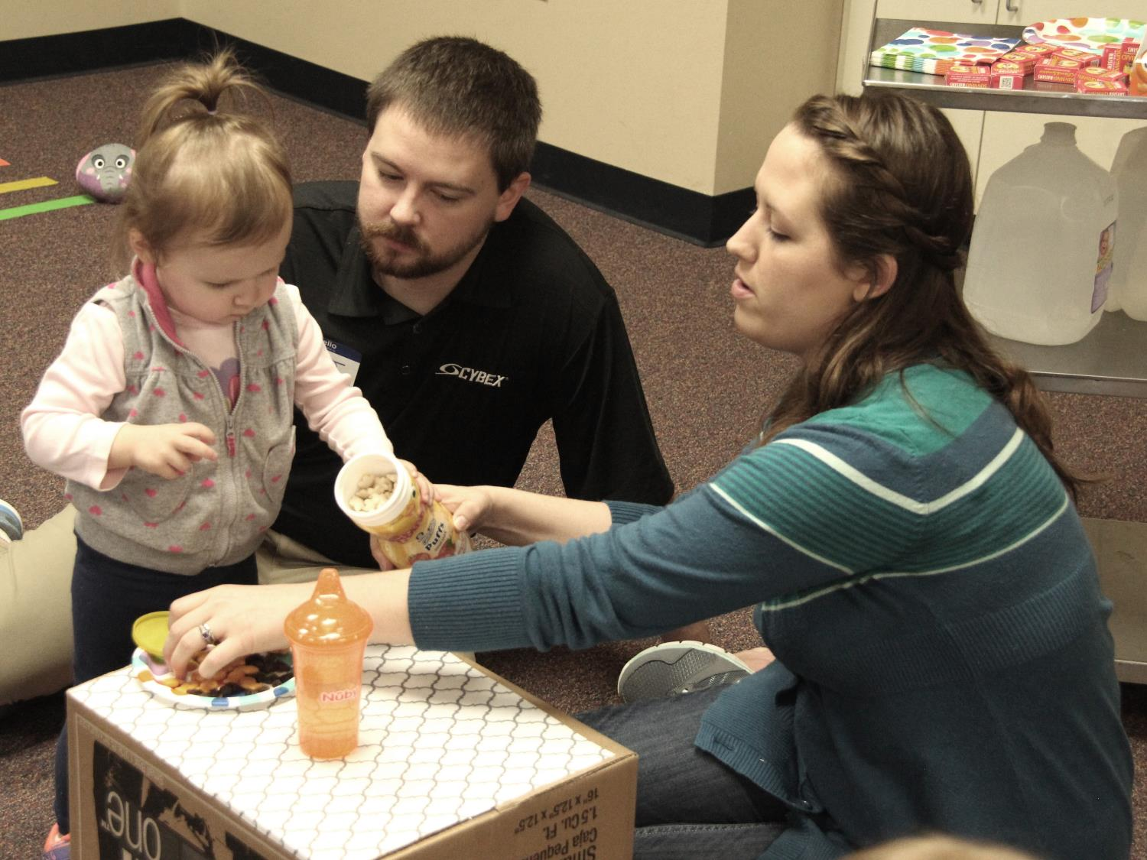
Learning During Daily Routines
Image credit: EarlyEdU

Slide 44
What Am I Learning?
Read each experience that a child could have with family members. With a partner, discuss:
What children may be learning.
How families can help
children learn.
How educators and families can work together to help children grow and progress.

Slide 45
When Families Face Challenges
Some families may face challenges that can impact interactions between parents and children.
It is important that you continue to build positive and supportive relationships with families and work to understand their perspectives.

Slide 46
Supporting Families
Support from a healthy web of relationships can offer families:
Strength
Hope
Respect for their role as lifelong educators of their children
A sense of competence and confidence
Security

Slide 47
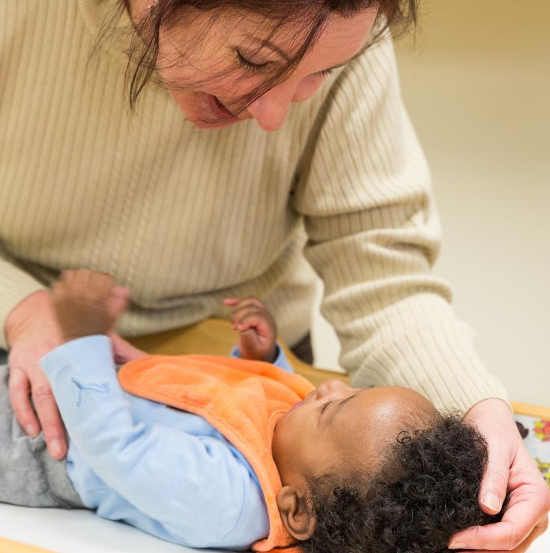
Time Away
Families may face separation due to:
  Employment
  Immigration issues
  Hospitalization, long-term care
  Deployment
  Custody issues
Image credit: EarlyEdU

Slide 48
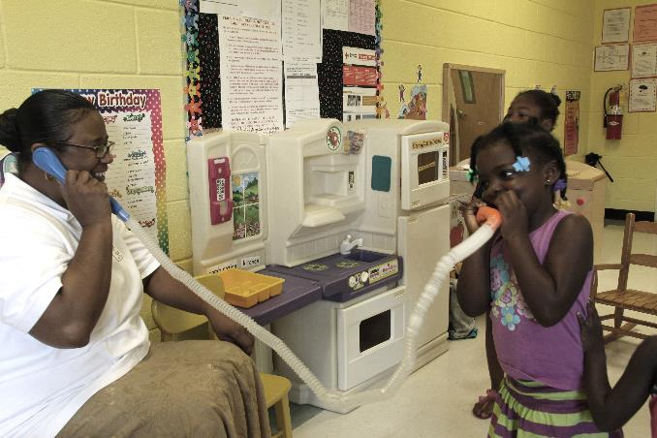
Keeping Connected
Pictures
Letters
Photographs
Phone calls
Video chats
Recorded stories
Image credit: EarlyEdU

Slide 49
What Are Your Ideas?
Read the scenario below:
Kiera is 2 years old. Her father just started a new job as a truck driver and is gone several nights in a row each week.
How could you support Kiera’s father in continuing to engage with her and promote her learning?

Slide 50
Learning Within the Community

Slide 51

Through a Family’s Eyes
Encourage families
to share their world with you.
Explore the importance of learning opportunities that bring families together.
See the community through a child and family’s eyes.
Image credit: EarlyEdU

Slide 52
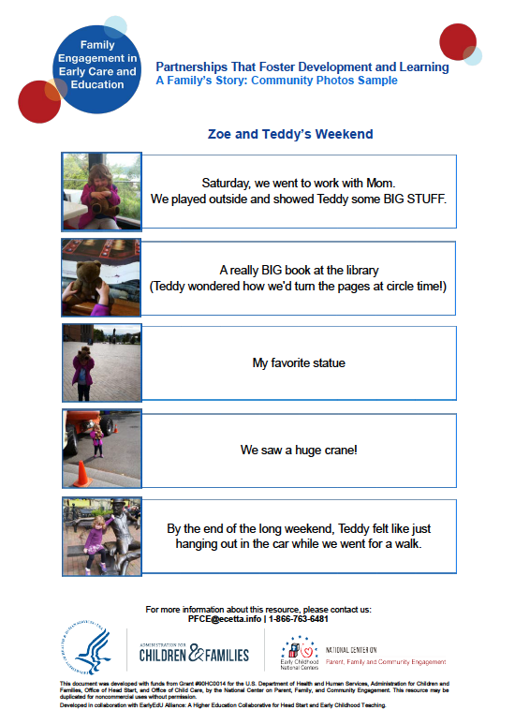
Use Family and Child Photos
Image credit: EarlyEdU

Slide 53
Families and Community Resources
How are community resources valuable to young children and families?
Turn and exchange ideas with
a partner.
Be ready to share your thoughts with the larger group.

Slide 54
Possible Community Partners
Public libraries
Museums
Public health departments
Hospitals
Local schools and school districts
Faith-based organizations
Parks
Recreation and community centers

Slide 55
Program-Community Partnerships
How could you and families plan to use community resources to support learning
in early childhood programs?
How might you work with community resources to help promote families as lifelong educators?

Slide 56
Ideas for Programs
Ask a librarian to help lead a family
event or children’s story time for children and families.
Request a bookmobile visit.
Ask a local library, hospital, or business to sponsor a gallery of children’s art.
Ask a museum representative to visit
your program.

Slide 57
Bringing It All Together

Slide 58
The Head Start Parent, Family, and Community Engagement Framework
Image credit: Office of Head Start

Slide 59
Where Does It Fit?
Which part of the Framework does this module connect with?
Turn and exchange ideas
with a partner.
Be ready to share your thoughts with the whole group.

Slide 60
Family-educator relationships and parent-child relationships influence children’s learning and development.
Responsive interactions are key to children’s growth.
Educators can partner with families to boost children’s learning at home and in the early learning program.
Families and educators can access community resources to support children’s learning.

Slide 61
Community Resource Map (Optional)
Identify at least three resources, such as libraries, museums, or recreation centers, that provide family or child activities in a community.
Investigate and gather information about the opportunities they offer.
Create a map of the community and label the kinds of resources available to families.

