Slide 1
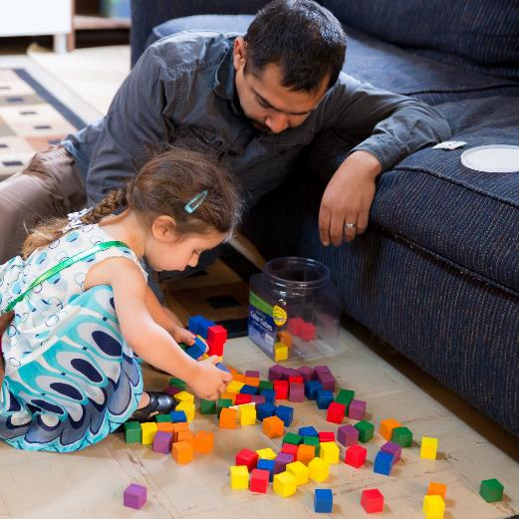

(Draft)
Family Engagement in
Early Care and Education
Engaging Fathers

Slide 2
Overview
This module will focus on:
Understanding the roles of fathers in children’s well-being and development.
Responsive ways to partner with fathers
to foster children’s development and learning.
Strategies to create a welcoming environment for fathers.

Slide 3
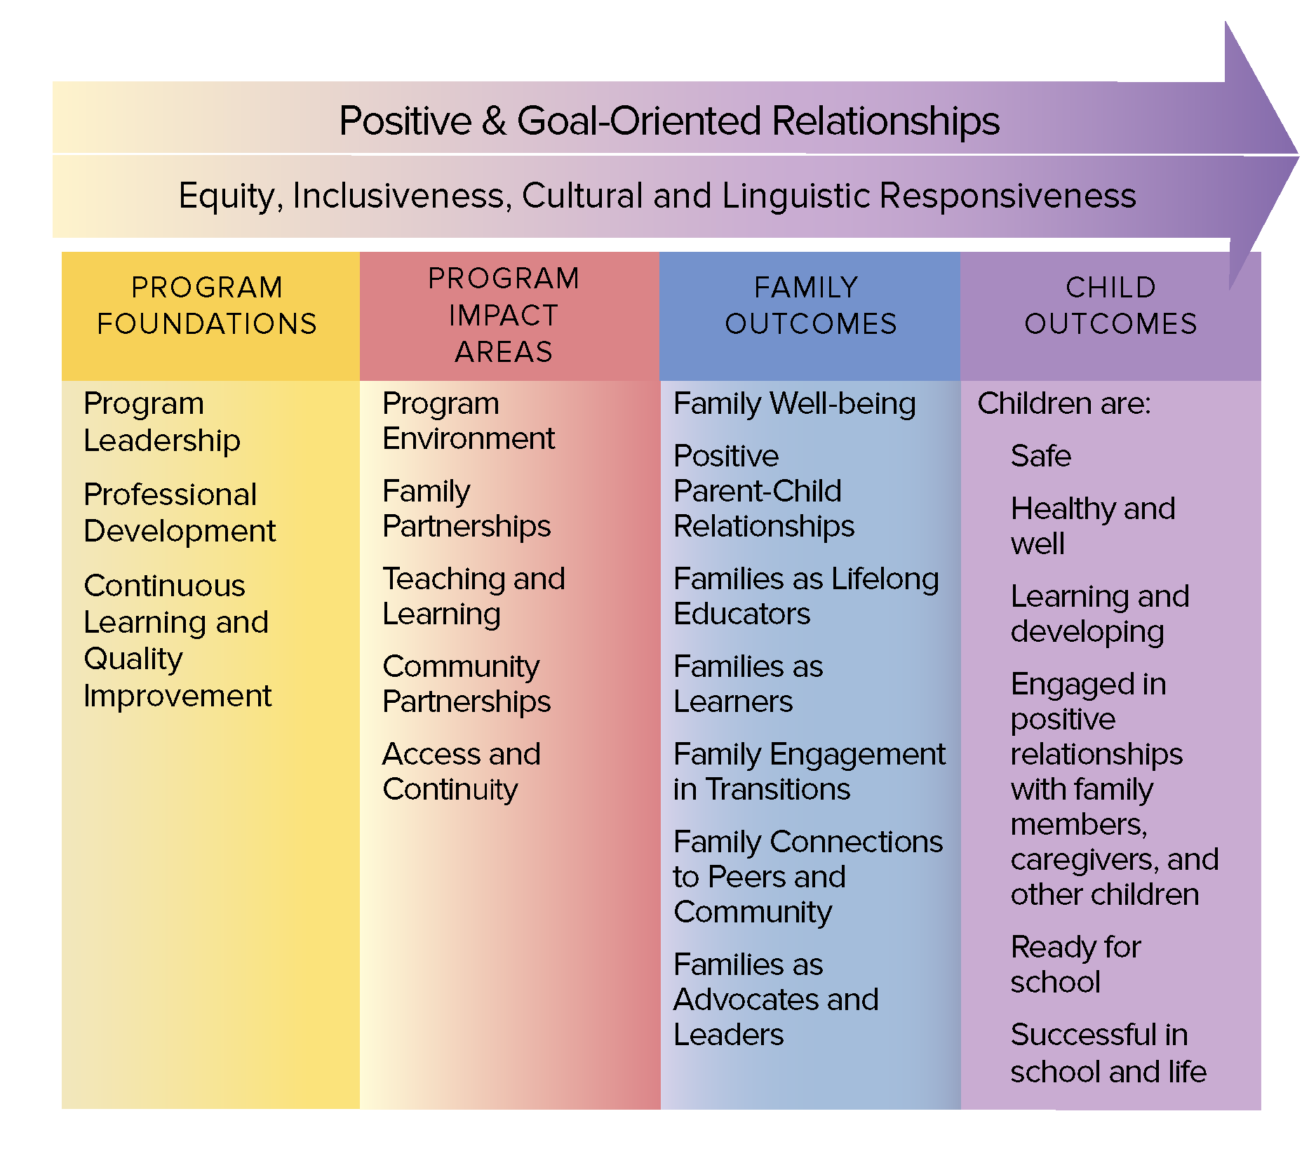
The Head Start Parent, Family, and Community Engagement Framework
Image credit: Office of Head Start

Slide 4
Where Does It Fit?
Which parts of the Framework does this module topic relate to?
Turn and exchange ideas with a partner.
Be ready to share your thoughts with the whole group.

Slide 5
Image credit: Office of Head Start

Slide 6
A Program-Wide Approach
A focus on the quality of full-program engagement
Opportunities for educators and other program staff to further develop competence and confidence in partnering with fathers

Slide 7
By the end of this module, you should be able to:
Describe the impact on
children when fathers are involved
in their lives.
Identify ways to encourage the relationships of fathers and children.
Use different approaches to create a welcoming environment for fathers and other important men in children’s lives.

Slide 8
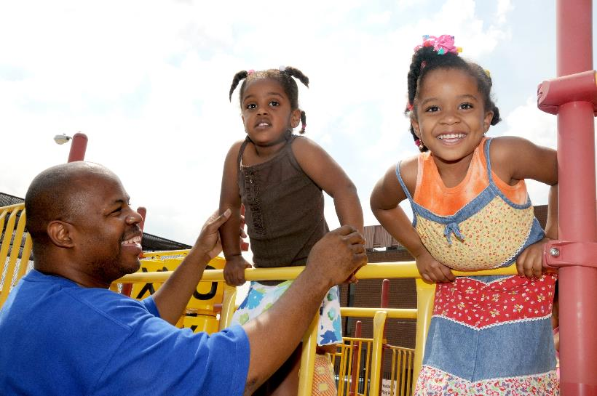
Children’s Interactions with Fathers and Mothers
Image credit: Office of Head Start

Slide 9
Relationships Between
Fathers and Their Children

Slide 10
Why Fathers Matter
Children can benefit from relationships with fathers by…
Mothers can benefit from relationships with fathers by...
Families can benefit from fathers by...
Programs can benefit from fathers by...

Slide 11
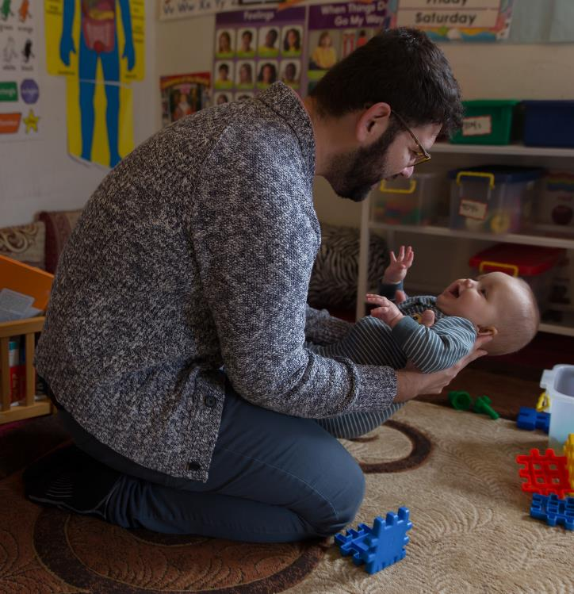
The quality of fathers’ involvement with their children is a key factor in promoting their children‘s development.
Image credit: EarlyEdU

Slide 12
Fathers’ Unique Roles
Father and mother parenting styles can overlap, but often have unique differences.
Fathers tend to:
Encourage more exploration and independent behavior in young children.
Use language that stretches and challenges children’s language competency.
Use complementary discipline and
parenting strategies.

Slide 13
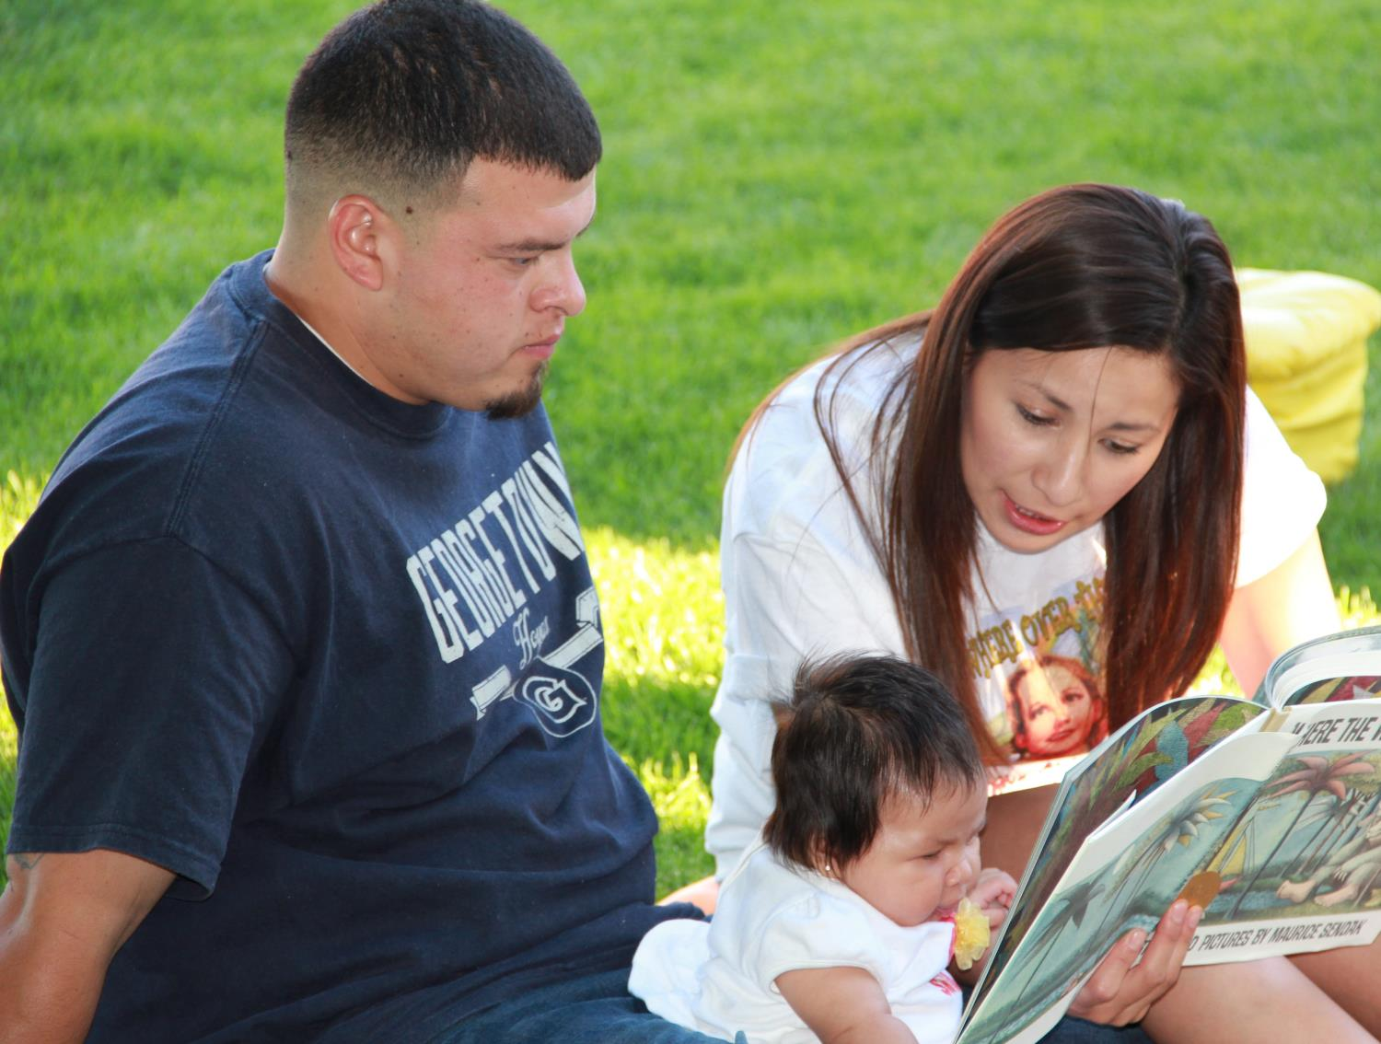
The Influence
of Culture
Image credit: EarlyEdU

Slide 14
When Fathers Are More Involved . . .
More
Positive
Child
Behavior
Fewer
Overall
Child
Behavior
Problems
Less
Aggressive
Behavior
Less
Hyperactive
Behavior
(Adapted from Office of Planning, Research, and Evaluation, 2006, p. 9)

Slide 15
Impacts on Father-Child Interactions
The father’s relationship with his own parents and his partner’s parents
His partner’s attitude toward his father role
The timing of fatherhood (life stage,
career stage)
The communities of support around
the father
His residential status with his children

Slide 16
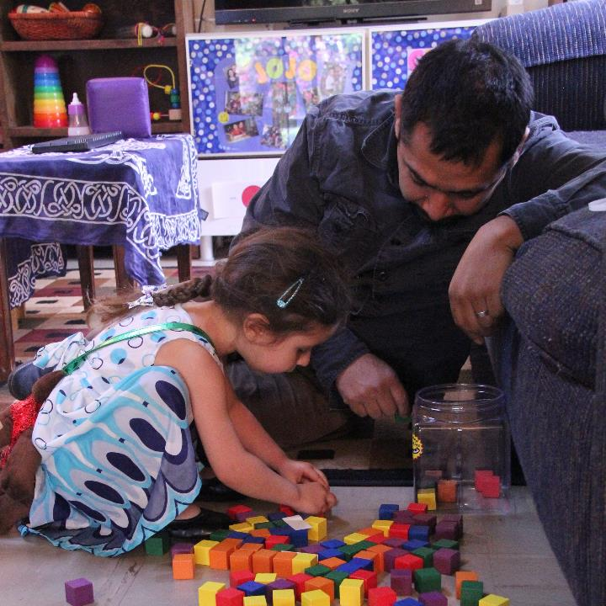
Recognizing and Encouraging
Educators can:
Recognize and understand the influence of culture
on manhood
and fatherhood.
Encourage a father’s efforts to connect with, nurture, and enjoy his child at each developmental stage.
Image credit: EarlyEdU

Slide 17
Ways to Support
Observe and stay curious.
Find out how fathers and their children like to spend time together.
Acknowledge responsive interactions.
Explore with fathers which program activities allow them to contribute most to their children’s learning.

Slide 18
Helping Fathers FIND
Their Strengths
The videos on the next two slides highlight a fatherhood initiative at the University of Washington.

Slide 19

VIDEO: Helping Fathers FIND
Their Strengths

Slide 20
VIDEO: Holly Schindler and
Do Dads Matter?

Slide 21
Video Debrief
What stood out to you from these two videos?
In what ways do your practices show that fathers matter?

Slide 22
Creating a Welcoming
Environment for Fathers

Slide 23
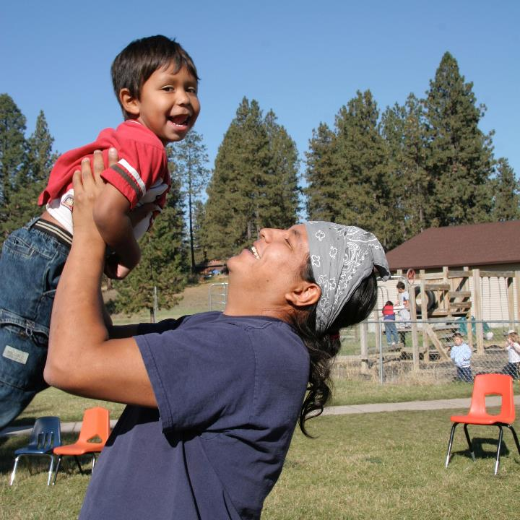
Engaging and Welcoming Fathers
Program staff can engage fathers with welcoming attitudes and approaches to:
Everyday routines
Father events
Program environment
Classroom spaces
Image credit: Office of Head Start

Slide 24
Messages Matter
When mothers, teachers, and others in a child’s life show confidence in a father’s parenting, a father will feel more motivated, competent, involved, and satisfied in his parenting role.

Slide 25
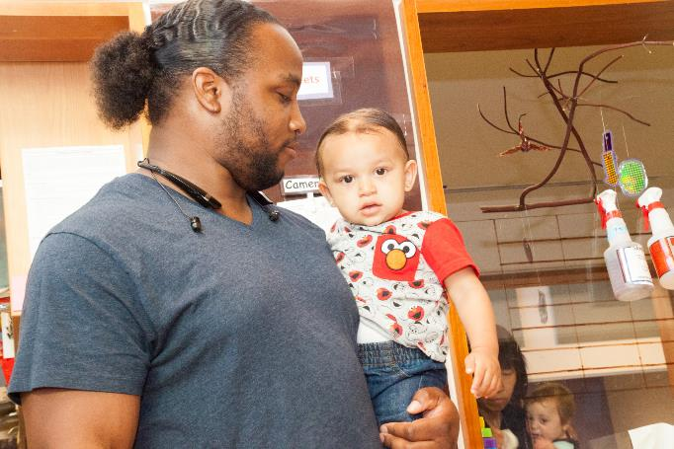
How do you find out how fathers feel when they come in and spend time in your program?
Image credit: EarlyEdU

Slide 26
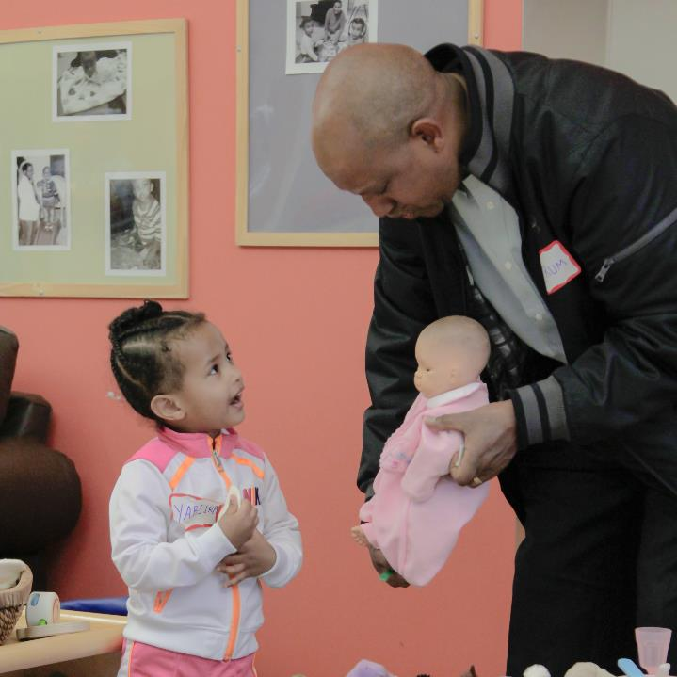
How Can You Welcome Fathers in Everyday Routines?
Arrival
Departure
Volunteer opportunities
Image credit: EarlyEdU

Slide 27
Arrival and Departure
Greet fathers by name.
Ask about the child’s and father’s day.
Invite fathers to share about their children and parenting.
Recognize a father’s role as a primary caregiver and lifelong educator of his child.
If parents arrive together, talk to both equally.
Address fathers in all types of family structures equally.
Be sensitive to fathers’ needs, especially those who do not live with their children.

Slide 28
Arrival at Family Child Care
As you watch this video,
notice the interactions
between the educator, father,
and young children.

Slide 29
VIDEO: Arrival at Family Child Care

Slide 30
Video Debrief
The educator:
Greets the father and both children by name.
Asks: “How are you today?”
Listens as the father tells about the boys’ breakfast.
Checks in: “How did batting practice go last night?”
Answers the father’s questions.

Slide 31
Getting on the Bus
Watch this silent video of an interaction between a bus aide and a father.
Afterward, you will work with a partner to prepare a role play for the interaction based on what you saw and what you would want to hear.

Slide 32
VIDEO: Getting on the Bus

Slide 33
Video Debrief
Find a partner and write a script with possible interactions to go with the video.
Be ready to do a role play, acting out the parts in your script.

Slide 34
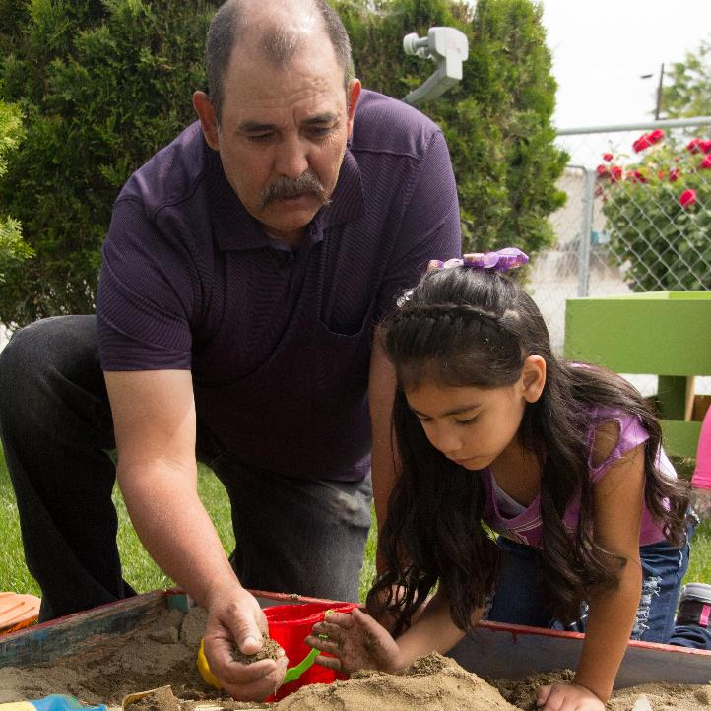
Volunteers
Invite fathers or male volunteers to take on roles they enjoy.
Support active play.
Notice and comment on connections between fathers
and children.
Image credit: EarlyEdU

Slide 35
Volunteers in the Classroom
Think about these questions while watching this video:
What positive interactions do you see between the father and child?
What might this experience be like for this father? The child?
What else might the educator do?

Slide 36
VIDEO: Volunteers in the Classroom

Slide 37
Video Debrief
Positive interactions between the father and child include:
Playful interactions and expanding the child’s idea
Eye contact, smiling
Encouragement (high-five)
The educator could also notice and comment on the father’s strengths and supportive interactions.

Slide 38

Images of Fathers
Show men in a
variety of roles,
including caring and nurturing ones,
throughout your program:
Staff roles and volunteering
Posters
Flyers
Artwork
Image credit: EarlyEdU

Slide 39
Inviting Program Spaces
Open floor space or adult-size furniture
Décor that appeals to both men
and women
Resource library with materials of interest to fathers, such as books on fatherhood
Male staff role models
Posters showing fathers in a variety of family structures

Slide 40
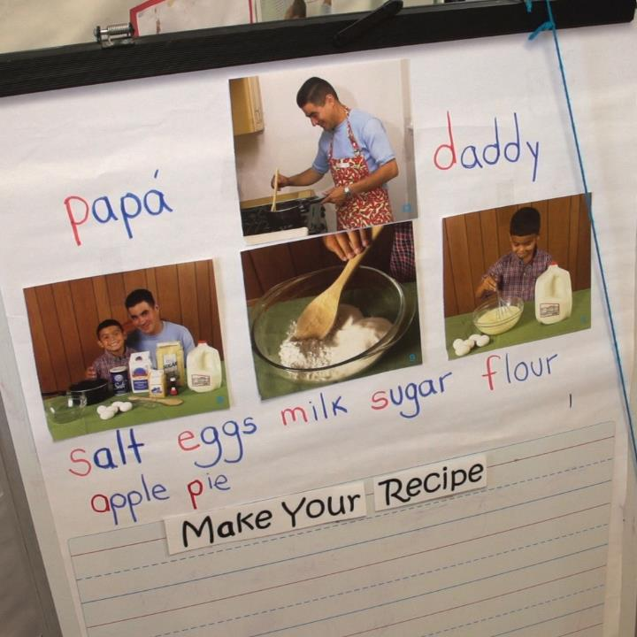
Classroom Images
Include photos of fathers and other important men in children’s lives.
Image credit: EarlyEdU

Slide 41
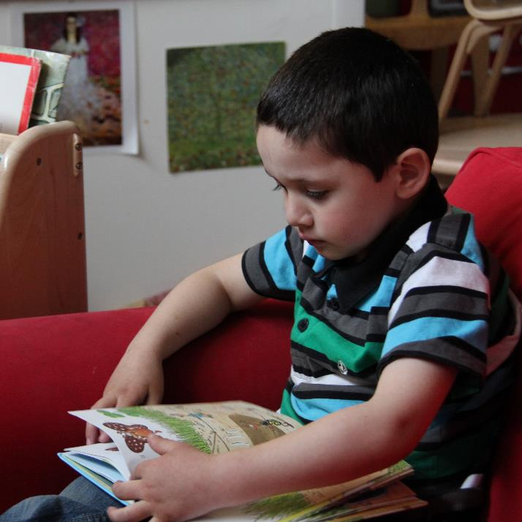
Classroom Books
Look at the books
in your classroom.
In what ways do they represent men?
How do they represent fathers?
Image credit: EarlyEdU

Slide 42
Program-Wide Practices
Some practices are:
Make sure that staff composition reflects cultures and languages of participating families.
Focus on all adults promoting healthy child development and setting goals.
Offer fathers’ groups and father-focused workshops.
Explore fathers’ needs for services, support, and resources.

Slide 43
Engaging Fathers
As you watch the video, think about what:
Strategies the program uses to engage fathers
Outcomes you see for fathers and children

Slide 44
VIDEO: Engaging Fathers

Slide 45
Video Debrief
What strategies did the program use to engage fathers?
What were outcomes for fathers and children?

Slide 46
Bringing It All Together

Slide 47
The Head Start Parent, Family, and Community Engagement Framework
Image credit: Office of Head Start

Slide 48
Revisiting Where Does It Fit?
Which parts of the Framework does this topic relate to?
Turn and exchange ideas
with a partner.
Be ready to share
your thoughts with the
whole group.

Slide 49
Fathers are critical to child development and family
well-being.
Early childhood educators and program staff can adopt practices that encourage the relationships of fathers and their children.
Educators and programs can create welcoming environments for fathers that boost positive outcomes for fathers, children, and families.

